Slide 1
Please read this before using presentation
This presentation is based on content presented at the 2016 Human factors forum
The Department of Mines and Petroleum (DMP) supports and encourages reuse of its information (including data), and endorses use of the Australian Governments Open Access and Licensing Framework (AusGOAL)
This material is licensed under Creative Commons Attribution 4.0 licence. We request that you observe and retain any copyright or related notices that may accompany this material as part of attribution. This is a requirement of Creative Commons Licences.
Please give attribution to Department of Mines and Petroleum, 2016.
For resources, information or clarification, please contact:
RSDComms@dmp.wa.gov.au or visit
www.dmp.wa.gov.au/ResourcesSafety

Slide 2
Critical risks in human factors

Slide 3
So why are we here?
Our view of the “State of the State”
Start a conversation
Where do we think we need to focus?
Future direction
Notes:
Explore how to incorporate processes to identify and mitigate human error.
Share knowledge and tips through a case study example.
Essential understanding of human factors and how to identify risks within your organisation.

Slide 4
A not too serious introduction

Slide 5
When we talk to most organisations about Human Factors, they think we’re talking about …
Notes:
Human behaviour is defined as the range of actions and behaviours exhibited by humans at certain stages of development. A society generally expects individuals to have good behaviour and shun roguish biases.
Factors that are predominantly linked to human behaviour include:
attitude
perception
genetics
culture
social norms and ethics of a society
religious inclination
coercion and influence by authority.
Reference: https://www.reference.com/science/factors-affect-human-behavior-3512986d01e403d4

Slide 6
This…
Notes:
Risk perception
Early research on risk perception assumed that people assess risk in a rational manner, weighing information before making a decision. This approach assumes that providing people with more information will alter their perceptions of risk. Subsequent research has demonstrated that providing more information alone will not assuage people’s fears and ideas about what is truly risky. The psychological approach to risk perception theory, championed by psychologist Paul Slovic, examines the particular heuristics and biases people invent to interpret the amount of risk in their environment.
Psychological research on risk perception has been dominated by the psychometric paradigm, which has been fruitful in bringing up important issues in research. Compared to cultural theory this paradigm has also been fairly successful in explaining and predicting perceived risk. Yet, most of the conclusions reached in the paradigm are not sufficiently based on empirical data and appropriate analyses.

Slide 7
…and this...
Notes:
Most humans engage in some kind of dangerous event(s) every day. This has prompted a substantial effort from researchers to understand how people understand risk.
Everyone is seeking to manage risk, and they are all guessing because if they knew for certain, they would not be dealing with risk.

Slide 8
But we’re not. What we’re talking about is an awareness of things like…..

Slide 9
This…
Notes:
"Human factors refer to environmental, organizational and job factors, and human and individual characteristics which influence behaviour at work in a way which can affect health and safety. A simple way to view human factors is to think about three aspects: the job, the individual and the organization and how they impact people’s health and safety-related behaviour." (Health and Safety Executive, United Kingdom)

Slide 10
…and this…

Slide 11
…and this…

Slide 12
We want organisations to look and fix these things because not doing anything leads to things like …

Slide 13
This…

Slide 14
…and this…

Slide 15
…and even this…

Slide 16
State of the state

Slide 17
State of the State
Still affected by human factors
Same problems and issued
Our investigating techniques are better, but fail to methodically include human factors
Engineering or material focus
Our 20/20 hindsight is getting better, however is failing to be incorporated back into the work task design
Notes:
Human factors, which includes ‘Ergonomics’ as it is called in some industries, is the practice of applying scientific knowledge from varied, mostly human science disciplines (such as psychology, medicine, anthropometrics and physiology) to designing, building, maintaining and managing systems and products.
Relevant quotes
Human Factors is not a pure science as it is not self referential, nor does it base its theories upon unique and exclusive conservation principles and postulates.[…] It is limiting to identify Human Factors as a discipline, as it goes far beyond the mere application of engineering, psychology, sociology and computer science principles. It enables us to represent working contexts and sociotechnical aspects in a theoretical form […] for implementation in real systems and for assessment of real working contexts.
Human Factors, together with computer science, is the most relevant science that has been developed over the past 50 years […].
Cacciabue (EC), “Guide to Applying Human Factors Methods”, Springer 2004.

Slide 18
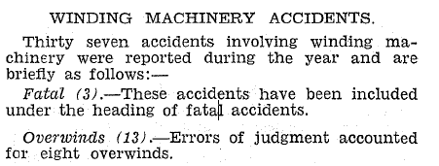
Is Human Factors a new thing for us?
From the 1955 Department of Mines Annual Report
Notes:
Over the last 60 years, recognition has grown that mishaps are inextricably linked to the (mal)functioning of that system — the surrounding organizations and institutions. People are not the instigators of failure, they are the recipients of it, the inheritors.
This is not new!

Slide 19
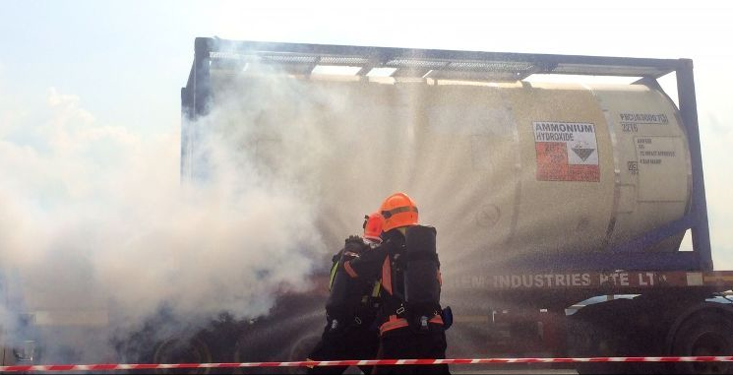
Is Human Factors a new thing for us?
From the 1997 Department of Mines and Energy Dangerous Goods Accident Summary
Notes:
Examples from government publications.

Slide 20
What does history tell us?
Human Factors as contributors to accidents/incidents are not “new”
Military – 1950s
Aviation – 1960s
Nuclear – 1980s
Rail – 1980s
……………….But are we heeding the lessons?
Notes:
Overview: key points
Formed in 1946 in the UK, the oldest professional body for human factors specialists and ergonomists is The Chartered Institute of Ergonomics and Human Factors, formally known as The Ergonomics Society.
The Human Factors and Ergonomics Society (HFES) was founded in 1957. The Society's mission is to promote the discovery and exchange of knowledge concerning the characteristics of human beings that are applicable to the design of systems and devices of all kinds.
Prior to World War I, the focus of aviation psychology was on the aviator himself, but the war shifted the focus onto the aircraft, in particular, the design of controls and displays, and the effects of altitude and environmental factors on the pilot. The war saw the emergence of aeromedical research and the need for testing and measurement methods.
Studies on driver behaviour started gaining momentum during this period, as Henry Ford started providing millions of Americans with automobiles. Another major development during this period was the performance of aeromedical research.

Slide 21
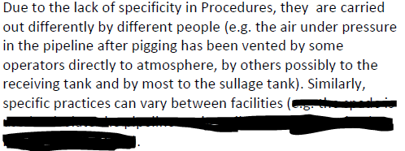
Investigation into a loss of containment following pipe maintenance
Notes:
Examples from government publications.

Slide 22
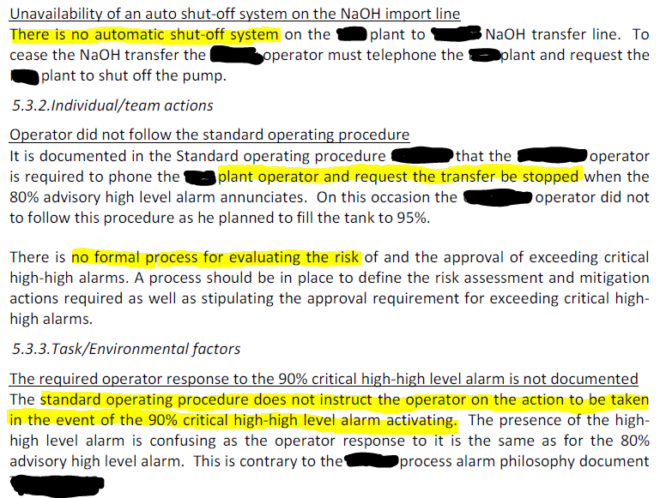
Investigation into a fire at a facility
Notes:
Examples from government publications.

Slide 23
Organisational change and major accidents
There is circumstantial evidence, from case study examples, to indicate a link between organisational change and accidents
1995 - whether the nuclear industry could learn anything from other industries in the application of human factors in safety management systems.
The result of the research was a checklist of good practice;
Senior management commitment; Communication; Safety management systems and organisational complexity; Measurement of safety; Operational feedback; Proprietary tools; Modification and evolution of proprietary systems; and Organisational structure
Notes:
It is, therefore, an issue for the management of health and safety by major hazard industry and should be part of the safety management system.

Slide 24
Where do we all need to focus?

Slide 25
We think we need to focus on……
Making ourselves “damage tolerant”
Recognising that our activities are the workings of an integrated system
Quick win areas
Design
Risk analysis
Procedures
Communications
Notes:
Understanding Human Factors and Engineering Psychology.
The primary focus of any human factors initiative is to improve safety and efficiency by reducing and managing human error.
Following the Texas City incident, there has been a significant increase in the amount of attention paid to performance indicators for process safety, with authoritative guidance being published in both the UK and US. The focus on Human Factors influences on process safety has also grown significantly over this time. However, while measurement of the technical aspects of process safety is well covered by the available guidance, there is little information available with regard to how Human Factors performance might be measured.

Slide 26
It starts at the start…design
Human Factors as an integral part of design and process
Many of the designs that we see either haven’t considered or considered strongly Human Factors to the…
Installer
Operator
Maintainer
Human Factors stressors often an “afterthought”
Layout and positioning
Lighting
A/C
Noise etc
Notes:
How can workplaces be designed and managed so that health and safety (H&S) is not traded for production?

Slide 27
Getting the risk analysis right
Many barriers and controls we see rely on procedure/training compliance but:
Assume:
“perfect” conditions at start of procedure
“perfect” competency/currency by person(s)
“perfect” adherence
“perfect” outcomes in all conditions/situations
Aren’t tested in “real” situations
Some are only partially tested

Slide 28
Getting the risk analyses right….
Acknowledging Humans Fail
We are very Unreliable, often even in benign situations
Even more often when under stress – like in emergencies
There is ALWAYS a “man in the loop” somewhere, somehow
Who does the risk analysis?
Head office vs site
Manager vs worker
Systematic processes such as incident investigation often do not assess the need to include people with skills to collect and analyse HF data, at time of investigation preparation
Notes:
A challenge for contemporary society, and for those attempting to explain the forces shaping it, is to understand the social nature of risk, how:
individuals address risk issues
decisions involving risk are made
these processes can be managed to individuals’ and society’s advantage.
Major forces characterising the risk debate include increasing demands for ever greater safety in our lives, and enhancing our inherent tendency to apportion blame to human agency.

Slide 29
Procedures, procedures, procedures
Understand the consequence of failure
What is the allowable failure rate
Need to move away from sole defence against human error
Appropriate level of detail for situation/task
Reason’s bolt
Competency vs content
Procedure management

Slide 30
Communicating
Understand the consequence of failure
What information needs to be passed and how critical is it?
Person sending has to know what, when, where, why and how to send
What’s the Signal to Noise ratio?
Person receiving also has to know what, when, where, why and how to receive

Slide 31
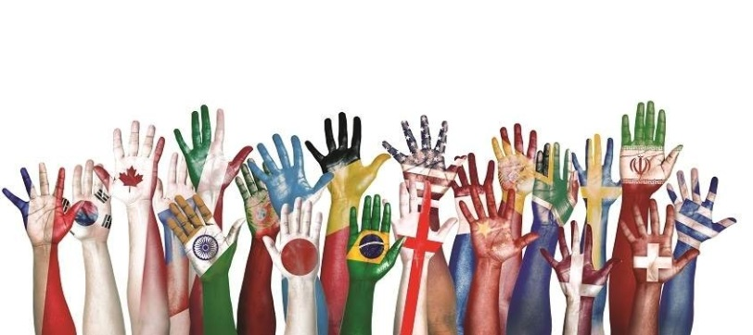
Cultural and industry learnings
Some societies such as Japan has been researching Human Factors since the 1920s
motor vehicle operational controls
street-crossing decisions
industrial robots
toilets
Other industries e.g.
Nuclear
Rail
Aviation
Health
Notes:
Greater openness in exchange of information in some industrial sectors exists as it is recognised that a major incident in one organization can affect public confidence in the whole industry (e.g. civil aviation).
Kirchsteiger argued that measures aimed at reducing risks to acceptable levels should be:
rational
transparent
accountable
targeted
consistent
proportional (costs/benefits)
and that risk assessments should balance benefits and risks.
The technical approach has dominated a majority of interventions characterising attempts to improve workplace H&S, and to a lesser extent, safety in other environments. Because of the extensive and ever-expanding regulatory framework for workplace H&S – at least in Western capitalist cultures – this domain has become a prime testing ground for the technical approach.
Behaviour modification, or one of its workplace manifestations such as behaviour-based safety (in which workers are consigned to follow pre-set patterns of behaviour as a means of reducing accidents and increasing productivity) illustrates one application of a technical approach to workplace risk.
This approach ignores implications based on the possibility that workplace behaviour that is considered to be “risky” may have individual, organizational, social, or cultural origins. The extent to which workers themselves are involved in developing behaviour standards to support such technical approaches to workplace risk may reflect their managerial self-regulatory role.

Slide 32
DMP focus areas

Slide 33
Future…
New Legislation
Codes of Practice
Guidance
Expect to closely follow information from international bodies such as UK HSE
Discuss with industry what we all do for Human Factors
What is the true “State of the State”?
Based on that discussion, what are our regulatory priorities?
Notes:
Working with industry to develop materials
From a cultural theory (CT) perspective, Tansey considered that the concept of risk has emerged relatively recently. However, this is only true from a purely linguistic perspective, and ignores the (unprovable) certainty that pre-literate societies’ activities were concerned with risk, which is implicit within a CT approach. The concept of risk and associated behaviours must have existed in some forms for much longer.
Trimpop argued that risk taking is inevitable in any changing environment, because change represents uncertainty about the future. Risk taking was essential in human evolution, and therefore has physiological and genetic pre-dispositions, as well as an intrinsic reward mechanism.
Priorities
Timeframe – 6 months
Focus on investigations where human factors is relevant.
Development of regulations.
Timeframe – 12-18 months
Focus on safety case.
Timeframe – 18-24 months
Focus on safety management systems.

Slide 34
We’d like to see operators…
Engage with recognised Human Factors industry bodies such as
Energy Institute
Human Factors and Ergonomics Society
IChemE
Help identify better ways of finding and addressing Human Factors issues
improve their internal competence in Human Factors
take a “whole of life, whole of capability” approach to Human Factors
Notes:
The Department of Mines and Petroleum use a wide range of strategies and mechanisms to nurture willingness and capacity to comply with work health and safety law. A balance is required which utilises an approach to blend knowledge from regulator and operator.
Processes
They communicate and provide information to operators through a wide variety of methods. These include:
guidance material which is accessible electronically at regulators’ websites or in publications at regulators’ metropolitan and regional offices
direct mail-outs as part of targeted campaigns
telephone or online information services
media advertising
seminars and workshops
participation in field days or other public events, among other methods.
In general, regulators work with and through industry and trade associations, unions, work health and safety consultants and professional bodies, and training providers to widen access to work health and safety information and support the development of health and safety capacity.
Vision
Cradle to grave philosophy.

Slide 35
Take home messages
Those who cannot remember the past are doomed to repeat it.
George Santayana “The Life of Reason”, 1905
When the situation was manageable, it was neglected, and now that it is thoroughly out of hand we apply too late the remedies which then might have effected a cure.
Winston Churchill, House of Commons, 2 May 1935
Notes:
Lessons learned
Fatal accidents occur even in petrochemical industries, where the principles of self-regulation embodied in the Health and Safety at Work Act may be expected to be carried out. Prevention of some accidents however requires a greater reliance on the human factor for control than others.
With consideration of emerging and systemic risks and inherent uncertainty associated with surprising events, planning for and managing risk, crisis and disasters requires understanding of the space of possibilities in order to avoid unrealistic expectations that can influence the management of disasters and catastrophes.
Black swans represent the unpredictable (see story below).
Story
“The black swan represents the rare, unforeseen catastrophic event that takes place with some regularity in the world. In the context of process safety, the black swan is a major process safety incident with fatalities and economic loss that had not happened before and was not thought to be possible. A number of these incidents have occurred over the years. Perhaps the two most notable are Flixborough, UK (1974), a vapor cloud explosion that killed 23 people and destroyed a chemical plant, and Bhopal, India (1984), a catastrophic toxic release that killed over 10,000 people. In process hazard analysis terms, the black swan is referred to as “not a credible scenario,” but as history has shown, these events occur with some regularity.” - John F. Murphy
Many of John’s publications discuss the urgent need to learn from black swan events, despite the fact that often the lessons of these events go unheeded. Furthermore, we suggest ideas on how to keep the lessons learned from black swan events fresh in our minds. Those of you that are interested in risk analysis and its limitations may want to read these papers again (PSP December 2011, PSP September 2012).
Stress how we must always maintain a sense of vulnerability, even when we feel we have reduced risk as low as possible.
Please continue to ask the question, “What can go wrong?”, and Beware of the Black Swan.

