Slide 1
Please read this before using presentation
This presentation is based on content presented at the Industry Forum on Reducing Approval Times: What is “Reasonably Practicable”?, held on 14 November 2014
It is made available for non-commercial use (e.g. toolbox meetings, safety discussions) subject to the condition that the PowerPoint file is not altered without permission from Resources Safety
For resources, information or clarification, please contact:
RSDComms@dmp.wa.gov.au
or visit
www.dmp.wa.gov.au/ResourcesSafety

Slide 2
Petroleum safety and major hazard facilities
What is the state-of-play in Western Australia?

Slide 3
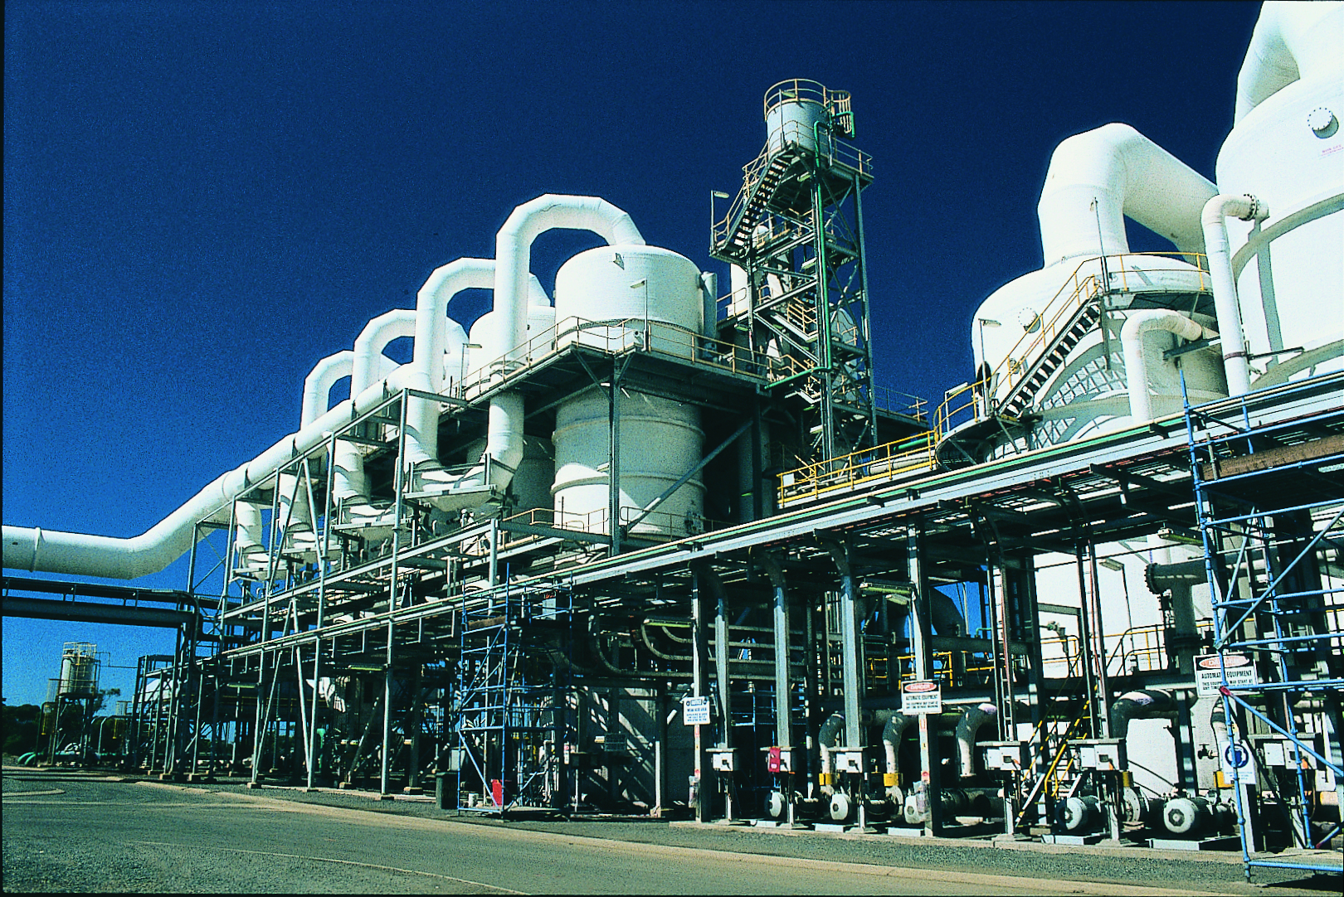
DMP’s commitment
To work with industry to reduce accidents and incidents, and provide tangible support in achieving a change in safety culture in order to minimise any impacts.
Notes:
This statement from the Department of Mines and Petroleum (DMP) underpins the regulatory approach taken by the Resources Safety Division under the Reform and Development at Resources Safety (RADARS) strategy.

Slide 4
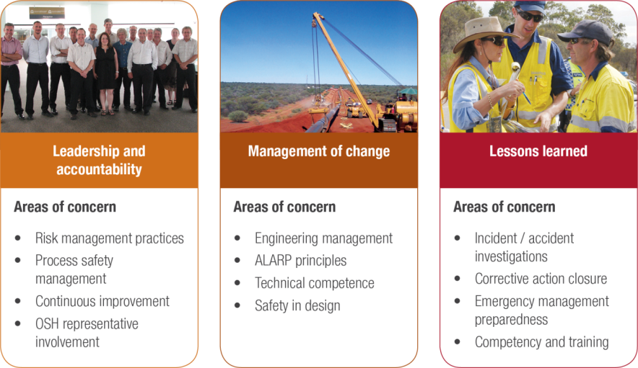
Resources Safety’s focus on petroleum and dangerous goods safety
Notes:
There are three themes that the Petroleum and Dangerous Goods Safety Branch is focusing on for the next few years, and within those themes is a number of areas of concern.

Slide 5
A brief chronology of the recent past
“Those that do not learn from history are condemned to repeat it” Winston Churchill
1 June 1974
Flixborough, UK
28 dead, 90 injured
10 July 1976
Seveso, Italy
3,000 pets, 70,000 livestock, ongoing population monitoring
3 December 1984
Bhopal, India
4,000 dead, 12,000 injured
22 March 1987
Grangemouth, UK
2 dead, 10 injured
6 July 1988
Piper Alpha, Offshore UK
167 dead, 60 injured
23 March 2005
Texas City, USA
15 dead, 100 injured
11 December 2005
Buncefield, UK
0 fatalities, 40 injured
Notes:
Why is it important to pay attention to critical risks?
This slide has a selection of major accident events from the recent past – note that it does not include any coal industry, nuclear or power industry, offshore drilling, marine and construction based incidents.
All of the above incidents have had an impact on how safety is managed in our industry by either legislation (e.g. regulation) or design (e.g. engineering standards, codes of practice).

Slide 6
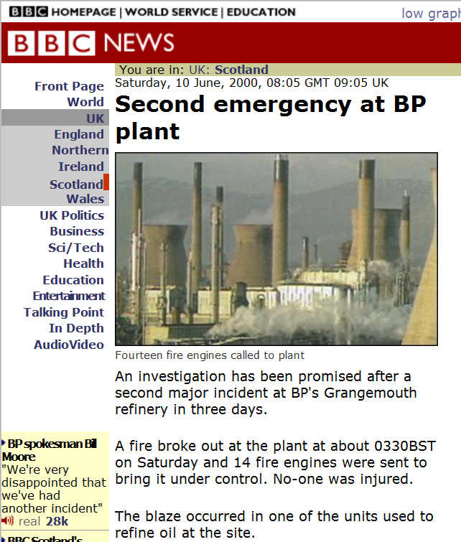
Case study: BP Grangemouth, Scotland
BP Grangemouth had three incidents in 2000 that were front page news in the UK
It took years for site to recover from adverse publicity and probably helped BP decide to exit petrochemicals
SAFE
EXPLORATION
Notes:
Let’s look at one of those major accidents.
In 2000, BP Grangemouth (UK) had three incidents that were front page news in the UK. It took years for site to recover from adverse publicity and probably helped BP decide to exit petrochemicals.
The following HSE observations are from the Competent Authority report released after the prosecutions were completed.

Slide 7
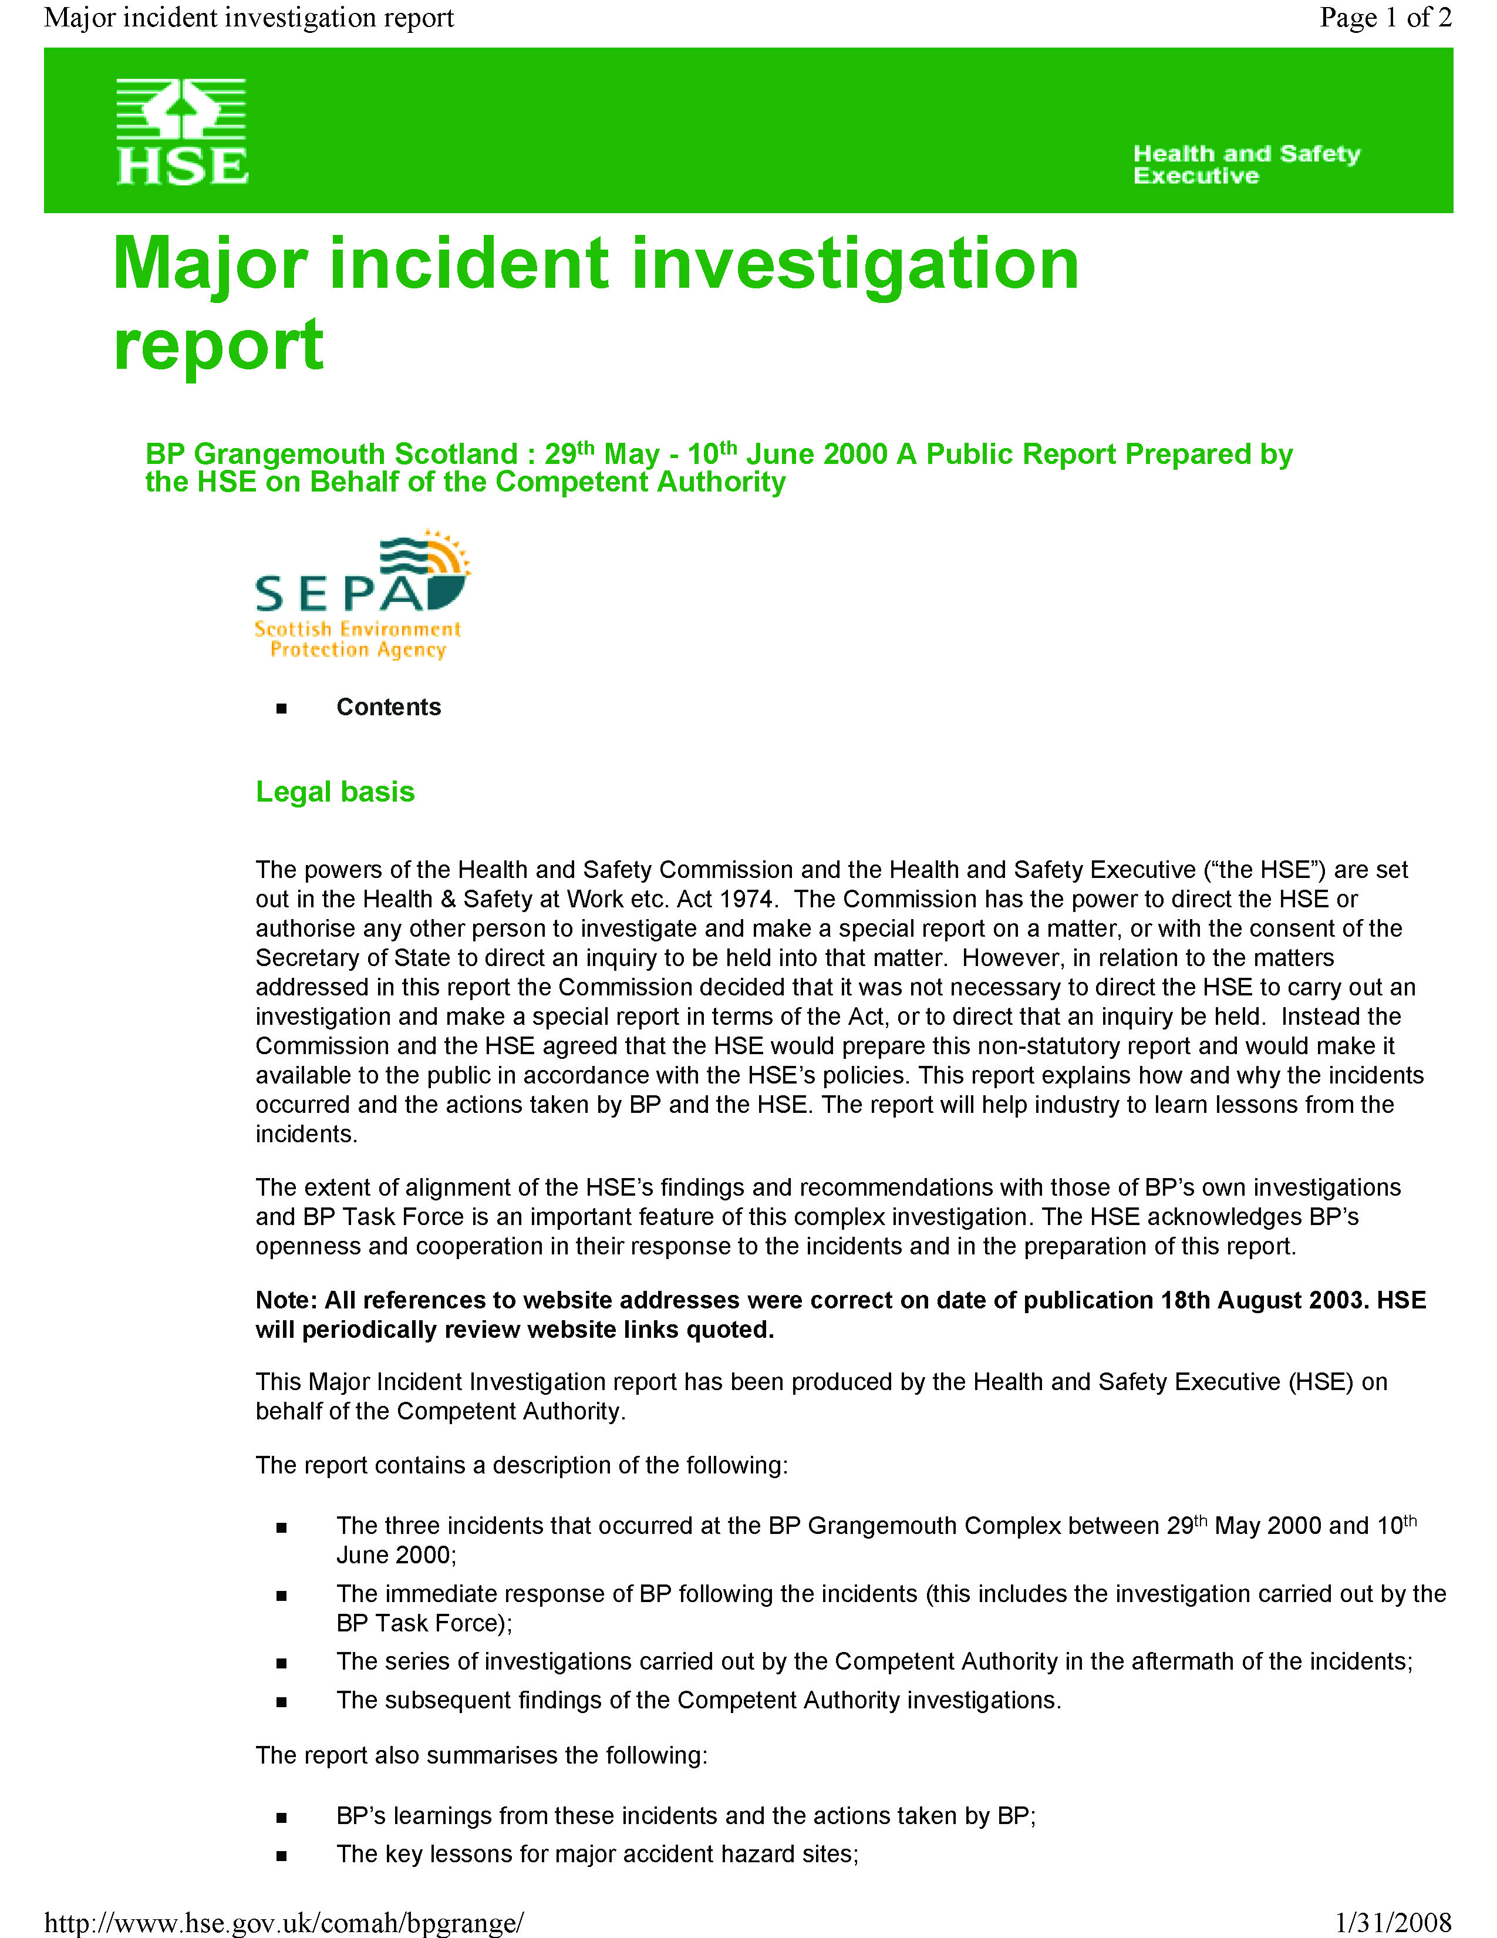
UK Health & Safety Executive (HSE) findings
Major accident hazard sites (MAHs) should be actively managed to allow control and the reduction of risks. Control of MAHs require a specific focus on process safety management over and above conventional safety management
KPIs should be developed for MAHs and ensure process safety performance is monitored against these parameters
Disruption to utility supply systems (e.g. steam, electricity, cooling water) on a major hazard site can cause significant problems and have the potential to result in a major accident
SAFE
EXPLORATION
Notes:
UK Health & Safety Executive (HSE) findings on BP Grangemouth released after prosecutions (31 January 2008)

Slide 8
More HSE findings
Major hazard industries should ensure that knowledge available from previous incidents, both within their organisation and externally, is incorporated into current safety management systems
Operators should increase focus on preventing major accidents to ensure:
serious business risk is controlled
corporate governance is effective
COMAH regime is a “living process” and should be used as management tool to assist in process safety management
COMAH = Control of major accident hazards

Slide 9
MHFs – regulation, self management or both?
The following are applicable to any facility — not just MHFs
The safety case and a safety management system (SMS) underpin the safe operation of MHFs
SMS provides structure and ensures facilities identify and more effectively manage their critical risks
It is not only about management but also leadership
Technical aspects of process safety management should be an embedded process including hazop, retro-hazop and ALARP principles
Notes:
List continues on next slide

Slide 10
Industry messaging “what gets measured gets managed” or “what interests my boss fascinates me” are examples of ways of focussing attention on this.
As is emergency preparedness — prepare for incidents, they do happen!
Facilities can either use their SMS as a defence or embrace it as a way of demonstrating management commitment to safety and ensuring continuous improvement as part of life cycle of the plant
If industry can’t or won’t act, regulation is an outcome – the community (and therefore government) expects hazards to be identified and risks to be managed
Notes:
List continued from previous slide

Slide 11
Piper Alpha commentary
“The oil industry has yet to learn lessons of Piper Alpha”
July 2013, Charles Woolfson, Linkoping University
(on the 25th anniversary of incident)
“Again, there is the same lethal cocktail of contingent circumstances and systemic underlying causes; multiple safety systems that did not function at the crucial moments, managerial failures immediately before and during the unfolding disaster, organisational failures embedded in distorted information flows and a lack of coherent safety management, defective regulatory authorities with contradicting responsibilities for both production and safety and even outright “capture” of regulatory processes by the industry itself.”
Has anything changed?

Slide 12
Societal obligations
Final thoughts
Society (the public) has an expectation that industry will protect its people, understand and manage its significant risks and also has an obligation to minimise its impacts on the wider community. An ongoing commitment to managing process safety is essential.
Seveso Directorates (I, II, III) 1982/1996/2012
The Seveso directive obliges Member states to ensure operators have a policy in place to prevent major accidents. Operators handling dangerous substances above a certain threshold must regularly inform the public likely to be affected by an accident, providing safety reports, a safety management system and an internal emergency plan.
(Prevention, Preparedness and Response)

Slide 13
What might this mean for WA?
European Seveso directorate could be applied in Australia as:
part of a licence to operate
to meet community expectations
Any potential societal impacts of critical risks need to be factored into a site and boundary conditions as QRA is not a precise tool, although it recognises things can (and will) go wrong
Notes:
The European Seveso directorate could be applied in Australia as part of a licence to operate and to meet community expectations. Any potential societal impacts of critical risks need to be factored into a site and boundary conditions as quantitative risk assessment (QRA) is not a precise tool, it however recognises things can (and will) go wrong.
The understanding of situational risk is generally better in the employer workforce than it is for their contractors - and it is debatable whether it is understood by the community at large.

Slide 14
The way forward …
As opportunities present themselves, corporate executives and management need to demonstrate leadership in educating both their workforce and the community to show their commitment to:
safe plant
safe people
Are you prepared to do this or can you demonstrate that you are already?
Any questions?

Slide 15
Don’t forget – Stay informed!
Visit www.dmp.wa.gov.au/ResourcesSafety
to sign up for our weekly news alerts

