Slide 1

Leading impactful research, meaningful collaboration and effective knowledge transfer
Anil Subramanya
GSWA Open Day
21 February 2020

Slide 2
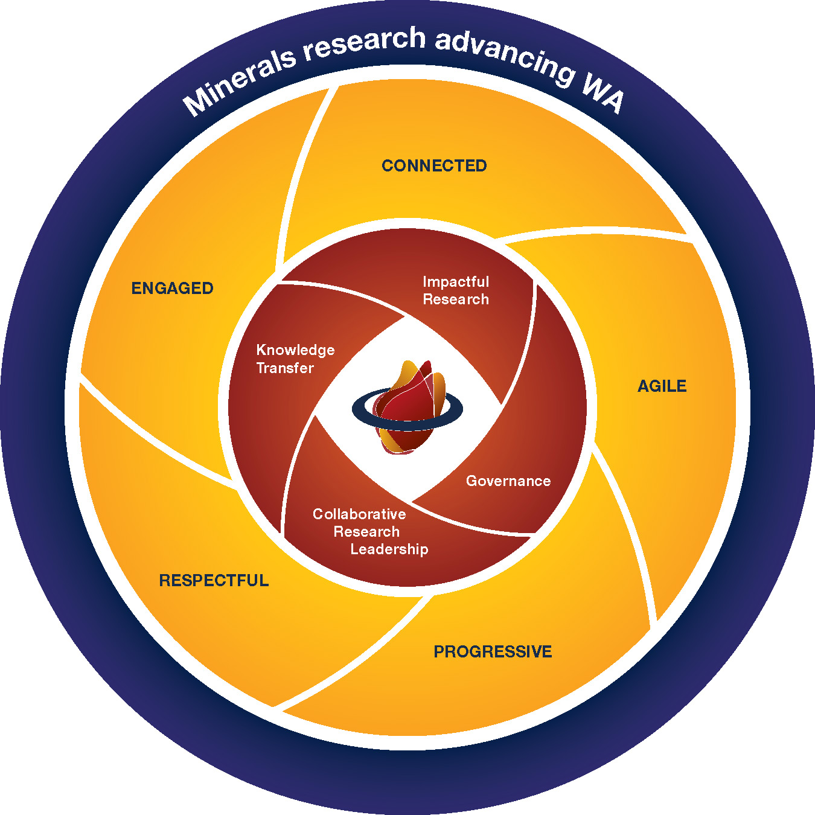
MRIWA Vision and Values
Notes:
The vision of the Minerals Research Institute of Western Australia (MRIWA) is to support research that will advance Western Australia. This is achieved by focusing on research that is impactful, encourages collaboration and enables effective knowledge transfer to the broader industry and community.

Slide 3
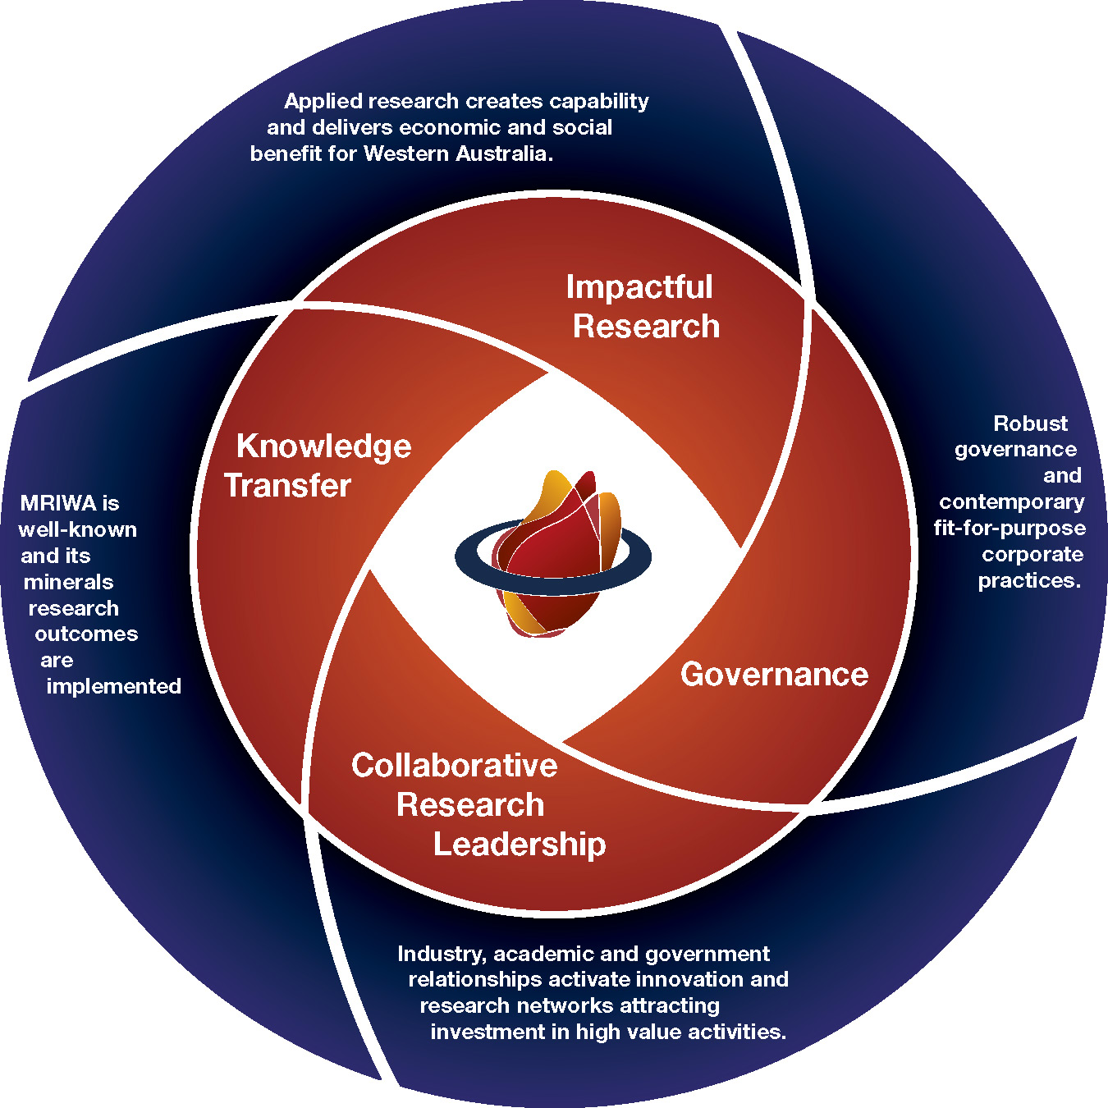
MRIWA Goals
Notes:
Research funding supports innovation in the academic as well as private sector, with MRIWA partnering with major universities, research agencies and the Mining Equipment, Technology and Services sector in Australia and overseas.

Slide 4
Fostering collaboration between industry and academia
Research funding supports impactful innovation in the academic as well as private sector
MRIWA partners with
    major universities,
    research agencies,
    mining and exploration companies,
    the Mining Equipment, Technology and Services (METS) sector
    Government agencies
  in Australia and overseas.
Notes:
Focus on effective knowledge transfer

Slide 5
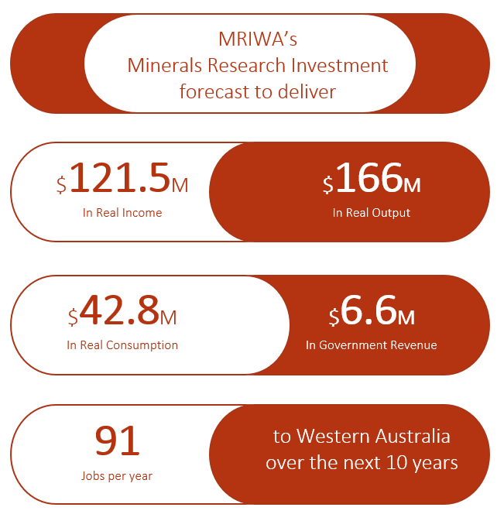
Overview and Impact
Notes:
The total value of research supported by MRIWA at the end of the 2018–19 financial year was $46.6 million of which $37.7 million was spread over 46 research projects, $7.1 million invested in three Cooperative Research Centres and $1.7 million invested in 17 PhD scholarships. A further 45 PhD scholars are supported through our project funding.
An economic impact assessment carried out by ACIL Allen Consulting in 2018 forecast MRIWA’s research investment to deliver significant economic and community benefits to the State over the next decade. Through our Research Priority Plan we enable research across the minerals value chain with the aim of increasing the sustainability of the sector, and enable applied research to create capability and deliver economic and social benefits within Western Australia.

Slide 6
Innovation across the minerals value chain
Exploration
Mining
Processing
New products and Markets
Followed by effective knowledge transfer
Opportunities
Growth of WA economy
WA as powerhouse of METS
Increase return on research investment
Drivers
Industry
Federal government
Investors
Notes:
MRIWA supports innovation across the mineral’s value chain by identifying key industry problems and finding the best research capability in academia or industry to solve those problems.
Focus on effective knowledge transfer

Slide 7
Anil Subramanya
Anil.Subramanya@mriwa.wa.gov.au

