Slide 1
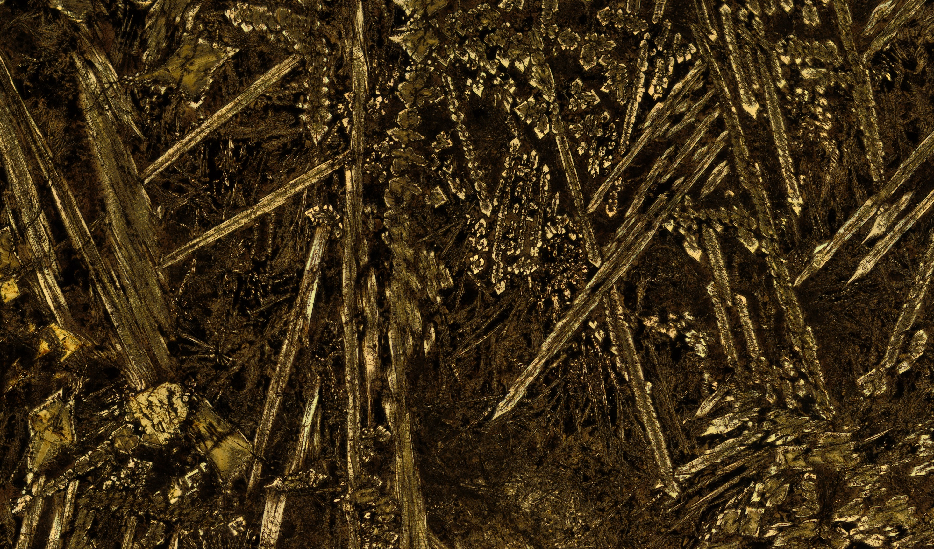
A subduction origin for 2820 to 2735 Ma magmatism
in the western Youanmi Terrane
Jack Lowrey, Tim Ivanic, Hugh Smithies (GSWA)
Derek Wyman (Uni of Sydney)

Slide 2
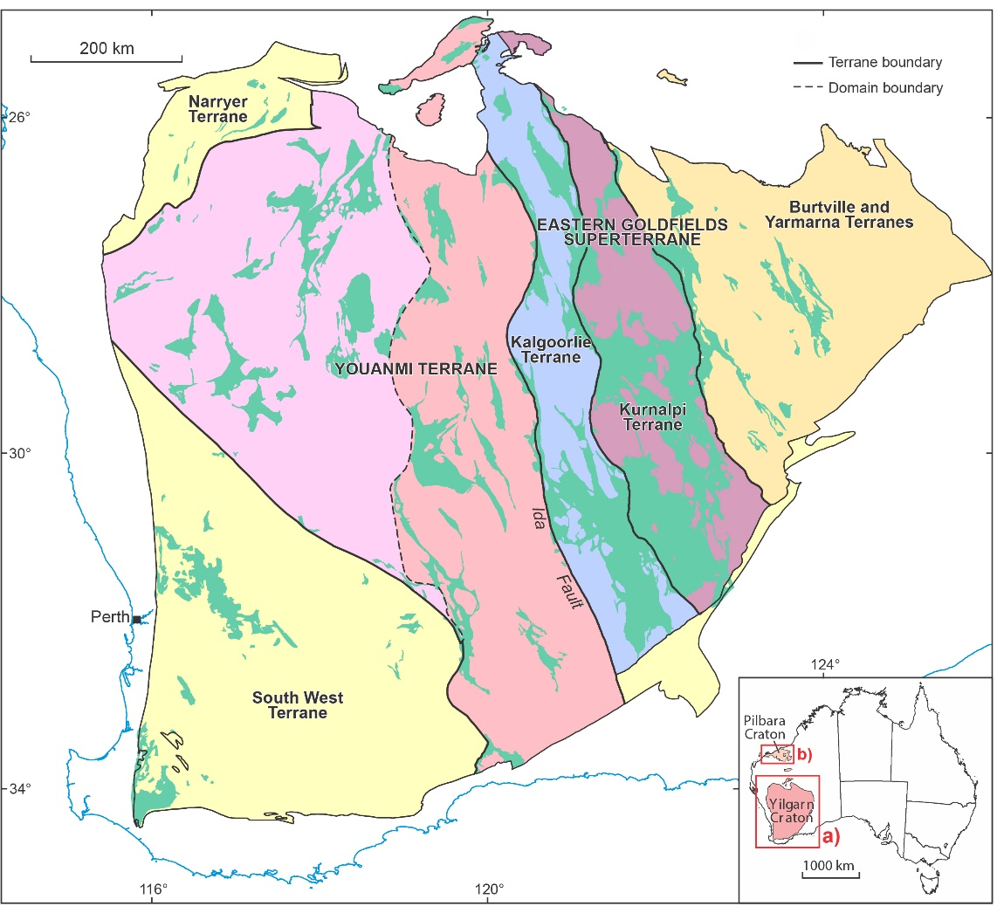
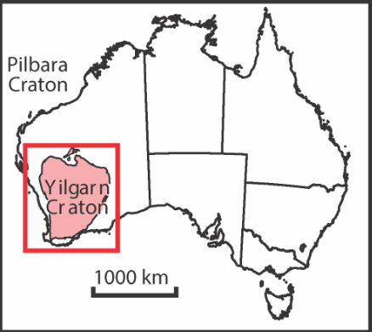
Reassessment of geodynamic model
Study Area:
2820 to 2735 Ma rocks
in the Western Youanmi
Terrane
Subduction-like rocks identified in Meekatharra to Cue region
Not reconcilable with existing plume-only model
Most primitive volcanic rocks (high-Mg basalt to andesite) show a strong ‘arc signature’
High-Si & Mg, decoupled LILE/HFSEs (e.g. Th/Nb)
These characteristics can be generated via two main magmatic processes:
Assimilation of felsic crust into high-MgO plume derived magmas, e.g. ‘contaminated komatiites’ in Kalgoorlie Terrane (suggested by previous studies for w. Youanmi Terrane)
Metasomatism of the mantle via subduction or delamination of crust (into the mantle)

Slide 3
Reassessment of geodynamic model
Study Area:
2820 to 2735 Ma rocks
in the Western Youanmi
Terrane
Attempts to explain subduction-like magmas within the existing mantle plume model encountered obstacles…
Previous studies overstated distribution of komatiites
All ‘komatiite’ localities were found to be high-Mg basalts with olivine cumulate zones
‘Olivine spinifex’ turned out to be a previously unrecognized platy pyroxene spinifex
Melting temperatures (1485 °C) do not require a mantle plume
Assessing the stratigraphic package as a whole
Majority of mafic-intermediate rocks have strong ‘arc signature’
Includes boninite-like rocks, primitive (high-Mg) basalts and andesites, sanukitoids and shoshonites
Many coeval intrusive suites, mafic & felsic, locally contain abundant hornblende
H₂O a key ingredient in generating subduction zone magmas
Strongly implicates metasomatism of the mantle

Slide 4
Crustal Assimilation or Mantle Metasomatism?
Archean
Felsic Crust
Crustal Assimilation
Linear trends between mantle and contaminant
e.g. komatiites to high-Th komatiitic basalt and low-Th basalt to high-Th basalts in Kalgoorlie Terrane
Metasomatised mantle
Melts/liquids with constant Th/Nb ratios
‘Mantle parallel’ trends equiv. modern arc array
Melting/FC of metasomatised mantle
Mixing / Assimilation

Slide 5
Geographic trends?
NNE trending regions or ‘belts’ of similar compositions and ages, ≤350 km long, ≤50 km wide.
Stepwise changes in ‘arc signature’ (Th/Nb) and isotopic ratios towards west and upward through stratigraphic sequence
Transition from primitive arc to moderately evolved arc magmatism over c.85 Ma? Greater slab component?

Slide 6
Summary
Apparent ‘arc signatures’ can be formed by a variety of magmatic processes (incl. crustal assimilation), however, in the western Youanmi Terrane:
Th/Yb-Nb/Yb and Nd isotope systematics indicate enrichment occurred in the mantle…
There is no field evidence in the western Youanmi Terrane for an ‘uncontaminated’ parent melt that could produce primitive lavas with arc signatures and Mg-numbers >65.
There is a c. 80 Ma long history of hydrous melts over broad range of chemical compositions
These characteristics are more easily reconciled with metasomatised mantle origin than with a contaminated komatiite/plume origin
Preserved stratigraphic components are compatible with subduction origin, possibly evolving from a ‘primitive arc’ setting towards a ‘moderately evolved arc’ over c. 85 Ma.
West Arunta
Musgrave
Yilgarn

