Slide 1

Please read this before using presentation
This presentation is based on content presented at the Mines Safety Roadshow in October and November 2016
The Department of Mines and Petroleum (DMP) supports and encourages reuse of its information (including data), and endorses use of the Australian Governments Open Access and Licensing Framework (AusGOAL)
This material is licensed under Creative Commons Attribution 4.0 licence. We request that you observe and retain any copyright or related notices that may accompany this material as part of attribution. This is a requirement of Creative Commons Licences.
Please give attribution to Department of Mines and Petroleum, 2016.
For resources, information or clarification, please contact:
  RSDComms@dmp.wa.gov.au or visit
  www.dmp.wa.gov.au/ResourcesSafety

Slide 2
How can a company's safety culture play a role in safety outcomes?

Slide 3
Overview
What is Human Factors?
Why is DMP interested in Human Factors?
How does Human Factors relate to safety culture?
Notes:
This presentation will cover:
What is Human Factors?
Why is the Department of Mines and Petroleum (DMP) interested in Human Factors?
How does Human Factors relate to safety culture?

Slide 4
Overview
What is Human Factors?
Why is DMP interested in Human Factors?
How does Human Factors relate to safety culture?

Slide 5
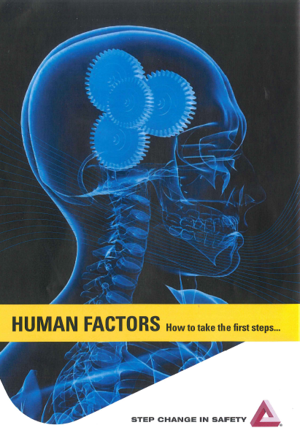
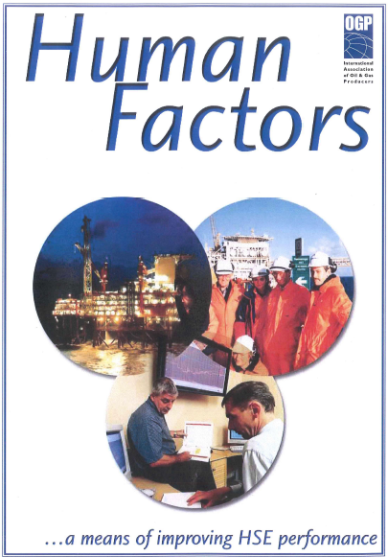
What is Human Factors? – a quick introduction
All those things that could affect human performance in a task
Understanding how human behaviour at all levels of an organisation can cause accidents
Recognises people make mistakes
Framework for driving safety
Notes:
Human Factors are factors that influence or affect human performance when completing a task – How a human interacts in an environment.
It is important to understand that human factors is throughout all levels of an organisation and is important to understand that human factors can contribute to incidences from all levels of organisations.
Human Factors is not about blaming a single person but recognising that people make mistakes.
Human Factors is an advantageous framework for driving safety in the workplace.
So how did Human Factors come about?
References:
Energy Institute Briefing Note No1
OGP – Human Factors – A means of improving HSE performance (OGP 368)
Step change in safety – Human Factors – How to take the first steps

Slide 6
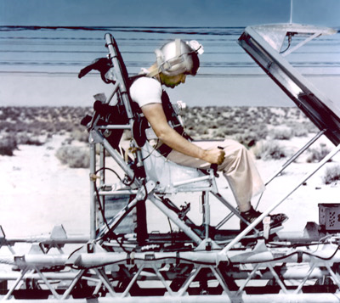
Murphy’s Law – a story about human error
Col. John Paul Stapp aboard the “Gee Whiz” rocket sled at Edwards Air Force Base.
Photo courtesy Edwards Air Force Base
Notes:
Murphy’s Law or ‘if it can go wrong, it will’, is a story about human error.
The law originated in 1949, when officers were conducting an experiment at the Edwards Air Force Base to determine how many ‘Gs’ – the force of gravity – a human being could withstand. Capt. Edward A. Murphy, an engineer working on Air Force Project MX981, (a project) designed to see how much sudden deceleration a person can stand in a crash.
Col. John Paul Stapp was to be attached to the ‘Gee Whiz’ and exposed to high G-forces to determine the maximum level a human can be exposed to. Attached on his chest was a monitoring device with a transducer that would read the g-forces.
After the experiment was completed, it was identified that the key sensor was installed completely backwards, resulting in zero data.
After finding out that the transducer was wired wrong, he cursed the technician, Capt. Edward A. Murphy saying, “If there is any way to do it wrong, he'll find it“ developing the idea of Murphy’s Law.
Source picture:
http://people.howstuffworks.com/murphys-law1.htm

Slide 7
Overview
What is Human Factors?
Why is DMP interested in Human Factors?
How does Human Factors relate to safety culture?

Slide 8
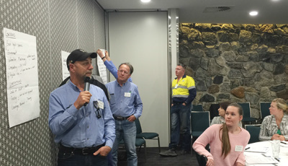
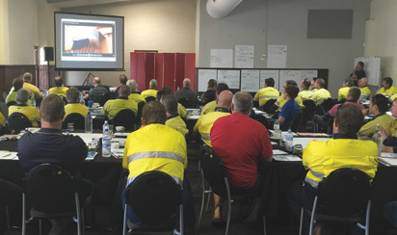
It started at the 2015 Roadshow…
We are not finding new ways of hurting or killing people
Why aren’t we learning?
Workshop question:
  What strategies will produce the best safety results?
Bunbury
Karratha
Notes:
The DMP 2015 Mines Safety Roadshow covered ‘why aren’t we learning?’
The industry is not finding new ways to injure and kill people, so why aren’t we learning from our ways?
This question was posed at the 2015 Roadshow with a workshop asking industry what strategies they believe will produce the best safety results to address this issue.
Recurring events – 2015 Roadshow Presentation
http://www.dmp.wa.gov.au/Documents/Safety/MSH_TB_RecurringEvents.pptx
What is happening in industry – 2015 Roadshow Presentation
http://www.dmp.wa.gov.au/Documents/Safety/MSH_TB_WhatsHappeningIndustry2015.pptx

Slide 9
Your workshop outcomes – a brief summary
Develop positive safety culture
  Ownership and accountability of safety
  Effective open communication
Positive leadership
  Consultation between workers, management and health and safety representatives
  Prioritising safety over production
Effective incident investigations
Improved competence
Invest in safety
    Focus on higher order “hierarchy of controls”
Notes:
The key workshop outcomes are listed on the screen. These are the areas that were most prominent that industry believe needed to be addressed to prevent injuries and fatalities.
Do you agree with these outcomes?
Have you seen any changes in these areas since 2015?
Additional outcomes from the 2015 Roadshow workshop activities were published in the February 2016 issue of the Resource Safety Matters magazine – pages 20 to 25
http://www.dmp.wa.gov.au/Documents/Safety/RS_RSM_Mag_Feb16.pdf

Slide 10
So what does this mean?
Safety culture is important, but…
…it’s not the full answer
Source:
2015 Mine Safety Roadshow workshop activity

Slide 11
Overview
What is Human Factors?
Why is DMP interested in Human Factors?
How does Human Factors relate to safety culture?

Slide 12
Safety literature tells us…
“We all make errors irrespective of how much training and experience we possess or how motivated we are to do it right.”
(Source: HSE HSG48 pg10)
“It is generally understood that virtually all major accidents include Human Factors among the root causes and that prevention of major accidents depends upon human reliability” IOGP, Report 434-5, 2010
Safety events
Source: U.S. DOE 2009a
(Vol 1; DOE-HDBK-1028-2009)
So the challenge is to create “human reliability”
Notes:
The US Department of Energy (DOE) has developed a model that safety events are due to 80 per cent human error and 20 per cent equipment failure.
Human error can occur despite training, experiences, processors and a motivation to complete tasks properly. The IOGP report states, ‘virtually all major accidents include Human Factors among the root causes and that prevention of major accidents depends upon human reliability”
Although important for safety, the challenge is not around equipment reliability but human reliability.
Source:
US Department of Energy (DOE) (2009a) Human performance improvement handbook: Concepts and principles (Vol 1; DOE-HDBK-1028-2009); page 1-10

Slide 13
It is not just about the last person to touch the equipment
Some people believe that they need to keep beating the “human” until “human error” goes away
(Source: Dekker, ISBN 978-1-14724-3904-8)
Notes:
During the creation of Murphy’s Law who was at fault?
Was it the designer, who months prior designed the instrument, allowing multiple installation options?
The technician, weeks prior, who incorrectly installed the instrument?
Was it the project manager and technician, hours before the experiment, who didn’t complete calibration tests on the instrument?
Or, minutes prior, the operator who failed to complete pre-start checks on the instrument?
Human Factors is not blaming the last person to touch the equipment. Human Factors are influenced by human error and organisational impacts.
Dekker states that people believe they need to keep beating the ‘human’ until the phenomenon of ‘human error’ goes away. But how true is this?

Slide 14
UK HSE view accidents through a framework of human failure
Human failures
Unsafe act
Incident
Latent errors
Unsafe plant /
condition
Active failures
Immediate consequence
Frontline people
Latent failures
Usually hidden until a trigger event
People removed in time and space
Fail to recover situation
Failure of mitigation
Accident
Reference: HSE Inspectors Toolkit, 2005
Notes:
The National Health & Safety Regulator for Great Britain has undertaken extensive research into this topic. There is only one regulator not numerous, resulting in extensive research into Human Factors.
As a result, a framework has been developed to review the involvement of human failures in incidences.
The framework represents that a human failure causing an unsafe act has to occur, in alignment with an unsafe plant or condition caused by latent errors for an incident to occur.
Human failures
Result in either latent or active failures.
Active failures
Have an immediate consequence.
Usually made by frontline people.
Latent failures
Made by people who are removed in time and space from the task.
Usually hidden until triggered by an event.
An incident is caused by unsafe acts and unsafe plant and/or conditions. For an accident to occur, there needs to be a failure to recover the incident situation.

Slide 15
There has been a lot of research into understanding human failure and how errors are made
Human failure
Errors
(unintended)
Slips
(of action)
Lapse
(of memory)
Mistake
(rules or knowledge)
Performance shaping factors
Violation
(intended)
Quality of decisions
Reference: HSE Inspectors Toolkit, 2005
Notes:
Human failures cont.
Human failures can occur due to an error or a violation.
Human errors
An action or decision which was not intended.
Involved a deviation from accepted standard.
Led to an undesirable outcome.
Human violations
A deliberate deviation from a rule or procedure.
Three types: routine, situational and exceptional.
Quality of decisions are influenced by performance shaping factors
Factors that make error more likely to occur (e.g. communications, procedures, environment, training, social).

Slide 16
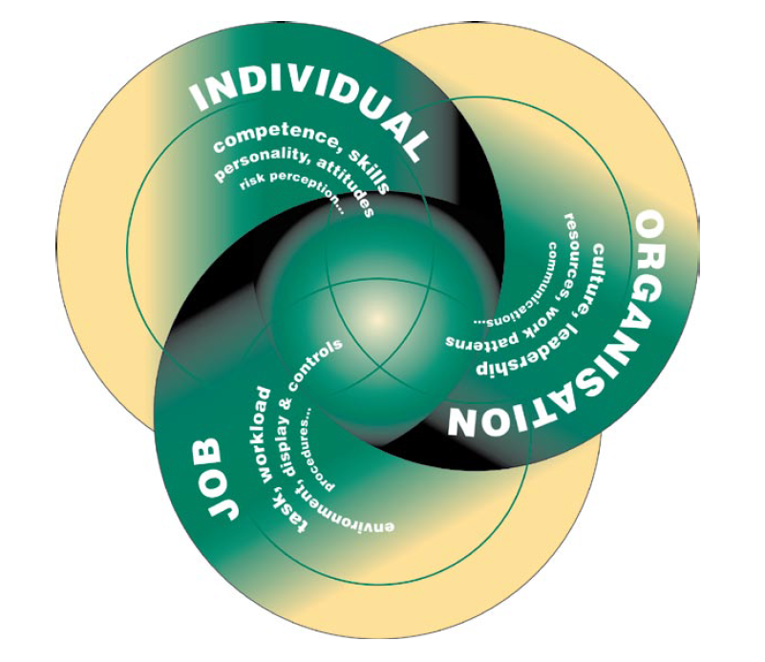
What are performance shaping factors?
Individual
Personal attitudes
Skills
Habits
Personalities
Mental wellbeing
Human Factors
Organisation
Safety commitment
Leadership
SMS
Learning
Job
Physical match
Mental match
Source: Reducing error and influencing behaviour, HSE, HSG48 page 5
Notes:
The United Kingdom’s Health and Safety Executive (UK’s HSE) has developed a model for performance shaping factors.
These three accident precursors make up Human Factors
Individual
Low skill.
Tired.
Job
High workload.
Missing instructions.
Organisation
Poor planning.
Poor culture.
Reference: UK Health and Safety Executive (HSE), Reducing error and influencing behaviour, HSG48, ISBN 978 0 7176 2452 2

Slide 17
UK HSE subsequently created a “Top 10” of Human Factor topics
Core Topic | Common Topic | Specific Topic
Competence assurance | Maintenance error | Alarm handling and control room design
Human Factors in accident investigations | Safety-critical communication | Managing fatigue
Identifying human failures | Safety culture | Organisational change
Reliability and usability of procedures
Emergency Response (No 11)
Some topics have sub-topics (not shown in table)
Objective:
To provide focus and structure to a very broad subject
Notes:
The UK’s HSE has found via incident investigation and inspection, subjects which are often not well-managed. Some of these topics have related sub-topics, resulting in a total of 20 topics and sub-topics.
As a result, the HSE has developed a ‘Top 10’ Human Factors topics. These provide focus and structure to a very broad and complex topic.
The topics were classified into three distinct categories defined as:
core topics — fundamental to good human factor arrangements at all sites
common topics — relevant at most sites
specific topics — only relevant to some sites.
Emergency Response was not included in the HSE’s ‘Top 10’, however the topic is included in the UK HSE’s Human Factors guide as an eleventh topic.
Source:
HSE, Inspectors Toolkit, Human Factors in the management of major accident hazards, page 8
http://www.hse.gov.uk/humanfactors/topics/toolkit.pdf

Slide 18
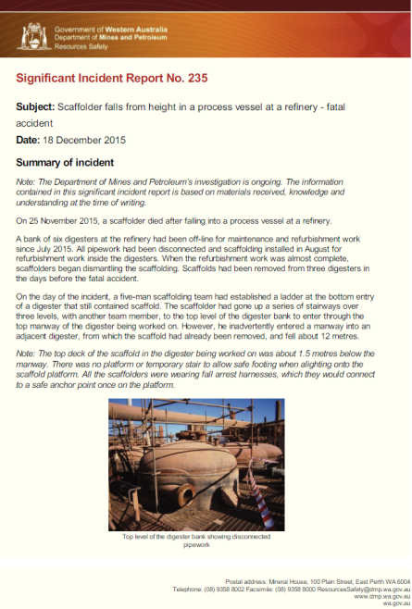
Are the UK HSE Human Factors relevant to the WA mining industry?
To answer this:
DMP Mine Safety Branch initiated a project
Engaged a Human Factors expert
Analysed data from:
  Industry literature
  DMP publications
  DMP incident and inspection data
Notes:
The DMP initiated a project to determine:
whether the existing UK HSE ‘Top 10’ are equally relevant to the Western Australian (WA) mining sector
identify any differences, and any additional human factors topics relevant to mining safety
select examples or case studies from the data which explain the relevance, using mining terminology.
A Human Factors expert was engaged to assist in the project.
Data was used to validate or invalidate the UK HSE ‘Top 10’ to the WA mining sector. Data included:
industry literature
DMP publications
DMP incident and inspection data.

Slide 19
DMP found evidence to support all UK HSE Human Factor topics
Outcome:
DMP data validated HSE top 10 Human Factor topics
Human Factor Topic
Observation:
Safety culture significant, but other factors just as important
Notes:
Data
Data cannot be used to rank top topics, but can be used to verify the relevance of the UK HSE ‘Top 10’ topics in the WA mining industry.
The topic ‘Not covered’ is an additional topic included to determine if there are additional topics relevant to the WA mining industry which are not included in the ‘Top 10’.
Study findings
All UK HSE Human Factor topics (except organisational change) are relevant however, DMP focus groups believed Organisation Change was relevant.
Each topic matched at least one source of data.
Safety culture is important, but there is clear evidence other topics are just as, or more, important.
UK HSE legislative framework means they don’t address health issues.
UK HSE Human Factor ‘Top 10’ concept needs expanding to include Emergency Response.
Language and context requires modifications to suit the WA mining industry.
The Not covered’ topic (which could be renamed Fitness for duty) included:
management of physical and mental health
bullying
drugs and alcohol
managing the demands of the fly-in fly-out (FIFO) mining lifestyle.

Slide 20
DMP human and organisational factors
GOAL Managing human reliability
Safety culture is important, but…
it is not the whole story
Health and safety culture
Organisational topics
Training and competency
Staffing and workload
Organisational change
Emergency Response
Task-based topics
Usable procedures
Fitness for work
Maintenance inspection and testing
Safety-critical communications
Designing for people
Notes:
The goal is to manage human reliability through the health and safety culture.
This is achieved by organisation topics and task-based topics.
So, what does this mean in regards to human factors and safety culture?
Safety culture is important, but… it is not the whole story.

Slide 21
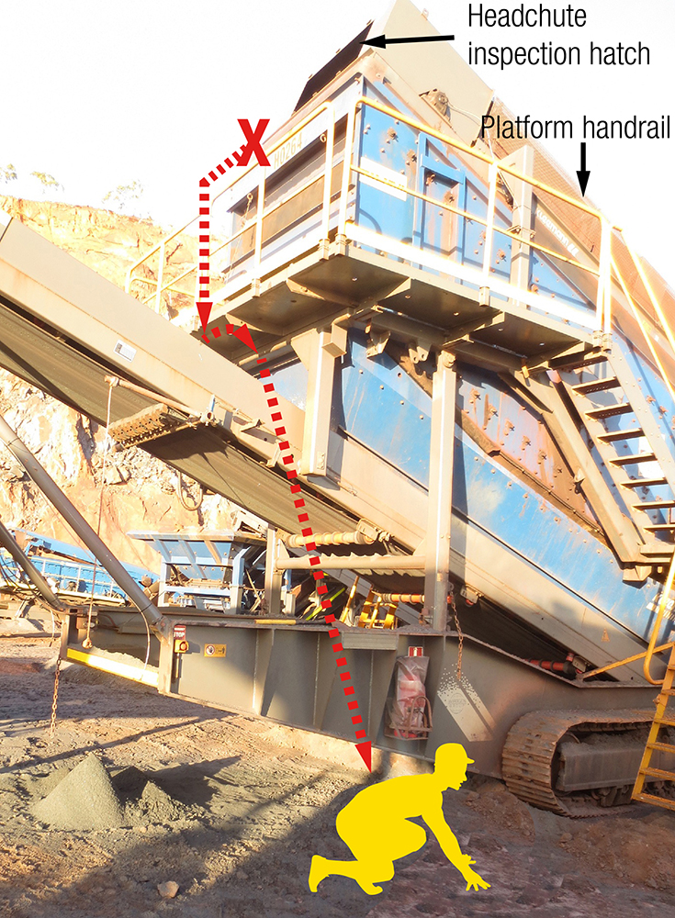
If we ignore human factors will we continue to make bad decisions?
Human Factor topic
Managing human reliability
Usable procedures
Training and competence
Staffing and workload
Organisational change
Safety-critical communications
Designing for people
Fitness for work
Health and safety culture
Maintenance error
Emergency Response
SIR 212
Notes:
A supervisor, needed to inspect the head chute of a mobile screening plant. To do so, he climbed the steelwork above the elevated platform and handrail to access the head chute inspection hatch.
As he opened the head chute inspection door, which weighed more than 10 kg, it came away from its hinge pins and fell onto the elevated platform.
The supervisor lost his balance. He fell backwards over the top handrail onto the conveyor, about 3 m below, and then to the ground, a further 3.5 m below that. Fortunately, he was not injured.
How does this relate to Human Factors?
Designing for people
Unable to use inspection hatch without committing a “violation”.
Managing human reliability
Supervisor committed a “violation”.
Health and safety culture
Organisational leadership not setting appropriate standards
Maintenance error
Hinges failed and not repaired, or not adequately inspected.
If Human Factors are not addressed and managed in the workplace, will bad decisions still continue?

Slide 22
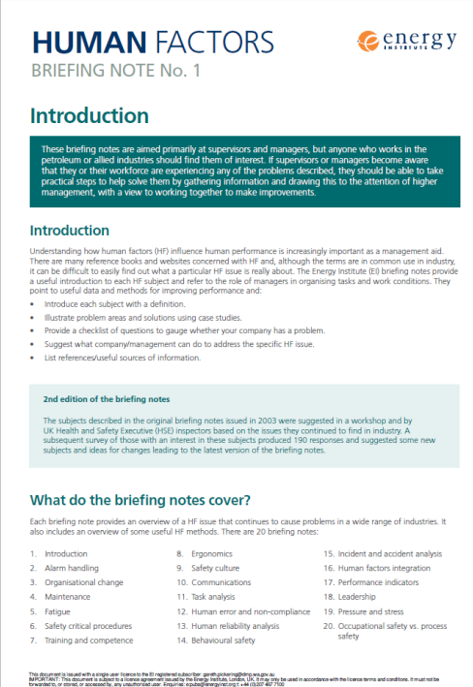
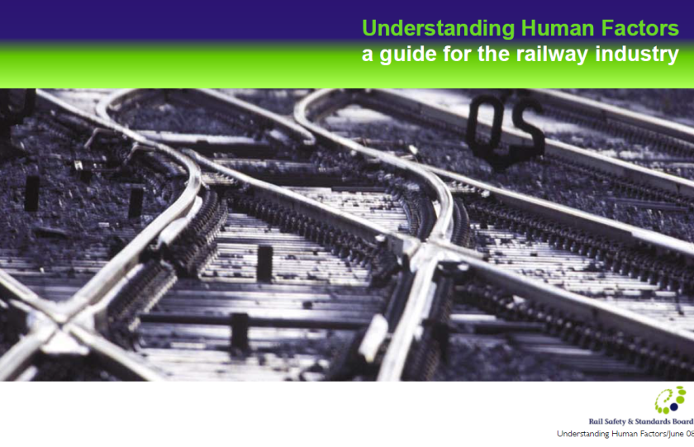

Further information?
There is plenty:
UK Health and Safety Executive
  www.hse.gov.uk/humanfactors/topics/
Energy Institute: Human Factors briefing notes 1 - 20
  www.energyinst.org/technical/human-and-organisational-factors/human-factors-briefing-notes
Rail Safety and Standards Board: Understanding Human Factors – a guide for the railway industry
  www.rssb.co.uk/Library/improving-industry-performance/2008-guide-understanding-human-factors-a-guide-for-the-railway-industry.pdf
Notes:
Human Factors is a well published topic with numerous sources available on the web.

Slide 23



Stay informed
Remember: Subscribe to our weekly email alert service to receive the latest news about what’s happening at Resources Safety
@ www.dmp.wa.gov.au/subscriptions
Follow us on social media:
Twitter
@DMP_WA
LinkedIn at Department of
Mines and Petroleum
Notes:
Subscribe to Resources Safety’s email alert service to receive invitations to provide input as well as the latest news about publications, safety alerts, events and safety reform progress. Safety news alerts are typically sent each Tuesday.
Follow us on LinkedIn to receive the latest resources safety news alerts and job opportunities at DMP.
Follow us on Twitter to stay up-to-date on a variety of the latest department news and information - from major project milestones and upcoming events, to updates regarding industry policies and guidelines.

