Slide 1
Please read this before using presentation
This presentation is based on content presented at the 2017 Emergency Management information session in November 2017.
Department of Mines, Industry Regulation and Safety(DMIRS) supports and encourages reuse of its information (including data), and endorses use of the Australian Governments Open Access and Licensing Framework (AusGOAL)
This material is licensed under Creative Commons Attribution 4.0 licence. We request that you observe and retain any copyright or related notices that may accompany this material as part of attribution. This is a requirement of Creative Commons Licences.
Please give attribution to Department of Mines, Industry Regulation and Safety, 2018.
For resources, information or clarification, please contact: SafetyComms@dmirs.wa.gov.au or visit www.dmirs.wa.gov.au/ResourcesSafety

Slide 3
The Big Bang! Dangerous goods and emergency response

Slide 4
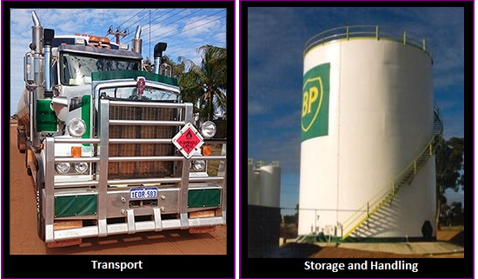
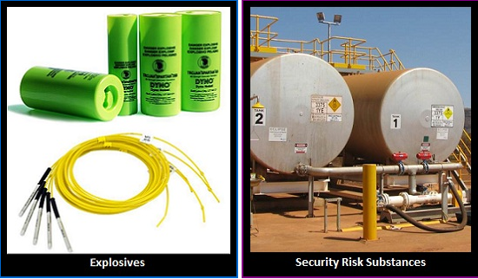
Dangerous goods operations

Slide 5
Who are we?
Dangerous goods
Major hazard facilities
Petroleum
Safety
Notes:
Dangerous Goods – is all about the safe storage and handling of DG’s, similar legislation across Australia and consistent internationally.
Petroleum Safety, manage a Safety Case regime in oil and gas (SC was an outcome of the Cullen enquiry into Pipa Alpha explosion in the north sea in 1988).
Both are concerned about societal risk as well as any employee risk and also focus on Emergency Management (for when things go wrong).

Slide 6
How do we achieve safety outcomes?
Legislation
Dangerous Goods Safety Act 2004
Petroleum and Geothermal Energy Resources Act 1967
Petroleum Pipelines Act 1969
Petroleum (Submerged Lands) Act 1982
Associated regulations
Licensing
Licensing Regulation Branch
Petroleum Division
Enforcement
Education
Notes:
Although we regulator of several pieces of legislation we expend significant effort on informing and educating.

Slide 7
https://youtu.be/horEcWw_KxM
Notes:
Video link - https://youtu.be/horEcWw_KxM

Slide 8
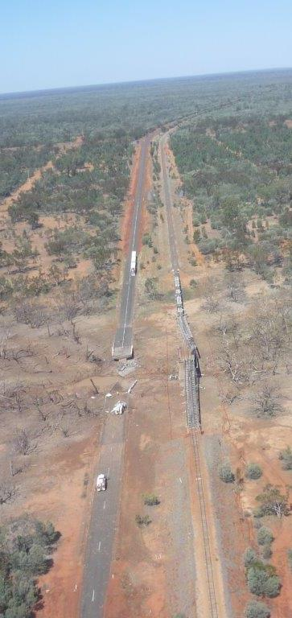
Further detail of incident
No deaths but serious injuries (people were crouched down)
Fire started soon after accident
1 hour 15 mins small pyrotechnic effect
2 minutes later a huge explosion

Slide 9
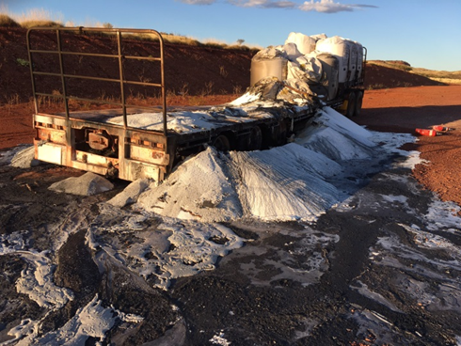
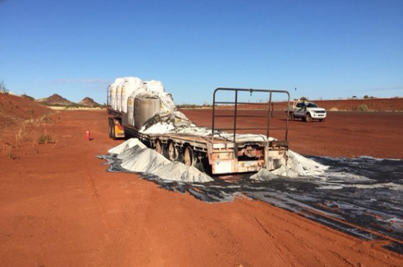
AN vehicle fire near Tom Price 23 March 2015
B double carrying 44 X 1.2 T bags AN
Rear axle fire
Tried extinguishing but unsuccessful
Decoupled prime mover
Good evacuation plan
Set up exclusion zone
Let it burn out overnight
No explosion

Slide 10
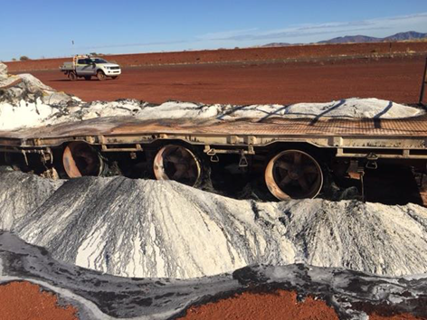
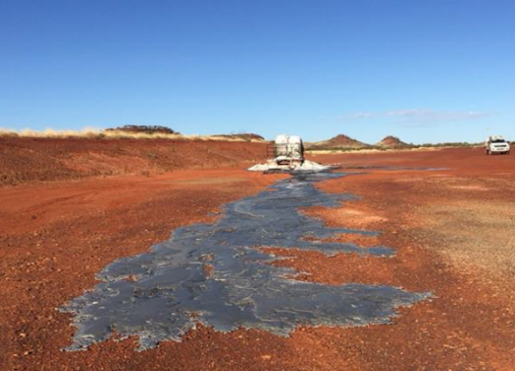
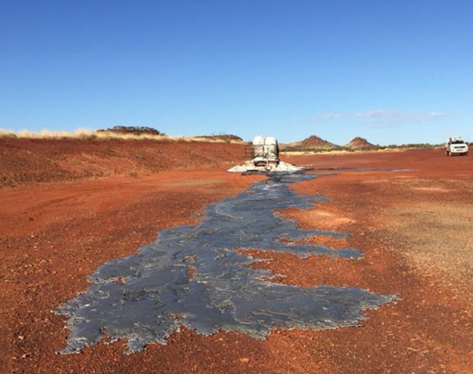
Comparisons
Fires started at opposite ends of vehicle
Amount of combustibles involved
Type of firescreen (Al vs steel)
Molten AN could flow away and did not pool
Good emergency plan

Slide 11
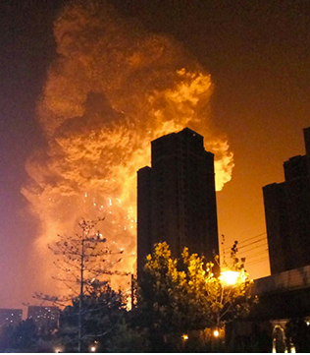
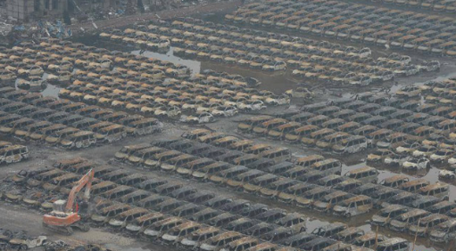
Port of Tianjin, China explosion
Huge explosion occurred
12 August 2015
Started by nitrocellulose drying out
290 T of nitrocellulose
800 T of AN
165 people killed
798 injuries
1.04 billion dollars damage

Slide 12
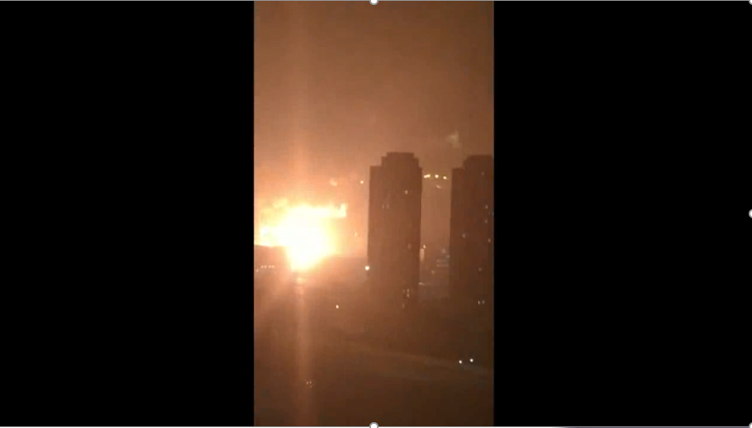
Tianjin explosion
https://youtu.be/993wlZ6XFSs
Notes:
Video link - https://youtu.be/993wlZ6XFSs

Slide 13
DFES – DGSB Interaction
DMIRS
DFES
Dangerous Goods
Response Agency
Regulatory Authority
WESTPLAN HAZMAT
Public Safety

Slide 14
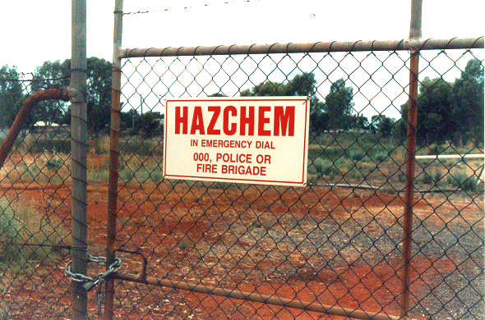
DMIRS’ responsibilities – Westplan Hazmat
To be contactable and available on a 24/7 basis
Provide a representative to the HEA
Provide advice on potential dangers to public safety and actions to be taken to mitigate the hazard effects. DMIRS may deploy a Dangerous Goods Officer to the incident scene, as required
Investigate the cause of the emergency, where applicable

Slide 15
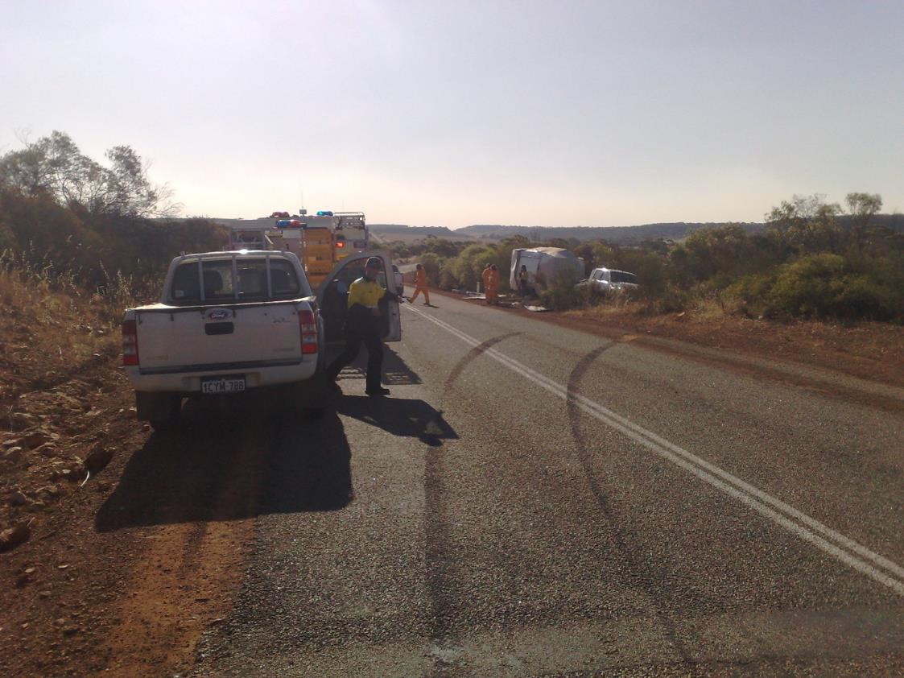
Traffic Crash or HAZMAT?

Slide 16
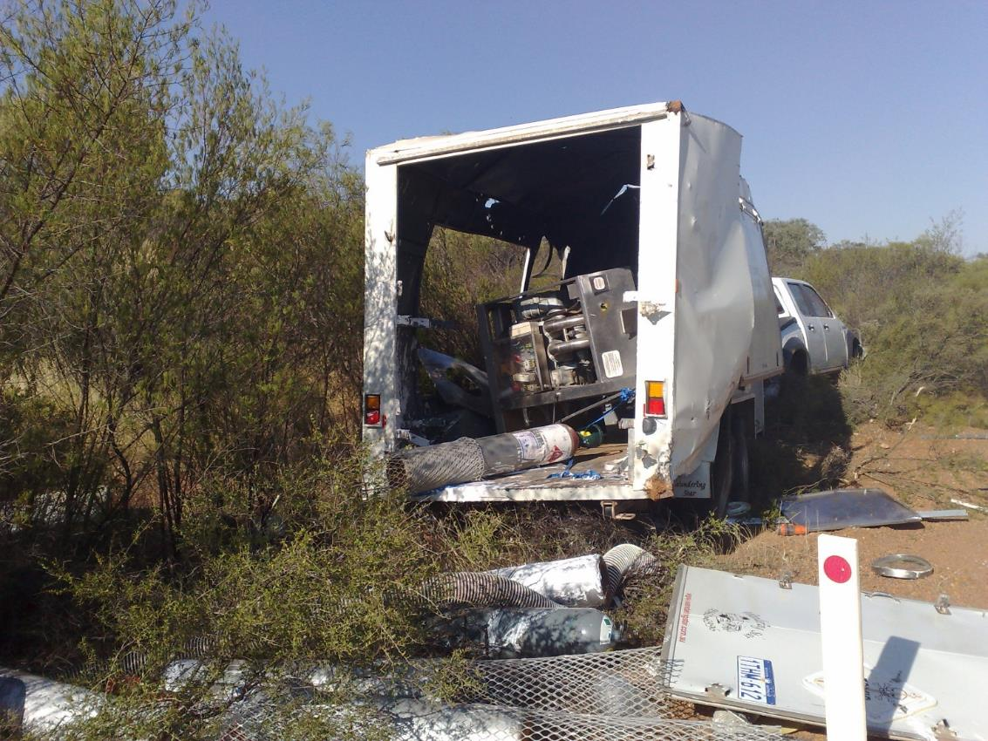
Spot the hazard!

Slide 17
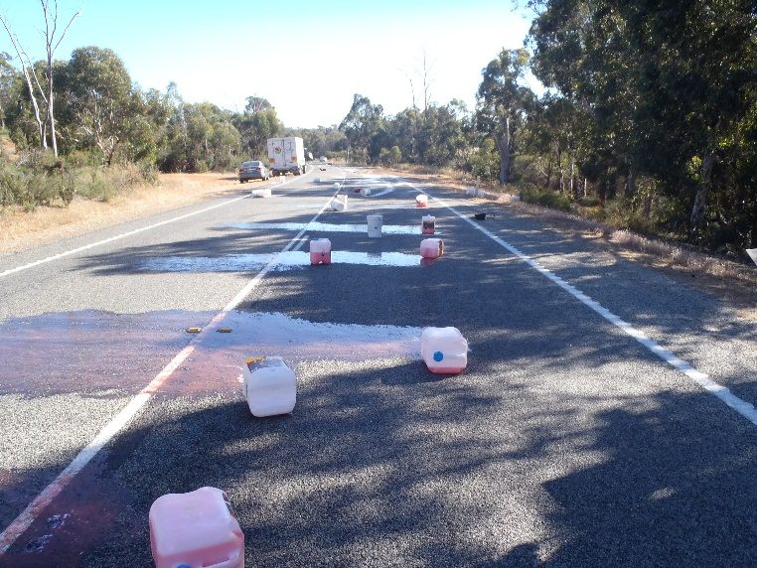
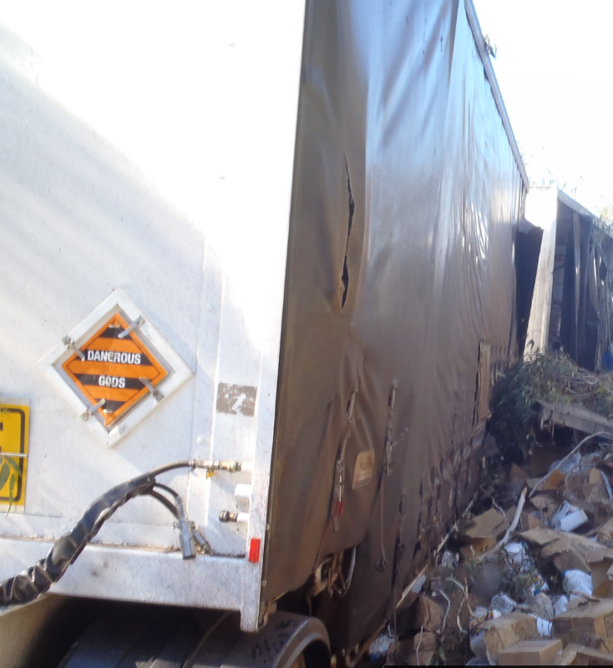
Incident reporting
Unintended spills, fire explosions or releases of energy, loss or theft of explosives or security sensitive ammonium nitrate
Involving death, serious injury or damage to property or the environment

Slide 18
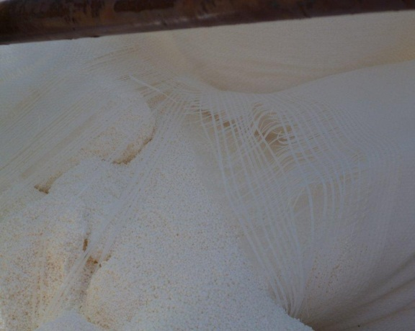
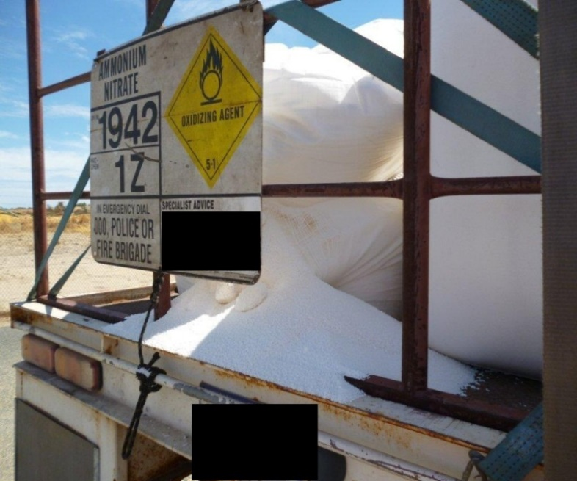
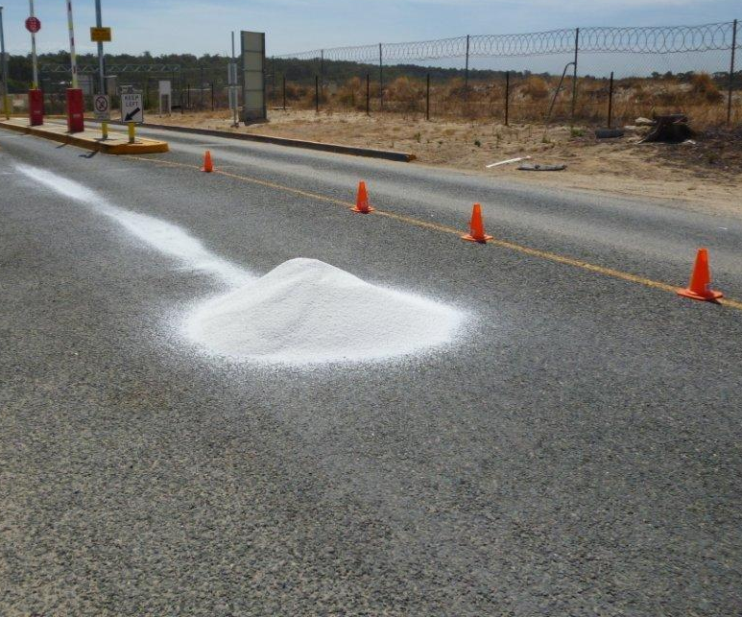
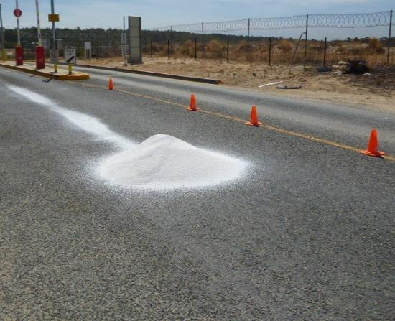
DG incidents - Baldivis
The loss of ammonium nitrate is unacceptable as it is an oxidising agent and a regulated security substance. Plugging holes in the FIBCs with oily rags must not be done as ammonium nitrate is incompatible with fuel and oils

Slide 19
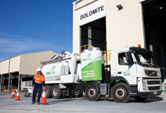
Transport - Approved Emergency Responders
All dangerous goods transport companies are required to provide an approved emergency site clean-up response for dangerous goods transport incidents
Source: www.toxfree.com.au
Notes:
Responsibilities.
a. Maintain all the requirements for accreditation, identified by the Department of Mines and Petroleum for the Class or Division of Dangerous Goods for which the proponent intends providing a cleanup
service.
b. Respond to the incident site as required, and upon handover by the
Incident Controller, conduct a site clean-up and disposal under
supervision of the Local Recovery Committee.
c. Ensure compliance with written handover processes from response to
recovery phase.

Slide 20
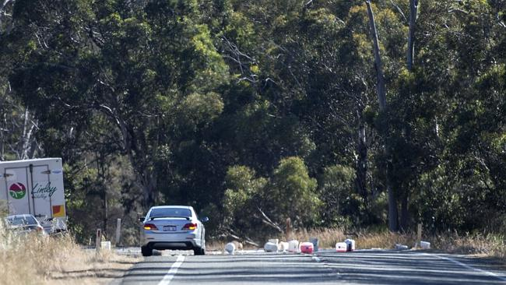
Transport – consignors or prime contractors
Required to provide support assistance to the hazard management agency during incident mitigation and to assume responsibility for site clean-up and disposal during the recovery phase
Ensure emergency plans are in place for dangerous goods transport, including contracts with Approved Emergency Responders

Slide 21
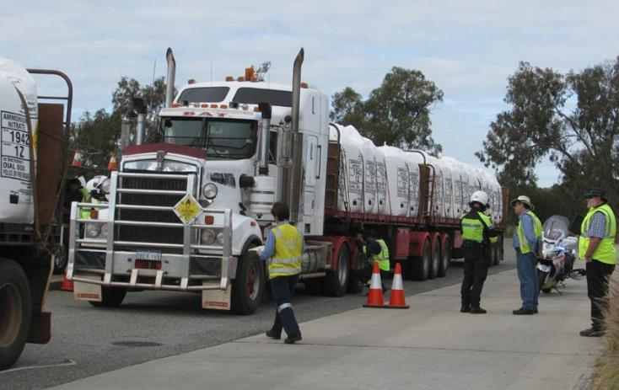
Transport – consignors or prime contractors
Safe recovery of dangerous goods
Ensure site clean-up and ensure restoration to its original condition as much as reasonably possible
Provide the Dangerous Goods Safety Branch with an incident report

Slide 22
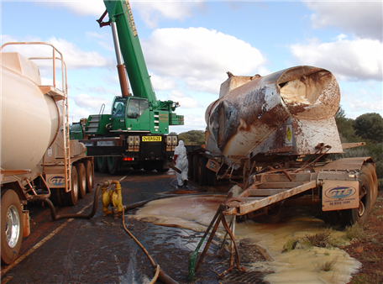
Incident Reporting [s. 9]
Examples of reportable spills:
>50 m³ of flammable gas
>100 m³ of non-flammable non-toxic gas
>5 m³ of toxic gas
>50 L / kg of Packing group I on-site, or >5 L / kg off-site
>1,000 L / kg of packing group II or III on-site, or >100 L / kg off-site
See reporting guidelines on the web page
Notes:
These examples are for spills relevant to the storage and handling regulations.
Reportable situations for explosives and SRS include theft and unexplained losses.
For further details, refer to the guidance note on incident reporting on the RSD web page.

Slide 23
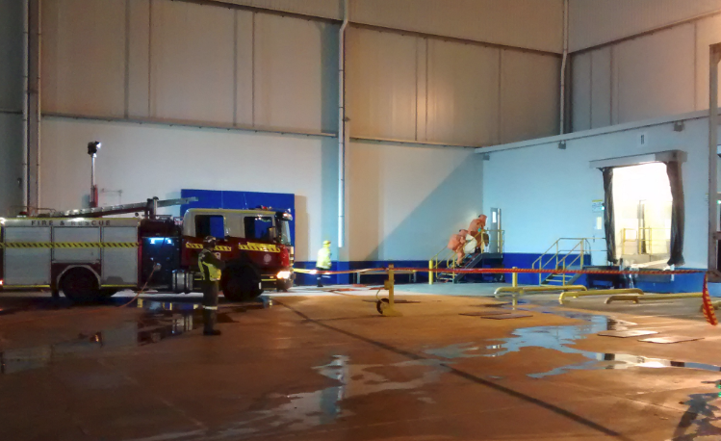
Understanding Hazmat Emergency Response
Transport Emergency Response Plan
Responsibilities under regulations
Credible scenarios
Spills, fire or explosion
Vehicle accident
Transfers

