Slide 1

Please read this before using presentation
This presentation is based on the content presented at the 2019 Mines Safety Roadshow in October 2019.
Department of Mines, Industry Regulation and Safety (DMIRS) supports and encourages reuse of its information (including data), and endorses use of the Australian Governments Open Access and Licensing Framework (AusGOAL)
This material is licensed under Creative Commons Attribution 4.0 licence. We request that you observe and retain any copyright or related notices that may accompany this material as part of attribution. This is a requirement of Creative Commons Licences.
Please give attribution to Department of Mines, Industry Regulation and Safety, 2019.
For resources, information or clarification, please contact: SafetyComms@dmirs.wa.gov.au or visit www.dmirs.wa.gov.au/ResourcesSafety

Slide 2

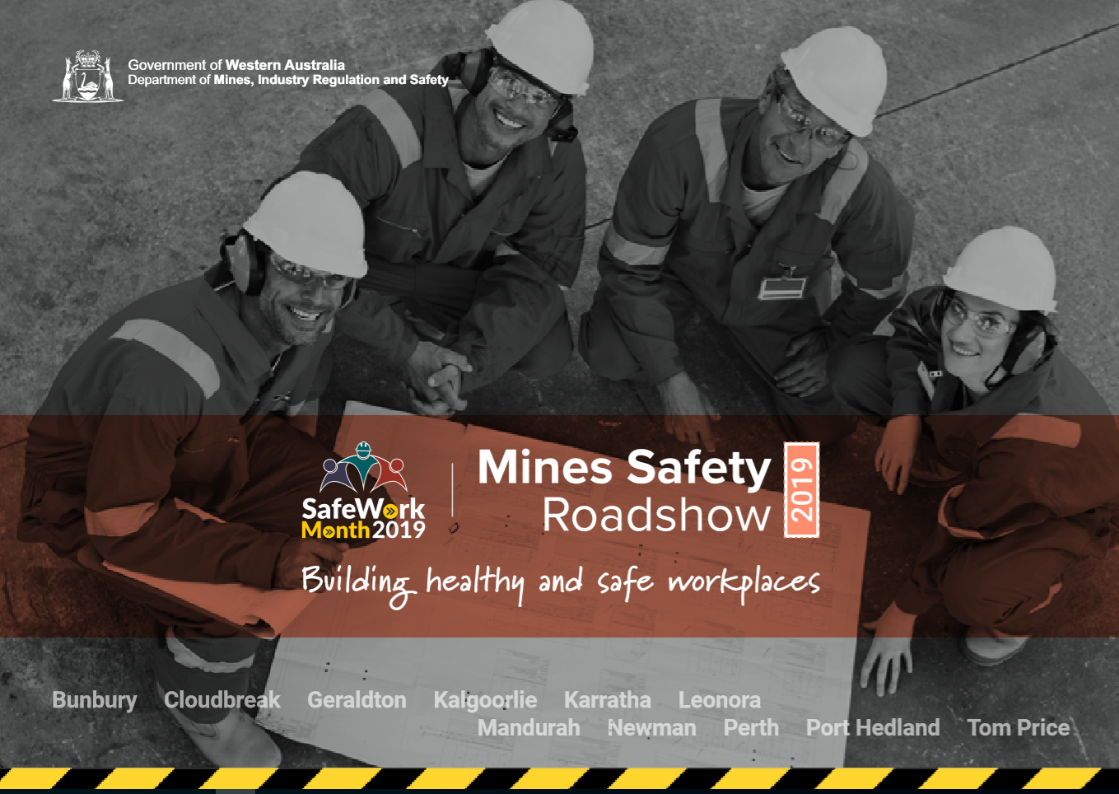
2019 Mines Safety Roadshow

Slide 3
Investigations – are we learning?

Slide 4

"Condemnation without investigation is the height of ignorance"
Albert Einstein
Notes:
Let’s start with a quote about investigations.
Do we still see this thinking after some incidents?
Have we heard people say -
“What was he thinking?
‘”Why were they doing that that way?”
“Only an idiot would have done that?”
These statements all demonstrate an unwillingness to learn from incidents.
Those thoughts are often followed by -
“Let’s re-train the persons involved”
“Let’s roll out a toolbox talk”
“Let’s have a safety pause”

Slide 5
Session outline
Incident context
Department investigations
Your investigation processes – HOF
Maximising learning opportunities
Notes:
This presentation will focus on:
Incidents that are occurring across the mining industry.
Some detail about what the Department of Mines, Industry Regulation and Safety (DMIRS) considers when we investigate incidents.
Some common investigation processes, and how we can maximise learnings from them with a bit of a focus on human and organisational factors.
And finish with some thoughts about developing a learning culture within your business.

Slide 6
Notifications to DMIRS
Mines Safety and Inspection Act, 1994 -
Section 76 – Accidents involving disabling injury
Section 78 – Occurrences to be notified
Section 79 – Potentially serious occurrences
Section 81 – Place of accident not to be disturbed
Notes:
Firstly, let’s recap some of the requirements for the reporting of incidents to the Department.
Section 76. Accidents involving disabling injury to be notified
(1) Where a person suffers injury in an accident at a mine and is disabled by that accident from performing his or her duties of employment as they were being performed at the time the accident occurred, the manager must cause notice of the accident to be given —
(a) in accordance with the regulations, to the district inspector for the region in which the mine is situated; and
(b) if the injured person so requests, to the secretary or local representative of a trade union of which that person is a member.
(2) The notice required to be given under subsection (1) must —
(a) if the injury appears to be serious, be given by the fastest practicable method of communication as soon as it is reasonably practicable to do so, and must subsequently be confirmed in writing; and
(b) if the injury appears not to be serious, be given in writing at the end of the month.
(3) A manager who —
(a) omits to give a notice required to be given by subsection (1); or
(b) fails without reasonable excuse to give a notice required to be given by subsection (1) in accordance with subsection (2),
commits an offence, unless the required notice was given by the principal employer at the mine.
(4) An injury is a serious injury for the purposes of this section if the injury —
(a) results in the injured person being disabled from following his or her ordinary occupation for a period of 2 weeks or more; or
(b) involves unconsciousness arising from inhalation of fumes or poisonous gases or asphyxiation due to lack of oxygen or displacement of oxygen by an inert gas; or
(c) results from an accident, including fuming, arising out of the use of explosives.
Section 78. Some occurrences at mines to be notified and recorded
(1) The manager must immediately give notice to the district inspector for the region in which the mine is situated of an occurrence to which this section applies, whether or not any bodily injury to any person or damage to property has resulted from the occurrence, and must give to the district inspector such particulars in respect of the occurrence as the inspector may require.
(2) The manager must without delay record particulars of an occurrence to which this section applies in the record book.
(2a) A manager who contravenes subsection (1) or (2) commits an offence.
(3) This section applies to an occurrence of —
(a) any extensive subsidence, settlement or fall of ground or any major collapse of any part of the operations of a mine, or any earth movement caused by a seismic event; or
(b) any outbreak of fire above or below ground in any mine; or
(c) any breakage of a rope, cable, chain or other gear by which persons are raised or lowered; or
(d) any inrush of water from old underground operations or other source; or
(e) any accidental ignition of dust below ground or the discovery of the presence of potentially harmful or asphyxiant gas or an outburst of such gas in any part of a mine; or
(f) any accidental ignition or detonation of explosives, or any delayed or fast ignition of explosives; or
(g) any explosion or bursting of compressed air receivers, boilers, or pressure vessels; or
(h) every electric shock or burn to a person and every dangerous occurrence involving electricity; or
(i) any incidence of a person being affected by poisoning or exposure to toxic gas or fumes; or
(j) any loss of control of heavy earth moving equipment, including failure of braking or steering.
Section 79. Some potentially serious occurrences to be notified
(1) The manager must inform the district inspector for the region in which the mine is situated of any occurrence at the mine which in the manager’s opinion had the potential to cause serious injury or harm to health (other than an occurrence referred to in section 78) although no injury or harm in fact happened.
(2) The manager must inform the district inspector as required by subsection (1) as soon as practicable after the manager has ascertained the facts and circumstances of the occurrence and, if required by the district inspector, must provide a written report on that occurrence.
Here also is a reminder about the requirements to maintain an incident scene, until proper authorisation has been received.
Section 81. Place of accident not to be disturbed
(1) A person must not disturb a place at a mine where an accident causing death or serious injury has occurred except with —
(a) a view to saving life or preventing injury to any person; or
(b) the permission of an inspector or, in the case of a fatal accident, the permission of a coroner.
(2) A person who contravenes subsection (1) commits an offence.

Slide 7

Notifications to DMIRS
Notes:
Please note that incident reports can now be lodged 24 hours a day by calling the 1800 SAFEMINE number.
This is also a contact line for general enquiries, or for the lodging of any complaints about mine safety.

Slide 8
Industry experiences – Across industry
MSIA 1994 - Section 76 – Accidents involving disabling injury
Forecasting at least another 48 disabling injuries to occur by the end of this year
Notes:
These incident numbers are the Serious Disabling Injury figures reported to DMIRS from the 560 mine sites and exploration sites.
N.B. The 2019 figures were for the period up to the end of August, plus a projection to the end of 2019. In this case there have been 96 injuries to the end of August with a prediction of a total of 144 by year’s end. Unfortunately this means we will still seriously injure 48 more employees before the end of the year.

Slide 9
Industry experiences – Across industry
Forecasting at least another 54 loss of control of a heavy vehicle incidences to occur by the end of this year
Forecasting at least another 134 electric shocks to occur by the end of this year
Notes:
Loss of control of heavy vehicle – Section 78(3)(j)
2018 – 171
2019 – 108 (162)
Electric Shock - Section 78(3)(h)
2018 – 393
2019 – 268 (402)

Slide 10
Industry experiences – Across industry
Forecasting at least another 63 outbreaks of fire to occur by the end of this year
Forecasting at least another 173 potentially serious occurrences to happen by the end of this year
Notes:
As you can see a significant number of potentially serious near misses are occurring every year. There is an enormous capacity to learn from these incidents, both within your own business and learning from other business’ experiences.
As an Inspector it is surprising just how common a lot of workplace occurrences still are.
The numbers on these previous slides have driven the question - Are We Learning?

Slide 11
Industry experiences – Individual
5 side tippers overturning within 2 ½ years
5 moxy’s tipping over in 18 months (3 in 3 weeks)
Franna hitting structure – 3 in 6 months
Notes:
To give some more specific examples of potential missed opportunities to learn, here are some site or business level examples.

Slide 12
Department investigations
Level 1 – Fatalities and serious injuries
Level 2 – Department investigation conducted
Level 3 – Followed up by Inspectors
Level 4 – Low risk, managed by site
Notes:
When it comes to incident notifications to DMIRS, some 4,500 notifications are received every year. While not all of these will be investigated, Department Inspectors will assess every notification that is received and determine a preliminary level of follow up.
Notification numbers
2019 – 3094 (4641 by year’s end)
2018 – 4638
2017 – 4206
Level 4 is our lowest level of assessment in which a case is noted and closed. These are typically low risk, or are expected to be well dealt with at a site level. Trends are monitored of these events to determine if any broad action by the Department is warranted.
If Department Inspectors want to obtain further information about an incident, it will be escalated to a Level 3. This may be to obtain further information about an injury, or to clarify details about the accident, or we may request a copy of the site incident investigation for review.
A Level 2 case is opened where we commence our own investigations. These are typically for incidents with more serious actual or potential consequences. Inspectors conducting these investigations will have completed a Certificate IV in Government Investigations.
All fatalities and very serious injuries are categorised as a Level 1 case. The Department has a dedicated Investigations branch which undertake these investigations.

Slide 13
Maximising learnings
Reactive investigations
Purpose of investigation
Participants – SHREPS
Starting point – risk register
Actions
  Appropriate
  Tactical vs Strategic
  Additional controls or tighten existing controls
Notes:
Purpose – ask yourself, why are we investigating this incident. Often the investigation is the end point. The incident procedure defines when an investigation is required so the attitude may be “We need to conduct an investigation so we can close off this incident.”
Participants – have you provided the right number and type of people to investigate the incident. Are you using your SHREPS to full effect?
Start point – Often we conduct an investigation in isolation and don’t consider existing processes and controls enough. Do we use our risk register to determine what controls should be in place, do we update the site risk register when we add additional controls.
Actions
Need to address the root causes of the incident.
While some actions may specifically address the incident that has occurred, the investigation should ideally also identify some broader actions that will improve the system controls to prevent all similar occurrences.
While it is tempting, and often easy, to identify additional controls that add layers of protection, there is also significant potential (that is often overlooked) to reduce future incidents by identifying flaws in existing controls. In terms of the Swiss Cheese model, it is often better to try and close the size of the holes in our existing cheese rather than simply add more and more layers of cheese.

Slide 14

Maximising learnings
Notes:
So if you’re making a Safety Management System Burger – don’t do this.

Slide 15
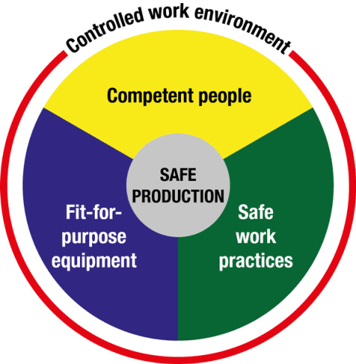
Investigation focus
ICAM
TapRoot
What Else?
Essential Factors
5 Why’s
Notes:
The Nertney Wheel is a useful model to provide clear risk management processes to achieve safe productivity in the workplace. Fit for Purpose Equipment, Safe Work Practices, Competent People and Controlled Work Environment all provide processes to help manage the risks to health and safety in the workplace.
Often investigations driven by the use of an investigation tool steer you towards looking at People, Equipment and Procedures or People, Equipment and Environment factors in a very fixed and structured way.
The process you use, whether it is Taproot, ICAM, Essential Factors or some other, should be seen as a starting point or a guide to your investigation. A good investigation will go beyond the tool and essentially seek to understand WHY.

Slide 16
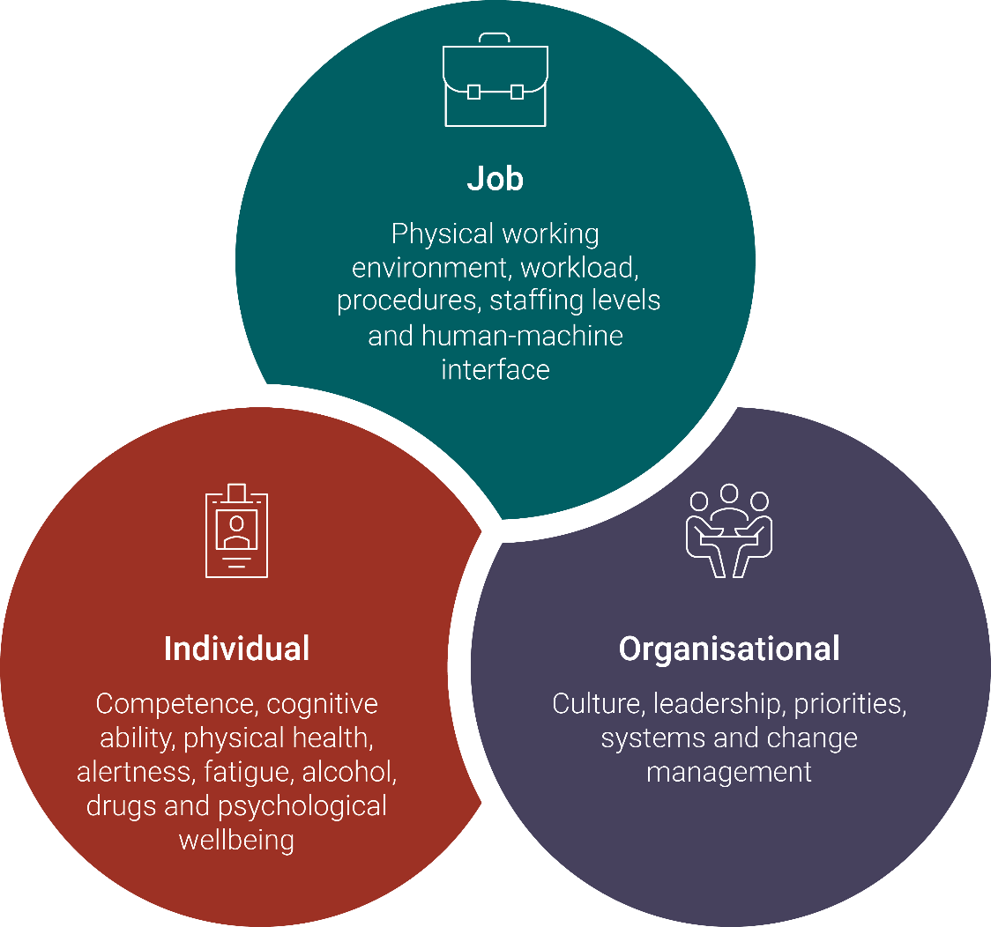
Human and Organisational Factors
Notes:
In this year’s Roadshow safety video (link below), we were introduced to this graphic. In order to investigate all the factors that are relevant to any given task, it can be helpful to consider these three interrelated areas.
https://vimeo.com/373837348/6fcf0531b8
Job – what people are being asked to do (the task and its characteristics).
Individual – who is doing the task (the person and their competence).
Organisation – where the person is working (the organisation and its attributes).
Often an investigation focuses heavily on the “Job” factors. It is easy to identify the what, where, when and how of a particular task – but there is much more extra learning to be gained by looking more closely at the individual factors, and organisational drivers that influence an incident.
This is what we mean when we talk about Human and Organisational Factors. It’s all elements within a workplace that have an influence on the people who work there.
Examples of Human and Organisational Factors
Over-reliance on procedures to manage risk and lack of user-friendly procedures.
Competence, through a combination of skills, experience and knowledge.
Staffing and workload – having the right numbers of the right people in the right place at the right time.
Management of organisational change and organisational structural design.
Communication of safety critical information, both verbally and written.
Design of control rooms, plant and equipment.
Fatigue from excessive work times or poorly designed shift-patterns.
Adequate resources for maintenance, inspection and testing.
Why are Human and Organisational Factors important?
Human and Organisational Factors impact on human reliability and performance, contributing to how effectively and safely a worker is able to do their job. How well these factors are managed will influence the likelihood of human failure.
Human failure refers to the error-making behaviour (e.g. mistakes and lapses) and violation behaviour (e.g. intentional rule-breaking) of individuals. Both components of human failure (error and violations) are heavily influenced by the work environment, the organisation people work in, and the design of the job they are asked to do.
When human and organisational factors are well managed, they set workers up for success – workers are more likely to do their job safely by not making errors or taking any violations. When they are poorly managed, or have not been considered, it increases the chances of human failure – worker performance reduces and incidents are more likely to happen.

Slide 17
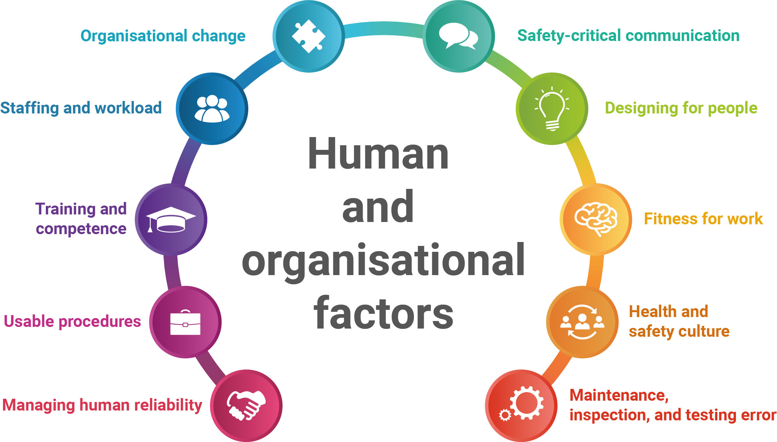
Notes:
Human reliability refers to the potential for error. Often an investigation stops at ‘operator error’, or doesn’t even start because there is an assumption of ‘operator error’.
People don’t make a choice that they think will cause them harm. If personal choice or error was identified in the accident sequence, we need to try much harder to understand why the choice was made.
Workers are very rarely the only instigator of accidents, they are more likely to be the last link in the chain of poor design, faulty installation, inadequate maintenance, poor management etc.
The principle of human factors is that we are normal people doing normal work in a normal organisation. An investigator is concerned with looking for what went wrong when people were trying to do a good job, so we need to identify the factors that drive individual choices and error.
The first factor here is “Managing Human Reliability”. Humans are prone to making errors. These are typically slips or lapses, mistakes, or violations.

Slide 18
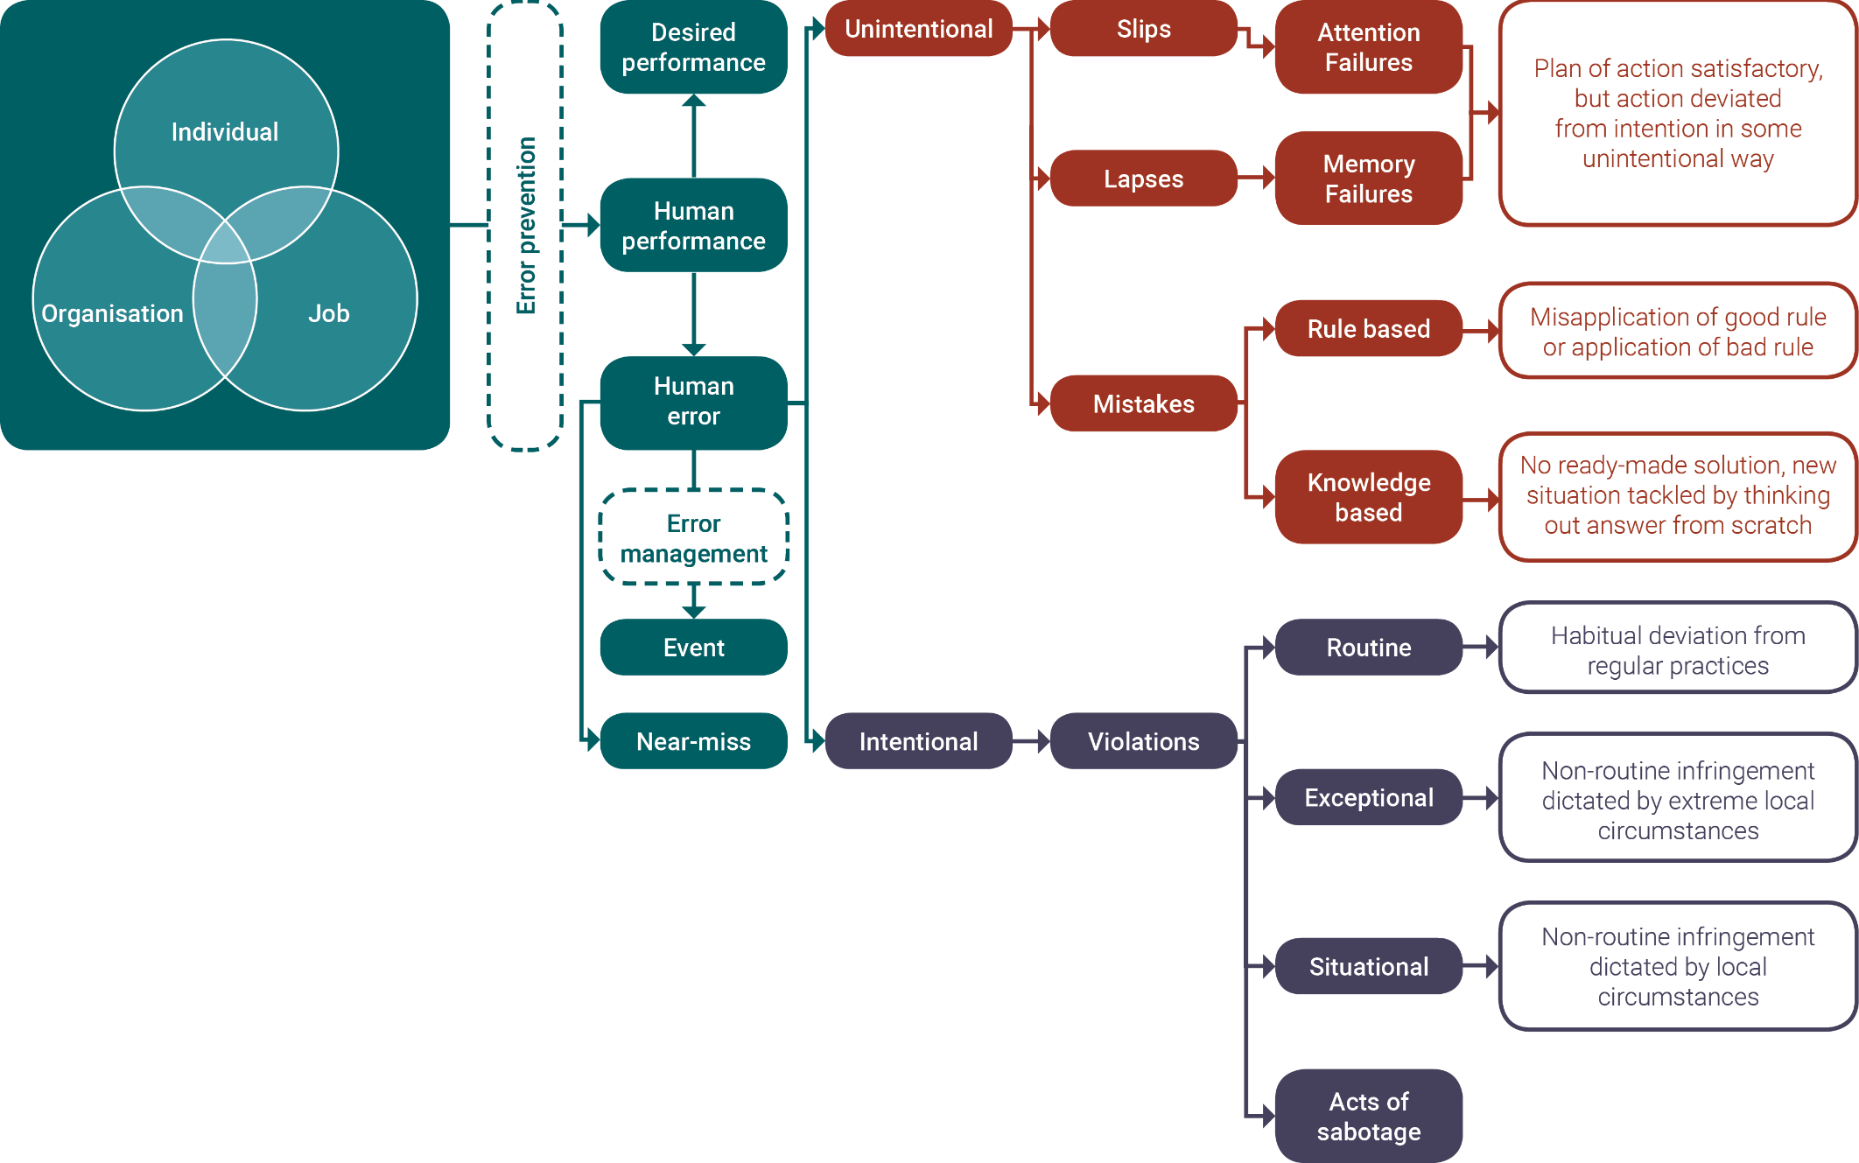
Notes:
Slips or lapses are actions that are not planned or intended. These types of errors are commonly made by highly trained people carrying out procedures where familiarity means the person does not need to concentrate closely on what they are doing. Slips and lapses cannot be eliminated by training, but improving design can reduce their likelihood and create a more error-tolerant system.
Errors of judgement or decision-making are where the intended actions are wrong. These also occur when we do the wrong thing, believing it to be the right thing. These errors tend to occur in situations where a person does not know the precise method of carrying out a task, either because it is new and/or unexpected, or because they have not been properly trained. Often in such circumstances people fall back on rules remembered from similar situations, and these rules may be incorrect or inappropriate in the new situation. Training based on good procedures is the key to avoiding mistakes like these.
Violations
Violations—non-compliance, circumventions, and shortcuts—differ from errors in that they are intentional, but usually well-meaning, failures. Typically, a person will deliberately carry out a procedure incorrectly for some perceived and/or expected gain (time, praise, ease, etc.).
Often the short cuts that people take (which may include unsafe acts) are not punished by an injury or breakdown, but instead the person is “rewarded” by the task being completed with a seemingly normal outcome. This encourages the person to repeat the behaviour and take short cuts/perform unsafe acts again in the future.
Often these individual actions are attributed to things like complacency, or perceived pressure.

Slide 19

Busting some myths
Complacency
Perceived Pressure
Notes:
Let’s look at these labels and think of them in terms of Human and Organisational Factors.

Slide 20
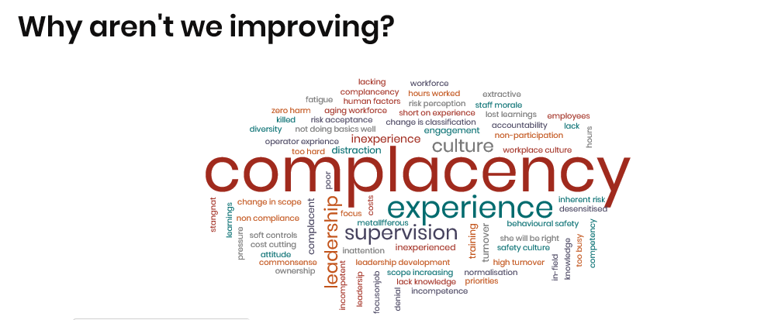
What the 2018 Registered Managers Forum told us
Why aren’t we improving?
Notes:
When asked the question “Why aren’t we improving” the universal theme from 2018 Registered Managers Forum, similar results were found at the 11 Roadshow events held last year as well. Both events cited Complacency as the key issue.
But what does that actually mean?
Who is being complacent? When are they being complacent? What are they being complacent about? Are we blaming workers for being complacent about safety? Are we asking our leadership teams where and how they may be exhibiting complacency?
There are a number of human and organisational factors that may be driving the behaviours that we are describing when we say “complacency”. Are workers fatigued, distracted, overworked, bored by repetitive and non-stimulating work, de-sensitised to risk, rushed or driven to complete tasks?
The term may sound a bit subjective and judgemental, and it would be much more useful to identify these individual or group behaviours, and take specific actions to address the drivers for that behaviour, rather than apply a possibly unhelpful mantra of “It’s about complacency”.

Slide 21

What the 2018 Registered Managers Forum told us
Why aren’t we improving?

Slide 22
Busting some myths
Perceived Pressure
Notes:
Another concept frequently stated as the reason for incidents involving human error is “perceived pressure”. The idea is that employees are perceiving that there is pressure to get a job done, and may hence take shortcuts, when there is no pressure.
Unfortunately this ignores the many subtle and subliminal ways that pressure is experienced within organisations.
While it is easy to verbalise that safety is a priority, a focus on targets, production, financial performance, work plans, budget cuts, staff rationalisation etc all add actual pressure to workers.
The issue when we hear “perceived pressure” should be seen, and accepted, as actual pressure. Organisations using this term should take more action to determine the causes, and follow up with more appropriate responses to workplace “pressure”.

Slide 23
Busting some myths
Perceived Pressure
Notes:
If workers are perceiving pressure, there is actual pressure. It is not a matter of having the wrong perception.

Slide 24
Notes:
Lets look at some other Human and Organisational Factors.
Usable procedures
Too often during an investigation we will identify that a procedure exists and not consider how useful the procedure actually is.
We need to ask is the procedure usable, is it appropriate, overly complex, is it easy to follow, was there enough worker involvement in writing the procedure, does the procedure actually reflect how the job should be done?
Training and Competence
Competence can be defined as the ability to undertake responsibilities and perform activities to a recognised standard on a regular basis. It is a combination of skills, experience and knowledge.
Make sure competence assurance systems take into account foreseeable work and operating conditions, including infrequent and complex activities, emergency situations and upsets, and maintenance
Make sure training and competence assessment methods are appropriate to the hazard profile of the tasks being undertaken. Make competency assurance systems for safety-critical tasks more robust.
Schedule refresher training for infrequent, complex or safety-critical tasks. This may include appropriate reassessment.
Staffing and Workload
People have finite capacity for processing information, holding items in working memory, making decisions and performing tasks. Excess workload can result in:
• human performance issues such as slower or compromised task performance
• increases in errors such as slips, lapses or mistakes.
Organisational Change
Organisational changes such as reduction in staffing levels, increased use of contractors and outsourcing, combining departments and restructuring roles and responsibilities are not usually as well analysed or controlled as changes to plant or process. If these changes are not managed properly, they can have significant impact on safety management.
Safety Critical Communications
Routinely seen as a contributing factor in incidents.
Safety-critical communication points to remember:
• identify who needs to communicate and what their communication needs are
• consider the mode of communication most appropriate for the situation, e.g. face-to-face, written, visual or verbal
• use language appropriate to the workforce, taking into account literacy and languages
• highlight safety-critical steps in procedure and draw attention to them in training. When trying to get an important message across, consider using two or more methods of communication.
Designing for People
Design points to remember:
• design control rooms and equipment in accordance with key ergonomic standards
• involve users in the design process. Include different types of users such as operators, maintenance and systems support personnel.
• give consideration to operator characteristics including body, size and strength and mental capability.
• design plant and processes for operability and maintainability. Do not neglect other elements of the lifecycle, for example decommissioning.
• give consideration to all reasonably foreseeable operating conditions, including emergencies
• consider the interface between the end users and the system.
Fitness for Work
Fatigue results in slower reactions, reduced ability to process information, memory lapses, absent mindedness, decreased awareness, lack of attention, underestimation of risk and reduced coordination. Fatigue can lead to errors and accidents, ill-health and injury, and reduced productivity.
Culture
Safety culture points to remember:
• management commitment and style is a key driver
• employee involvement is crucial
• good communication is essential
• compliance with procedures needs to be balanced with autonomously functioning work teams
• investigation of incidents should focus on the whole system not just the operator
• organisational learnings must be shared.
Maintenance, Inspection and Testing Error
Questions to ask about your company are:
• Have adequate resources and staff been made available to undertake the necessary maintenance, inspection and testing in your organisation?
• Do senior managers and directors fully understand the consequences of failing to provide these resources?

Slide 25
Investigation tools
ICAM
Taproot
Essential Factors
5 Why’s
Notes:
Looking at this in practice, how can we build more assessment of some of these hidden factors into our existing investigation process?
You may use one of these tools to guide your investigations.
They are simply that - a guide. It is often easier and more comfortable to follow a formal process for investigations, but these tools provide a framework for your investigation, and are definitely not a step by step recipe for success in identifying all the relevant factors to an incident.
Having said that, sometimes we don’t use all the tools available within our investigation technique. One example of this can be seen in some ICAM investigations that the Department reviews.

Slide 26
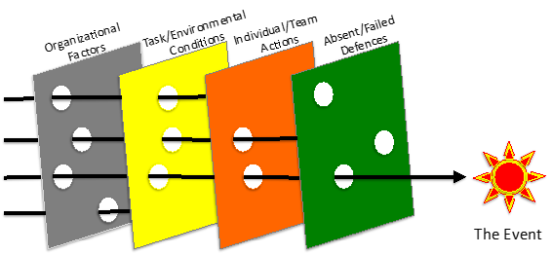
ICAM
Greater focus on Organisational Factors
Individual/Team Actions – an error is only an error in hindsight
Notes:
ICAM usually asks us
• What could (or should) have been in place to prevent this event from happening but was not in place?
• What was in place to prevent this event from happening but did not work?
• What could (or should) have been in place to minimize the consequences of this event but was not in place?
• What was in place to minimize the consequences of this event but did not work?
Unfortunately there is often a focus on the Task and Environmental Conditions, and the Failed Defences. These are the easy factors to identify.
It is more difficult to identify the Individual and the Organisational factors, but this is where much additional useful information can be uncovered.

Slide 27
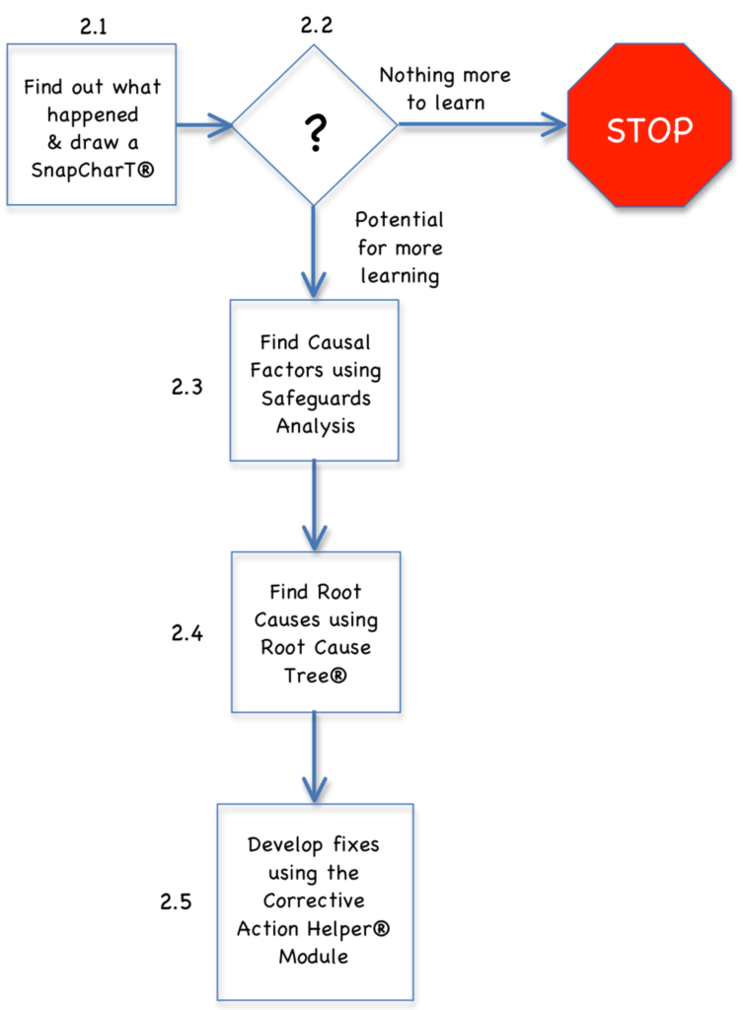
TapRoot
Very defined process
Root cause tree dictionary
Ask more critical questions when builing youtr developing SnapChart
Think outside the usual question
Notes:
Taproot is a very defined process, and it may be easy to rely too heavily on the process and tools within it to deliver a good investigation.
Often Taproot investigations leads to an identification that “Standards, Policies or Administration Controls” (SPAC) need improvement, without a more detailed assessment of underlying issues.
The Taproot process can also limit the in-depth identification of human and organisational factors that may be relevant.
If your are using TapRoot, ask more critical questions while compiling your timeline and Snapcharts.
Think outside of the Taproot “15 Questions” to try and provide additional avenues of enquiry.

Slide 28
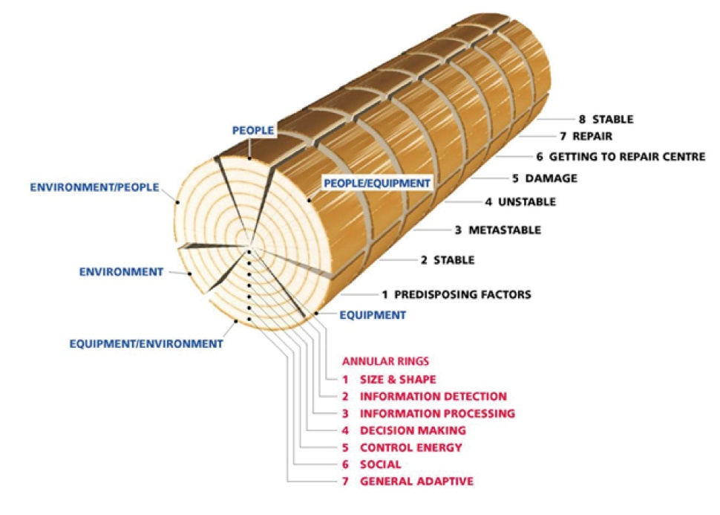
Essential factors
People, equipment and environment factors
Predisposing Factors - Stable – Metastable – Unstable – Damage – Recovery
Analyse the decision as well
as the action
Notes:
For Essential Factors investigations –
Essential Factors typically looks at People, Equipment and Environment Factors.
When developing the accident sequence Essential Factors uses a timeline of
Stable – Metastable – Unstable – Damage – Recovery.
When analysing the sequence moving from one stage to the next we normally focus on actions.
What if we started to think about “decisions” as the point at which things become unstable, and analyse the decision rather than the action.
Essential Factors also asks a specific set of questions at each of these points. There are learnings from these questions that may help users of other techniques. This is the “not” question. Often investigators are focussed on what was present, or known, or featured. All investigation techniques can be enhanced by asking what was not present, known or understood.

Slide 29
Essential factors
What did I do to prevent this incident?
What did I NOT do to prevent this incident?
What as a leader did I do that allowed this error to be made?
What as a leader did I NOT do that allowed this error to be made?
What as an organisation do we do or say that allows errors to be made?
What as an organisation do we NOT do or say that allows errors to be made?
Notes:
For Essential Factors investigations it is easy to formulate additional questions that specifically address human and organisational factors.
What did I do to prevent this incident?
What did I NOT do to prevent this incident?
What as a leader did I do that allowed this error to be made?
What as a leader did I NOT do that allowed this error to be made?
What as an organisation do we do or say that allows errors to be made?
What as an organisation do we NOT do or say that allows errors to be made?

Slide 30
5 Why’s
May be seen as a simple tool
Powerful if used correctly
5 is not the end point
Ask “Why” in relation to decisions not just actions
Notes:
This may be seen as a simple tool, but “Why” is a question that provides great understanding.
A focus on the what, where, when and how information is easy. It is easy to identify and easy to understand. They provide data but do not provide insight.
Asking more why questions in any investigation technique will provide much additional information to improve controls.

Slide 31
Considering Human Factors
Investigations – Reactive and proactive
Management system
Change management
Risk assessments
Pre task hazard assessments
Critical control verification
Notes:
There are many other opportunities to utilise Human and Organisational Factors to improve your organisation.
Look for areas within your other systems, processes and tools to ask questions about human error.

Slide 32

Proactive learning
Other potential learnings
  Near misses (Near hit)
  Investigate your successes - Celebrating success, business milestones
  Site Safety and Health Committees - SHREPs
  Industry data
Notes:
While not completely proactive, your near miss events (including the 590 potentially serious events mentioned earlier) are significant learning opportunities that are under utilised.
While I am sure we all see the opportunity, do we really treat a near miss as seriously as an incident with a defined consequence. A near miss is still an incident.
Treat every success as a learning opportunity.
Don’t just celebrate it, learn from it – minor successes and milestone events should trigger a proactive investigation.
100 days or 1 year LTI free – don’t just celebrate and share a BBQ, dedicate the time that you didn’t spend on incident management by investigating your success factors.
Are Safety and Health Representatives (SHREPS) involved in learning opportunities. If you are not engaging with your SHREPs you are not going to learn the lessons your business needs to learn.
Look outside your organisation, utilise industry data and look for other businesses that have got things wrong.
The Department of Mines, Industry Regulation and Safety provides a wealth of information that is underutilised. This includes –
Fatality and hazard registers
Significant incident reports
Mines safety bulletins
Monthly snapshots
Email alerts

Slide 33
Lessons learned
A lesson identified is not a lesson learned

Slide 34
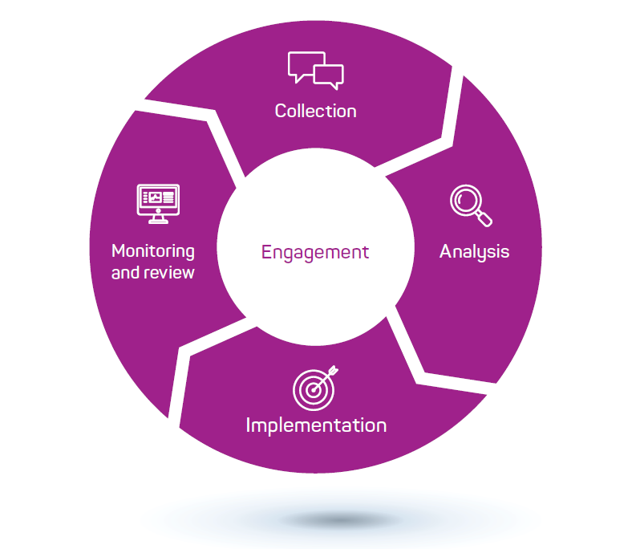
Lessons management
Source: Lessons Management Handbook (AIDR, 2019).
Notes:
Image taken from AIDR Lessons Management Handbook (AIDR, 2019).
A formal lessons management framework should involve –
Collection of information
Do you have the right people
Are you asking the right questions
Analysis
Reflect on the observations
Look for opportunity
Identify what needs to be done
Implementation
Do you share the lessons with the right people?
Do they understand why the change is important?
Develop actions to turn
Do the work
Review
Did anything change?
Did we improve?
Did we learn?

Slide 35
Learning culture
More formal lessons learnt processes required
Focus on the important lessons
Encourage a robust reporting, no blame culture
Identify the proactive learning opportunities
The role of leadership is crucial in validating that lessons are learnt
Notes:
Many of the world’s biggest and most famous disasters have found a root cause to be a failure to learn. BP Texas City, Macondo, Piper Alpha. These incidents all occurred in businesses that did not instil a culture of learning.
How do you build a learning culture -
A documented assessable function of your management system, that facilitates a learning process.
Ensure that it is isn’t that burdensome that you are required to assess everything. Focus on the important lessons.
Starts with good reporting.
Include appropriate proactive learning opportunities.
Driven by visible commitment to creating a learning culture. Safety and health culture discussions usually focus on safety behaviours, lets start also talking about learning behaviours.

Slide 36
Learning culture
Lessons are only learnt when behaviours change
Notes:
While lessons may be identified, controls introduced, procedures written and many improvements planned, lessons are only truly learnt when individual’s behaviours are changed.

Slide 37


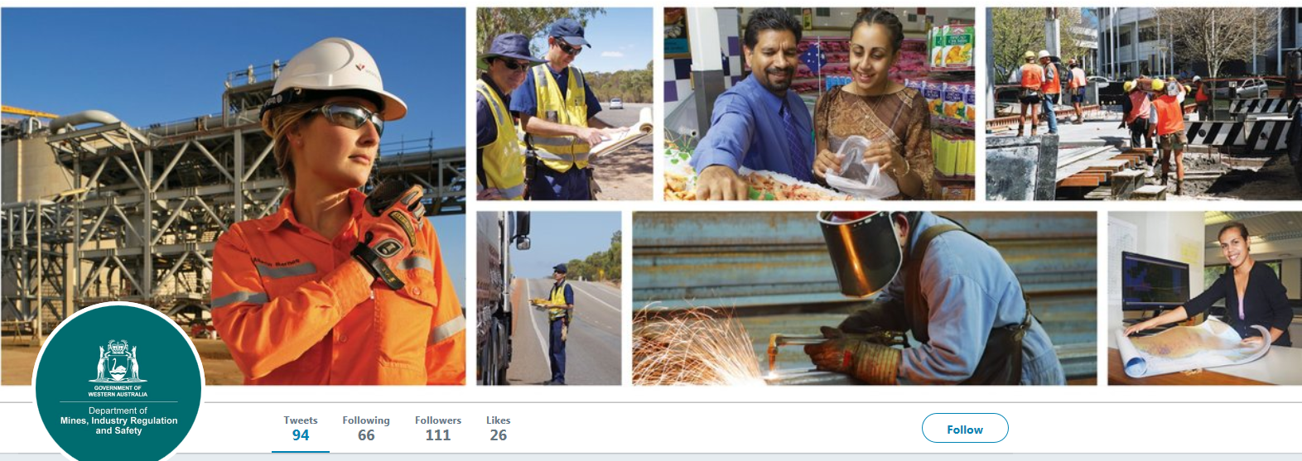
Follow us on social media and sign up for news alerts!
Twitter
@DMIRS_WA
@AndrewChaplyn
LinkedIn at Department of
Mines, Industry Regulation and Safety
Sign up to receive weekly news alerts @ www.dmirs.wa.gov.au

