Slide 1

Please read this before using presentation
This presentation is based on content presented at the Mines Safety Roadshow in October and November 2016
The Department of Mines and Petroleum (DMP) supports and encourages reuse of its information (including data), and endorses use of the Australian Governments Open Access and Licensing Framework (AusGOAL)
This material is licensed under Creative Commons Attribution 4.0 licence. We request that you observe and retain any copyright or related notices that may accompany this material as part of attribution. This is a requirement of Creative Commons Licences.
Please give attribution to Department of Mines and Petroleum, 2016.
For resources, information or clarification, please contact:
  RSDComms@dmp.wa.gov.au or visit
  www.dmp.wa.gov.au/ResourcesSafety

Slide 2
What are the key factors supporting mental wellbeing?

Slide 3

Question…
Notes:
Raise your hand if you know someone in your immediate family or circle of friends who suffers from some form of mental illness….??? (e.g. anxiety, depression, eating disorder)
I thought so…
According to the Australian Bureau of Statistics (2009). Almost half (45 per cent) Australians will experience a mental illness in their lifetime [1].
Now raise your hand if you believe you work for an organisation that provides appropriate support to employees who are dealing with these issues????
I thought so too….
So one could say that there is more work to be done in this space?
Reference:
Australian Government, Institute of Health and Welfare – Mental Health Services (in Brief) http://www.aihw.gov.au/WorkArea/DownloadAsset.aspx?id=60129554634
Image retrieved from: http://dy0719.com/

Slide 4
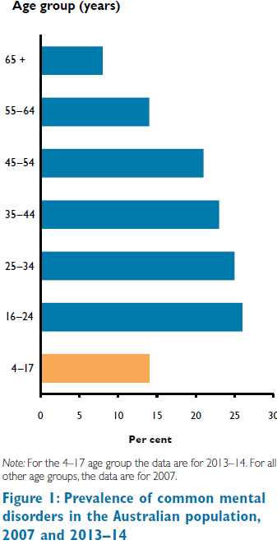

Data snapshot
Australian Government, Institute of Health and Welfare –
Mental Health Services
Notes:
Notice the age group who reported the highest levels of depressive and anxiety symptoms of all age groups. Are there workers at your workplace who are within this age group?
Reference:
Australian Government, Institute of Health and Welfare – Mental Health Services (in Brief) http://www.aihw.gov.au/WorkArea/DownloadAsset.aspx?id=60129554634

Slide 5

What is mental wellbeing?
“The state in which the individual realises his or her own abilities, can cope with normal stresses of life, can work productively, and is able to make a contribution to his or her community.”
World Health Organisation (WHO)
Notes:
The World Health Organisation (WHO) stresses that health is a state of complete physical, mental and social wellbeing and not merely the absence of disease or illness.
It’s important to understand that wellbeing is distinct from happiness, which can come and go, whereas wellbeing is a consistent state of wellness, satisfaction and contentment.
In Australia, many of us work and strive to improve our wellbeing and quality of life, and that of our families.
Elements that can contribute to a person’s wellbeing are:
health
personal relationships
feelings of safety
standard of living
sense of achievement and purpose
feeling part of the community
future security.
So an individual’s wellbeing is an ecosystem of sorts, based not only on mental and physical wellness, but also complex social factors and perceived security.
http://www.mindhealthconnect.org.au/wellbeing
Image retrieved from: https://s-media-cache-ak0.pinimg.com/564x/c4/cc/df/c4ccdf3a6bcf2206e5002b7dfd0c5df7.jpg

Slide 6
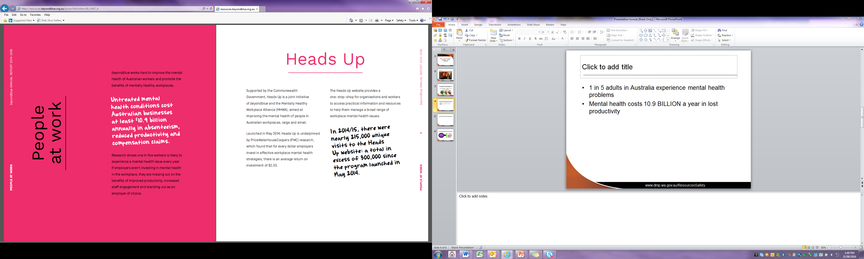
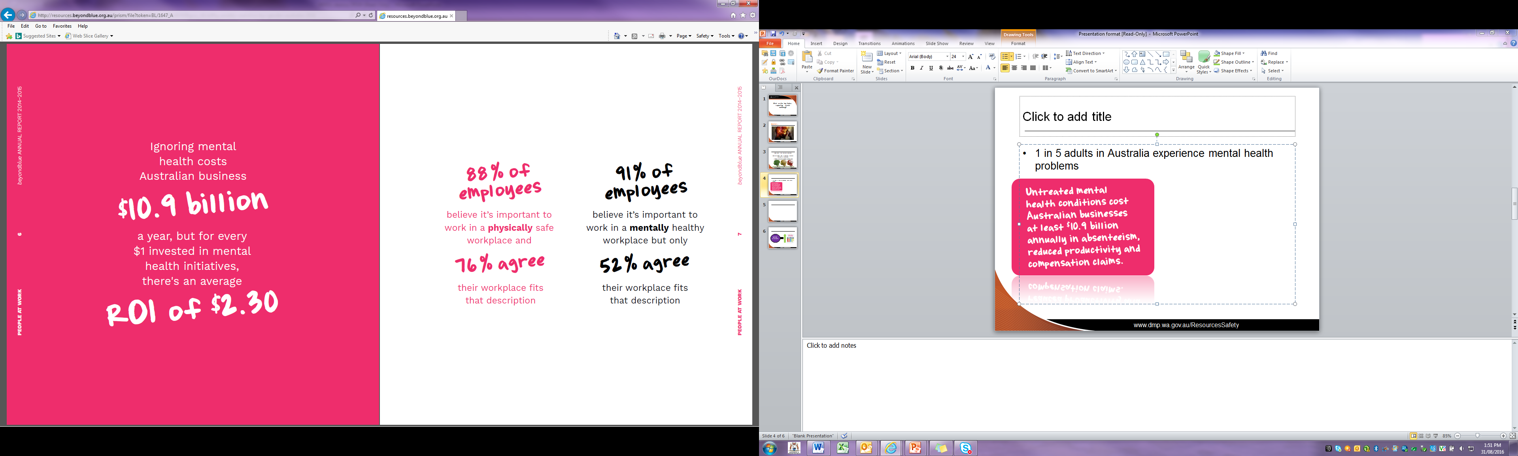
1 in 5 adults in Australia experience mental health problems
Beyondblue ANNUAL REPORT 2014–2015 - http://resources.beyondblue.org.au/prism/file?token=BL/1647_A
Notes:
Why should we worry about it?
Beyondblue and a number of other organisations have researched this topic and it’s been identified that…
Images retrieved from: beyondblue ANNUAL REPORT 2014–2015 - http://resources.beyondblue.org.au/prism/file?token=BL/1647_A

Slide 7

Mental health reform in the workplace
According to the Mental Health Commission of Western Australia, challenges are to:
Embed mental wellbeing into workplace practices
Lift the stigma of mental health
Improve equity
Retrieved from: Mental Health Commission - https://www.cmewa.com/images/safety-health-conference/2015-presentations/Addressing-Mental-Health-Tim-Marney.pdf
Notes:
Mental Health Commission - https://www.cmewa.com/images/safety-health-conference/2015-presentations/Addressing-Mental-Health-Tim-Marney.pdf

Slide 8

Why are we still making bad decisions?
OR
What can we do to help make better decisions when addressing mental health in the workplace?
Notes:
What can we do to help make better decisions when addressing mental health in the workplace?

Slide 9

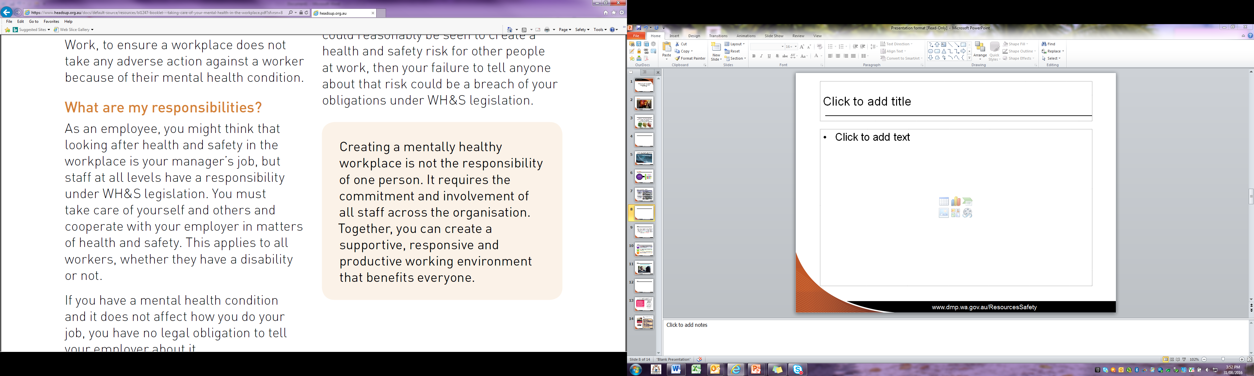
Who is responsible?
Beyond Blue “Heads Up” - https://www.headsup.org.au/docs/default-source/resources/bl1247-booklet---taking-care-of-your-mental-health-in-the-workplace.pdf?sfvrsn=8
Notes:
We are all responsible for creating a more mentally healthy workplace.

Slide 10

We can all work, but together we win…
Notes:
We can all work, but together we win…
The notion that it takes everyone within an organisation and/or workplace to do their bit towards creating a mentally heathy workplace…
This rings true to me…
During my second semester of university, our lecturer gave us a pop quiz. I was a conscientious student and had breezed through the questions, until I read the last one: “What is the first name of the woman who cleans the school?” Surely this was some kind of joke. I had seen the cleaning woman several times. She was tall, dark-haired and in her 50s, but how would I know her name? I handed in my paper, leaving the last question blank. Before class ended, one student asked if the last question would count toward our quiz grade. The professor said “Absolutely”.
“In your careers you will meet many people. All are significant. They deserve your attention and care, even if all you do is smile and say ‘hello’.
I’ve never forgotten that lesson. I also learned her name was Carla.
A little can go a long way…

Slide 11
So who’s we?
WHO | HOW (examples)
Employer and organisational leaders | demonstrating a visible, active commitment to mental health in the workplace speaking openly about mental health in the workplace (including any personal experiences) making mental health an objective of the business integrating good health and safety management into all business decisions, policies and procedures rewarding managers for maintaining a mentally healthy workplace developing their own leadership and people management skills allocating necessary resources for change, and establishing performance measures communicating a zero-tolerance approach to bullying and discrimination
Managers and Supervisors | identifying and eliminating health and safety risks, including those to mental health supporting employees with mental health conditions communicating effectively to employees about mental health making reasonable adjustments to support employees with a mental health condition to do their job
Human Resources Professionals | Implementing and reviewing policies and practices that have an impact on workplace mental health informing managers and employees about mental health, including training and support options.
Employees | taking reasonable care of their own mental health and safety, and that of their colleagues educating themselves about mental health cooperating with workplace policies and procedures supporting initiatives aimed at improving mental health in the workplace.
Employer and organisational leaders
demonstrating a visible, active commitment to mental health in the workplace
speaking openly about mental health in the workplace (including any personal experiences)
making mental health an objective of the business
integrating good health and safety management into all business decisions, policies and procedures
rewarding managers for maintaining a mentally healthy workplace developing their own leadership and people management skills
allocating necessary resources for change, and establishing performance measures
communicating a zero-tolerance approach to bullying and discrimination
Managers and Supervisors
identifying and eliminating health and safety risks, including those to mental health
supporting employees with mental health conditions
communicating effectively to employees about mental health
making reasonable adjustments to support employees with a mental health condition to do their job
Human Resources Professionals
Implementing and reviewing policies and practices that have an impact on workplace mental health
informing managers and employees about mental health, including training and support options.
Employees
taking reasonable care of their own mental health and safety, and that of their colleagues
educating themselves about mental health
cooperating with workplace policies and procedures
supporting initiatives aimed at improving mental health in the workplace.
Notes:
Presenter note: slide animation - click through each ‘who’ category
So who’s we? (click)
Employers and organisational leaders (click)
Managers and supervisors (click)
Human Resources professionals (click)
Employees (click)
Heads Up - https://www.headsup.org.au/docs/default-source/resources/bl1256-booklet---creating-a-mentally-healthy-workplace.pdf?sfvrsn=4

Slide 12

What next?
What is good practice?
How do we share this?
  Toolbox topics?
  Pre-start meetings?
  Awareness campaigns?
  Training?
Notes:
So what does good practice look like?
How can we share the learnings and make a difference in the workplace?

Slide 13

What does good practice look like?
Identify and reduce (where practicable) risks to employee mental health
Encouragement of speaking openly about mental health
Encourages career and personal development
Enjoys high staff loyalty
Supports all employees, including those with mental health conditions
Low staff turnover and sick/stress leave
Views diversity as an organisational advantage
Workforce consulted through their representatives during development of policies and procedures relating to mental wellbeing
Notes:
Presenter note: slide animation - click through each example of good practice
What are some ideas or strategies that have been implemented at your workplace?
Every organisation is different, but a healthy and safe workplace:
encourages everyone to speak openly about mental health (click)
enjoys high staff loyalty (click)
has low staff turnover and sick/stress leave (click)
views diversity as an organisational advantage (click)
supports all employees, including those with mental health conditions (click)
encourages career and personal development (click)
identifies and reduces, where practicable, risks to employee mental health (click)
has employees that are productive members of a team.
Source: www.headsup.org.au/docs/default-source/resources/bl1256-booklet---creating-a-mentally-healthy-workplace.pdf?sfvrsn=4

Slide 14
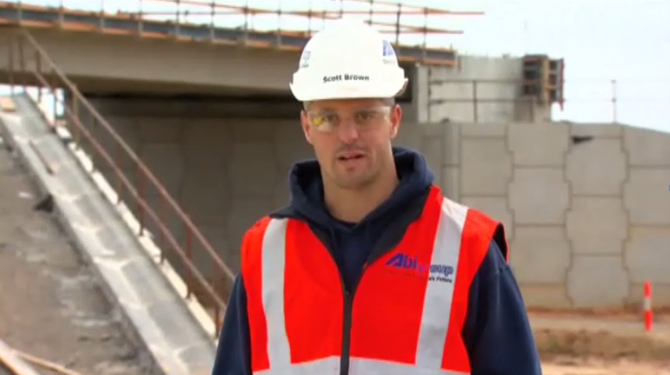
Scott's story – beyondblue
Notes:
Scott’s story http://www.youtube.com/watch?v=UhEOapg24FI&sns=em
The 2015 Mental Health First Aid Australia Manual revealed that only 39 per cent of people who suffer from a mental health issue actually receive support.

Slide 15

Stigma
Widespread reluctance to disclose mental health problems
Workers fear stigma and negative impacts on their career
Aim for mental health issues to be discussed as freely as physical issues
Notes:
Something that we can all do to help create a mentally healthy workplace is to assist in reducing the stigma attached to mental illness.
We also need to support people with mental health conditions while they’re at work and monitor discrimination.
Image retrieved from: https://soc331.wordpress.com/tag/stigma/

Slide 16
Why is it important that we help to reduce stigma?
1 in 4 people felt depression was a sign of personal weakness and would not employ a person with depression
.
42% thought people with depression were unpredictable
.
1 in 5 said that if they had depression they would not tell anyone
.
Source: http://www.mentalhealth.wa.gov.au/mental_illness_and_health/mh_stigma.aspx
Notes:
According to a 2006 Australian study conducted by the mental health commission, it was found that:
we all have a role in creating a mentally healthy community that supports recovery and social inclusion and reduces discrimination
people with mental illness can and DO work
people with mental illness successfully work across the full spectrum of workplaces
some people disclose their mental illness and some do not. Most importantly, people with mental illness can succeed or fail, just like any other worker.
Examples of prominent people with mental illness who openly discuss and reflect on their mental health issues and have developed successful careers include:
Dr Geoff Gallop – former WA Labor Premier
Craig Hamilton – ABC sports commentator
Olivia Newton John – entertainer
Pat Cash – tennis player.
Source: https://www.humanrights.gov.au/sites/default/files/document/publication/workers_mental_illness_guide_0.pdf

Slide 17
Ten things you can do to make a difference in the workplace
Talk openly about mental health in the workplace
Share your own personal experiences (if you feel comfortable)
Encourage open communication when problems arise to help find solutions
Respect other people and celebrate difference
Be open to learning about mental health conditions and other people’s experiences
Respect the privacy of others
Be a positive role model
Speak-up
Cooperate with workplace policies and procedures and support initiatives aimed at improving mental health
Understand how your workplace can support you and how you can access help if you need it
- Beyondblue “Heads Up” - www.headsup.org.au
Notes:
Presenter note: slide animation - click through each example
Simple ways to help include:
1. Talk openly about mental health in the workplace – Get to know people with personal experiences of mental illness
2. Share your own personal experiences (if you feel comfortable) – The more hidden mental illness remains, the more people continue to believe that it is shameful and needs to be concealed
3. Encourage open communication when problems arise to help find solutions – Offer the same support to people when they are physically or mentally unwell
4. Respect other people and celebrate difference
5. Be open to learning about mental health conditions and other people’s experiences – learn and share the facts about mental health and illness
6. Respect the privacy of others – don't label or judge people with a mental illness, treat them with respect and dignity as you would anyone else
7. Be a positive role model
8. Speak-up - in protest when friends, family, colleagues or the media display false beliefs and negative stereotypes
9. Cooperate with workplace policies and procedures and support initiatives aimed at improving mental health
10. Understand how your workplace can support you and how you can access help if you need it
Source: https://www.headsup.org.au/docs/default-source/resources/bl1247-booklet---taking-care-of-your-mental-health-in-the-workplace.pdf?sfvrsn=8

Slide 18
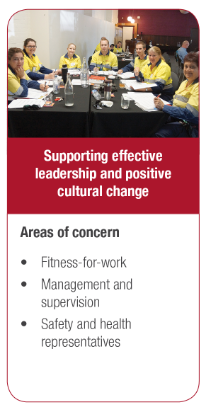
What is DMP doing in this space?
Mental health checklist developed into psychosocial harm audit
Fatalities report
Dedicated web pages
Workshop planner series on gender and safety
FAQs information sheet on fatigue
Checklist for prevention of bullying
Safety alerts
RSM articles
Mines Safety Roadshows
Toolbox presentations
Promotion of Mental Health Commission’s Working Away Alcohol and Drug Support Line
Fitness for work
Management and supervision
Safety and health representatives
Notes:
The Department of Mines and Petroleum (DMP) is committed to assisting industry drive positive cultural change within the workplace.
A suite of tools has been developed with industry consultation for use in the workplace
Dedicated web pages on fitness for work, www.dmp.wa.gov.au/Safety/What-is-fitness-for-work-7018.aspx
Psychosocial harm audit, www.dmp.wa.gov.au/Safety/Audits-16148.aspx
Fatal accidents in the Western Australian mining industry 2000-2012 report, www.dmp.wa.gov.au/Safety/Reports-16199.aspx
Workshop planner series on gender and safety, www.dmp.wa.gov.au/Safety/Reports-16199.aspx
Frequently asked questions on preventing and managing fatigue on Western Australian mining operations – information sheet, www.dmp.wa.gov.au/Safety/Information-sheets-and-16176.aspx
Site checklist for the prevention of bullying – template, www.dmp.wa.gov.au/Safety/Templates-and-checklists-16200.aspx
Safety alerts, www.dmp.wa.gov.au/Safety/Mines-safety-alerts-13194.aspx
Resources Safety Matters Magazines articles, www.dmp.wa.gov.au/Safety/Resource-Safety-publications-16440.aspx
Toolbox presentations, www.dmp.wa.gov.au/Safety/Toolbox-presentations-16177.aspx
Industry forums (e.g. Mines Safety Roadshows)
Promotion of Mental Health Commission’s Working Away Alcohol and Drug Support Line, www.dao.health.wa.gov.au/Gettinghelp/24HourAlcoholAndDrugSupportLines/WorkingAwayAlcoholAndDrugSupportLine.aspx

Slide 19
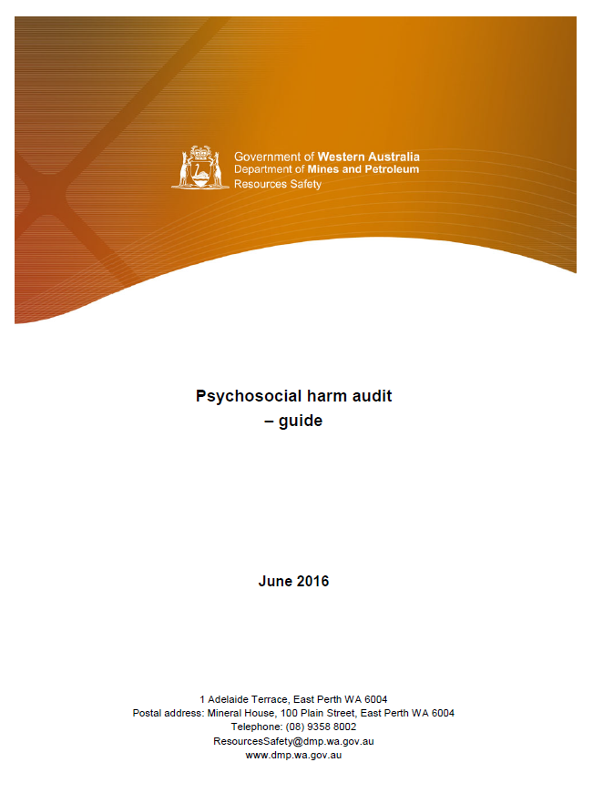
Psychosocial harm audit
Released in February 2016
Key focus area:
engaging representatives of the workforce when developing or reviewing mental wellbeing strategies
  Available on DMP website
Notes:
The psychosocial harm audit guide and template is designed to cover the standard related to the management of the risks associated with psychosocial harm in the workplace. The term “psychosocial harm” covers any risk that has the potential to negatively impact on the psychological and physical health of mine workers.
Following the release of the psychosocial harm audit and guide, DMP collected information from mining operations, petroleum and major hazard facilities over a ten-month period to October 2016. The objective was to establish a baseline against which to measure progress in mental health risk management in Western Australia’s resources sector.
The report of this audit process will be available on the DMP website in late 2016 – early 2017.

Slide 20

Resources
Psychosocial harm audit – guide http://www.dmp.wa.gov.au/Documents/Safety/MSH_AuditGuide_PsychosocialHarm.pdf
Dealing with workplace bullying – a worker’s guide www.safeworkaustralia.gov.au/sites/SWA/about/Publications/Documents/828/Workers-Guide-workplace-bullying.pdf
Western Australian Equal Opportunity Commission - www.eoc.wa.gov.au
WorkSafe WA - www.worksafe.wa.gov.au
Guide for managing the risk of fatigue at work www.safeworkaustralia.gov.au/sites/SWA/about/Publications/Documents/825/Managing-the-risk-of-fatigue.pdf
Working hours – code of practice https://www.commerce.wa.gov.au/publications/code-practice-working-hours
Alcohol and other drugs at the workplace – guidance note www.commerce.wa.gov.au/sites/default/files/atoms/files/alcohol_and_drugs_0.pdf

Slide 21
Resources
Equal Opportunity Commission - http://www.eoc.wa.gov.au/
WorkSafe WA – Toolkits and information resources – bullying www.commerce.wa.gov.au/worksafe/toolkits-and-information-resources-bullying
Working alone – guidance note www.commerce.wa.gov.au/sites/default/files/atoms/files/working_alone.pdf
Workers with mental Illness: a practical guide for managers www.humanrights.gov.au/sites/default/files/document/publication/workers_mental_illness_guide_0.pdf
Mental Health Commission - http://www.mentalhealth.wa.gov.au/Homepage.aspx
Comcare - http://www.comcare.gov.au
Gender and safety in mining – workshop planner series www.dmp.wa.gov.au/Safety/Is-there-a-relationship-between-5093.aspx
Psychologically safe and healthy workplaces: risk management approach toolkit www.sstuwa.org.au/application/files/9214/4655/0945/psychologically-healthy-and-safe-workplace-risk-management-toolkit.pdf

Slide 22
Resources continued…
Guide for preventing and responding to workplace bullying www.safeworkaustralia.gov.au/sites/swa/about/publications/documents/827/guide-preventing-responding-workplace-bullying.pdf
Violence, aggression and bullying at work – code of practice www.commerce.wa.gov.au/publications/code-practice-violence-aggression-and-bullying-work
beyondblue ‘Heads up’ www.headsup.org.au/
Blueprint for mental health and wellbeing
www.cmewa.com/images/files/policy/people-and-communities/Mental-Health-Blueprint.pdf
Get a Heads Up on mental health
www.safeworkaustralia.gov.au/sites/swa/media-events/media-releases/pages/mr160062014
Preventing psychological injury under work health and safety laws – fact sheet www.safeworkaustralia.gov.au/sites/SWA/about/Publications/Documents/855/Preventing-Psychological-Injury-Under-WHS-Laws.pdf

Slide 23
Resources continued…
Black Dog Institute - www.blackdoginstitute.org.au
SANE Australia – www.sane.org
beyondblue – www.beyondblue.org.au
beyondblue ‘Man Therapy’ – www.mantherapy.org.au
MATES in Construction - www.matesinconstruction.com.au
Suicide Call Back Service - www.suicidecallbackservice.org.au
MensLine Australia – www.mensline.org.au
Lifeline - www.lifeline.org.au
Safe Work Australia - www.safeworkaustralia.gov.au
Fair Work Ombudsman - www.fairwork.gov.au
Fair Work Commission - www.fwc.gov.au

Slide 24

Challenge
How will you:
Embed mental wellbeing into workplace practices?
Lift the stigma of mental health?
Improve equity?

Slide 25



Stay informed
Remember: Subscribe to our weekly email alert service to receive the latest news about what’s happening at Resources Safety
@ www.dmp.wa.gov.au/subscriptions
Follow us on social media:
Twitter
@DMP_WA
LinkedIn at Department of
Mines and Petroleum
Notes:
Subscribe to Resources Safety’s email alert service to receive invitations to provide input as well as the latest news about publications, safety alerts, events and safety reform progress. Safety news alerts are typically sent each Tuesday.
Follow us on LinkedIn to receive the latest resources safety news alerts and job opportunities at DMP.
Follow us on Twitter to stay up-to-date on a variety of the latest department news and information - from major project milestones and upcoming events, to updates regarding industry policies and guidelines.

