Slide 1
Please read this before using presentation
This presentation is based on content presented at the 2018 Emergency Management information session in February 2018.
Department of Mines, Industry Regulation and Safety(DMIRS) supports and encourages reuse of its information (including data), and endorses use of the Australian Governments Open Access and Licensing Framework (AusGOAL)
This material is licensed under Creative Commons Attribution 4.0 licence. We request that you observe and retain any copyright or related notices that may accompany this material as part of attribution. This is a requirement of Creative Commons Licences.
Please give attribution to Department of Mines, Industry Regulation and Safety, 2018.
For resources, information or clarification, please contact: SafetyComms@dmirs.wa.gov.au or visit www.dmirs.wa.gov.au/ResourcesSafety

Slide 3
Expectations and requirements for Project Management Plans (PMP)

Slide 4
Why is a PMP important?
Provides information regarding a proposed mining operation
Required for:
new operations
major changes or expansions to existing operations
change in Principal Employer – where major change to methods, systems and procedures is expected
Submission is completed online through the Safety Regulation System (SRS).
Notes:
PMPs need to be submitted as part of commencement notifications for new operations, major expansion/change to existing operations, where new Principal employer takes over mining operation and introduces major change to methods, systems, and risk.
We request PMPs for latter circumstances because these significant changes may introduce new substantial risks and we need to see that these risks have been identified and appropriate control strategies proposed. Some of the changes which commonly require a PMP include;
Change of mining method (open pit to underground),
Significant increase in mine size,
Change of target commodity,
Change of processing methodology,
Significant change in technology in use (eg Autonomous mining)
In some situations mine changes (eg additional mining pits using existing methods) a PMP is not required, however notification of the commencement of this new pit is requested.
Recommend early consultation with inspectorate in relation to any planned changes or expansion to existing operations.
PMPs are to be submitted online in SRS.

Slide 5
What is the purpose of a PMP?
Legal requirement for approval of commencement
Mines Safety and Inspection Act 1994 s.42
Mines Safety and Inspection Regulations 1995 r. 3.12 and r. 3.13
Identify risk management plans
Risk controls considered at design stage (hierarchy of control, safety in design)
Provides regulator an overview of:
planned operation
hazards likely to be present
ways in which risks are intended to be managed.
Notes:
Sites should not regard PMPs only as a legal requirement. Although it is a requirement to have your PMP approved prior to the commencement of mining operations.
Mining operations include: development, construction, operation, processing and rehabilitation to name a few. Ref s. 4 of the MSIA.
The preparation of a PMP is part of the initial identification of major risks at the various stages of the operation’s life cycle, from construction to development, production and closure. It is a starting point for building ongoing strategies to manage those risks.
The PMP should therefore be considered as an important tool in developing an appropriate site-specific occupational health and safety management system.
r. 3.13(1)(b) , broad assessment of major risks and management strategies
Further information: If such a plan is not in place, the safety of workers may be compromised and the department’s mines inspectors will suspend operations until a PMP is approved. Resources are available to assist operators to comply.

Slide 6
What should a PMP contain?
Minimum information required is outlined in legislation and PMP submission guide
General details
Description of operations, methods, facilities, key services
Emergencies and training
Safety and risk management
Mine plans
Same legal requirement of small and large operations
content, scale and complexity will vary
Approval and PMP can be staged or for entire life cycle of operation
Notes:
Information is generally summary, outline, broad assessment, statement of commitments and control strategies.
Also requirement for certain plans and drawings.
At a high level some of the major risks commonly identified include:
Ground control, hazardous substances, mobile plant, asbestiform minerals, biological, psychosocial, extreme weather events, gases (introduced, generated by processing and natural released during mining), manual handling, pressurised plant, construction activities, radiation (including NORM) & fire. This is not an exhaustive list, and needs to be developed as part of the hazard identification and risk assessment for the proposed mine. This is often presented in a site major risk matrix.
Common information that is presented with a PMP that assists in assessment:
Site risk assessment, standards above those legislated that the mine will comply with, general arrangement drawings for fixed plant and infrastructure, site plans, process flow sheets, geotechnical reports, approvals from other agencies (eg main roads), general description of operations, hydrological assessments (flood control), proposed management & supervisory structure (span of control).
Not all systems of works, policies and procedures are required at the PMP stage. The PMP is about the commitments of the Principal Employer relating to the identification and control of risks.
There is a guide for the submission of a PMP available at our website.

Slide 7
What is the review process for a PMP?
PMP submitted
PMP assessed
30 working day assessment timeline
All information received, recommendation made to State mining engineer
Finalisation – letter signed by State mining engineer
Assessment stops when further information is requested
Notes:
Flow chart outlines steps in MSB review process.
PMP may be assessed by one or several officers depending on the type and complexity of the proposed mining operation.
Officers review to establish if required information is supplied and adequate.
Target of 30 working days to review and approved PMPs.
May request further information in which case assessment clock will stop. (Chess clock)
Result of review process is recommendation on finalisation to the SME (Finalisation may be approve or reject)
The PMP will remain as incomplete until submitted. Once submitted the PMP can no longer be amended. Only users with the relevant SRS security for your company can view the PMP
When the PMP is submitted an alert is sent to the officers that have been given access to see those alerts. One of these officers will take ownership of the PMP (Role of manager)
The manager assigns the assessment to various officers depending on the speciality of the assessment required.
The officers provide advice relating to the acceptability of the PMP
The manager (owner) then makes a recommendation to the SME
The PMP is then accepted or rejected by the SME

Slide 8
Approval timelines
Notes:
What does this look like in practice?
Not a huge variation in the time taken to assess the applications – however huge variations in the time taken.
If you want a fast approval, provide a quality PMP.
1 completed late - 367 days vs. 33 days

Slide 9
Before you start mining
Mining proposal (Environmental)
Project management plan
Radiation management plan
Health and hygiene management plan
Notes:
Martin & Paul will provide more detail relating to RMP & HHMP.

Slide 10
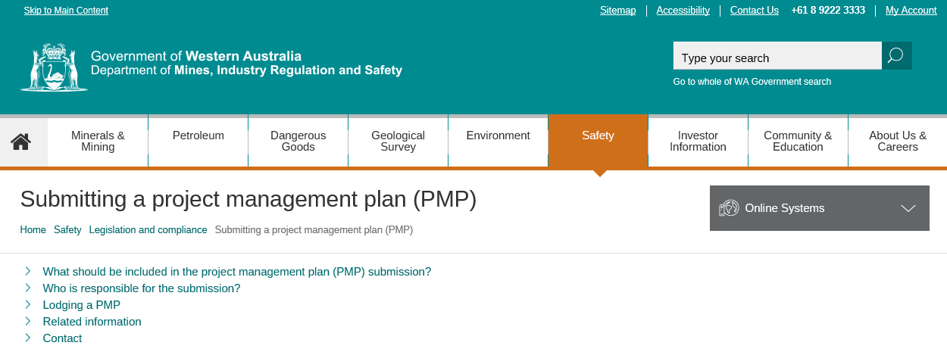
Where can I get more information?
SRS online help
www.dmp.wa.gov.au/Safety/Submitting-a-project-management-9184.aspx
www.dmp.wa.gov.au/Environment/Mining-proposals-5993.aspx

Slide 11
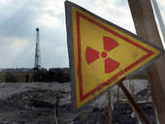
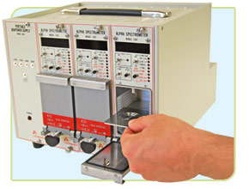
Expectations and requirements for Radiation Management Plans (RMPs)

Slide 12
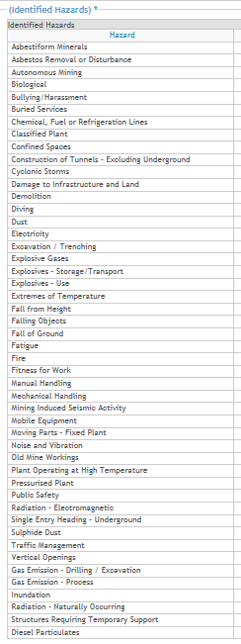
PMPs and radiation hazards
$$❶$$
$$❷$$

Slide 13
DMIRS and Radiological Council
MSIA Section 7: Relationship with other Acts
S.7(1) If a provision of this Act is inconsistent with a provision of the Radiation Safety Act (1975) the latter provision prevails to the extent of the inconsistency
i.e. Radiation Safety Act (and Radiological Council) has primacy
Mining operations will require approvals and licenses from the Radiological Council if:
Sources of electromagnetic radiation are used; or
Naturally Occurring Radioactive Materials (NORM) are encountered

Slide 14
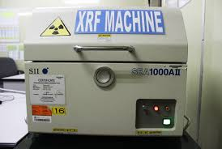
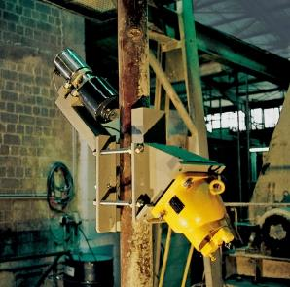
Electromagnetic radiation hazards
$$❶$$
Electromagnetic Radiation
MSIR Part 16 Division 3: Regulations 16.36 to 16.38
Apply to non-NORM
Sealed radiation sources and irradiating apparatus
A sealed source is not NORM!
Generally not well understood by the mining industry
Radiation Safety Act and Radiological Council have primacy
DMIRS role: ensure safe systems are implemented

Slide 15
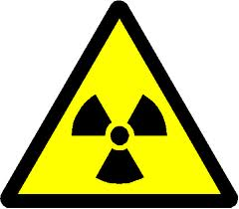
Radiation – naturally occurring
$$❷$$
Radiation – Naturally Occurring
MSIR Part 16, Division 1:
Regulation 16.1 terms used:
Ionising radiation material means a radioactive substance consisting of or containing … an amount of radioactivity that requires regulation under the Radiation Safety (General) Regulations
A radioactive substance has a Specific Activity of > 1 Bq/g

Slide 16
Radiation – naturally occurring (con’t)
$$❷$$
Radiation – Naturally Occurring
Division 2: MSI Regulations 16.2 to 16.35. Apply
Regulation 16.2 Application of the Division:
Thorium or uranium ores; or
Employees likely to receive doses > 1mSv; or
Members of the public > 0.5 mSv
Regulation 16.2 Sme Exemptions:
Each employee’s effective dose < 1mSv; and
Long term average concentration of Radon < 1000 Bq/m³

Slide 17
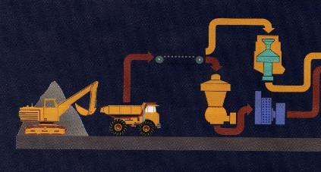
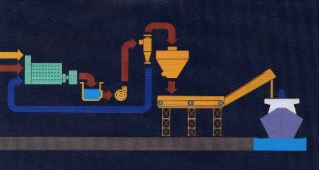
NORM in mining operations?
Check ore, process and tails streams:
Is Uranium content > 80 ppm? (80 ppm U-238 = 1 Bq/g)
Is Thorium content > 240 ppm? (240 ppm Th-232 = 1 Bq/g)
Is there a combination of U-238 and Th-232 content?
Divide the known concentration of U by 80 = U ratio
Divide the known concentration of Th by 240 = Th ratio
If U ratio + Th ratio > 1 = NORM

Slide 18
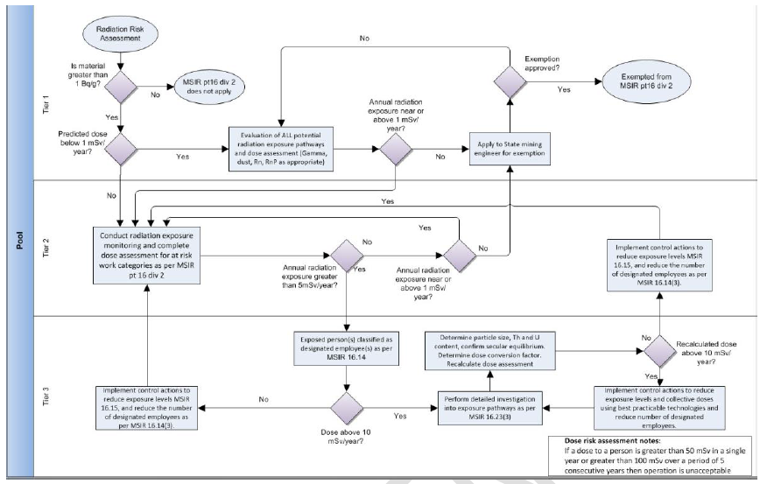
NORM in mining – Risk-based approach
4 current Lithium proposals have exposure scenarios approaching this level …

Slide 19
NORM is encountered – What now?
Regulation 16.6 Baseline monitoring program:
Needed before mining operations begin
Often overlooked
Does not have to be complex (but will take time):
Gamma, Radon, water and dust survey
Refer to NORM Guideline 3.1 (Appendix A) for guidance
Will require expert assistance to collect and evaluate the data.
Forewarning of site management is essential

Slide 20
NORM is encountered – What now? (con’t)
Regulation 16.7 Preparation of Radiation Management Plan (RMP), which needs to:
Be consistent with the PMP
Reflect stage of project:
Exploration vs. production
Be approved before operations commence:
r. 16.7(1)(b)
Be signed by the RM and Radiation Safety Officer

Slide 21
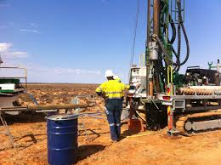
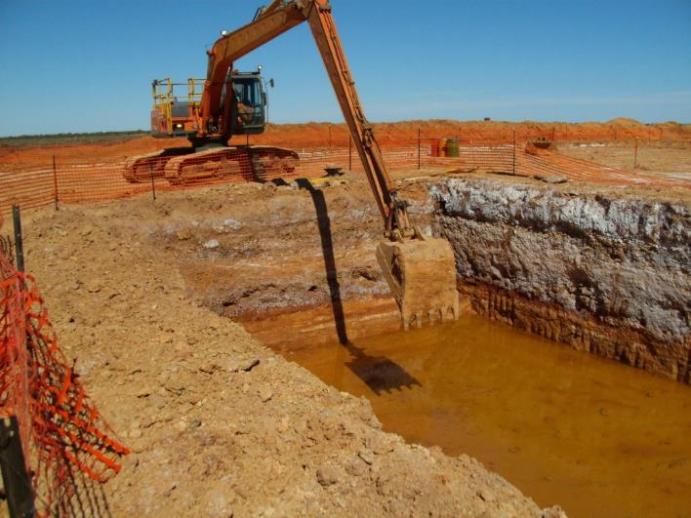
Exploration vs. operational RMPs
Simple exposure patterns
Mostly γ radiation
Dose calculations uncomplicated
RSO tasks relatively straightforward
Complex exposure patterns
γ and α radiation. Radon a factor?
Dose calculations complex
RSO tasks complex

Slide 22
NORM is encountered – What now?
Appointment of Radiation Safety Officers (r. 16.9)
Approved by Sme prior to appointment (r. 16.9(2))
Must hold a relevant first degree:
Geology, geophysics suitable for exploration activities;
Physical sciences or industrial hygiene for operations.
Surface ventilation officer and technician;
Experience includes working under RSO for 12 months.
Contract Radiation Safety Officers
RM to provide non-financial details of contract

Slide 23
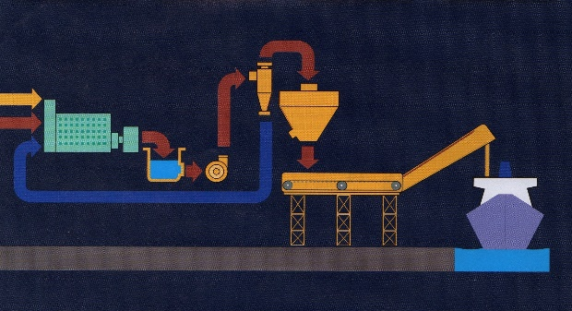
Guidance hint – Nuclide mass balance
Review each step of the production process:
Evaluate the U and Th concentration:
Where are the nuclides concentrating?
What happens to decay products during chemical separation?
Gamma dose rates can be estimated from the parent nuclide concentrations. Can assist greatly in:
Design of operations and controls for exposure minimisation;
Development of RMP and monitoring programs
Determination of tailings disposal strategies
Transport compliance requirements for products…

Slide 24
Guidance hint – Nuclide mass balance (con’t)
Gamma dose rate at 1m can be estimated from these values.
> 1 Bq/g = Radioactive
Gamma dose rate @ 1m = 1.3 uGy/h

Slide 25
Reporting requirements
Annual Reports
Regulation 16.26 Reporting to Sme:
Results of occupational radiation monitoring program
Results of environmental radiation monitoring program
Radiation Management Plan
Reviewed within 2 years of commencement of operations
Reviewed thereafter to Sme specifications:
Following substantive change to operations
Every 5 years (this policy change is pending)

Slide 26
Pitfalls
Mining approval by DMIRS Environment Division does not mean mining can commence:
PMP and possibly RMP are required
RMP can be staged or for entire life cycle of operation:
Caution – RMP must be approved before mining operations can commence
Can contribute to substantial delays while data is collected, submitted and evaluated
Same legal requirement of small and large operations:
Content, scale and complexity will vary.
Notes:
Information is generally summary, outline, broad assessment, statement of commitments and control strategies.
Also requirement for certain plans and drawings.

Slide 27
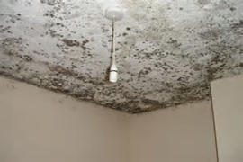
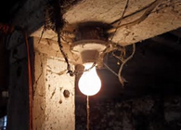
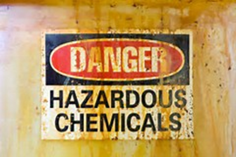
Expectations and requirements for Health and Hygiene Management Plans (HHMP)

Slide 28
Why a HHMP?
All workplaces have some form of chemical, biological, radiation or physical hazard that include:
Dusts, chemicals, noise, vibration, radioactive materials or devices, temperature extremes, bacteria, fungi, inadequate lighting
Meets legislative requirement to:
Identify hazards
Assess risks
Implement Controls
Verify that controls are effective
Provides a structured means of demonstrating an understanding of the hazards and risks at a mine site and verification that controls are effective

Slide 29
When is a HHMP required?
All registered mine sites require a HHMP (including exploration)
Prior to operations commencing (i.e. hazards are identified and controls must be implemented prior to operations starting)
Whenever a change occurs that alters risk profile
An annual summary report if risk profile or controls not significantly different
A five yearly formal and comprehensive report
Very small operations may be exempt e.g. those exempt from requiring a Ventilation Officer and hazard management requirements are covered in PMP

Slide 30
What should be included in HHMP (1)
Identify
Hazards
Assessment of Risk
Verification of Controls
Improvements Identified
Describe Operation
Description of operation
Principle function e.g. exploration, quarry, process plant
Status of operation e.g. new, reopening of suspended activities, expansion of existing facilities, continuation of normal operations
Location, activities at site (a schematic flowchart may assist), techniques and controls, size of operation
Basic geology e.g. principle mineral(s), contaminants in ore and waste, likelihood of harmful or flammable gases, chemically unstable minerals
Process chemicals used or created. Temperature and pressure of processing

Slide 31
What should be included in HHMP (2)
Identify
Hazards
Assessment of Risk
Verification of Controls
Improvements Identified
Describe Operation
Identify Hazards during
Exploration
Mining
Processing and stockpiling
Ancillary/Support Services
Identify the engineering, administrative and PPE controls
Document hazards and controls

Slide 32
What should be included in HHMP (3)
Identify
Hazards
Assessment of Risk
Verification of Controls
Improvements Identified
Describe Operation
Assess Risk
Define parameters used to assess risk and risk acceptability
Can use corporate method or AS/ISO 31000
Define Similar Exposure Groups (SEGs)
Risk Assess each SEG for the hazards
Document risk assessment with controls in place

Slide 33
What should be included in HHMP (4)
Example of Risk Assessment parameters
 |  |  | CONSEQUENCE
 |  |  | Probably not Carcinogenic to humans (IARC-Cat4) or causes minor Irritation | Not classifiable as Carcinogenic to humans (IARC-Cat3) or causes irritation, headache, nausea, shortness of breath, erythema Temporary Hearing Loss (Threshold Shift) | Possibly Carcinogenic to humans (Cat2b) or causes temporary incapacitation, or dermatitis, dizziness, poor coordination Permanent hearing loss/impairment | Probably Carcinogenic to humans (Cat2a) Permanent incapacitation/ sensitisation, liver or kidney damage. Significant Permanent hearing loss/impairment | Carcinogenic to humans (Cat1) Reproductive effects, Death, Deafness
 |  |  | Insignificant | Minor | Moderate | Major | Catastrophic
Likelihood/ Exposure | Always <10% of OEL | Very unlikely to occur | Low | low | Low | medium | medium
 | Consistently <50% of OEL and 0% of all samples above OEL | Unlikely to occur | low | low | medium | medium | high
 | Consistently <50% of OEL and <5% of all samples above OEL | Possibly could occur | low | medium | medium | high | Unacceptable
 | Consistently 50-100% of OEL or >5% of all samples above OEL | Probably will occur | medium | high | high | Unacceptable | Unacceptable
 | Consistently >100% of OEL | Almost Certain to occur | medium | High | Unacceptable | Unacceptable | Unacceptable

Slide 34
What should be included in HHMP (5)
Example of risk acceptability
Exposure that is “low risk” is permitted subject to controls being fully implemented
Exposure that is “medium risk” is permitted subject to existing controls fully implemented and other reasonably practical controls being implemented
Exposure that is “high risk” is generally not permitted unless further controls are implemented, that personnel are specifically aware of the risks, and that senior management has agreed to expose personnel to that risk
Exposure that is “unacceptable risk” is unconditionally not permitted. Significant improvements in controls to reduce risk are required before proceeding

Slide 35
What should be included in HHMP (6)
Identify
Hazards
Assessment of Risk
Verification of Controls
Improvements Identified
Describe Operation
Many techniques available including;
Atmospheric sampling
Biological monitoring
Noise dosimetry
Audiometric testing
Medical examinations
Ventilation system measurements e.g. capture velocities
Audits and inspections
Questionnaires and examinations
Record results and findings
Submit to DMIRS via SRS or Workcover as applicable
Conduct (Statistical) analysis of results
Present overview in annual report

Slide 36
What should be included in HHMP (7)
Identify
Hazards
Assessment of Risk
Verification of Controls
Improvements Identified
Describe Operation
Improvements
Confirm and document controls that are effective
Identify what additional controls are required
Summarise and present in annual report

Slide 37
Who has a role in HHMP development?
Registered Manager
endorses plan and commits organisation to fulfil commitments within it
Ventilation Officer
collates information, arranges production, ensures accuracy and is satisfied that methods and controls adequate
Ventilation Technician
ensure samples collected in accordance with approved methods, submitted correctly and highlights anomalies
Noise Officer
collates information, ensures accuracy and is satisfied that methods and controls adequate
Geologists, Area Superintendents, Lab Manager, Village Manager, others
provides accurate and timely information about hazards and controls

Slide 38
Other key points
HHMP is an integrated risk-based management plan not just a monitoring program
It supports the PMP by providing more detail on specific hazards
It compliments the RMP, Noise Control Plan and other hazard management plans
Current HHMP are valid until the review time

Slide 39
Closing remarks
A PMP is required if significant changes are made to operations:
Includes changing target commodity
Check whether operations can be exempt from MSIR Part 16, Divisions 1 and 2. If not:
Baseline radiation data must be submitted to Sme
RMP approved before operations can commence
Duly qualified and experienced RSO appointed
The HHMP should succinctly identify health hazards, assess the risk, document controls, and verify and validate the effectiveness of those controls

Slide 40
Recognising excellence
Safety and Health Resources Sector Awards
Recognises individuals, teams and companies that have developed a new initiative or an original solution to specific safety and health problems in the workplace.

Slide 41
Recognising excellence (con’t)
Award categories:
Safety representative
Systems and people
Engineering
Submissions opening this month.
To register your interest email
SafetyComms@dmirs.wa.gov.au
Notes:
Safety Representative: Safety and health innovations and leadership by an elected Safety and Health Representative.
Systems and people: Innovative implementation and/or design of systems or procedures to improve safety, health and wellbeing
Engineering: Innovation in maintenance, engineering and/or infrastructure to enhance safety and health.

