Slide 1

Please read this before using presentation
This presentation is based on the content presented at the 2019 Mines Safety Roadshow in October 2019.
Department of Mines, Industry Regulation and Safety (DMIRS) supports and encourages reuse of its information (including data), and endorses use of the Australian Governments Open Access and Licensing Framework (AusGOAL)
This material is licensed under Creative Commons Attribution 4.0 licence. We request that you observe and retain any copyright or related notices that may accompany this material as part of attribution. This is a requirement of Creative Commons Licences.
Please give attribution to Department of Mines, Industry Regulation and Safety, 2019.
For resources, information or clarification, please contact: SafetyComms@dmirs.wa.gov.au or visit www.dmirs.wa.gov.au/ResourcesSafety

Slide 2

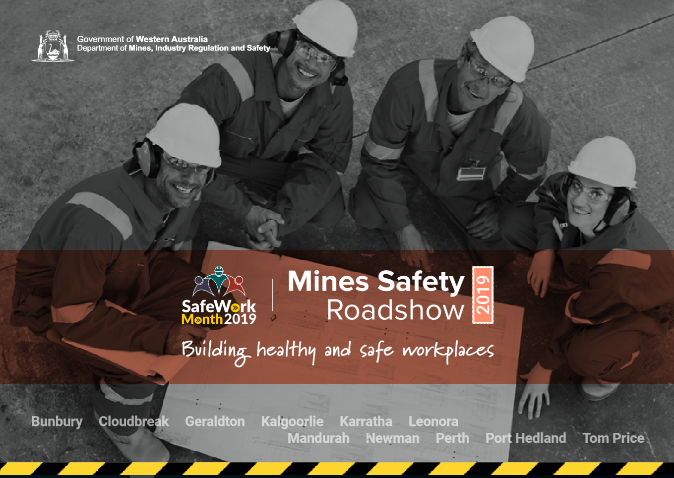
2019 Mines Safety Roadshow

Slide 3
Mentally healthy workplaces –
It’s about safety too

Slide 4
NOTE:
This presentation should be used in conjunction with the safety awareness video
  How workplace factors influence an incident

Slide 5


Why this session
Notes:
Your mental health is important.
Your mental health can also affect your physical health.
Mental health problems are more widespread and serious than many of us probably appreciate.
There is unfortunately a lot of stigma associated with mental health problems. People are often reluctant to talk about them and to listen to others who suffer from them.
Suicide is the most common cause of death for Australian adults under the age of 45. The stigma/reluctance to talk about mental health problems and the lack of awareness of available health services contribute to the suicide problem.
The are are a number of organisations that can provide advice and resources.
RU OK [<https://www.ruok.org.au/>]
Black Dog Institute [<https://www.blackdoginstitute.org.au/>]
Heads up [<https://www.headsup.org.au/>]
Beyond Blue [<https://www.beyondblue.org.au/>]
Mentally Health Workplaces Alliance [<https://www.headsup.org.au/general/about-us/mentally-healthy-workplace-alliance>]
WA Mental Health Commission [<https://www.mhc.wa.gov.au/>]
(NOTE: The first week of October, is Mental Health Week in WA. DMIRS was a sponsor).

Slide 6
Why this session
Issues workers bring on site
Issues on site
Notes:
Why is this session “. . . . about safety too”?
The focus of many of the support organisations is upon the individual with mental health problems and what employers can do to assist the individual with a mental health problem. Mentally Healthy workplaces can help prevent mental health issues developing into something more serious. Mentally Healthy workplaces support employees who are suffering from mental health problems.
These support organisations and the resources they provide play a very important role.
However:
It was pointed out in the video How workplace factors influence an incident that it is common fault to attribute incidents to human error. Focussing only upon the individual employee with a mental health problem can have the negative effect of reinforcing this bias.
It also needs to be recognised that workplaces that are not ‘mentally healthy’ can:
exacerbate existing mental health problems
create mental health problems
interact with hazards in the workplace to increase other injury/harm to health risks
So while employees may bring mental health problems to the mine site, there are “mental health bugs” on the mine site too.
The employer obligations in the Mines Safety and Inspection Act 1994 therefore apply.

Slide 7
Notes:
Another reason for the theme of this presentation is that there are proposed changes to the OSH Laws.
The Mines Safety and Inspection Act 1994 is to be replaced by the Work Health and Safety Act.
In the definition of heath in the new Act psychological health is to be included. So any provision that refers to health will also include psychological health.
Both the current Act and the new Act refer to what is “reasonably practicable”. What is practicable changes with new technology and equipment, awareness of risks etc. So these are moving goalposts. With the introduction psychological health, the goal posts will move further

Slide 8
What is meant by mentally healthy workplaces?
Healthy = more than just not being sick
Notes:
Being “healthy” in general terms is more than not being sick. It also involves being resistant to getting sick

Slide 9
What is meant by mentally healthy workplaces?
Healthy = ability to perform and withstand/survive the “bugs” you are exposed to
What you do on and off the job
The “bugs” you bring on site
The “bugs” that are on site
Notes:
Being “healthy” is also about fitness/the ability to do what you want to do and what you need to do, both on and off the job.
Your immune system protects your body against infection. A mentally healthy workplace is one that acts like an immune system. It helps protect us against the “bugs” (demands, stressors etcetera) in our lives, including those in your personal life and those to are ‘exposed’ to on site

Slide 10
What is meant by mentally healthy workplaces?
Healthy = ability to perform and withstand/survive the “bugs” you are exposed to
Safety is not the absence of accidents
It is the presence of capacity and defences
Notes:
“Safety” is similar to “healthy.” It is more than just not having accidents/incidents.
The presence of capacity and defences is a good analogy.
The capacity to do the work and manage risks and to identify new risk and defend against them.
A Safety/OHS Risk Management System is like an immune system. It protects the mine site from incidents occurring.
Source
Toolbox presentation Anagram approach to site incident investigations from the 2013 Roadshow
[<www.dmirs.wa.gov.au>]

Slide 11
A few words about Statistics, Stigma and Labels
Mental Problem
Mental Disorder
Mental Ill health
Mental Illness
Reduced ability to cope
Feel depressed, anxious, stressed
Harder to keep focussed on what you are doing
How you think, feel, behave, interact with other people seriously affected
Notes:
Our mental health exists on a continuum/spectrum
When the pressures start to get too much we can feel stressed, anxious, depressed. It can be hard to focus on other things. “Mental Problems” and “Mental Ill Health” are labels used to describe these ‘not mentally healthy’ concerns.
When the pressures get too much, the pressures are there for too long, or something traumatic occurs, we can develop serious mental health conditions. “Mental Disorder” and “Mental Illness” Illness” are labels used.
But if you are feeling stressed, or having a “bad hair day” does not mean you are going to develop a mental disorder.
Many of those who promote mental health quote the results of a large scale survey conducted by the Australian Bureau of Statistics from 2007. This survey found that:
20% of Australian adults suffer from a mental disorder every year (i.e. a mental health problem serious enough to be considered/diagnosed as a mental disorder)
45% of Australian adults will at some time in their lives suffer from a mental disorder (i.e. a mental health problem serious enough to be considered/diagnosed as a mental disorder)
The 20% statistic (usually reported as 1 in 5 Australians) is frequently quoted. We like using impressive statistics to sell a message.
On the one hand, the 20% and 45% statistics are important to know. They do help highlight just how widespread mental disorders are. The stigma associated with talking about them and seeking help contribute to suicide being the most common cause of death for Australian adults under 45. So it is important raise awareness and to address the stigma.
{But it must also be admitted that the some groups of people are at higher risk (e.g. unemployed, single parents, younger adults). So for people who are employed, married/in relationships, the percentage is lower.}
But this presentation is about prevention, it is primarily about stopping low level mental problems (and those things that contribute to them) – problems that 100% of us suffer from at some time or another resulting in more serious outcomes. (As will be discussed later in this presentation, on a mine site many of these outcomes are not mental health related)
So on the other hand, this this awareness raising about people with Mental Disorders may increase the stigma. If you a feeling stressed over all you have to cope with at the moment, you may become less likely to say something for fear of being labelled as having a mental disorder.
So it important to remember that just as mentally healthy is more than just not being sick, not being mentally healthy is not the same as being sick.
Sources:
National Survey of Mental Health and Wellbeing: Summary of Results
[<www.abs.gov.au>]
search for 4326.0
The Mental Health of Australians 2. Report on the 2007 National Survey of Mental Health and Wellbeing
[<www1.health.gov.au>]
Australia’s Health 2018
Australian Institute of Health and Welfare
[<www.aihw.gov.au>]

Slide 12
A few words about stress
Engineering definition:
That which causes strain
Notes:
A good way to understand mental health is to understand stress
Think of your brain as a boiler or some other type of pressure vessel
Stress is what occurs when the pressure puts strain on your ability to cope.

Slide 13
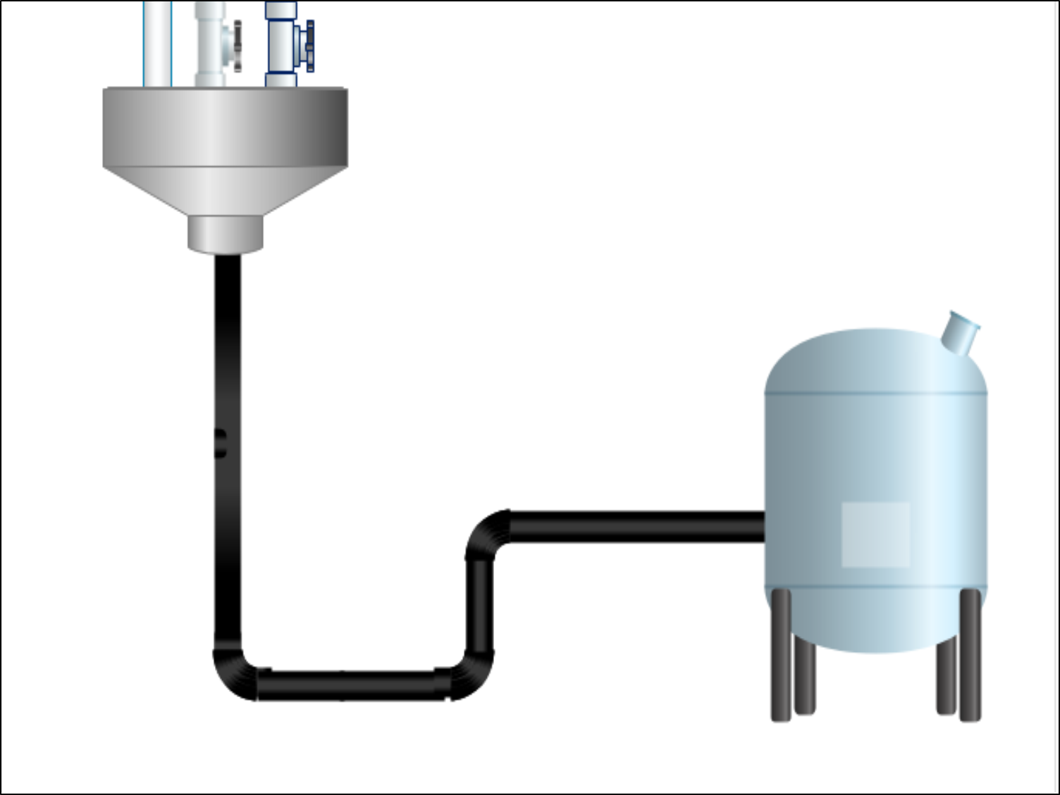
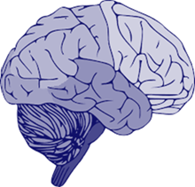
Notes:
Pressure is created by those things that feed into your life

Slide 14
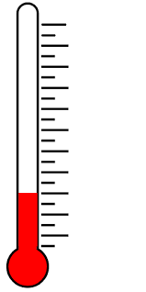

The work the boss gives you
Personal Stuff
All the other job –related “Stuff”
Time/production pressures
Notes:
The things that feed into your life include:
the job/work you do
things in your personal life
the paperwork, bureaucracy, dealing with difficult people and all the other job-related “Stuff” you have to do/deal with/cope with
Plus:
The hours you work per day
Your roster/swing
Environmental conditions
And for FIFO workers
all the issues associated with camp life
Time/production pressures act like a burner that heats up your “brain boiler” further increasing the pressure.

Slide 15
The work the boss gives you
Personal Stuff
All the other job –related “Stuff”
Training, Skills
Experience
Time/production pressures
Notes:
Training, skills and experience can have the effect of strengthening the “brain boiler” walls to enable you better deal with the work-related things that feed into your “brain boiler”.

Slide 16
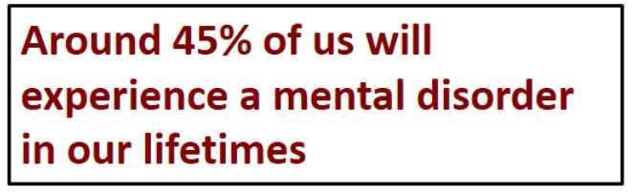
The work the boss gives you
Personal Stuff
All the other job –related “Stuff”
Training, Skills
Experience
Time/production pressures
Notes:
Here are some Australian Bureau of Statistics (ABS) survey statistics.
When someone is suffering from a mental health disorder, those “brain boiler walls” are weakened.
But even amongst those people whose mental problems are serious enough to have become a mental disorder, the effects are not permanent.
That same ABS survey also found that amongst those people who were suffering from a mental disorder at the time of the survey, for only 4 out of the previous 30 days they were unable to carry out their normal activities or had to cut down on what they did. What this shows is that these disorders are not permanent conditions. So only for a time are they less able to cope.
So healthy workplaces enable them to cope and not to put them or others at risk.
It is also relevant to mention that a more recent survey into Australian child and adolescent (i.e. between the ages of 4 to 17 years) heath found that almost 14% experienced a mental disorder in the 12 months before the survey. . . . . So if you have children, there is the possibility that this could increase the amount of “personal stuff” that comes down the pipeline.
Sources:
National Survey of Mental Health and Wellbeing: Summary of Results
[<www.abs.gov.au>]
search for 4326.0
The Mental Health of Australians 2. Report on the 2007 National Survey of Mental Health and Wellbeing
[<www1.health.gov.au>]
Australia’s Health 2018
Australian Institute of Health and Welfare
[<www.aihw.gov.au>]

Slide 17
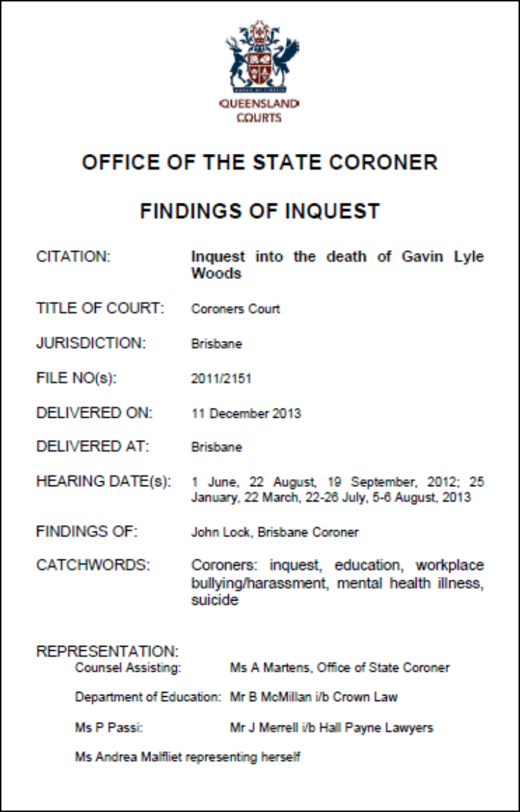
Notes:
A tragic Case Study
Gavin Lyle Woods was a teacher who suffered from a major depressive disorder.
He transferred to Burpengary State School as Deputy Principal, where Ms Passi was the Principal.
Ms Passi:
could be authoritative, behaviourally intimidating, very direct, brusque and with high expectations.
Gavin Woods did not perform to the high standards set by Ms Passi.
He was given a very hard time.
He committed suicide.
The Coronial Inquiry did not directly blame Ms Passi for Gavin Wood’s death.
But if you google “Burpengary suicide” or “Burpengary Passi” see how many results you get. There was a lot of bad publicity for the School and for the Principal.
So consider the “reputational risk”
Source:
[<www.courts.qld.gov.au>]

Slide 18
Notes:
We often talk about the OEM – the Original Equipment Manufacturer requirements. (Note: this is mentioned in the video. There are also Significant Incident Reports on the DMIRS website where the OEM is referred to. Some examples are given below)
There is more than enough information available to write an OEM for people, - that includes chapters on operating and maintenance requirements and breakdowns.
Were are aware that people are subject to “breakdowns.” This is foreseeable. With 45% of “us” likely to have a “serious breakdown” this crosses the threshold from what a responsible employer could do, to a legal requirement under section 9 of the Act.
Mine Safety and Inspection Act 1994
9. Employers, duties of
An employer must, so far as is practicable, provide and maintain at a mine a working environment in which that employer’s employees are not exposed to hazards
OEM Examples
Significant incident Report No. 184
A 4.5kg rail clamp fell about 10 metres to the ground from a shiploader rail system after the nut-and-bolt assembly had loosened, allowing the clamp to vibrate free. . . Many of the clamps had been modified from the original equipment manufacturer (OEM) design by cutting open-ended slots to the bolt holes to overcome what was believed to be a rail misalignment issue.
Significant incident Report No. 189
A crew was setting up a portable diamond drill rig for an underground drill operation. The drill site was in a decline that sloped about 10 degrees, requiring the rig to be levelled. As the integrated tool carrier used for repositioning and alignment was unavailable, the crew was using a portable jack and wooden blocks to level the 1.5 tonne rig. The rig toppled over, pinning the driller, who sustained serious crush injuries to both legs. The rig was not anchored as recommended by the original equipment manufacturer (OEM).
https://www.dmp.wa.gov.au/Documents/Safety/MSH_SIR_189.pdf
Significant incident Report No. 271
A worker was exposed to potentially serious injuries when a handrail latch failed, causing a handrail gate to swing open. The original equipment manufacturer (OEM) released a service bulletin in April 2017 relating to the latch; however, the recommended works were not actioned on this vehicle.
https://www.dmp.wa.gov.au/Documents/Safety/MSH_SIR_271.pdf
Significant incident Report No. 268
Workers were exposed to potentially serious or life threatening injuries when disassembling a haul truck's hydraulic accumulator. . . .deviated from the original equipment manufacturer's (OEM's) procedure.
https://www.dmp.wa.gov.au/Documents/Safety/MSH_SIR_268.pdf

Slide 19
The work the boss gives you
Personal Stuff
All the other job –related “Stuff”
Training, Skills
Experience
Time/production pressures

Slide 20
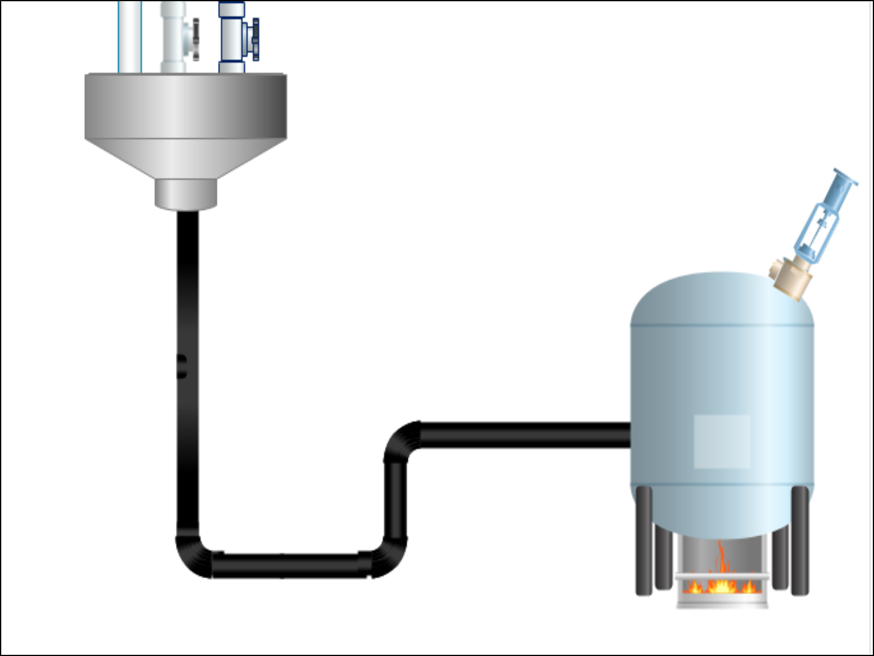

The work the boss gives you
Personal Stuff
All the other job –related “Stuff”
Pressure Release Valve
Training, Skills
Experience
Time/production pressures
Notes:
We do have the equivalent of a “Pressure Relief Valve.”
Those things we do to stop the pressure getting to much

Slide 21
The work the boss gives you
Personal Stuff
All the other job –related “Stuff”
Pressure Release Valve
Being able to “switch off”
Talk about it, “vent”
Talk to family, friends, Play sport/games
Drink, smoke etcetera.
Training, Skills
Experience
Time/production pressures
Notes:
The things we do to relieve the pressure include being able to:
switch off at the end of the shift
to talk about your concerns (i.e. to literally vent, let off steam) with co-workers, friends and family
to exercise, play sport, do those other things you enjoy doing
If these things are not available or we do not have the time/energy to do them, there is the risk we do some of the others things (e.g. drink or smoke excessively, use illicit drugs) that have other negative consequences.
The 20% and 45% is figures are frequently mentioned by those who seek to promote mental health.
It is important to remember that we are all at risk if too much comes down the pipeline at the same time for us to cope with.
Most of us cope with the pressures/stressors of our lives most of the time. This is partly due to having our “Pressure Relief Valve.”
So anything that interferes with the operation of our “Pressure Relief Valve” puts us at increased risk.
This can include:
being subject to call-outs (i.e. have to cope for longer, harder to switch off)
unnecessary camp rules and regulations (i.e. more stuff to cope with, unable to switch off)
poor internet access/communication with friends and families
long rosters

Slide 22
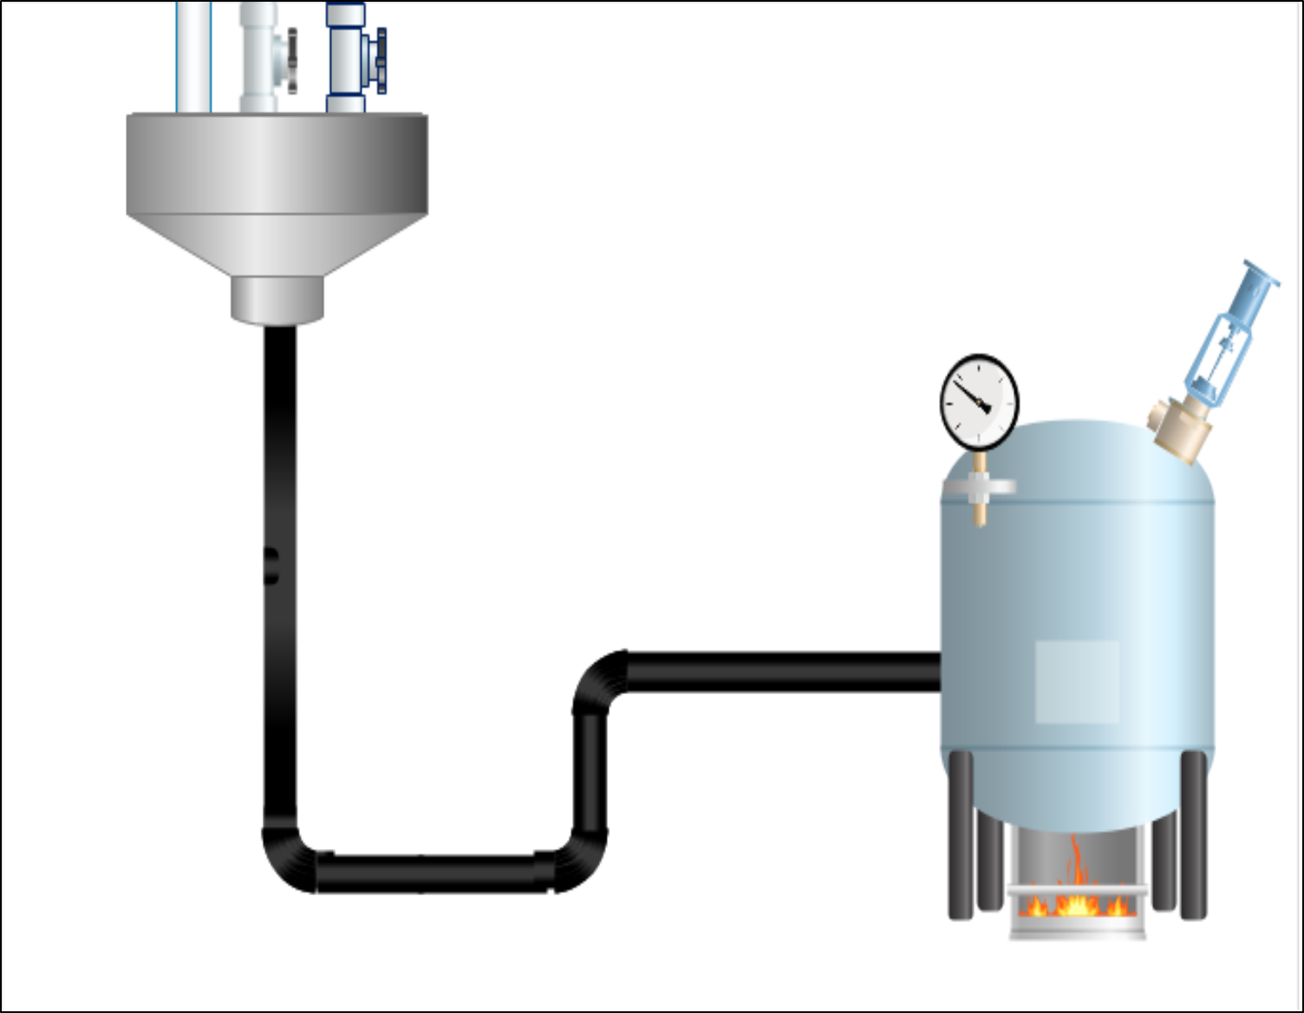
The work the boss gives you
Personal Stuff
All the other job –related “Stuff”
Pressure Release Valve
Pressure Gauge
Training, Skills
Experience
Time/production pressures
Notes:
It is important therefore to speak up when the work is getting too much and/you are not coping. To display our “Pressure Gauge”.
An important role of Managers/Supervisors is to control workload and to reduce it when it becomes excessive and/or employees are not coping.
A useful DMIRS resource
GUIDELINE Effective safety and health supervision in Western Australian mining operations
[<www.dmirs.wa.gov.au>].
In Appendix 1 for the element “Resourcing” it includes the following enabling actions:
Allocates adequate resources to meet legislative requirements and corporate commitments for safety and health, including supervision
Provides supervisors with sufficient time and resources to balance production demands with safety and health requirements
Ensures contractors are effectively supervised
Ensures equipment made available is fit for purpose

Slide 23

The work the boss gives you
Personal Stuff
All the other job –related “Stuff”
Pressure Release Valve
Pressure Gauge
Training, Skills
Experience
Time/production pressures
Notes:
One of our big problems is the stigma associated with admitting you have a mental health problem. We mask our “Pressure Gauges.”
A “Suck it up culture” can be very damaging. People don’t speak up, they keep on sucking it up till they break. Sometimes mentally and physically.
Imagine what it would do to our life expectancies if we had the same stigma associated with things like cancer or heart disease. If we never spoke about it or sought help.
But this is where the awareness raising about the percentage of Australians with mental health disorders can possibly create problems (i.e. a reluctance to say you are felling stressed because you might be labelled as having a mental disorder).
How to overcome this? Some suggestions
Talk about the job demands, those other things that add to the “stuff” you have to cope with, the lack of communication with home etc.
If the major concerns are the things in your personal life, emphasise the temporary inability to cope

Slide 24
The work the boss gives you
Personal Stuff
All the other job –related “Stuff”
Pressure Release Valve
Pressure Gauge
Training, Skills
Experience
Time/production pressures
Notes:
Illegitimi non carborundum
It is “made up Latin” and means
“Don’t let them grind you down”
Often pressures/stressors are not that high, but they are always/often there. So they wear you down over time.
This is can be the most insidious aspect of stress.
Because the effects of stress are often gradual, you may lack insight into how badly you are affected.
So we cant read our own “Pressure Gauges”

Slide 25
The work the boss gives you
Personal Stuff
All the other job –related “Stuff”
Pressure Release Valve
Pressure Gauge
Training, Skills
Experience
Time/production pressures
Notes:
This means that just having an Employee Assistance Programme is not good enough. A mine site cannot rely upon employees recognising they have problems.
So it is also necessary to:
have adequate/competent supervision to identify employees with performance and/or behaviour problems
create a culture where employees look out for each other and ask if you are OK

Slide 26
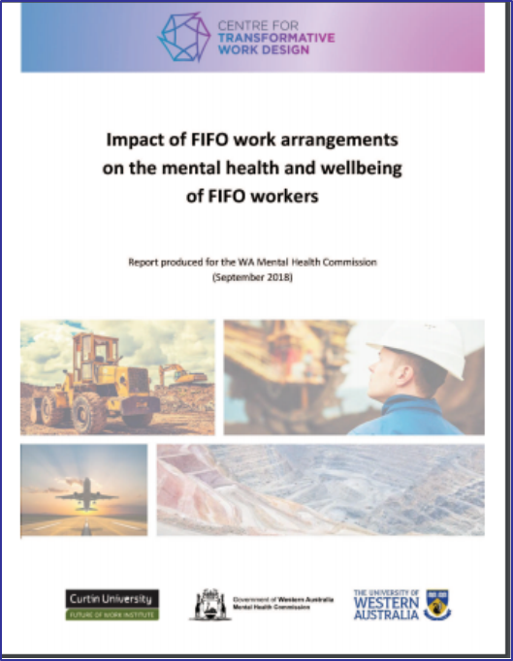

Higher levels of depression, anxiety, burnout and distress
High levels of stress:
1 in 10 Australian Adults
1 in 3 WA FIFO workers
Notes:
Due to the concern about suicides are other problem amongst FIFO workers the Mental Health Commission commissioned some research
Impact of FIFO work arrangements on the mental health and wellbeing of FIFO workers
[<www.mhc.wa.gov.au>]
Compared to the overall Australian population, the sample of FIFO workers surveyed reported higher levels of depression, burnout and stress.
In a 2014 – 2015 Australian Bureau of Statistics Survey approximately 1 in 10 (11.7%) of Australians reported high or very levels of stress. In the FIFO survey approximately 1 in 3 (32.6%) reported high or very levels of stress.

Slide 27
Higher levels of moderate depression than FIFO workers (1 survey)
The mental health and wellbeing of regional Australian
mineworkers
Country people score better on life satisfaction and wellbeing (???)
???
Poorer access to health services when things go pear-shaped
Notes:
To date most of the mining research has been upon FIFO workers. So there is no equivalent to the FIFO report for mining people living in rural or remote areas.
So that “book” has yet to be written.
What we do know is that lack of access to good healthcare can be a problem in rural and remote areas
Source:
Mental Health in Rural and Remote Australia
Fact sheet 2017
[<www.ruralhealth.org.au>]

Slide 28
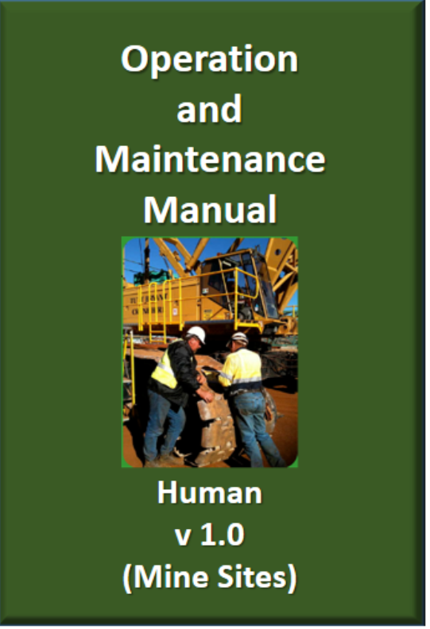
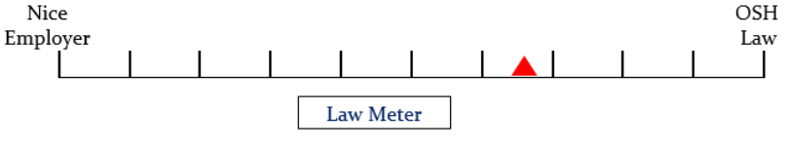
Harsher operating environments
More wear and tear
Further from (professional) breakdown service
Notes:
The OEM Manual (Mine Site Model) analogy revisited.
Compared to the majority of Western Australian workers many those who work on mine sites:
work in harsher operating environments (due to temperature, humidity and other environmental conditions)
are subject to more wear and tear due to shift lengths and rosters
may work/live away from friends and family – that can compromise the operation of the “Pressure Relief Valve”
May live in rural or remote area that have reduced access to health services (i.e. the “professional breakdown services”)
So on a mine site it is stronger legal requirement to “operate and maintain” employees in a mentally healthy manner.

Slide 29
The work the boss gives you
Personal Stuff
All the other job –related “Stuff”
Pressure Release Valve
Pressure Gauge
Training, Skills
Experience
Time/production pressures
Notes:
It is important to reduce unnecessary job/work demands and make it clear who does what.

Slide 30
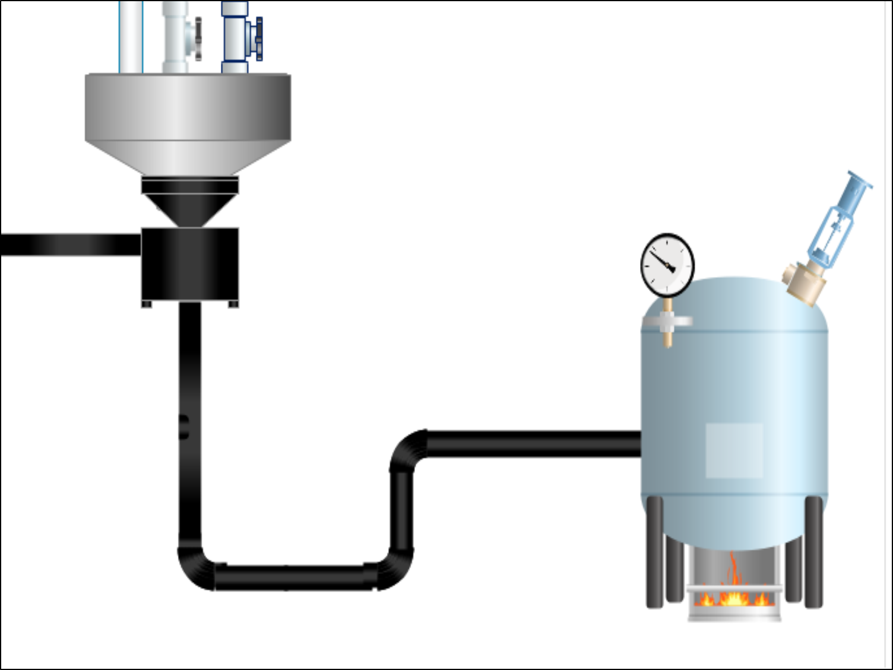
The work the boss gives you
Personal Stuff
All the other job –related “Stuff”
Pressure Release Valve
Not My Job
Not competent to do job
Pressure Gauge
Training, Skills
Experience
Time/production pressures
Notes:
So the workplace (through things like Duty Statements, Job Descriptions, Safe Operating Procedures/Safe Work Instructions/Safe Work Methods Statements) should have processes in place to ‘filter’ work. So employees know what they have to do (i.e. to reduce unnecessary work and the hassles associated with arguing over who does what) and know what they are not skilled/experienced/qualified/competent to do.
It is also important to ‘filter out’ those jobs the employee is not competent to do.
The video How workplace factors influence an incident showed what can occur when a Health and Safety Culture is allowed to develop where work is allocated without verifying whether the employee has the relevant competence.

Slide 31
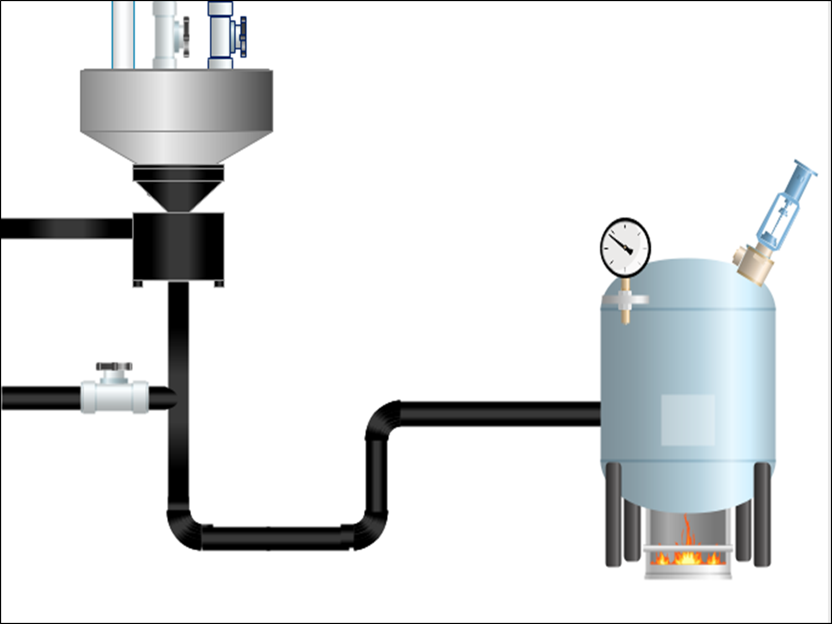
The work the boss gives you
Personal Stuff
All the other job –related “Stuff”
Pressure Release Valve
Not My Job
Not competent to do job
Pressure Gauge
Training, Skills
Experience
Co-worker “Diversion”
Time/production pressures
Notes:
Co-workers who are able and willing to help out when necessary act as a diversion line that take some of the work demands when they become too much.

Slide 32
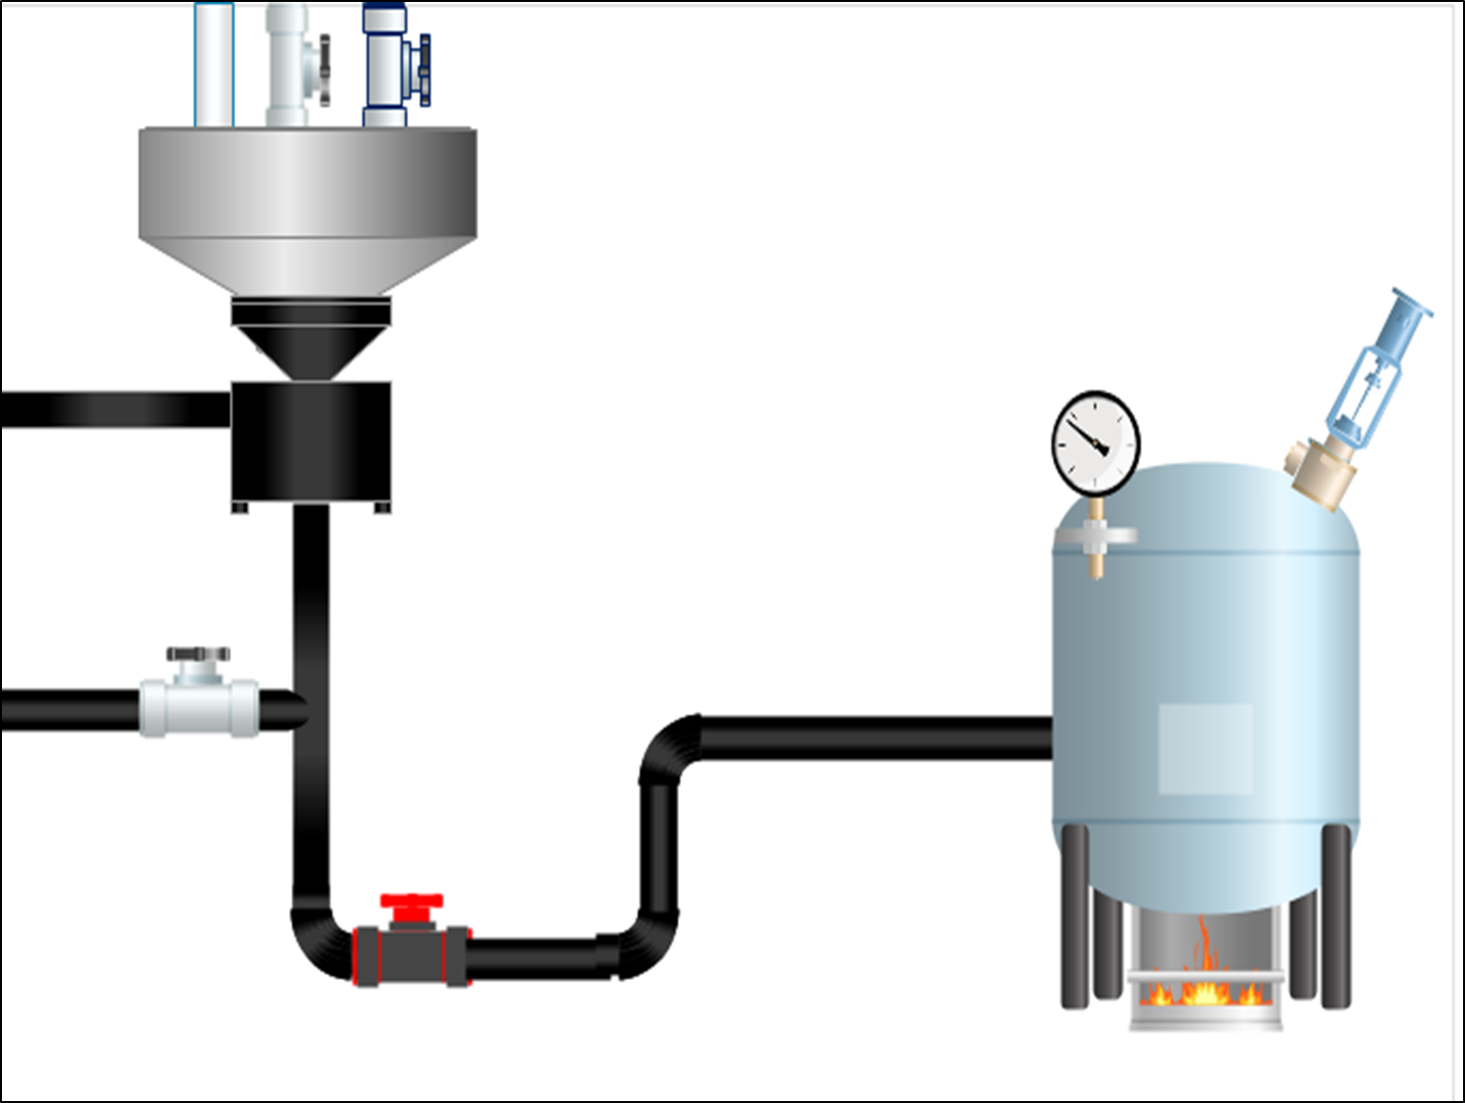
The work the boss gives you
Personal Stuff
All the other job –related “Stuff”
Pressure Release Valve
Not My Job
Not competent to do job
Pressure Gauge
Shouldn’t do it
Training, Skills
Experience
Co-worker “Diversion”
Policies on Grievances, Complaints etc.
Time/production pressures
Notes:
Having effective policies on grievances, complaints, bullying etc. can function to reduce or stop the work demands and other things the workers are forced to cope with.

Slide 33
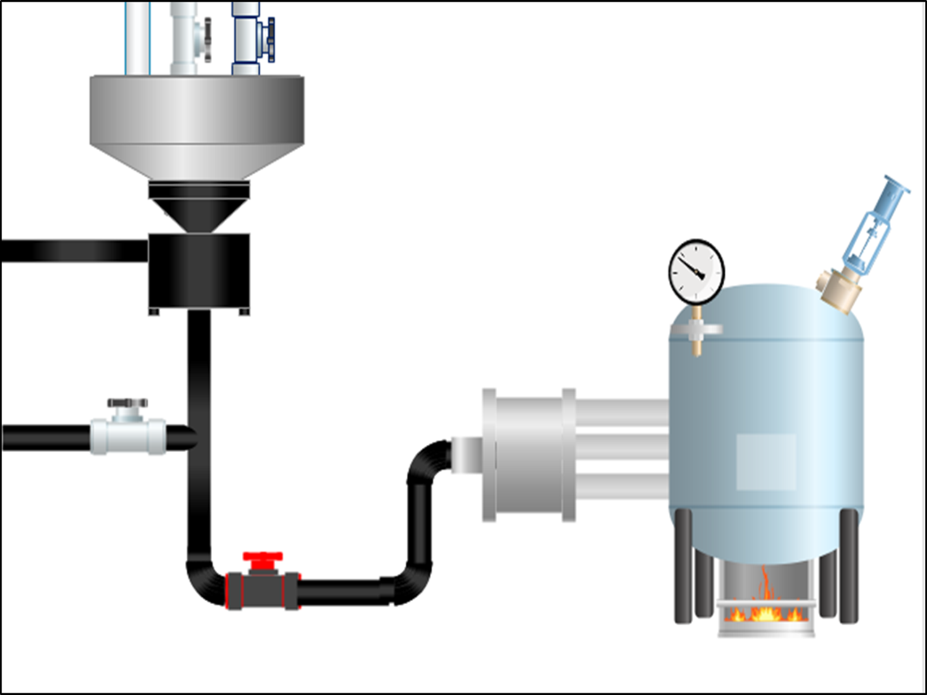
The work the boss gives you
Personal Stuff
All the other job –related “Stuff”
Pressure Release Valve
Not My Job
Not competent to do job
Pressure Gauge
Have some choice
Put stuff on back-burner
Do work at own pace
Open to suggestions of easier/safer was of doing it
Training, Skills
Experience
Co-worker “Diversion”
Policies on Grievances, Complaints etc.
Time/production pressures
Notes:
Having some control over what you do is important. It acts like a filter on the demands
Control includes:
having some choice over what work you are allocated
when high priority jobs ‘come down the pipeline’ you are able to put the lower priority work on hold
to do the work as far as possible at a pace you can cope with
having a culture where your Supervisor/management are open to suggestions for better/safer ways of doing the work. . . . . . . .Often the employees themselves are know best how to do the job. There is a saying:
“With every pair of hands you employ you get a free brain”
So employee brains should be used as well

Slide 34
The work the boss gives you
Personal Stuff
All the other job –related “Stuff”
WHERE ENGINEERING MEETS PSYCHOLOGY
Pressure Release Valve
Not My Job
Not competent to do job
Pressure Gauge
Have some choice
Put stuff on back-burner
Do work at own pace
Open to suggestions of easier/safer was of doing it
Training, Skills
Experience
Co-worker “Diversion”
Policies on Grievances, Complaints etc.
Time/production pressures
Notes:
Comment: we are a bit more complicated than boilers/pressure vessels

Slide 35
The work the boss gives you & is willing to listen
Personal Stuff
All the other job –related “Stuff”
WHERE ENGINEERING MEETS PSYCHOLOGY
Pressure Release Valve
Not My Job
Not competent to do job
Pressure Gauge
Have some choice
Put stuff on back-burner
Do work at own pace
Open to suggestions of easier/safer was of doing it
Training, Skills
Experience
Co-worker “Diversion” & are willing to listen
Policies on Grievances, Complaints etc.
Time/production pressures
Notes:
Sometimes just having a sympathetic ear is all that is needed. You just want someone to listen.
If co-workers are willing to listen, then hopefully employees with serious concerns will be more willing to ask for help.

Slide 36
The work the boss gives you & is willing to listen
Personal Stuff
All the other job –related “Stuff”
WHERE ENGINEERING MEETS PSYCHOLOGY
Pressure Release Valve
Not My Job
Not competent to do job
Pressure Gauge
Have some choice
Put stuff on back-burner
Do work at own pace
Open to suggestions of easier/safer was of doing it
Training, Skills
Experience
Co-worker “Diversion” & are willing to listen
Policies on Grievances, Complaints etc.
Time/production pressures
Unfairness, Frustrations, Meaningful work, positives to job
Notes:
There is also the nature of the jobs/work.
Often there are unpleasant jobs that need to be done. If they are fairly shared around, we can generally cope. But if we always get the unpleasant work, unreliable equipment etcetera, the unfairness can increase the pressure.
Meaningful, productive effort and those things that can make the work more fun/enjoyable can reduce the pressure. The frustrating stuff (e.g. lots of paperwork, unco-operative staff, poor documentation) can increase the pressure.

Slide 37
The work the boss gives you & is willing to listen
Personal Stuff
All the other job –related “Stuff”
WHERE ENGINEERING MEETS PSYCHOLOGY
Pressure Release Valve
Not My Job
Not competent to do job
Pressure Gauge
Have some choice
Put stuff on back-burner
Do work at own pace
Open to suggestions of easier/safer was of doing it
Training, Skills
Experience
Co-worker “Diversion” & are willing to listen
Policies on Grievances, Complaints etc.
Time/production pressures
Unfairness, Frustrations, Meaningful work, positives to job
Notes:
Training, skills and experience are important. But if the self-confidence is not there, they count for little.

Slide 38
The work the boss gives you & is willing to listen
Personal Stuff
All the other job –related “Stuff”
Pressure Release Valve
Knowing
Not My Job
Not competent to do job
Pressure Gauge
Have some choice
Put stuff on back-burner
Do work at own pace
Open to suggestions of easier/safer was of doing it
Training, Skills
Experience
Co-worker “Diversion” & are willing to listen
Policies on Grievances, Complaints etc.
Time/production pressures
Unfairness, Frustrations, Meaningful work, positives to job
Notes:
Knowing/Believing is important.
So knowing that your boss will cut you some slack and/or listen your concerns helps reduce the pressure, even if you don’t ask or talk about it.
The same goes for co-workers, the system and being in control.
Even if you do not ask, knowing is important.
Ever had a situation where you’ve gone to some outdoor event on a cool night and forgotten jacket/jumper? . . . . . You feel cold.
If you remembered the jacket/jumper and it is on the back of your chair, you may not feel as cold, knowing you have got it there.

Slide 39
The work the boss gives you & is willing to listen
Personal Stuff
All the other job –related “Stuff”
Pressure Release Valve
Knowing
Not My Job
Not competent to do job
Pressure Gauge
Have some choice
Put stuff on back-burner
Do work at own pace
Open to suggestions of easier/safer was of doing it
Training, Skills
Experience
Co-worker “Diversion” & are willing to listen
Policies on Grievances, Complaints etc.
Time/production pressures
Unfairness, Frustrations, Meaningful work, positives to job

Slide 40
The work the boss gives you & is willing to listen
Personal Stuff
All the other job –related “Stuff”
Pressure Release Valve
Knowing
Not My Job
Not competent to do job
Pressure Gauge
Have some choice
Put stuff on back-burner
Do work at own pace
Open to suggestions of easier/safer was of doing it
Training, Skills
Experience
Co-worker “Diversion” & are willing to listen
Policies on Grievances, Complaints etc.
Time/production pressures
Unfairness, Frustrations, Meaningful work, positives to job

Slide 41
The work the boss gives you & is willing to listen
Personal Stuff
All the other job –related “Stuff”
Pressure Release Valve
Knowing
Not My Job
Not competent to do job
Pressure Gauge
Have some choice
Put stuff on back-burner
Do work at own pace
Open to suggestions of easier/safer was of doing it
Training, Skills
Experience
Co-worker “Diversion” & are willing to listen
Policies on Grievances, Complaints etc.
Time/production pressures
Unfairness, Frustrations, Meaningful work, positives to job
Notes:
The same applies to policies on grievances, complaints etc. Knowing there are there, but also believing that are effective.

Slide 42
The work the boss gives you & is willing to listen
Personal Stuff
All the other job –related “Stuff”
Pressure Release Valve
Knowing
Not My Job
Not competent to do job
Pressure Gauge
Have some choice
Put stuff on back-burner
Do work at own pace
Open to suggestions of easier/safer was of doing it
Training, Skills
Experience
Co-worker “Diversion” & are willing to listen
Policies on Grievances, Complaints etc.
Time/production pressures
Unfairness, Frustrations, Meaningful work, positives to job
Notes:
Feeling in control, believing you can do the job are very important.
. . . . . . But over-confidence can be a problem. So it is also important to have that “not competent to do the job” filter.

Slide 43
Notes:
Due to the concern about mental health problems amongst FIFO workers DMIRS has released a Code of Practice
[<www.dmirs.wa.gov.au>]

Slide 44

Supervisor Support
The work the boss gives you & is willing to listen
Personal Stuff
All the other job –related “Stuff”
Work Demands
Pressure Release Valve
Not My Job
Not competent to do job
Pressure Gauge
Role Clarity
Have some choice
Put stuff on back-burner
Do work at own pace
Open to suggestions of easier/safer was of doing it
Level of Control
Training, Skills
Experience
Co-worker “Diversion” & are willing to listen
Co-worker Support
Policies on Grievances, Complaints etc.
Organisational Justice
Work Demands
Time/production pressures
Unfairness, Frustrations, Meaningful work, positives to job
Recognition & Reward
Notes:
These are the ‘”labels” used by the FIFO Code
There is no consistent terminology with mental health, so I refer to them as labels.

Slide 45
Supervisor Support
The work the boss gives you & is willing to listen
Personal Stuff
All the other job –related “Stuff”
Work Demands
Environment, Fatigue Isolation, Change, etc.
Pressure Release Valve
Not My Job
Not competent to do job
Pressure Gauge
Role Clarity
Have some choice
Put stuff on back-burner
Do work at own pace
Open to suggestions of easier/safer was of doing it
Level of Control
Training, Skills
Experience
Co-worker “Diversion” & are willing to listen
Co-worker Support
Policies on Grievances, Complaints etc.
Organisational Justice
Work Demands
Time/production pressures
Unfairness, Frustrations, Meaningful work, positives to job
Recognition & Reward

Slide 46
Supervisor Support
All the other job –related “Stuff”
Work Demands
Environment, Fatigue Isolation, Change, etc.
Role Clarity
Level of Control
Training, Skills
Experience
Co-worker Support
Organisational Justice
Work Demands
Time/production pressures
Recognition & Reward

Slide 47
Supervisor Support
All the other job –related “Stuff”
Work Demands
Environment, Fatigue Isolation, Change, etc.
MENTAL RESILIENCE
Role Clarity
Level of Control
Training, Skills
Experience
Co-worker Support
Organisational Justice
Work Demands
Time/production pressures
Recognition & Reward
Notes:
A short detour (difficult to know where to put this in the presentation).
Mental Resilience training is popular (as an exercise I typed “mental resilience training Australia” in Google and got over 14 million results!)
It attempts to increase your mental resilience, to strengthen those “brain boiler walls”.

Slide 48

feeling in control
belief in own abilities
prioritise, concentrate on what matters
social support
positive outlook
Notes:
Mental resilience training is popular partly because it is cheap. The focus is upon training the employees to be more resilient rather than fixing any problem at the mine site.
Mental resilience training belongs at the bottom of the hierarchy of control.
The training can be effective. You can cope with a lot more if you feel you are in control, you believe in your own abilities etc.
BUT
Mental resilience training will not be effective if:
you have no control (e.g. if you work for a “control freak”)
when you cannot do the job up to the standard required you are blamed for not being good enough
work load management is poor
there poor phone/internet access and you get ignored/put down by your co-workers
the culture on the mine site is very negative
So while mental resilience training can be effective, there are things in the workplace that need to be addressed first.

Slide 49

feeling in control
belief in own abilities
prioritise, concentrate on what
matters
social support
positive outlook
Notes:
Belief in your own abilities is very important. Often if you believe you can do the job/cope, you will
If you are told you cannot do the job, that you cannot cope, that you are inadequate etc. these messages can erode your belief in yourself and corrode those “brain boiler walls”
If you disagree with someone there is a difference between telling them that their idea/opinion is stupid and telling them they are stupid. If the culture is very negative and is more of the “your are stupid” way of expressing disagreements, then you may begin to believe it.

Slide 50
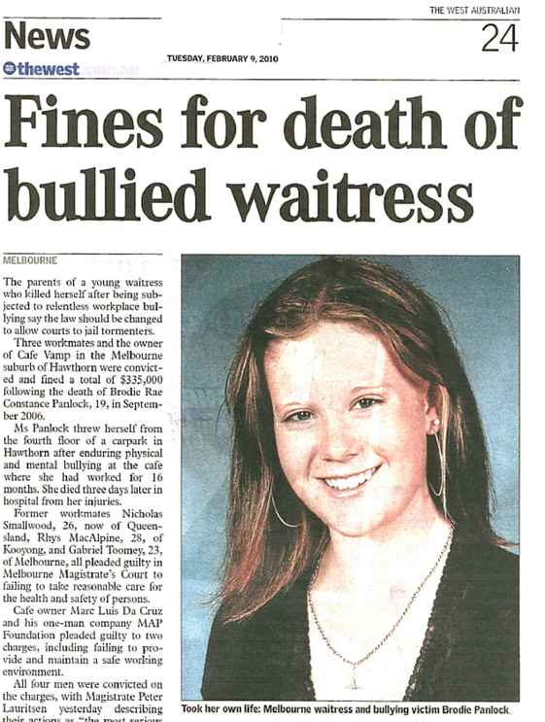
Notes:
Young adults can be vulnerable because they can lack self confidence.
One of the most well-known bullying related suicides is that of Brodie Panlock of Melbourne.
Bullying can be bad, but some behaviours are worse than others. In Brodie’s case, no matter how hard she tried, she could never do anything right by the males in the workplace. This had a fatal effect upon her self confidence.
From the Coronial Inquiry [<www.coronerscourt.vic.gov.au>]:
I can describe Brodie as a buoyant, chirpy, compassionate, patient, giving girl. She was like a little ray of sunshine. Unfortunately, she was young, naïve and working in an
environment that encouraged and supported bullying behaviour. In my opinion, Nick and Rhys were successful in bullying Brodie because she felt she deserved it. She had no
confidence in her beauty or self worth. Nick was the manager and Rhys was his side kick at Café Vamp. But no matter what she did, be it right or wrong, Brodie could never do anything right by Mark, the owner, Nick, Rhys or Gabe.
END OF DETOUR

Slide 51
Notes:
As mentioned in the introduction, this presentation is about safety too because much of the information on workplace mental health focuses just upon the mental health problems the employee brings to work.
Given that so many of us are at risk and that working on mine sites increases the risk, it is important that employers accommodate employees who do suffer from mental health problems.
So imagine from the video How workplace factors influence an incident if Phil’s wife had just left him, his Mum had just died and his little boy was sick. He could be very distraught.

Slide 52
Supervisor Support
All the other job –related “Stuff”
Work Demands
Environment, Fatigue Isolation, Change, etc.
Role Clarity
Level of Control
Training, Skills
Experience
Co-worker Support
Organisational Justice
Work Demands
Time/production pressures
Recognition & Reward
Notes:
So Phil would be at increased risk of a mental disorder.
So it is important that:
his supervisor is supportive
work demands are minimised
role clarity there
co-workers are supportive
the policies, procedures etc. are effective and credible
there is good recognition and reward
Phil feels that he is in control
. . . . . . So Phil is able to cope and function safely and effectively.

Slide 53

The “bugs” that are on site
Notes:
“Safety” is about capacity and defences.
Did Phil’s workplace have the capacity to get the work done when employees are on leave or allocated to other tasks?
Was Phil working in a mentally healthy workplace?

Slide 54
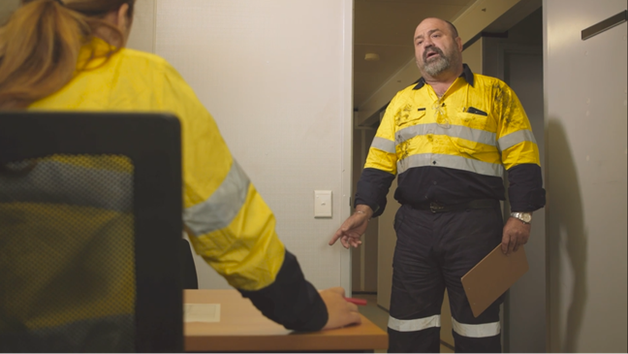
Notes:
The Manager was not supportive of the Supervisor.

Slide 55
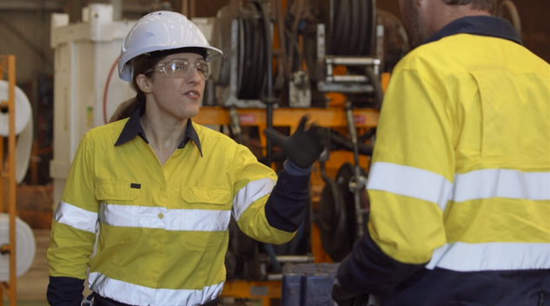
Notes:
The Supervisor was not supportive of Phil.

Slide 56
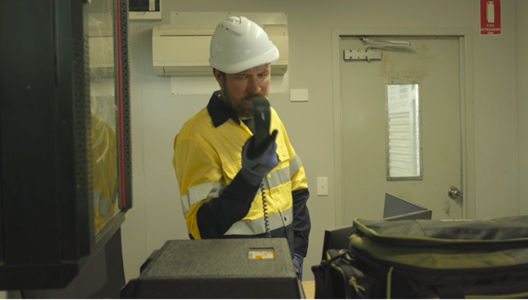
Notes:
The Supervisor was not contactable when needed.

Slide 57
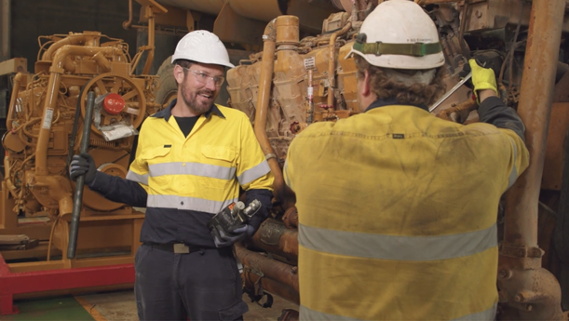
Notes:
The Co-worker was not supportive – well before lunch anyway.

Slide 58
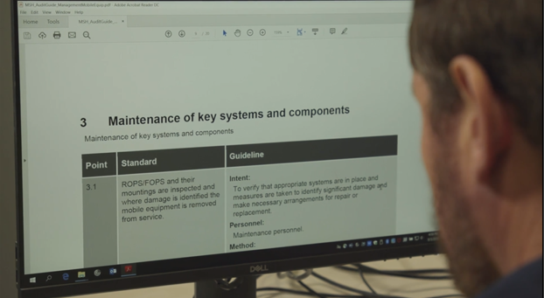
Notes:
The inability to find the relevant added to the “stuff”/frustrations Phil had to cope with.

Slide 59
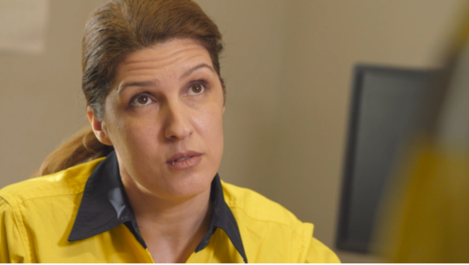
Notes:
The Health and Safety Culture lead to Phil being given the truck tray replacement job, despite never having done it before.

Slide 60
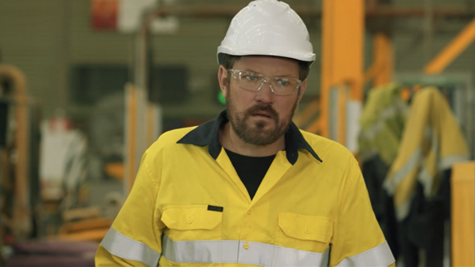
Notes:
This was not a mentally healthy workplace.
Phil was getting stressed. . . . . But was stress/mental ill-health the biggest problem?????

Slide 61
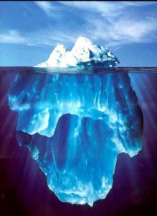

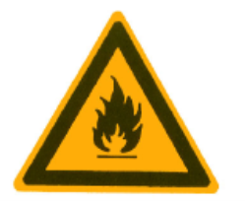

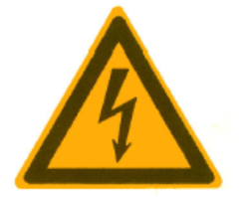
The “Stress Iceberg”
Suicides
Stress Worker’s Comp Claims
?
Sickies
Presenteeism
Long term health problems
Notes:
We sometimes talk about the Stress Iceberg. Because of the stigma and non-reporting, we do not know how big the problem is and what we see is often just the tip of the problem.
How many suicides are work-related we do not know. They can occur off site.
The ‘runners up’ in the ‘causes of death’ statistics for Australian adults under 44 years are drug and vehicle related. Some of those are likely to be suicides and/or stress related.
The most obvious stress-related problems are the workers’ compensation claims where the nature of injury is recorded as “exposure to mental stress”.
There are far more “sickies”.
Some consultants talk about “presenteesim”. This is being present physically at work, but not fully productive. (More about that later. This can contribute to “Line of Fire” related incidents).
Long term exposure to stress can cause physical health problems such as coronary heart disease.
Looking at the Lost Time Injury data for WA, mental stress is recorded as the “Nature of Injury” in around 4% of all LTI’s.
In mining it accounts for less than less than 2%.
Does this mean that stress/mental health related issues are not a concern on mine sites?????
Where on the risk register should they be????
If someone has a desk job in an office and is exposed to high work demands, low role clarity, poor support, low control etc. then over time they could develop a work-related mental health disorder.
If someone exposed to the hazards on a mine site is also exposed to high work demands, low role clarity, poor support, low control etc., then other outcomes are more likely.
Phil did not last long enough on the job to develop a work-related mental health disorder
Sources:
Safety performance in the Western Australian mineral industry 2016-2017
[<www.dmirs.wa.gov.au>]
Safety performance in the Western Australian mineral industry 2017-2018
[<www.dmirs.wa.gov.au>]
Workers’ Compensation Scheme Trends November 2018
[<www.workcover.wa.gov.au>]

Slide 62
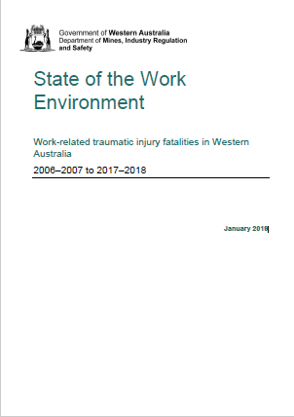
Notes:
Comment:
Some relative data.
In 2017/2018 Mining had the second highest fatality rate of any industry in WA.
Mining compared to other industries has a good safety record. but when things go pear-shaped, they go very pear shaped
Source:
State of the Work Environment. Work-related traumatic injury fatalities in Western Australia
2006–2007 to 2017–2018
[<www.dmirs.wa.gov.au>]

Slide 63
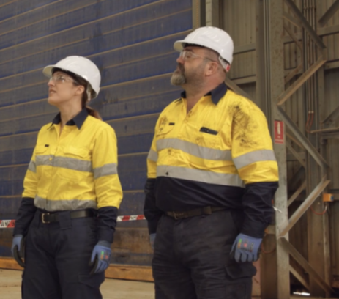
Notes:
Most of the information about mentally healthy workplaces is about the benefits of a mentally healthy workplace.
But what are the consequences of having a “mentally unhealthy workplace”?
Consider, what are the consequences of Mangers and Supervisors:
being totally production focussed and do not acknowledge that the work demands are too high
bullies
totally autocratic
do not listen to employees (e.g. “do it my way or the highway”)

Slide 64
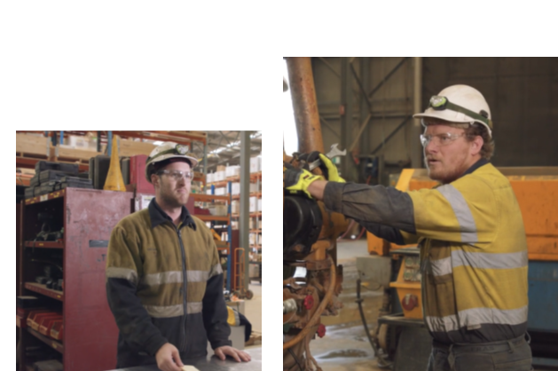
Notes:
Consider, what are the consequences of co-workers:
being bullies
that do not help, withhold information., do not communicate, make things as difficult as possible
talk about you behind your back

Slide 65
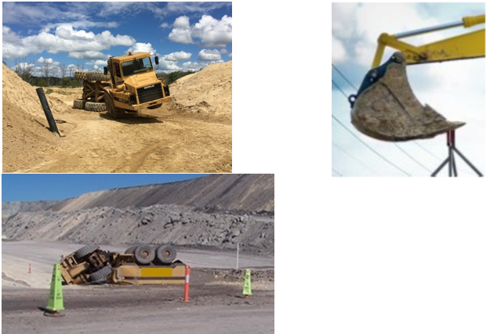
Notes:
Workplace inspections and investigations on mine sites across Australia find examples of situations where overloading, speeding and taking short cuts are contributing factors.
Sources
Mines Safety Bulletin No. 143
[<www.dmirs.wa.gov.au>]
Mines Safety Bulletin No. 170
[<www.dnrme.qld.gov.au>]

Slide 66
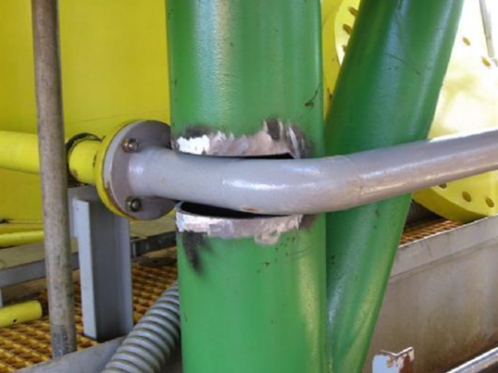
Notes:
If you work for someone who is an autocrat/”control freak”/does not listen etc. are you going to do EXACTLY what you are told to do?

Slide 67
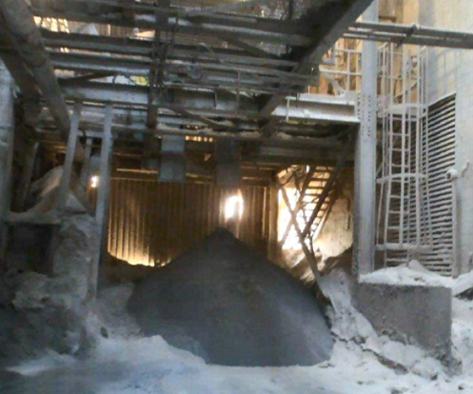
Notes:
When there are high work demands/negative reactions to complaining, a “Can Do Culture” can develop. Where there is poor role clarity, employees may do things they should not do.
Example: worker hits blocked overhead waste dust discharge pipe. It worked. The dust was over 600 degrees C.
Source
Quarterly Training Summit October 2016
[www.msha.gov>]

Slide 68
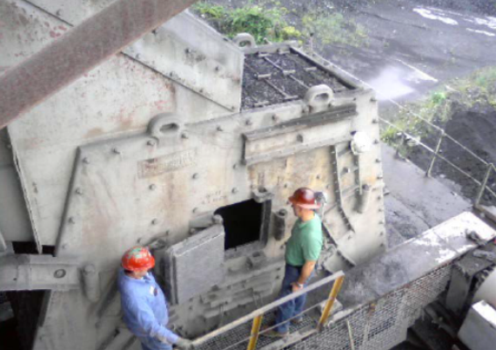
Notes:
Worker entered impact crusher to clear blockage. Engulfed him up to his knees.
Source
MNM Serious Accident Alert Plant - Clean Out
[<www.msha.gov>]

Slide 69
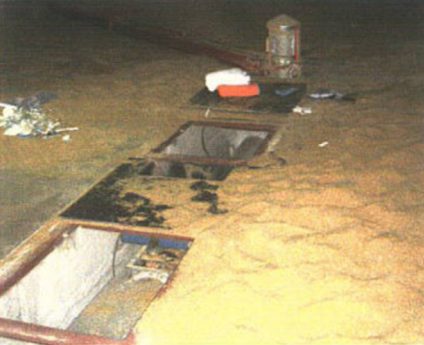
Notes:
Worker entered silo to clear blockage. Cover over auger missing. Foot trapped. Had to amputate foot to release him.. Died before he got to hospital.
Source;
Safety and Health Professional. December 2009

Slide 70
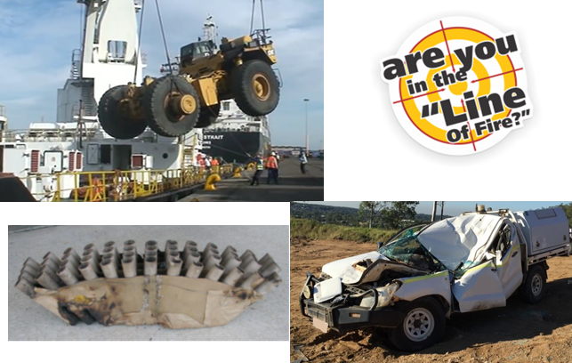
Notes:
We often talk about the “Line of Fire” - when you are at risk of coming into contact with a force that will, or may hurt you.
Line of fire injuries are a significant proportion of the total injuries reported to DMIRS including the major contributing factor for a number of fatalities.
Feeling pressured/stressed can affect your ability to keep your mind on the task at hand. This can contribute to “line of fire” related injuries.
So how many of the other 98% of Lost Time Injuries on mine sites was stress a contributing factor?????
Sources
Line of fire hazard recognition
[<www.dmirs.wa.gov.au]
Dangerous Goods Safety Significant Incident Report No. 02-18
[<www.dmirs.wa.gov.au>]
There is also a more recent fatality involving line of fire
Significant Incident Report No. 278 Trailer tarpaulin cover mechanism fracture – fatal accident
[<www.dmirs.wa.gov.au>]

Slide 71
Environment, Fatigue Isolation, Change, etc.
Adds to the “stuff” you have to cope with
85 dB(A) on site ⇨ Hearing loss risk
35-40 dB(A) in donga ⇨ sleep loss ⇨ Fatigue-related risk
Notes:
The hours your work, the roster, environmental conditions and camp rules and regulations also add to all the things you have to cope with.
There is also fatigue to consider. Fatigue can add to the things you have to cope with/interfere with your ability to cope.
To protect against hearing loss Regulation 7.3 gives an “action level” of 85 dB(A)
How noisy is the camp accommodation?
Australian/New Zealand Standard AS/NZS 2017: 2016 Acoustics – Recommended design sound levels and reverberation times for building interiors gives recommended noise levels for different types of buildings. For mining camp sleeping areas the recommended maximum levels are 35 to 40 dB(A).
So if the camp accommodation/control of noise levels do not meet this requirement, sleep and therefore fatigue may also be a problem.

Slide 72
Supervisor Support
All the other job –related “Stuff”
Work Demands
Environment, Fatigue Isolation, Change, etc.
Role Clarity
Level of Control
Training, Skills
Experience
Co-worker Support
Organisational Justice
Work Demands
Time/production pressures
Recognition & Reward
Notes:
SO:
This is a partly a mental health message and partly a safety and productivity message.
Employees with mental health problems are able to stay on the job and be able to work at low risk to themselves and others when the workplace is mentally healthy (i.e. there is the support, control, etc.)
Employees can cope with more, be more productive and focus upon the work they are paid to do when the unnecessary “stuff” is kept to a minimum, they know their role, the feel they are supported, the policies are procedures are credible they are in control, there are positives to the job etc.
Conversely:
When the workplace is not mentally healthy, employees with mental health problems are likely to stay off work, or if they do come to work be at risk to themselves and to others.
Workplaces that are unhealthy can lead to employees developing mental health disorders.
The things that make mine sites unhealthy (e.g. high work demands, poor role clarity, lack of support etc.) can be causal factors for many other injuries, incidents etc.

Slide 73
Your role
Notes:
So what is your role???

Slide 74
Your Everyone’s role
Notes:
The stigma associated with discussing mental health problems is something we all have to contribute to fixing. So this should be everyone’s role.

Slide 75


Any time you notice a change, no matter how small:
Notes:
Examples of resources

Slide 76
Your role

Slide 77

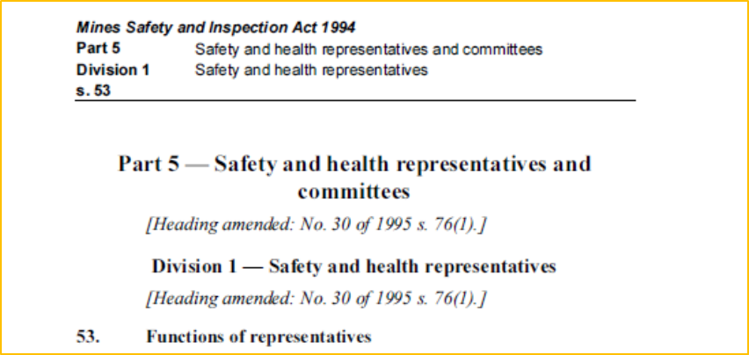
Inspect the workplace
Carry out appropriate investigations
Keep yourself informed and liaise with other bodies
Report hazards and potential hazards
Refer matters to the SH Committee you think appropriate
Consult and co-operate
Liaise with employer
Notes:
For Safety and Health Representatives a role prescribed in the Mines Safety and Inspection Act 1994 {Section 53(1)(b)} is to carry out appropriate investigations.
There is:
INFORMATION SHEET for safety and health representatives. Investigating incidents
[<www.dmirs.wa.gov.au>]
What is “appropriate”?
A suggestion – for every incident (i.e. not just those that are directly mental health related) play the evil’s Advocate and look at work demands.

Slide 78

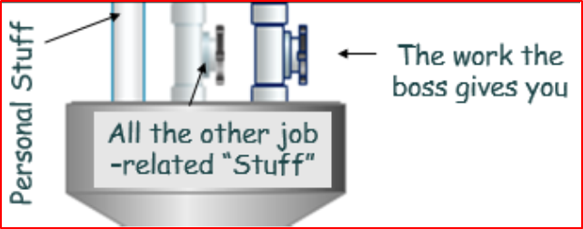
Was there pressure to get the job done?
Have there been recent changes in staffing, systems, equipment etc.?
How much other “stuff” did they have to deal with?
If they were to ask for more time, assistance, the right tools etc. what is likely to have happened?
Notes:
Was the job rushed, were shortcuts taken etc. because there was pressure to get the job done?
Was the workload excessive? This can be hard to determine. But if there were staff shortages (or replacement staff that are less experienced) or changes that add to the “stuff” you have to cope with AND the workload/expected performance has not changed, then that is good evidence that the workload was excessive
How much other “stuff” (e.g. paperwork, approvals, having to comply with lots of policies) do they have to do in order to get the work done?
It is all well and good to tell someone to “get help.” But if they ask, what is the likely reaction?
If you take away the immediate causes of the incident, what contributing or casual factors are still present?

Slide 79
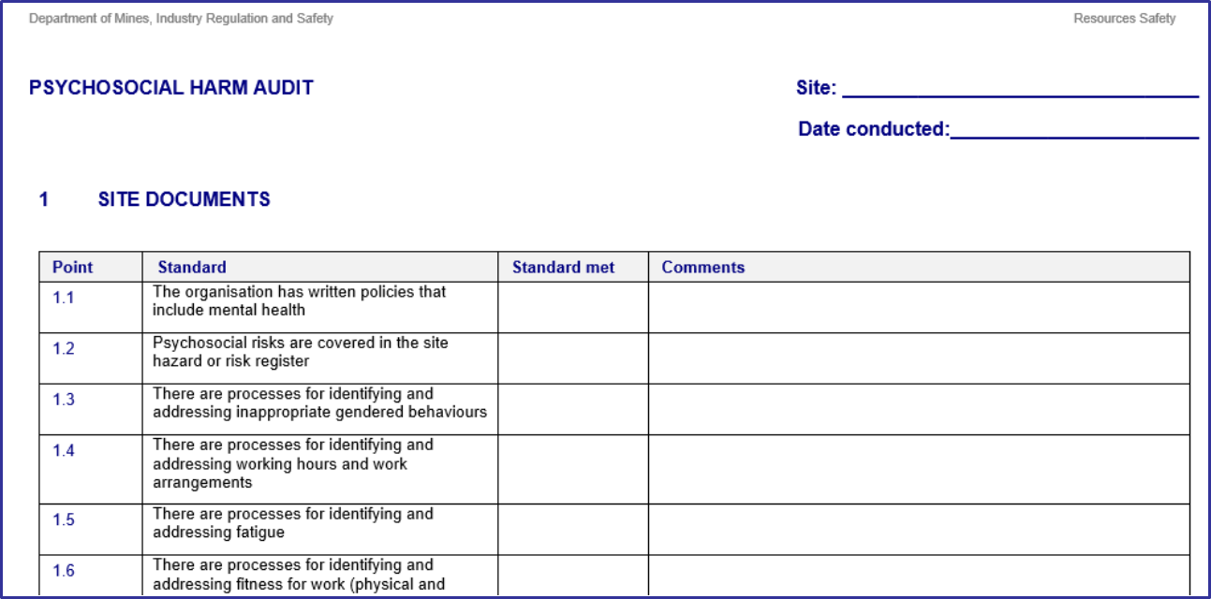
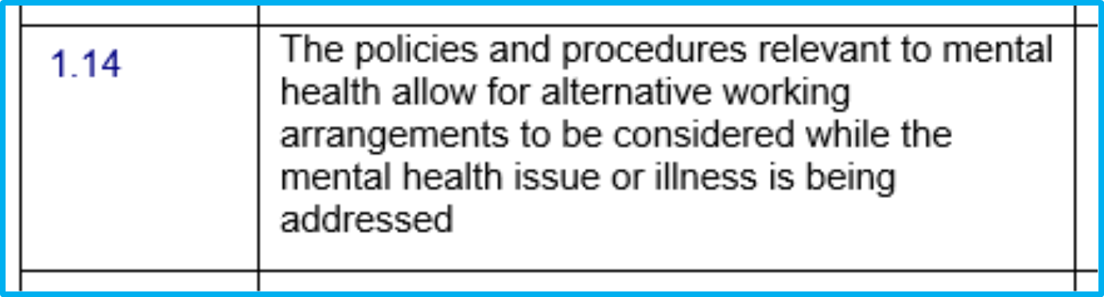
Was policy followed?
Notes:
DMIRS publish audit tools on our website.
These can be used to build a safety case (i.e. we need to do this)
OR
These can be used to support other arguments (e.g. if we claim we can manage the workload of staff with mental health issues, why cant we manage it for everyone else? . . . . . AND stop mental health issues from developing??)

Slide 80

Inspect the workplace
Carry out appropriate investigations
Keep yourself informed and liaise with other bodies
Report hazards and potential hazards
Refer matters to the SH Committee you think appropriate
Consult and co-operate
Liaise with employer
Notes:
It can be difficult to build a safety case on the basis of a single incident. A stronger case can be made if it can be shown that the same issues occur across the workgroup/mine site (e.g. poorly managed work load in a single incident compared to poorly managed workload reported by a large number employees/work groups).
This is where the Safety and Health Committee can play an important role.
53. Functions of representatives
(1) The functions of a safety and health representative are, in the interests of safety and health at the mine for which the representative was elected —
(e). where there is a safety and health committee for the mine, to refer to that committee any matters that the representative thinks the safety and health committee should consider
63. Functions of committees
(2) The functions of a safety and health committee are —
(c) to recommend to the manager, employers and employees at the mine the establishment, maintenance, and monitoring of programmes, measures and procedures at the mine relating to the safety and health of the employees

Slide 81
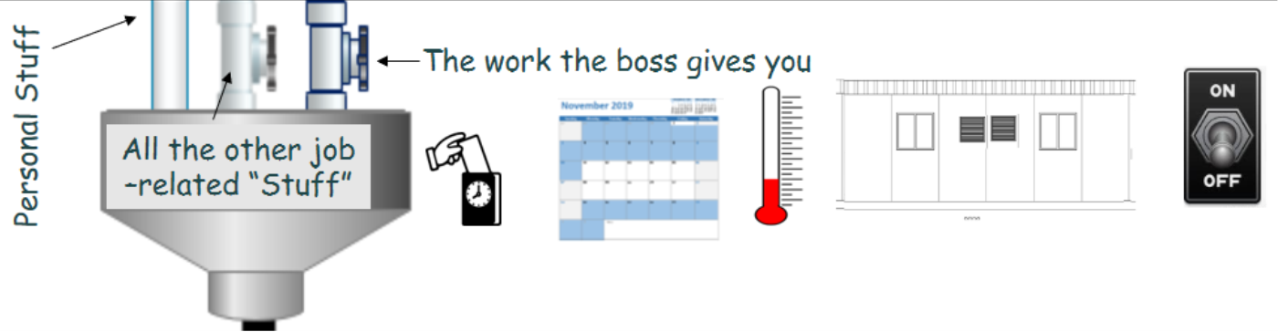
The necessity of all the other “stuff”
“Pressure Relief Valve Testing Procedure”
Satisfaction with accommodation and “camp life,” communication etc.
Notes:
Production/performance targets can be difficult to change.
But sometimes the other “stuff” that employees have to deal with/cope with are the things that add most to the work demands . . . . And they are things that often can be improved.
So asking staff what they find the most frustrating, annoying, difficult etc. can be useful. You may find some things that can be changed.
For FIFO workers, aspects of camp accommodation and camp life can significantly add to the other: ”Stuff” and these things may be able to be improved.
Good quality telephone and internet access are important.
Food quality important too.
Being able to play sport can be good. But the availability of recreational activities with a clear social element such as barbecues and more social sports are better.

Slide 82
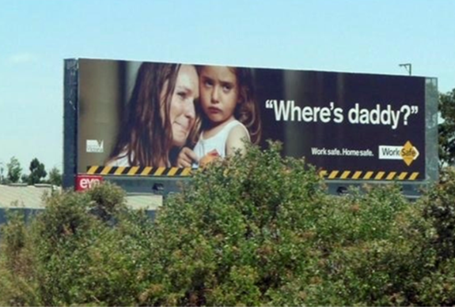
Notes:
Are telephone and internet access problems?
A common technique with safety promotion videos and posters is to get you to think of your family before you take that short cut, don’t follow the Safe Work Procedure etc.
But if communication with family is a problem on site, turn this message on its head.

Slide 83
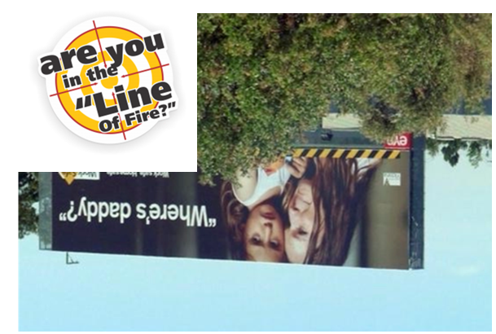
Notes:
If you have not provided adequate means of communication, not being able to stop thinking of family can increase the risk.

Slide 84
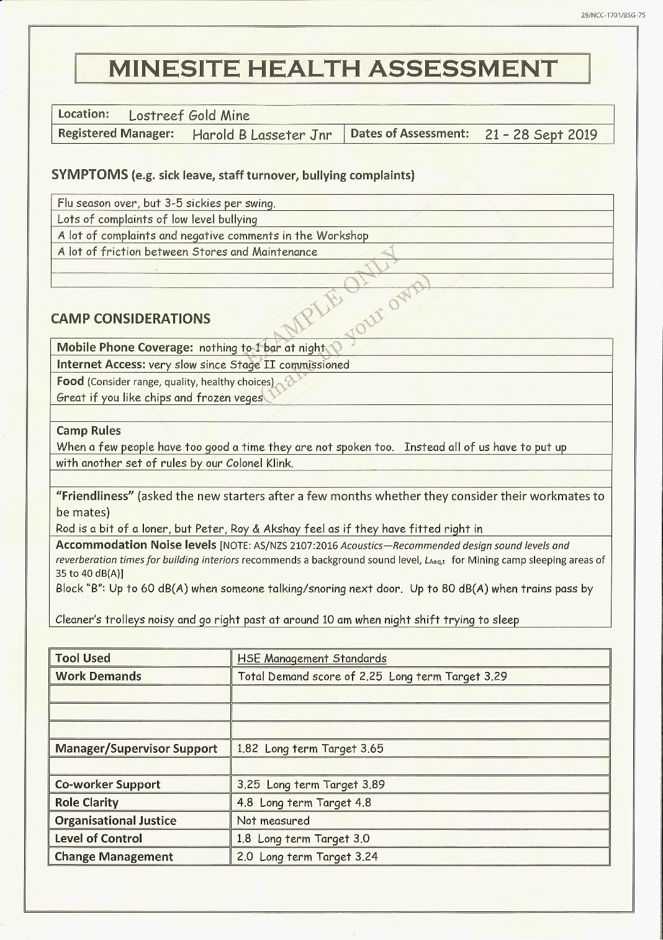
Notes:
There is a strong emphasis upon pre-employment medicals and fitness for work. Included in the “Human and Organisational Factors” (referred to in the video How workplace factors influence and incident) is Fitness for Work..
So if we are talking about mentally healthy workplaces, then an important roles of your Safety and Health Committee is to do some health assessments of the mine site.
Workers may feel uncomfortable speaking up as individuals. But they may be more willing so report what they feel/know as part of a survey.
Suggested questions/topics
Symptoms (e.g. sick leave, staff turnover, bullying complaints, friction between work groups, other things commonly complained about)
Mobile Phone Coverage
Internet Access
Food (e.g. range, quality, healthy choices)
Camp rules
Accommodation noise levels

Slide 85
AS/NZS ISO 31000:2009
Risk management ― Principles and guidelines
5.4.2: The organisation should apply risk identification tools and techniques that are suited to its objectives and capabilities, and to the risks faced
Notes:
Some employers take their OHS Risk Management Systems very, very seriously. Being able to show that their Risk Management System is compliant with the relevant system/audit framework can be seen as more important than making the workplace safe.
So looking at the Risk Management System requirements can be useful.
AS/NZS ISO 31000:2009 has superseded AS/NZS 4360: 2004 Risk management
Clause 5.4.2 AS/NZS ISO 31000:2009 requires risk identification tools to be suited to the risk faced. So to be compliant with the requirements of this standard, tools that are appropriate for identifying mental health related risks are required.

Slide 86
Supervisor Support
All the other job –related “Stuff”
Work Demands
Environment, Fatigue Isolation, Change, etc.
We have the tools and techniques to measure these
Role Clarity
Level of Control
Training, Skills
Experience
Co-worker Support
Organisational Justice
Work Demands
Time/production pressures
Recognition & Reward
Notes:
There has been a lot of work done in developing survey tools for measuring these things. We have the technology.
Many of these tools are free to use. So it is reasonably practicable to use them (i.e. too costly is not a good argument).
Employees may be unwilling to speak up during incident investigations. But they might be willing when completing anonymous surveys.

Slide 87
Note: it’s not rocket science!
Notes:
An example of a free tool, the Task Load Index developed by NASA in the USA. This tool has been in use for many years. It is still popular and now has been developed as a smartphone app.

Slide 88
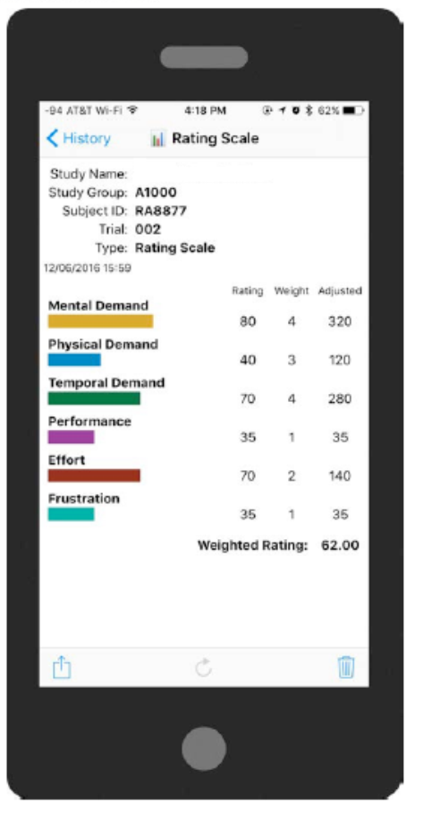
Notes:
What NASA’s Task Load Index (NASA-TLX) measures
Mental Demand - How mentally demanding was the task?
Physical Demand - How physically demanding was the task?
Temporal Demand - How hurried or rushed was the pace of the task?
Performance - How successful were you in accomplishing what you were asked to do?
Effort - How hard did you have to work to accomplish your level of performance?
Frustration - How insecure, discouraged, irritated, stressed, and annoyed were you?
So this tool might be appropriate to use when effort and frustration are a concern.

Slide 89
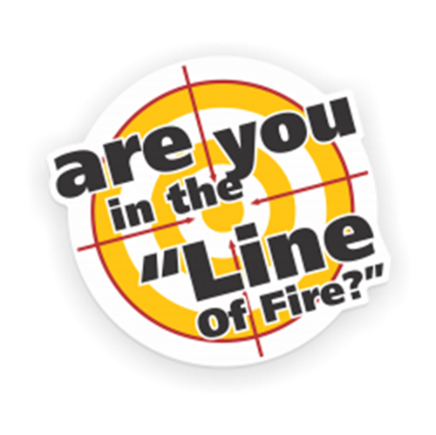
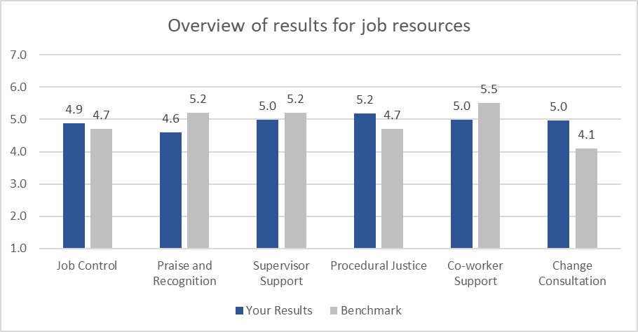
People at work (example results)
Level of Control
Organisational Justice
Recognition & Reward
Poor Organisational Change Management
Notes:
This is an example of the results from Queensland’s People at Work (PAW) tool.
This gives the survey results and give a comparison to what a workplace should be able to achieve (NOTE: PAW uses some slightly different labels.)

Slide 90
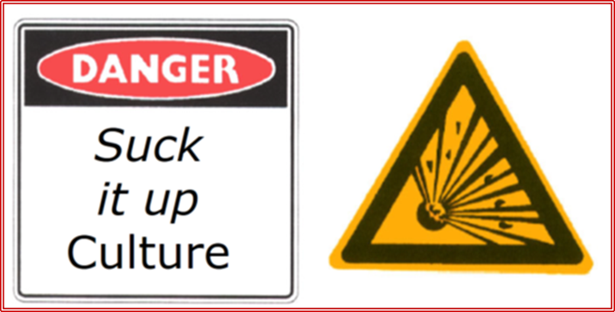
Harsher operating environments
More wear and tear
Further from (professional) breakdown service
Notes:
TO SUMMARISE
The Original Equipment Manufacturer operation and maintenance requirements revisited.
There are demands/pressures in our lives.
We generally cope most of the time. But we are all at risk of stress/mental issues if the pressures in our lives get too much for us to cope with.
Working away from home, friends, family etc. can make it harder to operated that “Pressure Relief Valve” to release that pressure.
Living in a remote are can also mean you a further from medical and other services.
Working on a mine site/living in a mining camp also add to the pressures.
There is also the stigma we all have to work at.

Slide 91
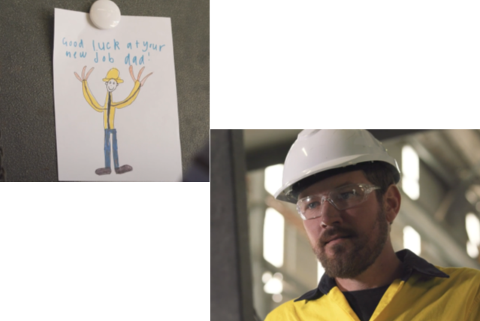
Notes:
There are some very useful resources available for those of us who develop more serious mental health issues.

Slide 92
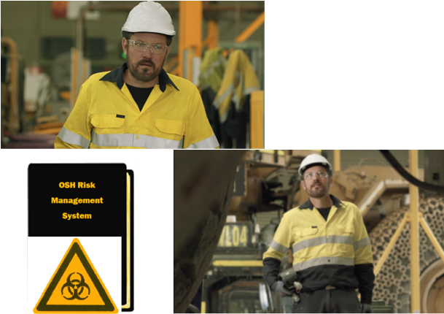
Notes:
Due to the reluctance to report mental health problems, they may be more widespread on site than we realise.
There is also the issue of mentally unhealthy workplaces. They can discourage people from speaking up, communicating, helping others. This can undermine the effectiveness of your OHS Management System.
In mining, less than 2% of Lots Time Injuries have “Exposure to Mental Stress” is recorded as the nature of injury.
But with how many other injuries do high work demands, low levels of controls, adequate support, poor role clarity etc. play a role?
An with how many “line of fire” related injuries does stress play a role?
So a stronger Safety Case might be made by focussing upon the more safety related implications of not managing workload, having poor role clarity, having non-supportive supervisors, co-workers etc.

Slide 93
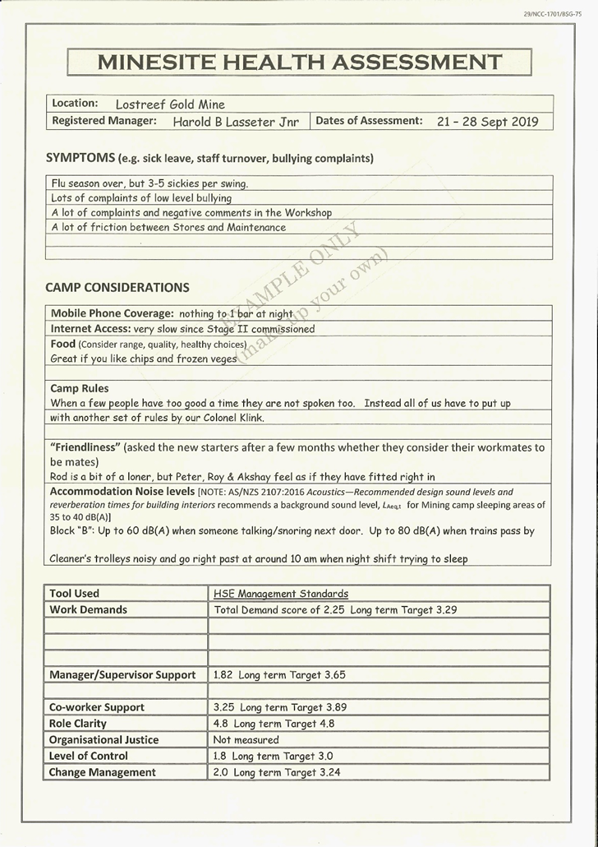

Notes:
A key role of Safety and Health Committees should be to conduct mine site health assessments.
DMIRS RESOURCES
www.dmirs.wa.gov.au ⇨ Resources Safety ⇨ search for your mental health at work
www.dmirs.wa.gov.au ⇨ Resources Safety ⇨ search for psychosocial harm
FREE ASSESSMENT TOOLS
Psychologically safe and healthy workplaces: risk management approach toolkit
www.dmirs.wa.gov.au ⇨ WorkSafe ⇨ search for toolkit
NASA Task Load Index
https://humansystems.arc.nasa.gov/groups/TLX/
People at Work
www.worksafe.qld.gov.au ⇨ search for people at work
Copenhagen Psychosocial Questionnaire (COPSOQ)
https://www.copsoq-network.org/

Slide 94



Follow us on social media and sign up for news alerts!
Twitter
@DMIRS_WA
@AndrewChaplyn
LinkedIn at Department of
Mines, Industry Regulation and Safety
Sign up to receive weekly news alerts @ www.dmirs.wa.gov.au
Notes:
Add slide about awards

