Slide 1
Please read this before using presentation
This presentation is based on the content presented at the 2019 Mines Safety Roadshow in October 2019.
Department of Mines, Industry Regulation and Safety (DMIRS) supports and encourages reuse of its information (including data), and endorses use of the Australian Governments Open Access and Licensing Framework (AusGOAL)
This material is licensed under Creative Commons Attribution 4.0 licence. We request that you observe and retain any copyright or related notices that may accompany this material as part of attribution. This is a requirement of Creative Commons Licences.
Please give attribution to Department of Mines, Industry Regulation and Safety, 2019.
For resources, information or clarification, please contact: SafetyComms@dmirs.wa.gov.au or visit www.dmirs.wa.gov.au/ResourcesSafety

Slide 2
2019 Mines Safety Roadshow

Slide 3
The power of identification

Slide 4
Way to harm
Hazard
Near Miss
Incident
Disaster
Proactive Zone
Reactive Zone
Harm
4
Notes:
This presentation explores what opportunities and foresight, within the proactive zone, to prevent the incidents from occurring.
This presentation also explains more about the hazard and its identification.

Slide 5
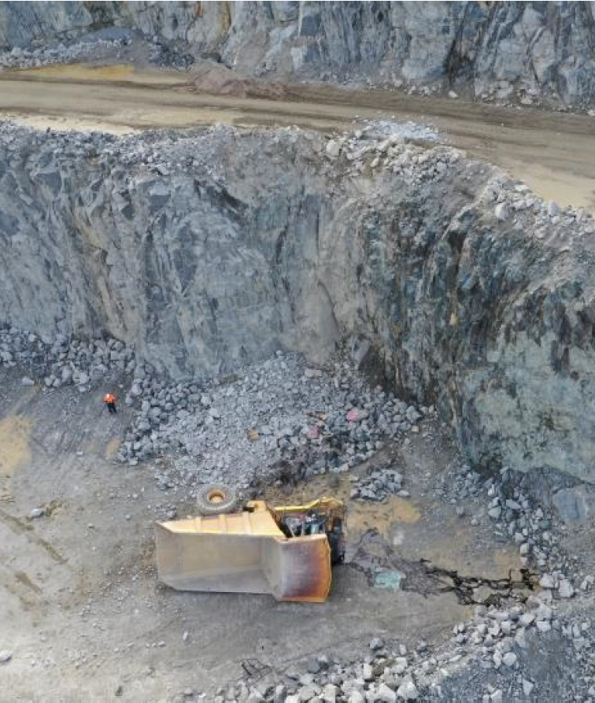
Why should we identify hazards and manage risks?
Reasons include -
Loss of life, injuries
Reputational damage
Business Impact
Legal action
5
Notes:
http://www.dmp.wa.gov.au/Documents/Safety/MSH_SIR_277.pdf
Why should we identify the hazards?
Because information is power.
Knowledge of a hazard, gives us an opportunity to do something about it.
There are many reasons to identify hazards and deal with them. These include – loss of life, reputational damage, law suits, share prices. They are all valid reasons.

Slide 6
When hazards are not managed…
6
Notes:
Source: https://www.youtube.com/watch?v=sKZUZQytads
You may have seen and heard about this event in the media. This is about the tailings dam failure in Brazil.
The risk management tools available to workers including a Job hazard analysis and take 5s are not going to work in a scenario like this.
Most workers that were killed in this incident had no ‘ability to see this hazard’ and respond in time.
Contributing factors for this incident may or may not become available, however one thing is clear that multiple layers of safe guards including surveillance arrangements, are needed and they need to be effectively designed.
And not all the hazards can be seen!

Slide 7
Identify the hazards?
7
Notes:
Can we identify the hazards and issues here in this image? Reference – politicalfact.com
Did you point out…
Wildlife?
Design, layout?
Competency?
Power lines?
PPE?
Often hazards and issues, at work place can include those we are familiar with and those that may surprise us!

Slide 8
Who can identify hazards?
8
Notes:
Who can identify hazards?
Do we have primitive ability to identify dangers and hazards?
Some of us may be keen senses very good at sensing our 5 senses but relying on our five senses means we are relatively close to hazards and may not be able to get out of the way of harm quickly enough.
How do we keep distance from hazard?
Is the distance from hazard is the only factor to ensure safety?
What about time and early intervention?
If the safe systems of work are not effective and jobs are not well planned, then our workers may have to carry out majority of the risk management right before the job, with time pressures, and what they can see at that very moment. Remember, not all hazards can be seen. And not everything can be organised (eg. Resources, tooling) at the last minute. These factors can also lead to human performance issues and errors.

Slide 9
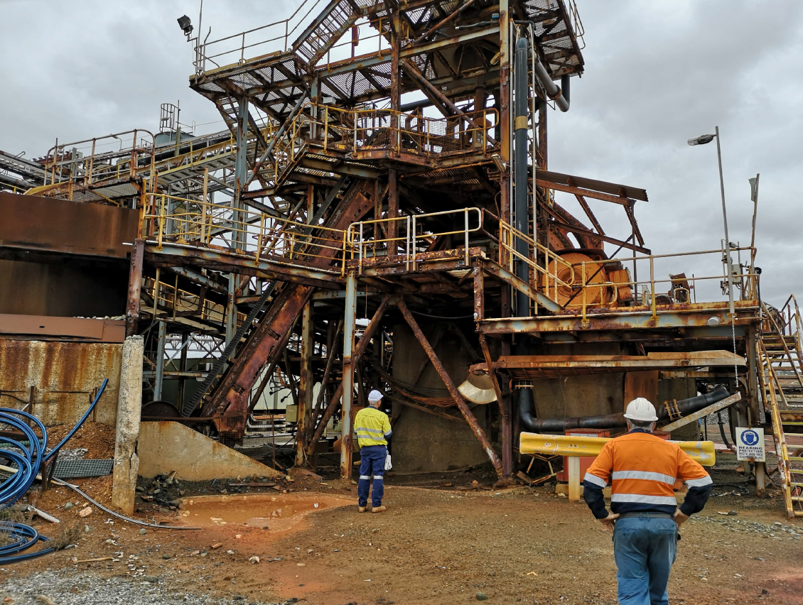
How can hazards be identified?
Senses –
eyes
ears
smell
taste
touch
9
Notes:
In this example, we can see condition of one of the plants in Western Australia, which was subject to regulatory intervention last year due to unsafe plant and workplace.
The mine operator was about to send workers here to carry out refurbishment.
How do you think those workers would manage risk? Some hazards here can be visualised and some may not be visible.
How did the plant get there, in this condition in the first place? How many people walked past it?
How old do you think this place is? What can accelerate this aging?
What's next stage for this plant?

Slide 10
Can all hazards be identified?
WA incident
13 metre
deep sinkhole in working pit
A floor subsided into a backfilled stope
Unlikely to be sensed using 5 senses on the day
www.dmp.wa.gov.au/Documents/Safety/MSH_SIR_272.pdf
10
Notes:
http://www.dmp.wa.gov.au/Documents/Safety/MSH_SIR_272.pdf
Some hazards may not be visible.
The subsidence event resulted in the loss of an integrated tool carrier and an explosives truck that were parked on the blast pattern. A number of charged blast holes were also engulfed in
the sinkhole.
The vehicles were also present in the area unoccupied at the time of collapse; however, up to 4 persons were working in close proximity.

Slide 11
Can planning help?
Queensland – Townsville Floods 2019 – Death toll 4
11
Notes:
Townsville Floods 2019 - https://www.theguardian.com/australia-news/2019/feb/05/townsville-floods-dam-management-under-scrutiny-as-experts-demand-greater-preparation#img-1
Some hazards may not be preventable, but their impact can be reduced with planning and preparation.
Coordinated efforts by authorities, helped evacuate people in time, saving lives.

Slide 12
Do we need multiple safeguards?
The Swiss Cheese model
12
Notes:
https://www.cos-mag.com/safety-leadership-culture/columns/time-to-look-beyond-swiss-cheese/
What is a Swiss cheese?
How many of these barriers are dependent on us sensing and picking the hazard and issues on the day.
What about protection from the hazards not visible or the unknown ones?
How many of these barriers have been put in place based on rigorous planning and preparedness?
Who prepares these barriers? How are these barriers chosen…? Have they been validated?

Slide 13
Solving the problem
13
Notes:
What is a PDCA cycle? How is it relevant to dealing with hazards?
Image shows a bit more realistic balance of the Plan, Do, Check, Act.
Traditionally, a lot of focus is always on execution and very little focus on planning. If we were take the example of the function of maintenance planning function and its output, it is more often resourced for logistics and accounting then the risk management. The risk management is predominantly left with the execution personnel. This is reinforced by the fact that most maintenance plans do not to triage high risk works and often resource allocation is also left to the execution team to sort out on the day. Considering this function processes a significant volume of high risk work at the mine, appropriate resourcing and surveillance of this function is crucial in risk management, at front end of the work.
In large shutdowns and construction project, the planning function is often slightly better resourced but the focus is often on managing the critical path then the high risk works. There is still a significant amount of unbalance between the tail end risk management prior to the task and the front end risk management.
Planning and risk management is an integrated function, if organisation is carrying these functions separately, introduces human and organisations factors into the equation.
A self evaluation of resources gap between planning and execution will give you indication of the potential issue at your work place.
An under resources planning function will be expensive, unsafe and unreliable.
There is no golden rule or magic balance, however its not difficult to work out, if one is focusing in this area.

Slide 14
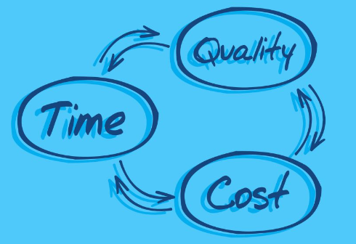
Key elements – Cost, quality, time
14
Notes:
http://www.smorad.com/project-management-triangle/project-management-triangle-time-cost-quality-miketoon-studio-tips/
http://www.smorad.com/project-management-triangle/the-triple-constraint-in-project-management-time-scope-cost/
In any undertaking, the balance of time, quality and resources will be at play.
A rushed work is likely to be poor quality, expensive and probably require to be redone.
An under resourced planning function in the organisation, like trying to do a work fast and cheap, and is likely to impact safety and quality associated with the work.
The hazards and issues that could be foreseen and managed will be left to be handled by the execution crew at the tail end and as we know, not everything can be resolved at last minute, placing people in challenging and stressful position.

Slide 15
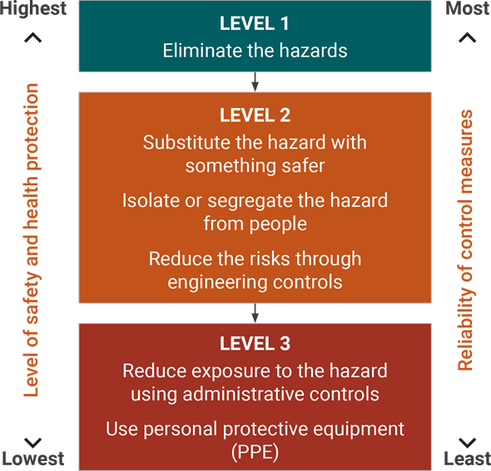
Hierarchy of control
More Effective
More Reliable
Less Effective
Less Reliable
More supervision and surveillance
Closer to harm
Harm
15
Notes:
Hierarchy of risk control is a powerful tool, and relevant for use at any stage and level of the business.
For Safety and Health representatives (Shreps), they have functions that include incident investigation and consultation in relation to workplace changes.
SHReps are encourage to ask questions and enquire about the controls proposed in any incident investigation or workplace changes and see if there is an opportunity to move up the hierarchy.
Effectiveness and cost of the controls should be assessed for the life cycle of a mine.
An administrative control, over the life cycle of a mine may require more efforts, surveillance and manpower to sustain and still will be less effective and less reliable then an higher level of control.

Slide 16
Life cycle of a mine
Where is your operation in this journey?
16
Notes:
https://www.decipher.com.au/environment/ ….. https://bathurst.co.nz/our-commitment/supporting-our-environment/rehabilitation/
Mankind has been mining for thousands of years. The fundamentals of mining haven’t changed, but we have learn to become more productive and efficient, thanks to technology.
If we look at the image here and think about our workplaces, we should be able to understand where we are in the life cycle, between exploration and mine closure.
This image tells us a story…a story of work that is likely to happen.. The finer details of challenges, problems, issues are likely vary from place to place, but there is a lot of things we can anticipate with this foresight and information.
What can we do with this information?
If we are about to start the journey, we may wish to look at the hazard registers, combine it with our experience using means of consultation and start preparing to deal with the issues.
If we have already stated the journey, we may have actual information from that work place that could be added to above efforts to keep refining it.
Develop hazard registers for every stage of a mine life cycle through a consultation process involving workers, staff and even community where it affects them.
Use hazard register on DMIRS website as a baseline and enrich. http://www.dmp.wa.gov.au/Documents/Safety/MSH_G_HazardRegisterUserGuide.pdf
Develop management plans and standardise risk controls.
Regularly review it after every significant incident, major changes to operations, release of a safety bulletin or significant incident report.
For eg, a mine site started a second pit and within the same week, there were two incidents of tyre explosion (within 24 hours). Investigation identified that in both the cases tyres were in good condition and failure was due to the rock damage to the side wall. Failure resulted in release of significant stored energy, causing the small rocks to be launched at excavator, damaging windscreen in both the events. Operators were unharmed.
When the new pit was started, the site had adequate trucks and loading units to operate both the pits but only had one rubber tyre dozer to clean up. Because of distance between the two pits, the rubber tyre dozer could not maintain both the loading area.
This example shows that business was aware of the pit development stages for years, however, yet failed to apply good risk management. Business later purchased another rubber tyre dozer, however had to wait for delivery for 9-12 months due to long lead time and remote location of the mine, meant there were no rental options available.
Most of the businesses have a very good understanding of commitment to share holders, supply and demand in the market, their production targets and the operational plans required to deliver them. However when the risk management and planning are not fully integrated, business and people could be exposed to risks.

Slide 17
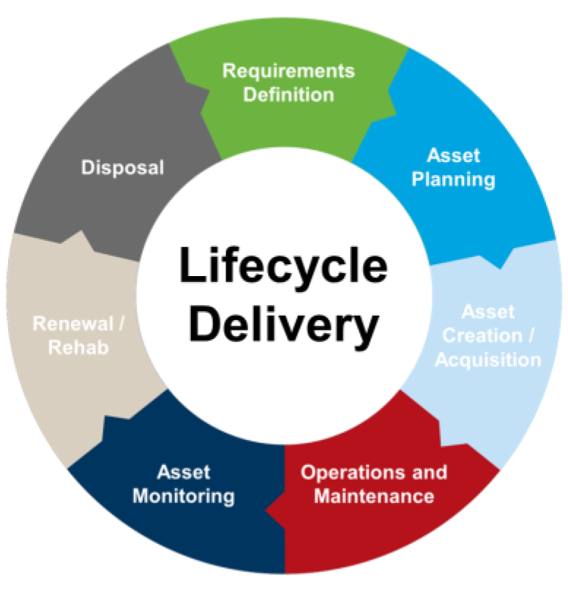
Life cycle management of an asset
17
Notes:
https://guelph.ca/wp-content/uploads/Corporate-Asset-Management-Plan-2017-Interim-Update.pdf
https://guelph.ca/plans-and-strategies/corporate-strategic-plan/asset-management-program/#!tab3
Just like the mine, an asset goes through a foreseeable life cycle through.
In this instance we can combine the hazards identification works with the information provided by the OEM, Australian Standards and our own experience.
Key point is that we should treat hazard identification and risk management as integral part of the work plan.
Most reputed OEM in this competitive world provide us with lot of information on how to safely use the asset.
Use OEM recommended life cycle management plans as a base line and improve, as required.
Identify the work that requires to be done; you may choose to look as far as you wish to look ahead.
This may range from rolling four week work schedule to a rolling annual work schedule to a whole of the mine life work schedule.
Identify the hazards using resources including Hazard registers, OEM manuals, Australian Standards, code of practices and industry standards.
Identify risk controls, key hold points and critical works.
This high level of planning and hazard and risk management, can form the basis for execution level risk management.
Identify resources required including funds, equipment, man power, tooling.
Managing assets can be high volume work and a typical mine site may have thousands of large and small plants.
Planning way ahead will give you time and opportunity to make better decisions.

Slide 18
Life cycle management of an asset
18
Notes:
Closer look at the lifecycle delivery wheel

Slide 19
Learnings
Understand life cycle of mine and assets
Foresee key work activities
Identify hazards – Hazard registers, broad brush risk assessments, management plans
Manage risk – critical actions, critical hold points, critical resources
Review and revise – formalise it, plan for it
19

Slide 20
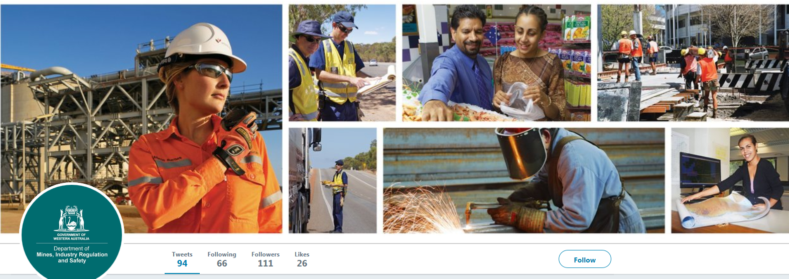
Follow us on social media and sign up for news alerts!
Twitter
@DMIRS_WA
@AndrewChaplyn
LinkedIn at Department of
Mines, Industry Regulation and Safety
Sign up to receive weekly news alerts @ www.dmirs.wa.gov.au
Notes:
Add slide about awards

