Slide 1
Please read this before using presentation
This presentation is based on the content presented at the 2018 Mines Safety Roadshow in October 2018.
Department of Mines, Industry Regulation and Safety (DMIRS) supports and encourages reuse of its information (including data), and endorses use of the Australian Governments Open Access and Licensing Framework (AusGOAL)
This material is licensed under Creative Commons Attribution 4.0 licence. We request that you observe and retain any copyright or related notices that may accompany this material as part of attribution. This is a requirement of Creative Commons Licences.
Please give attribution to Department of Mines, Industry Regulation and Safety, 2018.
For resources, information or clarification, please contact: SafetyComms@dmirs.wa.gov.au or visit www.dmirs.wa.gov.au/ResourcesSafety

Slide 2
2018 Mines Safety Roadshow

Slide 3
Safety and health representatives: a supervisor’s perspective

Slide 4
SHRep – Engagement
84% of Australian employees are NOT engaged at work
We must raise the bar on employee engagement
Increasing workplace engagement is vital to achieving sustainable growth for companies
Strengthen your culture and take action together.
Gallup Report:
www.solterbeck.com/news/3549
Notes:
Gallup Report:
www.solterbeck.com/news/3549
According to Gallup's 142 country study on the State of the Global Workplace, the bulk of Australian employees -- 60% -- are "not engaged", meaning they lack motivation and are less likely to invest discretionary effort in organisational goals or outcomes. And 16% are "actively disengaged", indicating they are unhappy and unproductive at work and liable to spread negativity to co-workers. Only 24% are “engaged”.
Gallup reported “Business leaders worldwide must raise the bar on employee engagement. Increasing workplace engagement is vital to achieving sustainable growth for companies, communities, and countries --- and for putting the global economy back on track to a more prosperous and peaceful future”. Recognition and reward continues to be a vital business strategy to improve business outcomes.
www.theemployeeapp.com/gallup-2017-employee-engagement-report-results-nothing-changed

Slide 5
SHReps overview for WA mines (Combined Operations)
Notes:
As per data from April 2018, gives an insight into how many Western Australian operations (mines) with active safety and health representatives (SHReps).
Cultivating the SHRep role for future generations – edification of the role was an obvious need. Sites were experiencing difficulty in getting new nominees, getting those elected to perform their function and getting interest from the next generation of mine workers.

Slide 6
SHReps overview for WA exploration companies
Notes:
As per data from April 2018, gives an insight into how many Western Australian exploration companies have active SHRep.
Discuss the opportunity for exploration companies to engage in having further SHReps.

Slide 7
Supervisor focus
The actions and behaviours of supervisors will influence the safety and health of workers, as well as the working environment.

Slide 8
Why is supervision important?
Supervision is a fundamental safety function applicable within all levels of an organisation.
It complements the provision of information, instruction and training, and influences how well organisations achieve the safety and health objectives of the Mines Safety and Inspection Act 1994.
Notes:
Discuss how your company provides information, instruction and training, and influences how well organisations achieve the safety and health objectives?
SHReps are the key to good communication in the mine by making it easier to exchange ideas and concerns about safety between employers and employees.

Slide 9
Effective supervisor
Provide relevant up-to-date information and instructions
Monitor workgroup activities
Not permit unauthorised deviation from site procedures, whether by act or omission
Manage fitness for work
Identify and rectify hazards
Identify and address at-risk and inappropriate behaviour
Report incidents, including near misses, and injuries
Report potentially hazardous situations to management so the adequacy of control measures can be assessed and addressed as necessary.
Notes:
Effective safety and health supervision in Western Australian mining operations.

Slide 10
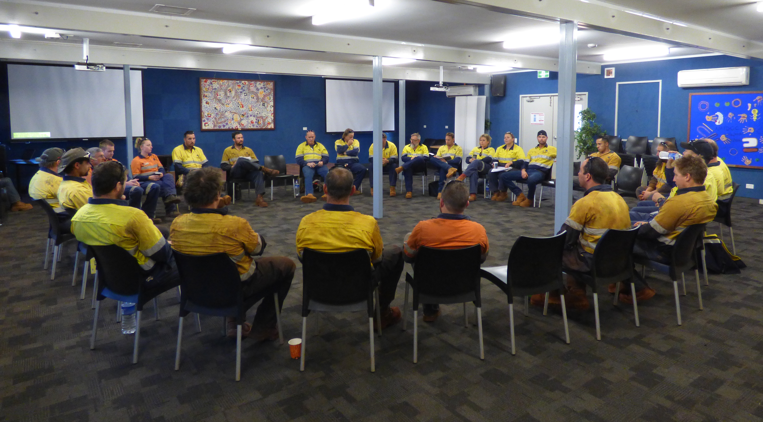
Supervisor focus
Having insufficient or inexperienced supervisors can lead to situations that increases safety and health risks to workers.

Slide 11
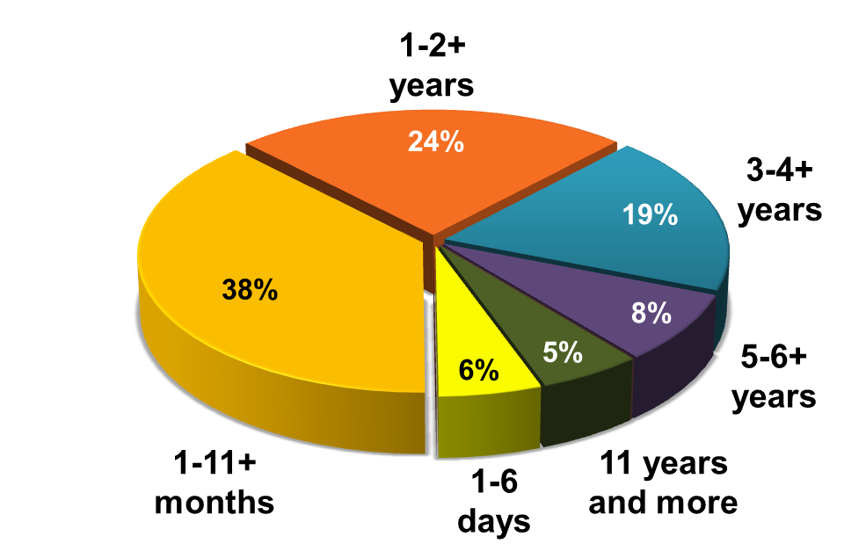
Supervisory experience and fatalities
44% of fatalities occurred under supervision of supervisors who had been in role for less than one year
Notes:
Source: http://www.dmp.wa.gov.au/Documents/Safety/MSH_R_FatalAccidents200012.pdf

Slide 12
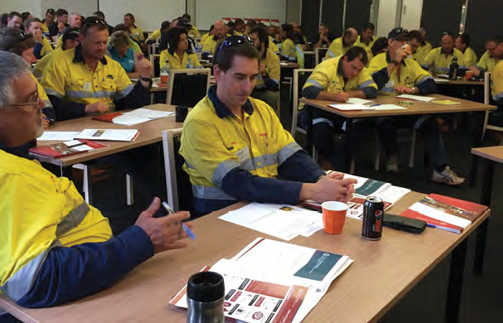
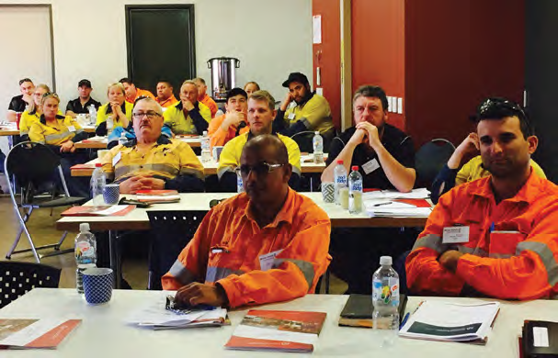
Importance of safety and health representatives
A safety and health representative is the key to communication by making it easier to exchange ideas and concerns about safety between employers and employees.
Notes:
Benefit to stakeholders – SHReps are a significant investment for employers in training, time and associated costs.
Elected SHReps are critical in managing safety in the mine. Once trained in their role they have a unique opportunity to assist management with safety and in mitigating hazards on site as they understand the legislation as well as site processes, practices and hazards.
SHReps are the key to good communication in the mine by making it easier to exchange ideas and concerns about safety between employers and employees. SHReps raise and discuss safety issues and concerns with employers so they can work together and arrive at solutions to make the mine safer.

Slide 13
Focus
Safety and health representatives are not safety and health officers or coordinators and they are not responsible for solving safety and health problems in the workplace.
That’s still up to the employer.
But the safety and health representative is an important link between employers and employees.
Notes:
The Mines Safety and Inspection Act 1994 encourages employers and employees to talk to each other about safety matters, particularly through SHReps.
SHReps raise and discuss safety issues and concerns with employers so they can work together and arrive at solutions to make the mine safer. The Mines Safety and Inspection Act 1994 (MSIA) encourages employers and employees to talk to each other about safety matters, particularly through SHReps.

Slide 14
What are our expectations from the audits?
Once trained, a SHRep is an asset empowered to assist management with mitigating hazards as they are aware of legislation and compliance, as well as site processes, practices and hazards.
SHRep audit:
Promotes best practice and consistent SHRep operating standards across the mining industry
Seeks to re-invigorate SHRep role
Improves engagement with inspectors
Improves communication between employers and employees
Measures compliance with legislation.
Notes:
The scope of this audit is designed to include operating standards associated with the election, training, role, functions and duties of safety and health representatives at mining operations.
The audit was also developed to highlight for employers what functions a SHREP can and should perform to contribute to a positive safety culture on a mine site. Safety is much about awareness and being able to identify and address system failures that can only be raised by the employees tasked to keep a site productive. A SHRep is a conduit for information flow between management and workers.
Best practice principles – the full development of a SHRep provides the employer with an asset who is empowered to deal with workplace hazards, implement the appropriate controls and mitigate risk at the workplace.

Slide 15
Background on the audit
Based on legislative framework
17 audits have been conducted
Audits were conducted across industry
Positive feedback from management and SHReps
Audit takes one day to complete when the site has prepared relevant documentation
SHRep role and contribution to safety varies site to site.
Notes:
Audits throughout industry as a compliance measurement tool to assist management in achieving compliance with legislation. There was nothing in the DMIRS system available to measure compliance with the MSIA and Mine Safety and Inspection Regulation.
The SHRep role, acceptance by management and contribution to safety varies from site to site. The audit has assisted to reinforce that elected SHReps are critical in managing safety in the mine. Once trained in their role they have a unique opportunity to assist management with safety and in mitigating hazards on site as they understand the legislation as well as site processes, practices and hazards.

Slide 16
How is the audit structured?
Table of contents |  | Criteria
1. | Election of safety and health representatives | 3
2. | Training | 3
3. | Role of the safety and health representative | 2
4. | Site function of the safety and health representative | 3
5. | Employers duties to safety and health representatives | 7
6. | Discrimination against safety and health representatives in the performance of their functions | 2
7. | Safety and health resolution | 1
 |  | Total: 21

Slide 17
Audit – Level of compliance / Non-compliance
Notes:
The audit was also developed to highlight for employers what functions a SHRep can and should perform to contribute to a positive safety culture on a mine site.
Discuss level of compliance and non-compliance in the above chart and what are the gaps you are seeing in your site or company?

Slide 18
1) Election of safety and health representatives
Non-compliances relates to:
Sites having no policy or procedures in place related to SHRep election processes
Poor site notification to employees and to DMIRS
Recommendations:
Approve and implement policies and procedures related to SHReps
Ensure prompt notification of election results to workers and to the Department
Notes:
Leadership in the workplace by an elected safety and health representative by introducing and driving a new approach or program to improve the safety, health and wellbeing of the workforce (e.g. training program, safety culture initiative, fitness for work program, mental health and wellness program and accident investigation method).
When workers formally request a SHRep be elected, the employer has systems, policies and procedures in place to accommodate such nominations by an acknowledged election process.
A suitable election process where required has been established to meet the sites needs through a process of consultation by all parties.
There was prompt notification by the employer of the election results to the site’s workers, the State mining engineer and those successfully elected to the position.

Slide 19
New – SRS online functionality for SHReps
Sites enter SHRep election details, advise areas of responsibility and track election terms
SHReps can nominate their preferred contact details
Details can be updated online in SRS
Automatic provision of supporting information to newly appointed SHReps
Training details can be updated in SRS when introductory or refresher training has been completed
Reminders will be sent via SRS to prompt when election terms are coming to a close.
Notes:
Under mines safety legislation, industry is required to notify the Department of the election of SHReps. Notifications of these elections are now made using the Safety Regulation System (SRS). This has removed the need for hard copy notifications to be sent or emailed to the Department.
This new functionality enables industry to:
notify the Department of election notifications online, and 24/7, using SRS
manage and update multiple election notifications for their site
update SHRep details as they change
update training details in SRS when introductory or refresher training has been provided.
Other benefits include:
SHReps being able to nominate their preferred contact details
automatic provision of supporting information to newly appointed SHReps
reminders sent via SRS to prompt sites that election terms are coming to a close
SHReps will receive notification of any proactive and announced inspections or audits by the Department
SHReps will have the ability to view site visit records, audits and notices after the site visit.

Slide 20
New – SHRep access to SRS
SHReps that have their notification of election entered in SRS have access to the SRS ‘Compliance’ module, which comprises of audits, inspections and notices
SHReps can receive notification of any proactive and announced inspections or audits
SHReps can view site visit records, audits and notices after the site visit.

Slide 21
Qlik SHReps report
SHReps report has gone live now, available at https://qbi.dmp.wa.gov.au/qbi/sense/app/87bbedd8-df20-44d5-8f62-6f94bd85ce24
Notes:
This data is extracted from the Safety Regulation System
Who can I contact?
SRS Manager Department of Mines, Industry Regulation and Safety Email: SRSManager@dmirs.wa.gov.au Phone: (08) 9358 8001

Slide 22
2) SHRep training
Non-compliance relates to:
Refresher training not being provided to re-nominated SHReps
Recommendations:
Newly appointed SHReps have training, fully aware of their roles and functions in a timely manner
For re-elected SHReps, training is provided to update their knowledge of current legislation.
SHReps are provided with the skills and knowledge to carry out the functions of a SHRep without financial penalty.

Slide 23
3) Role of the SHRep
Non-compliance relates to:
No site committee meetings
Gaps in representation
Shift absence
Recommendations:
Develop dedicated SHRep Committee Meetings
Include contractors in the SHRep Committee Meetings
Policy/procedure development
Monitoring/development program
Notes:
SHReps are able to consult with workers and the employer to promote a positive safety culture at the mine.
SHReps are able to participate in the site safety and health committee meeting to assist with safety across the entire site.
Notes - No site committee meetings – meetings were operational and not dedicated to safety. Some Safety committee meetings appeared to be driven and controlled by management and SHReps did not have the opportunity to discuss issues or contribute to the agenda.
Gaps in representation – representation was ad hoc, not evenly distributed over the site and in some cases the SHRep was the supervisor.
Work areas had no SHRep to attend the site meetings or conduct toolbox safety meetings.
Contractors and office staff not represented.
Shift absence – This is an issue that affects the elected SHReps ability to attend meetings, fulfil functions, represent some work areas, participating in investigations and the capacity to complete certain SHRep tasks.

Slide 24
4) Site functions
Non-compliance relates to:
SHReps not given opportunities to conduct workplace inspections
Involvement in investigations
Hazard identification
Consultation with management
Recommendations:
Meet the intent of the legislation
Involving SHReps in safety related projects, procedure development / reviews and consultation on change management issues
Notes:
SHReps are able to carry out their role and functions on site.
The set up and composition of the site’s safety and health committee reflects work groups within the organisation and meets the intent of the legislation.
The safety and health committee reviews, recommends and assists the site employer to improve site practices, policies and procedures to reduce injury and disease, control hazards and promoting a positive safety culture. vs SHReps at committee meetings.
The bigger picture items are those involved in committee work, procedural review and embracing corporate safety strategies.
Notes - SHReps not being involved in safety related projects, procedure development/reviews or consulted on change management issues.
No involvement in safety initiatives.
Shift workers not able perform functions or attend committee meetings.
Not being given the opportunities to conduct work place inspections, involvement in investigations, hazard ID, consultation with management.
Not performing the prescribed functions required by s. 53 of MSIA.

Slide 25
5) Employers duties to SHReps
Non-compliance relates to:
Information related to hazards not provided
Lack of consultation with SHReps
Inspection of work areas and being escorted in other work areas during an inspection
No support facilities provided
No time allocated to perform SHRep functions (including attendance at meetings).
Notes:
Inspector engagement – Regulatory contact is beneficial to the SHRep but also to DMIRS inspectors. It provides a point of contact for the SHRep for legislation clarification, where to look for research matters, mentoring, advice and guidance. The inspector benefits by getting their message to those that are risk takers, that can drive safety culture and share that with their co-workers.

Slide 26
5) Employers duties to SHReps
Recommendations:
Information relating to hazards at mine is made available to SHReps
Provide reasonable assistance and facilities to allow SHReps to perform their duties
Inform SHReps of accidents, incidents and dangerous occurrences
SHReps assist with incident investigations
SHReps are consulted on mine changes
Allow SHReps to accompany mines inspectors
Develop and mentor SHReps performing site inspections
Upon a worker request, a SHRep is made available during a safety and health related interview with management.
Notes:
Re-invigorate the role of being a Safety and Health Representative – some sites are discovering the benefits of training and further development of their site SHReps.

Slide 27
6) Discrimination
Non-compliance relates to:
SHReps being treated poorly
Site leadership not supporting SHReps to perform their role and functions and at times treating a SHRep differently by allocating menial tasks
Recommendations:
Workers are not discriminated against or disadvantaged by raising a safety or health issue with the site SHRep, committee or a mines inspector
Ensure SHReps are not disadvantaged due to past or present work functions performed as a SHRep.
Notes:
To verify no discrimination against workers or prospective workers where they may have made a safety and health complaint or provided assistance or information to a mines inspector, a SHRep or the site safety and health committee. This includes contract workers and temporary workers utilised for shut down maintenance work.
Unlawful discrimination is when a person is treated less favourably than another person in the same or similar circumstances. This can include taking workers off their normal operating machine, not allowing workers to perform their normal tasks, demotion, failure to obtain a job when applied for, and being asked to achieve unreasonable tasks set in the mine.
To verify SHReps can perform the functions of a SHRep on safety and health matters and not have adverse effects to his or her employment position, pay, potential promotions they may have been eligible for or
re-employment elsewhere.
To verify contractors are provided the same level of protection as prescribed for employees.

Slide 28
7) Safety and health resolution
Non-compliance relates to:
No formal resolution procedures in place
Recommendation:
There is an agreed procedure to resolve any conflicting safety and health issues with the employer or manager of the mine.

Slide 29
Some best practices identified
Development program:
Working towards OSH qualifications
Investigation training
Career path to supervision or safety advisors
SHReps being allocated tasks relating to safety to assist the supervisor and as a result gaining acceptance and feeling more fulfilled in the role
SHRep hub – a central area where resources and facilities are made available for the site SHReps
Development of a SHRep manual.
Notes:
Some companies value add by providing additional training to SHReps to enable them to be more effective in their role. The training and experience in the SHRep role has enhanced their career opportunities which has been viewed in a positive way by SHReps.
SHReps being allocated tasks relating to safety to assist the supervisor and as a result gaining acceptance and feeling more fulfilled in the role.
Working with supervisors, reducing supervisors workload by taking on safety-related tasks.
Attending to hazard card reporting, investigating workplace near misses and conducting workplace inspections are some of the simple functions they can perform.
They are grooming their SHReps with Cert IV in Work Health and Safety (OSH) and Supervisory training, looking to take advantage of them in potential future site leadership roles. Fulfilment of performing the SHRep site functions – the functions can alleviate some of the pressures placed on the supervisors.

Slide 30
Workshop
How can supervisors help to improve safety and health in the workplace?
What could be improved or changed at your workplace so safety and health representatives can be more effective and engaged at your operation?
Is there anything the Department can assist you or your safety and health representatives with in the improvement of safety? (e.g. tools, information, guideline, poster)
Can you outline an example of a safety and health innovation by your elected safety and health representative?
Notes:
Discuss in groups or individual the three questions!
Question three (3), The Department of Mines, Industry Regulation and Safety (DMIRS) has nominations for the Resources Sector Awards for Excellence (see slide 31)

Slide 31
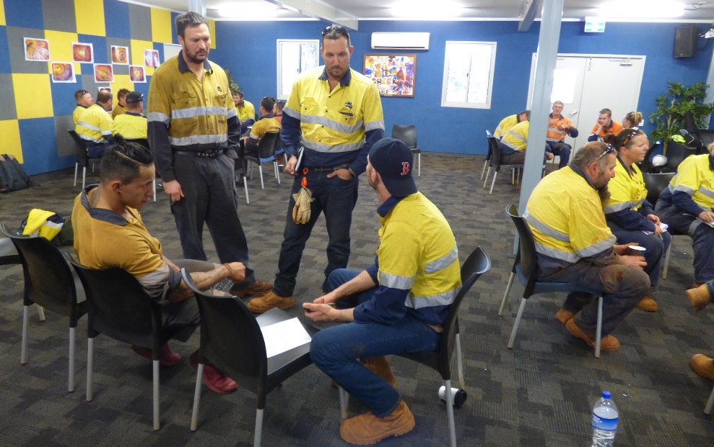
Recommendations
Conduct the SHReps audit at your sites, as it has added value to sites where the audit has been conducted.
Encourage those sites without SHReps to have elected SHReps to assist them in managing safety.
Notes:
Available on the Department of Mines, Industry Regulation and Safety website - Safety and health representatives audit – guide and template

Slide 32
Effective safety and health supervision guideline
Effective safety and health supervision in Western Australian mining operations - guideline
This guideline highlights the importance of frontline supervision within workplace safety and health systems, and the role of management.

Slide 33
Notes:
Link https://vimeo.com/304728073

