Slide 1
Please read this before using presentation
The Department of Mines and Petroleum (DMP) supports and encourages reuse of its information (including data), and endorses use of the Australian Governments Open Access and Licensing Framework (AusGOAL)
This material is licensed under Creative Commons Attribution 4.0 licence. We request that you observe and retain any copyright or related notices that may accompany this material as part of attribution. This is a requirement of Creative Commons Licences.
Please give attribution to Department of Mines and Petroleum, 2015.
For resources, information or clarification, please contact:
RSDComms@dmp.wa.gov.au or visit
www.dmp.wa.gov.au/ResourcesSafety

Slide 2
Safe drilling: The journey (part 2)
The present – How far have we progressed?

Slide 3
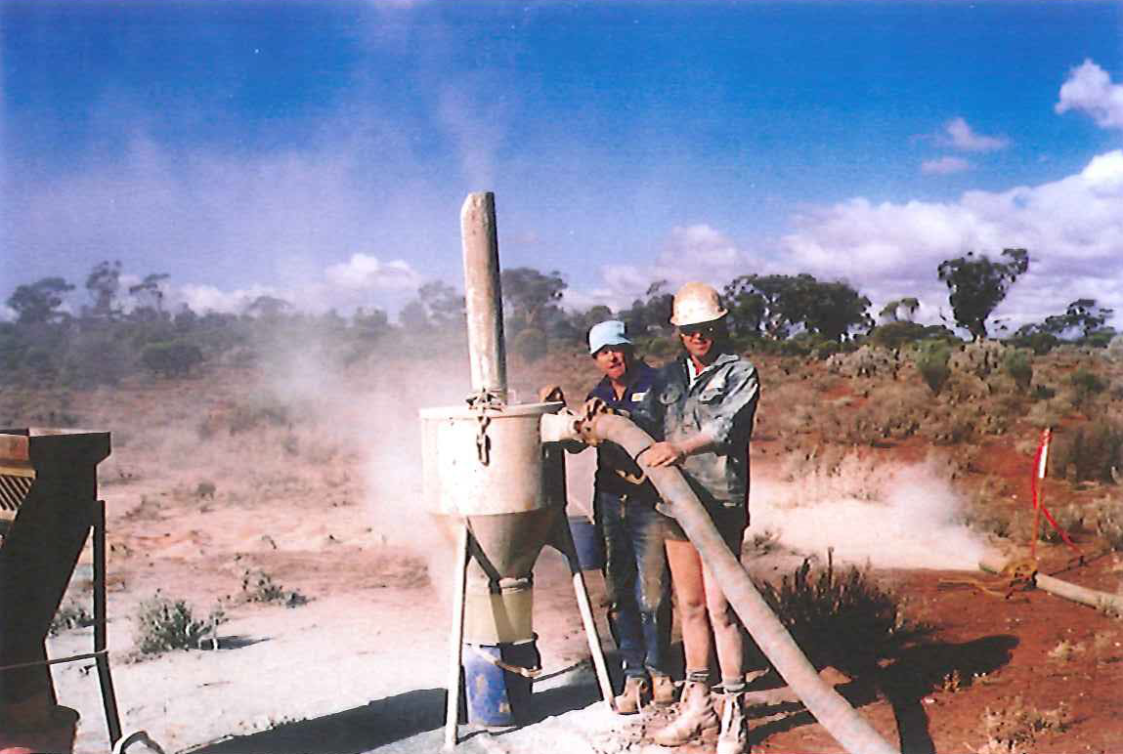
How far has the drilling industry come with safety?
Previously accepted standards
Notes:
In the last few years, exploration drilling safety has progressed significantly. Back in the 1980s and 1990s the above picture was an accepted practice.
No high-visibility (hi-vis) clothing.
No dust masks.
No safety glasses.
Dust was accepted as normal.
Today…
Personal protective equipment (PPE) is worn e.g. safety glasses, gloves and hi-vis clothing, including long sleeves shirts and pants to protect workers from the sun.
Automatic drill rod handlers have been introduced to reduce manual handling injuries.
However, these safety modifications are not the only positive changes that drilling companies have implemented.

Slide 4
Dust was accepted during the 1980s and 1990s
Luckily the wind was blowing the right way!
Notes:
During the 1980s and 1990s dust levels like this were an accepted part of exploration drilling.
Today…
Exploration and mining companies require that water injection is used.
Best practice promotes fit testing to ensure respirators and masks fit each individual correctly.
Note: If employees are not fit tested the mask may not seal against the face meaning they are not being protected as the PPE was designed.

Slide 5
How it was done in the 1980s!
Can you spot the hazards here?
Notes:
This was considered a safe work environment back in the late-1980s.
Using the hook and clam shell.
Working under a suspended load.
No hard hats or gloves.
Inappropriate clothing.
No hearing protection.
Poor housekeeping.
How much worse could it get?

Slide 6
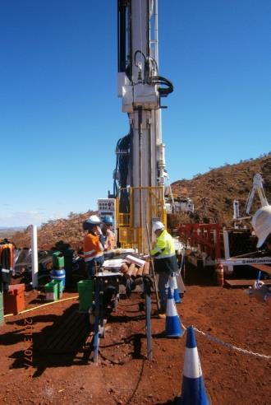
Acceptable PPE for today
Notes:
Personal protective equipment (PPE) practices have improved significantly in the last few years. All employees are now required to wear appropriate PPE, including:
Hi-vis clothing, and long sleeved shirts and long pants for sun protection.
Hard hats.
Safety glasses.
Fit-testing for dust masks.
Hearing protection is now mandatory during drilling operations.

Slide 7
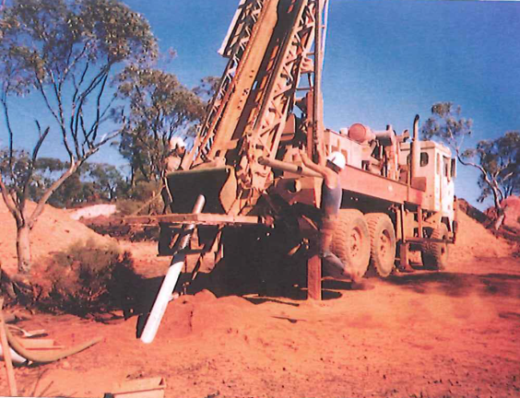
Who can remember doing this?
Running RC drill rods with the hook and clam shell.
Which competent person ensured that winch cable attachments were fastened correctly?
Notes:
Drill rod handling like this was an accepted practice in the 1980s and 1990s.
Who ensured the winch cable and attachments were rated for the job and fastened correctly?
Today…
Thankfully this type of drill rod handling has been eliminated with the implementation of automated drill rod handlers.

Slide 8
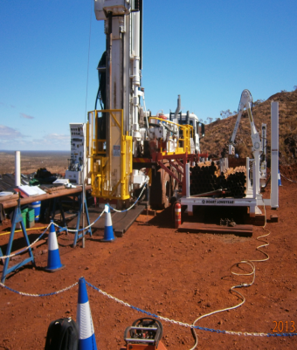
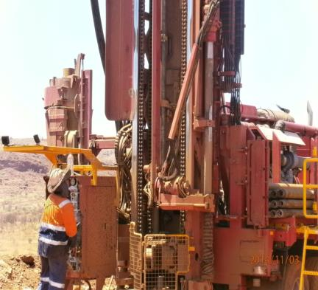
This is how we do it now
Drill rods added and removed from the drill rod string using remote control and automated rod handlers. Much safer than hook and clam shell and people not exposed to hazards.
Work areas barricaded off when drill rods being handled so people not exposed to hazards

Slide 9
Hierarchy of control – start at the top
Elimination
Substitution
Engineering
Isolation/ Segregation
Use mechanical lifting aids
Administrative control
Rotate workers between different task
PPE
Replace heavy items with lighter, smaller or easier to handle
Automate manual task (e.g. remote controls)
Deliver goods directly to point of use to eliminate multiple handling
Replace hand tools with power tools to reduce level of force required to do task
Provide workstations that are height adjustable
Arrange workflows to avoid peak physical and mental demands towards end of shift
Shock absorbent shoes for work on hard concrete floors
Heat resistant gloves for handling hot items
Isolate vibrating machinery from user (e.g. providing fully independent seating on mobile plant)
Increasing effectiveness
Notes:
The higher up the hierarchy of control your solution is, the greater its effectiveness or protection.
The graphic in this slide is a slightly different approach to help people visualise what this means and hopefully better remember the levels.
Think of these coloured semi-circles as shields of protection.
PPE represents limited protection – a very small “shield”.
Isolation or segregation (of individuals not involved in the hazardous activity) – bigger “shield” of protection.
Elimination of hazard – no risk, “completely shielded”.

Slide 10
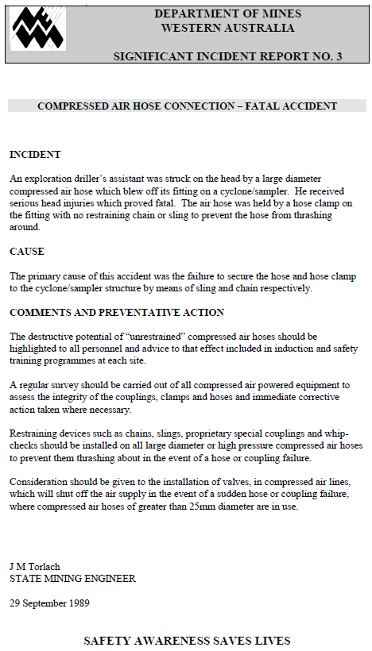
Compressed air
“Genie in the bottle”
SIR No. 3 – 29 Sept 1989
Notes:
Compressed air is one of the greatest hazards found in the drilling industry. There have been numerous incidents involving the unexpected release of compressed air (stored energy) which have seriously or fatally injured workers. Also, debris from blown compressed air lines can travel at speeds such that there is no time to react.
Mines Safety Significant Incident Report No. 3 Compressed air hose connection – fatal accident released in 1989 illustrates how dangerous compressed air can be.

Slide 11
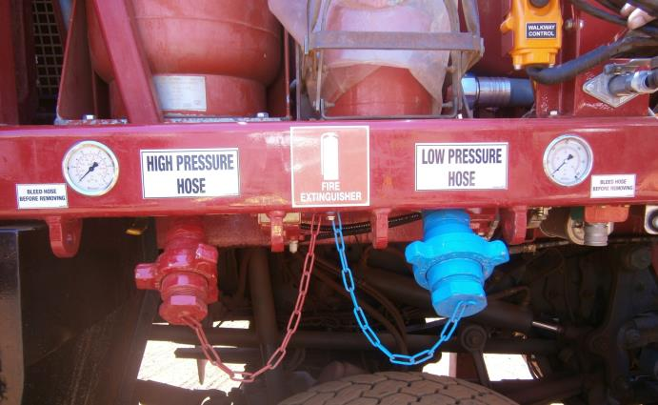
Compressed air – appropriate practice now
Notes:
The Department of Mines and Petroleum is seeing a greater level of protection on drill rigs using compressed air.
Some of these best practices include:
Rated hose attachments.
Lines hard plumbed into compressed air systems.
Stocking-type restraints
Anchor points designed and installed by qualified persons, used for sock-type or internal hose restraints.
Suitable hose tails and nuts, with adequate clamping of the hose to tail.
Specific training provided in the correct fitting of hose connectors and restraining devices.

Slide 12
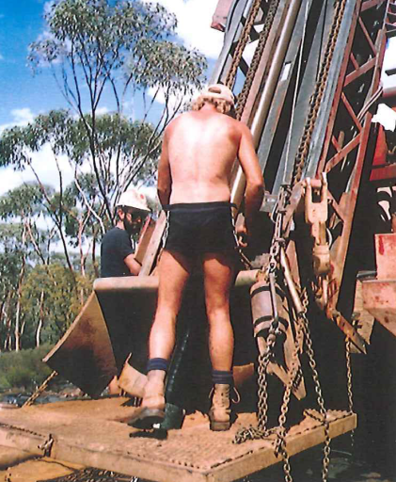
Modified tooling or breakouts in the 1980s
Spot the hazards!
Notes:
Drilling during the 1980s and 1990s. Can you name the hazards that were accepted at the time?
Using a hook and clam shell not rated for the load.
No hard hats.
Modified tooling (breakouts).
No appropriate clothing.
No hearing protection.

Slide 13
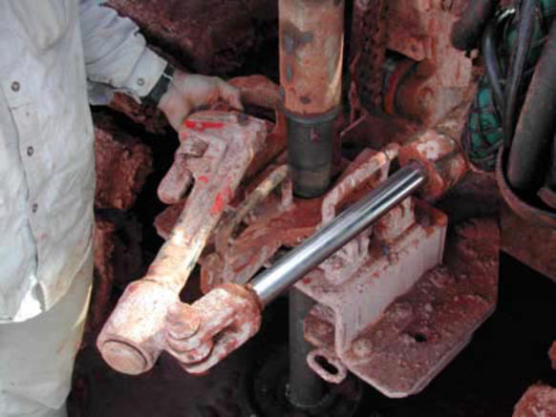
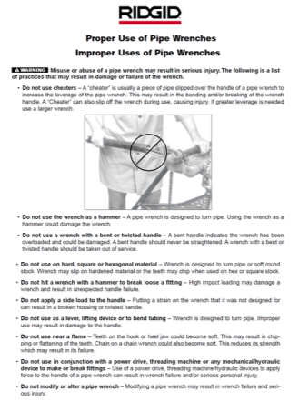
Breakout spanner – modified tooling
Not recommended by original equipment manufacturer
www.dmp.wa.gov.au/ResourcessSafety
Notes:
Above is an example of a typical breakout spanner used on an reverse circulation (RC) drill rig in the 1980s and 1990s. This breakout spanner was a pipe wrench that was modified against the original equipment manufacturer’s (OEM’s) recommendations .
A safety alert was issued by the OEM recommending that the spanner not be modified or used with hydraulic power.
The picture is a good example of some of the possible dangers associated with the use of a hydraulic pipe wrench.
Cluttered work area.
Manual handling issues.
Impact and pinch points.
Driller has a restricted view of the offsider’s actions.
Potential for serious injury from projectiles.
Note: This manufacturer’s product safety alert is available on the Department of Mines and Peteroleum’s website at www.dmp.wa.gov.au/Safety/Manufacturer-s-product-safety-4998.aspx

Slide 14
Specially designed and manufactured drill rod breakout spanner
Notes:
Breakout spanners have come a long way from what was used in the 1980s and 1990s. There is now a huge range of specially designed and manufactured breakout spanners.

Slide 15
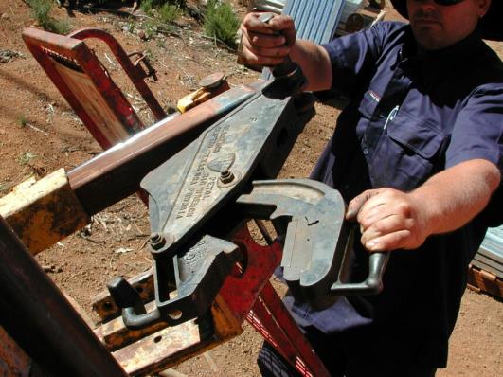
Mechanised break out tools
Notes:
There are now many mechanised systems available to remove the hazards associated with drill rod break outs.

Slide 16
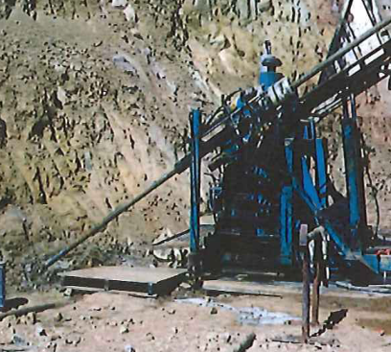
Non-existent guarding of both RC and diamond drill rod strings
“Each responsible person at a mine must ensure that any moving machinery at a mine which creates a risk of injury to an employee through inadvertent contact is screened or guarded to prevent such contact”. MSIR 1995
1980s
1990s
Notes:
Previously, it was an accepted practice to not guard drill rod strings. Even diamond drill rods, that rotate at high revolutions per minute (RPM), were not guarded. However, drive shafts on any machinery had guarding.
The Mines Safety and Inspection Regulations 1995 states:
“Each responsible person at a mine must ensure that any moving machinery at a mine which creates a risk of injury to an employee through inadvertent contact is screened or guarded to prevent such contact.” [r. 4.4(3)].

Slide 17
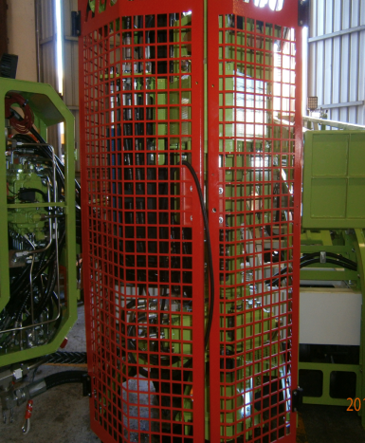
Drill rod guarding is now commonplace
Even on RC drill rigs
Notes:
This is typical of the drill rod guarding that the Department of Mines and Petroleum is seeing in the field on most drill rigs. Most mining companies today will not allow a drill rig on site that does not have sufficient guarding in place. The risk of injury to employees from not using guarding is extremely high.
However, there are still some in industry who are not complying with r. 4.4(3) of the Mines Safety and Inspection Regulations 1995.

Slide 18
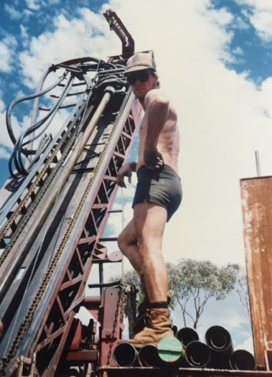
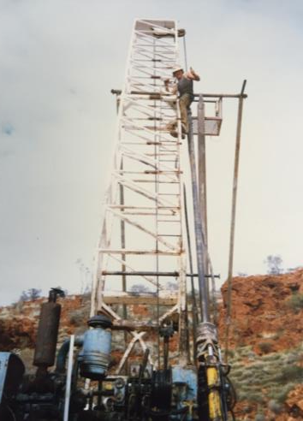
Working at height in the 1980s
Notes:
Examples of how industry used to access drill rig masts – working at heights without fall protection and appropriate personal protective equipment (PPE).
Today…
Working (and subsequently falling) from height is one of three main hazards identified as leading to serious and fatal injuries on mining and exploration operations.
‘Down to earth’ is a set of two videos in the Department of Mines and Petroleum’s hazard awareness video series. These focus why falling from any height can have serious outcomes as well as the consequences of the injured person and their families.
The videos can be shared or downloaded, and distributed for educational purposes (e.g. toolboxes) from www.dmp.wa.gov.au/Safety/Hazard-awareness-videos-16435.aspx

Slide 19
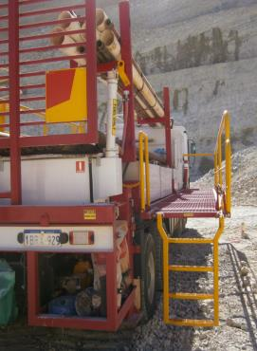
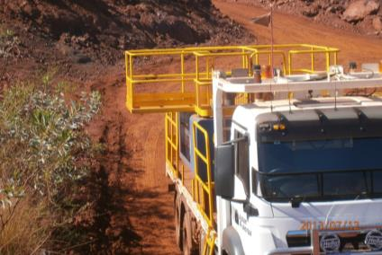
Examples of safe access to drill rig mast and support truck
Notes:
Today…
There are many good examples of drilling companies setting up their drill rigs and support trucks to eliminate the fall from height hazards. These photos show examples of how to access the drill rig mast and support truck safely.

Slide 20
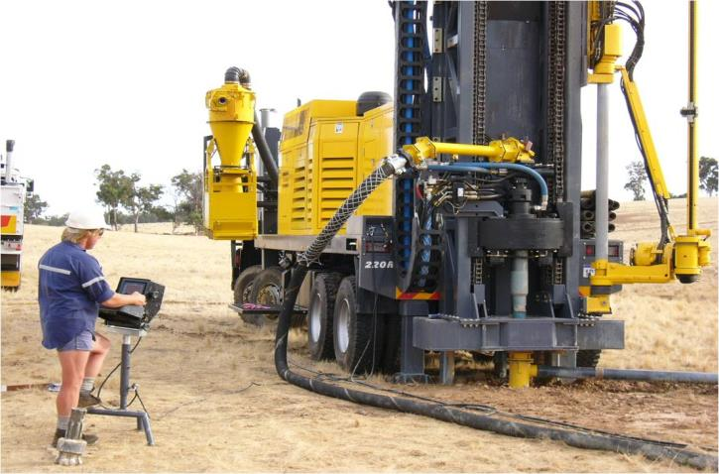
How far can we go?
Notes:
Over the last 5 years there has been enormous progress made with the introduction of many new safe systems. Examples of industry innovations include:
Radar-type systems developed to shut down the rod rotation if an unauthorised person enters an area while drilling.
Drill rig control panels no longer in close proximity to the rig. This helps to eliminate the hazards of:
dropped objects
compressed air
caught in rotating drill rods.

Slide 21
Where are we now?
Level of safety within drilling industry in Western Australia has moved forward at dramatic rate
As mining companies require higher levels of safety for all people working at their sites, drilling companies are developing new safety features for their drilling rigs
Drilling companies are also making innovative safety changes without input from mining companies
Notes:
The level of safety within the drilling industry in Western Australia has moved forward substantially. Mining and exploration companies are now requiring a higher level of safety for all people working at their sites. In response drilling companies are developing new safety features for their drill rigs and some are making great safety changes without input from mining companies.
Exploration and mining companies now have a procedure that drilling companies must comply with prior to gaining access to their sites. The Department of Mines and Petroleum sees this as a very positive measure.

Slide 22
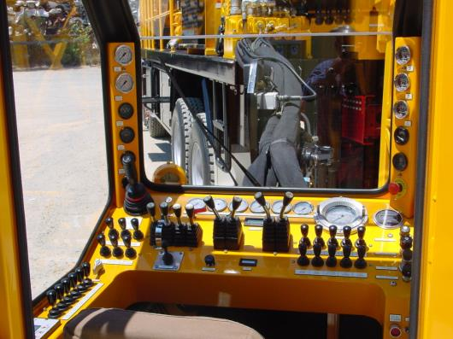
What does the future hold for drilling safety?
Possibilities for drilling safety are endless
Last 5 years has seen enormous progress with introduction of many new safe systems. E.g. Fully-enclosed drill operator’s cabin set back from drop zone around drill rig mast
Notes:
We are also now seeing fully enclosed driller’s cabins set back from the drop zone around the drill rig mast. The benefits of this are endless.
Where we go to now with drilling and exploration operations safety is determined by you, the mining, exploration and drilling companies.

