Slide 1

Please read this before using presentation
This presentation is based on content presented at the 2017 Mines Safety Roadshow in October 2017.
Department of Mines, Industry Regulation and Safety(DMIRS) supports and encourages reuse of its information (including data), and endorses use of the Australian Governments Open Access and Licensing Framework (AusGOAL)
This material is licensed under Creative Commons Attribution 4.0 licence. We request that you observe and retain any copyright or related notices that may accompany this material as part of attribution. This is a requirement of Creative Commons Licences.
Please give attribution to Department of Mines, Industry Regulation and Safety, 2017.
For resources, information or clarification, please contact: RSDComms@dmirs.wa.gov.au or visit www.dmirs.wa.gov.au/ResourcesSafety

Slide 2


2017 Mines Safety Roadshow

Slide 3
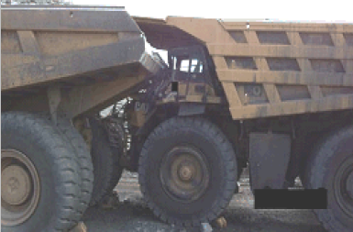
Traffic management
Safe
people

Slide 4
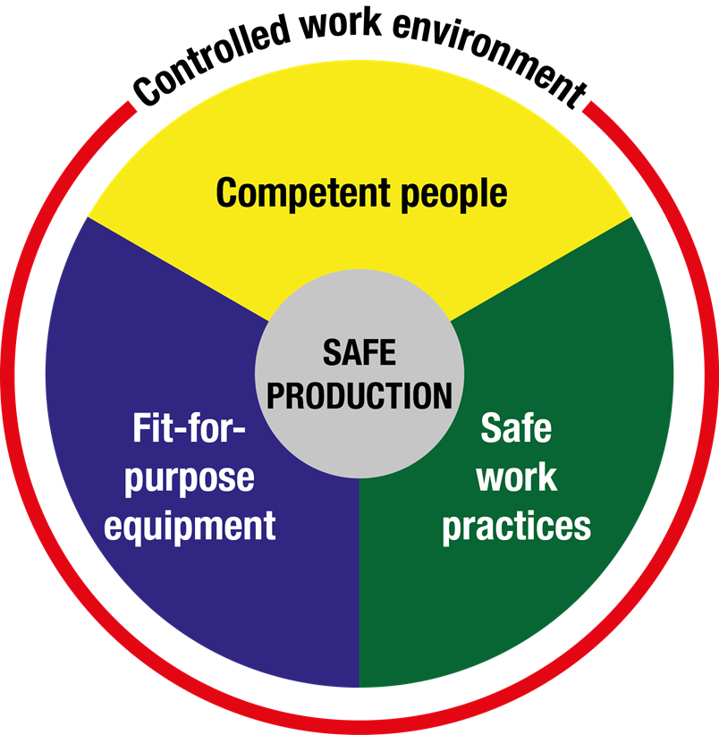
Risk management principles – Nertney wheel
Based on established risk management principles
Safe systems
Safe vehicles
Safe people
Notes:
The Nertney Wheel is a useful model to provide clear risk management processes to achieve safe productivity in the workplace. Fit for Purpose Equipment, Safe Work Practices, Competent People and Controlled Work Environment all provide processes to help manage the risks to health and safety in the workplace.
Competent People
A person who conducts a business or undertaking must ensure they provide suitable and adequate information, training and instruction to a worker so they can work without risks to health and safety. They must ensure that a person has the required skills and knowledge to carry out a task.
Safe Work Practices
A person who conducts a business or undertaking must ensure they provide and maintain safe systems of work. Documented Safe Work Method Statements, Safe Work Procedures, Work Plans and so on all provide clear work expectations of work processes for a person to perform work without risks to health and safety in the workplace.
Fit For Purpose Equipment
A person who conducts a business or undertaking must ensure they provide and maintain safe plant and equipment that is fit for purpose. A risk management approach is adopted to determine the suitability of plant and equipment to be used by workers to perform tasks. Poor design, inspections and maintenance of plant and equipment contribute to risks to health and safety in the workplace.

Slide 5
What are human and organisational factors?
Human and organisational factors is the term given to all elements within a workplace that have an influence on the people who work there
“When human and organisational factors are well managed, they set workers up for success”
Notes:
In order to consider all the factors that are relevant to any given task, it can be helpful to consider these three interrelated areas.

Slide 6
Why are human and organisational factors important?
Human and organisational factors impact on human reliability and performance, contributing to how effectively and safely a worker is able to do their job
How well these factors are managed will influence the likelihood of human failure
“We cannot change the human condition, but we can change the conditions under which humans work”
Notes:
Professor James Reason

Slide 7
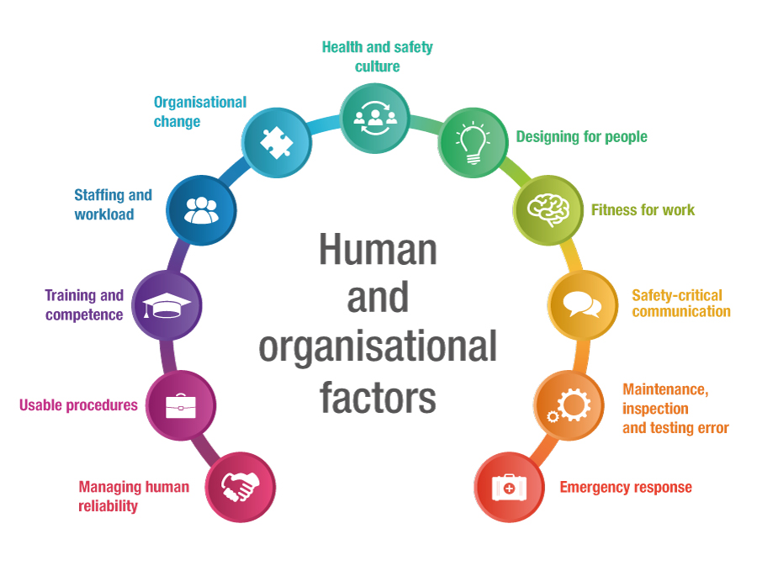
Top 11 human and organisation factors for WA resources industry
Notes:
The Department considered this model to be potentially applicable to the Western Australian mining industry, so Departmental and other data sources were reviewed to identify human and organisational factor trends.
The review validated the relevance of the UK HSE’s top 10 factors to the mining industry, and was used as a basis (with minor modifications) for the Department’s top 11 factors for mining.
Following industry consultation, the top 11 human and organisational factor topics were adopted for the Western Australian resources sector.

Slide 8
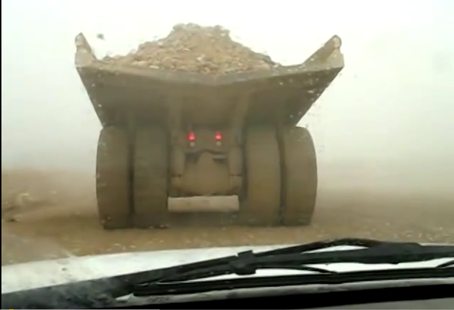
Video - Drive to conditions / re-training
https://www.youtube.com/watch?v=5kdrtOgJ6OA&sns=em
Notes:
Ask: What factors have failed to result in this incident/accident?
Ask: Do you think we are setting this operator up for success.
Quote “drive to conditions” and “re-training”
Discuss:
Organisation: Culture, leadership and supervision, Risk assessments, Inspections of roads/pits etc.
Procedures: stopping work when road conditions change
Environmental: Mist/Visual, road conditions
Maintenance: Tyre conditions
Ask: Add human factors now!

Slide 9
Workshop
Discuss with your table:
For this incident what controls do you think have failed?
What controls would you put in place to prevent a reoccurrence?
Are these controls in place at your mine site?
Notes:
Discuss the dump truck incident with the following questions
Discuss with your table:
For this incident what controls do you think have failed?
What controls would you put in place to prevent a reoccurrence?
Are these controls in place at your mine site?

Slide 10
Organisational factors
Procedures
Competence
Staffing and workload
Management of organisational change
Communication of safety critical information
Design of mine design, plant and equipment
Adequate resources for maintenance, inspection and testing
Notes:
Dump truck incident, discuss the organisations factors
Over-reliance on procedures to manage risk and lack of user-friendly procedures.
Competence, through a combination of skills, experience and knowledge.
Staffing and workload – having the right numbers of the right people in the right place at the right time.
Management of organisational change and organisational structural design.
Communication of safety critical information, both verbally and written.
Design of control rooms, plant and equipment.
Adequate resources for maintenance, inspection and testing.

Slide 11
Individual factors – situations associated with an increased risk of error
Limited memory capacity
Unfamiliarity with the task
Inexperience
Fatigue
Fitness for work
Stress
Hunger
Illness
Language or cultural factors
Hazardous awareness
Notes:
Dump truck incident, discuss the individual factors situations associated with an increased risk of error

Slide 12
Human error
Regardless of their experience, intelligence, motivation or alertness, people make mistakes
Notes:
Discuss: we are all humans and as humans we make mistakes, however in mining if we make mistakes it can be fatal, or resulting in a serious incident/injury to yourself and other workers

Slide 13
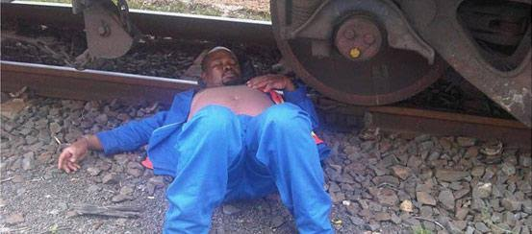
Have you ever?
Notes:
Ask:
Have you ever driven somewhere and have zoned out (autopilot) or had a micro sleep - fatigue

Slide 14
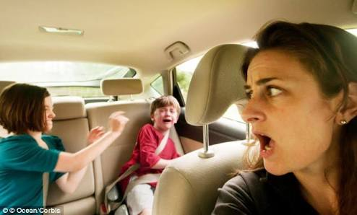
Have you ever (continued)
Notes:
Ask:
Have you ever been distracted?

Slide 15
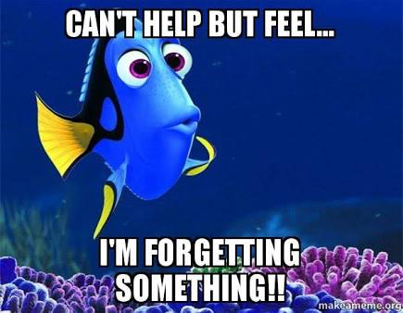
Have you ever (continued)
Notes:
Ask:
Have you ever gone to get something and have forgotten what you are doing? - old age

Slide 16
Related errors or incidents
Poor attention
and concentration can lead to memory lapse errors
Distraction
Fatigue
Can lead
to poor communication
Impaired decision-making
Lowered perception
of risk
Mental health
Minimise distractions
Quality of sleep
Notes:
Discuss:
1. Discuss the underlying contributing factors which we don’t see until we have an incident/injury

Slide 17
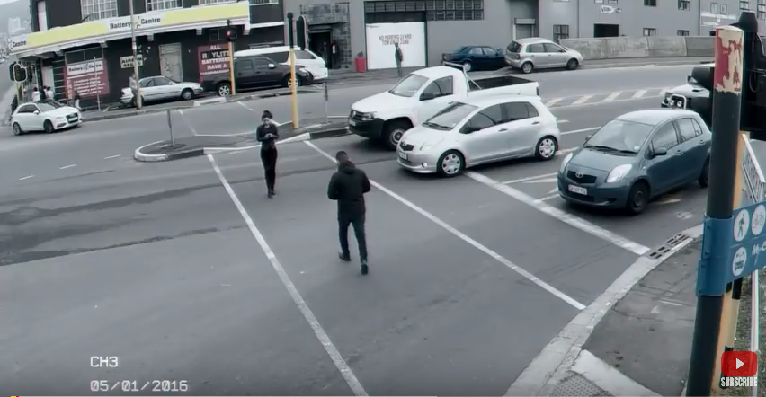
Video - Distraction
https://www.youtube.com/watch?v=_KQoYiCAhZE&app=desktop
Notes:
Video: distraction
Discuss: distractions of using mobile phones

Slide 18
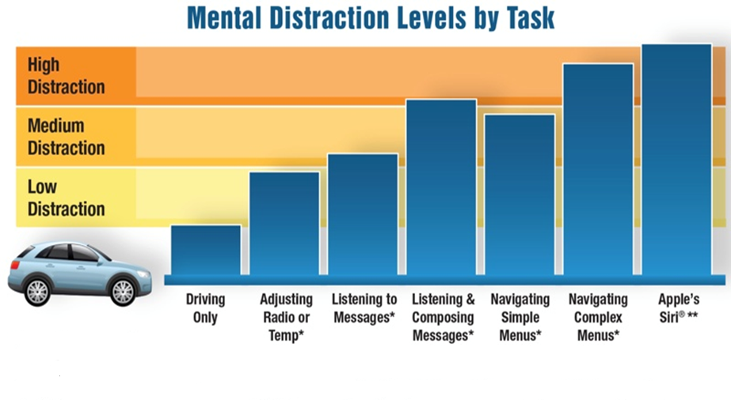
Distraction
Source: www.AAA.com/distraction
Notes:
Discussed mental distraction levels by task chart

Slide 19

Distraction strategies
Source: www.dmv.org/distracted-driving-pledge.php
Notes:
3 simple distraction strategies

Slide 20
What is fatigue?
It is a state of mental or physical exhaustion that reduces a person’s ability to perform work safely and effectively
Fatigue is the state of feeling very tried, weary or sleepy
Resulting from insufficient sleep, prolonged mental or physical work, shift, or extended periods of stress or anxiety
Notes:
Expand if need be into: ‘What does fatigue mean to you?’, ‘What do you notice in yourself when you’re fatigued?’
(Get responses from the group, depending on how interactive they are, ask the quieter ones for ideas of what they think fatigue looks like.)
Recent research indicates that being awake for 17 to 19 hours continuously produce similar or worse levels of performance than a BAC of 0.05.

Slide 21
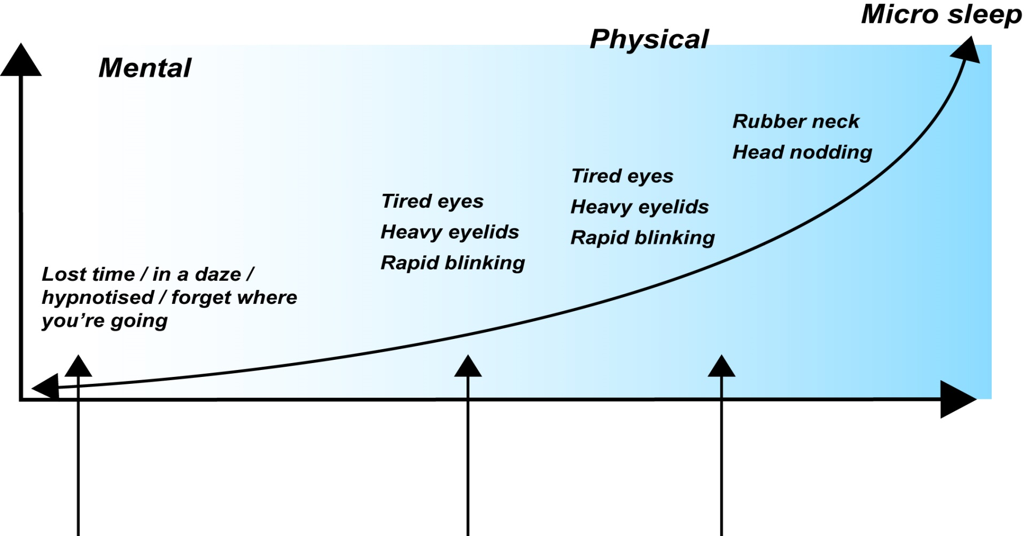
Fatigue
DRIVING TIRED CAN KILL
Notes:
Discuss: signs and symptoms of fatigue
Ask: who has been fatigue an still gone to work?
Discuss: micro sleep
Including travel to site drive in and drive out.
But data from Western Australia indicate that around 30 per cent of rural crashes could be attributed to fatigue.

Slide 22
Fatigue management strategies
Report to supervisor if you are feeling fatigue
  Develop risk assessments and procedures that address risk factors and guard against fatigue
  Fool proof – sleep monitor in cab
  Emergency button in cab – train – every 60 sec – vigilant button
  Safety and health representatives to be consulted when policies and procedures are:
  being developed and reviewed
Notes:
Ask: innovations or ideas from the group for fatigue management strategies

Slide 23
Good mental health
According to the World Health Organisation, good mental health is not simply an absence of a mental disorder
It is a state of wellbeing where an individual:
  realises their own potential
  manages everyday stresses
  works productively
  contributes to their community

Slide 24
Mental health
However, due to complex interactions between the mind, body and environment, mental illness and problems can develop
This can affect a person’s thinking, their emotional state and behaviour
It can disrupt a person’s ability to work or carry out other daily activities as well as engage in satisfying personal relationships

Slide 25
Stress
When someone is under chronic stress, it can negatively affect that person’s physical and mental health
Stress can be caused by a variety of events including:
a major accident
a death in the family or to a friend
personal threats
injury or major health issue
Notes:
Ask: what's the different between the physical and mental health stress

Slide 26

Social factors
Social factors such as isolation, financial problems, family breakdown or violence can also influence a person’s mental health
Notes:
Social isolation: Many people who work shifts feel socially isolated.
Effect on family: Balancing family and work can be difficult at the best of times, even more so when you’re out of the loop for 2-3 weeks at a time. It can be frustrating to you and your family that you’re not available to participate.
Ask: How many of you have children at home? How many of you are leaving partners/wives/husbands behind?
Try to get a bit of conversation going around this – do they have strategies in place to manage this? Have they sat down and discussed it all with their partners and children?

Slide 27
Bullying, aggression and violence
Workplace bullying is repeated unreasonable or inappropriate behaviour directed towards one or more workers, that creates a risk to health and safety
Bullying includes intimidation, threats, humiliation and victimisation
Steps should be taken to stop this behaviour within the workplace

Slide 28
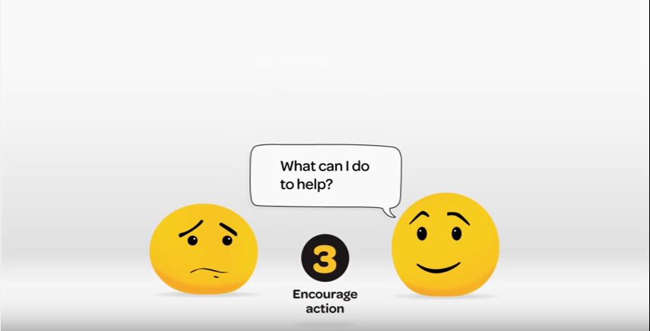
Video - Mental health – strategies
You've got what it takes to ask R U OK?
Notes:
"As a manager, you are in a unique position to be able to identify when a member of your team is struggling so knowing what to look out for and where to find help if it is needed is crucial,"
Access EAP
Maintain regular contact with and get to know their employees, which helps managers "develop important connections" with staff and notice any behavioural changes, like withdrawal, irritability, unexplained absences or declining performance;
Clarify concerns through simple, private conversations with struggling employees to see if they're okay or would like any help;

Slide 29
Mental health – strategies (continued)
Identify and manage psychosocial hazards
  Operational risk assessment
  Team based and individual risk management
  Pre-start and toolbox meetings
Management systems that address mental wellbeing
Resourcing of systems relating to mental wellbeing
Consultation with workforce on mental wellbeing strategies
Preventative and protective measures in place
Notes:
Discuss: DMIRS Psychosocial harm audit

Slide 30
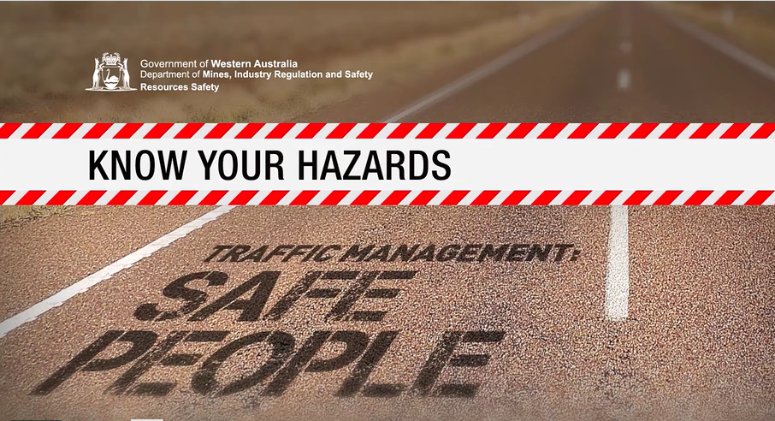
Video – safe people
https://vimeo.com/241991460
Notes:
The Safe people video, is one of three in the Know your hazards: Traffic management series.
http://www.dmp.wa.gov.au/Safety/Hazard-awareness-videos-16435.aspx
Note: Videos may be shared or downloaded from vimeo.com and distributed for educational purposes.

Slide 31
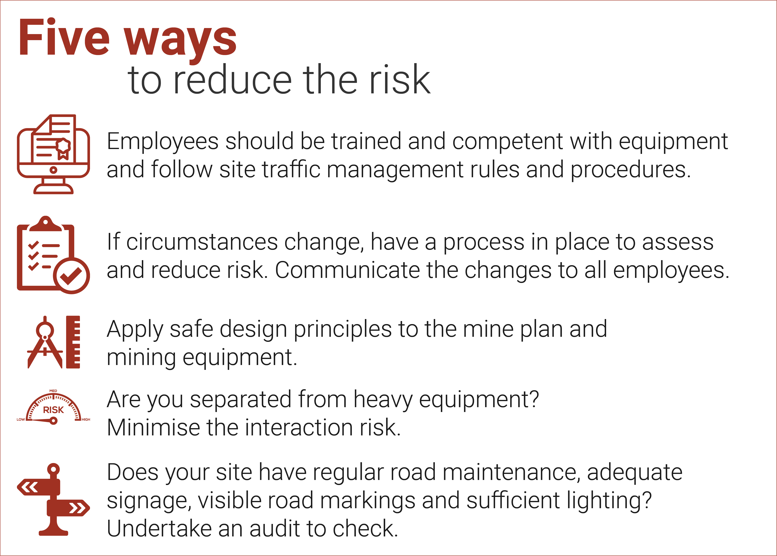
Notes:
Discuss the five ways to reduce the risk of traffic management incidents
Ask: how can you improve your site traffic management plan

Slide 32
Family and social life
What's important to you?
Remember
Bad things happen when
good people do nothing
Notes:
Ask: What’s important to you?
Quotation by Edmund Burke (1729-1797) It's a very true quote too, if you want the world to change, do something about it!!!!

Slide 33
Mental heath - contact numbers
Lifeline on 13 11 14
MensLine Australia on 1300 789 978
Suicide Call Back Service on 1300 659 467
Beyond Blue on 1300 22 46 36
Headspace on 1800 650 890
Access to confidential Employee Assist Program
Seek medical advice or assistance
Notes:
Question to group

