Slide 1

Please read this before using presentation
This presentation is based on content presented at the 2017 Mines Safety Roadshow in October 2017.
Department of Mines, Industry Regulation and Safety(DMIRS) supports and encourages reuse of its information (including data), and endorses use of the Australian Governments Open Access and Licensing Framework (AusGOAL)
This material is licensed under Creative Commons Attribution 4.0 licence. We request that you observe and retain any copyright or related notices that may accompany this material as part of attribution. This is a requirement of Creative Commons Licences.
Please give attribution to Department of Mines, Industry Regulation and Safety, 2017.
For resources, information or clarification, please contact: RSDComms@dmirs.wa.gov.au or visit www.dmirs.wa.gov.au/ResourcesSafety

Slide 2

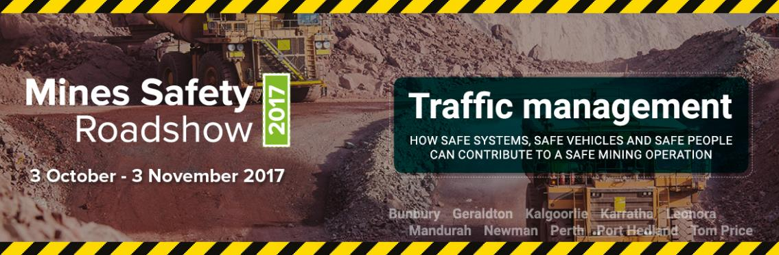
2017 Mines Safety Roadshow

Slide 3
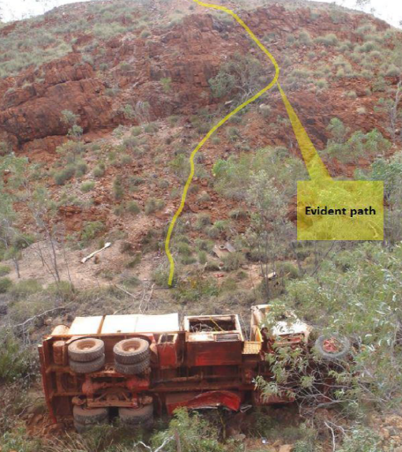
Traffic management
Safe
vehicles

Slide 4
Types of vehicles
Heavy mining vehicles
Haul trucks
Wheel loaders / boggers
Diggers / excavators / Dozers / track vehicles
Light vehicles
Service vehicles (utilities)
Elevating work platforms
Personnel vehicles
Highway type vehicles
Road trains
Delivery trucks
Explosive trucks (MMUs)
Water carts
Mobile cranes
Service trucks

Slide 5
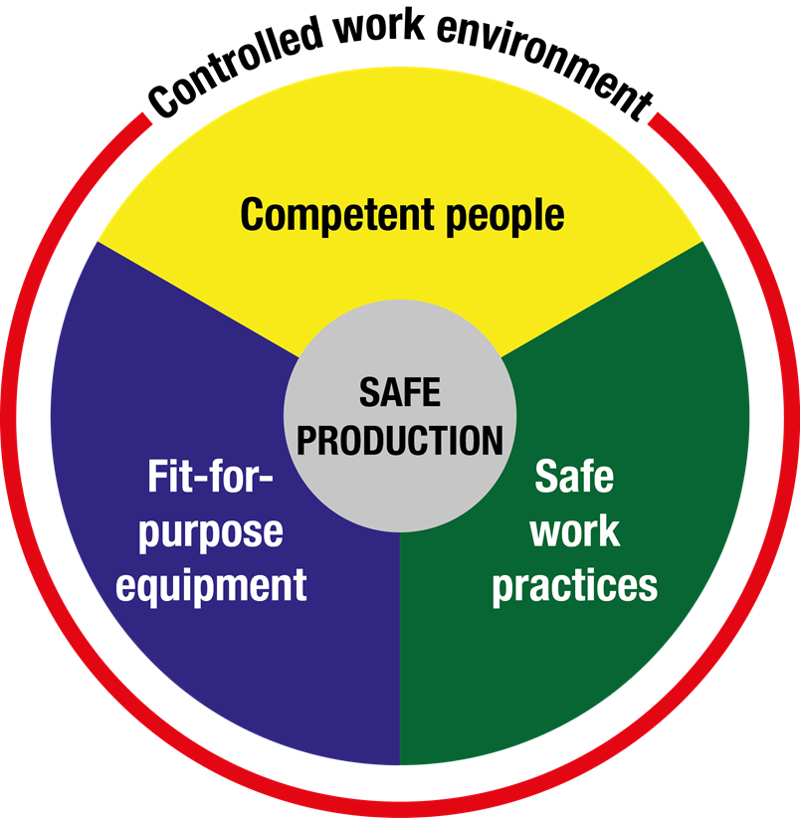
Risk management principles – Nertney wheel
Based on established risk management principles
Safe systems
Safe vehicles
Safe people
Notes:
By the way this is in line with Internationally accepted models of road safety and those of Main roads WA.
Safe System Approach of Main roads WA
Safe System is a philosophy that has been incorporated into our road safety strategy "The Road Towards Zero". The Safe System acknowledges that human error within the transport system is inevitable, and that when it does occur the system makes allowance for these errors so as to minimise the risk of serious injury or death.
The Safe System approach is based on four key cornerstones:
Safer vehicles
Safer speeds
Safer drivers
Safer roads and roadsides

Slide 6
Following incidents
Lets look at some incidents covering the following:
Vehicle selection requirements
Operational requirements
Maintenance requirements

Slide 7
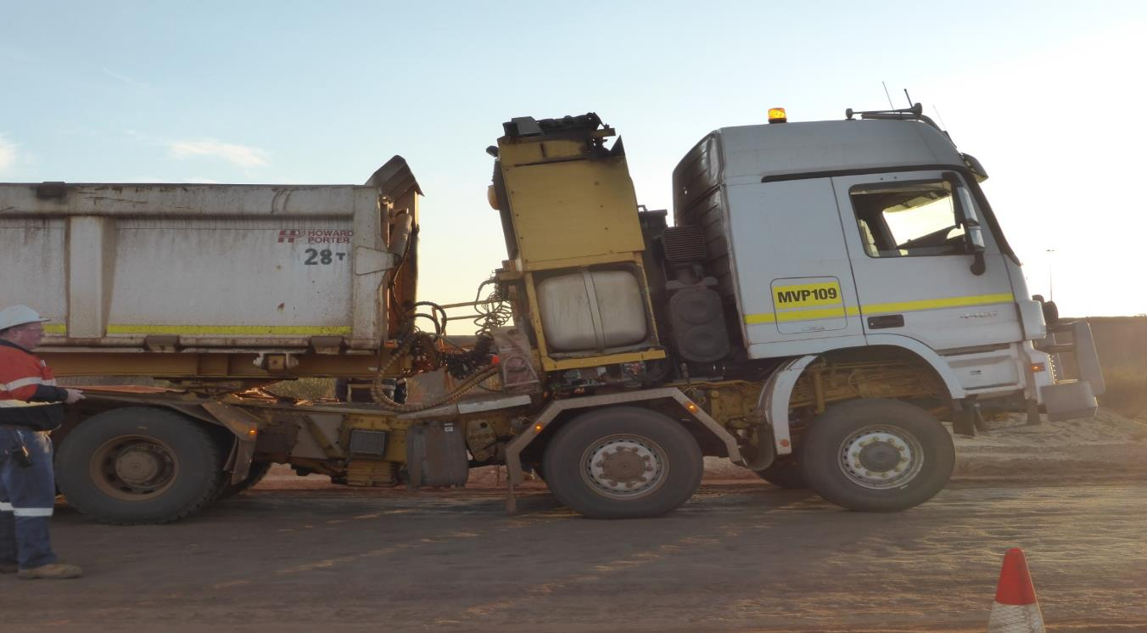
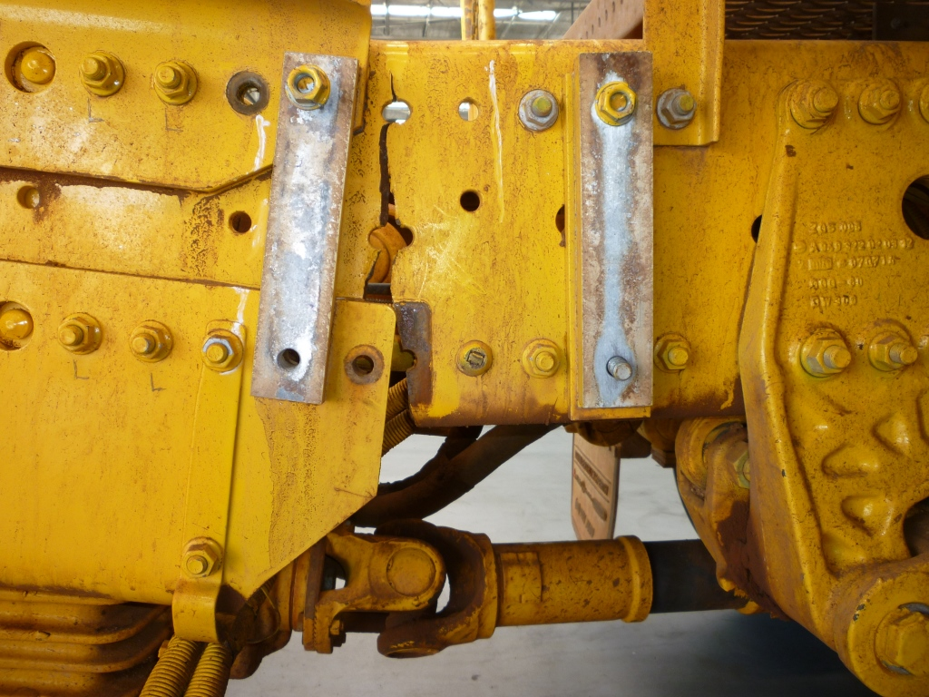
Selection requirements
Notes:
A Road train operator driving a loaded triple up a ramp when he heard a noise from the back of the cab and felt the cab lift up.
The driver pulled up and conducted a inspection of the truck and found the truck had a crack in the right hand side chassis between the 2nd and 3rd axle.
Second Photo (which wipes in) showing crack through the truck main chassis
The trucking company involved engaged the trucks original manufacture to investigate the incident. The investigation identified the truck chassis was not suitable for the task.
A road train operator driving a loaded triple up a ramp when he heard a noise from the back of the cab and felt the cab lift up.
The driver pulled up and conducted a inspection of the truck.
Inspection of the truck identified a crack in the right hand side chassis between the 2nd and 3rd axle.
A second truck of the same make and model also cracked in a similar position while under operation.
Trucks removed from service.
Original Equipment Manufacture (OEM) assisted with the investigation into the failure:
Identified the chassis was not suitable for the task.

Slide 8
What went wrong?
Suitable risk assessments must be conducted on all vehicles prior to use at a mine
  This is even more important when the machine is not specifically designed for operating in a mining environment
Check the maximum load-carrying capability of vehicle against its operating and braking characteristics to determine its maximum capacity
If it is not suitable for the task don’t use it!

Slide 9
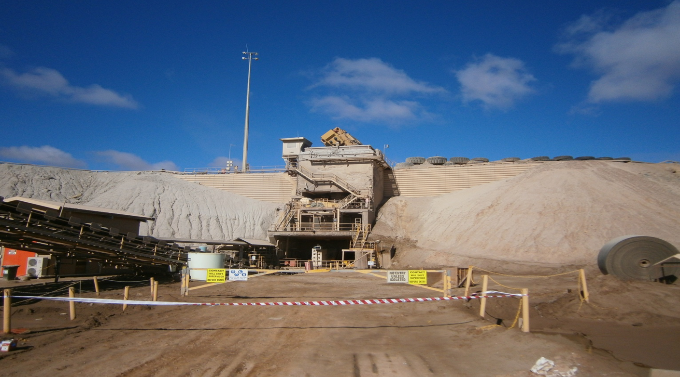
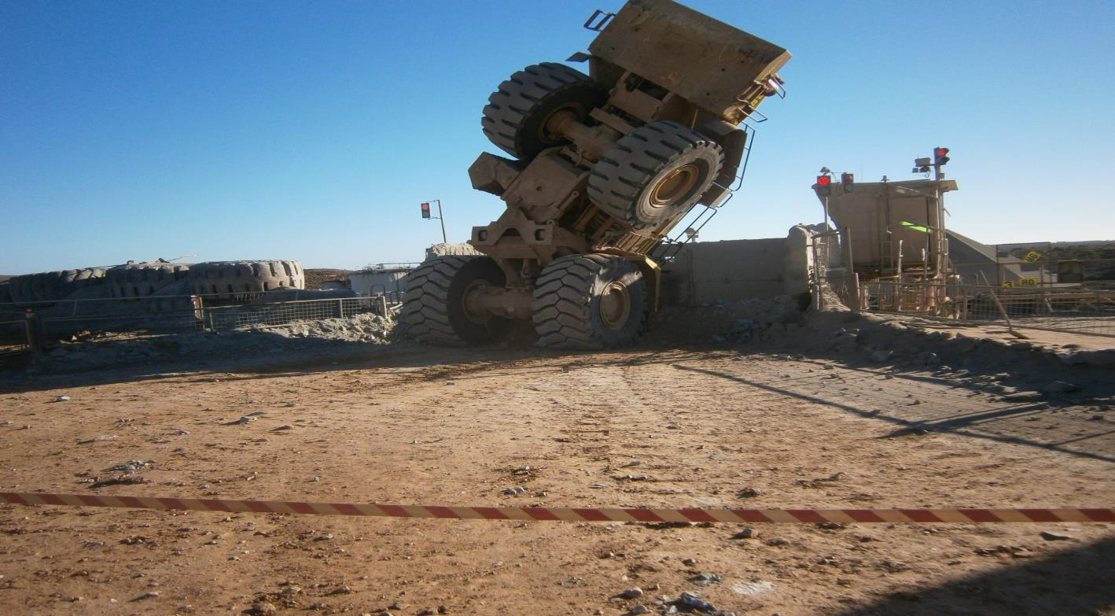
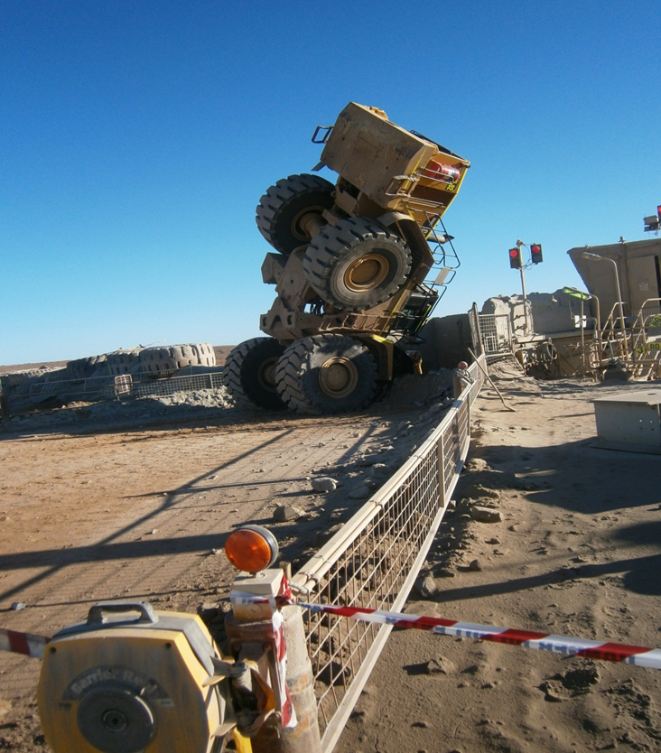
Operational Requirements
Notes:
A loader operator operating Cat 990 loader was feeding the primary crusher ROM bin with ore.
On approach to the ROM bin the operator slowed down, elevated the bucket and started to tip the load of ore into the ROM bin, as he was tipping the operator felt the rear wheels lift up and the front end continued to lurch forward until the bucket came to rest inside the ROM bin of the primary crusher.
The operator was held vertically in position by his seat belt for an unspecified period prior to a rescue being conducted by available personnel.
An EWP and work-at-heights equipment was used to effect the rescue. Medical assessment of the operator off site revealed no injuries.
No procedure was available on site for feeding the crusher or maintaining the ROM.
No risk assessment had been completed prior to the purchase and commissioning of the Loaders on the ROM.
The bucket of the loader was sitting against the crusher spider arm which held the loader in the vertical position.
This prevented the loader from falling over the opposite side of the ROM bin and approximately 12 to 15 metres to the ground.

Slide 10
What went wrong?
No procedure was available on site for feeding the crusher or maintaining the ROM
Loader has braked heavily prior to tipping
There was a downward gradient sloping toward base of truck stop from the entry point of bin travel-way
No risk assessment had been completed prior to purchase and commissioning of loaders on ROM
Notes:
The bucket of the loader was sitting against the crusher spider arm which held the loader in the vertical position.
This prevented the loader from falling over the opposite side of the ROM bin and an estimated 3 stories to the ground.

Slide 11

Operational requirements
Notes:
The operator of a service truck lost control of the vehicle while driving down a access ramp. The vehicle breached a windrow on the ramp and travelled down an embankment before rolling over.
The operator was wearing a seat belt at the time and the truck was fitted with roll over protection.
The operator was not trained or deemed competent to operate Service Trucks on the site.
The truck operator manual required 2 gear to be used when driving down a ramp.
The vehicle was in the incorrect gear to drive the down the ramp

Slide 12
What went wrong?
Operator was not trained or deemed competent to operate service trucks on site
Truck operator manual required 2 gear to be used when driving down a ramp
Vehicle was in the incorrect gear to drive down ramp

Slide 13
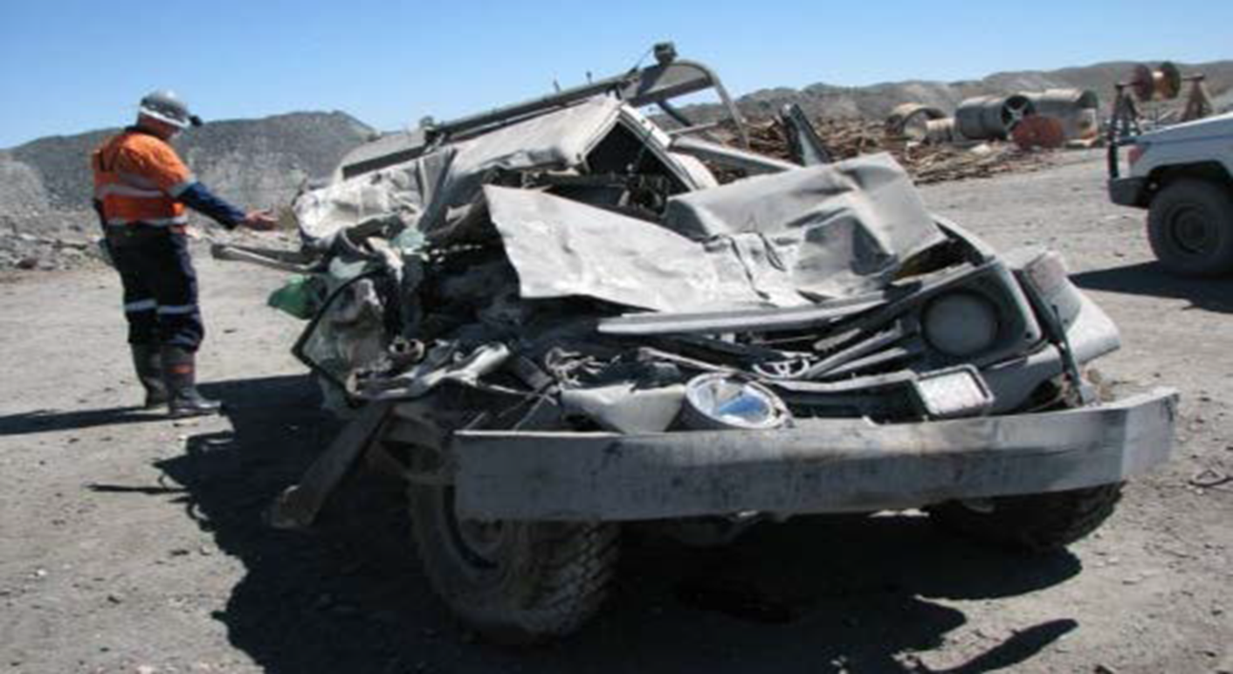
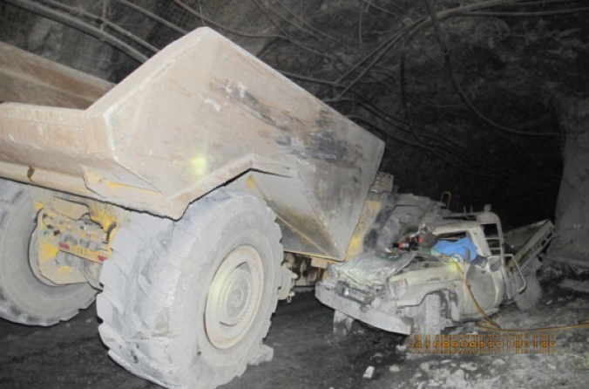
Operational Requirements
Notes:
A light vehicle driver travelling up a decline misjudged a radio call and thought he could safely make it to the next safe parking location.
As he approached a blind bend, he saw the headlights of a truck coming down the decline.
He anticipated that the truck driver would not see him and attempted to pull into a pump cuddy.
His vehicle did not have enough momentum to negotiate the step up into the pump cuddy and fully exit the decline.
As the truck travelled past the pump cuddy, its right hand side collided with the rear of the light vehicle.
The light vehicle was pulled out of the cuddy and its front wedged under the truck’s rear tyre.
A moving pump line was the only indication the truck driver had that he had hit something. He stopped and exited the truck to investigate possible damage to the pump line and discovered the light vehicle wedged under the truck.
Fortunately, the light vehicle driver sustained only minor injuries

Slide 14
What went wrong?
Direct cause
Light vehicle driver attempted to travel further along decline than was practicable
before interacting with truck
Indirect
Absence of designated and standard signs at call-up locations for trucks using decline
Light vehicle driver attempted to enter and park in an unsuitable location
A blind bend on decline and location of the beacon on light vehicle did not provide sufficient illumination to make light vehicle visible to truck driver

Slide 15
Operational requirements close out
Operators must be suitably trained to operate equipment which is specific to the site and machine requirements
Ensure operators understand limitations of vehicle utilised
Operators must follow site operating and safety procedures
Suitable operating procedures are required for each type of vehicle and task performed
  e.g. required speed limits and gear selection must be specified for each type of vehicle when operated on declines or gradients
Enforce and follow procedures
If you are not competent or not authorised don’t drive it!
Notes:
Direct Cause
The LV driver attempted to travel further along the decline than was practicable before interacting with the truck.
Indirect
Absence of designated and standard signs at call up locations for trucks using the decline
The LV driver attempted to enter and park in an unsuitable location
A blind bend on the decline and the location of the beacon on the LV did not provide sufficient illumination to make the light vehicle visible to the truck driver.
Actions
Review the site’s traffic management plan with respect to the potential for collisions and contacts between underground mobile equipment.
The plan should
Identify adequate call-up points, establish appropriate signage along the decline to indicate each call up point
Establish clear radio usage protocols
Mines Safety Significant Incident Report No. 188

Slide 16
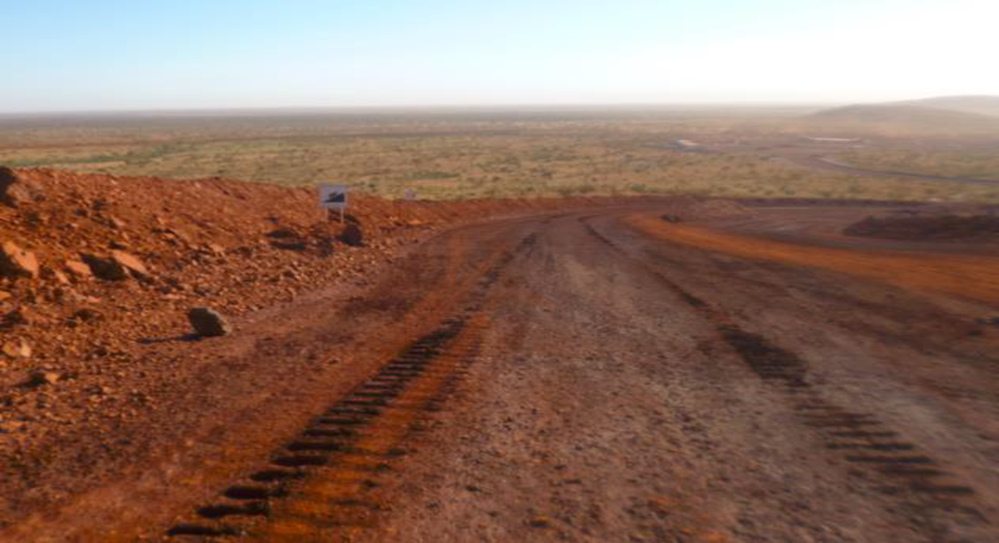
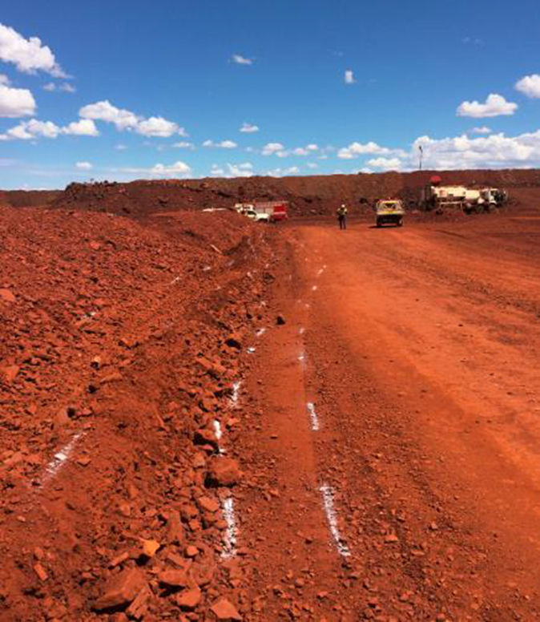
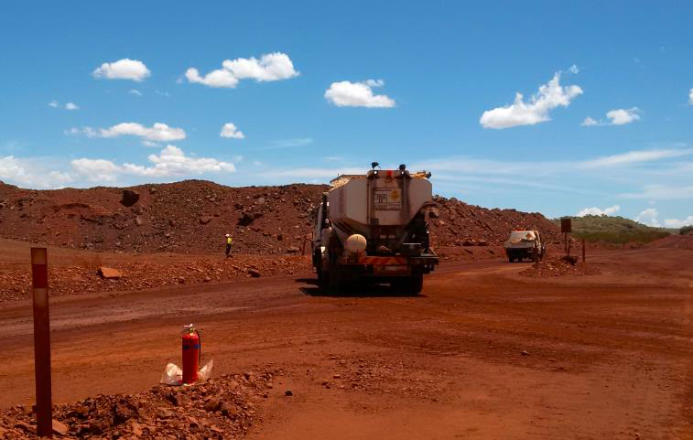
Maintenance Requirements
Notes:
Operator of Mobile mixing unit (MMU/ Explosive truck) was descending down a pit ramp and lost control of the vehicle when the bakes failed.
The operator immediately made a call over the two-way radio advising that MMU had suffered a brake failure and attempted to steer the MMU towards the offside windrow in an attempt to slow the vehicles speed. The MMU skimmed the offside windrow 3 times, the operator managed to avoid losing control of MMU and came to a stop at the bottom of the ramp.
No injuries were sustained.
Operator of Mobile mixing unit (MMU/ANFO truck) was descending down a pit ramp
lost control of the vehicle when the brakes failed.
The operator immediately made a call over the two-way radio advising that MMU had suffered a brake failure
attempted to steer the MMU towards the offside windrow, trying to slow the vehicles speed.
The MMU skimmed the offside windrow 3 times;
The operator managed to avoid losing control of MMU and came to a stop at the bottom of the ramp.

Slide 17
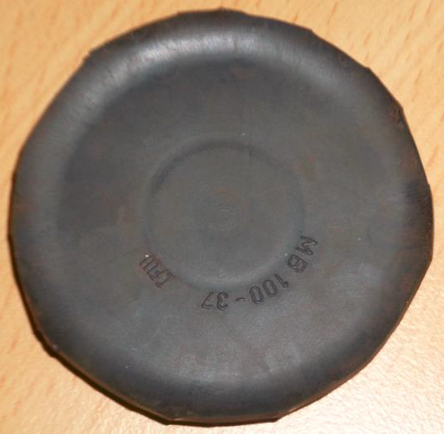
Maintenance requirements (continued)
A non-genuine diaphragm (custom made part) had been recently installed to quick release valve of rear braking system
Part was made and installed by a supervisor who was not competent to perform maintenance work on brake system of truck
Incident resulted in company who owned and operated truck being prosecuted under MSIR 1995:
  Failed to ensure the operator was competent to perform the task r. 4.13(1)(b)
  Failed to ensure any repair, inspection and where necessary testing of plant is carried out by a competent person, r. 6.22(b)

Slide 18
What was the cause?
MMU operators had been reporting brake system air leaks on daily prestart check sheets
Brakes were incorrectly adjusted which affected the braking performance of truck
A non-genuine diaphragm (custom made part) had been recently installed to quick release valve of rear braking system
Operator had selected incorrect gear prior to driving MMU down ramp
Operator had not completed required training and assessments required to operate MMU
Notes:
Impact marks from the MMU contacting the windrow of the ramp
Operators had been reporting brake system air leaks on the daily prestart check sheets.
A non-genuine diaphragm (custom made part ) had been recently installed to the quick release valve of the rear braking system.
The part was made and installed by a Supervisor who was not competent to perform maintenance work on the brake system of the truck.
The brakes were incorrectly adjustment which affected the braking performance of the truck .
The operator had selected the incorrect gear prior to driving the MMU down the ramp.
The operator had not completed the required training and assessments required to operate the MMU.

Slide 19
Maintenance requirements

Slide 20
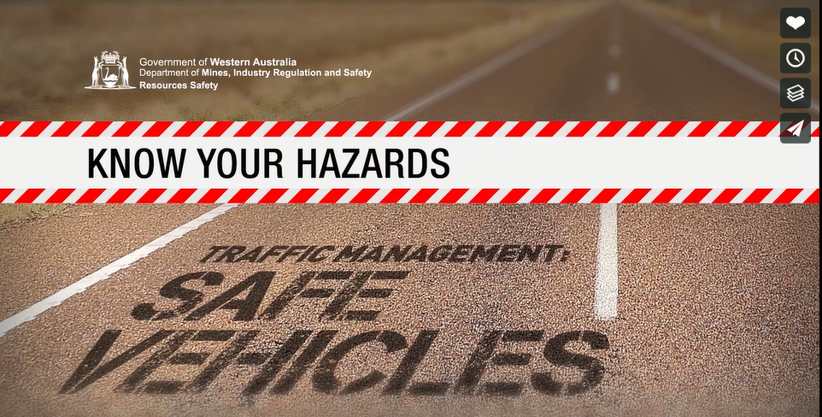
Video – safe vehicles
https://vimeo.com/241992978
20
Notes:
The Safe vehicles, is one of three in the Know your hazards: Traffic management series.
http://www.dmp.wa.gov.au/Safety/Hazard-awareness-videos-16435.aspx
Note: Videos may be shared or downloaded from vimeo.com and distributed for educational purposes.

Slide 21
What was the cause?
An operator of service truck descending down a decline lost control of vehicle
Operator reported he had no brakes and attempted to steer service truck into decline wall in an attempt to slow the vehicles speed
Vehicle made contact with decline walls and came to a stop when it impacted right side wall and wedged itself in decline

Slide 22
Maintenance requirements close out
Maintenance staff must be trained and competent to conduct required maintenance actives on vehicle
Vehicle equipment manuals need to be available for service crew as required
Regular and effective examination and maintenance of braking and steering systems is required
Ensure suitable tests are conducted on vehicle brake and steering systems prior to vehicle being returned to service
Determine service intervals on basis of OEM recommendations and mine operating conditions

Slide 23
Additional information
MSB No. 73 - Loss of control on highway-type vehicles
MSB No. 72 - Loss of control LME on gradients
MSB No. 52 - Operation of water trucks in open pit mines (quarries)
SIR No. 183 - Loss of brakes on dump truck
SIR No. 178 - Water cart loss of control at portal - inadvertent access to underground
SIR No. 139 - Loss of control of service vehicles
SIR No. 84 - Loss of control of water cart - fatal accident
SIR No. 214 - Haul truck collides with light vehicle in a designated controlled area
SIR No. 188 - Light vehicle struck by underground truck in decline

