Slide 1
Please read this before using presentation
This presentation is based on the content presented at the 2019 Mines Safety Roadshow in October 2019.
Department of Mines, Industry Regulation and Safety (DMIRS) supports and encourages reuse of its information (including data), and endorses use of the Australian Governments Open Access and Licensing Framework (AusGOAL)
This material is licensed under Creative Commons Attribution 4.0 licence. We request that you observe and retain any copyright or related notices that may accompany this material as part of attribution. This is a requirement of Creative Commons Licences.
Please give attribution to Department of Mines, Industry Regulation and Safety, 2019.
For resources, information or clarification, please contact: SafetyComms@dmirs.wa.gov.au or visit www.dmirs.wa.gov.au/ResourcesSafety

Slide 2
2019 Mines Safety Roadshow

Slide 3
Safety performance state-of-play

Slide 4
The Department of Mines, Industry Regulation and Safety (DMIRS) Safety Regulation Group, is the primary safety regulator for the minerals, petroleum and dangerous goods industries in Western Australia.
Its role is to promote safety and health through:
Notes:
Further explanation on the role of DMIRS
Employees
Mining companies
The community
Chamber of Minerals and Energy
Association(s) of Mining and Exploration Companies
Chamber of Commerce and Industry
Other industry groups

Slide 5
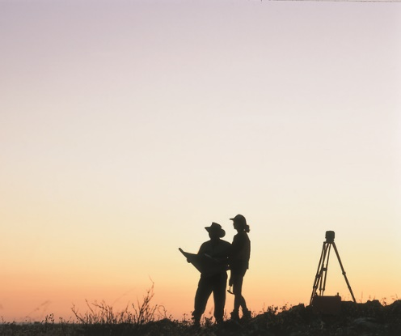
Well-informed industry
To work with industry to reduce serious accidents and incidents, and to provide tangible support in achieving a positive cultural change.
Risk-based approach that places the onus on operators to demonstrate:
an understanding of the hazards and risks of their workplace
they are operating as safely as possible.
Notes:
As part of the inspectorate’s commitment statement we wish to ensure that industry is well informed, and that the information we provide is used as the basis of good risk management decision making.
We believe that the better the industry is informed, the better mining operations will understand the hazards and risks in their workplaces, and therefore the level of safety afforded to the workforce will increase.
However, we have not always been successful in getting our message out – as witnessed by the following example.

Slide 6
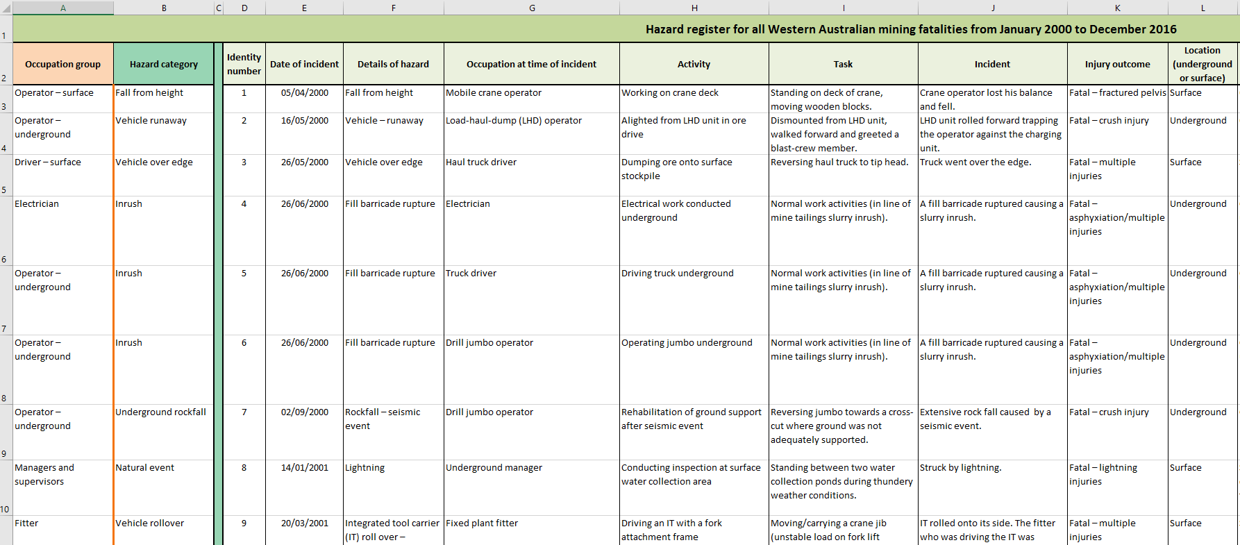
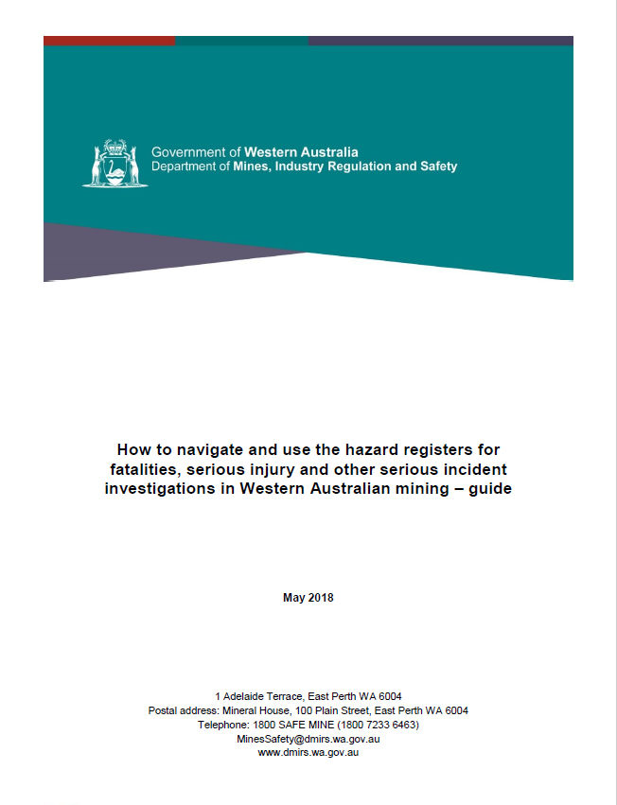
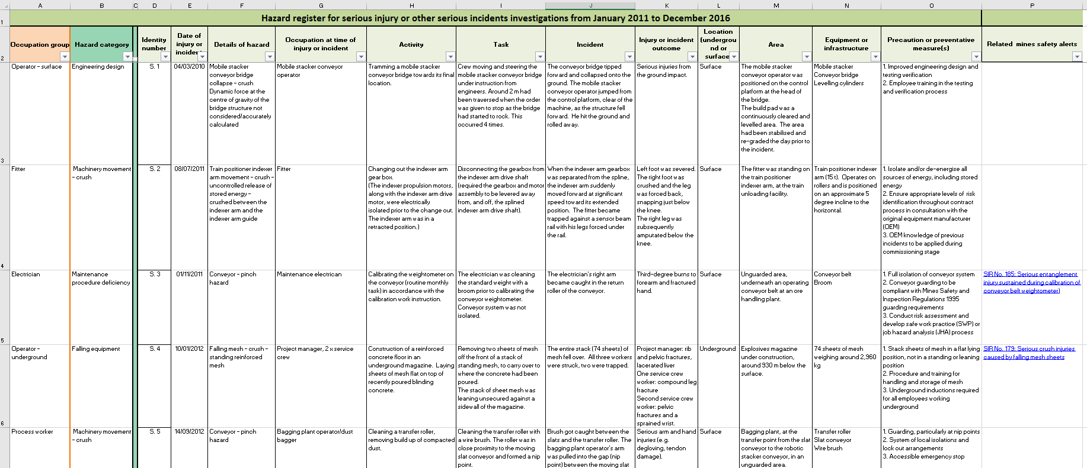
Well-informed industry: Hazard registers
Fatalities hazard register Jan 2000 to Dec 2018
Serious injury hazard register Jan 2011 to Dec 2017
Notes:
DMIRS publishes “Hazard Registers” available at: http://www.dmp.wa.gov.au/Safety/What-accident-and-incident-19287.asp
The Registers outline the mining industry’s reported serious and fatal accidents, including details as to the factors that contributed to the accident, it’s location and the task being conducted at the time of the accident.
In effect, the Registers provide an ideal learning experience for mining operations – and the Department encourage sites to review the accidents that appear on the Registers, and assess the possibilities of a similar accident occurring at their operations. This as a very powerful tool for safety committees to elevate their conversations on managing the risks in their operations.
SHReps should note the availability of the Hazard Registers, and bring them to the attention of their colleagues, and site management.
Our Fatality and Hazard registers need a more succinct description e.g. “Available on our website are two very useful tools, filled with rich information. This is x years’ worth of data which interrogates the serious potential incidents and fatalities in the WA resources sector. This powerful data can be used in any of your risk assessments from Hazard Operability studies to job hazard analysis, how you use this meaningful data is up to you and we strongly encourage you to include this data in your decision making processes.”

Slide 7
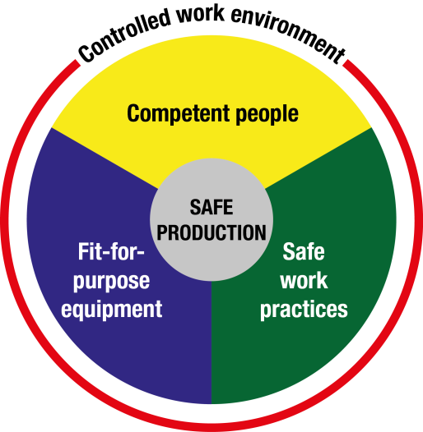
Safety regulator expectations of industry
Notes:
Employers should implement safe systems of work that are thorough and up-to-date, and ensure employees receive information and training on procedures (and put them into practice).
Ultimately to eliminate hazards or reduce risk, there must be effective controls in conjunction with adequate training and safety procedures. Supervisors and workers must remain vigilant.
Mines Safety will continue to work with industry to ensure resilient safety cultures and best practice standards are adopted and maintained as we work together towards safe production.
The Nertney Wheel is a useful model to provide clear risk management processes to achieve safe productivity in the workplace. Fit for Purpose Equipment, Safe Work Practices, Competent People and Controlled Work Environment all provide processes to help manage the risks to health and safety in the workplace.

Slide 8
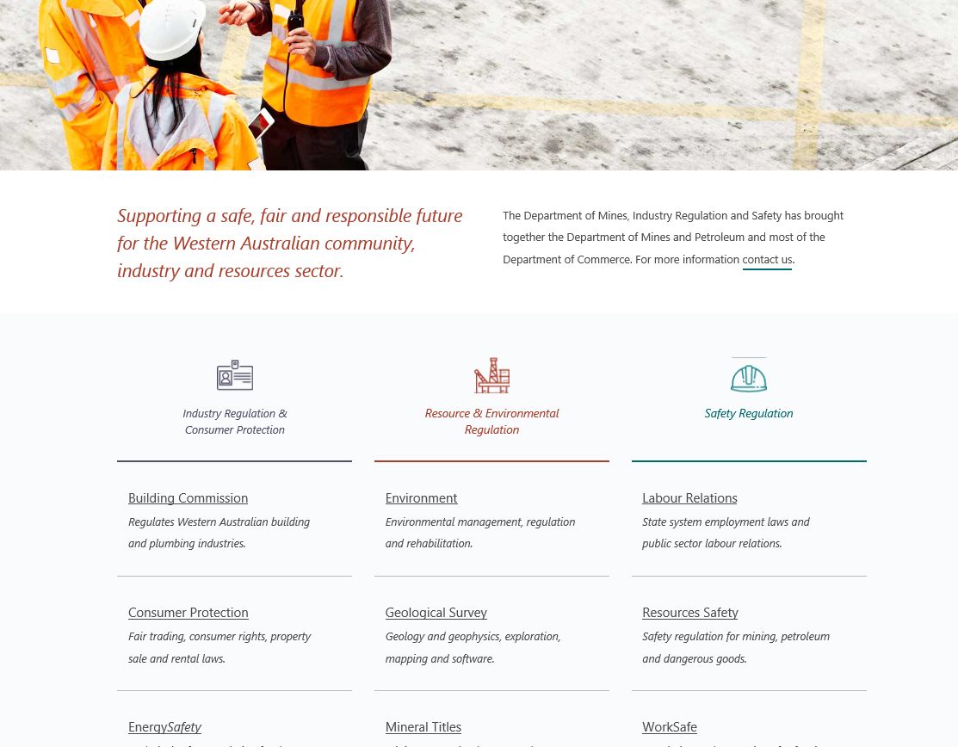
www.dmirs.wa.gov.au
Notes:
Mines Safety information can be found on the DMIRS website under “Resources Safety”

Slide 9
DMIRS – Website
Notes:
Our website, www.dmirs.wa.gov.au
Excellent source of information to assist you

Slide 10
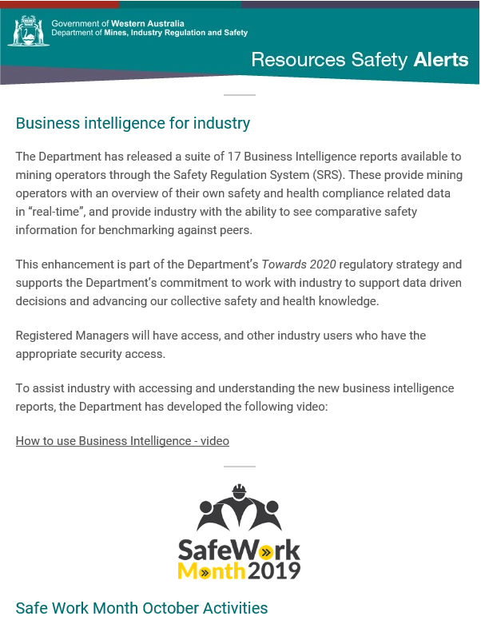
DMIRS – Resources safety news alert
Notes:
Sent out once a week – sign up online

Slide 11
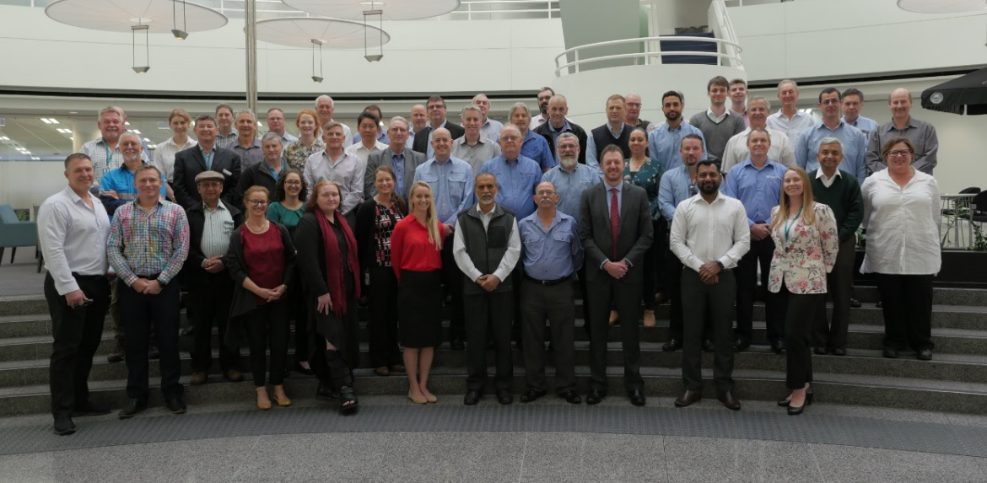
DMIRS – Mines inspectors
Notes:
DMIRS Mines inspector team.

Slide 12
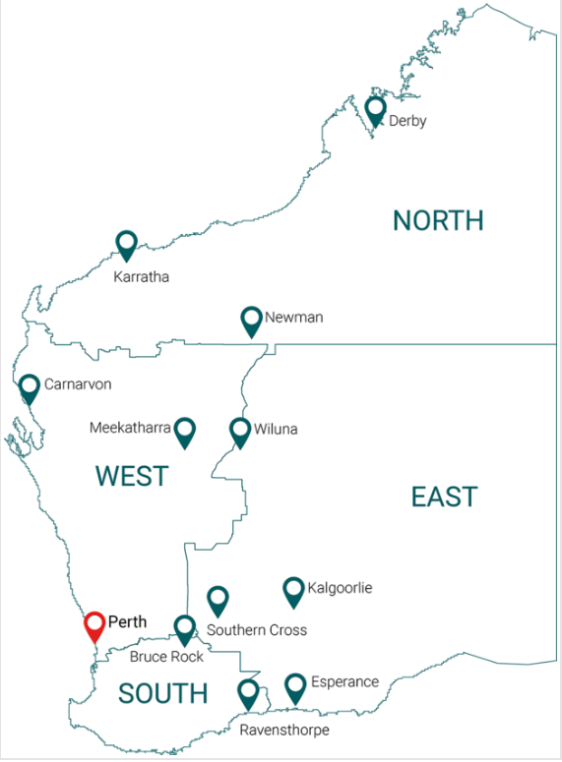
DMIRS – Inspector regions
Notes:
DMIRS Mines safety is divided into 4 regions across WA, plus two State wide teams, Health and Engineering

Slide 13
DMIRS – East inspectorate
Notes:
Complaints investigated can be about bullying, safety or general eg what does the legislation say
East
Inspectorate: East
Year Audits Inspections Investigations
2018 36 343 258
"2019(Jan-Aug)" 14 228 127

Slide 14
DMIRS – East inspectorate
Notes:
Complaints investigated can be about bullying, safety or general eg what does the legislation say
East
2018 2019 (ytd)
Investigations 248 181
Audits 39 13
Inspections 374 268

Slide 15
DMIRS – North inspectorate
Notes:
Complaints investigated can be about bullying, safety or general eg what does the legislation say
Inspectorate: North
Year Audits Inspections Investigations
2018 34 188 229
"2019(Jan-Aug)" 9 145 81

Slide 16
DMIRS – North inspectorate
Notes:
Complaints investigated can be about bullying, safety or general eg what does the legislation say
North
2018 2019 (ytd)
Investigations 226 123
Audits 48 11
Inspections 224 190

Slide 17
DMIRS – South inspectorate
Notes:
Complaints investigated can be about bullying, safety or general eg what does the legislation say
Inspectorate: South
Year Audits Inspections Investigations
2018 21 222 206
"2019(Jan-Aug)" 8 131 80

Slide 18
DMIRS – South inspectorate
Notes:
Complaints investigated can be about bullying, safety or general eg what does the legislation say
South
2018 2019 (ytd)
Investigations 173 107
Audits 22 10
Inspections 223 131

Slide 19
DMIRS – West inspectorate
Notes:
Complaints investigated can be about bullying, safety or general eg what does the legislation say
Year Audits Inspections Investigations
2018 26 220 96
"2019(Jan-Aug)" 15 167 58

Slide 20
DMIRS – West inspectorate
Notes:
Complaints investigated can be about bullying, safety or general eg what does the legislation say
West
2018 2019 (ytd)
Investigations 96 98
Audits 33 12
Inspections 220 165

Slide 21
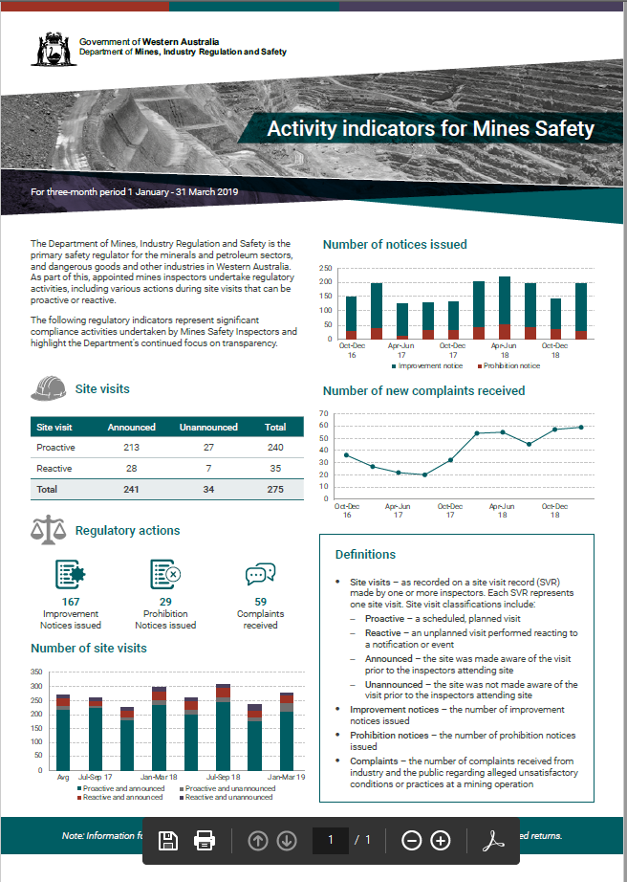
DMIRS – On the ground
1 January to 31 August 2019
# site visits proactive 605
reactive 141
audits 47
# notices prohibition 98
improvement 341
# complaints investigated 108
Notes:
Complaints investigated can be about bullying, safety or general eg what does the legislation say, 24 of these complaints were raised to level 3 requiring follow up investigation

Slide 22
Fatalities: What is the data telling us?
Notes:
Sadly, the story of the recent history of fatal accidents in the mining sector illustrates that an average of 3 fatal accidents have occurred across the sector per year since a fatality free 2012.
Need to target sustainable zero fatalities.
There were 4 fatal accidents in the 2018 financial year.

Slide 23
Fatalities: What is the data telling us?
Notes:
2013-14 to 2018-19

Slide 24
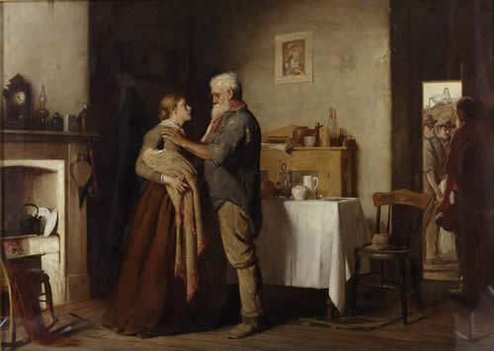
Fatalities: Impact on others
Notes:
Breaking the news on a fatality is very tough.
John Longstaff 1887
The Bulli Mine Disaster of 23 March 1887 involved a gas explosion in the mine that killed 81 men and boys, leaving 50 women widows and 150 children without fathers.
Multiple impact of a single death
The investigating commission was scathing in their findings. They placed the blame firmly on the heads of mine management, and the miners themselves. Citing their totally lackadaisical approach to safety as the predominant cause of the explosion.

Slide 25
Fatalities: What is the data not telling us?
Notes:
Near misses – how many near miss events have occurred that could have resulted in a fatality.
Potentially the average of 3 per year could be higher

Slide 26
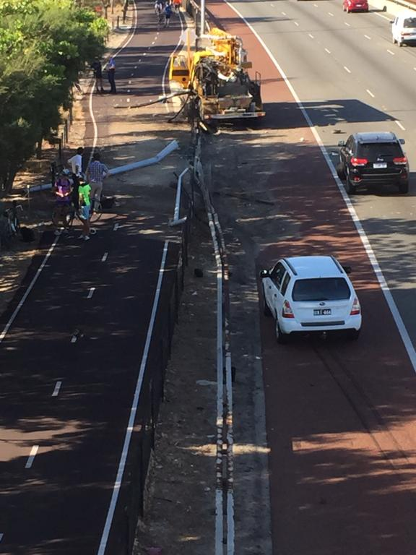
Fatalities: Near miss
Notes:
My near miss fatality – saved by PPE
How many near fatalities do we have at our work site – serious injuries
- no injuries at all

Slide 27
Serious injuries: What is the data telling us?
What can we do to improve?
Notes:
The fatal accident data only tells a small part of the story of the State’s safety performance.
This chart summarises the frequency rate (per million hours) of serious injuries reported to the Inspectorate (the red line), and the subset of serious injuries that resulted in amputations, fractures or crush injuries (AFC - the green line).
It is evident that over the past 9 years, little has changed in either of these performance indicators, with AFC performance decreasing over the past 2 years, and serious injuries increasing by approximately 10% between 2016 and 2017.
hours AFC serious All serious
2011 +20% -7% -1%
2012 +15% +30% +18%
2013 +3% +9% +4%
2014 -6% -12% -16%
2015 -6% -19% -8%
2016 -6% +10% -6%
2017 +4% +14% +12%
2018 +8% +5% -1%

Slide 28
Serious injuries: A closer look
What can we do to improve?
In fact – why are we getting worse?
Notes:
This slide follows from the previous, but talks in terms of total number of injuries, as opposed to a frequency rate. The trend for AFC injuries over the past 3 years is a concern, and indicates that an increasing number of workers have mainly suffered serious fractures as well as amputations or crush injuries.

Slide 29
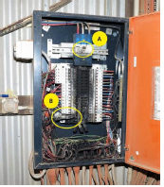
Significant incident report 259
Notes:
http://www.dmp.wa.gov.au/Documents/Safety/MSH_SIR_259.pdf
Example of a serious injury incident, this related to no isolations specifically electrical.

Slide 30
Significant incident report 275
Notes:
http://www.dmp.wa.gov.au/Documents/Safety/MSH_SIR_275.pdf
Example of a serious injury incident, this related to no isolations specifically electrical.

Slide 31
What the 2019 Registered Managers Forum told us
Why aren’t we improving?
Notes:
This was the word cloud that arose from the audience members feedback at the 2019 Registered Managers Forum. Similar feedback was provided by those that attended the 2018 Mines Safety Roadshow.
The more central the word (or phrase) and the larger it is, the more times it was supplied by the members of the audience (each audience member only had one vote).
Complacency (of the workforce) was seen as the major contributor to the deterioration in the State’s safety performance. When pushed for an explanation of what “complacency” meant we were advised by the audience that “safety efforts have become ‘more of the same’ and often repetitive or boring”.
An example: a site required people to regularly report on the work environment work hazards, they found it quite difficult after time to find new workplace hazards, became an irrelevant task as they were identifying frivolous hazards.

Slide 32
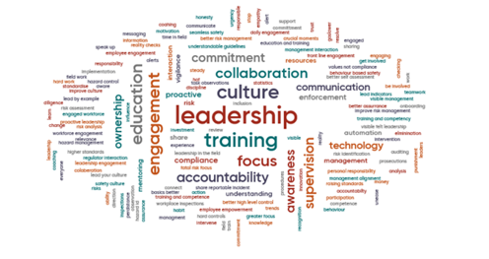
What the 2019 Registered Managers Forum told us
How are we going to turn this around?
Notes:
This was the word cloud that arose form the audience members feedback on the 2019 Registered Managers forum.
The more central the word (or phrase) and the larger it is, the more times it was supplied by the members of the audience (each audience member only had one vote).

Slide 33
What can we do?
What can we do to step change our safety performance?
Address complacency – Leadership
Understand our workplace – sense of purpose
Understand the factors that influence the workplace
Notes:
This is what today is about;
Leadership - everyone
Invigorating safety to a sense of purpose “safety efforts have become ‘more of the same’ and often repetitive or boring”.
HOF – human and organisation

Slide 34
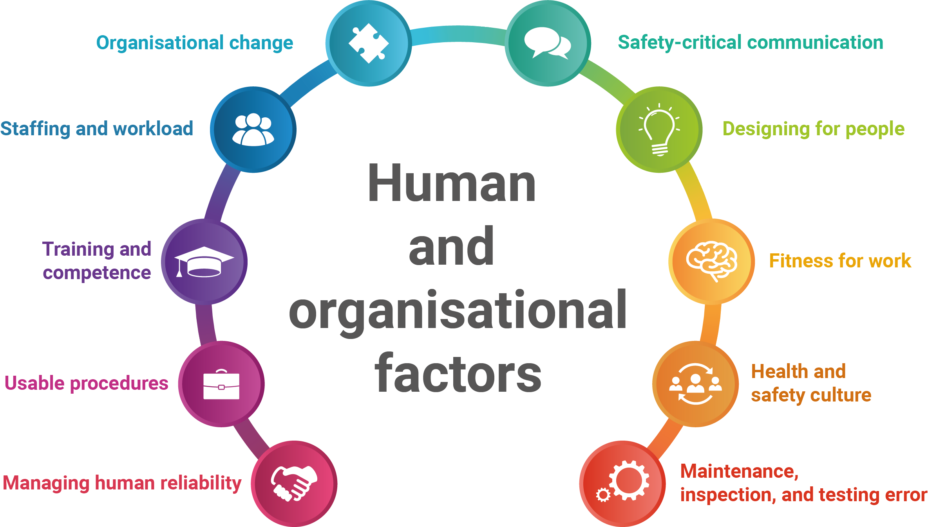
Human and organisational factors – influencing a healthy and safe workplace
Notes:
The department has worked with the Keil centre to validate the UK HOFs with an analysis of existing DMP data. Understanding the human factors in your organisation will help to improve your safety performance
Five Golden Principles of Human Performance
Principle
1 People are fallible, and even the best people make mistakes
2 Error-likely situations are predictable, manageable and preventable
3 Individual behaviour is influenced by organisational processes and values
4 People achieve high level of performance because of the encouragement
and reinforcement received from leaders, peers and subordinates
5 Events can be avoided through an understanding of the reasons mistakes
occur, and the application of the lessons learned from past events
2016 Registered Managers forum identified the following four factors requiring
Managing human reliability – designing for people
safety critical communication
HF in incident investigation
maintenance error
HF sub topics
Preventing human failure
Leadership
Effective supervision
Individual duty of care
but are the UK HSE Human Factors relevant
to the WA Mining industry? To answer this…
• DMP Mine Safety Branch initiated a
project
• Important not to re-invent the wheel
• Engaged a human factors expert
• Analysed data from:
– Industry literature
– DMP publications
– DMP incident and inspection data
HOF – Human and organisation factors e.g. The department worked with leading Human and organisation factors experts the Keil Institute to examine the same date from our fatality and hazard register. We dived deeply into each event to assist us in identifying the ten most frequently encountered human and organisational factors in the WA resources sector. These ten factors may differ for each individual site, however it is a good representation of industry as a whole. Our objective is to embed Human and Organisational Factors (HOF) principals into the safety and health management systems within the resources sector and to grow the knowledge that we have as inspectors in human and organisational factors. – feel free to cull this to what you need

Slide 35
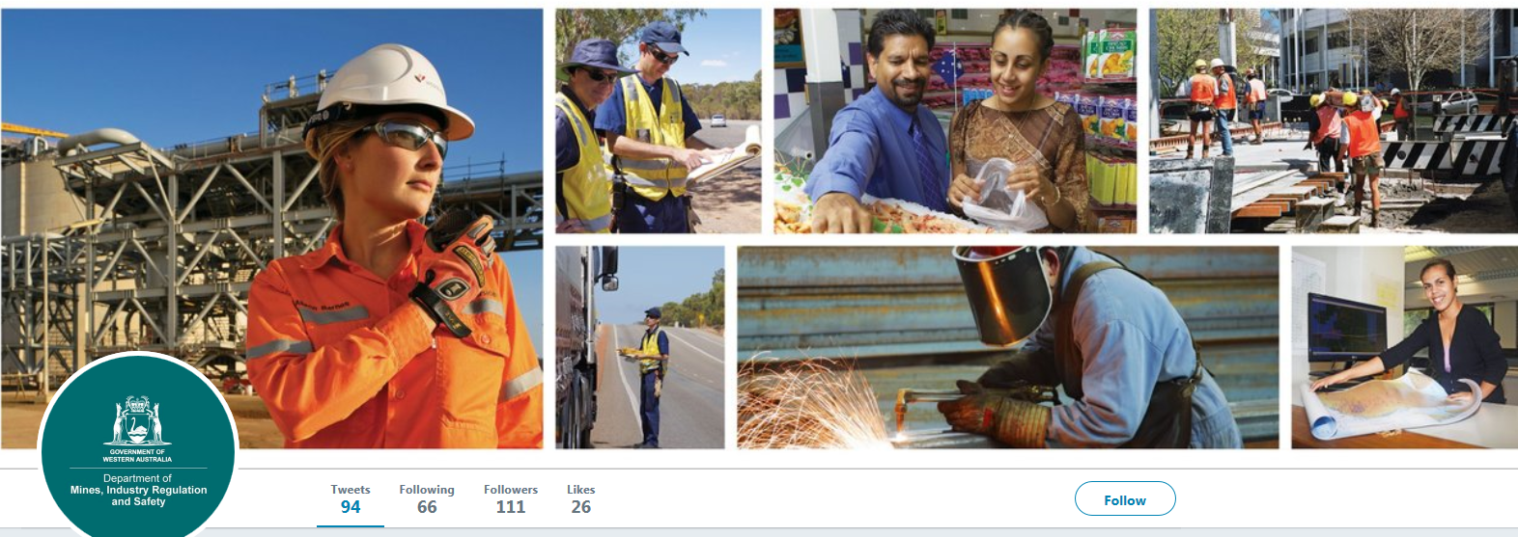
Follow us on social media and sign up for news alerts!
Twitter
@DMIRS_WA
@AndrewChaplyn
LinkedIn at Department of
Mines, Industry Regulation and Safety
Sign up to receive weekly news alerts @ www.dmirs.wa.gov.au
Notes:
Add slide about awards

