Slide 1
Please read this before using presentation
The Department of Mines and Petroleum (DMP) supports and encourages reuse of its information (including data), and endorses use of the Australian Governments Open Access and Licensing Framework (AusGOAL)
This material is licensed under Creative Commons Attribution 4.0 licence. We request that you observe and retain any copyright or related notices that may accompany this material as part of attribution. This is a requirement of Creative Commons Licences.
Please give attribution to Department of Mines and Petroleum, 2015.
For resources, information or clarification, please contact:
RSDComms@dmp.wa.gov.au or visit
www.dmp.wa.gov.au/ResourcesSafety

Slide 2
Structural integrity: Legislative requirements

Slide 3
Topics to be discussed
What is compliance?
Safety culture and regulation
Hierarchy of enforcement
Retrospectivity
Types of plant
Regulations specific to plant
How is competency defined?
Duty of care – origins in law
Practicable
Modernised legislation

Slide 4
What is compliance?
Any plant operated on WA mine sites must comply with the following – mandatory or enforceable (statute law):
Mines Safety and Inspection Act 1994
last amendment gazetted 5 June 2015
Mines Safety and Inspection Regulations 1995
last amendment gazetted 5 June 2015
Any Australian standards specifically referred to by the Act or regulations.
version that was published as at 11 January 2013
Other standards and codes of practice are ‘guidance only’ ― not directly enforceable but may be relevant
Notes:
Compliance is about following rules and standards.
If your safety culture is only concerned with following rules then it is not a robust, enlightened or resilient safety culture (refer next slide).

Slide 5
What are the characteristics of a resilient culture?
Vulnerable | Rule followers | Robust | Enlightened | Resilient
In denial Messengers ‘shot’ Whistleblowers dismissed or discredited Protection of the powerful Information hoarded Responsibility shirked Failure punished or covered up New ideas crushed | Deal ‘by the book’ Conform to rules Target = ‘zero’ Reactive Repair not reform Information neglected Responsibility compartmentalised New ideas = ‘problems’ | Develop risk management capacity Enhance systems Improve suite of performance measures Develop action plans Monitor and review progress Clarify/refine objectives | Active leadership Safety management plan widely known Competent people with experience Accountabilities understood Advanced performance measures Regular reviews Range of emergency responses catered for | Strive for resilience of systems Reform rather than repair Responsibility shared Actively seek new ideas Messengers rewarded Proactive as well as reactive Failures prompt far-reaching inquiries Flexibility of operation Consistent mindset is ‘wariness’
‘in disarray’ pathological | ‘organised’ reactive | ‘credible’ calculative | ‘trusting’ proactive | ‘disciplined’ generative
Sanction | Direct | Encourage | Partner | Champion
Notes:
What do we mean by supporting positive cultural change?
Here is the safety reform spectrum, which is available from the Department’s website. It lists the attributes of different organisations – starting with the most prone to failure on the left and moving across in increasing levels of trust and system development. The row across the bottom shows the ways in which regulators tend to vary their strategies to deal with these types of organisations.
Clearly, all operations should aspire to be RESILIENT.
To strive for resilience of systems you must be able to take a hit and recover (e.g. receive negative feedback and react proactively).
Reform rather than repair. If something goes wrong, or there is a near miss, take the opportunity to really address the issues using the hierarchy of control rather than do a “quick fix”.
Responsibility shared. Every employee on the mine is responsible for safety not just safety representatives, safety advisors and management.
Seek new ideas. Is there a better way of doing what we are doing?
Messengers rewarded with positive feedback and recognition.
Proactive as well as reactive. Use audit findings and consult with the workforce to proactively deal with hazards prior to an event.
Failures prompt far reaching inquiries and do not just blame the operator. What can we do as an organisation?
Flexibility of operation to overcome and resolve issues and deal with change.
Consistent mindset, maintain a state of awareness. Celebrate success and do not rest on your achievements.

Slide 6
Safety culture and regulation
Where do you think WA mine sites sit on the spectrum?
Where does your site sit?

Slide 7
Hierarchy of enforcement
Inspector’s tools
Verbal directive
Ascending

Slide 8
Hierarchy of enforcement
Inspector’s tools
Record book entries
Verbal directive
Ascending
Notes:
Section 23 of the Mines Safety and Inspection Act 1994 (MSIA) contains the requirements for mine record book entries.

Slide 9
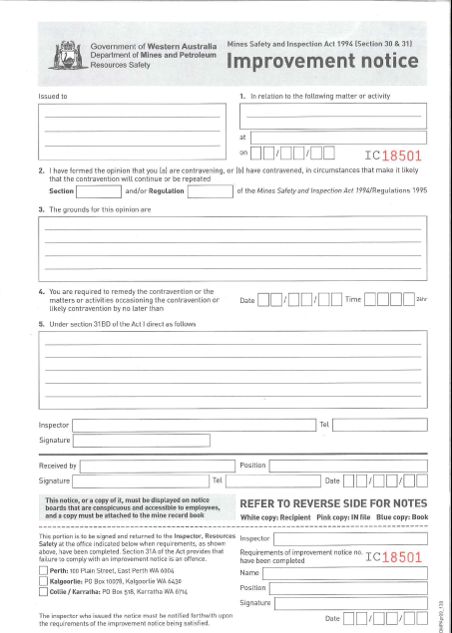
Hierarchy of enforcement
Inspector’s tools
Improvement notices
Record book entries
Verbal directive
Ascending
Notes:
Sections 30, 31, 31A and 31AA of the MSIA contain the requirements for improvement notices.

Slide 10
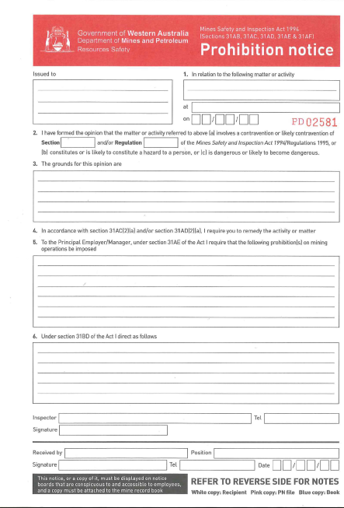
Hierarchy of enforcement
Inspector’s tools
Prohibition notices
Improvement notices
Record book entries
Verbal directive
Ascending
Notes:
Requirements for prohibition notices in relation to:
hazards and breaches of the Act – ss. 31AB, 31AC, 31AD, 31AE, 31AF and 31AG of the MSIA
occupation of residential premises by employees – ss. 31AH, 31AI and 31AJ of the MSIA. These provisions may be used, for example, in relation to employer provided mine camp accommodation, provided it is not on an established town site.
Other sections of the MSIA – 31AK to 31BE inclusive – include numerous administrative provisions in relation to improvement and prohibition notices. Some important points are:
Failure to comply with notices is in itself an offence.
Notices can be challenged (i.e referred to the State Mining Engineer for review).

Slide 11
Hierarchy of enforcement
Inspector’s tools
Section 45 report
Prohibition notices
Improvement notices
Record book entries
Verbal directive
Ascending
Notes:
Section 45 of the MSIA provides the State Mining Engineer with authority to obtain (by issue of a notice), from the principal employer, an independent (third party) study at the mine about any aspect of the mining operation relating to health and safety, or an accident or occurrence.
The cost of the study (no limits) is to be paid by the principal employer. The State Mining Engineer must approve the qualified person(s) who will perform the study.

Slide 12
Section 45
45. State mining engineer may require independent study at mine
(1) If at any time the State mining engineer so requires by notice in writing, the principal employer or the manager of a mine must, without delay, procure and provide to the State mining engineer, at the principal employer’s expense, an independent study —
(a) concerning safety and health at the mine, generally or in some particular respect specified by the State mining engineer, or safety of all or some specified part of the mine’s plant, buildings, operations, or structures; or
(b) with respect to an accident or a dangerous occurrence at the mine that an inspector is investigating.
(2) The State mining engineer must state in any notice referred to in subsection (1) the reasons why the independent study is required.
(3) An independent study required under this section must be prepared by a professionally qualified engineer or some other qualified professional person who is approved for the purpose by the State mining engineer.
(4) A principal employer or manager who contravenes subsection (1) commits an offence.

Slide 13
Hierarchy of enforcement
Inspector’s tools
Prosecution (Act or regulations)
Section 45 report
Prohibition notices
Improvement notices
Record book entries
Verbal directive
Ascending
Notes:
Section 21(1)(m) of the MSIA provides district inspectors and special inspectors with the authority to initiate and conduct prosecutions.

Slide 14
Retrospectivity
Issue of retrospectivity is a frequently asked question.
Requirements of current legislation or Australian Standards cannot be enforced retrospectively on old plant that was manufactured before the legislation or standard came into effect.
However, duty of care obligations (MSIA ss. 9 and 14) apply to all plant, regardless of age.
If older plant designed to superseded standards has a lower standard of safety than more modern practicable solutions then you have a duty of care to address this.
Notes:
Your prime duty is always your duty of care to do everything reasonably practicable to protect people from harm (in everything you do).

Slide 15
Types of plant
In general, plant at a mine can be divided into following broad groups:
Classified plant (registered and unregistered)
‘Duty of care’ type plant
Mine winders and shaft-sinking equipment
Dredges
Fixed plant structures and most rail-mounted structures are regulated as ‘duty of care’ type plant unless they are part of a crane, hoist, lift or a winding system
All cranes, hoists and lifts are classified plant ‒ certain types and sizes require registration
Notes:
Fixed building cranes (e.g. bridge cranes, gantry cranes, pillar and jib cranes, monorails) include their supporting structures and foundations.

Slide 16
Definition of plant
Definition of plant in MSIA section 4:
“ plant includes machinery, equipment, appliance, implement, or tool and any component or fitting of, or accessory to, any such article”
For the purposes of the Mines Safety Act, all load supporting structures are part of plant including buildings, bins, chutes, silos, tanks, piperacks
Inspectors have observed that some asset integrity teams on mine sites do not manage buildings and structures with the same diligence as equipment, whose availability is more immediately critical to production.
Notes:
Buildings, support structures, access structures and their foundations are all part of “plant.”

Slide 17
Additional definitions
More definitions from MSIA section 4:
“mining operations .. includes — (g) the operation of any support facilities on the minesite, including mine administration offices, workshops, and services buildings; ..”
“workplace .. means a place, whether or not in a vehicle, building, or other structure, where employees or self-employed persons work or are likely to be in the course of their work,..”
Therefore, all buildings and structures on a mine site must be managed – not just production plant

Slide 18
Act and regulations
Parts of mines safety legislation that are most relevant to fixed plant structures are:
Reg. 6.2 – Plant to be maintained and operated in a safe manner
Reg. 6.21 – Employer to prevent unsafe use of plant
Reg. 6.22 – Employer’s duties when plant is damaged or repaired
Reg. 6.23 – Employer’s duties when plant is altered
Reg. 6.32 to 6.40 – Classified plant regulations
Parts 11 and 12 MSIR – Winders and shaft sinking
Sections 9 and 14 of MSIA – Duty of care obligations

Slide 19
Definitions of competency
Section 4 of MSIA, 1994 says:
“competent person means a person who is appointed or designated by the employer to perform specified duties which the person is qualified to perform by knowledge, training and experience;”
Regulation 1.3 of the Worksafe OSH Regs 1996 says:
“competent person, in relation to the doing of anything, means a person who has acquired through training, qualification or experience, or a combination of those things, the knowledge and skills required to do that thing competently;”

Slide 20
Competency
Lack of competency (e.g. in design) has long been identified as one of the precursors of structural failures in general industry. Inspectors have observed that structural failures on WA mine sites share same causal factors as failures in general industry.
It is not easy to VOC engineers, consultants and other technical specialists – needs a combination of measures (e.g. checking CV, interviews, investigating performance on previous jobs, accreditations with professional bodies, verification by third party engineers, adequate inspection and testing during commissioning, effective quality management systems)

Slide 21
Competency
Are you doing everything reasonably practical to ensure (and be able to prove if necessary) that your structural designers (and engineering service providers in general) are competent?
Trusting a person’s competence based on reputation, good references or past performance alone may not be sufficient to fully discharge your duty of care obligations. More diligence is required.
Even most competent people are inherently unreliable – need strong quality management, document control, record keeping, checking and verification procedures

Slide 22
Duty of care
Section 9 (1)(a) of the MSIA says:
“An employer must, so far as is practicable, provide and maintain at a mine a working environment in which that employer’s employees are not exposed to hazards and, in particular, but without limiting the generality of that general obligation, an employer must —
(a) provide and maintain workplaces, plant, and systems of work of a kind that, so far as is practicable, the employer’s employees are not exposed to hazards;”

Slide 23
Duty of care
Section 14(1) of the MSIA says:
“A person who designs, manufactures, imports or supplies any plant for use at a mine must, so far as is practicable —
(a) ensure that the design and construction of the plant is such that persons who properly install, maintain or use the plant are not, in doing so, exposed to hazards; and
(b) test and examine, or arrange for the testing and examination of, the plant so as to ensure that its design and construction are as mentioned in paragraph (a); and

Slide 24
Duty of care
(c) ensure that adequate information in respect of —
(i) any dangers associated with the plant; and
(ii) the specifications of the plant and the data obtained on the testing of the plant as mentioned in paragraph (b); and
(iii) the conditions necessary to ensure that persons properly using the plant are not, in doing so, exposed to hazards; and
(iv) the proper maintenance of the plant,
is provided when the plant is supplied, and
subsequently whenever requested.”

Slide 25
Duty of care – origins
1932 Donoghue v Stevenson
1928 Mrs Donoghue drank a bottle of ginger beer in a café in Paisley (Scotland). She became ill and sued the manufacturer of the ginger beer, Mr Stevenson.
SAFE
EXPLORATION

Slide 26
Duty of care – origins
1932 Donoghue v Stevenson
Ice cream and ginger beer float (opaque bottle).
When the remaining ginger beer was later poured into a glass, a decomposing snail floated out.
Admitted to hospital with severe gastroenteritis and shock.
SAFE
EXPLORATION

Slide 27
Duty of care – origins
1932 Donoghue v Stevenson House of Lords (won 3-2)
Lord Atkin (Australian)
“You must take reasonable care to avoid acts or omissions which you reasonably foresee would be likely to injure your neighbour. Who then, in law is your neighbour? The answer seems to be persons who are so closely and directly affected by my act that I ought reasonably to have them in contemplation as being so affected when I am directing my mind to the acts or omissions which are called into question.”
SAFE
EXPLORATION

Slide 28
Duty of care – origins
1932 Donoghue v Stevenson
The manufacturer owed a duty of care, which was breached, because it was reasonably foreseeable that failure to ensure the product’s safety would lead to harm of consumers.
Donoghue won, Stevenson died in the interim and was reported to be settled out of court for £200.
SAFE
EXPLORATION

Slide 29
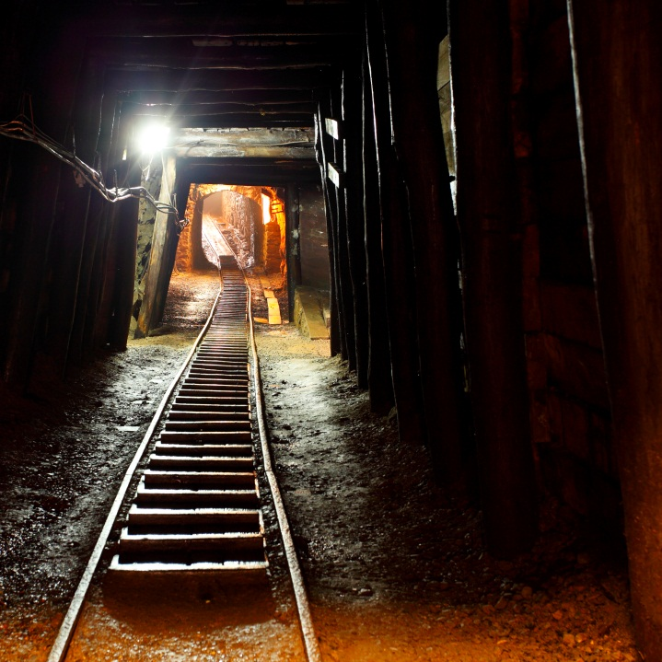
Reasonably practicable – origins
1949 Edwards v National Coal Board
Was it reasonably practicable to prevent even the smallest possibility of a rockfall in a coal mine?
Mr Edwards died after the supporting structure of the roadway failed
NCB argued that it was too expensive to shore up every roadway in all of their mines
Case turned on “not all needed shoring… just the ones requiring it”
= Risk assessment
SAFE
EXPLORATION

Slide 30
Quantum of risk
Judge Asquith
“ Reasonably practicable is a narrower term than ‘physically possible’ and implies that a computation must be made….in which the quantum of risk is placed in one scale and the sacrifice involved in the measures necessary for averting the risk (whether in time trouble or money) is placed on the other and that, if it be shown that there is a great disproportion between then – the risk being insignificant in the relation to sacrifice – the person upon whom the obligation is imposed discharges the onus which is upon him.”
SAFE
EXPLORATION

Slide 31
Quantum of risk
SAFE
EXPLORATION
Quantum of risk severity and likelihood of event
Sacrifice in time, money and trouble
Notes:
The cost of a risk treatment or risk control should be proportionate to the quantum of risk, not the financial circumstances of the business. Reasonably practicable does not mean reasonably affordable.

Slide 32
Modernised resources safety legislation
Principal hazard management plans (PHMPs)
Principal control plans (PCPs)
Managing other hazards
Notes:
Under the nationally harmonised legislation, a mine operator must ensure risk management processes and procedures, including risk assessments, are implemented at the mine.
“Work health and safety management systems” refers to that part of the overall management system which includes:
organisation structure
planning activities
responsibilities
practices
procedures
processes
resources for developing, implementing, achieving, reviewing and maintaining policies, and managing the work health and safety risks associated with the mining operations.

Slide 33
Principal hazard management plans (PHMPs)
What is a principal hazard?
A hazard associated with mining operations that, although it has a low likelihood of occurrence, has the potential for multiple fatalities, including cumulative.
What is a PHMP?
Plan that documents how risks to health and safety of a person arising from principal hazard will be eliminated or mitigated so far as is reasonably practicable (SFAIRP).
Notes:
Prescribed principal hazard management plans (PHMPs)
Prescribed principal hazards.
Ground or strata control.
Inundation and inrush.
Mine shafts and winding operations.
Roads and other vehicle operating areas and traffic management.
Air quality, airborne dust and other airborne contaminants.
Fire and explosion.
Gas outbursts.
Spontaneous combustion.
Ionising radiation.

Slide 34
What is a principal control plan (PCP)?
Definition
Identifies controls implemented to manage risks to health and safety of persons in mining operations
Monitors and ensures effectiveness of controls
PCPs listed in national model legislation:
Mechanical engineering (includes structures)
Electrical engineering
Ventilation
Explosives
Health
Plan developed to manage risks arising from the aggregation and/or interaction of principal hazards
Notes:
Here is the definition.
What does it really mean? What’s the difference between a PHMP and principal control plan (PCP)?
The easiest way to explain is to look at what PCPs will be required for.
A PCP must:
Cover life cycle of the particular plant, equipment, processes, procedures and practices relevant to the plan.
Be developed, implemented and periodically reviewed through consultation with a qualified and competent person, commensurate with the risks of the mining operation.

Slide 35
Option for managing other hazards
Identify reasonably foreseeable hazards
Assess risks
Eliminate or mitigate hazards identified
Monitor controls
Expected outcomes – benefits?
Criteria against which to evaluate

Slide 36
Work Health and Safety (Resources) Bill
MINING
Mines Safety and Inspection Act 1994
PETROLEUM
Petroleum and Geothermal Energy Resources Act 1967
Petroleum Pipelines Act 1969
Petroleum (Submerged Lands) Act 1982
Petroleum and Geothermal Energy Safety Levies Act 2011
MAJOR HAZARD FACILITIES
Dangerous Goods Safety Act 2004
Occupational Safety and Health Act 1984 (WorkSafe)
Notes:
The three main petroleum Acts will be retained, but safety provisions move to WHS (Resources) Bill.
Major hazard facilities (MHFs) provisions from the Dangerous Goods Safety Act 2004 and Occupational Safety and Health Act 1984 will be covered under the Bill.
Also, 12 sets of safety regulations and 2 sets of cost recovery regulations are being consolidated into just 1 set of regulations.
Cost recovery models are unchanged, but a review will be undertaken later, with separate consultation.

Slide 37
WHS (Resources) Bill
SEP-NOV 2014
RIS on structure
JAN 2015
Decision RIS recommends consolidation
MAR 2015
Development of drafting instructions
JUL-AUG 2015
Consultation RIS on WHS (Resources) Bill
OCT 2015
Decision RIS
NOV 2015
Cabinet approval to draft Bill
DEC 2015-MAR 2016
PCO draft Bill
APR-AUG 2016
Bill in Parliament
1 JAN 2017
Act implemented
Notes:
Tight timeframe.
Public comment period ended 14 August 2015. Responses are being analysed for the decision RIS.
Decision RIS will go to Minister for consideration.
Transitional arrangements to be developed in consultation with stakeholders.
Post-implementation, the Department of Mines and Petroleum will focus on providing support and guidance to operators.

Slide 38
WHS (Resources) Regulations
JUL-NOV 2015
Develop mock-up regs
NOV 2015-FEB 2016
Consultation via MAP & workshops
MAY-JUN 2016
Consultation RIS on regs
SEP 2016
Decision RIS on regs
SEP-DEC 2016
PCO draft regs
1 JAN 2017
Act implemented
Notes:
Mock-up regulations currently being drafted – copies will be provided to the Ministerial Advisory Panel.
Stakeholder workshops will be held on specific issues from November 2015.
Regulations will be considerably modified from the model WHS Regulations, with removal of excess prescription and unnecessary detail.

Slide 39
Designers and manufacturers’ obligations
Designers or manufacturers supplying plant or equipment to a WA resources site must ensure it meets Australian safety and health requirements.
Example:
Designer of a crane must ensure it is designed to Australian requirements
PCBU (Person carrying on a business or undertaking) for the resources site is not responsible for design or fabrication of the crane. However, the PCBU is responsible for safe operation of the crane on site.
Notes:
Department of Mines and Petroleum (DMP) inspectors can request independent validation of infrastructure, plant or equipment. If anomalies are identified, approval may not be given by DMP.
A PCBU is the legal entity operating a business or undertaking. A PCBU may be an individual person or an organisation conducting the business or undertaking.
In mining, this is currently the principal employer or contractor.
In petroleum, MHFs and Dangerous Goods sites, this is currently the operator.
This is not a new position; the PCBU replaces and broadens the scope of ‘employer’.

