Slide 1
Please read this before using presentation
The Department of Mines and Petroleum (DMP) supports and encourages reuse of its information (including data), and endorses use of the Australian Governments Open Access and Licensing Framework (AusGOAL)
This material is licensed under Creative Commons Attribution 4.0 licence. We request that you observe and retain any copyright or related notices that may accompany this material as part of attribution. This is a requirement of Creative Commons Licences.
Please give attribution to Department of Mines and Petroleum, 2015.
For resources, information or clarification, please contact:
RSDComms@dmp.wa.gov.au or visit
www.dmp.wa.gov.au/ResourcesSafety

Slide 2
Structural integrity: What is your responsibility?

Slide 3
What are we going to cover?
Duties of:
Designers
Manufacturers
Importers
Suppliers
Installers and erectors
Principal employers
Employees
Other employers and self-employed persons
Risk-based and precautionary approaches to meeting duty of care obligations

Slide 4
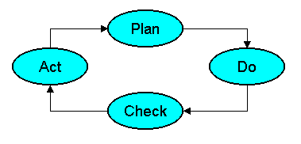
Words of wisdom
Words of wisdom from a management guru: William Edwards Deming.
“Learning is not compulsory….But neither is survival.”
“The worker is not the problem. The problem is at the top! Management!”
“A system must be managed. It will not manage itself.”

Slide 5
Setting the scene
Mines Safety Bulletin no. 43 issued in August 1998 is still highly relevant today.
Inspectors are continuing to observe the same type of issues raised in MSB 43 with disturbing frequency:
Excessive corrosion damage
Dangerous modifications
Inadequate design
Drawings missing important design information
As-built plant not checked or verified against design
Structural integrity not proactively managed over life cycle
Notes:
Mines Safety Bulletin No. 43 Structural safety of buildings and plant can be downloaded from Department of Mines and Petroleum’s website
www.dmp.wa.gov.au/Safety/Mines-safety-alerts-13194.aspx

Slide 6
Is it safe? Managing plant structures
Does full compliance with legislation = Safe?
Does full compliance with Australian Standards = Safe?
Does controlling risks to pre-defined residual risk levels = Safe?
Does controlling risks to ALARP levels (As Low As Reasonably Practicable) = Safe?
Does controlling risks to SFAIRP levels (So Far As is Reasonably Practicable) = Safe?
Does controlling risks using a ‘safety case’ = Safe?
What criteria do the courts apply when deciding negligence or breach of duty of care?
When is it safe enough?
Notes:
Compliance alone (the first two questions) is usually not enough to fully protect people from harm. If you only think in terms of compliance then you may have a vulnerable safety culture.
The risk management methodology (3rd and 4th questions) – when properly applied by competent persons, together with any mandatory requirements – should provide better risk control than compliance alone. However, an excessive preoccupation with achieving corporate risk criteria, predefined acceptable risk levels, risk ranking and re-ranking may distract people or provide an excuse for not doing everything reasonably practicable to control risks.
The due diligence or the precautionary approach (5th and 6th questions), together with any mandatory requirements, should provide the best safety outcomes.
The SFAIRP (so far as is reasonably practicable) concept aligns with duty of care obligations enshrined in current mines safety legislation in Western Australia.

Slide 7
Consider these duties and obligations
Designers
Manufacturers
Importers
Suppliers
Installers and erectors
Principal employers
Employees
Other employers and self-employed persons

Slide 8
Designers
Specific duties of designers of plant given in section 14 (MSIA) and regulations 6.3, 6.4, 6.5 and 6.33 (MSIR) ― these parts of legislation are specifically directed at the designer and may potentially be used in a prosecution of a designer
Many other parts of MSIA and MSIR also affect how plant is designed but are not specifically directed at designer ― they are directed at manager of the mine or responsible person at the mine
Also a general duty of care under common law
Notes:
As a minimum, designers are required to comply with the law – that is, any sections of an Act or Regulations that have relevant jurisdiction (legal authority over what a designer does), and are specifically directed at the designer.
Section 14 of the Mines Safety and Inspection Act 1994 (MSIA) contains the duty of care obligations of the designer (whether company or individual). This is a legal obligation, regardless of any commercial or contractual arrangements with the client or purchaser. No form of indemnity insurance (or disclaimer) can protect a designer if charged with a breach of the legislation.
The Mines Safety and Inspection Regulations 1995 (MSIR) contain numerous regulations specifically directed at designers. These are also legal obligations, regardless of any commercial or contractual arrangements with the client or purchaser.
To be found guilty of a breach of the MSIA or MSIR, the regulator must separately prove each of the charges to a magistrate who will judge the matter to the criminal standard of proof “beyond reasonable doubt.”
A designer may also be found guilty of gross negligence if it is proven that they knowingly or deliberately exposed people to harm.
Regardless of the obligations under the MSIA and MSIR for designers, there is always the possibility that any party who has suffered damages (e.g. injury, financial loss) could initiate legal proceedings seeking compensation for negligence.
Civil negligence or common law negligence is a ‘tort’ rather than a crime. Civil negligence requires a lower standard of proof “on the balance of probabilities” rather than the criminal standard of proof of “beyond reasonable doubt.”

Slide 9
Manufacturers
Specific duties for manufacturers of plant are in section 14 (MSIA) and regulations 6.6, 6.7 and 6.8 (MSIR) ― these relate to hazard identification, risk assessment and risk reduction
If the designer is outside of the jurisdiction of the State, the manufacturer is responsible for the duties of designer (MSIR reg. 6.6)
Also a general duty of care under common law
Notes:
Similar legislative obligations apply to manufacturers as for designers.

Slide 10
Importers
Specific duties for importers of plant are in section 14 (MSIA) and regulations 6.9, 6.10 and 6.11 (MSIR) ― these relate to hazard identification, risk assessment, risk reduction and provision of adequate information
If designer and manufacturer are outside of the jurisdiction of the State, importer is responsible for duties of designer and manufacturer (MSIR regulation 6.9)
Also a general duty of care under common law
Notes:
Again, similar legislative obligations apply to importers.

Slide 11
Suppliers
Specific duties for suppliers of plant are in section 14 (MSIA) and regulations 6.12 and 6.13 (MSIR) ― these relate to risk assessment and providing adequate information
Persons can become a supplier through hiring or leasing of plant ― duties of such persons are covered by regulation 6.14 (MSIR)
Also a general duty of care under common law
Notes:
Again, similar legislative obligations apply to suppliers.

Slide 12
Installers and erectors
Specific duties of installers and erectors are in section 14 (MSIA) and regulations 6.15 and 6.16 (MSIR) ― these relate to hazard identification, risk assessment and risk reduction
Also a general duty of care under common law
Notes:
Again, similar legislative obligations apply to installers and erectors.

Slide 13
Principal employers
In relation to plant safety, the main obligations placed on principal employer include:
Section 9 (MSIA) (Employer’s duty of care)
Reg. 6.2 (MSIR) (Plant to be operated and maintained in a safe manner)
Regs 6.17, 6.18 (Risk identification and hazard reduction)
Reg. 6.20 (Installation and maintenance)
Reg. 6.21 (Prevention of unsafe use)
Reg. 6.22 (Duties when plant is damaged or repaired)
Reg. 6.24 (Dismantling and Storage)

Slide 14
Principal employers continued
Reg. 6.25 (Keeping of records)
Reg. 6.26 (Plant under pressure)
Reg. 6.27 (Plant with moving parts)
Reg. 6.28 (Plant with hot or cold parts)
Reg. 6.29 (Electrical hazards)
Regs 6.30, 6.31 (Industrial robots and lasers)
Part 6, Division 3 (MSIR) – Suite of regulations relating to classified plant and registered classified plant
Reg. 4.4 (Guards and handrails)

Slide 15
Principal employers (continued)
Reg. 4.10 (Safety signs)
Numerous regulations in Parts 11 and 12 (MSIR) that relate to winding engines, hoists and shaft sinking equipment
Numerous regulations in Part 14 (MSIR) that relate to dredges

Slide 16
Employees
Main duties of employees are in section 10 (Employee’s duty of care) and section 11 (Reporting of occurrences) of the MSIA
Notes:
All employees working at a mining operation (including contractors and visitors) have a legal duty, under s. 10 of the Mines Safety and Inspection Act 1994 (MSIA), to take reasonable care to ensure they do not expose themselves or others to harm through any act or omission at work.
All employees working at a mining operation (including contractors and visitors) have a legal duty, under s. 11 of the MSIA, to report any observed or potential hazards and any potentially serious incidents to their immediate supervisor/manager (as a minimum).

Slide 17
Other employers and self-employed persons
Duties are in section 12 (MSIA)
Essentially a duty of care requirements
Notes:
The duties and obligations on self-employed persons working at a mining operation are very similar to the duties and obligations on employees – to take reasonable care to ensure they do not expose themselves or others to harm through any act or omission at work.

Slide 18
Complying with duty of care responsibilities –risk-based approach
Risk management methodology of AS/NZS ISO 31000 includes following steps:
Establish the context – decide risk assessment criteria
Risk identification – Hazard ID
Risk analysis – Determine existing controls, likelihood and severity
Risk evaluation – Compare calculated risk level against acceptable risk criteria
Risk treatment – Develop and implement actions to reduce risk to acceptable levels
Notes:
Most risk assessment tools used at mining operations are based on the AS/NZS ISO 31000 approach to risk management – identify, quantify and treat the risk.
Hazard identification and risk assessment tools such as JSAs, JHAs, Take 5s, WRACs, CRAWs and HAZOPs are all based on this high level methodology.
In conjunction with the various risk assessment tools, many mining operations use a variation of the 5 x 5 matrix (likelihood x severity) to evaluate risks. The 5 x 5 matrix used is usually defined in the corporate risk management policy or procedure, which also defines what the operation’s acceptable risk level is (i.e. green squares of the 5 x 5 matrix).

Slide 19
Risk management process
Notes:
Diagrammatic representation of risk management process taken from AS/NZS ISO 31000.

Slide 20
AS 5104:2005 General principles on reliability of structures
Introduces concept of a target ‘Reliability Index’ (β) or failure probability for structures. These apply to the ultimate and serviceability limit states of structure for a defined period of time (design life).
β = 4.7 corresponds to probability of a person present in building at time of collapse getting killed, P = 10⁻⁶ per year. AS 1170 codes are based on this criteria.
However, despite β value used by designers, most failures are actually result of ‘gross errors’
Notes:
AS 5104 General Principles on Reliability of Structures (identical to ISO 2394) introduces the concept of a target ‘reliability index’ (β), or failure probability for structures. These apply to the ultimate and serviceability limit states of a structure for a defined period of time (i.e. design life).
The reliability index where β = 4.7, corresponds to probability of a person present in building at time of collapse getting killed; and P = 10⁻⁶ per year (i.e. 1 in a million chance per year). All of the AS/NZS 1170 suite of loading codes are based on this criteria.
AS 5104 is a precursor standard to the AS/NZS 1170 codes. It is not about a ‘safety factor’ – it is about the probability of someone being fatally injured, or ‘residual risk.’ One in a million per year is generally regarded as an acceptable risk level in many international standards that relate to safety of people.
However, despite the inherent β value built into the structure loading codes used by designers, most failures are actually the result of gross errors.
Any gross errors or defects – from design, fabrication, construction, maintenance –present in plant structures may mean that the β value is not 4.7. Therefore the new (unknown) residual risk level may be higher than is acceptable (reasonable practice).

Slide 21
What does the legislation say?
Current mines safety legislation does not require risk of structural failure to be controlled to a pre-determined risk or reliability level
Expectation of employer’s duty of care obligations (section 9 MSIA) is that all risks of employees exposure to hazards are controlled to SFAIRP levels (So Far As Is Reasonably Practicable)
Reasonably practicable is defined in section 4(1) (MSIA)
Notes:
Although there is no acceptable risk level mandated by legislation, there is a risk value built into the structural loading codes. There is an expectation that the AS 5104 (β = 4.7 ) residual risk level is achieved because it is established in industry (internationally) and built into the Australian structural loading codes (AS/NZS 1170) as reasonable practice.
SFAIRP (so far as is reasonably practicable) is a tidy acronym that is effectively the ‘duty of care’ obligation in s. 9 of the Mines Safety and Inspection Act 1994 (MSIA). It does not require any specific residual risk level to be achieved, but implies the highest level of protection (lowest level of risk) that is reasonably practicable. However, because the AS 5104 and AS/NZS 1170 codes are accepted as reasonable industry practice (reasonably practicable) then the β = 4.7 (or 1 in a million per year) residual risk levels are indirectly relevant (but not directly enforceable).
It is important to study the definition of practicable in s. 4(1) of the MSIA since this is key to understanding the duty of care and negligence concepts. It is important to understand that ‘practicable’ does not mean the same as ‘practical.’ The difference is not always commonly understood. Practical can mean quick, easy and cheap. Practicable or reasonably practicable means achieving a reasonable standard that can be expected from a reasonable (competent) person (i.e. good industry practice or best practice).
Reasonably practicable does not always mean reasonably affordable. The cost of a risk control measure should be considered in proportion to the risk it is controlling. However, the financial circumstances (e.g. budgets, affordability, cash flow) of a business are not relevant when deciding what is reasonably practicable.

Slide 22
Complying with duty of care responsibilities – precautionary approach
Focused on controls rather than evaluating risk or residual risk
Ensuring all reasonably practicable precautions are in place ― achieving the highest level of protection (SFAIRP) requires you to demonstrate ‘due diligence’
Risk management approach is about adding enough controls or precautions until an acceptable or tolerable level of residual risk is achieved ― requires you to demonstrate appropriate risk assessment.
Notes:
The precautionary approach (or due diligence approach) is all about complying with duty of care obligations by managing risk to the SFAIRP standard.
There is no calculation of residual risk or risk evaluation using a 5 x 5 matrix to inform risk treatment. There is no ranking and re-ranking of risks to decide whether action is required. Instead all reasonably practicable precautions must be adopted.
The hierarchy of controls concept is relevant when considering what is reasonably practicable. Risk ranking should only be used to prioritise actions, not avoid or defer actions that are reasonably practicable.

Slide 23
Complying with duty of care responsibilities – precautionary approach
A ‘safety case’ is a documented due diligence argument as to why an operation is considered to be safe.
“ …the safety case is a document – meant to be kept up to date – in which the operator sets out its approach to safety and the safety management system which it undertakes to apply….” Lord Cullen, 2001
Major Hazard Facilities (MHF) operate under a safety case environment – a contract between the organisation and the regulator that permits the organisation to operate within defined limits and in accordance with documented procedures
Notes:
Safety case legislation does not apply to mining operations in Western Australia.
The Mines Safety and Inspection Act 1994 and the Mines Safety and Inspection Regulations 1995 have a mixture of risk-based and prescriptive requirements.

Slide 24
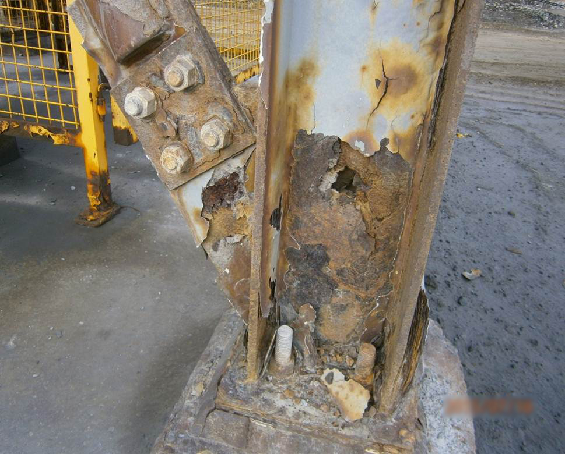
Discussion
Has this column already failed?
What is correct response?
Who is responsible and accountable for managing such an issue on your site?
What management systems do you have to control such hazards?
Notes:
DISCUSSION OF FAILURE
The column has failed as it can no longer be expected to support the loads it was designed for. It is most likely still standing as a worst case load combination (e.g. wind and fully loaded) has not been imposed.
The correct response is to get the structure immediately assessed by a competent person (usually a competent structural engineer) who can:
recommend immediate temporary actions to make it safe
recommend permanent repair actions
assess the risk of collapse
recommend the priority (e.g. repair immediately or within a timeframe).
This is a legal obligation of the employer under r. 6.22 Mines Safety and Inspection Regulations 1995 (MSIR).
Under r. 6.22 MSIR the employer is responsible for ensuring a competent person makes an assessment and the necessary recommended actions are completed. The employer’s duty of care under s. 9 of the Mines Safety and Inspection Act 1994 (MSIA) is also applicable.
Employees have a duty to report such hazards under s. 11 MSIA.
Safety and health representatives should be taking up the issue and consulting with management when there is inadequate response – it is everyone’s problem.
Recommended management systems to control hazards:
Operators and maintainers should be trained to identify and report corrosion damage to structures.
Safety management systems should include procedures for regular periodic inspection or auditing of structures by competent persons, particularly in highly corrosive environments.
Repair actions should be prioritised based on risk assessment rather than budget or production priorities.

Slide 25
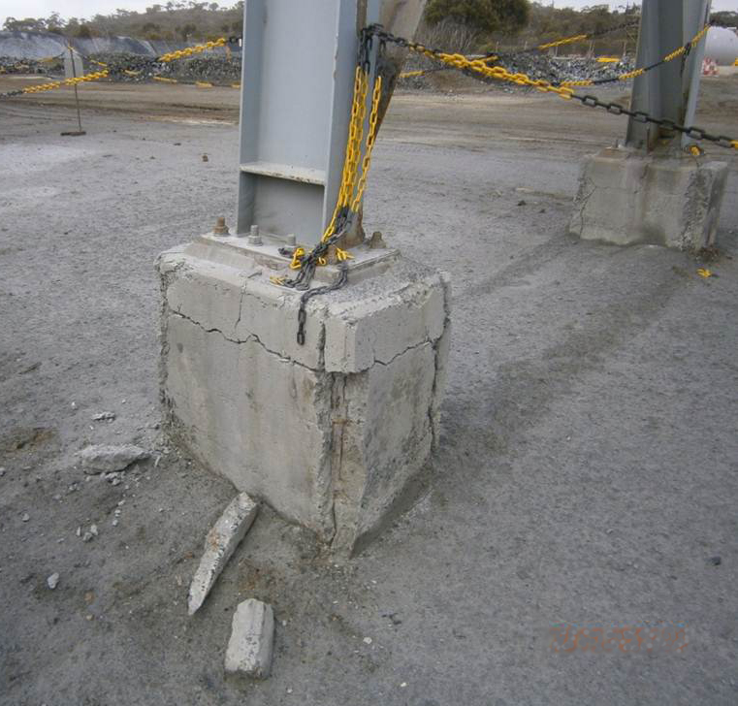
Discussion
Has this pedestal already failed?
What is the correct response?
Who is responsible and accountable for managing such an issue on your site?
What management systems do you have to control such hazards?
Notes:
Structures include foundations and founding ground conditions.
When reinforced concrete starts to crack, water ingress causes the steel reinforcement to corrode and expand, leading to spalling of the concrete cover over the reinforcement. Once the concrete cover starts to spall, this process accelerates, leading to rapid failure.
When reinforcing steel is lost to corrosion, the load-carrying capacity of the concrete is compromised.
Note: The questions raised in this slide are answered in the notes to the previous slide.

Slide 26
Some key messages to take away
The minimum safety factors required by the codes (AS 1170) that are built into properly designed and built structures must not be allowed to degrade over time for any reason. Otherwise this may expose personnel to hazards (i.e. breach of duty of care & Reg. 6.22). Therefore, additional robustness may be required in the initial design of mining structures and adequate controls put into effect to manage the inevitable misuse and damage.
Minimise gross errors by ensuring persons involved in designing, verifying, fabricating, installing, inspecting, repairing and maintaining plant structures are suitably competent.

Slide 27
More key messages
Establish reliable systems of work, procedures and sufficient resources to manage plant structures at all stages of the plant design life such that their reliability is not compromised. Plant structures will not manage themselves.
Don’t use risk assessments as an tool to justify doing nothing or deferring action. You cannot “kick the can down the road” forever. Adopt a precautionary approach ― be diligent and focus on having adequate risk controls ― use risk assessments to prioritise repair actions rather than defer them.

