Slide 1
Please read this before using presentation
This presentation is based on the content presented at the 2019 Registered Managers Forum in August 2019.
Department of Mines, Industry Regulation and Safety (DMIRS) supports and encourages reuse of its information (including data), and endorses use of the Australian Governments Open Access and Licensing Framework (AusGOAL)
This material is licensed under Creative Commons Attribution 4.0 licence. We request that you observe and retain any copyright or related notices that may accompany this material as part of attribution. This is a requirement of Creative Commons Licences.
Please give attribution to Department of Mines, Industry Regulation and Safety, 2019.
For resources, information or clarification, please contact: SafetyComms@dmirs.wa.gov.au or visit www.dmirs.wa.gov.au/ResourcesSafety

Slide 3
Safety Regulation System (SRS) Business Intelligence update

Slide 4
New SRS functionality – Exemptions
A company may seek an exemption from a specific requirement of the Mines Safety and Inspection Regulations 1995, where:
there is substantial compliance with the requirement (r. 1.4), or
compliance with the requirement would be unnecessary or impracticable (r. 1.5).
From October 2019 applications will be via SRS

Slide 5
New SRS functionality – Agreements
Agreement to operate without a quarry manager
Under certain conditions the principal employer can apply for approval to operate a quarry without a quarry manager.
Agreement to operate without an underground manager
A small syndicate can apply for an agreement to operate an underground operation without appointing an underground manager.
From October 2019 applications will be via SRS

Slide 6
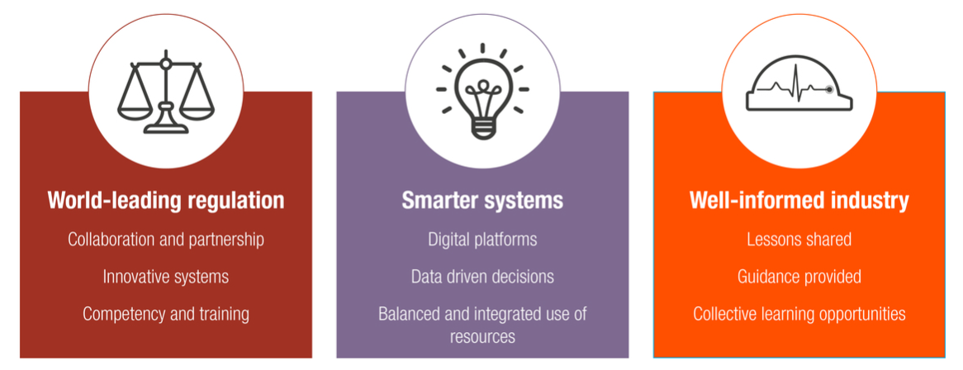
Context
Towards 2020
Smarter systems
Data driven decisions
Well-informed industry
Notes:
Delivering these Business intelligence reports to industry is in line with our Towards 2020 regulatory strategy.
We are working to deliver innovative and smarter systems. You will have seen this with the development in SRS and the introduction of new functionality in the system.
We are committed to making data driven decisions, and having a well-informed industry, of which these Business Intelligence reports are a critical factor.

Slide 7
Intent
To help you see information related to your mine(s) and trends over time
It’s the same information that inspectors see
Can be across an organisation (if you have access)
To see comparative safety information
Initially with operations mining the same commodity
Other comparisons planned (e.g. type of operation)
Help you stay on top of things
Complete actions in a timely manner

Slide 8
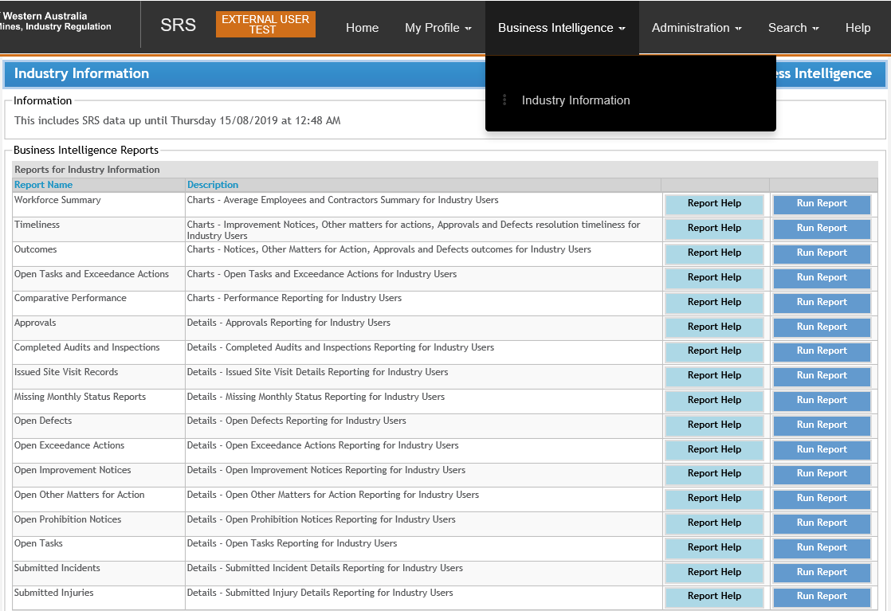
Available reports
Charts and trends
Details and lists

Slide 9
Navigation and selection
Report period
12 or 24 months
Principal Employer
Based on SRS security access
Combined operations (mines)
Can select one or multiple mines (based on SRS security access)
Site operations (areas of a mine)
Can select one or multiple areas
e.g. Open pit, Underground, Processing, Port

Slide 10
“Real time” information
Information is updated daily (overnight)
Whatever was ‘issued / completed’ yesterday is visible today
For 3 reports, industry submit information after the end of the month, so the information is 1 to 2 months old. (Clarified in Report Help)
Missing monthly status report
Workforce summary
Comparative information

Slide 11
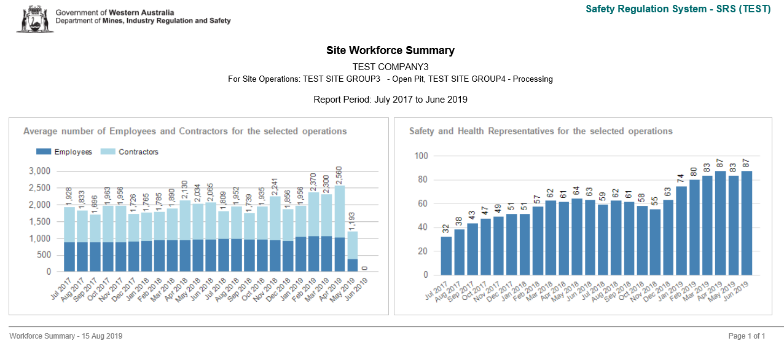
Sample chart: Workforce summary
Workforce and Safety and health representatives

Slide 12
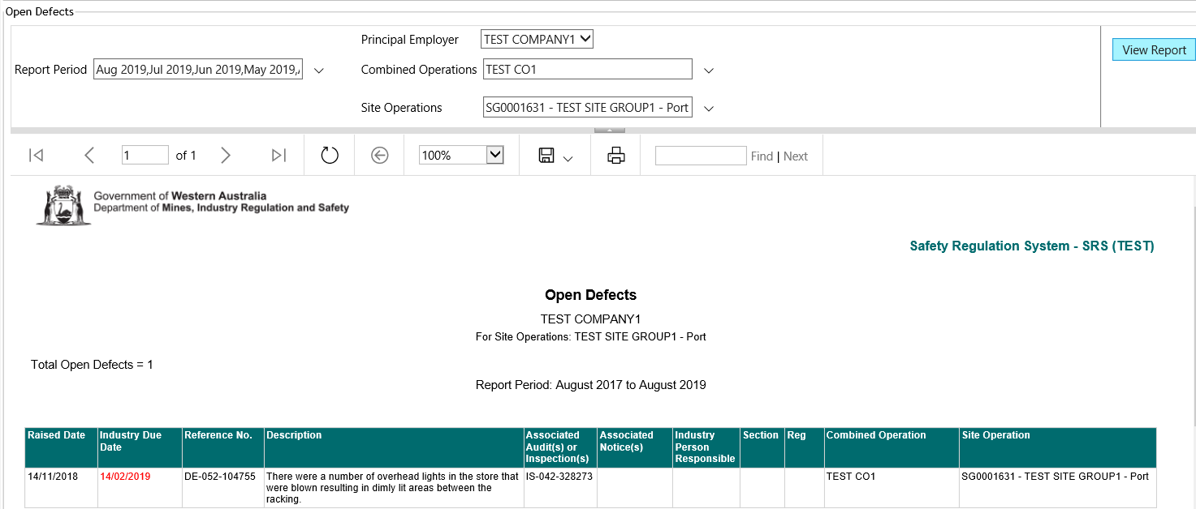
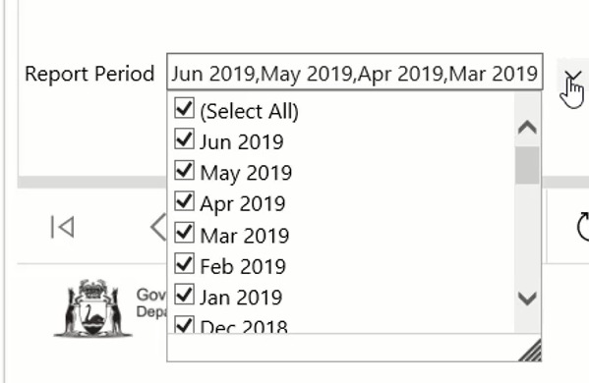
Sample detail report: Open defects

Slide 13
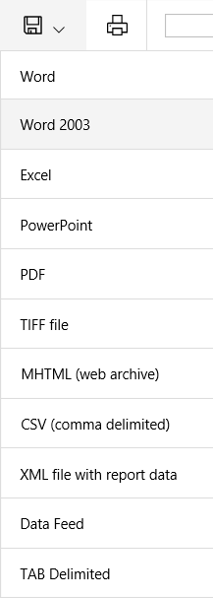
Information is easily exported
Charts
To Word, PowerPoint, PDF, etc.
Details
To Excel, etc.

Slide 14
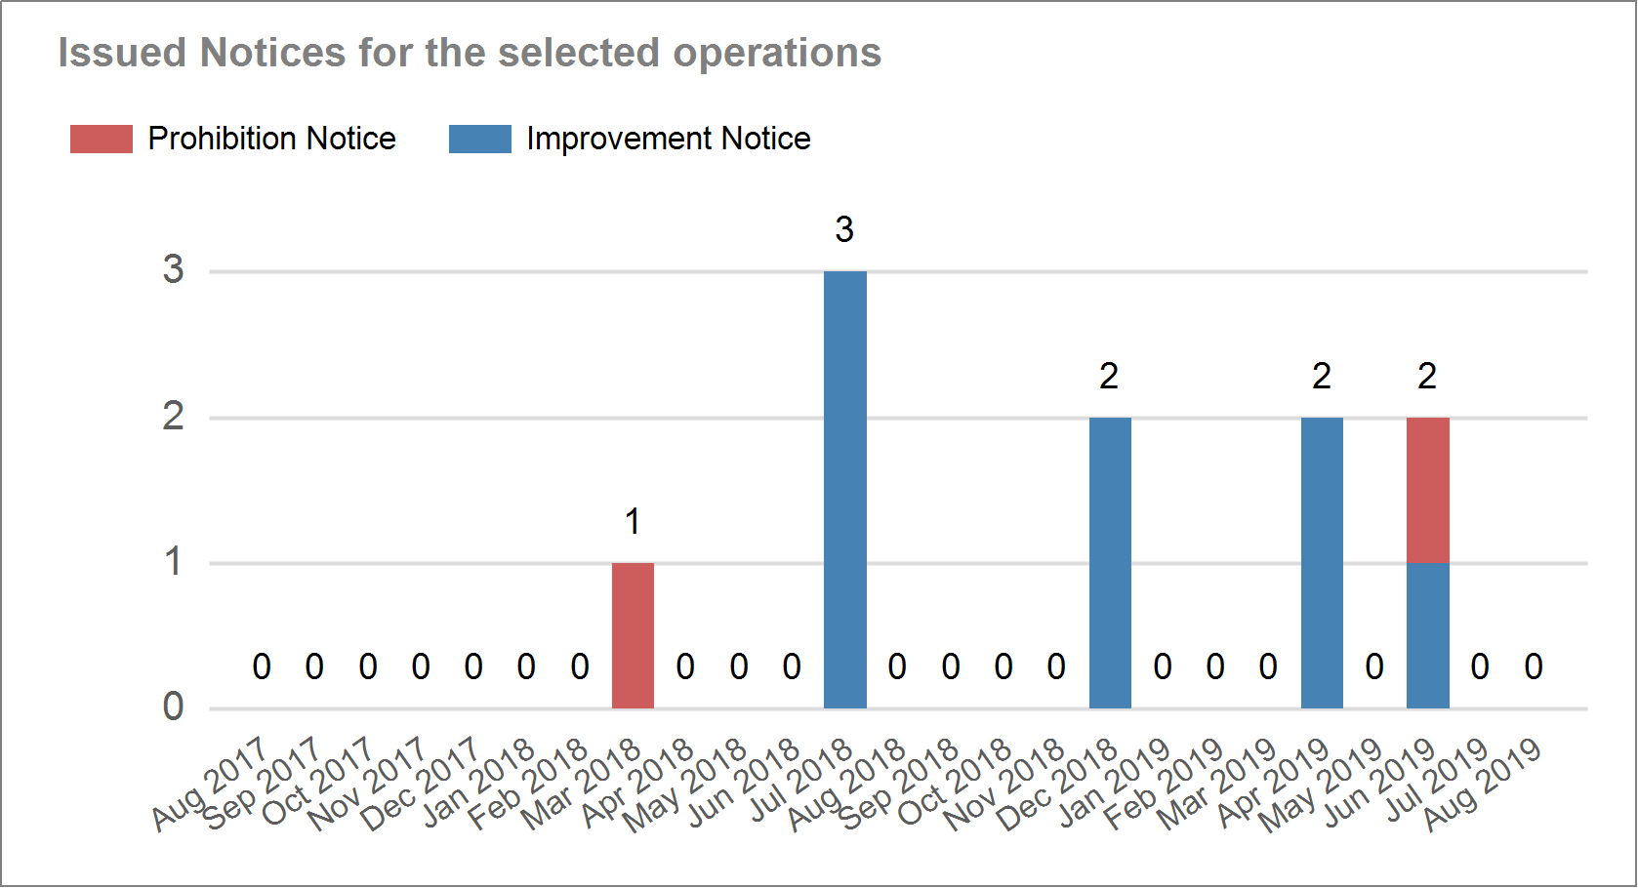
Outcomes: Issued notices

Slide 15
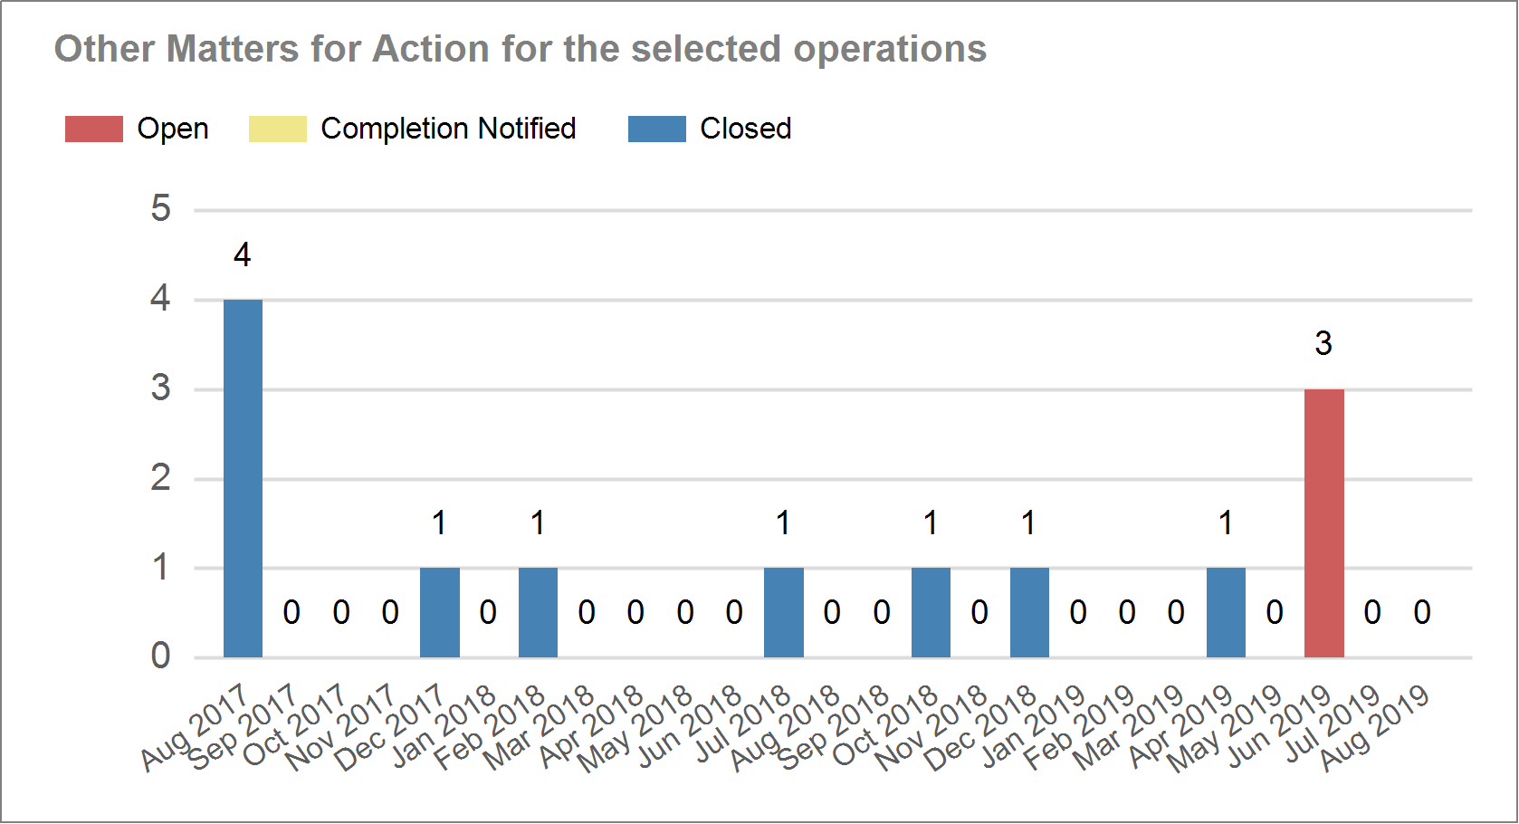
Outcomes: Other matters for action

Slide 16
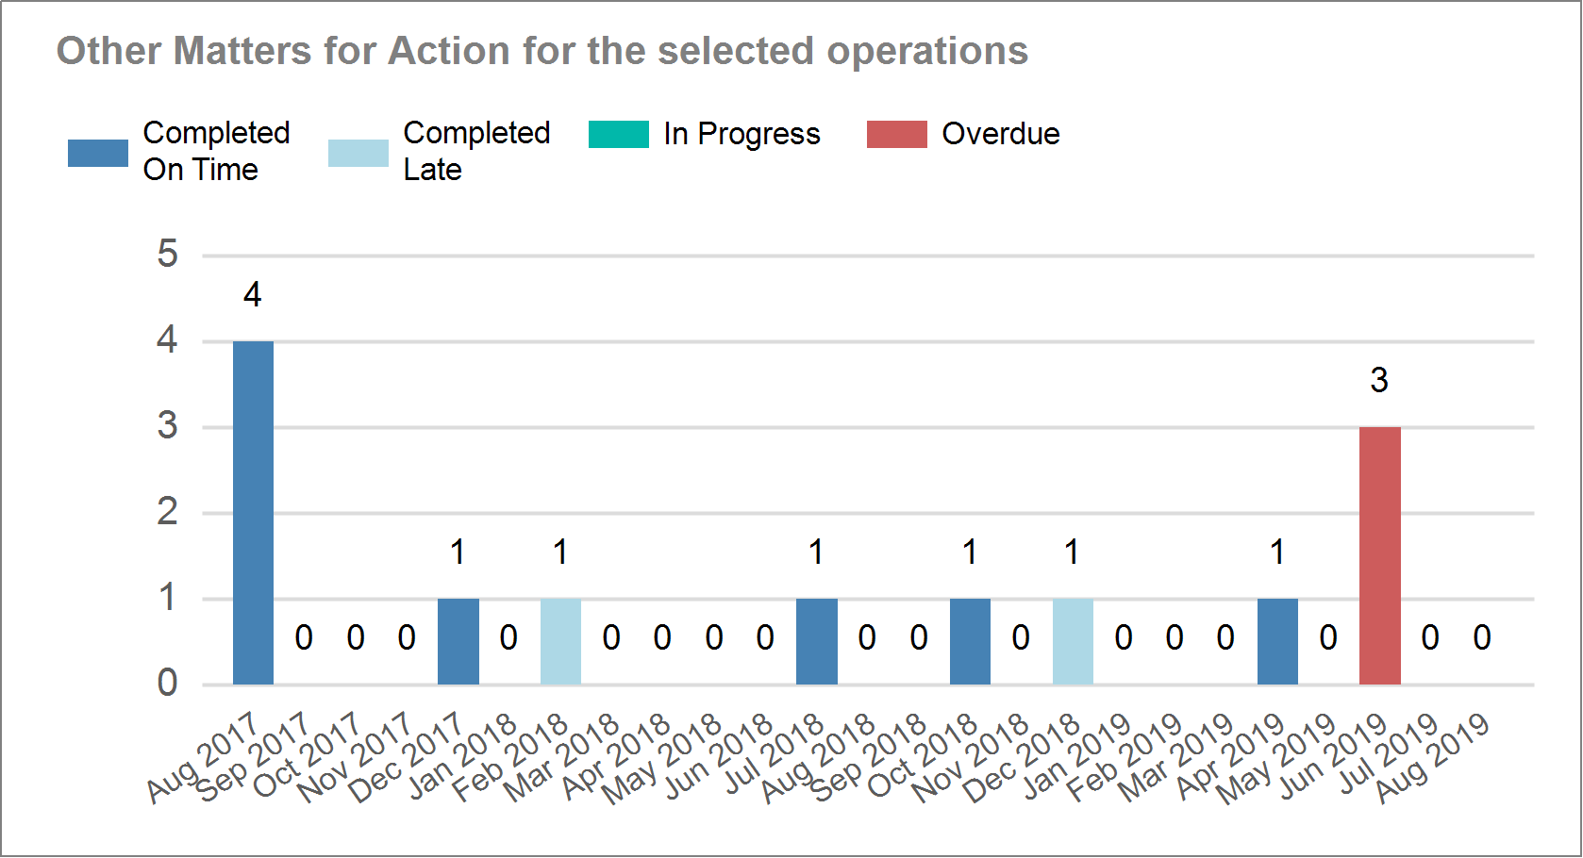
Timeliness: Other matters for action

Slide 17
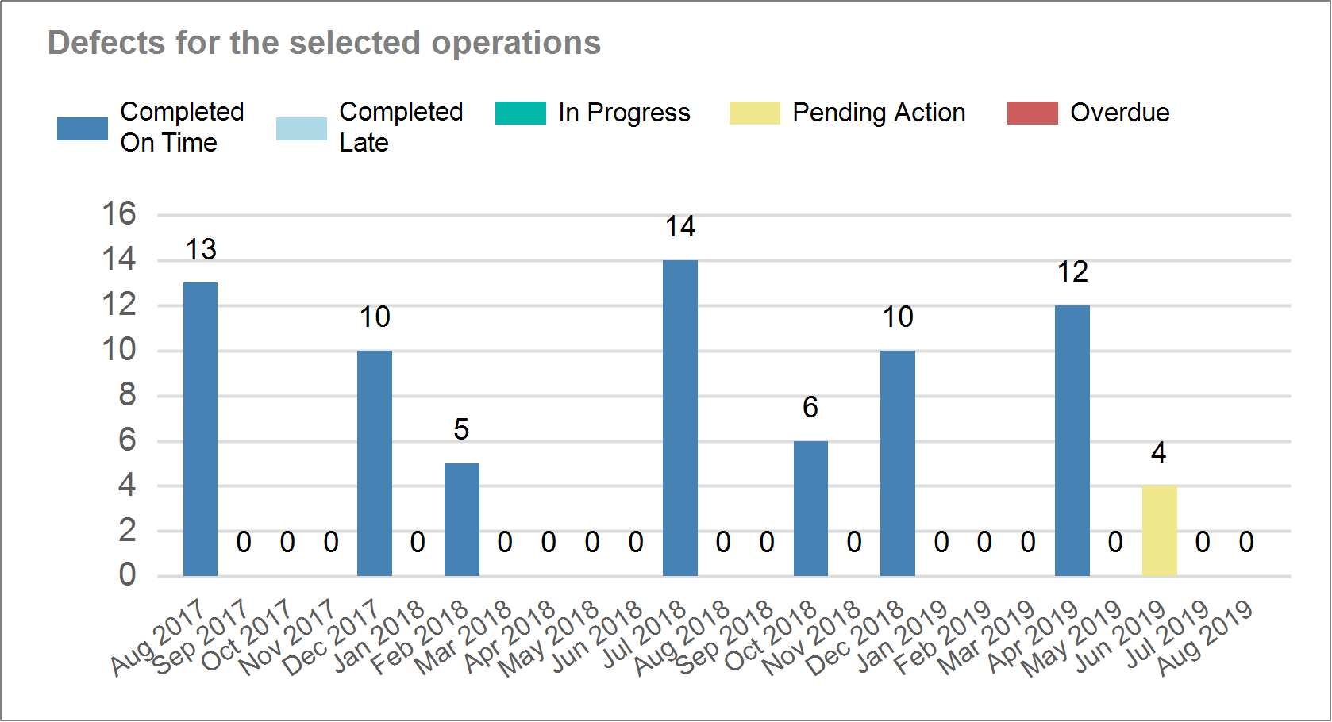
Timeliness: Defects

Slide 18
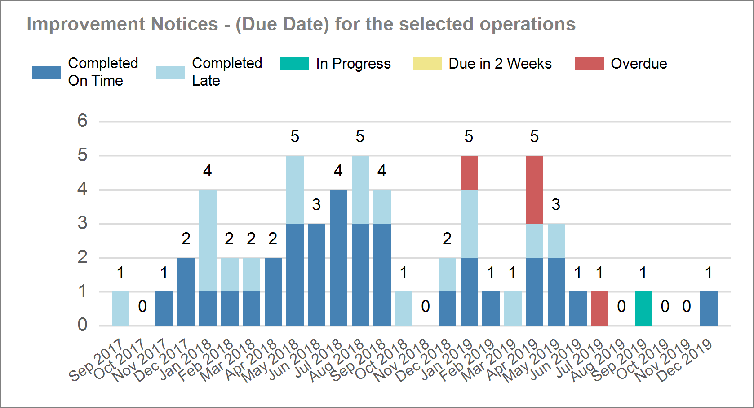
Timeliness: Improvement notices

Slide 19
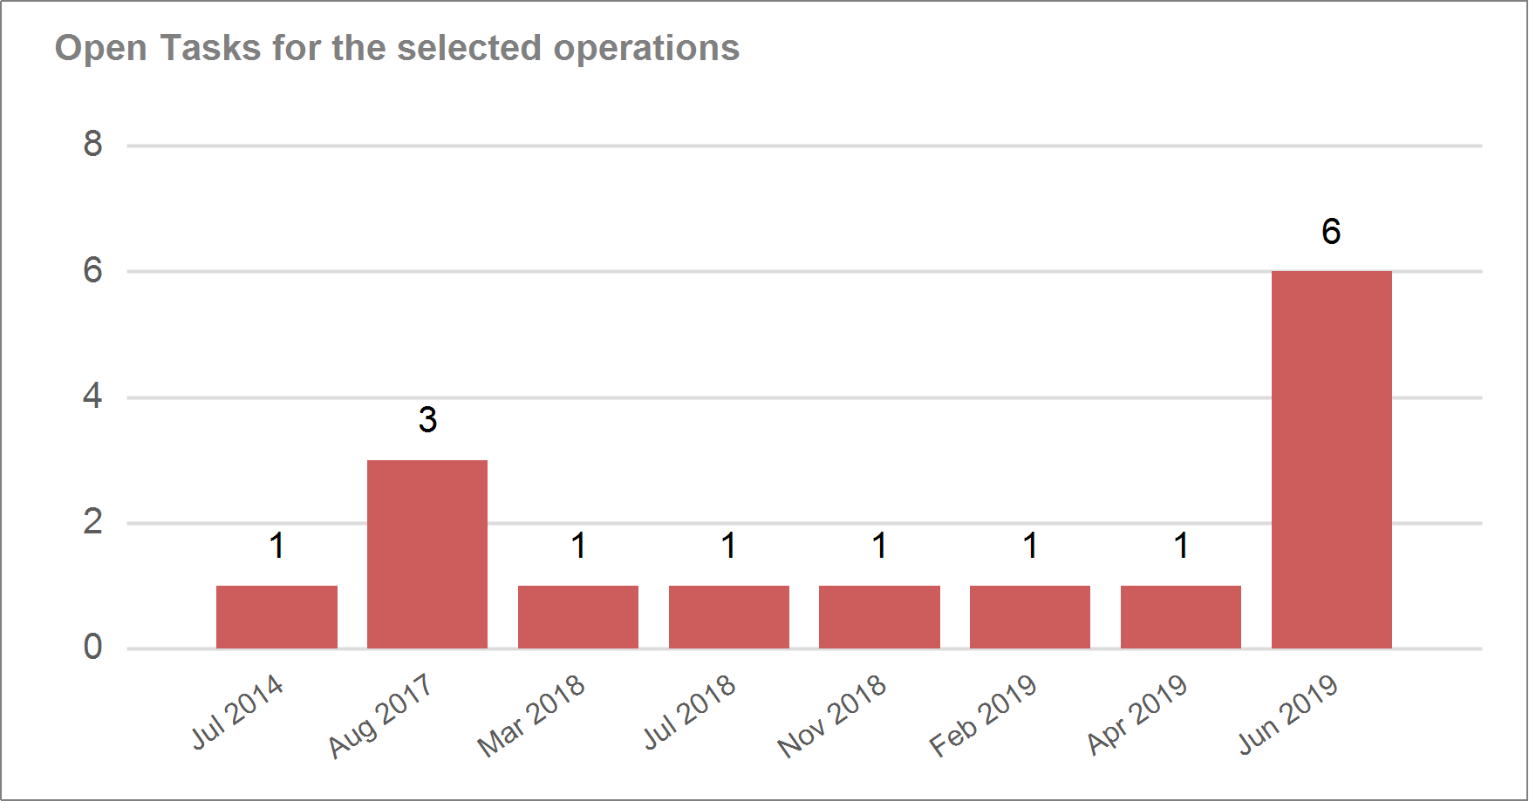
Open tasks

Slide 20
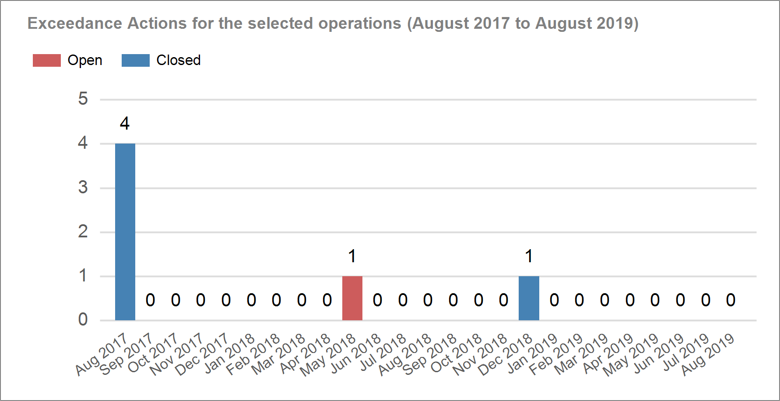
Open exceedance actions

Slide 21
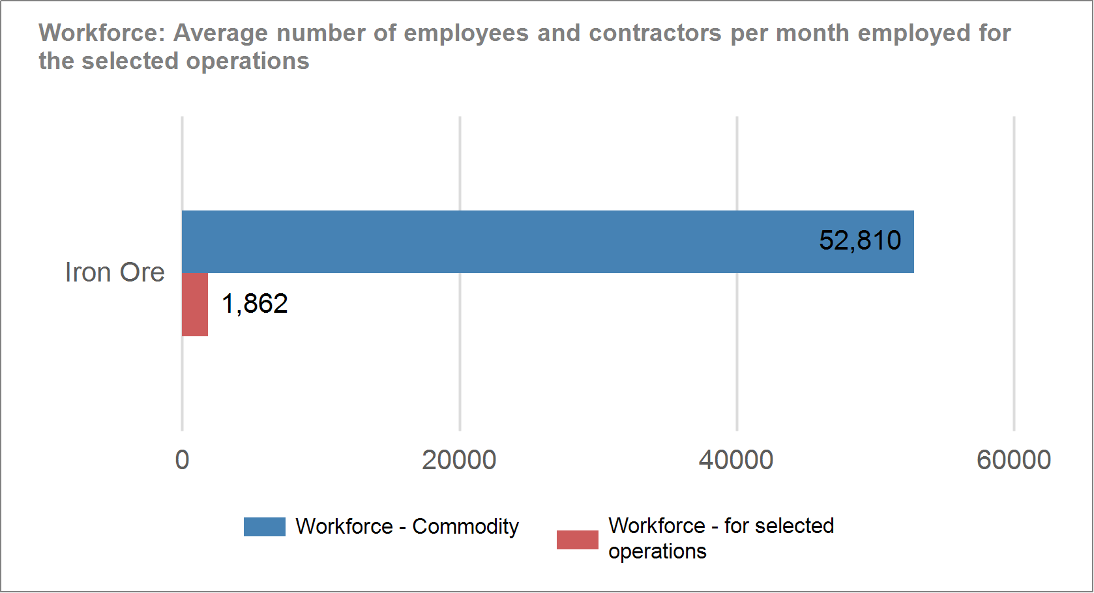
Comparative performance: Context

Slide 22
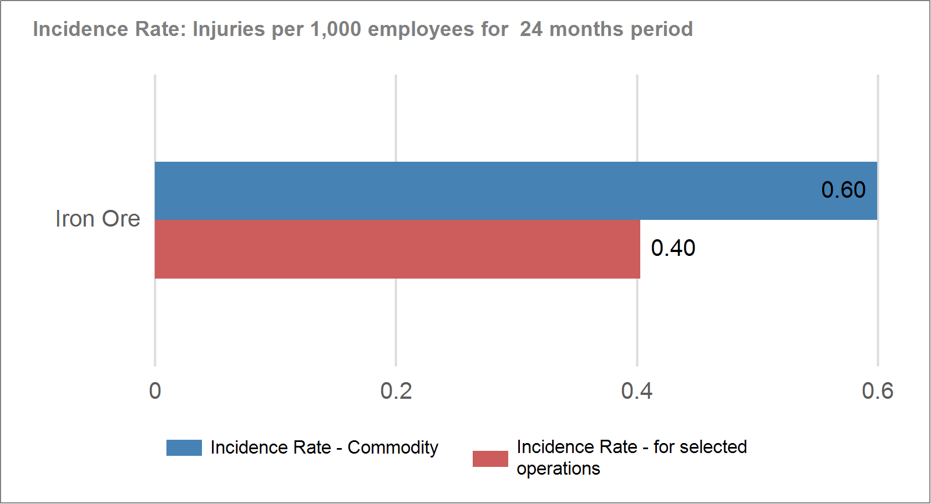
Comparative performance: Incidence rate

Slide 23
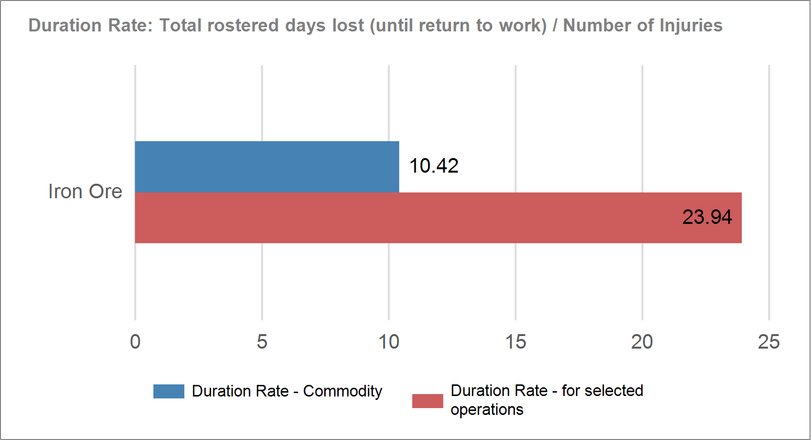
Comparative performance: Duration rate

Slide 24
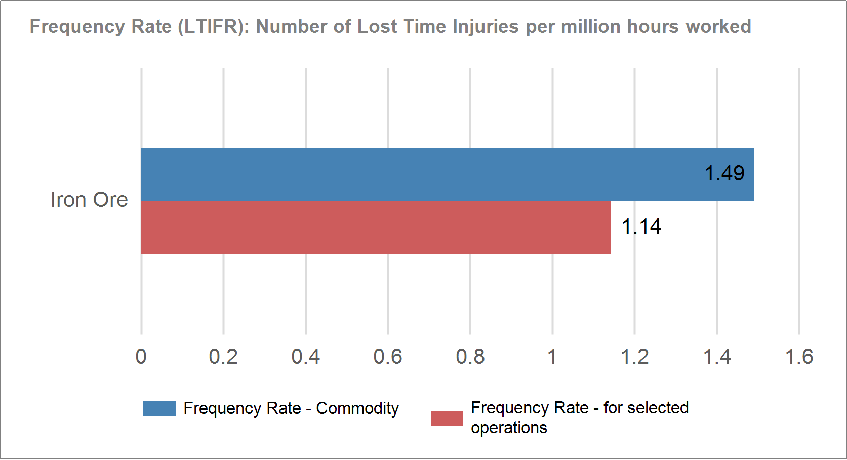
Comparative performance: Frequency rate

Slide 25
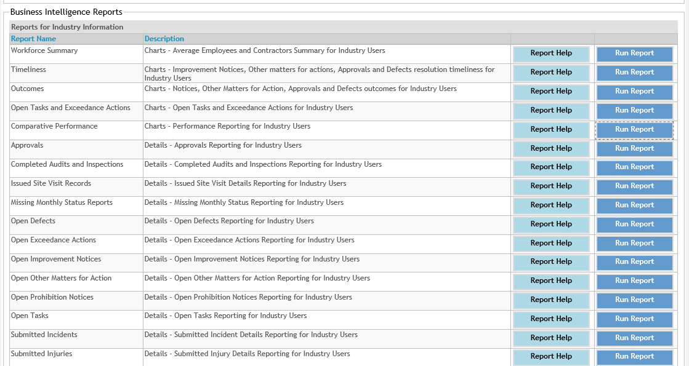
That’s just a sample

Slide 26
Early feedback from industry users
Some industry users reviewed this functionality in July.
Their feedback was extremely positive
“This is really good stuff”
“It is so user friendly”
“This will save us hours of work”
“Really like it”
“It’s easy to use, simple and gives us access to real time data”

Slide 27
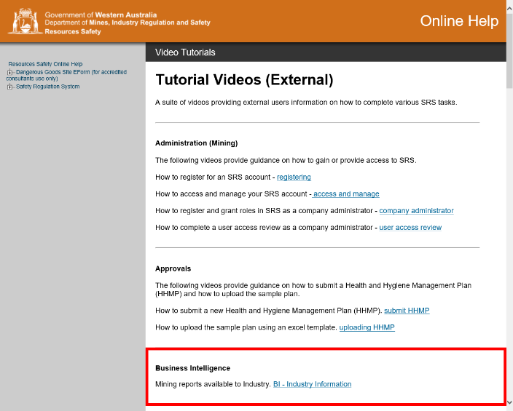
When is this available?
From today (23 August 2019) access has been granted to:
Registered Managers
Alternative Registered Managers
Company Administrators (for Compliance)
There is a short video (3.5 min) on Business Intelligence Reports
Access videos via SRS ‘Help’

Slide 28
Moving forward
We understand it may take some sites / organisations a little while to get on top of things
Inspectors will be able to assist you and will discuss your reports with you when they visit
Additional reports and functionality will be added over time

Slide 29
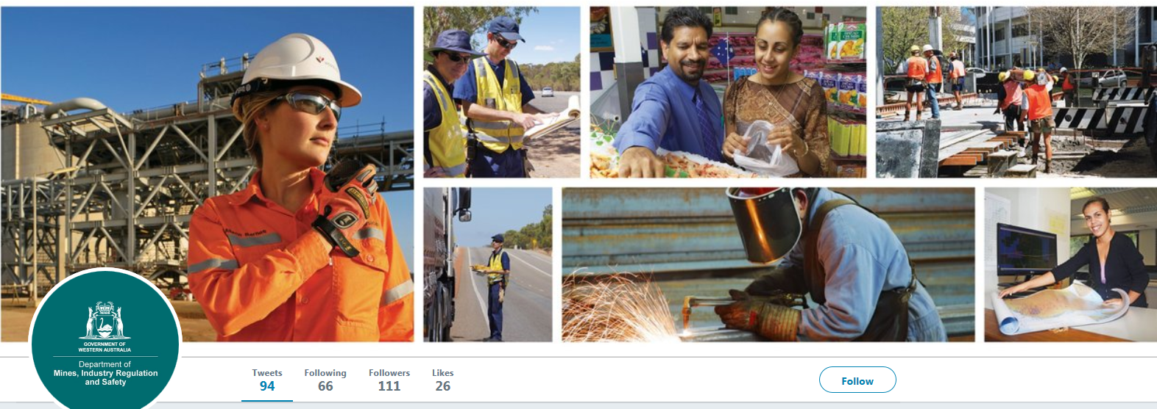
Follow us on social media and sign up for news alerts!
Twitter
@DMIRS_WA
@AndrewChaplyn
LinkedIn at Department of
Mines, Industry Regulation and Safety
Sign up to receive weekly news alerts @ www.dmirs.wa.gov.au
Notes:
Add slide about awards

