Slide 1
Please read this before using presentation
This presentation is based on the content presented at the 2019 Registered Managers Forum in August 2019.
Department of Mines, Industry Regulation and Safety (DMIRS) supports and encourages reuse of its information (including data), and endorses use of the Australian Governments Open Access and Licensing Framework (AusGOAL)
This material is licensed under Creative Commons Attribution 4.0 licence. We request that you observe and retain any copyright or related notices that may accompany this material as part of attribution. This is a requirement of Creative Commons Licences.
Please give attribution to Department of Mines, Industry Regulation and Safety, 2019.
For resources, information or clarification, please contact: SafetyComms@dmirs.wa.gov.au or visit www.dmirs.wa.gov.au/ResourcesSafety

Slide 3
Where are we going?
Regulating the mining industry in the future

Slide 4
Registered Managers Forum for Managers of Western Australian Mines
Regulating the mining industry in the future

Slide 5
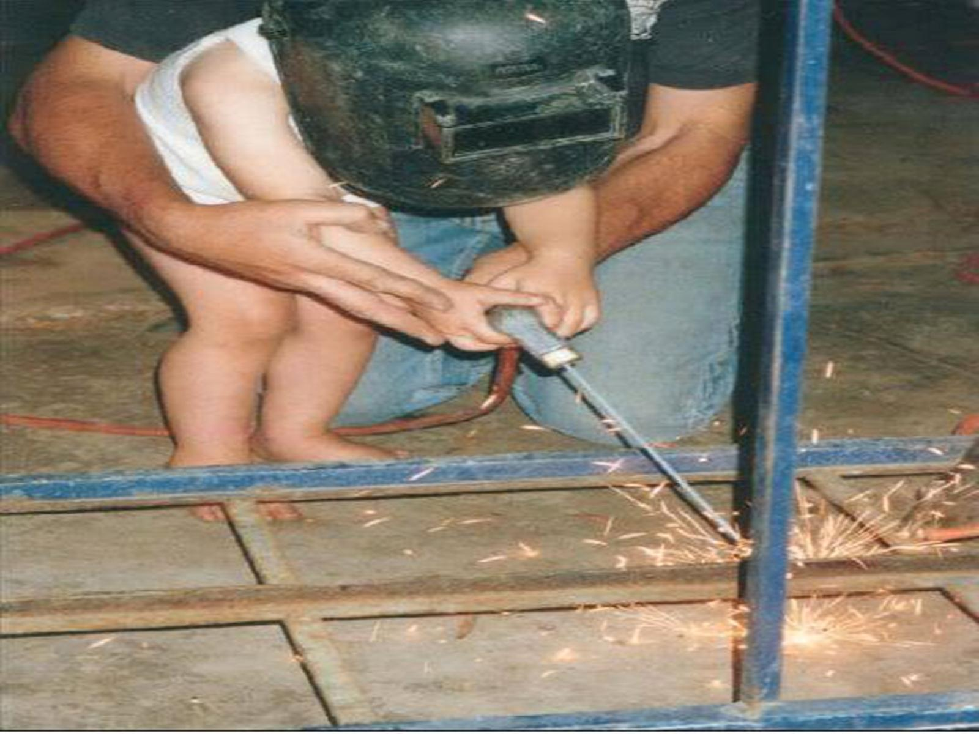
Notes:
Early training of the risk-takers of tomorrow.

Slide 6
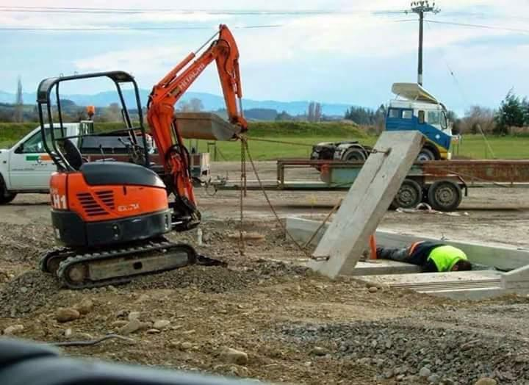

Slide 7
The Safety Ethos of the Workplace Leader
Scientia Est Potentia
“Deep and persistent safety problems are never solved by accident; they are solved only by the living..”
Dr Garry Claxton
Notes:
knowledge is power

Slide 8
The Sad Reality of Workplace Safety
According to Norris et al 2019*:
Most workers of the world share a common goal:
“To return home to their families after a shift or rotation”.
Yet recent ILO statistics inform us that every 12 x seconds a worker dies while at work.
In the words of Dr Lana Cormie who lost her husband Charlie to a workplace accident last year:
“Our daughter Sophie is four, our son, George, is one year old. My husband never came home he just became another dead body who is carried out of an Australian workplace every (1.54) days. His death was a result of a failure in the culture, values, systems and laws of our country. What is left is our broken family”..
*Professional Safety, Journal of the American Society of Safety Professionals, June 2019

Slide 9
The Heart Breaking Truth
According to ‘Safe Work Australia’ from 1 January – 31 December 2017 there was a total of 230 notifiable workplace fatalities in Australia, up from 203 the previous year.
In 2018, there was over 40,000 workers’ WA Compensation claims..
Notes:
When you have to legal represent the families of the deceased worker you begin to realise the absolute tragedy of the loss of a loved one.
And what becomes increasingly obvious as you go through the evidence and listen to witness testimony is just how preventable the loss was.

Slide 10
The Dangers of Delegating
Too many managers and supervisors are under the misapprehension that by devoting sufficient resources to safety programs is enough to meet their duty of care obligation.
Here are some of these systems, programs and people that determine life or death in work places:
Behavioural based safety
The best OHS manager in Australia
Occupational Health & Safety Management Systems (OSHMS)
Safety Gap Analysis
Strategic Health and Safety Mentoring Workshops
Strategic OSH Planning
OSH Culture Climate Surveys
OSH Compliance Audits
And many other 2 x ply defensive solutions..
Notes:
Delegation = Dereliction.
Abdication is the management term used to describe what happens when you delegate a task to a person and then wash your hands of responsibility for results.

Slide 11
The Business Case for a Safe Workplace
Repeatedly, evidence from organisations both small and large, demonstrates that failure costs associated with an injury or incident is substantially greater than the foregone cost of prevention.
Some costs are hidden but more concerning is that other potential costs are ignored due to active but incorrect judgements about the likelihood of their reality.
Workplace safety done well has a positive effect on the bottom line… e.g. WC premium is just one such effect..
Notes:
Workers compensation premium rate.

Slide 12
Two Sources of OHS law
Common Law or Judge made law.
Statutory Law or Parliament made law.
Mine Safety Inspection Act 1994 (WA)
Work Health Safety Act (4 x States and both Territories). Victoria and Western Australia yet to adopt..

Slide 13
A Duty of Care
As employers are in control of the workplace and workplaces can have significant risks to health and safety, employers, and their nominated officers, are required to organise their workplace and their work systems to ensure people at work are not put in harm’s way.
Often referred to as a General Duty.
There exists a Statutory and Common Law - Duty of Care..

Slide 14
Where Reasonably Practicable!
The ‘so far as is practicable’ qualification is a statutory codification of ‘the calculus of negligence’ which evolved from common law negligence actions.
Section 9 of the Mine Safety Inspection Act 1994 WA requires:
An employer must, so far as is practicable, provide and maintain at a mine a working environment in which that employer’s employees are not exposed to hazards..

Slide 15
So What Does it all Mean?
‘So far as reasonably practicable’ in a nut shell means that a reasonable person would have:
identified the hazard,
considered the risk, and
where necessary put a control or controls in place.
Risk is measured by considering:
The magnitude of the risk, the probability of its occurrence and the means of removing or mitigating the potential injury or harm to health.
Weighed against
the expense, difficulty and inconvenience..

Slide 16
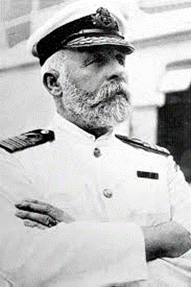
Risk Perception
A tendency towards bias.
Anyone remember Captain E J Smith?
Capitan E J Smith provided a powerful diatribe to a meeting of investors on the risks of travel by ocean/sea..

Slide 17
The Risk Assessment
Probability of adverse event happening.
In the beginning Bolton v Stone [1951] AC 850..

Slide 18
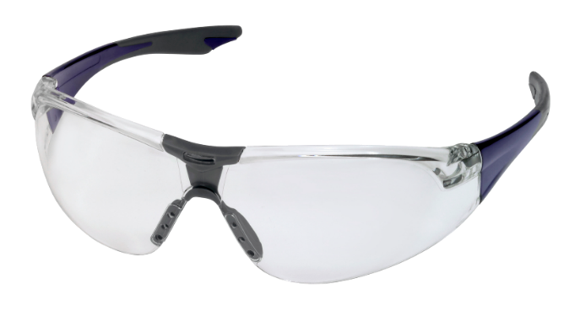
The Risk Assessment
The severity or magnitude of the risk.
In the beginning Paris v Stepney Borough Council [1951] AC 367..

Slide 19
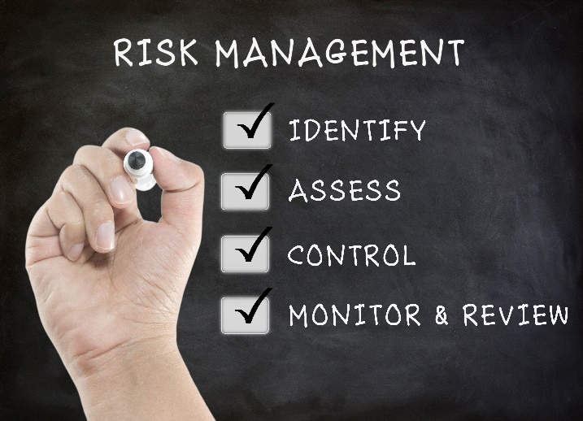
Putting it Simply
The duty holder must have identified all the hazards associated with an undertaking.
The duty holder must have risk assessed all of these identified hazards.
Subject to level of risk, the duty holder must put an effective control in place to keep the risk of a hazard causing an adverse event ALARP..

Slide 20
Passage of time is no defence
Perth Magistrate Martin Flynn recently pointed out that performing the same task for 10 years without prior incident didn’t reduce the seriousness of an offence.
An Exact Mining worker was crushed to death in December 2014 when a 60 metre long polyethylene pipe slipped while being moved.
Exact Mining was given a penalty of $130,000.
The worker was given a funeral and the workers’ family were given life sentences..

Slide 21
Australian Institute of Company Directors
According to Christopher Niesche of the Australian Institute of Company Directors - Directors (and company Officers) need to understand what ‘due diligence’ is because it will be applied a lot more literally and to every level of the company, not just the big guys, which is where the regulators have been hunting..*
*Niesche., Christopher, 2019), Directors, is your board paying enough attention to WHS, Australian Institute of Company Directors Magazine, 01/07/2019..

Slide 22
Meeting the Due Diligence Requirements through Processes.
In demonstrating due diligence, section 27 of the WHS Act requires officers to show that they have ‘taken reasonable steps’ to acquire and update their knowledge of health and safety matters.
My research suggests that there are ‘six essential elements’ to achieving this end..
Notes:
The first element is:
A number of processes are required to identify and facilitate the personal understanding of officers of the hazards and risks associated with their operations; processes that can include knowledge management systems…….that in effect can assist in educating the officer into meeting their duty.
Before I move on let me provide you with an example of the importance of knowledge management or what some commentators refer to as organisational learning:
The Space Shuttle Columbia disaster occurred on February 1, 2003, shortly before it was scheduled to conclude its 28th mission, the Shuttle Columbia disintegrated over Texas and Louisiana during re - entry into the Earth’s atmosphere, resulting in the death of all seven crew members.
The Colombia space shuttle explosion could have been avoided and seven lives saved if warnings from NASA engineers about previous foam block incidents (failures) on another shuttle booster had been addressed.
The moral to this tragic story is what is known is shared and, more importantly, acted upon. This requirement is linked to the Third Element.
The second element:
An assessment tool and financial analysis is required in order to permit the officer to discharge their duty in relation to the allocation of resources and processes.
The third element:
Positive safety key performance indicators must be established, data collected, analysed and disseminated to officers as part of a comprehensive reporting system, then read, understood, and acted upon by the officer in order to discharge their duty.
The fourth element:
A legal compliance inspection and audit system must be developed and maintained in order for officers to be satisfied all is running well.
The fifth element:
It is recommended that the audit system must be accompanied by a quality assurance system to ensure the quality and/or accuracy of safety audits.
The sixth element:
Any non-compliances that the safety audit uncovers must be taken seriously by the officer, and acted upon in a timely manner where necessary.
Barry Sherriff, who was a member of the panel that made recommendations culminating in the WHS Act said recently that “Due diligence is not unqualified.
It is not the case that Officers must absolutely ensure absolute safety”. He said
“an officer must take reasonable steps”.
“Reasonableness”, he said, “will be determined by who you are, your controlling influence and your involvement”.
He went on to say that “Officers will need to ensure the information they are getting is credible, that the sources are objective, and this it is verified by other processes such as auditing”.
Although from my own research relying on the audit has its limitations as we will see in the next slide.
Next Slide: But regardless you will have noted that several of the elements discussed point towards ‘Verification’ as a common denominator..

Slide 23
Proactivity and Due Diligence
The six components of the due diligence duty.
Knowledge of work health safety matters.
Understanding of the nature of the operations of the business and the hazards and risks associated with those operations.
Resources and processes.
Information regarding incident, hazards and risks and responding in a timely way to that information.
Legal compliance.
Verification..

Slide 24
Knowledge of and commitment to work health safety matters
The key role of a leader is to provide safety direction and oversight of the operation of the business.
To be a safety leader you need to be a volunteer…it is not a job; it's a calling.
In a positive safety culture nothing takes precedence over safe work.
You will need to know what questions to ask and when to ask them.
Never forget…Ignorance of the law is not a defence.
A leader must systematically inform themselves of relevant developments and trends.
I would recommend that you appraise yourself of the fundamentals of risk management, incident investigation, auditing and horizon gazing, to name a few..

Slide 25
Understanding the nature of operations
A leader is not only required to acquire and maintain a base knowledge but also contextualise that knowledge in relation to the business or undertaking.
Put a required safety action in a context that enables all workers to completely understand what is required of them to stay safe.
Identify the hazards, assess the risks and put the necessary controls in place..

Slide 26
Resources and Processes
Due diligence requires the safety impact of every resource decision to be assessed.
Resources includes human resources and not just financial resources.
Safety expenditure may be better characterised as a capital investment.
Safety in design is implied in the duty to ensure adequate resources and processes are provided..

Slide 27
Monitoring Performance
Analyse and learn from incidents, hazards and risks.
Rely on a ‘Just’ safety culture.
A blame culture does not support the desired outcome that is the continual improvement of OHS.
Analyse and learn from incidents and near miss data to avoid further incidents.
There is a role for a properly constructed incentive scheme as part of the mix of tools to drive better safety performance..

Slide 28
Legal Compliance
Leaders must ensure that they implement a process for legal compliance audits.
This is where the standard against which the system is measured is the law itself..

Slide 29
Verify
The final element requires ‘verification’ of the implementation of the due diligence framework.
Verification can be typically achieved through system performance audits and should be treated as opportunities for learning, refocusing the organisation back to its roots in a cycle of continuous improvement.
A more holistic journey towards verification is using the combination of …safety observations, peer reviews and safety surveys which become all the more effective when incorporated with safety audits.
Audits must be conducted by competent persons…without fear or favour.
Audits are required at reasonable intervals..

Slide 30
Are these Liabilities Insurable?
While directors and managers will often have ‘directors and officers (D&O) liability insurance’, these insurances are problematic in relation to work health and safety offences.
As a result of Hillman v Ferro Con (SA) Pty Ltd [2013] SAIRC 22…Judges seeking to mete out meaningful penalties are more likely to consider custodial sentences where D&O policies are in place.
The recent Senate inquiry into industrial deaths called for urgent reform of the WHS laws to make it unlawful to insure against a fine or defence costs when related to personal liability for WHS breaches..

Slide 31
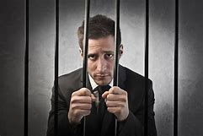
Thirteen Black
You can take the ‘gamble’ and leave the safety of your workers or work colleagues to chance or you can be PROACTIVE and make your legacy the winner..

Slide 32
Any Questions?
Prepare and prevent instead of repair and repent..
For further information
www.fidesconsulting.com.au

