Slide 1

Please read this before using presentation
This presentation is based on content presented at the 2016 Human factors forum
The Department of Mines and Petroleum (DMP) supports and encourages reuse of its information (including data), and endorses use of the Australian Governments Open Access and Licensing Framework (AusGOAL)
This material is licensed under Creative Commons Attribution 4.0 licence. We request that you observe and retain any copyright or related notices that may accompany this material as part of attribution. This is a requirement of Creative Commons Licences.
For any questions regarding the presentation please contact the author, Martin Anderson at martin.anderson@woodside.com.au
For resources, information or clarification, please contact:
  RSDComms@dmp.wa.gov.au or visit www.dmp.wa.gov.au/ResourcesSafety

Slide 2
Influencing the behaviours and decisions that people make – optimising human factors

Slide 3
Optimising human factors:
Influencing behaviours and decisions
Martin Anderson – Manager Human Factors
Department of Mines and Petroleum: Human Factors Forum, 28 April 2016

Slide 4
Disclaimer and important notice
This presentation contains forward looking statements that are subject to risk factors associated with oil and gas businesses. It is believed that the expectations reflected in these statements are reasonable but they may be affected by a variety of variables and changes in underlying assumptions which could cause actual results or trends to differ materially, including but not limited to: price fluctuations, actual demand, currency fluctuations, drilling and production results, reserve estimates, loss of market, industry competition, environmental risks, physical risks, legislative, fiscal and regulatory developments, economic and financial market conditions in various countries and regions, political risks, project delay or advancement, approvals and cost estimates.
All references to dollars, cents or $ in this presentation are to US currency, unless otherwise stated.
References to “Woodside” may be references to Woodside Petroleum Ltd. or its applicable subsidiaries.

Slide 5
Overview
Where it all started (for me)
Key concepts
Are you managing human factors?
Where to start?
Influencing behaviours and decisions: Our approach

Slide 6
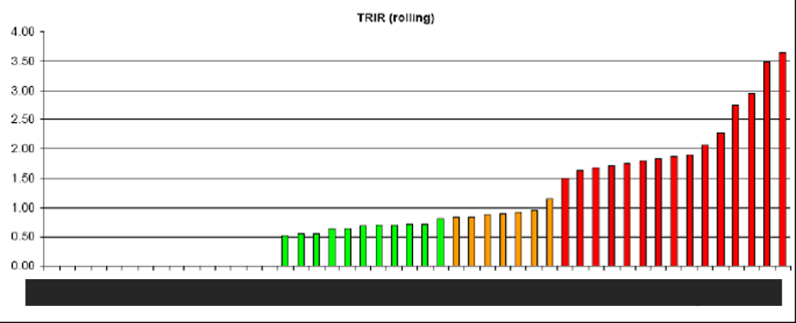
Where it all started (for me)
“different organisations doing similar work are known to have different safety records and certain specific factors in the organisation are related to safety”
“Third Report: Organising for Safety”
ACSNI* Human Factors Study Group, 1993
* Advisory Committee on the Safety of Nuclear Installations
Total Recordable Injury Rate (TRIR)
Real data showing variation in safety performance across different facilities in an international organisation (not Woodside)

Slide 7
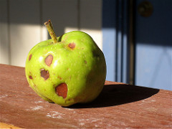
Key concept 1: “Human error” is inevitable. . .
“It is generally understood that virtually all major accidents include Human Factors among the root causes and that prevention of major accidents depends upon human reliability” IOGP, Report 460, 2010
Alan Levine: flickr.com/photos/cogdog/2715544998
The challenge is to create human reliability

Slide 8
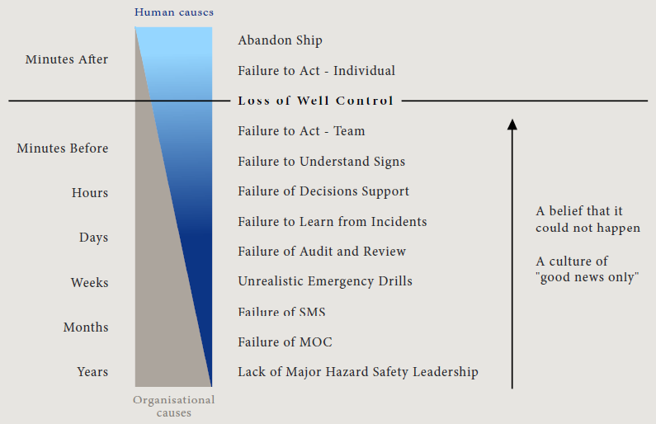
Key concept 2: Last person to touch equipment?
Analysis of Deepwater Horizon
… and BP Texas City
“The disaster at Texas City had organizational causes, which extended beyond the ISOM unit, embedded in the BP refinery’s history and culture”
CSB Report into BP Texas City, March 2007, p.139
Source: Norwegian Oil Industry Association (OLF, 2012)

Slide 9
Key concept 3: Human reliability can be influenced
. . . by Performance Shaping Factors, such as fatigue, workload, distractions
“People's actions are influenced by the organizations in which they work, shaping their choices in directions that even they may not realize”
NASA – Shuttle Columbia Accident Investigation Board
“Although actions or errors by operations personnel at the BP Texas City site were immediate causes of the accident, numerous latent conditions and safety system deficiencies influenced their actions and contributed to the accident”
CSB, BP Texas City Investigation Report
Woodside framework: Adapted from UK HSE guidance “Reducing Error and Influencing Behaviour”, HSG48, 1999

Slide 10
Key concept 4: Whose behaviours and decisions?
“Behavioural safety” does not equal “human factors”
Is it more effective to change people, or the conditions in which people work?
“Behavioural safety and major accident hazards: Magic bullet or shot in the dark?”, (Anderson, 2004)
Front line staff often have little control over a range of influences:
Shift patterns
Competing demands
Staffing levels
Quality of contractors
Competence programme
Permit system
Layout of plant
Procedures
Distractions
Design of controls and displays
Handover arrangements
Clarity of roles and responsibilities
Quality of supervision

Slide 11
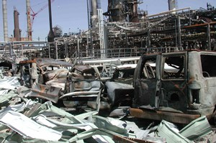
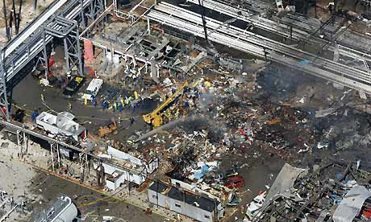
Key concept 5: UK HSE Top 10 HF topics
Top 10 topics (adapted from www.hse.gov.uk/humanfactors)
Optimising human performance
Design of equipment, processes, tasks and environment
Organisational change
Supervision
Staffing levels and workload
Training and competence
Procedures
Safety critical communications
Fatigue and shiftwork
Organisational and safety culture
Examples: BP Texas City 2005
No proactive analysis of DCS issues. Issues in previous start-ups not investigated.
Control system did not support operations personnel
Various changes not evaluated for their impact on the control of major hazards
Ineffective supervisory oversight and technical assistance during unit start-up
Insufficient staffing to handle board operator workload during the high-risk time of unit start-up
Inadequate operator training for abnormal and start-up conditions
Not up-to-date or accurate. Start-up procedure lacked sufficient instructions
No policy for effective shift communication
Unit operators were likely fatigued (e.g. 12-hour shifts, 29 days in a row)
A work environment that encouraged operations personnel to deviate from procedure
BP Texas City refinery (2005). Images from U.S. Chemical Safety and Hazard Investigation Board (www.CSB.gov)
Operating philosophy relied on the correct and timely action by operators

Slide 12
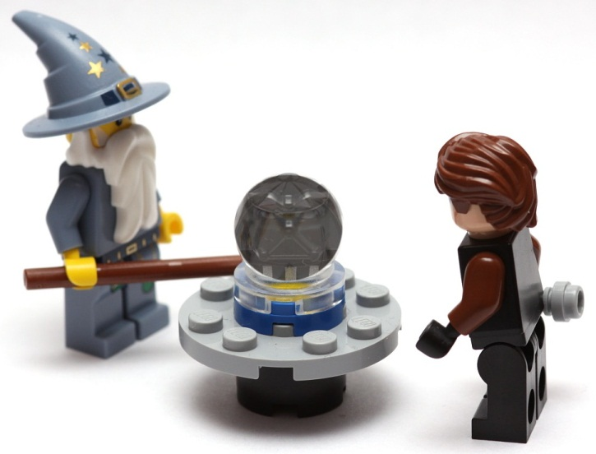
Key concept 6: Human factors applied proactively
When something
goes wrong
Understand
the human
component
“Pre-incident”
investigations?
+
Before something
goes wrong
Applying human factors to investigations is part of the picture. . .
. . . but what about applying human factors to incidents that haven’t occurred yet ?
CC0 1.0 flickr.com/photos/pasukaru76/3998273279

Slide 13
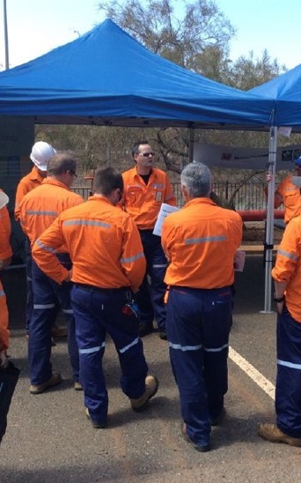
Are you managing human factors?
Have a human factors strategy?
Employ suitably qualified and experienced human factors professionals (or engage external support)?
Include human factors issues in risk assessments?
Understand why human failures occur?
Address the range of Top 10 topics?
Human factors input does not need to be justified?
Human factors seen as a technical discipline?

Slide 14
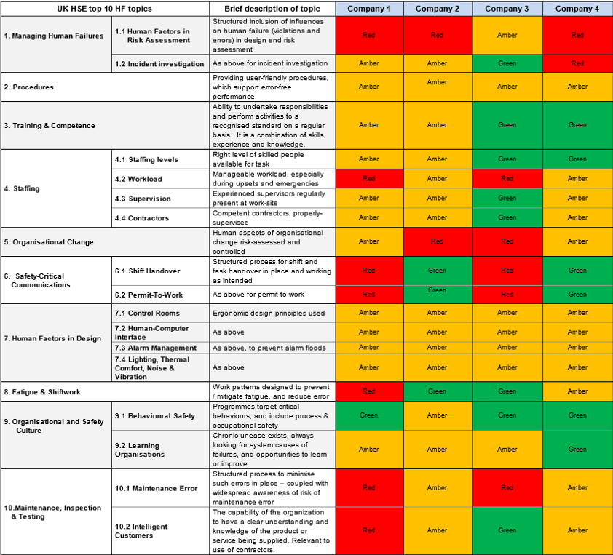
Where to start? Take action
  Assign human factors champion(s) and engage senior leadership
Perform a gap analysis against the Top 10:
  e.g. using questions in the UK HSE Inspectors Toolkit and the Energy Institute Briefing Notes
  involve the workforce
Review incident history
Highlight 1 or 2 topics to address in 2016, 2017, 2018 . . . and create some SMART actions
Commit resources and take action !
Review, learn, improve and share
Gap analysis findings: Fictitious data

Slide 15
Influencing behaviours & decisions: Our approach
1
Set people up to succeed through good design
Design things so it’s easy to do the right thing and hard to do the wrong thing (and make ‘wrong’ things noticeable)
Ensure our ‘end-users’ are involved in design
Consider capabilities, limitations and needs of users
2
Ensure human reliability on critical tasks
Identify critical tasks in your business area
  Understand the potential for human failure in these tasks and the conditions or influences that make them more likely
Implement control measures (using the hierarchy of control)
3
Understand and learn from events (good and bad)
Seek to understand how and why something went wrong
Report and discuss errors, and understand the conditions that make errors more likely
Understand why we were successful, so we can replicate success
4
Continue to maintain “Our Safety Culture”
Engage people using the Discussion Cards
Understand key behaviours in investigations
Incorporate the framework into everything we do
Create the environment that underpins the above key areas

