Slide 1
Please read this before using presentation
This presentation is based on content presented at the Six Pillars of Dangerous Goods Transport information sessions held in October 2014
It is made available for non-commercial use (e.g. toolbox meetings, safety discussions) subject to the condition that the PowerPoint file is not altered without permission from Resources Safety
Supporting resources, such as brochures and posters, are available from Resources Safety
For resources, information or clarification, please contact:
RSDComms@dmp.wa.gov.au
or visit
www.dmp.wa.gov.au/ResourcesSafety

Slide 2
Placarding
Learn all about how to placard and why it’s so important

Slide 3
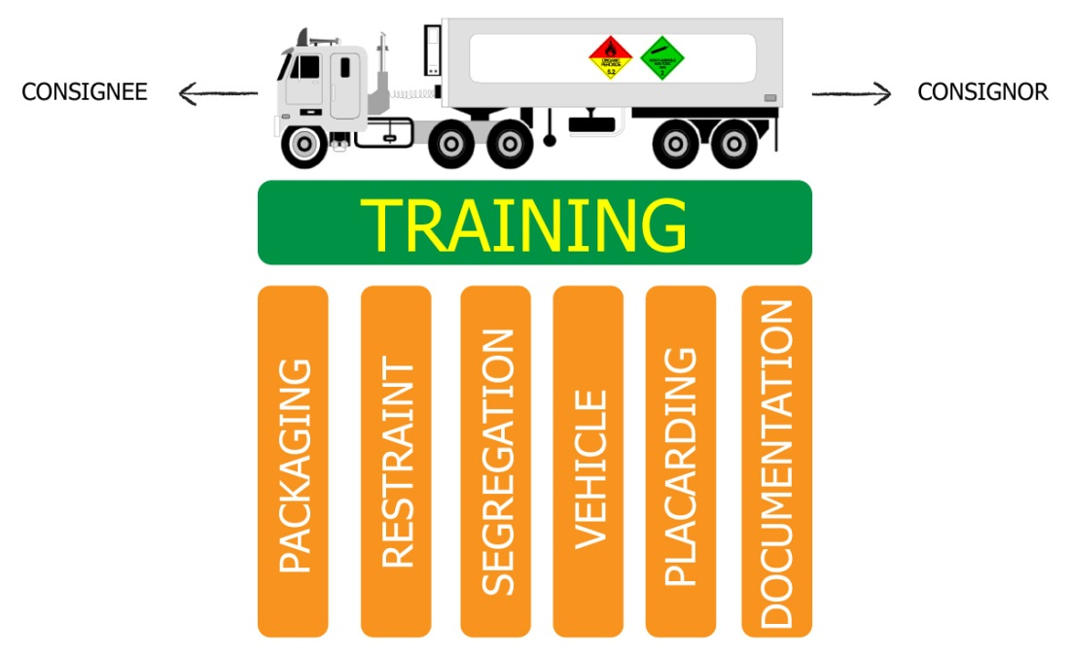
Six pillars of dangerous goods transport
Notes:
This presentation focuses on placarding, one of the Six Pillars of Dangerous Goods Transport. What are the six visible elements of your transport system for dangerous goods? [LISTED IN GRAPHIC]
The Department of Mines and Petroleum views training as the platform that holds these elements or pillars together.
Packaged dangerous goods transport has often been afforded a low priority in organisations that cart general freight- the poor cousin of bulk tanker transport. However, when you consider that dangerous goods freight movement currently constitutes 8% of road transport activity, the safe movement of multitudes of placard and sub-placard loads is important in terms of road networks and the exposure of the public.
The risk to personnel in your transport activity is determined by the integrity of the packaging. Pause and consider the effects of a single 32 kg chlorine cylinder releasing its contents while your driver is checking the pallet restraints and tyre pressures after a rest break.
This information presented here is a snapshot of the common considerations applied to the transport of packaged dangerous goods. Each business will have some unique challenges for carting mixed loads and a range of container types. Nevertheless, applying the safe transport principles stipulated in the Australian Dangerous Goods Code will guide you toward minimising risk.
There are five other toolbox presentations in the Six Pillars series available at www.dmp.wa.gov.au/14788.aspx. They related directly to the self-audit template for prime contractors available on the Resources Safety website at www.dmp.wa.gov.au/17148.aspx.
The audit can be used to conduct a “health check” of your dangerous goods transport system.

Slide 4
When is placarding required?
Placarding is required when you are carrying a placard load
A placard load may include a placardable unit

Slide 5
What is a placard load?
For a placard load consisting of packages or articles, such as drums, gas cylinders, fire extinguishers, car batteries
For a load containing 2.1, 2.3 or Packing Group I dangerous goods ≥250 L/kg
For all other loads ≥ 1000 L/kg
Notes:
See Safety Data Sheets to find out what Packing Group and Class/Division you are dealing with

Slide 6
What is a placardable unit?
A dangerous goods receptacle with a capacity > 500 L
OR
> 500 kg of dangerous goods in a receptacle

Slide 7
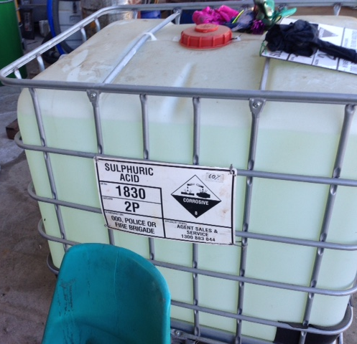
Package versus placardable unit
The IBC is a placardable unit
Each cylinder is a package
Notes:
Here’s an example of a package (cylinder).
The IBC is a placardable unit.

Slide 8
Mixed classes
Notes:
This is the diamond used for mixed classes of dangerous goods in packages.

Slide 9
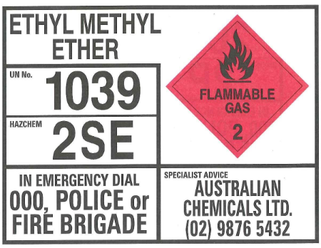
Emergency Information Panels (EIPs)
Notes:
This shows the information included on an EIP.

Slide 10
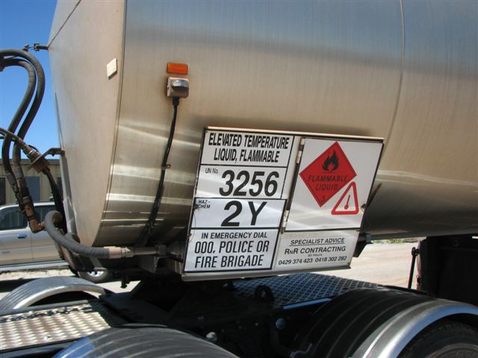
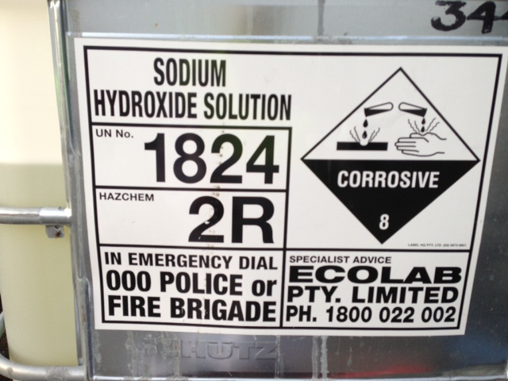
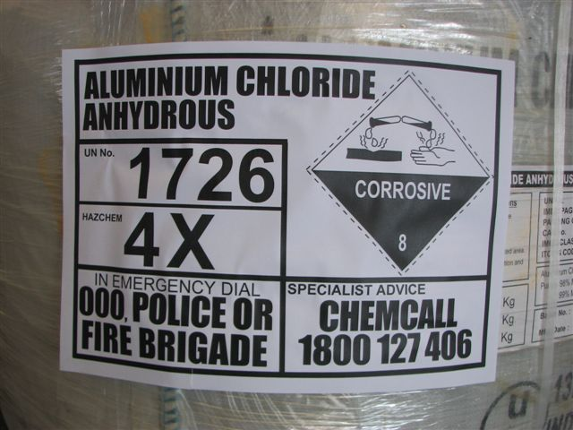
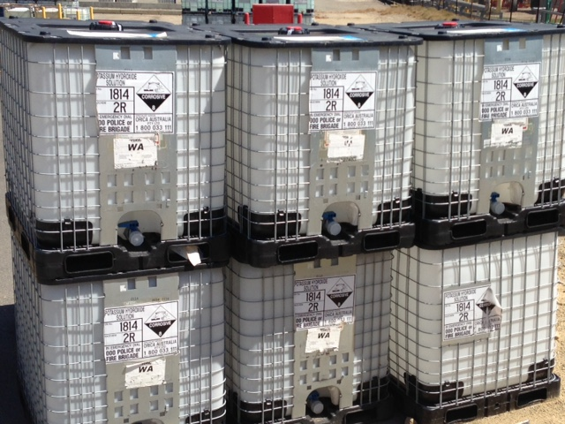
Examples of EIPs

Slide 11
Placarding method (ADG7.3, Chapter 5.3)
Placarding must be in a substantially vertical plane and:
Securely fixed, stencilled or in frame on unit.
Durable, weather-resistant, legible.
Placed on both sides of container.
Have required information as per figure 5.3.2 of ADG 7.3
Notes:
ADG7.3 = The Australian Dangerous Goods Code, Edition 7.3
General information available at www.infrastructure.gov.au/transport/australia/dangerous/dg_code_7e.aspx
Code available at www.ntc.gov.au/heavy-vehicles/safety/australian-dangerous-goods-code

Slide 12
Road vehicle placarding (ADG 7.3 Chapter 5.3.6)

Slide 13
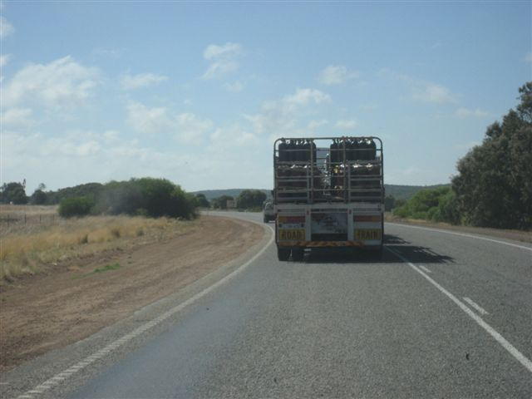
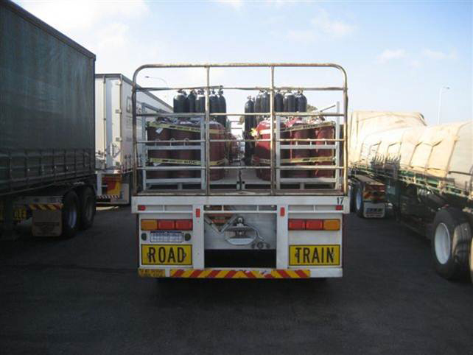
Package placarding
Where’s the placard?
Notes:
These photos show a common problem with rear placards – the diamond is obscured and not readily visible.
Placards are there to be seen!

Slide 14
Vehicle combination placarding examples

Slide 15
Any questions…
Email packages@dmp.wa.gov.au
Email punit@dmp.wa.gov.au
Notes:
For further information on Dangerous Goods Transport, send an email to these addresses

Slide 16
Don’t forget – Stay informed!
Visit www.dmp.wa.gov.au/ResourcesSafety
to sign up for our weekly news alerts

