Slide 1
Please read this before using presentation
This presentation is based on content presented at the Six Pillars of Dangerous Goods Transport information sessions held in October 2014
It is made available for non-commercial use (e.g. toolbox meetings, safety discussions) subject to the condition that the PowerPoint file is not altered without permission from Resources Safety
Supporting resources, such as brochures and posters, are available from Resources Safety
For resources, information or clarification, please contact:
RSDComms@dmp.wa.gov.au
or visit
www.dmp.wa.gov.au/ResourcesSafety

Slide 2
Segregation
Learn how to segregate dangerous goods for transport

Slide 3
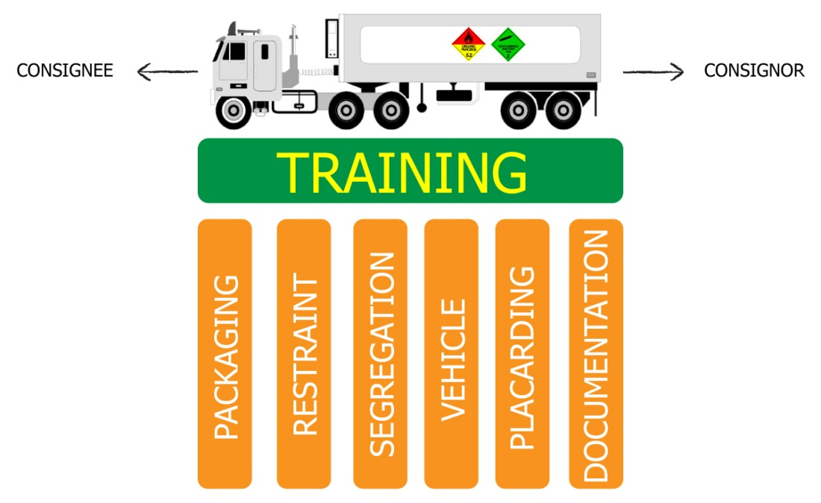
Six pillars of dangerous goods transport
Notes:
This presentation focuses on segregation, one of the Six Pillars of Dangerous Goods Transport. What are the six visible elements of your transport system for dangerous goods? [LISTED IN GRAPHIC]
The Department of Mines and Petroleum views training as the platform that holds these elements or pillars together.
Packaged dangerous goods transport has often been afforded a low priority in organisations that cart general freight- the poor cousin of bulk tanker transport. However, when you consider that dangerous goods freight movement currently constitutes 8% of road transport activity, the safe movement of multitudes of placard and sub-placard loads is important in terms of road networks and the exposure of the public.
The risk to personnel in your transport activity is determined by the integrity of the packaging. Pause and consider the effects of a single 32 kg chlorine cylinder releasing its contents while your driver is checking the pallet restraints and tyre pressures after a rest break.
This information presented here is a snapshot of the common considerations applied to the transport of packaged dangerous goods. Each business will have some unique challenges for carting mixed loads and a range of container types. Nevertheless, applying the safe transport principles stipulated in the Australian Dangerous Goods Code will guide you toward minimising risk.
There are five other toolbox presentations in the Six Pillars series available at www.dmp.wa.gov.au/14788.aspx. They related directly to the self-audit template for prime contractors available on the Resources Safety website at www.dmp.wa.gov.au/17148.aspx.
The audit can be used to conduct a “health check” of your dangerous goods transport system.

Slide 4
Overview
What is segregation of dangerous goods?
Applying Australian Dangerous Goods Code 7.3 (ADG7.3):
What dangerous goods to segregate
How to segregate dangerous goods
Worked example

Slide 5
What is segregation of dangerous goods?
Some combinations of Classes or Divisions of dangerous goods are incompatible and must be kept apart.
Examples of incompatible dangerous goods:
Ammonium nitrate + Diesel
Hypochlorite + Acid
Strong acids + Strong bases
Food + Class 8, Class 6 or Division 2.3
Notes:
What happens if there is a vehicle crash or the load is poorly restrained? Can chemicals mix?
Incompatible chemicals can cause a fire or react together to form another hazard.

Slide 6
Worked example
Planning to transport a load of:
A: Hydrochloric acid (UN1789 Class 8, PG II) 2 x 20 L containers
B: Petrol (UN1203, Class 3, PG II) 6 x 200 L drums
C: Sodium Cyanide, Solid (UN1689 Division 6.1, PG 1) 2 x 25 KG bags
What needs to be segregated – Table 9.1
How to segregate?

Slide 7
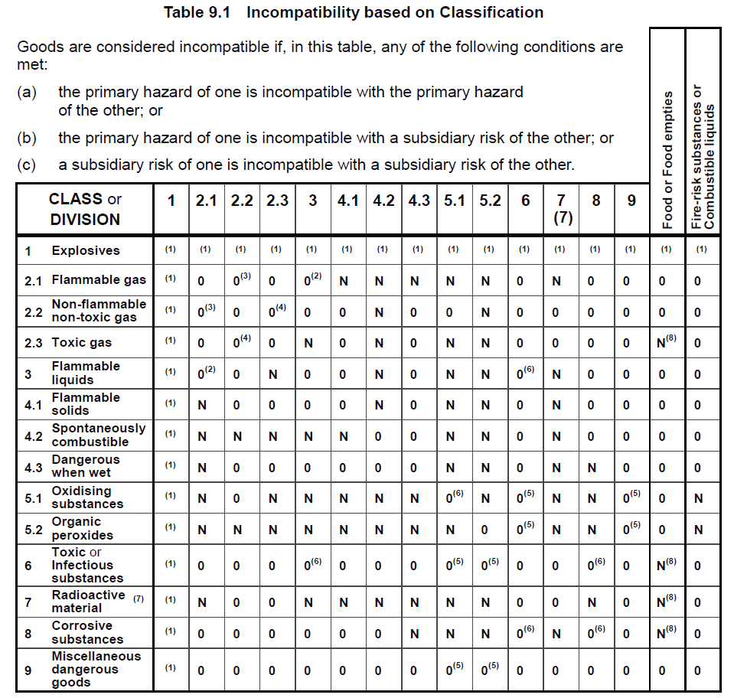
Notes:
Table 9.1 from ADG7.3 showing incompatible dangerous goods.
Acids and cyanide require separation as a mixture will generate hydrogen cyanide gas, a highly toxic gas.
ADG7.3 = The Australian Dangerous Goods Code, Edition 7.3
General information available at www.infrastructure.gov.au/transport/australia/dangerous/dg_code_7e.aspx
Code available at www.ntc.gov.au/heavy-vehicles/safety/australian-dangerous-goods-code

Slide 8
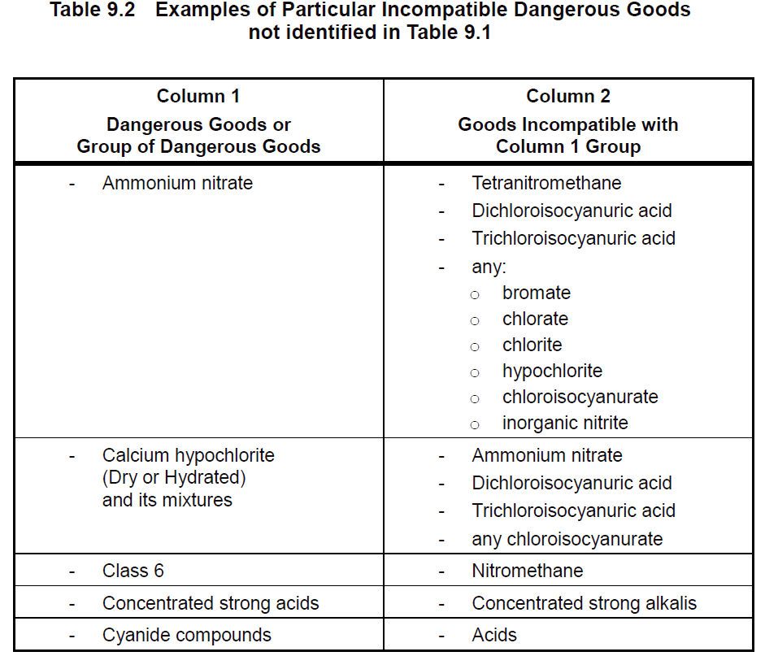
Notes:
More examples of incompatible dangerous goods

Slide 9
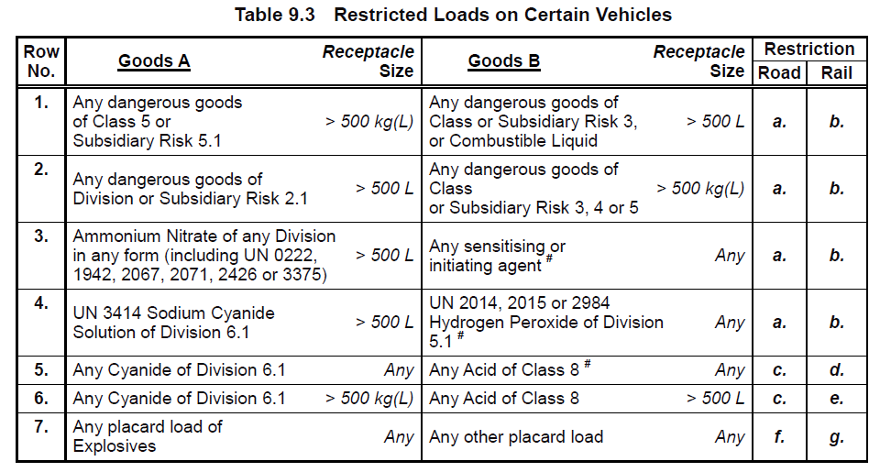
Notes:
These dangerous goods are incompatible on the same road vehicle.
You cannot segregate the dangerous goods listed on this table by putting them on different trailers.

Slide 10
How to segregate?
Use incompatibility table (table 9.1) to assess whether dangerous goods are incompatible
See ADG7.3 part 9.2.2 for how to segregate:
Carried on separate vehicles of the same combination road vehicle
Approved segregation devices
Packaging approved for segregation (part 9.2.2.4).
Refer to table 9.3 for special segregation provisions prohibiting certain combinations for multiple trailer loads

Slide 11
Any questions…
Email packages@dmp.wa.gov.au
Email punit@dmp.wa.gov.au
Notes:
For further information on Dangerous Goods Transport, send an email to these addresses

Slide 12
Don’t forget – Stay informed!
Visit www.dmp.wa.gov.au/ResourcesSafety
to sign up for our weekly news alerts

