Slide 1
Geological Survey of
Western Australia
Geophysical acquisitions
AusAEM20-WA
John Brett and David Howard
Geological Survey
OPEN DAY
2020
Image courtesy of SkyTEM

Slide 2
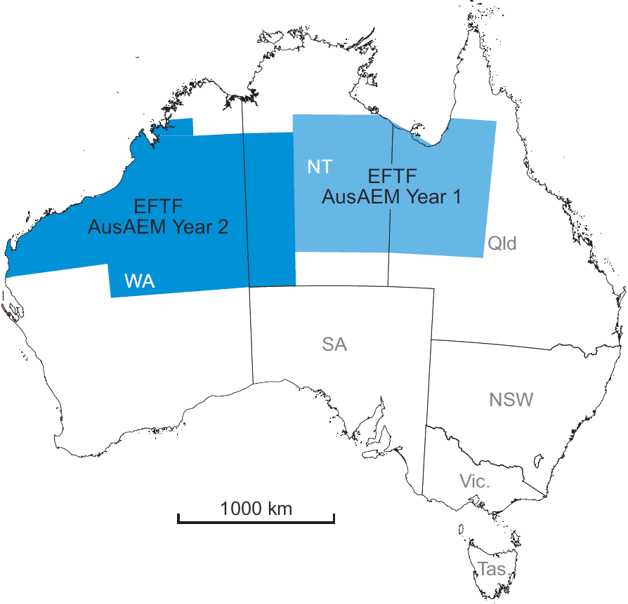
AusAEM
72,000 line km 2019 – 2020
67,000 line km 2017 - 2018

Slide 3
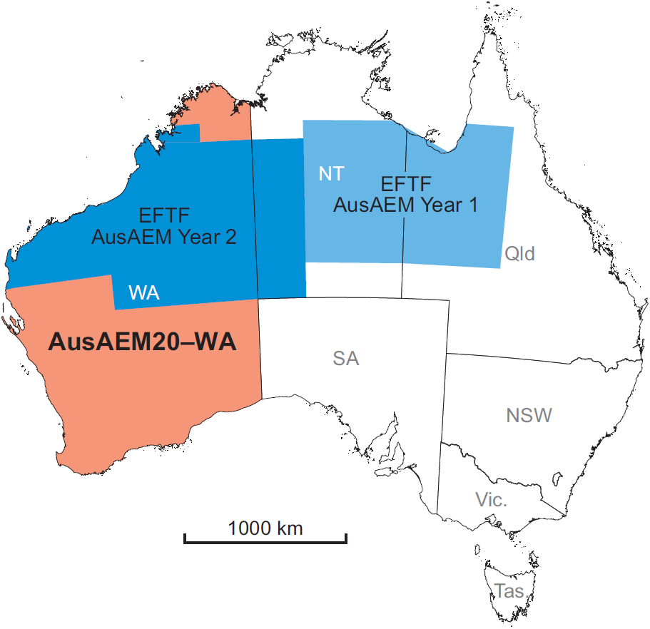
AusAEM20-WA
65,000 line km

Slide 4
AusAEM20-WA - Objectives
Provide explorers with insights into areas of thick cover and areas with potential targets for further investigation
The data from these surveys will also assist in the production of a national conductivity map of Australia

Slide 5
AusAEM20-WA - Planning and preparation
Jan 2020 Stakeholder Engagement Plan
Mar 2020 Request for Quotation
Apr 2020 Preferred respondent selected
May 2020 Contract issued
Jul 2020 Acquisition commences

Slide 6
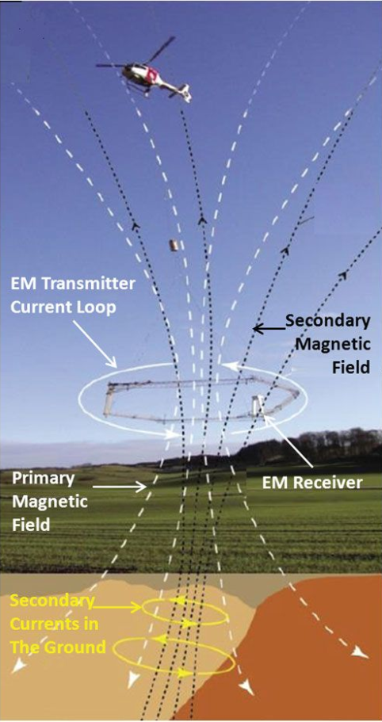
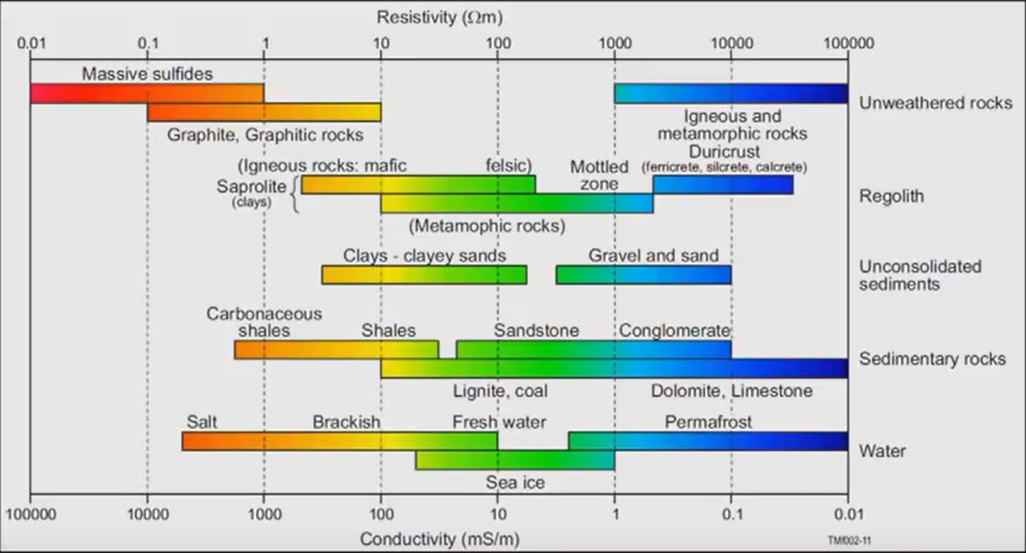
Conductivity-resistivity values of various rock-forming materials, adapted from Palacky (1987)

Slide 7
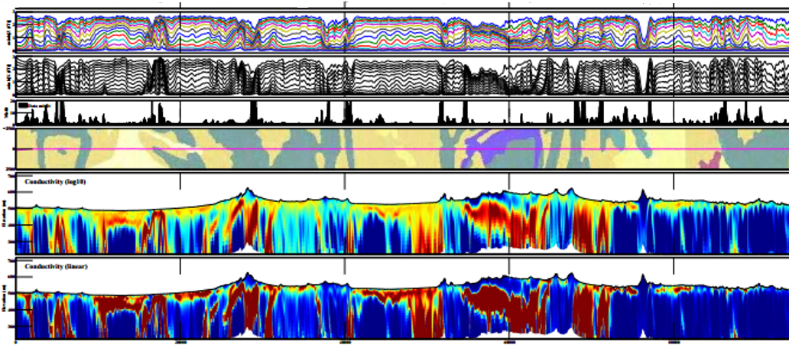
Geoscience Australia Layered Earth Inversions
Image courtesy of Geoscience Australia

Slide 8
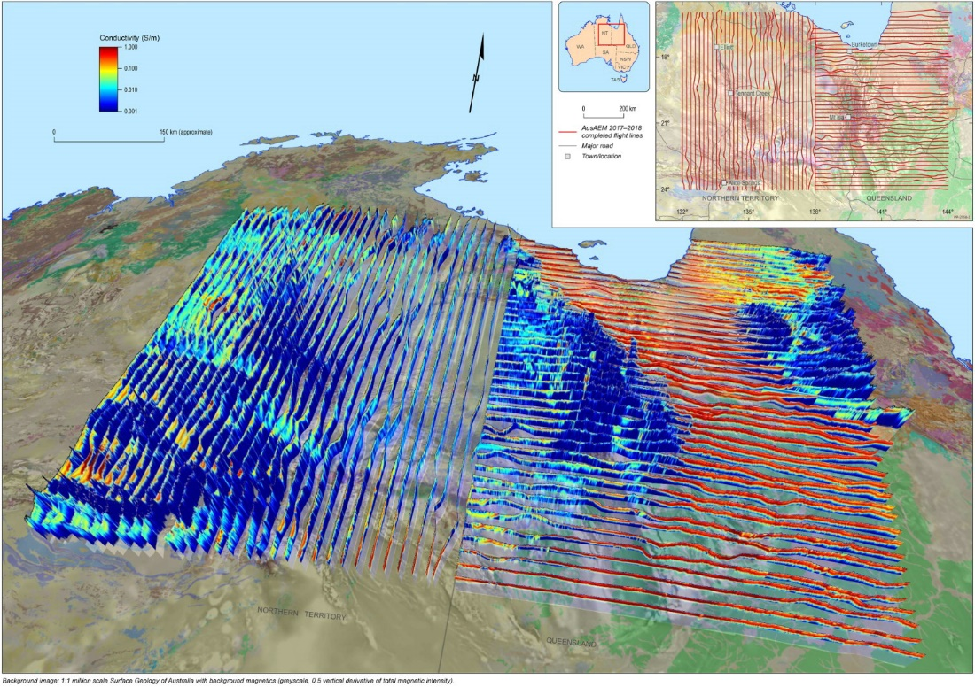
to determine trends in regolith thickness
to map regional variations in bedrock conductivity, within the depth of penetration of the system
to set context for and guide mineral exploration project generation by industry
to improve targeting for water resources definition
as input for other land use applications in other industry sectors and land use agencies.
"AusAEM: Australia’s airborne electromagnetic continental-scale acquisition program“
Image courtesy of Geoscience Australia

Slide 9
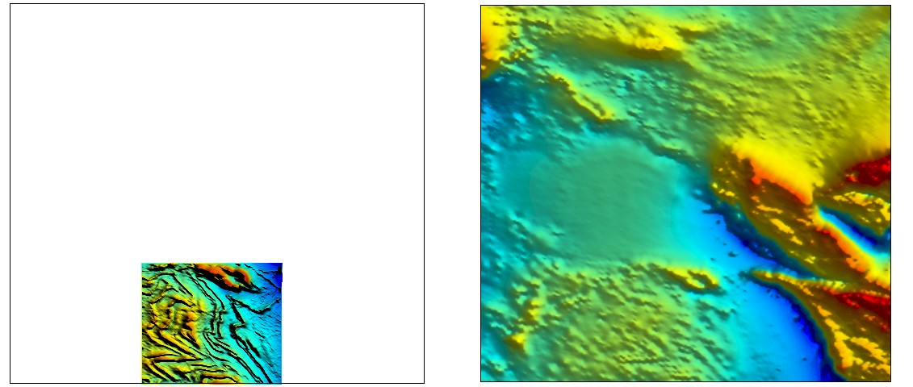
Acquisition — general planning criteria
Coverage – Resolution trade-off
Coverage before resolution
Resolution
Best affordable
“Factor of 4” improvement
Collaborate
Increase coverage, resolution, methods
Reduce cost
For my limited money, do I want to know a lot about a little or a little about a lot?
High res — small area
Low res — large area
Equal cost surveys

Slide 10
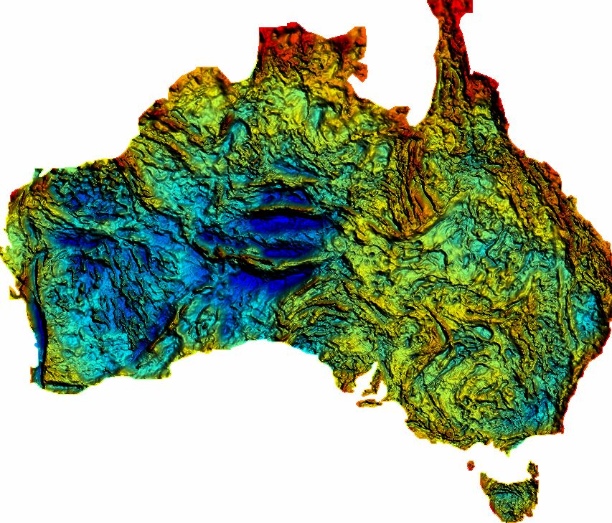
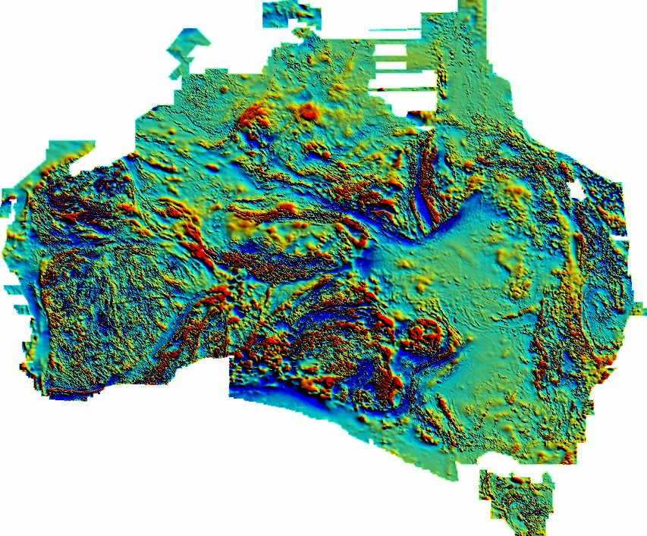
BMR Regional compilations
Gravity 11 km spacing
Magnetics 1.5 km spacing
AEM 20 km spacing

