Slide 1
Please read this before using presentation
This presentation is based on content presented at the Mines Safety Roadshow held in October 2014
It is made available for non-commercial use (e.g. toolbox meetings, OHS discussions) subject to the condition that the PowerPoint file is not altered without permission from Resources Safety
Supporting resources, such as brochures and posters, are available from Resources Safety
For resources, information or clarification, please contact:
  RSDComms@dmp.wa.gov.au
  or visit
  www.dmp.wa.gov.au/ResourcesSafety

Slide 2
Appropriate risk management strategies
Mobile equipment on mines

Slide 3
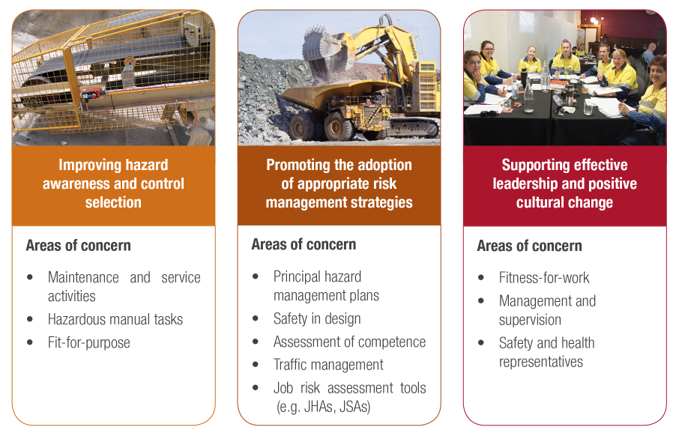
Resources Safety’s focus
Maintenance and service activities
Hazardous manual tasks
Fit for purpose
Principal hazard management plans
Safety in design
Assessment of competence
Traffic management
Job risk assessment tools (e.g. JHAs, JSAs)
Fitness for work
Management and supervision
Safety and health representatives
Notes:
This presentation relates primarily to the adoption of appropriate risk management strategies but has some elements of hazard awareness and control selection, as well as fitness for work. Incidents involving mobile equipment continue to be of concern to the Department and this presentation discusses some of the safety performance data as well as raising awareness of the availability of the four-part mobile equipment audit.

Slide 4
Why do we need to manage the risks associated with mobile equipment on mines?
We are still having mobile equipment accidents and incidents.
These include collisions, run away vehicles, rollovers and fires.
Potential for serious consequences arising from these accidents and incidents.
Notes:
Accidents and incidents involving earth moving equipment are still occurring.
Many of these have the potential to cause a fatality, as has been shown in the past.

Slide 5
Incidents reported July 2013 to June 2014
Notes:
There are certain incidents or occurrences that must be reported to the Department of Mines and Petroleum under Sections 78 and 79 of the Mines Safety and Inspection Act.
This graph show reporting for the financial year 1 July 2013 to 30 June 2014.
Total incidents reported = 2,376
69 incidents reported directly involving light vehicles
386 incident reported directly involving heavy haulage-type equipment

Slide 6
Heavy haulage vehicle incidents reported
July 2013 to June 2014
Occurrence type | Total number
Vehicle collision | 131
Vehicle rollover | 24
Vehicle over edge | 25
Loss of control of vehicle (not included above) | 78
Others (not included above) (e.g. equipment failure) | 128
Total | 386
Notes:
Figures not included on table include: Truck mobile equipment fires = 294
“Loss of Control (not included above)” obviously excludes losses of control resulting in collisions, rollovers and vehicle over edges, which are reported under those categories.
It does include loss of control incidents such as trucks sliding on a ramp through overwatering, a driver having a micro-sleep resulting in the truck drifting off its normal path. It also includes equipment failure resulting in a loss of control of the equipment.
“Others (not included above)” includes mobile equipment contact with person = 7
It also includes potentially serious occurrences excluding a vehicle loss of control, collision, rollover or vehicle over an edge.
This includes equipment failures (e.g. brakes, hoses, tyres). Examples of other are rear trailers disconnecting
There were 180 loss of control incidents reported for 2012-13
Loss of control figures for 2013-14 decreased to 138, which is a decrease but there is still some way to go.

Slide 7
Main causes - examples
Operator issues – fatigue, distractions, not competent
Equipment selection – not fit for purpose
Maintenance – equipment failures
Traffic management – poor mine design, overwatering of roads
Notes:
Operator issues – Operators suffering micro-sleeps, not following fatigue management requirements or site not having effective fatigue management plan, mobile phone usage
Equipment issues – On road equipment used rather than fit for purpose equipment (e.g. Agi trucks and service trucks)
Maintenance – Brake failures, steering failures
Traffic management – Poorly designed intersections, poor segregation between light vehicles and heavy haulage equipment, overwatering of roads.

Slide 8
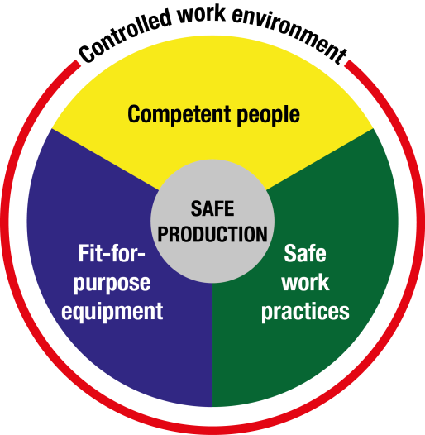
Managing mobile equipment risks
Safe work
Notes:
To best manage mobile equipment risk we need to have competent people, fit for purpose equipment and safe work practices in a controlled work environment (i.e. traffic management).
NOTES:
The Nertney Wheel is very useful for demonstrating the 4 components contributing to the safe and effective management of workplace activities:
Competent people
Safe methods of work
Right tools for the job, and
Controlled work environment – not just climatic or physical conditions but also the “culture” within the workplace.
Note: The Nertney Wheel is named after Bob Nertney. In 1976 he was employed at EG&G in Idaho and was thinking about what aspects of the work process were involved in keeping people safe. The three requirements for people, equipment and work practices that he came up with make sense and is practical. The heart and goal of the work process is production but it needs to be done safely. We have used “Safe work” as it covers exploration, transport, and many other mining activities.
There is also an all-encompassing requirement to ensure the work environment is understood, controlled and managed.
Some references:
Nertney RJ & Bullock MJ 1976 “Human Factors in Design”, US Department of Energy, Systems Safety Development Centre: EG&G Idaho Falls USA
Anonymous 2007 “Topic 11: Summing up – The Work Process Model” in Generic Induction – Coal Core, Mining Industry Skills Centre Inc., Brisbane (www.miskillscentre.com.au)

Slide 9

WORKSHOP EXERCISE 1
Describe a mobile equipment incident you know of or investigated
What happened?
What was the hazard?
How did you deal with it?
What controls were put in place to prevent the incident from happening again?
Where do these controls fit into the hierarchy of control
Notes:
“Tell your story” session.
This exercise is designed to get people talking about the variety of incidents involving mobile equipment, and sharing the learnings. Depending on audience size, can be done individually or in small groups.
Go to next slide to remind people about the hierarchy of control.

Slide 10
Hierarchy of control – reducing exposure to hazards
Elimination
Substitution
Engineering
Isolation/Segregation
Administrative control
PPE
Notes:
Reminder about hierarchy of control
The higher up the hierarchy of control your solution is, the greater its effectiveness or protection. The graphic in this slide is a slightly different approach to help people visualise what this means and hopefully better remember the levels.
Think of these coloured semi-circles as shields of protection.
ANIMATION – CLICK TO ADD “SHIELDS”
PPE = limited protection – very small shield!
Isolation or segregation (of individuals not involved in the hazardous activity) = bigger “shield” of protection
Elimination of hazard = no risk, completely shielded
Go to next slide to bring exercise back up on screen.

Slide 11
WORKSHOP EXERCISE 1
Describe a mobile equipment incident you know of or investigated
What happened?
What was the hazard?
How did you deal with it?
What controls were put in place to prevent the incident from happening again?
Where do these controls fit into the hierarchy of control
Notes:
“Tell your story” session.
This exercise is designed to get people talking about the variety of incidents involving mobile equipment, and sharing the learnings. Depending on audience size, can be done individually or in small groups.

Slide 12
Opportunities for improvements
Inspections
Investigations
Audits
Communication, consultation
Risk
management
Resilience
Notes:
What can be done to improve the situation?
Inspections, investigations, discussing the situation with those involved in the work, ensuring we adopt a risk management approach and …… audits!

Slide 13
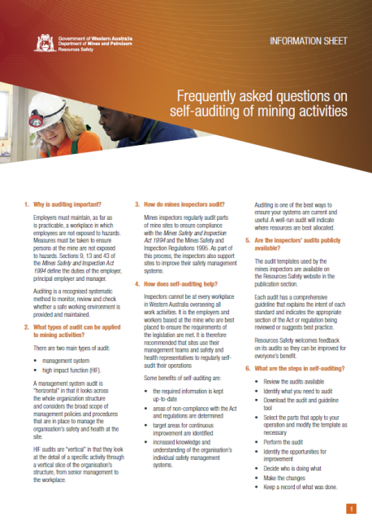
Why conduct an audit?
.
One of the best ways to ensure your systems are current and useful
If well-run, indicates where best to allocate resources
Notes:
Auditing is one method that may be used to tackle mobile equipment incidents occurring on mines.
Auditing:
Identifies holes in your system, both in the documentation and system implementation
Assists in identifying hazards and ensuring controls are in place
Ensures required information is kept up-to-date and document controlled
Identifies areas of non-compliance with legislation
Creates a positive cycle of continuous improvement
Increases workers’ knowledge and understanding of the organisation’s systems
Improves management’s awareness of potential weaknesses and problems
Information sheet on self-audit (shown on slide) is available at www.dmp.wa.gov.au/14970.aspx#15053

Slide 14
Mobile equipment on mines audit
Part 1 – Traffic management
Part 2 – Mining operations and equipment selection
Part 3 – Operating mobile equipment
Part 4 – Management of mobile equipment maintenance
Same audit as used by mines inspectors so use them to audit yourself!
Notes:
The Department of Mines and Petroleum has introduced four High Impact Function Audits relating to mobile equipment on mines. The audits will allow management to see how they are performing with mobile equipment issues at their sites.
A particular audit or a number of them can be selected for use depending on the situation on site.
The Department recommends that you try the audits at your mines to gauge how the mine is performing against the audit standards.
The audits address with the main causes of mobile equipment occurrences on mines e.g. Operator Issues, Equipment Selection, Maintenance, and Traffic Management.
They can help confirm alignment with the Nertney Wheel:
Competent people, fit for purpose equipment and safe work (operating and maintenance) practices in a controlled work environment (i.e. traffic management).

Slide 15
Where can you get the audits?
Visit www.dmp.wa.gov.au/ResourcesSafety
Online one-stop shop for mobile equipment
OR
Mining publications section – audit guidelines and templates
Notes:
In the One stop shop and FAQs section, you can access a range of information including links to audits, relevant guidance, significant incident reports, safety bulletins etc. at www.dmp.wa.gov.au/8027.aspx
In the publications section, you can download the audit guidelines and accompanying Word templates for your site to use at www.dmp.wa.gov.au/15565.aspx

Slide 16
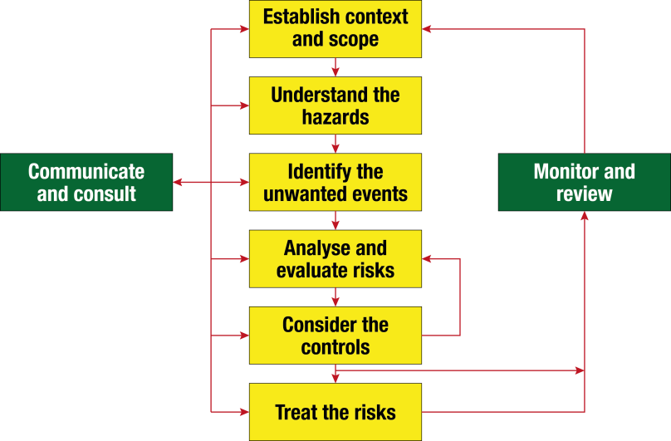
Audits as part of risk management approach
Notes:
Auditing is a recognised systematic method to monitor, review and check whether a safe working environment is provided and maintained.
The audits provide an opportunity to analyse and evaluate the effectiveness of the controls and gauge how the mine is performing.
The mobile equipment audits can be used as part of the risk management approach to deal with mobile equipment on mines.

Slide 17
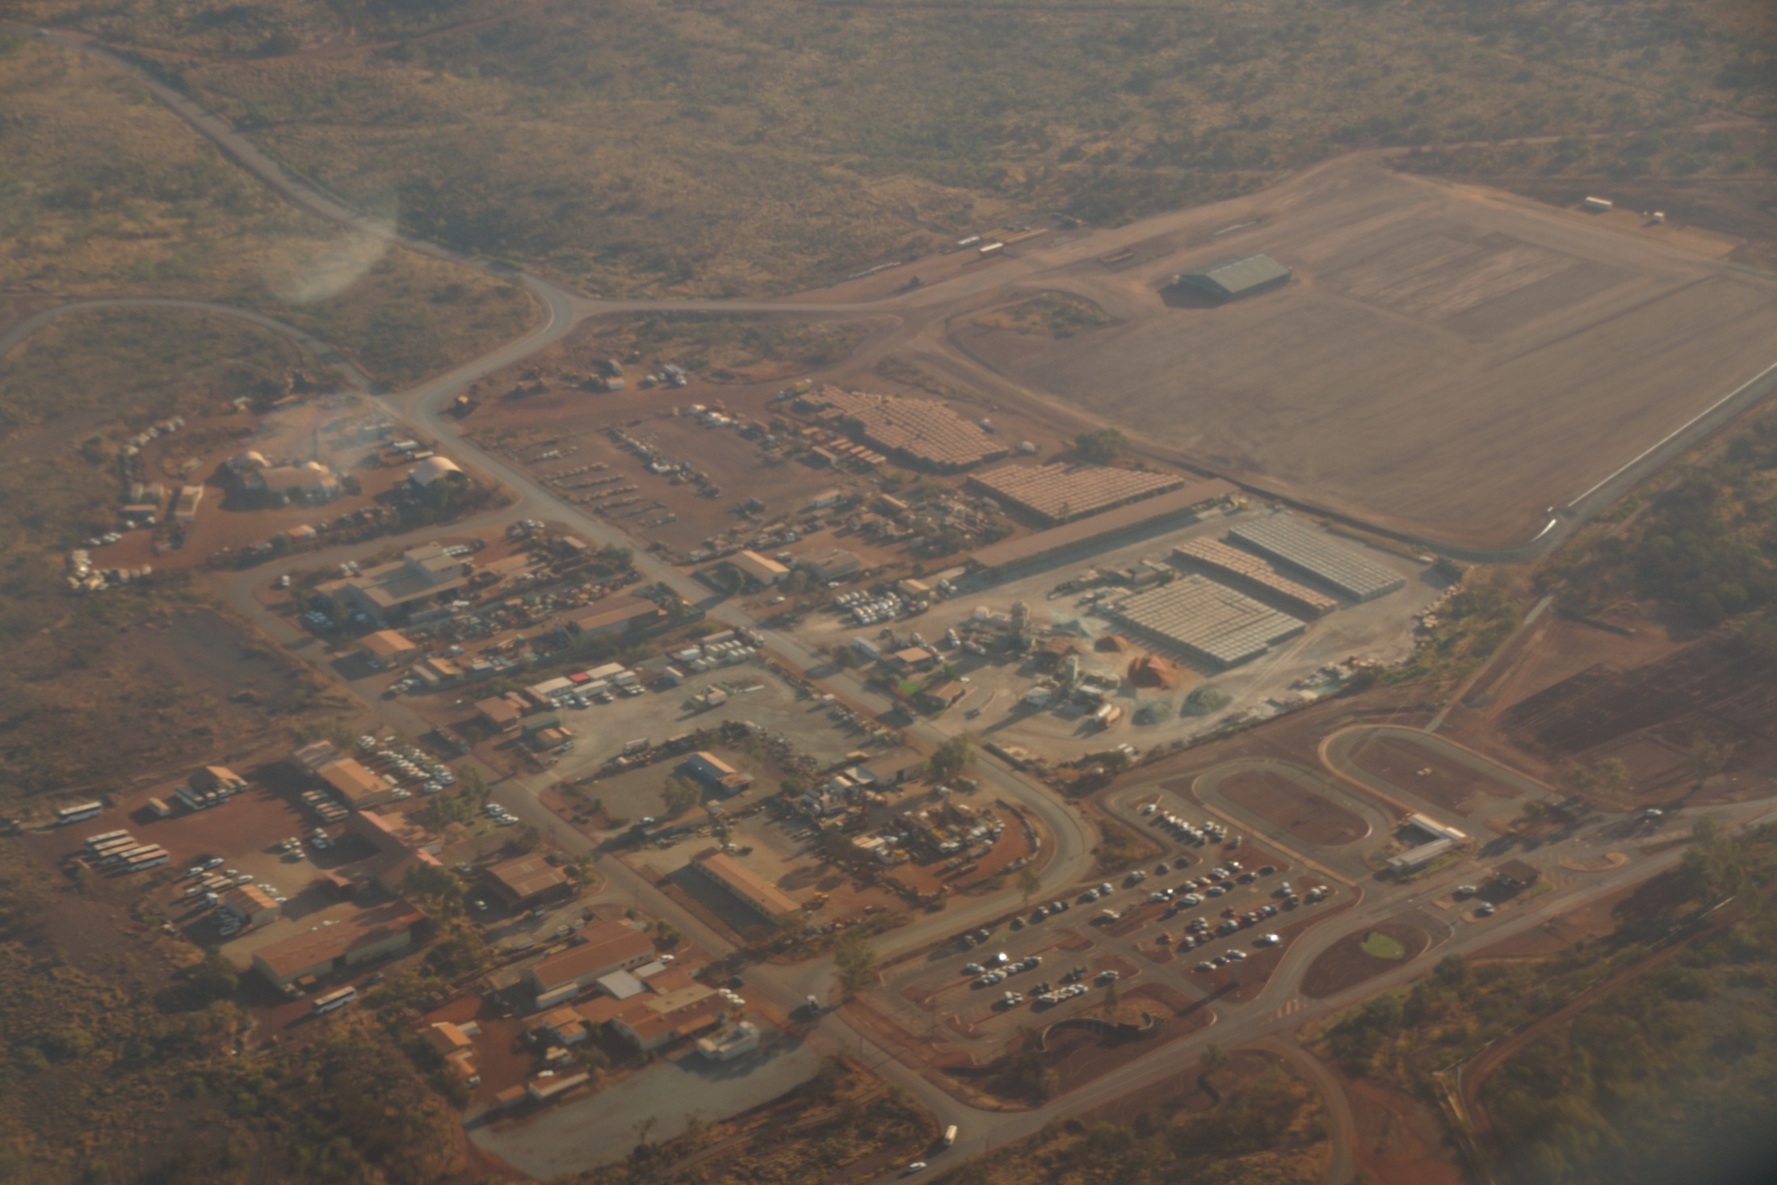
WORKSHOP EXERCISE 2
How hard is it to conduct an audit?
Let’s find out!
Notes:
Exercise showing that self-auditing is possible.
Do you travel along the mine access road? Obviously you do! Can you remember what is on the route?
What do you think you would be looking for from a safety perspective? What have you observed? List the items.
Look at Section 2 of Mobile equipment on mines Audit Part 1: Traffic Management – Mine Access Roads at http://www.dmp.wa.gov.au/15565.aspx
Look at the 8 audit items - How do these compare with your list?
Congratulations! You have started the auditing process for one part of the mine.
And if you don’t know the responses for some of the audit questions, have a look the next time you are on the mine access road. If you spot any issues, don’t forget to report them!

Slide 18


Don’t forget – Stay informed!
Visit www.dmp.wa.gov.au/ResourcesSafety
to sign up for our weekly news alerts

