Slide 1
Please read this before using presentation
This presentation is based on the findings of investigations by Department of Mines, Industry Regulation and Safety.
Department of Mines, Industry Regulation and Safety(DMIRS) supports and encourages reuse of its information (including data), and endorses use of the Australian Governments Open Access and Licensing Framework (AusGOAL)
This material is licensed under Creative Commons Attribution 4.0 licence. We request that you observe and retain any copyright or related notices that may accompany this material as part of attribution. This is a requirement of Creative Commons Licences.
Please give attribution to Department of Mines, Industry Regulation and Safety, 2017.
For resources, information or clarification, please contact: RSDComms@dmirs.wa.gov.au or visit www.dmirs.wa.gov.au/ResourcesSafety

Slide 2
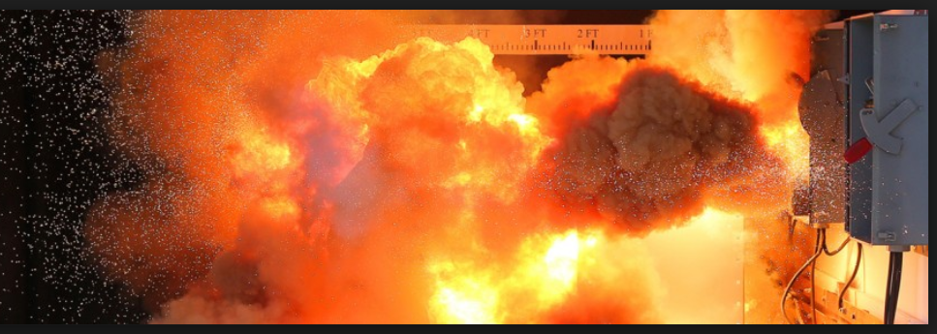
Arc Flash Awareness
Source – www.westex.com
Notes:
Don’t try this at home….. Or at work!
Many Australian Electrical Workers are injured each year from the effects of Arc Flash / Arc Blast

Slide 3
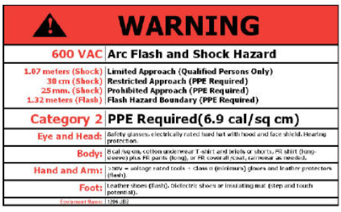
Arc flash awareness (continued)
De-energised = no arc flash hazard
Notes:
Whenever possible Isolate at the Source of Supply before opening motor control centres and distribution boards
REMEMBER – If it is not energised there is no arc flash hazard

Slide 4
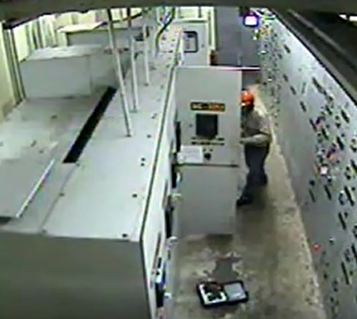
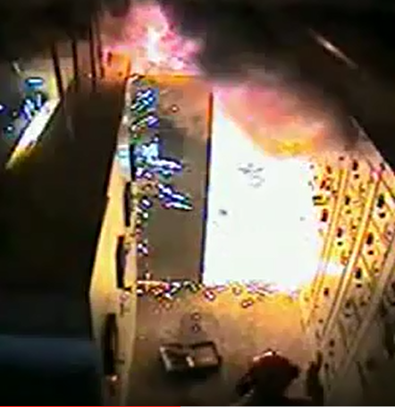
Arc flash awareness
20,000 Deg C
Arc Plasma
Vaporised metal
Hazards
Electric Shock
Burns
Blast trauma
Respiratory trauma
Notes:
The electrical worker in these photographs was seriously injured. He was completely engulfed by the arc plasma cloud
His associate (bottom LH corner of 2nd photo) was extremely lucky to be out of the line of fire
Hazards:
Electric Shock Hazard
- If engulfed in plasma, workers cannot be protected from electric shock by any conventional means
Burn Hazard
- Plasma at 20,000 degrees Celsius will burn clothes, skin, eyes, throat, airways, lungs….
Blast Trauma Hazard
- Copper expands to 67,000 times its solid volume when vaporised in an arc flash
- The expanding gasses can cause a shock wave of 2000psi (14MPa) in close proximity to the arc fault, causing serious blast injuries

Slide 5
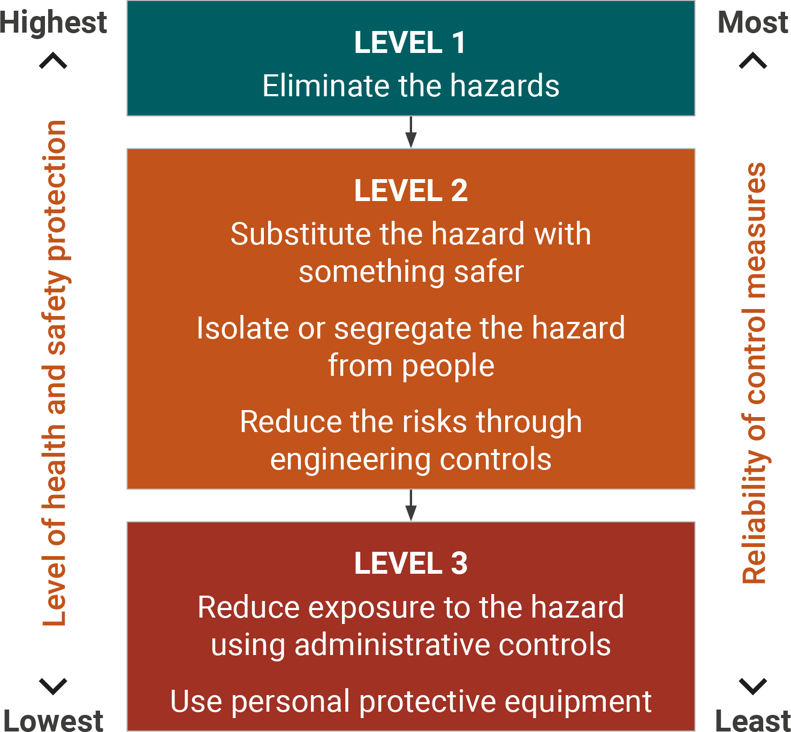
Arc flash awareness (continued)
Use Effective Controls
Apply the Hierarchy of Controls
Elimination of the hazard is best
PPE is the lowest level of control
Don’t work live!
Isolate
Lock out and tag
Test for dead
Notes:
Always use the Hierarchy of Controls
The most effective control is to ELIMINATE THE HAZARD i.e. ISOLATION of SUPPLY
PPE is the last line of defence. Don’t rely on PPE.
Don’t work live.

Slide 6
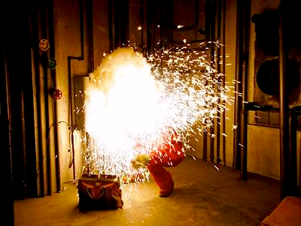
Arc flash awareness (continued)
Live testing – refer to:
Electrical Licensing Regulations, Australian Standards and Guidelines
Carry out a risk assessment
Independent assessment may be required
Loss of production or inconvenience is not a justification for live work
Image – www.voltimum.co.uk
Notes:
Reference Electrical Licensing Regulations
Code of Practice for safe low voltage work by electricians
AS/NZS 4836 – 2011 Safe work near live electrical installations
Live testing is only allowed in certain circumstances.
A detailed risk assessment must be carried out, and effective controls are required before live work can take place.
Loss of production or inconvenience IS NOT a justification for live work.

Slide 7
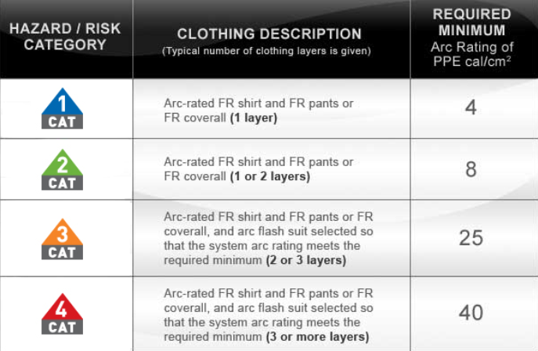
Arc flash awareness (continued)
Arc Flash risk is not restricted to high voltage installations
Low voltage, high current installations can develop huge incident energy levels
Carry out an arc flash study
Identify the arc flash boundary
Identify the category of PPE required
Source – www.voltimum.co.uk
Notes:
Low voltage installations can present a very high arc flash risk, due to the very high fault currents involved.
Carry out an Arc Flash Study to determine the magnitude of the risk.
There are NO specific Australian arc flash standards, so overseas standards may have to be used, for example:
IEEE 1584 – to calculate the incident energy and the arc flash boundary
NFPA 70E – To determine the appropriate PPE category
Use the Arc flash study to determine the safe approach distances and the minimum rating of PPE required
Remember - PPE is the LAST line of defence! Don’t put your life (or somebody else’s life) on the line

Slide 8
Arc flash awareness (continued)
De-energised = no arc flash hazard
Source – www.westex.com
Notes:
Simple, isn’t it?
No electrical energy = no arc flash hazard
DO NOT work live when you have the opportunity to isolate
Isolate, Lock-out, Tag, and Test for Dead – Every time!

