Slide 1
Please read this before using presentation
This presentation is based on content presented at the Registration of cranes information session held in July 2014
It is made available for non-commercial use (e.g. toolbox meetings, OHS discussions) subject to the condition that the PowerPoint file is not altered without permission from Resources Safety
Supporting resources, such as brochures and posters, are available from Resources Safety
For resources, information or clarification, please contact:
RSDComms@dmp.wa.gov.au
or visit
www.dmp.wa.gov.au/ResourcesSafety

Slide 2
Crane registrations in Western Australia –Common non-compliances

Slide 3
How is industry performing?
Data collected from 58 crane registrations submitted between July 2012 and April 2014
Comparisons refer primarily to initial submission attempts
Data primarily addresses areas where high degree of non-compliance was identified
Non-compliance is of regulations 6.33 and 6.34 of Mines Safety and Inspection Regulations 1995
Notes:
The comparisons presented in the following slides relates to a period of increased registrations from industry, which corresponded to the completion of many new mine sites across Western Australia.
The comparison was done on the first submission review, as the Department expects that to be correct, on the basis that verification is mandatory.
Non-compliance with the Mines Safety and Inspection Regulations 1995 includes non-compliance of AS 1418 and the associated Australian standards including:
AS 1170 loading standards
AS 4100 and AS 3990 for steelwork
AS 3600 reinforced concrete.

Slide 4
How many submissions were AS 1418 compliant?
Major compliance issues
Deflection checks
Fatigue checks
Seismic checks
Combined stress evaluation
Welding and other connection checks
and AS 1418 criteria failures not
addressed
Notes:
Excessive deflection of crane support structures and misalignment of rails has been found to directly contribute to crane failures and de-railment.
Fatigue failures have also been directly linked to poor assessment at design stage and specifying inappropriate weld details.
Seismic loading requirements become especially critical if the crane is indoors and/or not subject to wind. This does not mean wind loading is automatically the worst case and that seismic loading can be ignored – both load cases must be considered.
Combined stresses were often not checked. Although specifically noted in AS 1418.18 (Runways), these checks apply to crane bridges which are runways for the hoist.
Connection failures account for many structural failures worldwide, and are often the most under addressed by the designer. The dissemination of design intent, including connection design details is essential for the safety of all structures.

Slide 5
Common non-compliances – Design
Notes:
As can be seen here, there is a general increase in compliance over the 9% in the previous slide, when the crane design and structure design are considered individually.

Slide 6
Percentage of submissions with compliance issues
Notes:
Note that only the nine most common non-compliance issues are shown above.
“Other calculation errors and omissions” grouped issues that were individually less than 7% each (so actually there were more than fifteen areas of non-compliance)
“AS 1418 criteria failure not addressed” refers to a design check not done
“Welds” covers both strength and detailing errors.

Slide 7
Notes:
There is a notable difference in areas of non-compliance compared with the crane calculations.
For example when compared with the previous slide:
Deflection requirements of supports structures is more than double that of the crane structure
Combined stress eccentricity and torsion considerations is less than in the crane structures.

Slide 8
Common non-compliances – Verification
From r. 6.34(2), verifier role is defined as:
(c) verification by a person other than the person who
prepared the design that the design complies with the
Australian Standard applicable under regulation 6.33
Also recall that under r. 6.33 …
ensure that the plant is designed, constructed and tested in accordance with —
(b) in the case of a crane or hoist, AS 1418
Notes:
It is necessary for the designer to comply with the standards and that the verifier confirm that this has been done.
With only 9% compliance what is not understood? Perhaps the definition of verifier.

Slide 9
Definition of verify
Oxford Dictionary:
Make sure or demonstrate that (something) is true, accurate, or justified
TheFreeDictionary (online):
To prove the truth of by presentation of evidence or testimony; substantiate
To determine or test the truth or accuracy of, as by comparison, investigation, or reference
Notes:
Bearing in mind these definitions, the Department expects that submissions are:
Free of calculation errors
Meet requirements of AS 1418 and other materials standards
Tested by verifier independently with sufficient comparisons or checks to confirm there are no errors
In other words, that some time and effort has been spent to justify the verification statement.
Based on the evaluation of what DMP receives, this is not the case.

Slide 10
Notes:
When we compare how long the verifier took to complete the verification, we found some alarming statistics.
Some verification certificates dates even occur before the design sign off date – the Department sincerely hopes that these are typing errors.

Slide 11
Notes:
93% of the crane submissions which had a short verification time (two days or less) also had non-compliance issues.

Slide 12
Time span between
original support structure calculation and verification
Notes:
It appears that the support structure calculations are being verified with greater intensity than the crane calculations with more time is spent on the verification process when compared with crane designs
However, there is still a ‘negative time’ with verification certificate issued before the design is completed.

Slide 13
Notes:
The difference in using in-house verification to external verification is apparent
This graph shows 7% compliance when the parties were ‘connected’
However when parties are independent, the compliance rose to over 80%.

Slide 14
Documentation practices considered to be poor when:
Important documents or information missing from the submission
Submission is disorganised or sections are not well labelled
Notes:
The next few slides relate to quality control aspects of the documentation
Documentation should be the easiest part to get right but leads to delays and frustration when its not complete or accurate.
The Department cannot proceed with an application if critical documents are missing.
Where documents are disorganised with no indexing or order the Department spends more time with the submission to try and sort it out
Please follow the structure of the registration of classified plant application form, available on the DMP website.
The following are useful links on the DMP website:
Registration of Classified Plant section www.dmp.wa.gov.au/6702.aspx#6926
For the registration of classified plant application form www.dmp.wa.gov.au/documents/Forms/MSH_F_RegistrationOfClassifiedPlant.doc
For the documents specific to cranes www.dmp.wa.gov.au/documents/Forms/MSH_F_DocsRequiredApplyBridgeGantryCraneRegistration.docx

Slide 15
Inconsistent parameters are situations where:
Measurements or parameters differ between two sources in document (e.g. between drawings and calculations)
Parameters used are incorrect, leading to calculation errors
Parameters are not sourced correctly, and lack any justifying references
Notes:
Simple things like wheel spacing and span of the crane, differ in the same submission
Other examples include:
Wheel loadings from the crane calculations differing from the runway structure calculations
Runway calculations use an arbitrary source to determine the crane wheel loads, for example, not to Australian Standards
The Department needs to see quality control exercised and consistency throughout the application

Slide 16
Missed sections may include:
The crab
The hoist
End stops
End carriages
Notes:
50% compliance is not acceptable given these are the basic components for which drawings and designs must be readily available
These slides were aimed at showing you the trends and where there is a link, for example poor verification leans towards higher likelihood of non-compliance.

Slide 17
Factors contributing to structural safety
The Australian Steel Institute on confidential reporting on structural safety (December 2013) David Ryan – ASI National Manager “Commonly identified risks include lack of competence and engineering appreciation, fixings, tensile components, poor communications, over-reliance on IT, temporary works, free standing walls, lack of maintenance and falsified documentation, with the risk increasing when factors are combined.”
Notes:
It is important to note these indicators are very similar or the same as those we see in the crane industry
These are further supported by the statement in the next slide which relates to international findings by the Institute of Structural Engineers

Slide 18
Institute of Structural Engineers
Dr Soane of the Institute of Structural Engineers recently highlighted that some identified risks which frequently appear in structural-safety reports and alerts include issues of competence, and stated: “Before most, if not all, collapses there are pre-cursers elsewhere and if these are recognised, and lessons learned from them, then more serious events may be prevented.”
Notes:
It important to realise that multiple factors of non-compliance are a warning and pre-cursor which results in failures
This is demonstrated graphically in the next slide

Slide 19
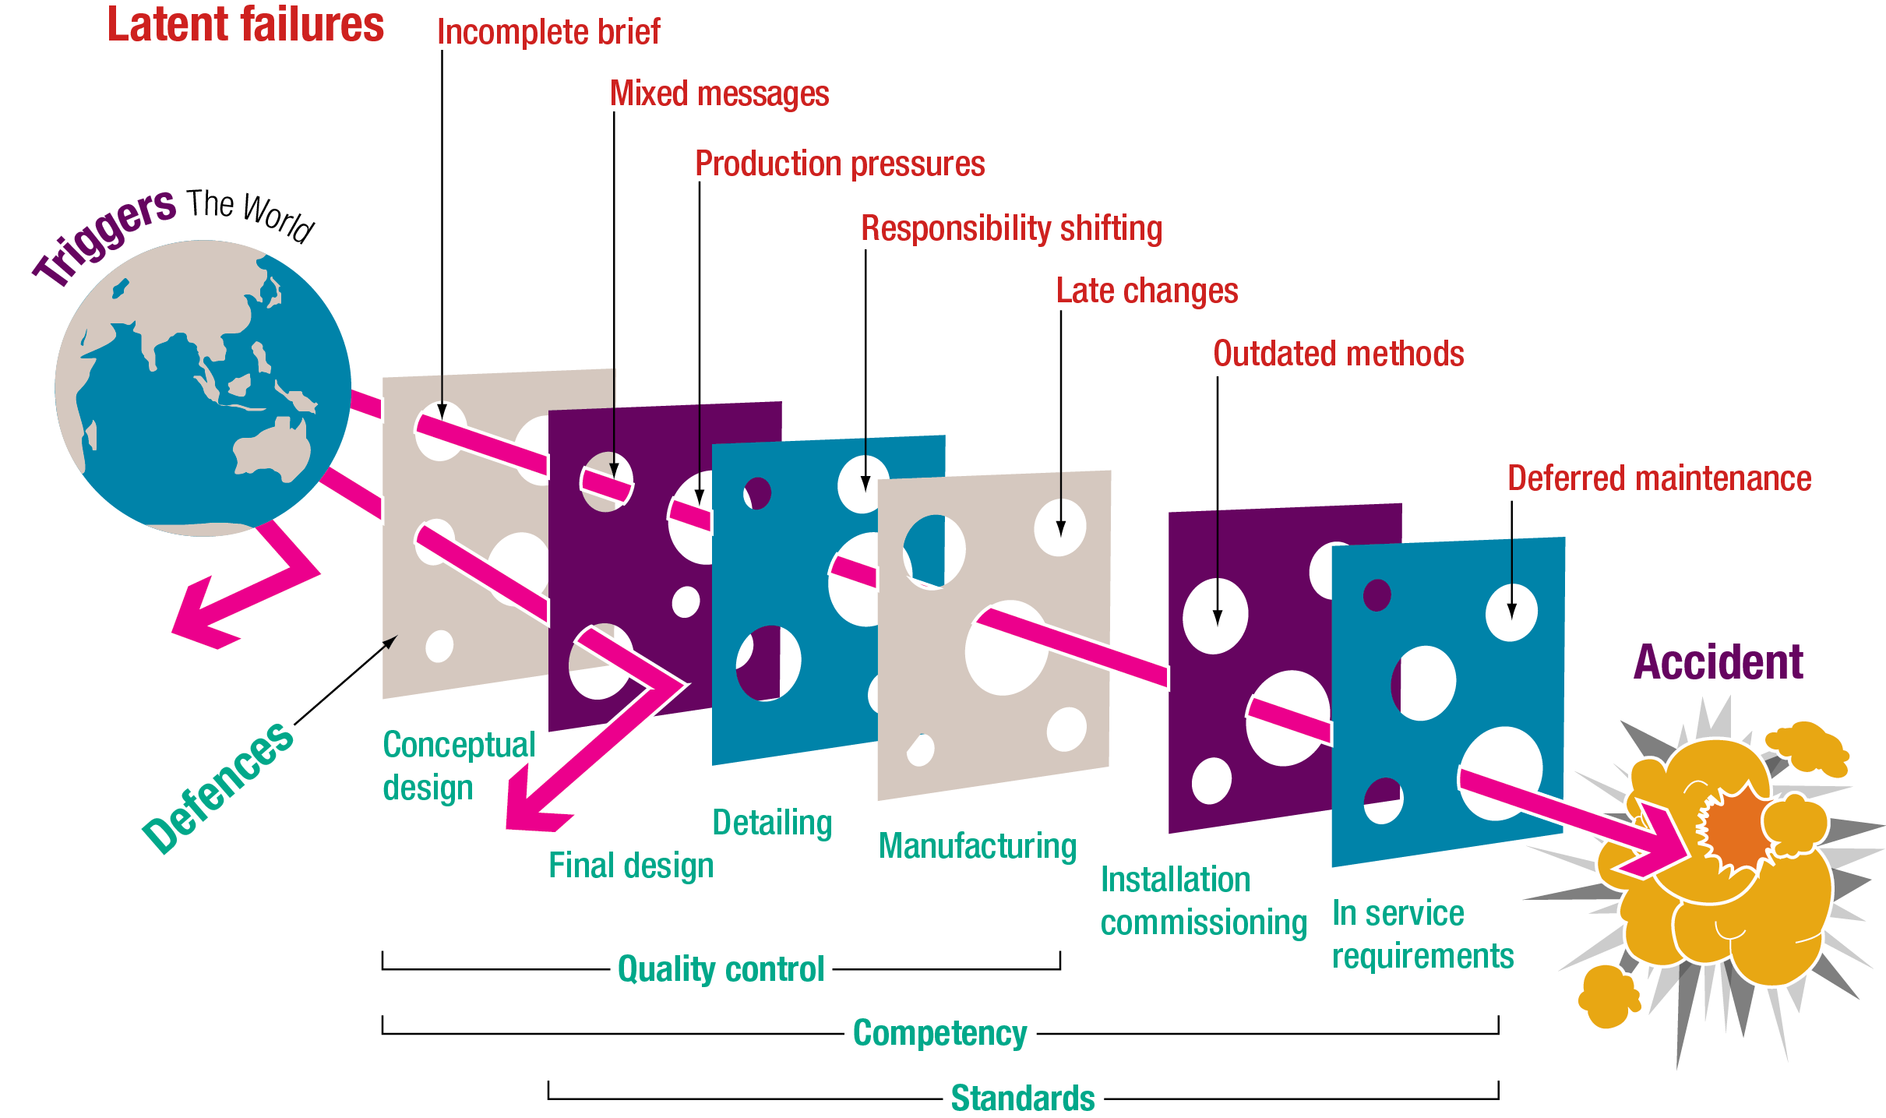
Swiss cheese model of accident causation
Notes:
The model was propounded by Dante Orlandella and James T. Reason of the University of Manchester and is the universally accepted accident causation model
What seems small or trivial may escalate when “the holes line up”
It illustrates that, although many layers of defence lie between hazards and accidents, there are flaws in each layer that when aligned result in an accident
Although many separate layers are present there are common threads which apply to all of them, such as adherence to norms and standards and of competency.

