Slide 1
Please read this before using presentation
This presentation is based on content presented at the Registration of cranes information session held in July 2014
It is made available for non-commercial use (e.g. toolbox meetings, OHS discussions) subject to the condition that the PowerPoint file is not altered without permission from Resources Safety
Supporting resources, such as brochures and posters, are available from Resources Safety
For resources, information or clarification, please contact:
  RSDComms@dmp.wa.gov.au
  or visit
  www.dmp.wa.gov.au/ResourcesSafety

Slide 2
Crane registrations in Western Australia –
The state-of-play and verification

Slide 3
Hierarchy of control – start at the top
Elimination
Substitution
Engineering
Isolation
Modify tools or equipment to minimise exposure to hazard
Administrative control
Modify work practices to minimise exposure to hazard
PPE
Last resort when other controls not practicable
Isolate or separate the hazard or hazardous work practice from people not involved in work
Replace the hazard or hazardous work practice with a less hazardous one
Remove the hazard or hazardous work practice
Increasing effectiveness
Notes:
The higher up the hierarchy of control your solution is, the greater its effectiveness of the control measures
Elimination by designing out a hazard is the most effective in the hierarchy of control
Elimination of hazard = no risk
Substitution = broad “shield” of protection
PPE = limited protection – very small shield!

Slide 4
Background information – crane registration
Definitions r. 6.1
A crane is an appliance intended for raising or lowering a load and moving it horizontally and –
  Includes the supporting structure of the crane and its foundations
Cranes are part of a larger group known as “classified plant”
Notes:
The Mines Safety Inspection Regulations 1995 definition of classified plant 6.1 means any –
Boiler
Crane
Hoist
Lift
Pressure vessel
So cranes are part of a larger group known as Classified Plant
The Mines Safety Inspection Regulations 1995 define a crane to mean
An appliance intended for raising or lowering a load and moving it horizontally and –
Includes the supporting structure of the crane and its foundations
This definition is important. When applying for registration, the information submitted must allow the regulator to review not only the design of the crane but also its supporting structure to the foundations.

Slide 5
Background information – crane registration (continued)
Regulations
All cranes must comply with AS 1418 (r. 6.33)
All gantry cranes > 5T and bridge cranes > 10T must be registered before they may be used on a mine site (r. 6.34)
To apply for registration of a crane you must submit:
  Design calculations
  Detailed drawings
  Verification that design complies with AS 1418
Notes:
Regulation 6.33. Design, construction and testing of plant details that;
A person who designs, manufacturers, imports or supplies any classified plant for
use at a mine must ensure that the plant is designed, constructed and tested in
accordance with –
(b) in the case of a crane or hoist, AS 1418
Regulation 6.34 (5)(j) Registration of plant directs that;
Before a gantry crane > 5T or a bridge crane > 10T can be used at a mine site they must be registered.
To apply for registration you must submit design calculations, detailed drawings and Verification that the design complies with AS 1418

Slide 6
How are crane registrations assessed?
Application received by DMP
Entered into a database
Reviewed against guidance material and for high risk areas
Comments sent to applicant
Responses received and reviewed
Registration letter completed
Notes:
In 2013, after consultation with industry, Resources Safety developed draft guidance material to assist industry identify the drawings and calculations required to be submitted for crane registration.
This document is now finalised and plays a key role in how registrations are assessed. It available on the DMP website in the Classified Plant section at www.dmp.wa.gov.au/6702.aspx
When an application is submitted to the Department, the details are entered into a database
The application is then reviewed against the guidance material.
Once the application meets the criteria on that form, the Department’s senior structural engineer reviews the design by looking at known potential high risk areas. This does not mean that the Department is acting as a verifier (or second verifier), and this process should not be considered as a free safety check.
Any comments or queries will then be sent to the applicant, and only once these comments and queries have been adequately addressed, will the registration letter be completed and sent out via email, with the original posted to the applicant.

Slide 7
Definition of designer
Regulation 6.1 definition
Means a person who designs plant for use in a mine or intended for use in a mine or is responsible for the design of that plant
Notes:
Regulation 6.1 designer definition
Means a person who designs plant for use in a mine or intended for use in a mine or is responsible for the design of that plant

Slide 8
Obligations for crane designers
“It is within the designer’s discretion to decide where compliance is necessary.”
True or False?
False
Compliance with AS 1418 is law
Should you be found not to comply, you are liable for prosecution under r. 6.33
Notes:
Note: This slide has animations
The Department is often given the impression that designers believe it is ultimately within their discretion to decide if compliance with the Standard is really appropriate or necessary.
(Click)
This is totally incorrect. Compliance with AS 1418 is law.
This standard should be viewed as a non-negotiable minimum for the design of a crane.
It is expected that under certain situations and environmental conditions that crane designs will go above and beyond what is required in the standard. Based on the crane’s environment and the way the crane will be used, certain additional design features or checks may need to be completed.
Should your design not comply with the standard, and you have not been issued an exemption, you may be liable to prosecution under regulation 6.33.
With regards to exemptions, please be aware that these will only be issued if it can be proved that the alternate, non-compliant design is just as safe, if not safer, than one that complies with the standard.

Slide 9
Obligations for crane verifiers
Role of verifier is to confirm that the design complies with AS 1418
You only supply a verification certificate for a design once you have confirmed it complies with AS 1418
If you are found to have verified a design that does not comply with AS 1418, you may be prosecuted under s. 101 – False or misleading information
Notes:
The role of the verifier is to confirm whether or not the design complies with AS 1418
In line with the duties of the crane designer, it is also not within the verifier’s discretion to decide if compliance is necessary.
Compliance is mandatory and you are legally obliged to only supply a verification certificate of compliance if the design DOES comply with AS 1418.
There has been cases where non-compliance with the standard has even been stated on the Verification Certificate and not addressed.
If the design does not comply, you must not issue a certificate of compliance.
Verifiers must set the standard. Verification is an extremely important function that is relied on to ensure plant is safe.
You must take whatever steps are required to ensure full verification of the design.
If you provide this verification and it is found that the design does not in fact comply then you risk being prosecuted under section 101 – False or misleading information.

Slide 10
Common non-compliances with AS 1418
Undersized weld specified
Connection between bridge beam and end carriage, no bending or prying checks completed on end plate
Check of vertical loads on web (AS 1418.18, cl. 5.7.3.3)
Checks of the support structure’s deflection (AS 1418.18, cl. 5.13)
Assessment that end stop loads have a suitable resistance path back to columns and vertical bracing
Fatigue analysis
Seismic assessment
Notes:
Although there has been an improvement in compliance rates, DMP is still receiving designs that do not fully comply with AS 1418.
Common issues often neglected in submissions include:
Weld sizes that do not comply
Connections between bridge beam and end carriage – no bending or prying checks completed on the end plate
Check of vertical loads on web as per cl 5.7.3.3 (AS 1418.18)
Checks of the support structures deflection as per cl. 5.13 (AS 1418.18)
Assessment that end stop loads have a suitable resistance path back to columns and wall bracing
Fatigue analysis – DMP see cranes being rated as C5 that are only intended to be used (and have only been assessed) as C3/C4
Seismic assessment is frequently missed
Common issues are covered in further detail in the toolbox presentation, “Crane registrations in Western Australia – Common non-compliances”, available in the toolbox presentation section at http://www.dmp.wa.gov.au/8054.aspx

Slide 11
Quality management
Crane design often involves sub-contractors
Are enough resources being directed into project’s QM?
Some main issues are:
  Lack of document control
  Inconsistency with regards to parameters used
  Calculation errors – no peer review of calculations
  Lack of traceability of drawing approvals
  Lack of formal processes to resolve technical queries across various stages of design
  No evidence of drawing review against calculations
Notes:
Quality management does not specifically relate to ‘good quality’ but rather focuses on the importance of consistency
Typically, the design of a new crane is sub-contracted out to at least two different groups
With this considered, the regulator is concerned that not enough attention and time are being directed into communication and ensuring consistency across the groups involved.
Some of the main issues relating to this area are:
Lack of document control
Inconsistency with parameters being used (e.g. crane classification, dimensions, crane speeds, weights)
Calculation Errors - Limited evidence of calculation peer review
Lack of traceability of drawing approvals
Lack of formal processes to resolve technical queries across various stages of the design
No evidence of drawing review against calculations
For the majority of applications, especially earlier on, this lack of consistency can give the impression that the regulator is the first to view the complete design package.

Slide 12
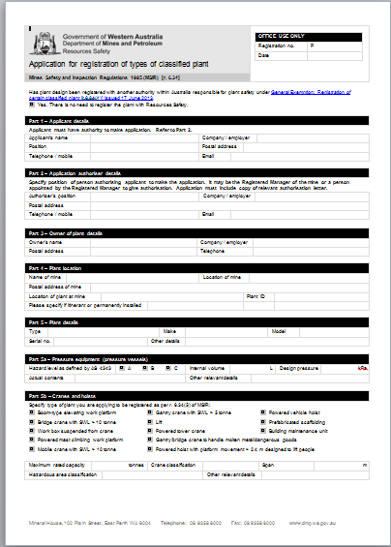
How is the regulator helping?
Updated form for registration of classified plant
Removed unnecessary details
Emphasised frequently overlooked items
Allowed for up to three designers and verifiers
Expanded sections for the documentation submitted
Clarified applicant’s declaration
  Applicant is authorised
  Information submitted is compliant and a true and correct representation of plant
  All relevant safety and health information has been passed on to owner of plant
Notes:
In April 2014, the application form for registration of all classified plant was updated. This form applies to all classified plant, including cranes and pressure vessels.
Changes include:
Removal of unnecessary details (e.g. fax number)
Emphasis on important items that are frequently overlooked (e.g. requirement for letter of authorisation if applying for registration on behalf of the Registered Manager or principal employer, is now typed in bold under Part 2)
Tailored form to suit crane design by allowing for up to three designers and verifiers and adding more room under part 10 and 11 to list drawings and design calculations
Applicant’s declaration now states “I declare that I am a person authorised in writing by the registered manager or principal employer to make this application, that the information contained in this application is compliant and is a true and correct representation of the plant; and that relevant safety and health information required by Australian Standards to enable the plant to be used safely has been made available to the required party by the owner of the plant.”
There are a number of checks delegated to the applicant to complete before submitting the application. In the past, and still today (although to a lesser degree), DMP receive applications that appear not to have been reviewed in their entirety before submission and, as a result, contain a number of issues with consistency and correctness.
So it is imperative that the following checks are completed before submitting an application:
Applicant has been authorised in writing and has enclosed a letter confirming this
Information contained is compliant with the applicable regulations and standards
Information contained is a true and correct representation of the plant
All relevant safety and health information has been passed on to the owner.

Slide 13
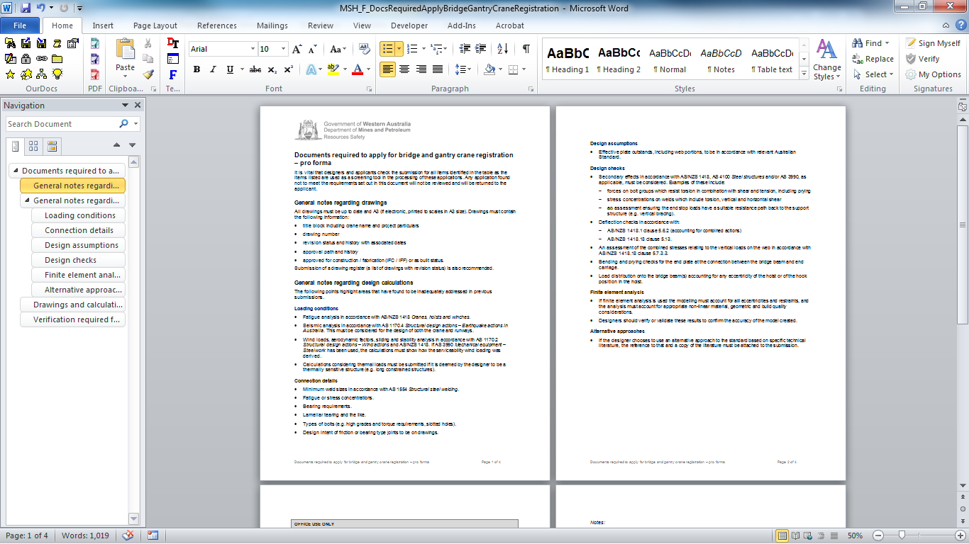
What else is available?
Updated guidance material that lists documents required when applying for bridge and gantry crane registration
Amended layout to improve clarity
Circulated to industry last year and feedback addressed
Visit registration of classified plant section at www.dmp.wa.gov.au/ResourcesSafety
Notes:
Guidance material that accompanies the classified plant registration form has also been updated. This document lists information to be submitted when applying for bridge or gantry crane registration
The layout has been improved, with the general notes now at the front, and a single table listing the drawings and calculations required
Both the registration form and guidance document are available on the DMP website in the classified plant section at www.dmp.wa.gov.au/6702.aspx

Slide 14
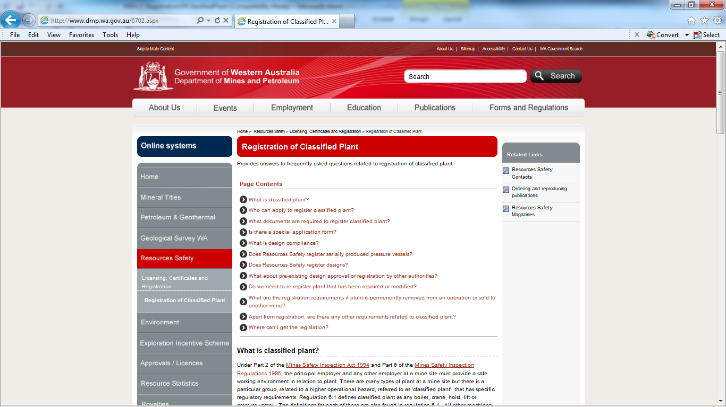
What is coming?
Development of online one-stop shop for all classified plant to replace current “Registration of Classified Plant”
Legislation and exemptions
Clearer definitions
Updated FAQs
Safety alerts
Articles
Forms
Guidelines
Notes:
Resources Safety has commenced developing one-stop shop for classified plant.
This will include:
Applicable legislation and exemptions
Clearer definitions and explanations
Updated frequently asked questions (FAQs)
Relevant safety alerts
Incidents or articles relating to classified plant
Forms and guidelines useful to industry

Slide 15
Other plans
Looking into making application process electronic via:
Safety Regulation System (SRS)
File transfer system
Web page
Thoughts and ideas on this are welcome!
plantregistrations@dmp.wa.gov.au
Notes:
DMP is looking into options to allow electronic submission of registrations. Suggestions and recommendations are welcome.
These options could include:
Registration via the Safety Regulatory System (SRS). This would include functionality so that you could submit an application for registration with all communication done through SRS as well, potentially allowing tracking of applications.
Setting up a File Transfer System. Allows transfer of all relevant documents electronically
Webpage or Microsoft word document with fields that allow applicants to drag and drop information into them
A dedicated plant registration mailbox is now available. Please feel free to use this mailbox for any related queries, as your email will be forwarded to the DMP inspectors dealing with classified plant.

Slide 16
FAQ regarding plant already registered
Where specific items of classified plant have already been design registered by another Commonwealth, State or Territory authority within Australia, you do NOT need to apply to DMP to have plant registered.
WorkSafe Design Registration Number Individual Registration Number | DMP Individual Registration Number
Notes:
At the top of the classified plant application form, it states that if you already have design registration with another state authority you do not need to submit anything to the Department.
Keeping a copy of the registration documents from the other state authority fulfils your obligations with regards to r. 6.34.
Be aware of the general exemption attached to this (dated June 2013), that outlines certain conditions which must be met for you to be exempt. A copy of this exemption is available on the DMP website in the classified plant section at www.dmp.wa.gov.au/6702.aspx#6921
The form highlights all other regulations regarding classified plant that you still must adhere too, such as keeping the classified plant log book, reporting of incidents.
The following example highlights the difference between Worksafe’s registration process and DMP’s registration process. Pressure vessels have been used for this example (see table).
WorkSafe first issues a Design Registration, which is for the design and therefore could apply to a number of items of plant. WorkSafe then undertakes Individual Plant Registration (which is registration of the individual item).
DMP only processes one type of registration (which is an amalgamation of the two). It is a registration where DMP review each design and registers the item individually. Essentially, each item of plant is treated as a unique design (because quite often this is the case, especially with cranes)
So, as long as you have a valid Design Registration from another recognised authority, you are exempt from getting the item individually design registered with DMP (as per general exemption)
Note: There have been cases where site operators have insisted on two registration numbers being provided before the plant may be used. This requirements is not applicable to DMP-registered equipment on a mine (as defined by the Mines Safety and Inspection Act 1994)

