Slide 1
Please read this before using presentation
This presentation is based on the content presented at the 2019 Health and Hygiene Forum in June 2019.
Department of Mines, Industry Regulation and Safety (DMIRS) supports and encourages reuse of its information (including data), and endorses use of the Australian Governments Open Access and Licensing Framework (AusGOAL)
This material is licensed under Creative Commons Attribution 4.0 licence. We request that you observe and retain any copyright or related notices that may accompany this material as part of attribution. This is a requirement of Creative Commons Licences.
Please give attribution to Department of Mines, Industry Regulation and Safety, 2019.
For resources, information or clarification, please contact: SafetyComms@dmirs.wa.gov.au or visit www.dmirs.wa.gov.au/ResourcesSafety

Slide 2
2019 Health and hygiene
forum
Notes:
Held at the Hyatt Regency, Perth, 24th June 2019

Slide 3
Health and hygiene management plans (HHMPs) – the hows and whys

Slide 4
Why the focus on health and hygiene
Safe Work Australia states that more than 10,000 workers suffer serious disease effects each year and they estimate that around 5000 cancers are attributed to occupational exposures.
DMIRS is committed to:
reducing health and hygiene risks
improving SRS
deploying resources based on risk (both industry’s and Dept.)
Notes:
Health and hygiene has been identified as one of the key commitments in the Mines Safety Towards 2020 regulatory strategy. It is closely aligned with the comitments of risk-based resourcing and using SRS as a major data exchange tool.

Slide 5
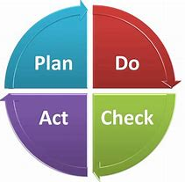
What is a Health and Hygiene Management Plan (HHMP)?
A HHMP is an integrated risk-based management plan not just a monitoring program
It supports the project management plan (PMP) by providing more detail on specific hazards
It must contain measurable and verifiable commitments
It compliments the radiation management plan (RMP), Noise Control Plan and other hazard management plans
Will form required component of a Mine Safety Management System in the harmonised WHS regulations
It is a concise means of demonstrating an understanding of health hazards, how they are managed, and how the effectiveness of controls are verified
It is not a sampling quota (Workforce surveys and quotas not issued since 2013)
It is not CONTAM (CONTAM database has not existed since 2017).
Notes:
Note that the CONTAM system ceased in 2017, and that all mining operations in WA are now required to comply with the HHMP requirements.

Slide 6
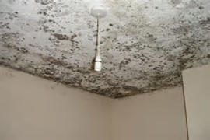
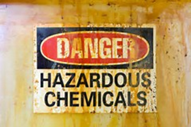
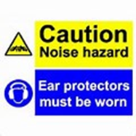
Why a HHMP?
All workplaces have some form of chemical, biological, radiation or physical hazard that include:
Dusts, chemicals, noise, vibration, radioactive materials or devices, temperature extremes, bacteria, fungi, inadequate lighting
Meets legislative requirement to:
Identify hazards
Assess risks
Implement controls
Verify that controls are effective
(Principle Hazard Management Plan and Health Management Plan required in upcoming WHS Regs)
Provides a structured means of demonstrating an understanding of the hazards and risks and verification that controls are effective.
Notes:
DMIRS (and the broader industrial hygiene community) use the term AGENTS to describe the various chemical, biological, radiation or physical hazards.

Slide 7
When is a HHMP required?
Prior to operations commencing
Hazards are to be identified and controls implemented prior to operations starting
All registered mine sites require a valid HHMP (including exploration) by 30 June 2019
Letter was sent from State mining engineer Sept 2018 to all mines
Existing RBHMP’s will be valid till expiry (~Nov 2019)
Very small operations may be exempt if requirements are covered in PMP of other documents.
A HHMP template is being developed to assist operations that may meet the exemption criteria applied to the Mine Safety levy.
Notes:
Mines that are exempt from the Mines Safety levy may be exempt from HHMP – but this is not always the case. Registered Managers of levy-exempt mining operations need to check with their District Inspector who cant grant the exemption – and not to assume that an exemption applies.

Slide 8
When are documents submitted?
Plans can be submitted at any time
Plan is valid for (up to) five years
A revised plan can be submitted at any time when a change occurs that alters risk profile of the site
Revised plan is valid for (up to) five years i.e. the “clock is reset”
A (brief) annual summary report is submitted if the risk profile or controls have not significantly changed (otherwise a revised plan is required)
Annual report should:
confirm commitments made in the plan have been fulfilled
justify why commitments made in the plan have not been fulfilled
highlight non compliances and the actions proposed to remedy
highlight proactive actions and achievements
proposed control verification methods for next 12 months.

Slide 9
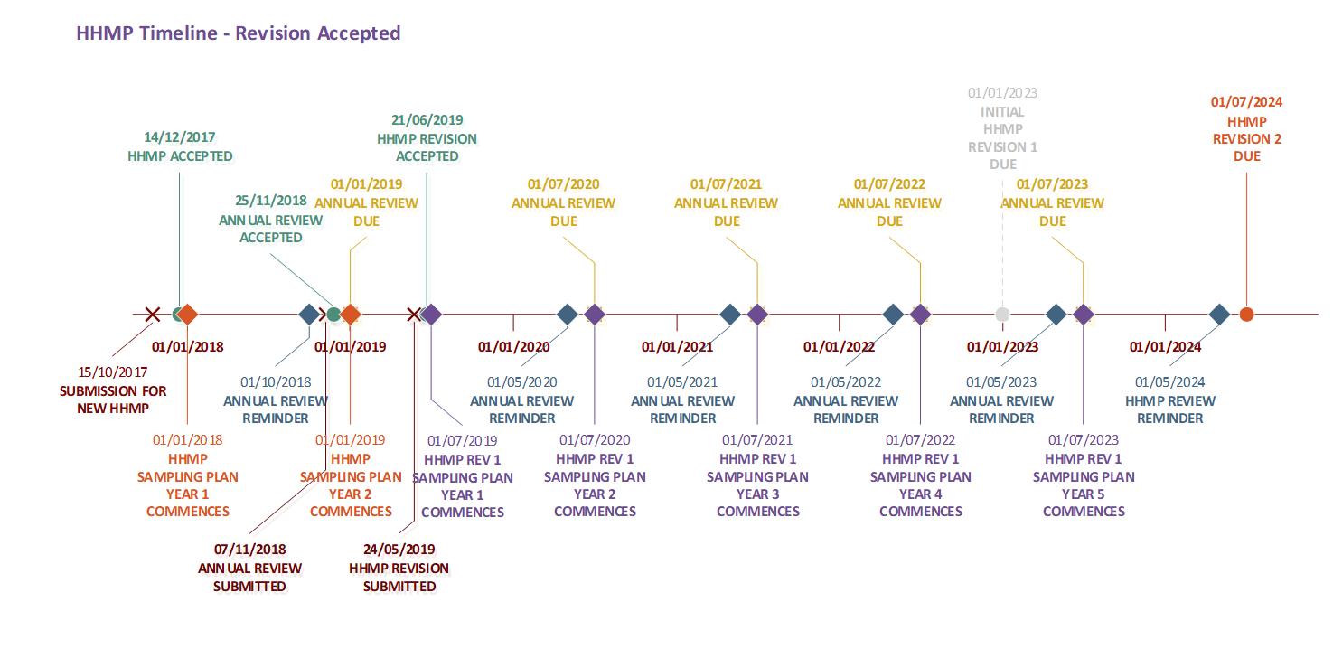
Example of HHMP and Annual Review timeline
Notes:
This is an example of how a submission timeline might evolve. It is not meant as guidance …

Slide 10
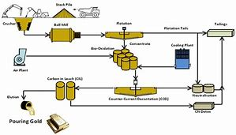
What should be included in HHMP
Description of operation
Principal function e.g. exploration, quarry, process plant
Status of operation e.g. new, reopening of suspended activities, expansion of existing facilities, continuation of normal operations
Location, activities at site (a schematic flowchart may assist), techniques and controls, size of operation
Basic geology e.g. principal mineral(s), contaminants in ore and waste, likelihood of harmful or flammable gases, chemically unstable minerals
Process chemicals used or created. Temperature and pressure of processing

Slide 11
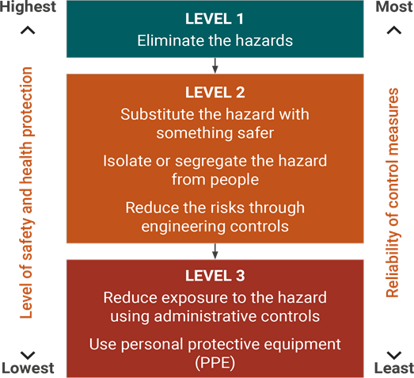
What should be included in HHMP
Identify hazards during:
Exploration
Mining
Processing and stockpiling
Ancillary/Support Services
Identify the engineering, administrative and PPE controls
Document hazards and controls

Slide 12
What should be included in HHMP
Assess risk
Define parameters used to assess risk and risk acceptability
Can use corporate method or AS/ISO 31000
Define Similar Exposure Groups (SEGs) –not the operational org chart
Risk Assess each SEG for the hazards
Document risk assessment with controls in place

Slide 13
Example of Risk Assessment Tool
 |  |  | CONSEQUENCE
 |  |  | Probably not Carcinogenic to humans (IARC-Cat4) or causes minor Irritation | Not classifiable as Carcinogenic to humans (IARC-Cat3) or causes irritation, headache, nausea, shortness of breath, erythema Temporary Hearing Loss (Threshold Shift) | Possibly Carcinogenic to humans (Cat2b) or causes temporary incapacitation, or dermatitis, dizziness, poor coordination Permanent hearing loss/impairment | Probably Carcinogenic to humans (Cat2a) Permanent incapacitation/ sensitisation, liver or kidney damage. Significant Permanent hearing loss/impairment | Carcinogenic to humans (Cat1) Reproductive effects, Death, Deafness
 |  |  | Insignificant | Minor | Moderate | Major | Catastrophic
Likelihood/ Exposure | Always <10% of OEL | Very unlikely to occur | Low | low | Low | medium | medium
 | Consistently <50% of OEL and 0% of all samples above OEL | Unlikely to occur | low | low | medium | medium | high
 | Consistently <50% of OEL and <5% of all samples above OEL | Possibly could occur | low | medium | medium | high | Unacceptable
 | Consistently 50-100% of OEL or >5% of all samples above OEL | Probably will occur | medium | high | high | Unacceptable | Unacceptable
 | Consistently >100% of OEL | Almost Certain to occur | medium | High | Unacceptable | Unacceptable | Unacceptable
Notes:
The Risk Assessment tool is found in the HHMP Guideline.
Note – if operations have their own risk assessment protocol it should be applied – with a cautionary note that ‘normal’ risk assessment matrices generally are not suitable for application to health based outcomes.

Slide 14
What should be included in HHMP
Many techniques available to verify control effectiveness
For example: Atmospheric sampling, Biological monitoring, Noise dosimetry, Audiometric testing, Medical examinations, Ventilation system measurements e.g. capture velocities, Audits and inspections, Questionnaires and examinations
Record results and findings
Submit to DMIRS via SRS or Workcover as applicable
Conduct (Statistical) analysis of results
Present overview in annual report

Slide 15
Using the correct statistics to determine compliance
The mean (average) of the samples (or the upper confidence limit of the mean) is not the correct statistic to determine compliance
The 95%ile of the predicted population exposure is a better indicator of compliance
Notes:
The new SRS functionality incorporates a statistical analysis package and the capacity to benchmark against other, similar mining operations.

Slide 16
Example of SRS HHMP statistics package
Notes:
The new SRS functionality incorporates a statistical analysis package and the capacity to benchmark against other, similar mining operations.

Slide 17
What should be included in HHMP
Improvements
Document what controls are effective
Identify what additional controls are required
Summarise and present in HHMP annual report (opportunity to present achievements as well as improvements)
If required update health risk assessment and submit a HHMP revision (5yr cycle restarts)

Slide 18
Ten common “issues/ failings/mistakes” with some HHMPs
This was not easy to give a heading to
Proposed “The ten common failings or mistakes in submitted HHMPs”
Too negative (some might be upset or offended)
Recommended a more positive heading

Slide 19
Ten common “issues/ failings/mistakes” with some HHMPs
This was not easy to give a heading to
Proposed “The ten common failings or mistakes in submitted HHMPs”
Too negative (some might be upset or offended)
Recommended a more positive heading
Proposed “ The ten rules to follow when submitting an HHMP”
Too authoritarian (some might be alienated)
Recommended a more engaging heading

Slide 20
Ten common “issues/ failings/mistakes” with some HHMPs
This was not easy to give a heading to
Proposed “The ten common failings or mistakes in submitted HHMPs”
Too negative (some might be upset or offended)
Recommended a more positive heading
Proposed “ The ten rules to follow when submitting an HHMP”
Too authoritarian ( some might be alienated)
Recommended a more engaging heading
Proposed “The ten tenets when submitting an HHMP”
Nice little catchy phrase that shouldn’t upset or alienate anyone

Slide 21
The ten tenets of HHMP’s
So I asked for some help with a graphic

Slide 22
The ten tenets of HHMP’s
Clearly noise induced hearing loss is not restricted to the mining industry
So another change was required

Slide 23
The Ten Commandments for HHMP submissions

Slide 24
The Ten Commandments for HHMP submissions
Thou shalt remember that the purpose of the plan is to prevent harm to thy fellow workers not the accumulation of KPI points or to provide an audit tool for thy regulator, for thy regulator has many, many forms already.

Slide 25
The Ten Commandments for HHMP submissions
Thou shalt remember that the purpose of the plan is to prevent harm to thy fellow workers not satisfy the accumulation of KPI points or to provide an audit tool for thy regulator, for thy regulator has many, many forms already.
Thy plan shall overfloweth with facts and data not opinions and aspirations.

Slide 26
The Ten Commandments for HHMP submissions
Thou shalt remember that the purpose of the plan is to prevent harm to thy fellow workers not satisfy the accumulation of KPI points or to provide an audit tool for thy regulator, for thy regulator has many, many forms already.
Thy plan shall overfloweth with facts and data not opinions and aspirations.
Thou shalt supply a plan of management actions, not a status report or list of health hazards.

Slide 27
The Ten Commandments for HHMP submissions
Thou shalt remember that the purpose of the plan is to prevent harm to thy fellow workers not satisfy the accumulation of KPI points or to provide an audit tool for thy regulator, for thy regulator has many, many forms already.
Thy plan shall overfloweth with facts and data not opinions and aspirations.
Thou shalt supply a plan of management actions, not a status report or list of health hazards.
Remember that recommendations have no place in thy plan, only actions. Thy actions shalt be S.M.A.R.T.
Specific, Measureable, Achievable, Responsibility assigned and Time bound

Slide 28
The Ten Commandments for HHMP submissions
Thou shalt remember that the purpose of the plan is to prevent harm to thy fellow workers not satisfy the accumulation of KPI points or to provide an audit tool for thy regulator, for thy regulator has many, many forms already.
Thy plan shall overfloweth with facts and data not opinions and aspirations.
Thou shalt supply a plan of management actions, not a status report or list of health hazards.
Remember that recommendations have no place in thy plan only actions. Thy actions shalt be S.M.A.R.T.
Specific, Measureable, Achievable, Responsibility assigned and Time bound
Thou you may covet thy neighbours HHMP - do not copy- for thee hazards and controls will be different.

Slide 29
The Ten Commandments for HHMP submissions
Thou shalt remember that the purpose of the plan is to prevent harm to thy fellow workers not satisfy the accumulation of KPI points or to provide an audit tool for thy regulator, for thy regulator has many, many forms already.
Thy plan shall overfloweth with facts and data not opinions and aspirations.
Thou shalt supply a plan of management actions, not a status report or list of health hazards.
Remember that recommendations have no place in thy plan only actions. Thy actions shalt be S.M.A.R.T.
Specific, Measureable, Achievable, Responsibility assigned and Time bound
Thou you may covet thy neighbours HHMP - do not copy- for thee hazards and controls will be different.
Thy plan shalt be succinct. Understand thy hazards and controls and the words will be few.

Slide 30
The Ten Commandments for HHMP submissions
Thou shalt remember that the purpose of the plan is to prevent harm to thy fellow workers not satisfy the accumulation of KPI points or to provide an audit tool for thy regulator, for thy regulator has many, many forms already.
Thy plan shall overfloweth with facts and data not opinions and aspirations.
Thou shalt supply a plan of management actions, not a status report or list of health hazards.
Remember that recommendations have no place in thy plan only actions. Thy actions shalt be S.M.A.R.T.
Specific, Measureable, Achievable, Responsibility assigned and Time bound
Thou you may covet thy neighbours HHMP - do not copy- for thee hazards and controls will be different.
Thy plan shalt be succinct. Understand thy hazards and controls and the words will be few.
Thy law requires ALL workers to not be harmed irrespective of obscurity of work location or employment contract -so thy plan shalt cover all aspects and hazards of the operation even though thy dangers are far from view and only few may be affected.

Slide 31
The Ten Commandments for HHMP submissions
Thou shalt remember that the purpose of the plan is to prevent harm to thy fellow workers not satisfy the accumulation of KPI points or to provide an audit tool for thy regulator, for thy regulator has many, many forms already.
Thy plan shall overfloweth with facts and data not opinions and aspirations.
Thou shalt supply a plan of management actions, not a status report or list of health hazards.
Remember that recommendations have no place in thy plan only actions. Thy actions shalt be S.M.A.R.T.
Specific, Measureable, Achievable, Responsibility assigned and Time bound
Thou you may covet thy neighbours HHMP - do not copy- for thee hazards and controls will be different.
Thy plan shalt be succinct. Understand thy hazards and controls and the words will be few.
Thy law requires ALL workers to not be harmed irrespective of obscurity of work location or employment contract -so thy plan shalt cover all aspects and hazards of the operation even though thy dangers are far from view and only few may be affected.
Remember that quoting out of date sampling methods, legislation, or incorrect statistics does not portray an understanding of thy obligations and is likely to incur the rathe of thy reviewing officer.

Slide 32
The Ten Commandments for HHMP submissions
Thou shalt remember that the purpose of the plan is to prevent harm to thy fellow workers not satisfy the accumulation of KPI points or to provide an audit tool for thy regulator, for thy regulator has many, many forms already.
Thy plan shall overfloweth with facts and data not opinions and aspirations.
Thou shalt supply a plan of management actions, not a status report or list of health hazards.
Remember that recommendations have no place in thy plan only actions. Thy actions shalt be S.M.A.R.T.
Specific, Measureable, Achievable, Responsibility assigned and Time bound
Thou you may covet thy neighbours HHMP - do not copy- for thee hazards and controls will be different.
Thy plan shalt be succinct. Understand thy hazards and controls and the words will be few.
Thy law requires ALL workers to not be harmed irrespective of obscurity of work location or employment contract -so thy plan shalt cover all aspects and hazards of the operation even though thy dangers are far from view and only few may be affected.
Remember that quoting out of date sampling methods, legislation, or incorrect statistics does not portray an understanding of thy obligations and is likely to incur the rathe of thy reviewing officer.
Thou should know that exposure standards and shift roster adjustments are critical in managing risk and failure to provide does not display knowledge of thy hazard and may bring to question the competency of those responsible .

Slide 33
The Ten Commandments for HHMP submissions
Thou shalt remember that the purpose of the plan is to prevent harm to thy fellow workers not satisfy the accumulation of KPI points or to provide an audit tool for thy regulator, for thy regulator has many, many forms already.
Thy plan shall overfloweth with facts and data not opinions and aspirations.
Thou shalt supply a plan of management actions, not a status report or list of health hazards.
Remember that recommendations have no place in thy plan only actions. Thy actions shalt be S.M.A.R.T.
Specific, Measureable, Achievable, Responsibility assigned and Time bound
Thou you may covet thy neighbours HHMP - do not copy- for thee hazards and controls will be different.
Thy plan shalt be succinct. Understand thy hazards and controls and the words will be few.
Thy law requires ALL workers to not be harmed irrespective of obscurity of work location or employment contract -so thy plan shalt cover all aspects and hazards of the operation even though thy dangers are far from view and only few may be affected.
Remember that quoting out of date sampling methods, legislation, or incorrect statistics does not portray an understanding of thy obligations and is likely to incur the rathe of thy reviewing officer.
Thou should know that exposure standards and shift roster adjustments are critical in managing risk and failure to provide does not display knowledge of thy hazard and may bring to question the competency of those responsible .
Thou shalt stipulate how result anomalies and exceedances will be reported, investigated and rectified else thy regulator will be required to use thy powers to specify thy controls.

Slide 34
The Ten Commandments for HHMP submissions
Thou shalt remember that the purpose of the plan is to prevent harm to thy fellow workers not satisfy the accumulation of KPI points or to provide an audit tool for thy regulator, for thy regulator has many, many forms already.
Thy plan shall overfloweth with facts and data not opinions and aspirations.
Thou shalt supply a plan of management actions, not a status report or list of health hazards.
Remember that recommendations have no place in thy plan only actions. Thy actions shalt be S.M.A.R.T.
Specific, Measureable, Achievable, Responsibility assigned and Time bound
Thou you may covet thy neighbours HHMP - do not copy- for thee hazards and controls will be different.
Thy plan shalt be succinct. Understand thy hazards and controls and the words will be few.
Thy law requires ALL workers to not be harmed irrespective of obscurity of work location or employment contract -so thy plan shalt cover all aspects and hazards of the operation even though thy dangers are far from view and only few may be affected.
Remember that quoting out of date sampling methods, legislation, or incorrect statistics does not portray an understanding of thy obligations and is likely to incur the wrath of thy reviewing officer.
Thou should know that exposure standards and shift roster adjustments are critical in managing risk and failure to provide does not display knowledge of thy hazard and may bring to question the competency of those responsible .
Thou shalt stipulate how result anomalies and exceedances will be reported, investigated and rectified else thee regulator will be required to use thy powers to specify thy controls.

Slide 35
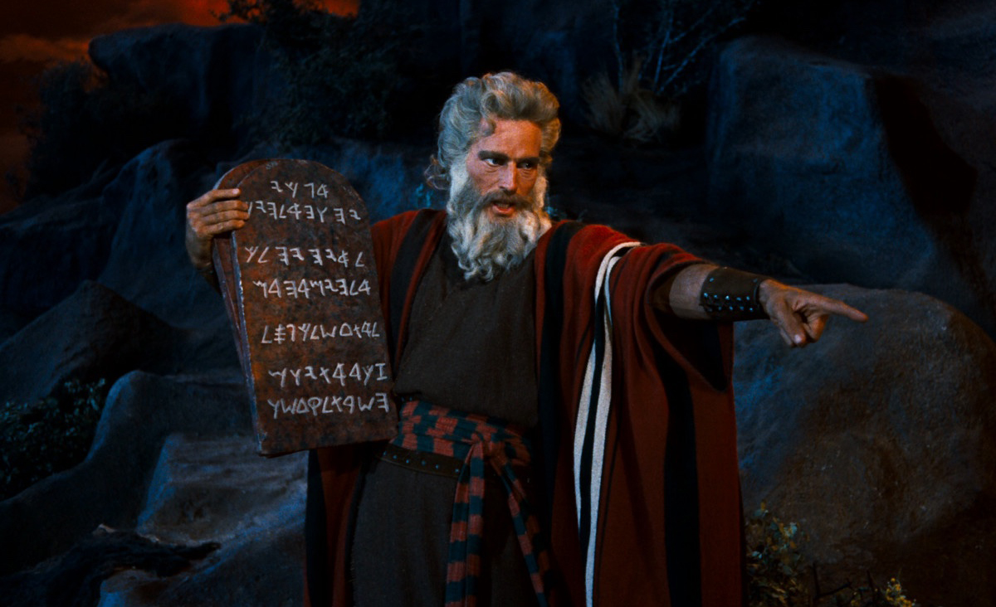
Questions on HHMP submissions
Those that seek higher understanding shalt not be afraid to ask questions at the panel session or by calling 1800 SAFE MINE (1800 7233 6463)

Slide 36
DMIRS contacts
1 800 SAFE MINE (1 800 7233 646)
Email: MinesSafety@dmirs.wa.gov.au

Slide 37
Follow us on social media
Twitter
@DMIRS_WA
@AndrewChaplyn
LinkedIn at Department of
Mines, Industry Regulation and Safety
Notes:
Add slide about awards

