Slide 1
Please read this before using presentation
This presentation is based on content presented at the Mines Safety Roadshow held in October 2014
It is made available for non-commercial use (e.g. toolbox meetings, OHS discussions) subject to the condition that the PowerPoint file is not altered without permission from Resources Safety
Supporting resources, such as brochures and posters, are available from Resources Safety
For resources, information or clarification, please contact:
  RSDComms@dmp.wa.gov.au
  or visit
  www.dmp.wa.gov.au/ResourcesSafety

Slide 2
Improving hazard awareness
Lifting the game – resources to raise awareness of lifting and rigging issues

Slide 3
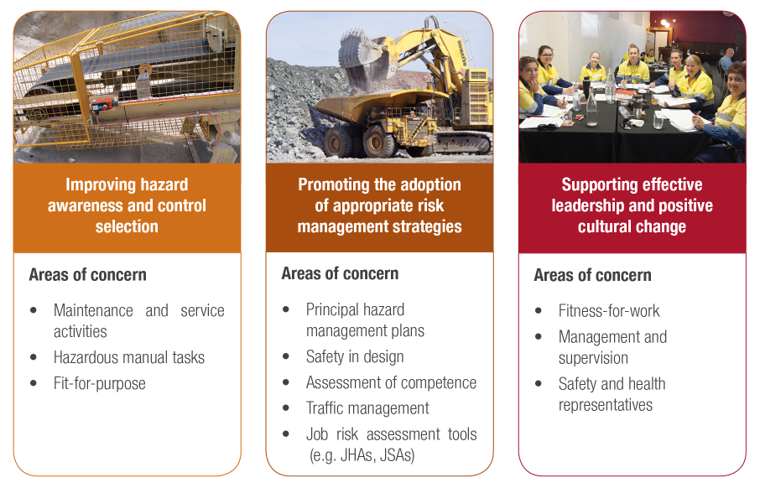
Resources Safety’s focus on mines safety
Maintenance and service activities
Hazardous manual tasks
Fit for purpose
Principal hazard management plans
Safety in design
Assessment of competence
Traffic management
Job risk assessment tools (e.g. JHAs, JSAs)
Fitness for work
Management and supervision
Safety and health representatives
Notes:
This statement from the Department of Mines and Petroleum underpins the regulatory approach taken by the Resources Safety Division under the Reform and Development at Resources Safety (RADARS) strategy.
This presentation relates to hazard awareness and control selection as applied to lifting, rigging and dogging. There have been some serious incidents over the last few years and Resources Safety has decided to try a different approach to raising awareness.

Slide 4
What are we looking at today?
Stored energy
Gravitational potential energy
Issues relating to mechanical handling
  centre of gravity
  friction
  tensile strength and metallurgy

Slide 5
Stored energy
Force (N)
Energy (J) 1 Nm
Notes:
Let’s explore some important concepts before starting – force and energy.

Slide 6
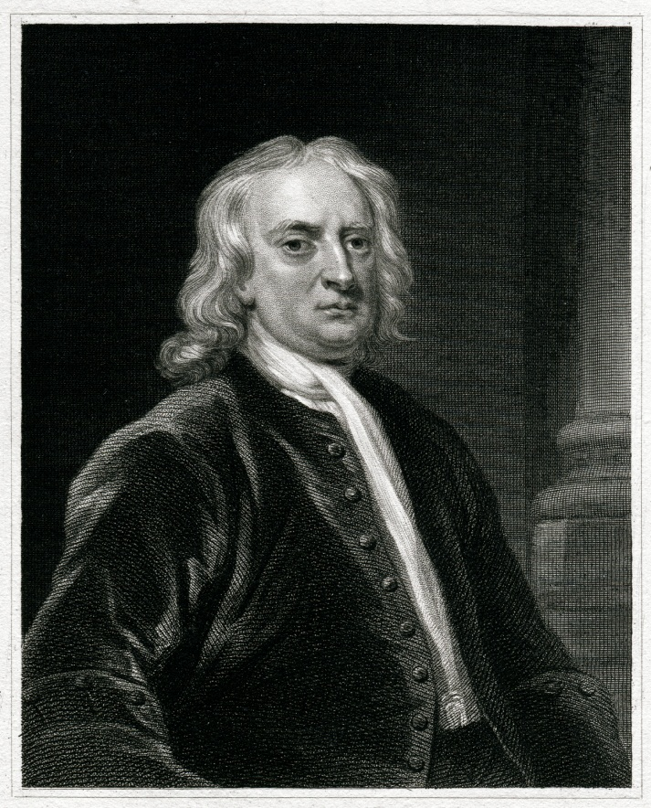

Sir Isaac Newton
Lived 1642-1727
British physicist & mathematician
SI Unit of force = Newton (N)
Notes:
Newton was a physicist and mathematician.
His laws of motion and universal gravitation are the foundation of the theory of motion. One of the concepts they are based on is FORCE. Essentially, force causes or changes motion.
The SI unit of force is named in his honour.
If we want to think of what a Newton might be, think of a small apple. Keep this in mind!

Slide 7
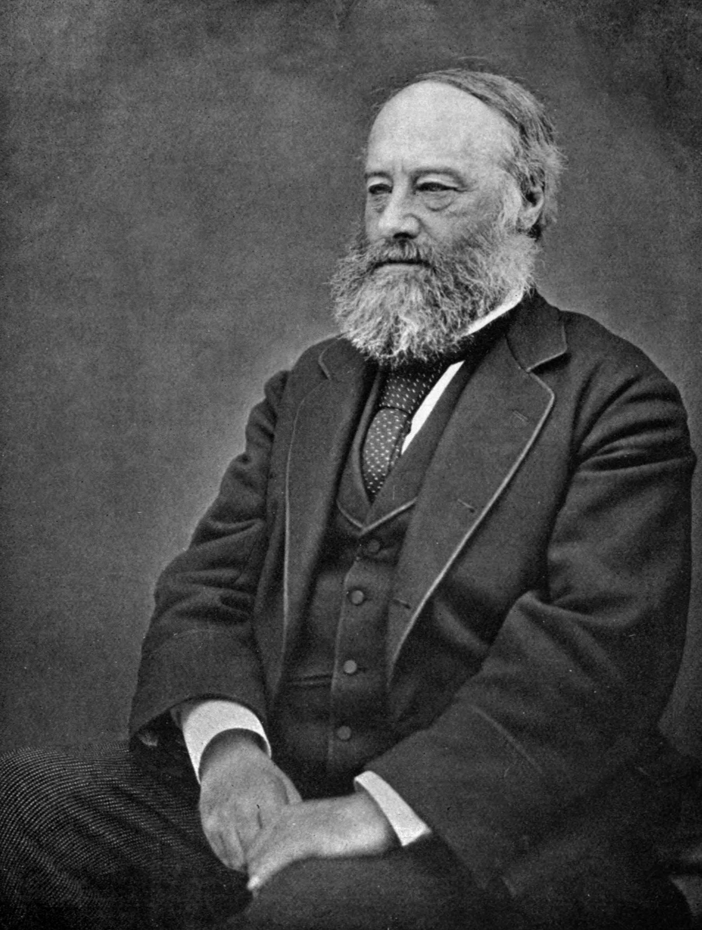
James Prescott Joule
Lived 1818-1889
British physicist
SI Unit of energy = Joule (J)
Notes:
Joule was an English physicist - and brewer! He studied the nature of heat and described its relationship to mechanical work or energy.
The SI unit of energy is named in his honour.

Slide 8
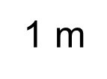

Stored energy
1 Joule (J)
=
1 Newton metre
Notes:
One of the reasons why Resources Safety is so concerned about lifting, rigging and dogging is that these activities add energy to a load, which is stored in the form of gravitational potential energy.
Let’s explore the idea of stored energy a bit further and think about what some of the units mean for us.
One Joule is the energy required to move our small apple (i.e. Newton) slowly and steadily through one metre.
ANIMATION – Apple moves on click.
To get 30 Joules we could move 30 apples through one metre, or one apple through 30 metres, or even 2 apples through 15 metres, or 5 apples through 6 metres – you get the idea!
Note: Some concepts and calculations are necessarily simplified in this presentation to convey the ideas to a generalist audience.

Slide 9

Example of stored energy
Gravitational potential energy = m x g x h
m = mass (kg)
g = gravity (m/s²) 9.81
h = height (m)
Example: 6 x 9.81 x 5 = 294.3 J
Notes:
So what amount of stored energy could be involved on mining operations? Let’s look at an example for an exploration drill rig.
What gravitational potential energy could be generated by dropping a large pipe wrench from a rig?
The formula is mass in kilograms multiplied by the acceleration due to gravity (commonly known as “g” and usually rounded to 10 metres per second squared) multiplied by the height in metres.
If we have a 6 kg pipe wrench dropped from 5 metres, it can generate almost 300 Joules of energy.
ANIMATION – Wrench drops on click.

Slide 10
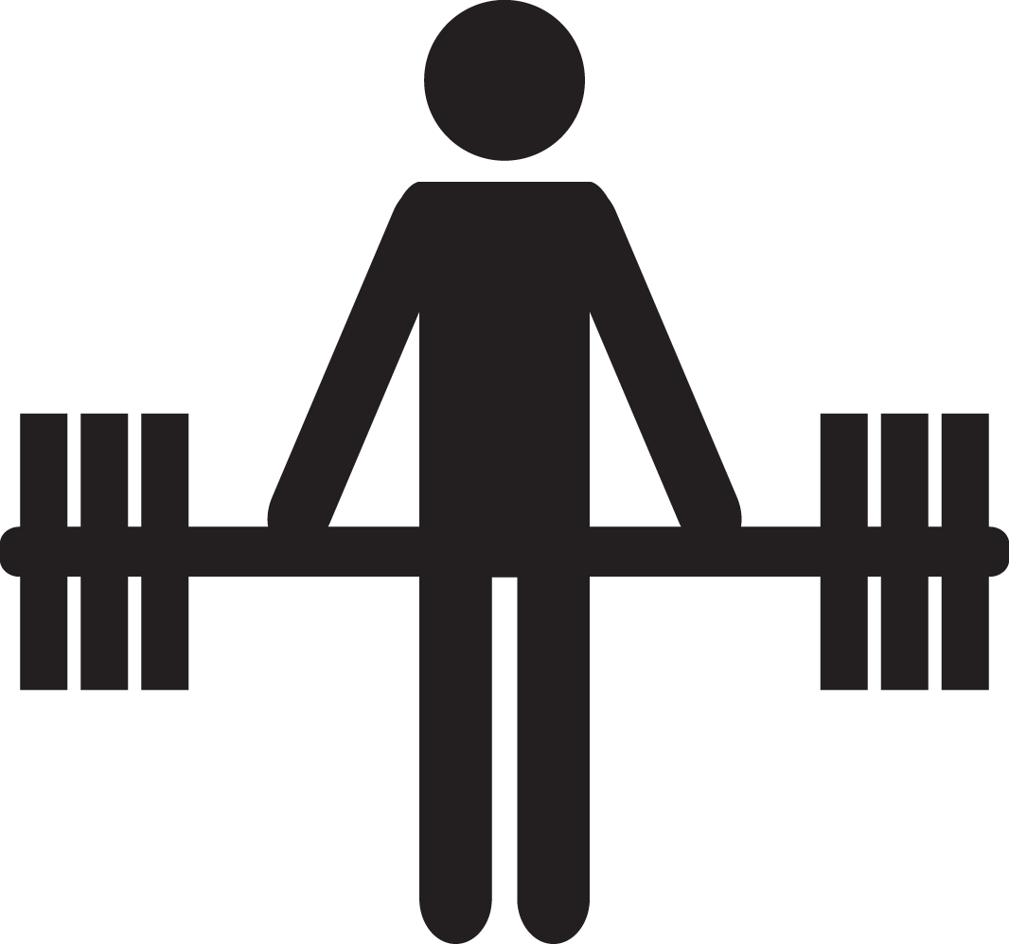
Human-generated stored energy
Deadlift (world record)
m x g x h = ? x 9.81 x 0.8 = ? J
Notes:
Let’s continue exploring stored energy.
How much gravitational potential energy could a person generate?
Does anyone know what the world deadlift record is?
Note: As at October 2014 – update next slide if the record changes!

Slide 11
Human-generated stored energy
Deadlift (world record)
m x g x h = 523 x 9.81 x 0.8 = 4,104 J
Z. Savickas [REF 1]
Notes:
The world record for the deadlift was set at the 2014 Arnold Strongman by Zydrunas Savickas, who lifted 1155 pounds. This is about 523 kg!
If we assume that the bar was lifted to about 80 cm height (i.e. 0.8 metres), then the gravitational potential energy generated was over 4,000 Joules.
Nobody would like that weight dropped on them and we’d consider the outcome to be almost certainly fatal.

Slide 12
Human-generated stored energy
What would be typical?
Manual handling of 25 kg
m x g x h = 25 x 9.81 x 0.8 = 196 J
Notes:
Of course, lifting over half a tonne probably has limited applications because it’s unlikely that Mr Savickas would carry the weight anywhere (and he did in fact drop it immediately)!).
Assuming that most of us could handle up to 25 kg, we could routinely generate almost 200 Joules. Could this energy be fatal?

Slide 13
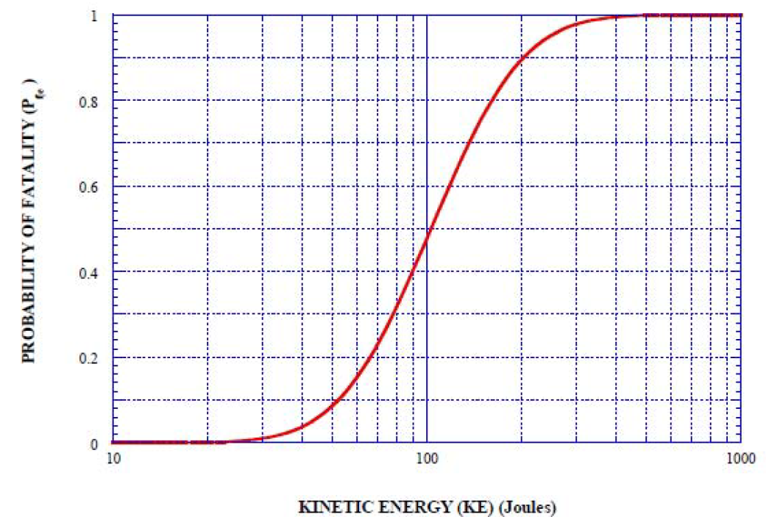
Lethality criteria for debris generated from accidental explosions (2010)
1.0
0.8
0.6
0.4
0.2
0
Probability of fatality
10 100 200 300 1,000
Kinetic energy (Joules)
[REF 2]
Notes:
This plot shows the probability of a fatality depending on the energy of moving fragments hitting the human body. Where the body is hit will influence whether a hit is likely to be fatal or not (e.g. more likely to be killed if hit in the back of the head than the upper leg).
Using this as a general guide, we can see that at 100 Joules there is a 50% chance. At 200 Joules we are up to 90%, and it is 98% at 300 Joules – and most of us wouldn’t take on a 2% probability of survival.
So we can select 300 Joules as the energy level we definitely don’t want to exceed.

Slide 14
What does this all mean?
Say ~300 J ≈ 98% chance of a fatality
Looking at gravitational potential energy for cranes and objects at height
m x g x h > 300 J
Notes:
Let’s explore this 300 Joules “limit” and what it means in terms of cranes and lifting things.
Under what circumstances might we exceed this value?

Slide 15
Energy (m x g x h) to equal 300 J
>300 J
Height (m)
<300 J
Notes:
The red line plotted on this graph shows the relationship between height and mass to obtain an energy value of 300 Joules.
If we are in this area of the graph [ANIMATION – click to get green <300J], we are below 300 Joules and there is less probability of a fatality (i.e. possible but less likely).
If we are in this area of the graph [ANIMATION – click to get pink >300J], we are above 300 Joules and a fatal outcome is almost certain.
How much does it take to get into the fatal domain? Not much!
Use Mines Safety Significant Incident Report No. 184 as an example. [available at www.dmp.wa.gov.au/15563.aspx#7002]
This involved a 4.5 kg rail clip falling about 10 metres from a shiploader rail system.
What was its likely gravitational potential energy at the point of impact?
[ANIMATION – Click to get the relevant measurements.]
Above 300 Joules! That is why the Department of Mines and Petroleum is interested in this type of incident. It may seem minor but, had someone been walking underneath at the time, would a hardhat have been sufficient protection depending on where and the angle of impact?

Slide 16
Issues with mechanical handling
Human limit ~ 500 kg (½ tonne), limited application
Most humans ~ 50 kg maximum
Need for mechanical lifting on mining operations
Largest crane (bridge) in last few years =
122 t + 75 t = 197 t @ 38 m
m x g x h = 197,000 x 9.81 x 38 = 73,437,766 J
73 MJ
Notes:
So why have we been discussing energies and what could be generated?
Well, we know that the types of energies that humans can produce through manual handling are not large enough for many mining operations. So we need to consider mechanical handling if we are going to lift things.
The largest crane registered by the Department of Mines and Petroleum in the past few years is a bridge crane. The structure and crane parts weigh 122 tonnes and it is rated to lift 75 tonnes through 38 metres.
If that came down with a load a full height it could generate 73 Megajoules – a lot of energy in anyone’s terms.

Slide 17
Why are we covering these issues?
The number of fatalities, accidents and injuries – and near misses
Of the 60 fatalities in WA since 2000, five involved mechanical handling
Notes:
We know that the energies involved in lifting can be fatal – and unfortunately the Department of Mines and Petroleum is still receiving reports of accidents and incidents.
Of the 60 fatalities in Western Australia from 2000 to October 2014, five involved mechanical handling.

Slide 18
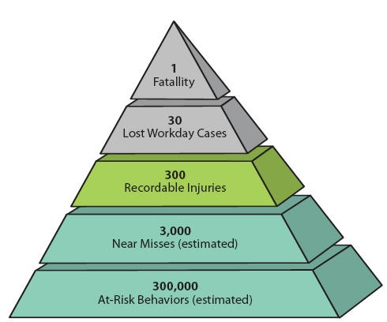
ConocoPhillips Marine study
Extrapolating ~15 years of data
5
  150
    1,500
      15,000
        1,500,000
[REF 3]
Notes:
In 2003, ConocoPhillips Marine conducted a study demonstrating a large difference in the ratio of serious accidents and near misses. The study found that for every single fatality there are at least 300,000 at-risk behaviours, defined as activities that are not consistent with safety programs, training and components on machinery.
If we use this approach, based on 5 fatalities over a period of almost 15 years, one and a half million at-risk behaviours would be expected. This translates to 100,000 at-risk behaviours each year. This is probably a reasonable estimate.
So what are we going to do about it?

Slide 19
What are some requirements?
High Risk Work Licences [r. 6.37, MSIR 1995]
  Note: CN ≠ DG, RB, RI, RA
Verification of competency (VOC) on mine site [r. 4.13, MSIR 1995]
Still many accidents, injuries and potentially serious occurrences
Notes:
Firstly, there are some regulatory requirements under the mines safety legislation in Western Australia. People undertaking high-risk work involving cranes, rigging and dogging are required to have a licence – and be verified as competent.
Note: Holding a crane licence does not equate to having a dogging or rigging licence, for which another licence is required.
However, despite the requirements for licensing and competency testing, we are still having near misses and accidents, and people are getting hurt.

Slide 20
Some topics to raise awareness
Centre of gravity (invisible)
Friction (can be invisible)
Tensile strength and metallurgy (can be invisible)
Notes:
To address this, the Resources Safety Division of the Department of Mines and Petroleum decided to try something a bit different.
The “Know Your Hazards” video series aims to assist workers to identify and understand common hazards in the resources industry. The ability to correctly identify potential hazards in the workplace can be critical in reducing the severity and frequency of workplace accidents and incidents.
The first instalment of three short educational videos is called “Raising the issues” and aims to assist workers to understand the concepts behind some common hazards encountered when lifting, rigging or dogging.
The videos provide key pointers on the basics of friction, tensile strength and centre of gravity.
IMPORTANT NOTE: Please read disclaimer.
This video is designed to raise general awareness and improve understanding of the issues surrounding the work practices shown. It is not a substitute for training nor does it constitute training, which should address the application of concepts presented here and ensure recipients have the necessary knowledge and understanding to operate in a safe and efficient manner.
Before undertaking rigging, dogging or lifting work, you must be trained and assessed as competent and hold the appropriate class of high risk work licence.
Note: The videos presented in this presentation may be downloaded and imbedded or linked in the presentation.
Friction vimeo.com/108303043
Centre of Gravity vimeo.com/108304626
Tensile Strength vimeo.com/108305795

Slide 21
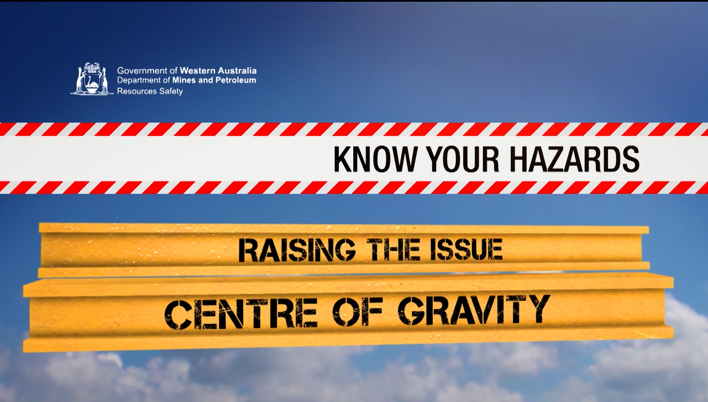
Centre of gravity – video 1

Slide 22
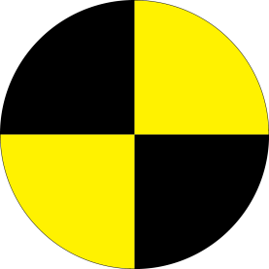
Centre of gravity – key messages
The centre of gravity is not always obvious
Determine the location of your load’s centre of gravity before lifting
Be aware of moving loads ‒ including liquids
Notes:
Discuss messages.
NOTE: Key messages are provided for each video to reinforce some of the learnings.
Importantly, even if audience members aren’t involved directly in the lifting, rigging or dogging, they may see something that doesn’t look quite right when involved in a job. They may want to ask the question, “Is that how it should be?”

Slide 23
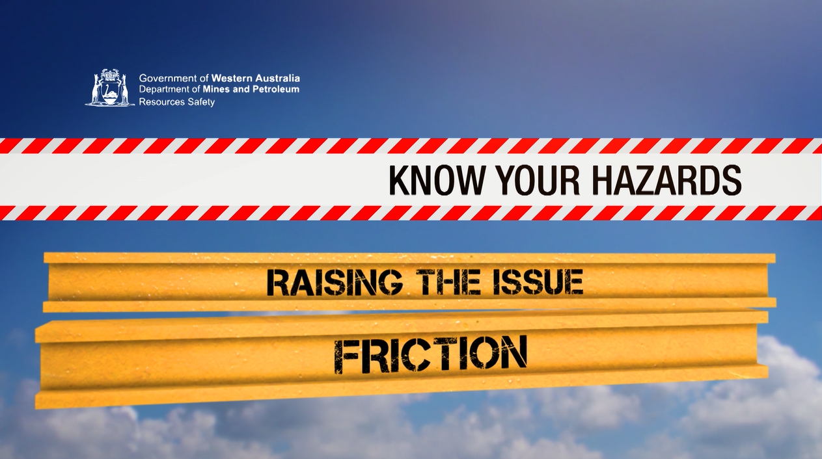
Friction – video 2

Slide 24
Friction – key messages
Friction can be variable, and is usually given as a range
  For example:
  Steel–steel from 0.8 to 0.1 (factor of 8!)
  Steel–nylon from 0.25 to 0.3 [REF 4]
Options
  Eliminate reliance on friction
  Increase friction
Notes:
It can be difficult to determine the friction coefficients of materials.
[Quote examples. Can be highly variable for steel-steel depending on surface, any lubricants etc. Steel-nylon could be when using soft sling, smaller range but still variable.]
If you don’t want a load to slip then there are essentially two options – discuss based on principles shown in video.

Slide 25
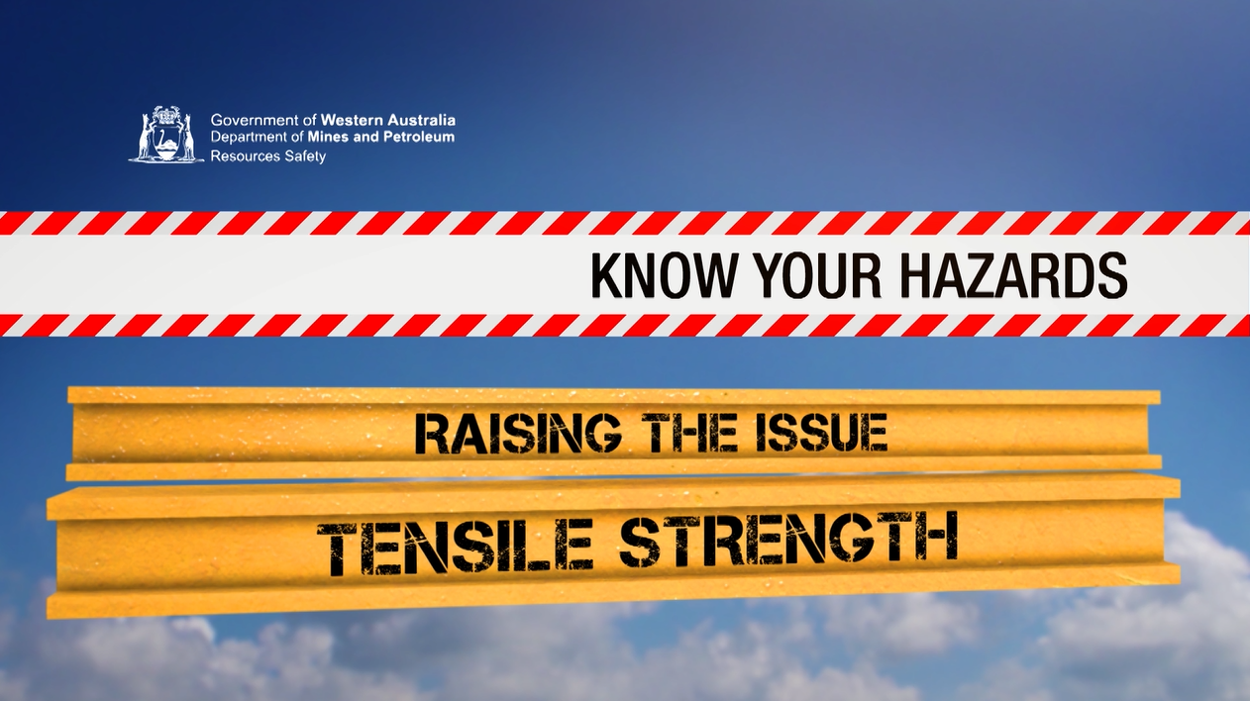
Tensile strength – video 3

Slide 26
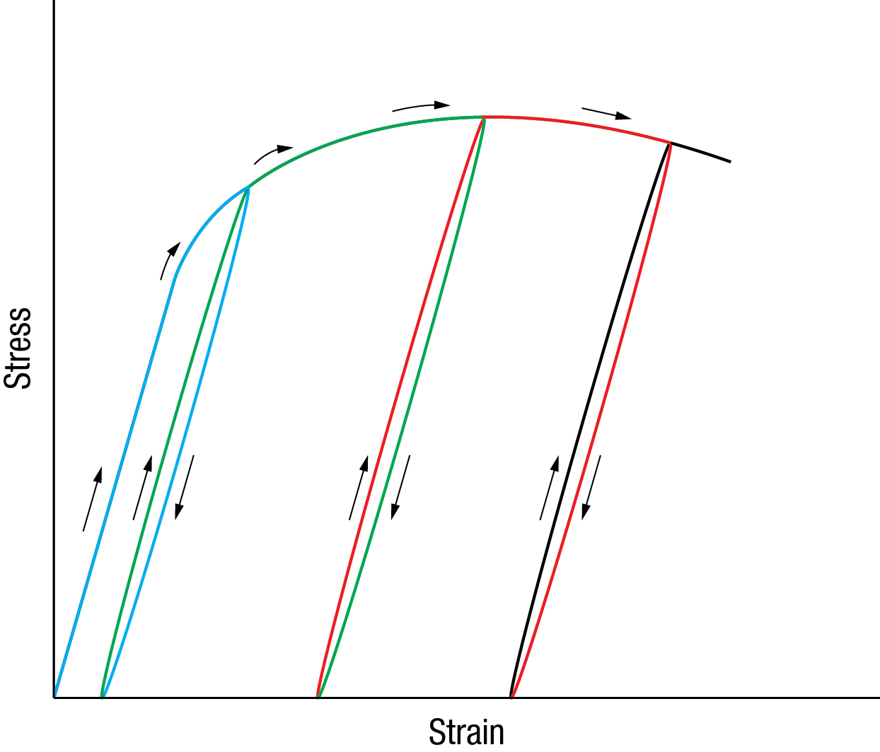
Tensile testing - metallurgy
Overloaded once
Overloaded twice
Overloaded again
Notes:
We are adding some metallurgy to the principles covered in this video.
Remember the chain that broke when it was overloaded several times? This diagram attempts to demonstrate what happens.
When a chain is not overloaded, its properties effectively move up and down the straight part of this play. [ANIMATE – Click and purple line appears to show normal operating conditions].
[ANIMATE – Click to show first overloading episode]. If the chain is overloaded, the plot starts to follow a curved patch and doesn’t return to the starting point. The time bomb has started ticking.
What if we overload the chain again? …. [ANIMATE – Click to show second overloading episode] … and again? [ANIMATE – Click to show next overloading episode] Eventually something gives.

Slide 27
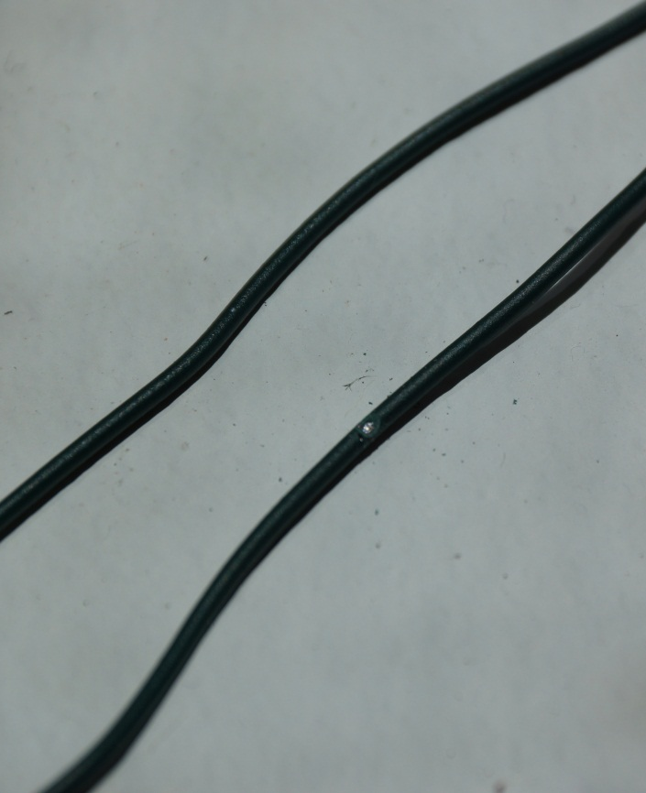
Metallurgy exercise
  Whole wire – bend back and forth through the middle
  Nicked wire – bend on the nick
  How many times did you bend
  the whole wire before it broke?
  What about the nicked wire?
Notes:
NOTE: This exercise can be used to reinforce the message about metallurgy and why it is important to NOT use damaged lifting gear.
Use some thin garden wire cut into 10 cm lengths. Provide each person (or selected volunteers) with one piece of wire that is intact and another that has a very small nick made with a file or knife. To determine the depth of the nick, try the exercise a few times to check that you get a reproducible difference between the data collected for the whole wire and nicked wire samples.
TIP TO IMPROVE RESULTS: Ensure the wire does not rotate or slip while bending!
Collate the results and compare. Assuming consistent operator technique, the nicked wire should break before the whole wire – even with the smallest of nicks.

Slide 28
Tensile strength & metallurgy – key messages
Do not exceed load ratings (WLL) ‒ otherwise “bomb is ticking”
Condition of lifting equipment is important ‒ check for deformation and damage
Notes:
WLL = Working Load Limit

Slide 29
Ask yourself …
Can I identify hazards associated with stored energies in mechanical handling?
Where is the centre of gravity of my load? Can it move?
Am I relying on friction to hold my load? Can I eliminate this need?
Is the lifting equipment in good order and hasn’t been overloaded?
  any deformation? (e.g. elongation)
  any damage? (e.g. nicks, notches, kinks)

Slide 30

Take-away message
The human body is very fragile.
Where mechanical handling is involved it almost invariably entails energies that exceed human tolerability.
Notes:
The serious take home message is this.
Where engineers employ mechanisms, valves, cylinder, motors and energies this almost invariably means energies for human tolerability are exceeded. Every time you touch something at work, almost invariably, if it goes wrong you’ve got levels of energy that can kill you.

Slide 31
References (for those interested!)
Deadlift world record www.youtube.com/watch?v=SBFTB7Xjk3U <viewed 11 August 2014>
Lethality Criteria for Debris Generated from Accidental Explosions (2010)
  Author : Mr Jon Henderson, Deputy Chief Inspector Explosives (MoD)
  Fir 3 C, #4304, MOD Abbeywood, Bristol, BS32 8JH
Conoco Phillips Safety Triangle www.osha.gov/dte/grant_materials/fy11/sh-22318-11/Mod_3_ParticipantManual.pdf <viewed 8 October 2014>
Poly-Tech Industrial - Products www.polytechindustrial.com/products/plastic-stock-shapes/nylon-66 <viewed 8 October 2014>

