Slide 1
Please read this before using presentation
This presentation is based on content presented at the 2015 Exploration Industry Forum in June 2015
The Department of Mines and Petroleum (DMP) supports and encourages reuse of its information (including data), and endorses use of the Australian Governments Open Access and Licensing Framework (AusGOAL)
This material is licensed under Creative Commons Attribution 4.0 licence. We request that you observe and retain any copyright or related notices that may accompany this material as part of attribution. This is a requirement of Creative Commons Licences.
Please give attribution to Department of Mines and Petroleum, 2015.
For resources, information or clarification, please contact: RSDComms@dmp.wa.gov.au or visit ww.dmp.wa.gov.au/ResourcesSafety

Slide 2
Introduction to mining radiation safety in Western Australia Information Session

Slide 3
What legislation applies?
Mines Safety and Inspection Regulations 1995
Part 16 – Radiation Safety
16.2 Application of Division
This Division applies only to and in relation to a mine if:
thorium or uranium ores are mined at the mine;
employees at the mine are likely to receive doses of radiation in excess of an effective dose of 1 millisieverts per year arising from mining; or
members of the public at, or in the vicinity of, the mine are likely to receive doses of radiation, as a consequence of that mining operation, in excess of one half of the dose limits set out in regulation 16.19

Slide 4
Radiation protection in mines

Slide 5
Sources of Naturally Occurring Radioactive Material (NORM)
Uranium mining and processing
Mineral sands, rare earths, TiO₂/Rutile, Zircon, Leucoxene
Oil production - as Ba(Ra)SO₄ or Ra226 and Ra228
Gas production - condensation of Pb-210 via extracted/decayed Rn-220 & Rn-222
Phosphate industry
Coal power production
K-40, U-235, U-238 Th-232 in ash
Po-210 & Pb-210 volatiles in stack emissions
Ra-226, Ra-228 in heat exchangers

Slide 6
Known radioactive minerals in WA

Slide 7
Dose limits
ARPANSA Radiation Protection Series No. 6 National Directory for Radiation Protection Schedule 1 – Dose Limits
Public 1 mSv in a year
Radiation Worker 20 mSv per year (5 year avg) 50 mSv max in a single year not withstanding the above limit.

Slide 8
Dose in perspective
mSv | Effect
10,000 | 100% mortality
6,000 | Early death
4,000 | 50% mortality
2,000 | Threshold for early death
500 | Nausea & reduced white blood cell count
131 | NATURAL annual background dose_{peak} in Ramsar, Iran
100 | Limit for exposure of a radiation worker over a 5 year period.
20 | Limit for exposure of a radiation worker in 1 year***
5 | Whole body CT scan, single
2 | Average annual exposure from natural radiation
1 | Limit of exposure of a ‘member of the public’ in a single year
0.05 | Exposure from 7 hour flight
0.02 | Typical chest x-ray

Slide 9
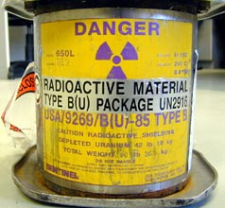
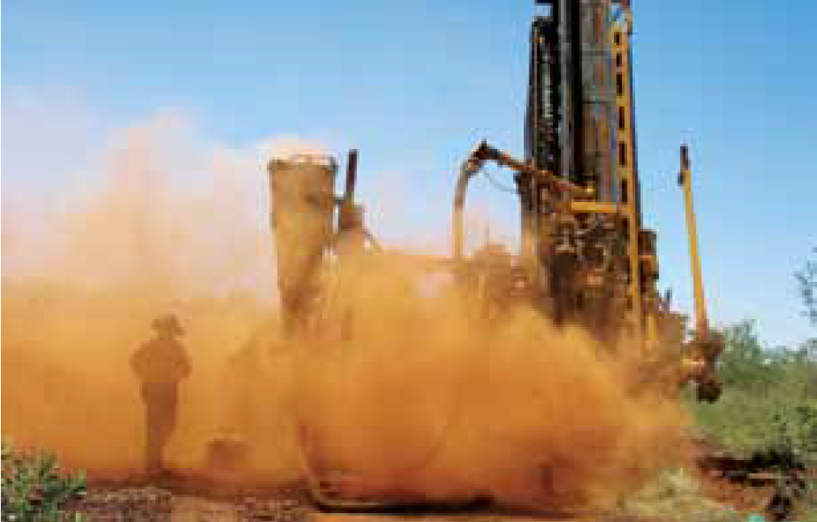
Dose and exposure pathways

Slide 10
Radiation dose assessment
Total dose to a person (or SEG) =
Dose from gamma exposure +
Dose from ingestion of radioactive material
+ Dose from inhalation of radioactive dust + Dose from Radon gas

Slide 11
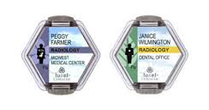
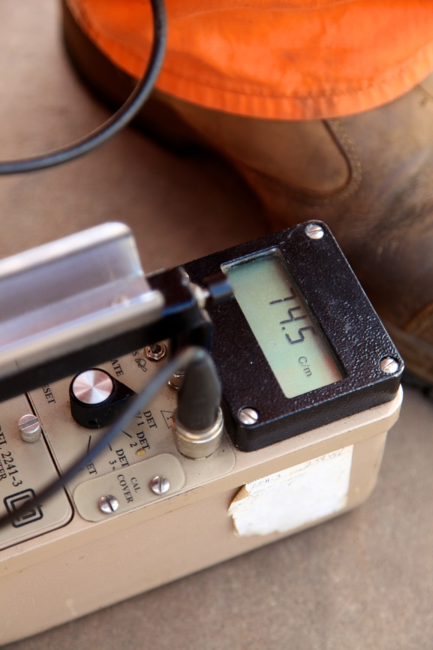
Gamma exposure monitoring
Occurs when:
Radioactive material is stockpiled
Ore body is at, or close, to surface
Sealed sources
Can be monitored with:
TLD badges or EPDs
Area gamma surveys
Both methods require consideration of how quickly hazards may change

Slide 12
Ingestion
Occurs when
When hygiene rules are not followed
When site water is sourced from local bores
Can be monitored with
Estimations of cross contamination on hands etc.
Trends in increased radionuclide in water concentrations during exploration/mining
Baseline monitoring, baseline monitoring and more baseline monitoring!

Slide 13
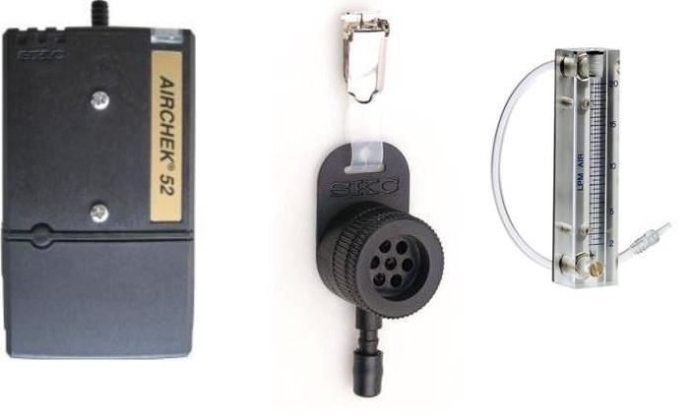
Inhalation – sample collection
Air sampling
Same rules apply as silica or other airborne contaminant sampling
Sample period should be sufficient however not so long as to overload the filter

Slide 14
Radiation Safety Officer competency
Individual Internal Dose = AM× HW×BR×DCF AM arithmetic mean of gross α-activity concentration for the work category (Bq/m₃);
HW hours worked by an employee for the period of assessment in the work category;
BR assumed breathing rate of an employee (1.2 m³/hour);
[AM×HW×BR] personal intake for the period of assessment for the work category (Bq)
DCF dose conversion factor in mSv/Bqα for different AMAD sizes and different uranium and thorium weight ratios
Ref: DMP NORM guideline

Slide 15
Annual reports
Requirement in WA to submit an annual report
Reporting and dose calculation must be consistent with DMP NORM guideline methods
Reporting must meet certain minimum requirements
Report must compare current exposures and exposure rates to previous reported figures
DMP officers are looking for site knowledge of trend analysis of on-going radiation monitoring systems

Slide 16
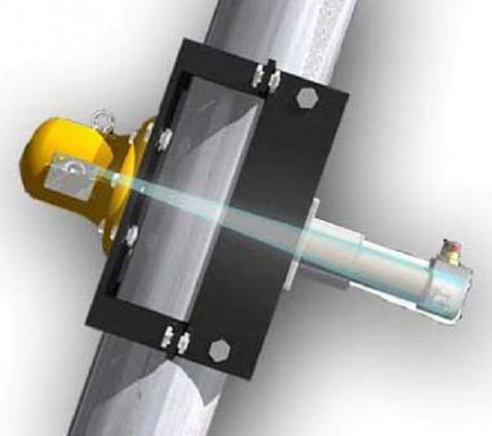
Sealed sources
Density gauges*
Level gauges
Multiphase flow meters
Smoke detectors
Borehole logging*
Moisture gauges*
Non-destructive testing (gamma)

Slide 17
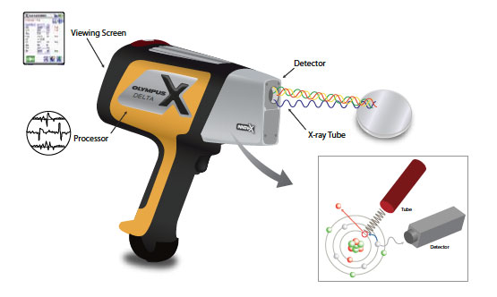
Irradiating (x-ray) devices
XRF – lab
XRF – handheld
Non-destructive testing (x-ray)

Slide 18
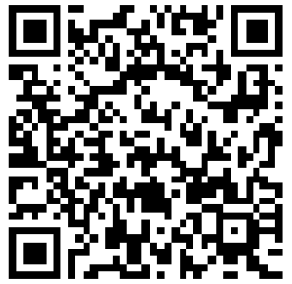
Stay informed!
Subscribe to our email alert service
and receive weekly news about:
recent publications
latest safety alerts
what’s happening at Resources Safety.
Visit www.dmp.wa.gov.au/ResourcesSafety
to sign up

