Slide 1
Please read this before using presentation
This presentation is based on content presented at the 2015 Mines Safety Roadshow in October 2015
The Department of Mines and Petroleum (DMP) supports and encourages reuse of its information (including data), and endorses use of the Australian Governments Open Access and Licensing Framework (AusGOAL)
This material is licensed under Creative Commons Attribution 4.0 licence. We request that you observe and retain any copyright or related notices that may accompany this material as part of attribution. This is a requirement of Creative Commons Licences.
Please give attribution to Department of Mines and Petroleum, 2015.
For resources, information or clarification, please contact:
RSDComms@dmp.wa.gov.au or visit
www.dmp.wa.gov.au/ResourcesSafety

Slide 2
Recurring events

Slide 3
What are we going to cover today?
Recent incidents
Recent injuries

Slide 4
Resources Safety’s focus on mining activities
Maintenance and service activities
Hazardous manual tasks
Fit for purpose
Falling from height
Principal hazard management plans
Safety in design
Assessment of competence
Traffic management
Job risk assessment tools (e.g. JHAs, JSAs)
Fitness for work
Management and supervision
Safety and health representatives
Notes:
Resources Safety’s focus on mining activities can be grouped into three areas or ‘pillars’.
All three pillars are covered in the roadshow workshops.
Note that proposed new legislation will have an increased focus on:
safety and health representatives
management and supervision
risk management strategies.

Slide 5
Safety alerts issued by Resources Safety
Significant Incident Report (SIR) – since 1989
Single incident of significance (fatal or serious injury, potentially serious incident)
Linked to WA occurrence report
Mines Safety Bulletin (MSB) – since 1990
Cluster of incidents or trend in poor work practices or inadequate control measures
May or may not be linked to occurrence report/s
Topics sourced from WA, Australia or world wide

Slide 6
Stay informed!
Subscribe to our email alert service
and receive weekly news about:
recent publications
latest safety alerts
events
what’s happening at Resources Safety.
Visit www.dmp.wa.gov.au/ResourcesSafety
to sign up
Notes:
I strongly recommend that if you aren’t already signed up for our alert service, that you do so today. It’s very easy – just provide your name and an email address.
This alert service is the fastest way for us to keep you informed about what’s happening in the world of mines safety regulation.
The alerts are generally sent out on a Tuesday afternoon.

Slide 7
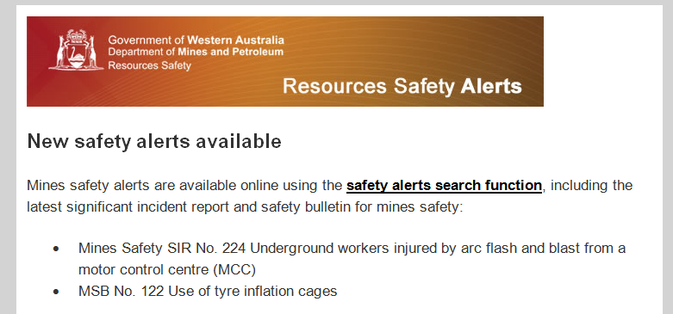
Weekly resources safety alerts
Notes:
This is an example of one of the weekly Resource Safety updates.

Slide 8
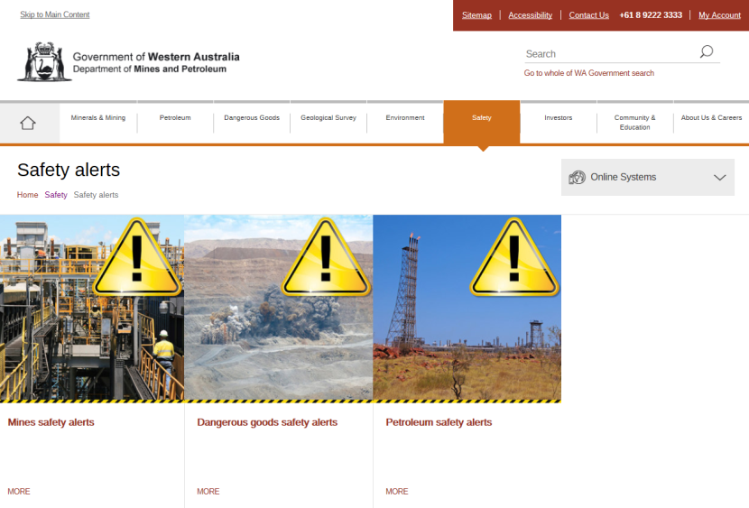
DMP website
Notes:
Safety alerts are also available through the Department of Mines and Petroleum (DMP) website.

Slide 9
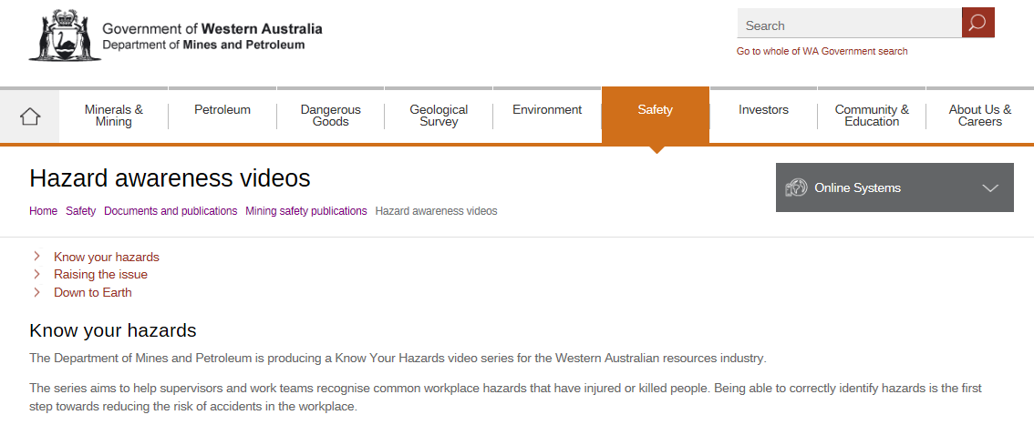
DMP website
Notes:
The videos from last year’s roadshow are also available online. Easiest way to find them is to type ‘video’ in the search box.
Alternately open Documents and publications and look for the hazard awareness videos in the Mines Safety publications area.
www.dmp.wa.gov.au/Safety/Hazard-awareness-videos-16435.aspx

Slide 10
Recurring events
Information contained in the SIRs used today are based on knowledge and understanding at the time of writing.
Some Department of Mines and Petroleum's investigations are ongoing.

Slide 11
Workers struck by falling rocks
Issued February 1992
A popperman (underground operator that drills and blasts oversize rocks) died when he was struck by rocks which fell from a rock “hang up” in a draw point

Slide 12
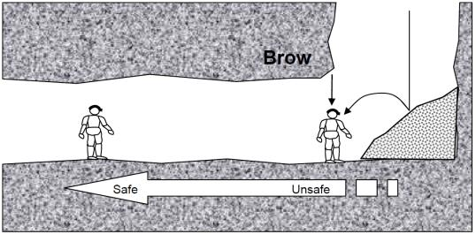
Workers struck by falling rocks (continued)
When popperman went to attempt to recover a stuck drill steel, he went under (and probably beyond) the brow of the draw point
It is likely that production activities in draw-points on opposite side of stope contributed to release of the ‘hang up’
Stope

Slide 13
On 11 May 2015, a load-haul-dump (LHD or bogger) operator was fatally injured when he was struck by a rock weighing about 700 kg that rolled from an open stope. The bogger was parked in the stope access drive and the driver was on foot in front of the bogger bucket.
There was a substantial gap between the brow and the rill at the stope draw point. The rill extended well into the draw point. The rock appears to have rolled down the rill and struck the operator, who was using a hose to water down the rill.

Slide 14
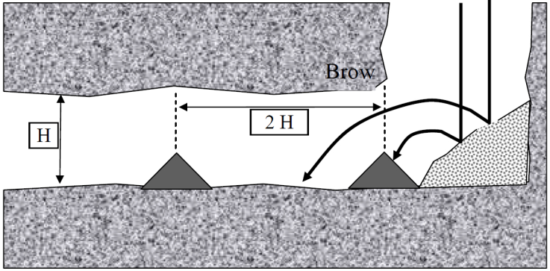
SIR 221 (continued)
Stope
Rill
Bund
Bund
Queensland Guidance Note QGN 13

Slide 15
SIR 221 (continued)
Direct causes
Large open stope with the hazard of falling rocks
Bogger operator was working outside the cabin at the base of the rill
Contributory causes
Any rocks that fell inside the open stope could drop and eject from the stope
Small bund was in place but it did not prevent the rock from rolling down the rill with sufficient momentum to strike the operator
No written procedure for clearing stope draw points that were blocked or hung up

Slide 16
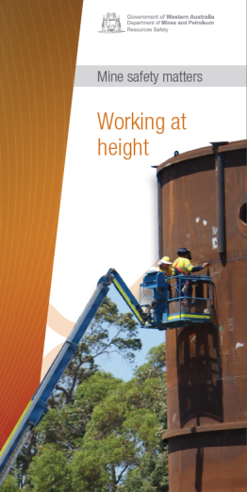
Entrapment by elevated work platforms
Working at height
Mine Safety Matters pamphlet published 30 June 2011

Slide 17
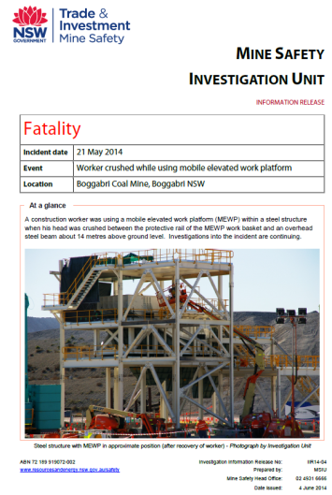
NSW incident in May 2014
On 21 May 2014, a construction worker at a NSW coal mine was using an EWP within a steel structure.
His head was crushed between the protective rail of the EWP work basket and an overhead steel beam about 14 metres above ground level.
Published 4 June 2014
Notes:
This is a NSW Mine Safety version of a significant incident report for a fatality that occurred on 21 May 2014.

Slide 18
NSW incident in May 2014 (continued)
At the time of the incident, the deceased worker was observed standing alone in the EWP basket
When last observed by a worker, there was only a small distance between the worker’s safety hard hat and an overhead 600 mm steel beam
Shortly afterwards, the deceased worker was seen with his head caught between the steel beam and the safety rail protecting the operator’s console

Slide 19
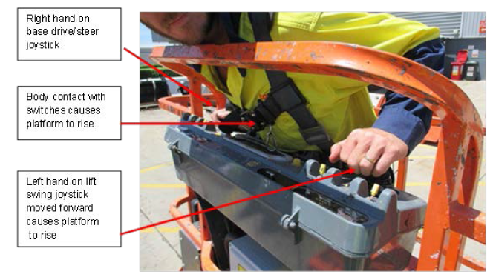
NSW incident in May 2014 (continued)

Slide 20
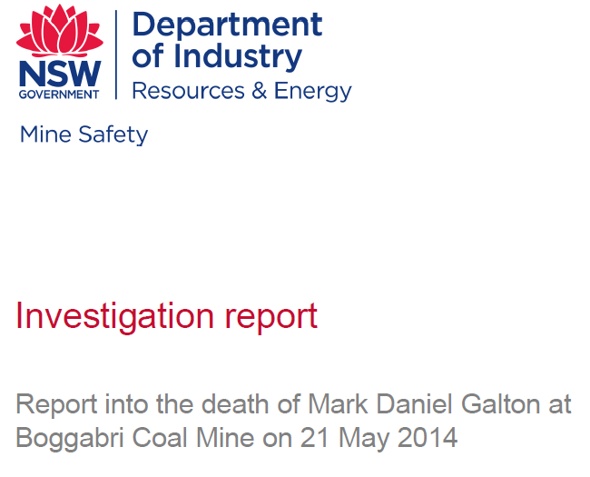
NSW mine safety investigation report
Report published August 2015 by NSW Mine Safety Investigation Unit found most likely cause to be that voluntary or involuntary bodily contact with console switch caused unintended platform rise
Notes:
Investigation report published in August 2015.

Slide 21
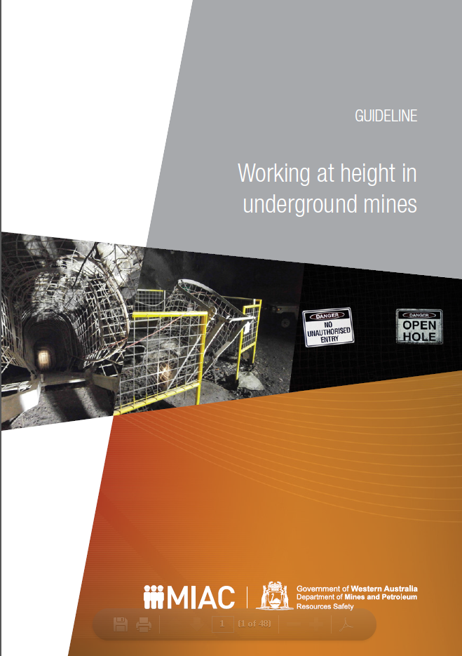
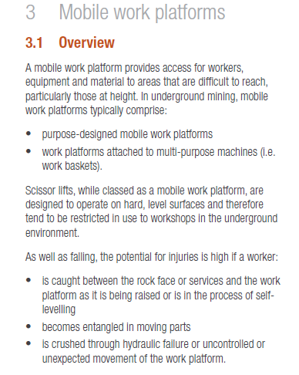
Guideline published 31 October 2014

Slide 22
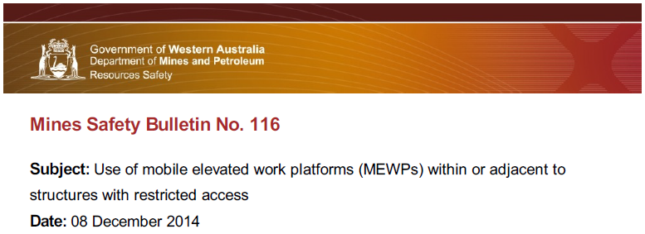
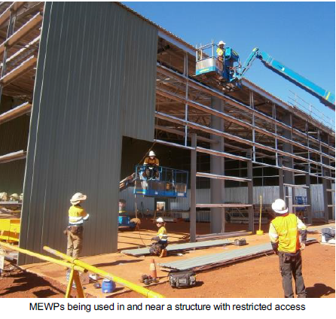

Slide 23
MSB 116 (continued)
Incidents include:
a worker attempting to manoeuvre into a steel structure was seriously injured when he became trapped between the MEWP control panel and framework
all eight connecting bolts between a MEWP basket and rotator assembly sheared when the basket came into contact with a steel structure
a MEWP basket knuckle was damaged when the basket became entangled in a steel structure while being withdrawn

Slide 24
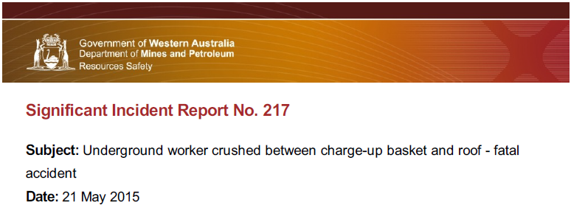
On 15 May 2015, an underground worker using an EWP was fatally injured when the charge-up basket he was in moved upwards, crushing him against the roof of the cross-cut. It appears he was leaning over the front of the basket when he accidentally activated the control stick for raising and lowering the basket.
After the accident, the control stick was found to be bent forward (i.e. in "raise basket" position).

Slide 25
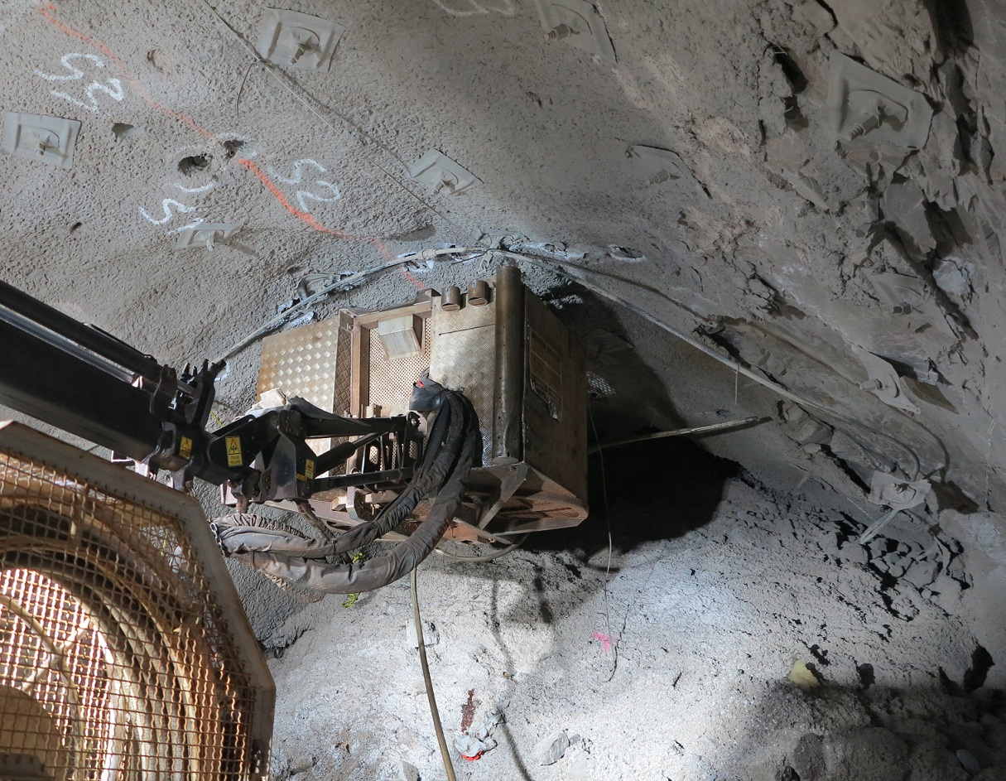
SIR 217 (continued)
Notes:
Underground charge up basket

Slide 26
Falls from height
Published 6 January 2010
While erecting structural steelwork, an experienced tradesperson fell about 10 metres through a grid mesh floor and died from the injuries sustained.

Slide 27
Falls from height (continued)
Published 15 July 2010
An employee sustained fatal injuries when he fell through a grizzly installed over an ore pass in an underground mine. The employee had been instructed to cover the grizzly to improve ventilation quality.
It appears that, while installing mesh over the grizzly, the employee fell through one of the grizzly openings to the broken rock about 25 metres below.

Slide 28
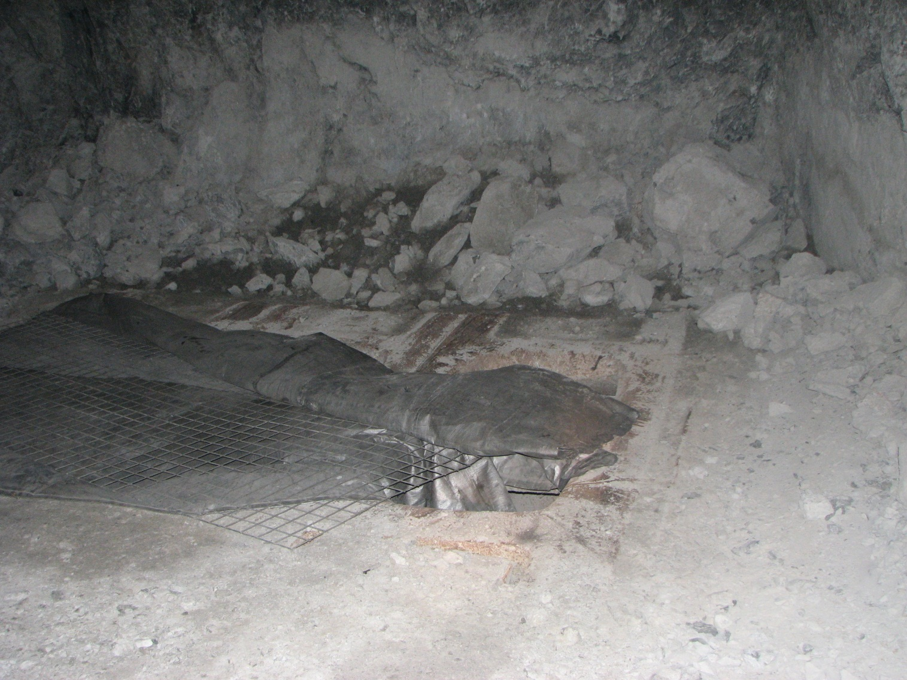
SIR 164 (continued)
Notes:
Corner of grizzly where the operator has fallen through

Slide 29
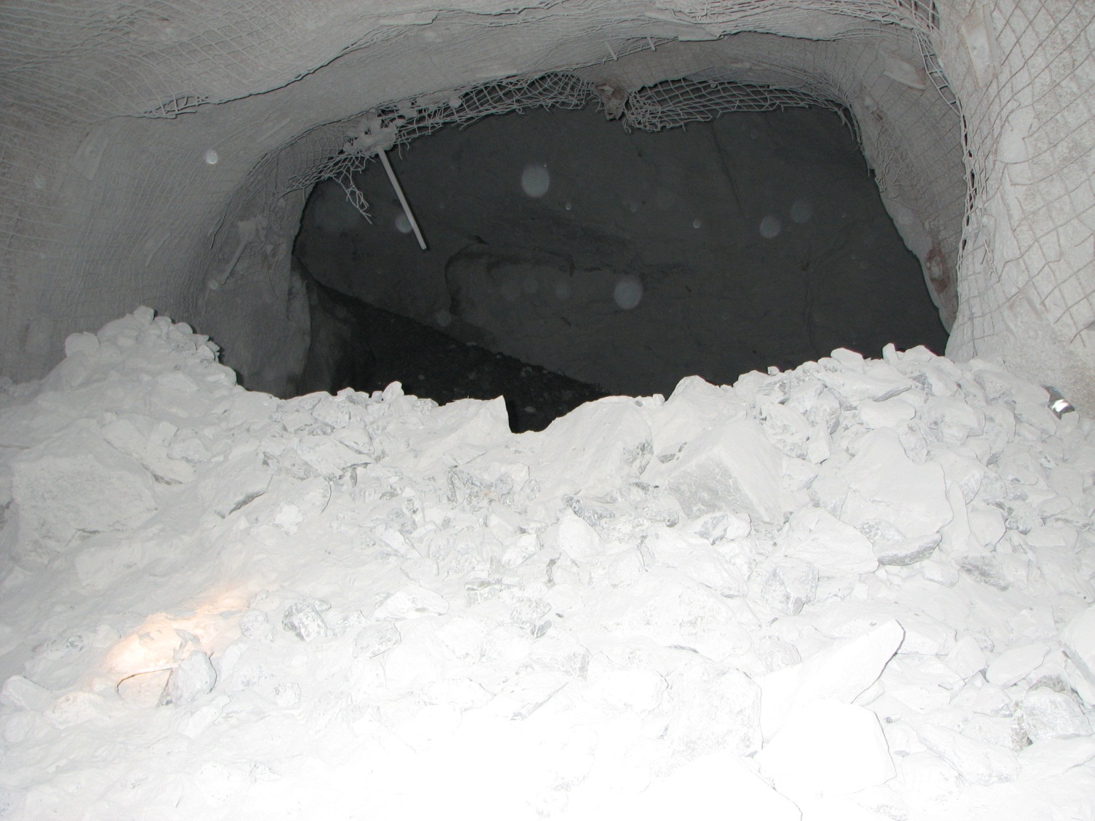
SIR 164 (continued)
Notes:
Looking down the grizzly

Slide 30
Falls from height (continued)
Published 16 December 2010
An employee sustained fatal injuries when he fell at least 25 metres.
It appears that the deceased had fallen into the lower chamber of the process vessel and then to the ground via a discharge chute.

Slide 31
Falls from height (continued)
A worker climbed the access ladder to the deck of the crane to guide the counterweight.
He lost his balance and fell almost 2 metres from the deck to the ground below, breaking his collarbone.

Slide 32
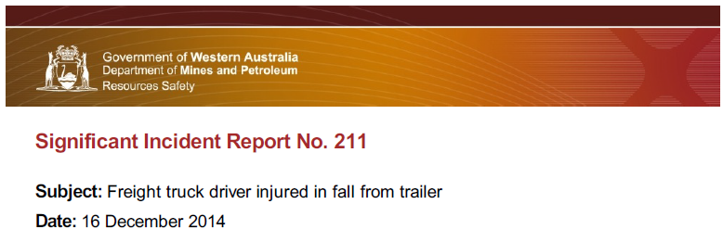
Falls from height (continued)
Truck driver was delivering 100 metre coils of 110 mm diameter poly pipe to a mine. Each coil weighed more than 300 kg.
Driver climbed into a row of five coils to release two binding straps. When the straps were released the coils slid off the trailer, dragging the driver with them.
Driver fell to the ground, landing on his head and shoulder and received a compound leg fracture.

Slide 33
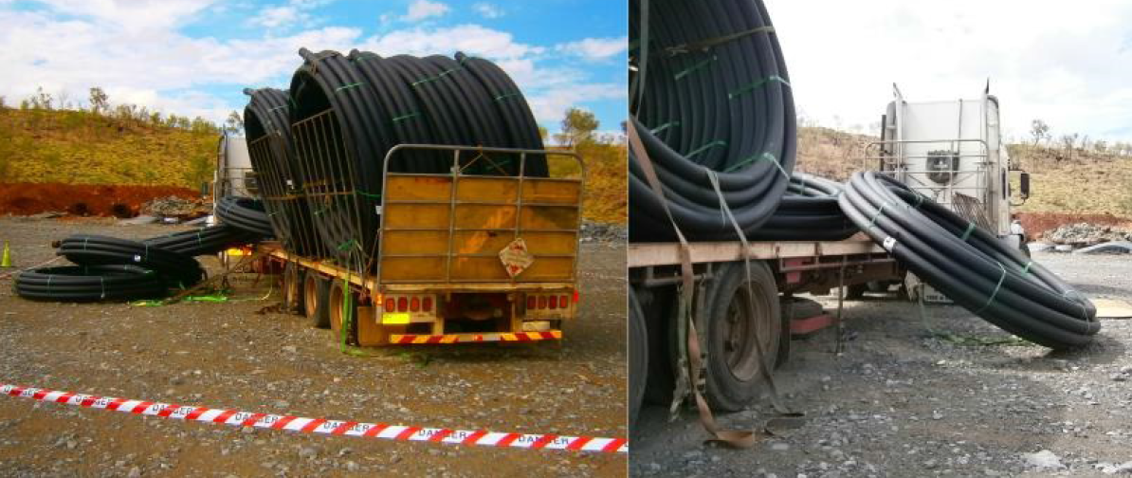
SIR 211 (continued)
Notes:
Truck showing the coils of poly that have fallen off the truck

Slide 34
Falls from height (continued)
Supervisor had climbed the steelwork above the walkway and handrail to access the headchute inspection hatch.
As he opened the headchute inspection hatch it came away from its hinge pins and fell onto the walkway platform.
The supervisor lost his balance, fell backwards 3 metres to the conveyor below, and then a further 3.5 metres to the ground
Fortunately, he was not injured.

Slide 35
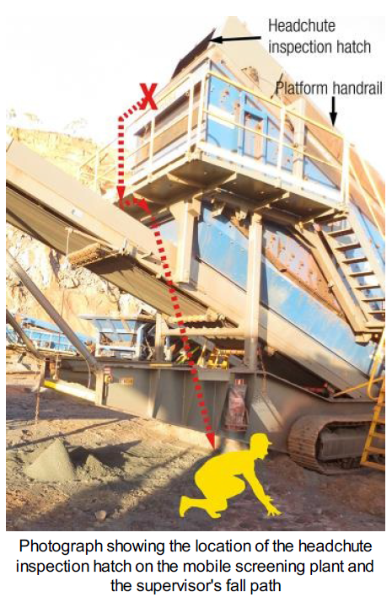
SIR 212 (continued)

Slide 36
Vehicles over an edge
Published 22 October 1991
Caterpillar 769 haul truck was reversed to the edge of a 6 metre high stockpile which collapsed, causing the truck to topple over the edge and come to rest upside down at its base.
The truck driver suffered serious injuries including fractured ribs, shoulder and several vertebrae.

Slide 37
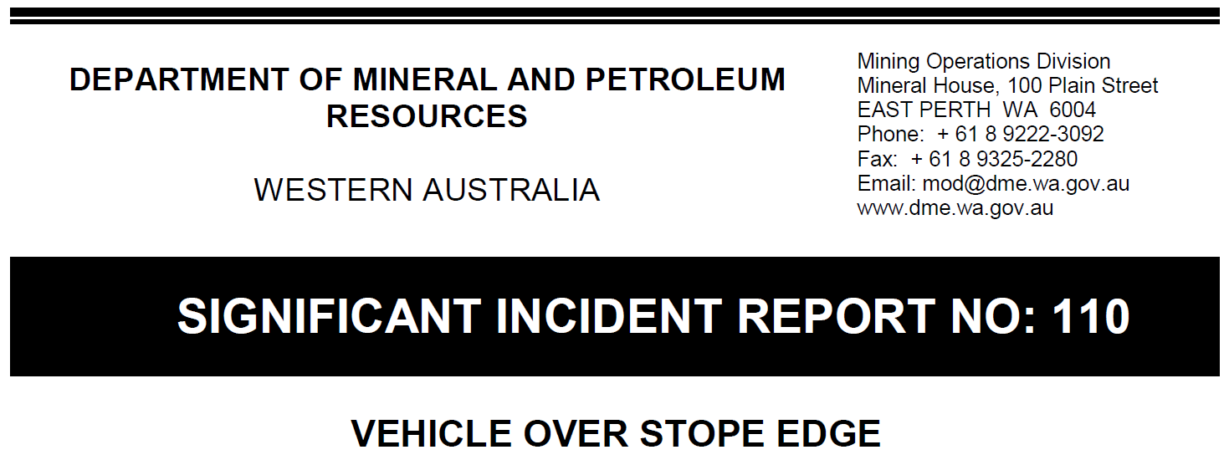
Vehicles over an edge (continued)
Published 9 October 2001
Toyota personnel carrier was reversing into an ore drive in an underground mine, when it went over the bench edge of an open stope.
Fortunately, the vehicle became stuck on the edge and this enabled the driver to exit the vehicle. The vehicle slipped entirely over the edge and fell 15 metres into the stope drawpoint on the level below.
The driver was badly shaken by this incident and was fortunate not to have sustained serious or fatal injuries.

Slide 38
Vehicles over an edge (continued)
Published 2 August 2007
Loader operator was working at the top of a 15 metre face when the loader slipped sideways down the edge and rolled over coming to rest on its side on the pit floor.
The operator sustained minor injuries.

Slide 39
Vehicles over an edge (continued)
Published 10 April 2008
While backfilling of an open stope was in progress, a loader fell about 15 metres from the top level of the stope to the bottom level.
The loader landed upside down and the operator was fatally injured. The operator remained in the cabin during the accident and received head and other injuries.

Slide 40
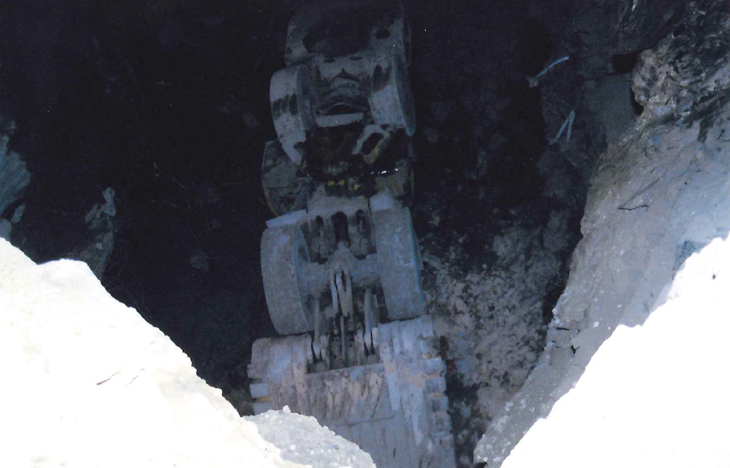
SIR 149 (continued)
Notes:
Looking down at the bogger (underground loader) from the level where the bogger was working.

Slide 41
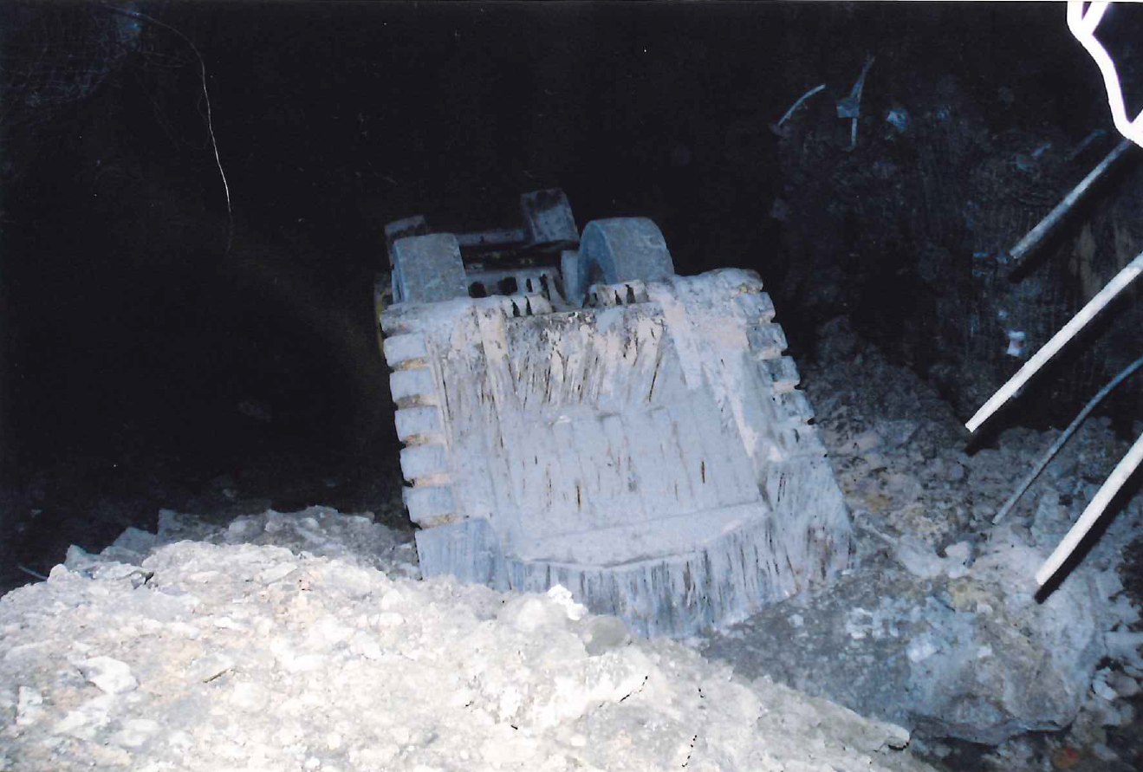
SIR 149 (continued)
Notes:
Looking at the bogger from the level where the bogger came to rest. Notice the rill.

Slide 42
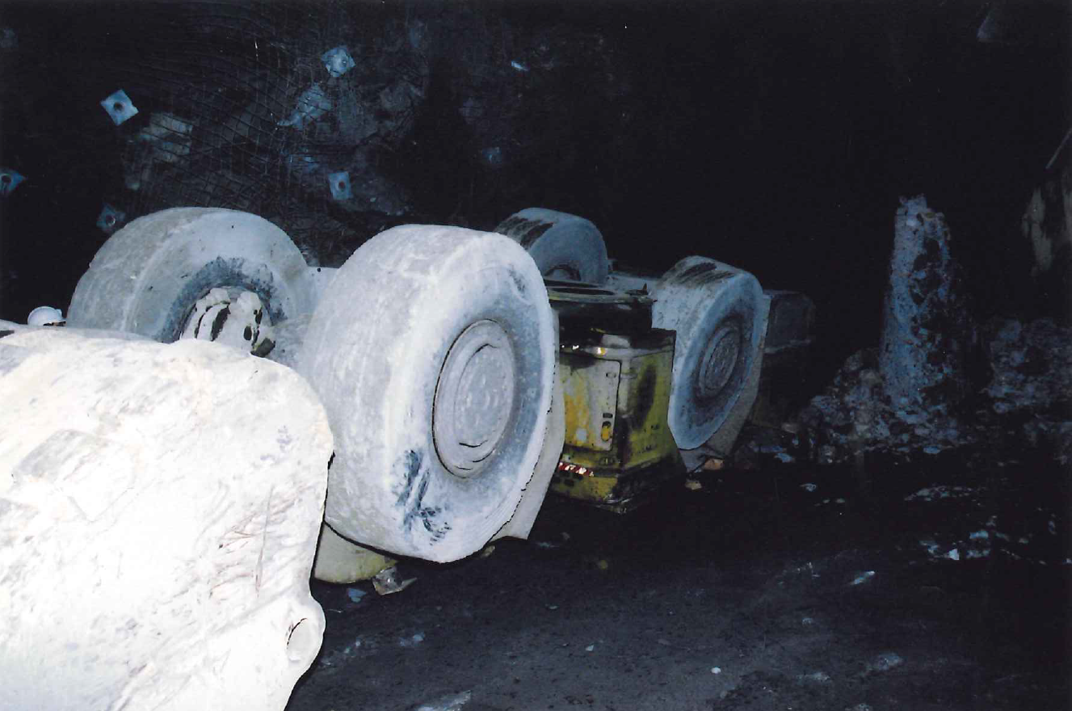
SIR 149 (continued)
Notes:
Bogger from the side.

Slide 43
After the coroner’s report SIR 199 was released.
In April 2010 an operator drove a loader over the edge of an open stope as there was no safety bund present. The loader fell 25m to the level below.
The operator was killed.
*Not included in your pack

Slide 44
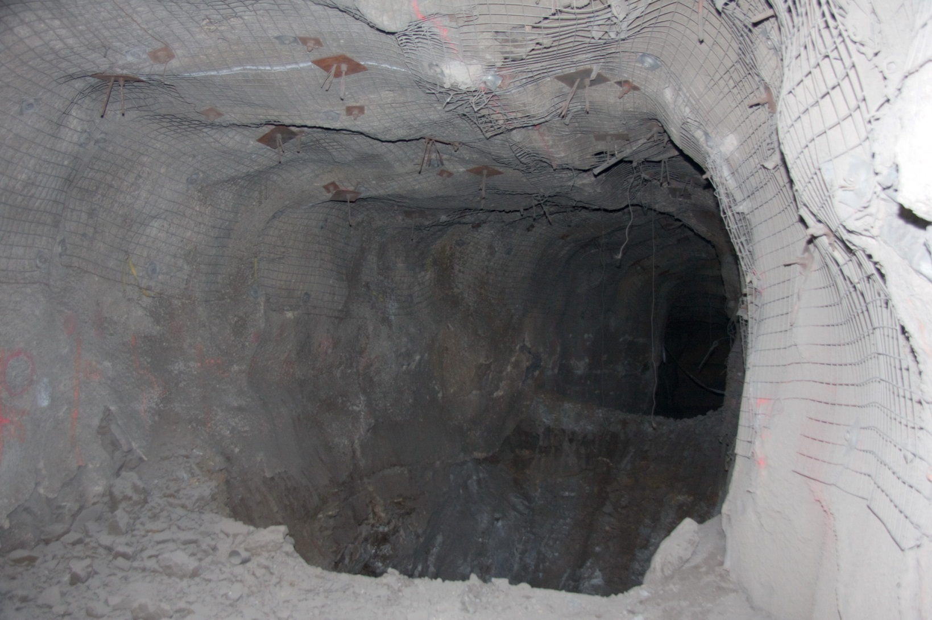
SIR 199 (continued)
Notes:
Level from where the bogger fell in to the stope.

Slide 45
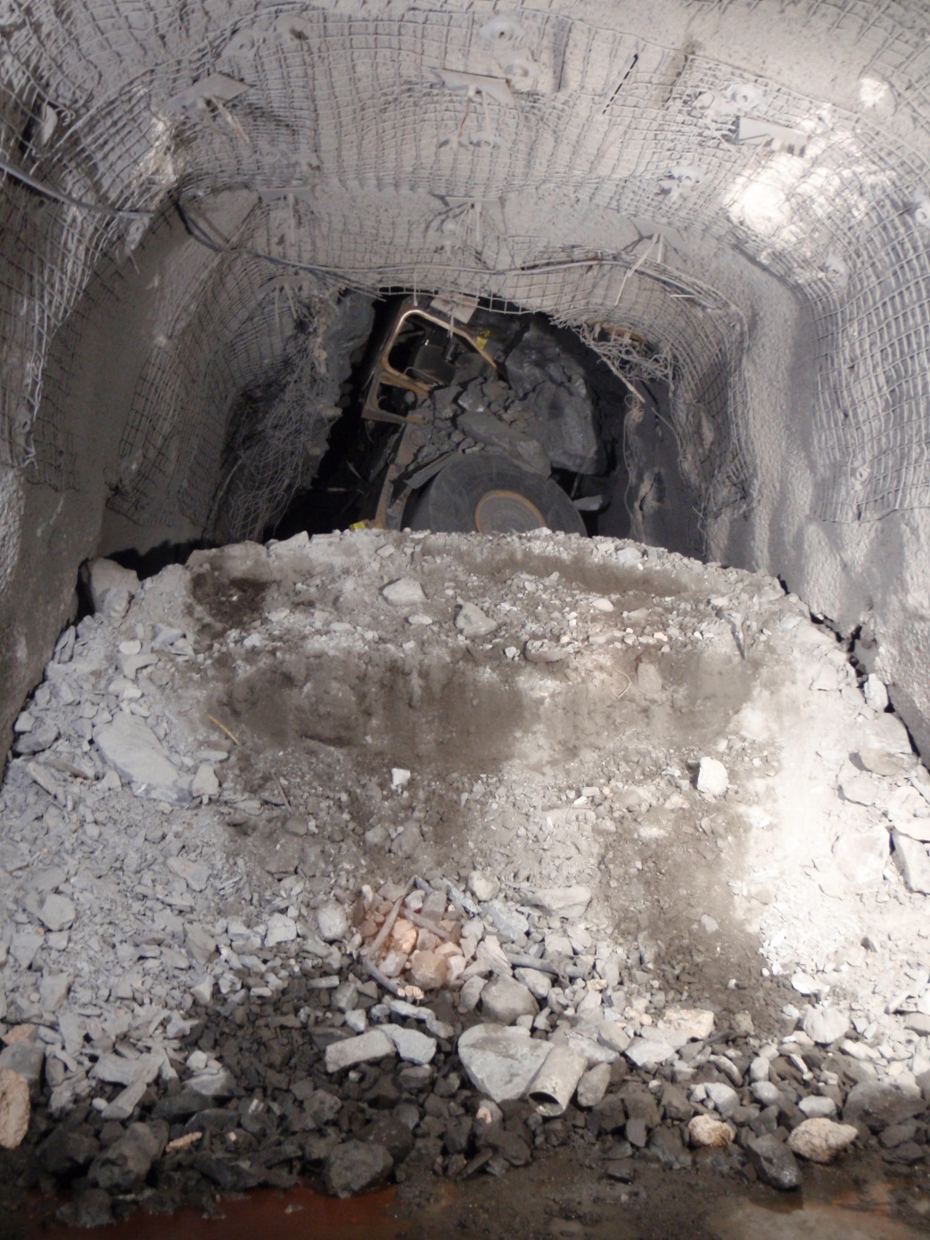
Notes:
You can see the bogger’s front tyre and operator’s cab at the bottom of the stope.

Slide 46
One week before the incident, part of a temporary road had been excavated.
Confusion with access sign numbers resulted in a supervisor carrying out inspections being granted permission to use the temporary road.
The supervisor was travelling slowly enough to enable him to stop before driving completely over the edge. Almost 2 metres of the vehicle, including the front wheels, were left perched about 5 metres above the excavated floor. The supervisor was able to exit the vehicle without further incident.

Slide 47
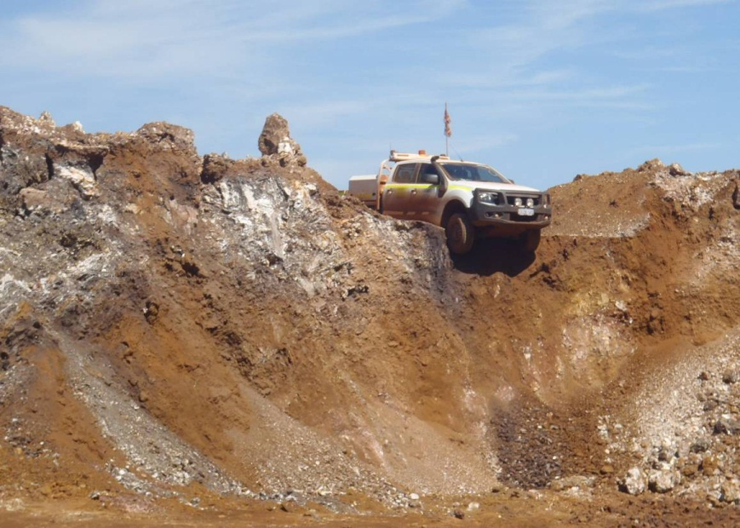
SIR 196 (continued)

Slide 48
Vehicles over an edge (continued)
SIR 234 Light vehicle driven partly over edge of open stope
In April 2015, an underground surveyor removed the danger or warning signs at the access to an open stope and reversed along the access expecting to stop and park at a second sign in the access as per the site's standard procedure.
The surveyor continued to reverse until the rear wheels of the LV dropped over the edge of the open stope and the frame bottomed out on the floor at the edge of the stope void. The depth of the void was approximately 18 metres.

Slide 49
SIR 234 (continued)
Once the LV had stopped, the surveyor called for emergency assistance via the two-way.
A bogger arrived shortly after the emergency request and secured the LV to the bogger using a chain.
The emergency response team used additional slings to secure the LV and decided to extract the surveyor from the LV through the window of the driver-side door.
The surveyor received no serious injuries from the incident.

Slide 50
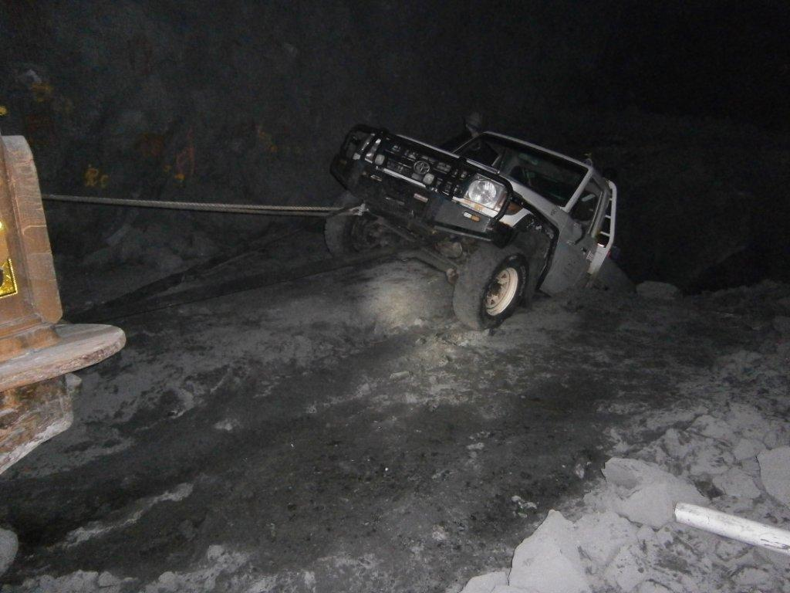
SIR 234 (continued)
Notes:
Light vehicle secured to the back of the bogger by a chain.

