Slide 1

Please read this before using presentation
The Department of Mines and Petroleum (DMP) supports and encourages reuse of its information (including data), and endorses use of the Australian Governments Open Access and Licensing Framework (AusGOAL)
This material is licensed under Creative Commons Attribution 4.0 licence. We request that you observe and retain any copyright or related notices that may accompany this material as part of attribution. This is a requirement of Creative Commons Licences.
Please give attribution to Department of Mines and Petroleum, 2015.
For resources, information or clarification, please contact:
  RSDComms@dmp.wa.gov.au or visit
  www.dmp.wa.gov.au/ResourcesSafety

Slide 2
Structural integrity: Practical applications and survey

Slide 3
What are we going to cover?
Old and new structural safety bulletins
Consider full lifecycle – what can go wrong?
What are requirements of structural integrity – should intervention be necessary?
Common structural integrity failing indicators
Findings internationally – lack of competency, poor communication and lack of maintenance are all key precursors to failure

Slide 4
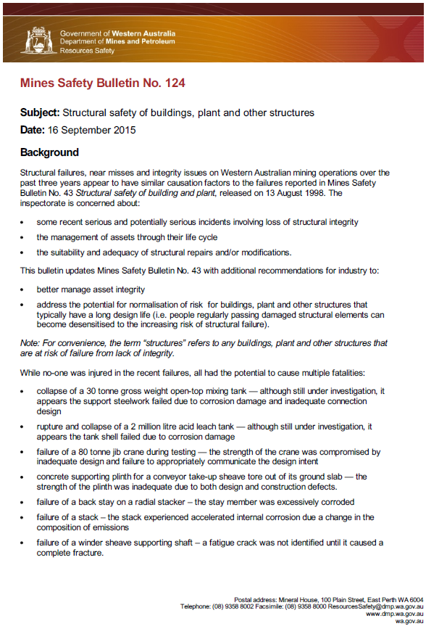
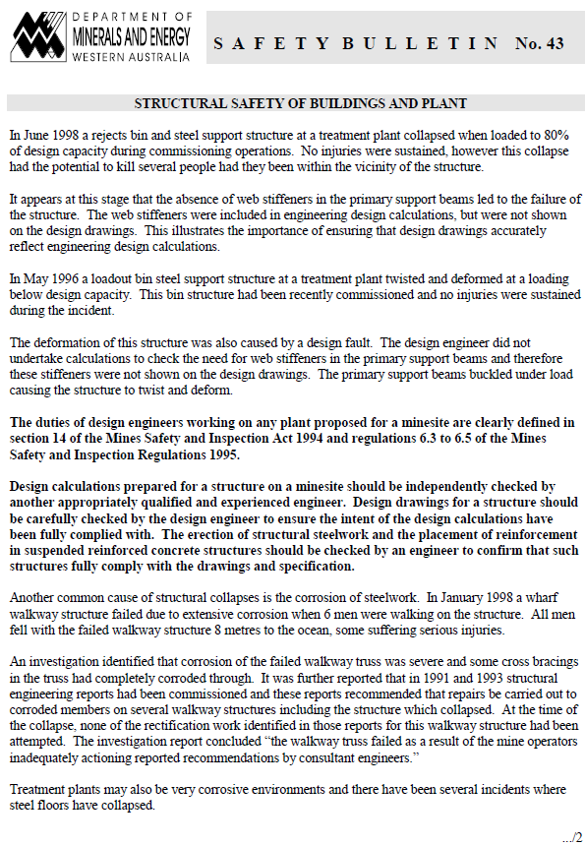
Mines Safety Bulletins
Notes:
Both Mines Safety bulletins No. 43 and No. 124 cover similar issues relating to structural integrity. The latest, Mines Safety Bulletin No. 124 Structural safety of buildings, plant and other structure gives more guidance on the causes and expectations.

Slide 5
What is the legal requirement?
Reminder of the requirements of MSIA s. 9(1)
provide and maintain workplaces, plant, and systems of work of a kind that, so far as is practicable, the employer’s employees are not exposed to hazards;
“provide” entails the design and construct portions of the lifecycle
Notes:
This is a quick reminder – all areas of a mine site contains structures.
Structures are not only the support for parts that move material. Structures may be a workshop or building , or contain material (e.g. bins, tanks, silos).

Slide 6
What best describes “provide” and “maintain” with respect to structures?
AS 5104 (ISO 2394) General principles on reliability for structures
4.1 Fundamental requirements
Structures and structural elements shall be designed, constructed and maintained in such a way that they are suited for their use during the design working life …
Notes:
Structural safety does not stop at the design stage. It also relies on suitable construction and ongoing maintenance, which includes monitoring.

Slide 7
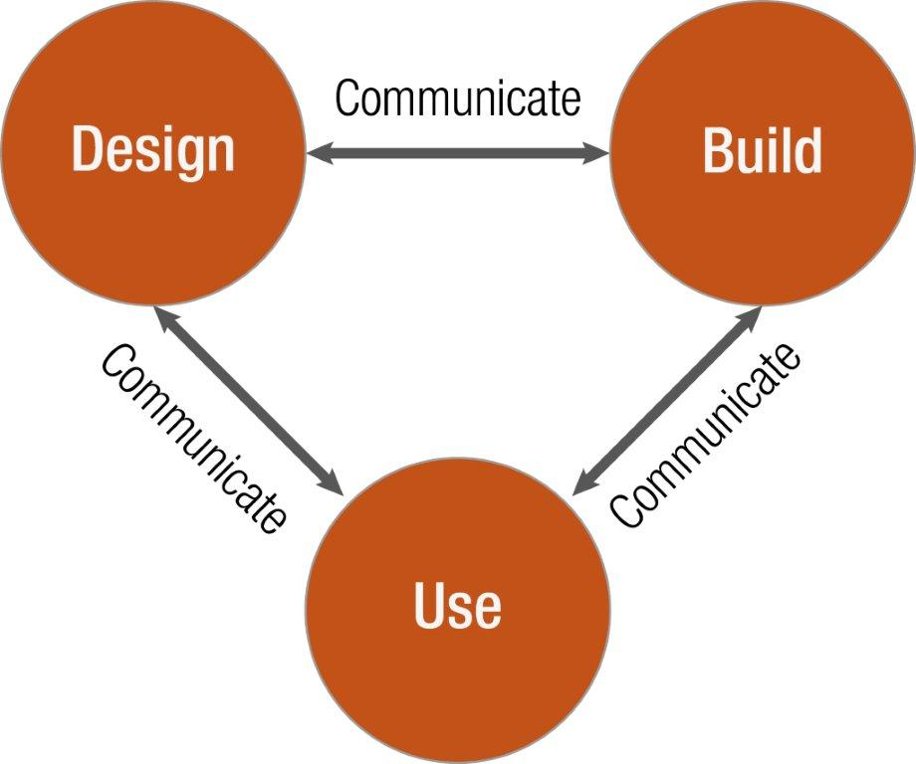
Structural integrity and safety relies on good practice throughout the Lifecycle Model: AS 5104 (ISO 2394) Table A.1
Arrows indicate “bridges” for transfer of intent – if a bridge is missing or broken, structural safety is compromised
Notes:
This diagram represents a summary of the requirements for structural integrity. Without the full lifecycle and interconnection of key activities and actions, including communication, a breakdown can happen. This can result in failure of a structure.
Communication of what is expected regarding loading, methods of construction, risks at all stages and many more are all important, to achieve structural reliability.

Slide 8
Why do we need to monitor structures ?
AS ISO 13822 Basis for design of structures –assessment of existing structures
Monitoring – frequent or continuous, normally long-term, observation or measurement of structural conditions or actions
Many mine sites tend to maintain only when defects become visible
Structures should be monitored as required to ensure the design intent is maintained
Notes:
It is too late when structures collapse. Structures must be monitored to ensure an adequate level of integrity is maintained.

Slide 9
Other useful terms – and expectations
AS 5104 (ISO 2394)
2.2.6 Failure: Insufficient load-bearing capacity or inadequate serviceability of a structure or structural element.
2.2.7 Reliability: Ability of a structure or structural element to fulfil the specified requirements, including the working life, for which it has been designed
2.2.14 Structural integrity (structural robustness): Ability of a structure not to be damaged by events like fire, explosions, impact or consequences of human errors, to an extent disproportionate to the original cause.
Failure is not a collapse
Reliability and Integrity is not “availability” of plant
Notes:
Strictly speaking “failure” is not a collapse – it is an unacceptable structural state. This can be represented in a graphical way in the next slide.
Reliability and integrity is not “availability” of plant.

Slide 10

Requirements of structural reliability – Graphical
Basis for design of structures – Assessment of existing structures
Notes:
The upper curve is the resistance of the structure or part.
The lower curve is the loading.

Slide 11
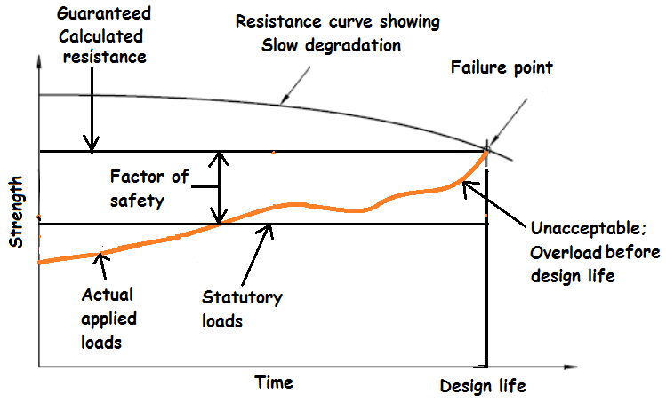
This is not necessarily a catastrophic collapse
Structures are often perceived as “too strong” to start with: Consider however reliability for example a F1 engine or a short mine life
Consider “normalisation of risk” i.e. de-sensitisation over time
Notes:
The lower applied loads are represented by the orange line which is snaking upward. This is a loading curve.
When it passes the lower horizontal line, it is “eating” into the factor of safety. This is unacceptable.

Slide 12
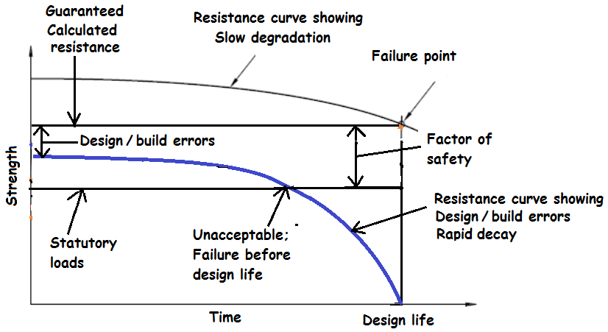
This is not necessarily a catastrophic collapse
Original design and construct faults not identified
“Normalisation of risk” over time
Notes:
The resistance curve (blue line) dropping rapidly represents a decay condition that is less than the original design assumption. The entire blue line is an unacceptable condition.
It shows an original design and/or build error, which if not identified and corrected, means the factor of safety is immediately less than required.
If there is a rapid decay (e.g. severe corrosion) the resistance quickly passes the possible loading and failure can happen. If left uncorrected a failure is bound to happen before the design life is reached.

Slide 13
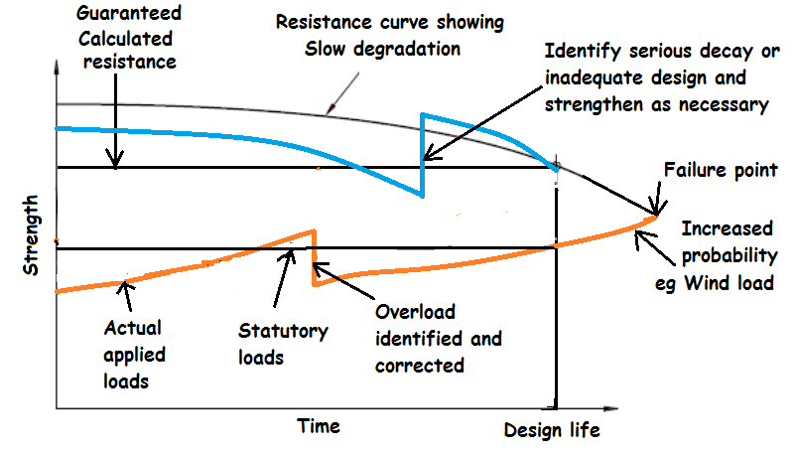
What are acceptable solutions?
Notes:
This diagram shows intervention possibilities for both the resistance and loading curves.
Looking at the upper resistance curve (blue line) , an accelerated decay condition is identified in time. It is stopped, strengthening is carried out (which is the step upward), then decay continues.
Looking at the lower loading curve (orange line), an overload condition is identified and corrected (resulting in a step downward). This is followed by normal combined loading. This should not exceed the unfactored design loads within the design life of the structure.

Slide 14
What does this mean in practical terms?
Following are unacceptable states of structures:
Corrosion of steelwork
Degraded concrete
Modifications
Distorted members and “out of shape”
Cracked members
Missing members
Uncontrolled construction (no design and quality control)
  All of above require a quantitative assessment by competent persons
Notes:
All of these conditions would normally need a quantitative (calculated) analysis to assess the reliability and robustness of the structure, if the original design intent did not allow for them. An example of when a condition is allowable is ( say ) when the original designer allowed for certain corrosion, communicated this on drawings and/ or in hand over documentation, and it is monitored in the maintenance programme. Normally missing members, bent members, cracks and other structural defects are indicators of a failed state. The structure would not necessarily have the necessary reserve robustness to disperse the loading if these conditions occurred.

Slide 15
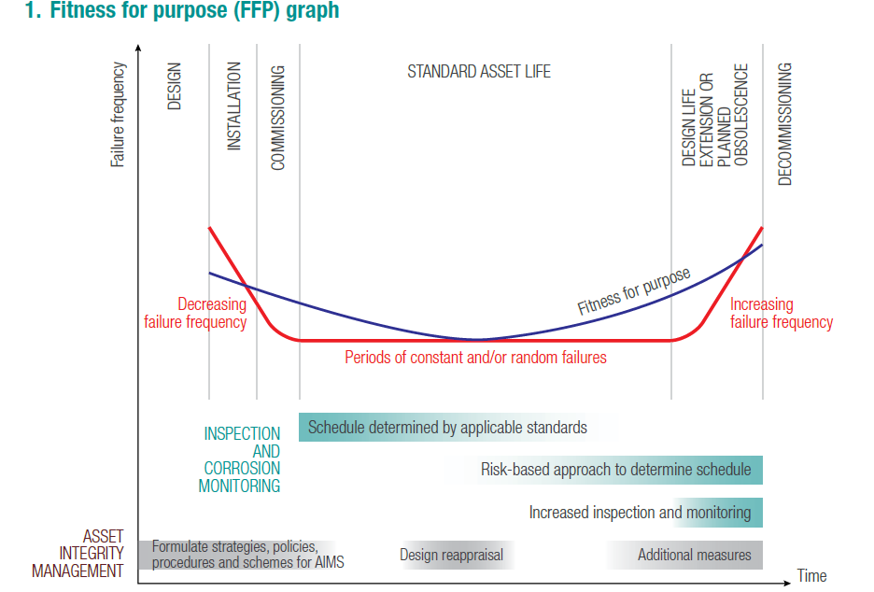
Similar approach used in the oil and gas industry
Notes:
The curves on the previous slides are similar to the integrity curves used in the oil and gas industry. This slide shows a curve from a asset integrity management systems (AIMS) publication on the Department of Mines and Petroleum’s website. The fit for purpose (blue) curve is above the (red) condition line
For AIMS publications published by DMP please refer to:
Guides and procedures, www.dmp.wa.gov.au/Safety/Guides-and-procedures-16202.aspx
Templates and checklists, www.dmp.wa.gov.au/Safety/Templates-and-checklists-16206.aspx

Slide 16
Some considerations for quantitative analysis
AS/NZS 1170.0 Structural design actions Part 0: General principles
“This Standard is based on the philosophy and principles set out in ISO 2394:1998, General principles on reliability for structures. ISO 2394”
This standard is the basis of all Australian building design
The importance level is defined by the probability of human occupancy – this defines all further loading requirements (level 2 minimum for mine sites)
Notes:
The Australian standards AS 1170 series is known to most engineers as the ‘Loading standards’, and is referred to by all the ‘Materials standards’. For example, concrete (AS 3600) and steelwork (AS 4100 and AS 3990).
A lesser known fact is that the standard AS/NZS 1170.0 is based on the principles of ISO 2394, which has been adopted as AS 5104.

Slide 17
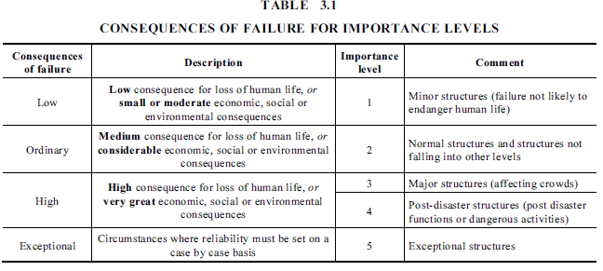
Some considerations for quantitative analysis
AS 1170.0
Notes:
Importance level 2 is commonly applied to mine site structures. It should be assessed on a case-by-case basis, in consultation with the developer or end user. Communication and recording of these types of decisions is necessary.

Slide 18
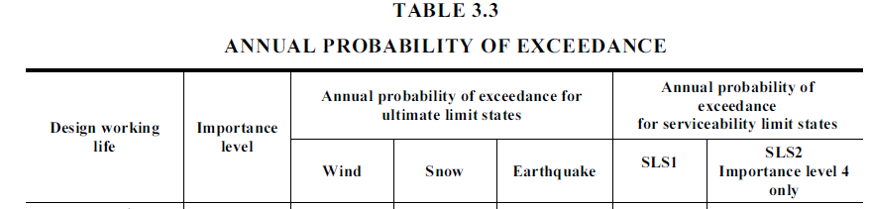
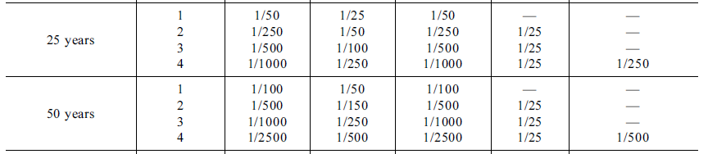
Some considerations for quantitative analysis
AS 1170.0
Notes:
Snow loading is not required on WA mine sites at this time.
Note the differences in probability of exceedance when working with ultimate or serviceability limit states.

Slide 19

Some considerations for quantitative analysis
AS 1170.0
Notes:
Normally the design life is 50 years, however it can be as low as 25 years.
In the case of designing for a 25-year life, an extended life past 25 years will mean a full design and fit-for-purpose review, including appropriate increased loading conditions.

Slide 20


Some considerations for quantitative analysis
AS ISO 13822 – two possible methods given
C.2.1 Given the result of an investigation, there is a need to update the properties and reliability estimates of the structure. Two different methods can be distinguished:
a direct updating of the structural failure probability;
b) updating of the (multivariate) probability distribution of the random variables.
Probability of failure criteria (not likely)
Probability of a variables qualities (possible)
20
Notes:
AS ISO 13822 Basis for design of structures — Assessment of existing structures is a standard associated with AS 5104. This standards sets out methods and principles for assessing the reliability of structures for continued use.
If a structures reliability for continued use is doubtful – for example condition of members (e.g. corrosion, bent shape) or loading conditions – either or both of these areas can be investigated further by statistical means.
This requires an in-depth knowledge of the procedures and processes to:
gather a sufficient data pool
analyse the data to determine the degree of compliance.
Do not attempt this unless you have competency in this area.

Slide 21
Some considerations for quantitative analysis
AS ISO 13822
Annex C (informative)
Updating of measured quantities
After the evaluation of the updated design values, one may check the structural reliability using the standard procedure for new structures: it should be verified that, based on the design material and geometrical properties, all relevant limit states are not reached when the design actions are applied to the structure.
These methods to be undertaken only by professionals with competency in this area only.
Examples and papers by Prof. Emeritus Dan M. Frangopol (Lehigh University, USA)
Notes:
The evaluation using the new figures, for material strength or load effects would be applied to the applicable material standard. This note highlights that both serviceability and ultimate limit state requirements must be met.

Slide 22
So what does this mean in practice?
If material strength (e.g. yield strength, section size) can be proved by sufficient measurements and probability as exceeding original design assumption, it can be used
If loading on structure, for its design life, can be proved with adequate probability (i.e. based on sufficient sampling) to be less than originally designed, it can be used
Beware! Probabilistic studies of loading is derived from decades of measurement results – are you prepared to take on all of academia?
This usually leaves only first option

Slide 23
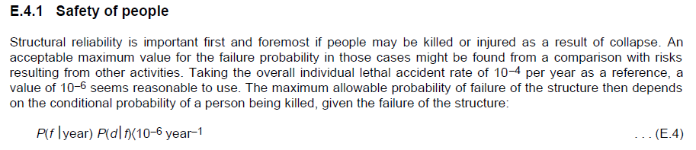
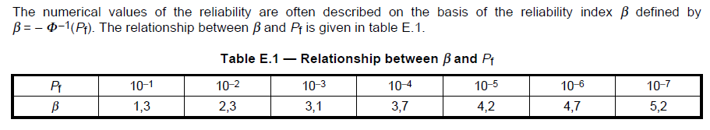


What is the minimum requirement on which standards are based ?
This may not necessarily be minimum practicable effort.
Excerpt: AS 5104
Notes:
The reliability index figure (β) associated with an accident rate of 1 in 10E-6 per year is 4.7 [Table E.1 of AS 5104 General principles on reliability for structures].
As will be seen on the next slide, this is also the industry acceptable norm for lethal accidents due to other hazards.

Slide 24
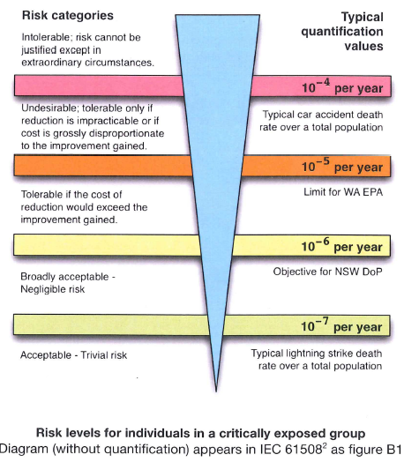
This is an adaptation from the International Electrotechnical Commission (IEC) Code 61508
Notes:
This graphical representation is from the International Electrotechnical Commission (IEC). Note the “broadly acceptable” occurrence level of 10E-6 per year.

Slide 25
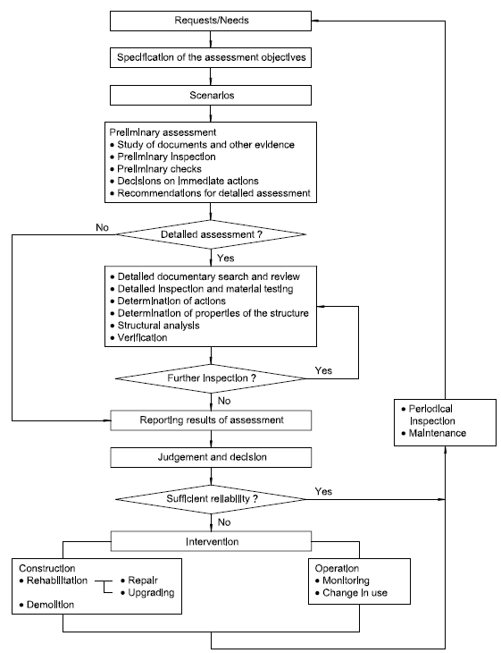
What is the typical flowchart to assess structures?
AS ISO 13822 Appendix B
Notes:
This flowchart is and excerpt from Appendix B of AS ISO 13822 Basis for design of structures — Assessment of existing structures. It is a guide on the normal process to assess structures for continued use.
It relies heavily on the competency of the assessor to know what physical condition of the structure constitutes unacceptable risk. This is commonly referred to as a qualitative assessment as it relies on a non-calculated opinion with “qualifications” explaining what the assumptions and assessment conditions are.
The slides following this will show some of the conditions which are unacceptable. The condition remains unacceptable unless it can be proved acceptable by quantitative (i.e. calculated) assessment, as spelled out in the previous slides.

Slide 26
Limits of steel corrosion
Any loss of material may severely affect the strength
Corrosion to the extent of change of shape (below) can result in catastrophic failure ― requires assessment
Reduced capacity is far less than the reliability target ― can be calculated accurately
Notes:
The diagram shows unacceptable conditions. Corrosion – which severely decreases the strength or the function of the structure – is usually unacceptable. As parts become thinner, they tend to become more unstable and can easily buckle or tear. These are both rapid effects with little or no warning.

Slide 27
This state of corrosion is on curve below
Notes:
If we recall the previous slide illustrating a deficient resistance curve – the rapid decay portion would be indicative of severe corrosion conditions.

Slide 28
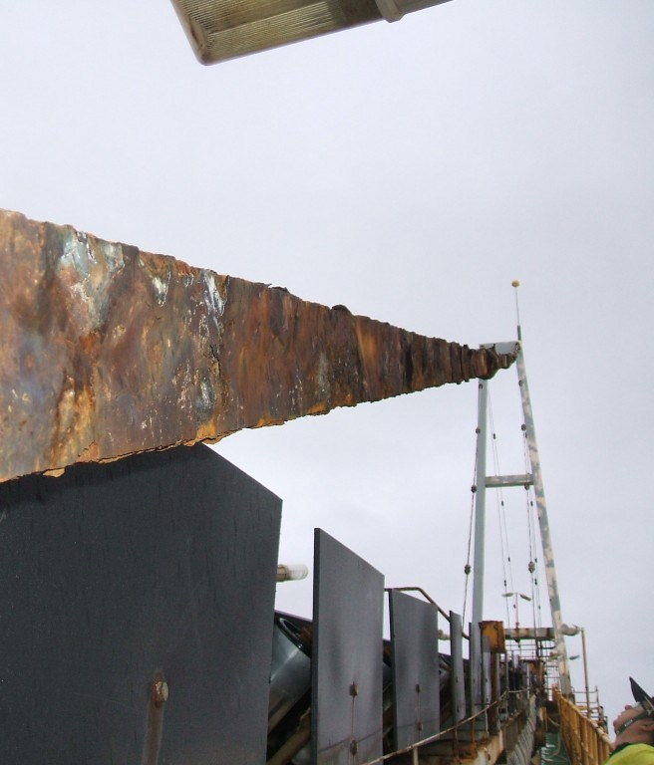
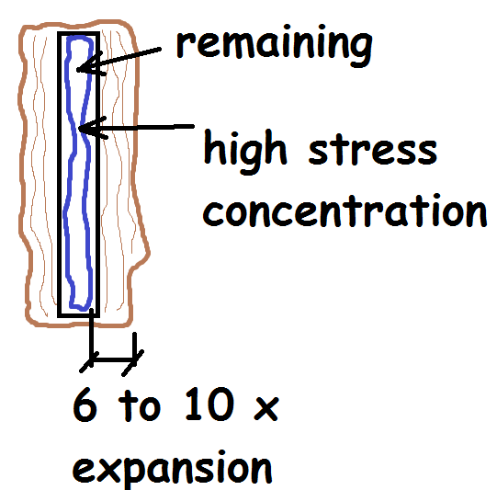
Limits of steel corrosion – book effect
May not look “too bad”
Eccentric effects
Internal pressure
Notes:
As mentioned in the previous slides, corrosion can introduce more risk than immediately apparent. In this case uneven corrosion pitting has introduced a stress concentration. This can lead to a rapid tear, often called an “unzipping” failure.
The added problem with corrosion is that the part may look alright but under the surface the degree of corrosion can vary. The only way to be sure is to establish the exact profile after shot blasting (or equivalent). This is near impossible with surfaces in contact, and for connections which require a more thorough investigation.

Slide 29
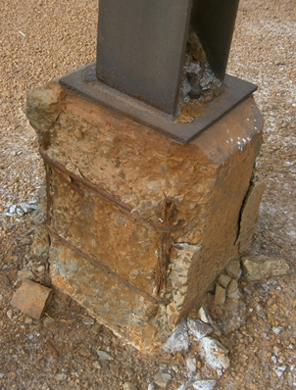
Limits of concrete degradation (footings)
Loss of bond strength of reinforcing
  Carbonation is caused by a CO₂ reaction which neutralises the alkaline state of concrete
  Corrosion after or with carbonation causes spalling
Loss of concrete strength
  Chemical degradation (alkaline)
  Alkaline aggregate reaction (incompatibility of the aggregates)
  Differential settlement
  Rotation of fixed bases
Notes:
The picture shows unacceptable conditions.
Once spalling of concrete starts it means there has been a loss of the passivating layer of the reinforcing steel. This is often due to carbonation and frequently associated with accelerated attack from salts and other chemicals.
Carbonation is the normal reaction between carbon dioxide and the alkaline and calcium hydroxides which reduce the protective attributes of the concrete cover. Once parts of the concrete start spalling, it is an indicator that large areas are affected.
Concrete bases can also experience damage due to vehicle impact and overloading. Often the overloading is associated with changes to the foundation soil or the structural response associated with differential movements.

Slide 30
Reinforced concrete
Concrete spalling is a late condition failure ― spalled concrete is usually too far gone to repair economically
Carbonation breakdown for 40 mm cover usually breaks down within about 40 years (unless specially protected and depending on the chemical exposure)
Extra cover is counter productive unless fibre reinforced
Level of decay requires laboratory confirmation
Permanent shuttering corrosion can reduces slab capacity to less than safe-weight resistance ― mesh in slab is to prevent total collapse
Notes:
When spalling occurs, its often too late to make an economical repair.
The 40 mm carbonation in 40 years depends on many factors. It is often faster than this in harsh mining environments.
Too much concrete cover is often counterproductive
Permanent shuttering can break down quickly in harsh chemical environments. If the decking was not augmented by internal reinforcing, the suspended slab may not be able to resist even its own weight.

Slide 31
Examples of structural standard changes due to failure learnings
Duty of care – to keep up with risks:
Steelwork: Prying effects ― 1980s (Hyatt), 1990s - Shear lag rules and block shear failures (numerous failures and material testing)
Steelwork: subsurface defects ― Weld lamellar tearing risk (EN3-1-10; ZR value determined)
Concrete: Deep RC beams (Canadian bridge 2006), strut and tie and detailing rules after Kobe (1995) and Christchurch (2011)
Notes:
Engineers have a duty of care to ensure they remain knowledgeable with industry findings and changes. Often codes and standards are updated as risks to certain hazards are identified. The following are examples of such cases.

Slide 32
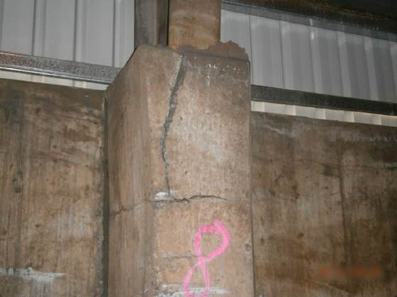
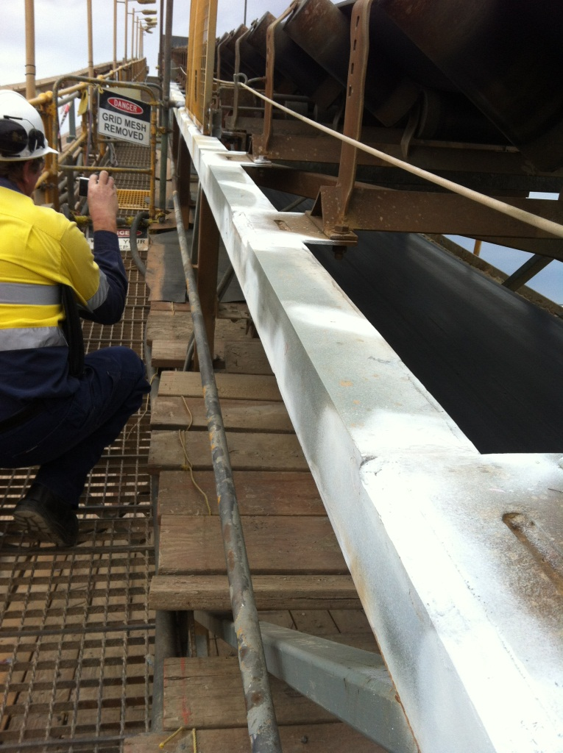
Severe corrosion and degradation
Buried, cast in steelwork and hollow sections are all hidden corrosion risks
Notes:
The addition of mass concrete over steelwork is not acceptable. This example shows how the mass concrete has cracked and is falling off. Cracked mass concrete also allows the ingress of moisture, even through small cracks by capillary action, causing internal corrosion.
By welding additional parts onto existing steelwork, the risk of internal corrosion is increased. Hollow sections are at risk unless galvanised or hermetically sealed.

Slide 33
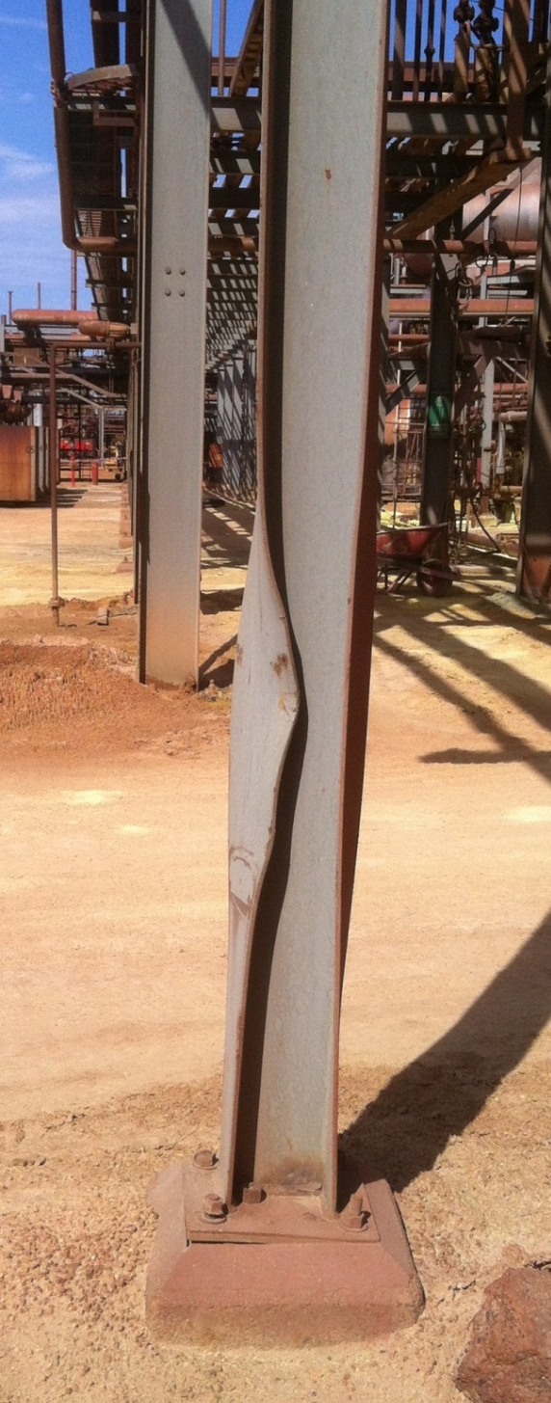
Impact damage
If it looks severe, it usually is
Distortion limits are defined by parts of AS 4100 - usually length or span/1000 or 3 mm
When are these identified and by whom (de-sensitised or “normalisation”)?
Notes:
Impact damage such as this (or less) is unacceptable.
In all cases where damage is predictable, sufficient protection should be provided by means of bollards or similar.

Slide 34
Impact damage
Bends, distortion and buckling shape are signs of an already failing structure or much reduced capacity of members
Most prevalent at main columns that are the predominant load-carrying members ― total structure collapse when the load is high (e.g. high wind, accidental knock, major rebuild or maintenance activities)
Notes:
When parts are impact damaged, their buckling resistance is less than allowable. The damaged parts are often already in a yielded (failing) state.
Impact damage often affects more parts, including the end connections and foundations. These all need to be considered.

Slide 35
Modified structures
Includes missing components not correctly quality-controlled during construction
Removal or cutting of structural members such as post-commissioning installations
Bracing not connected at common points or off sets (eccentricity)
Notes:
Missing parts, cut away parts and eccentric connections are all indicators of modified structures. Often these conditions also indicate inappropriate modifications and not using sufficiently competent persons to manage the design, build and maintenance of the structure.

Slide 36
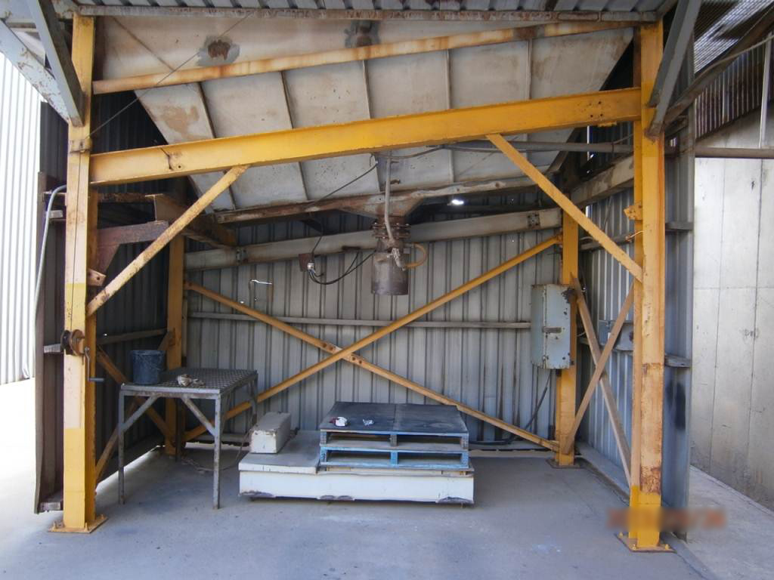
Modifications – what to look for
This is resistance below the line
Missing brace imposes different loads
Added pieces may not be adequate
Notes:
Modified structures not assessed by competent persons are at risk of failure.

Slide 37
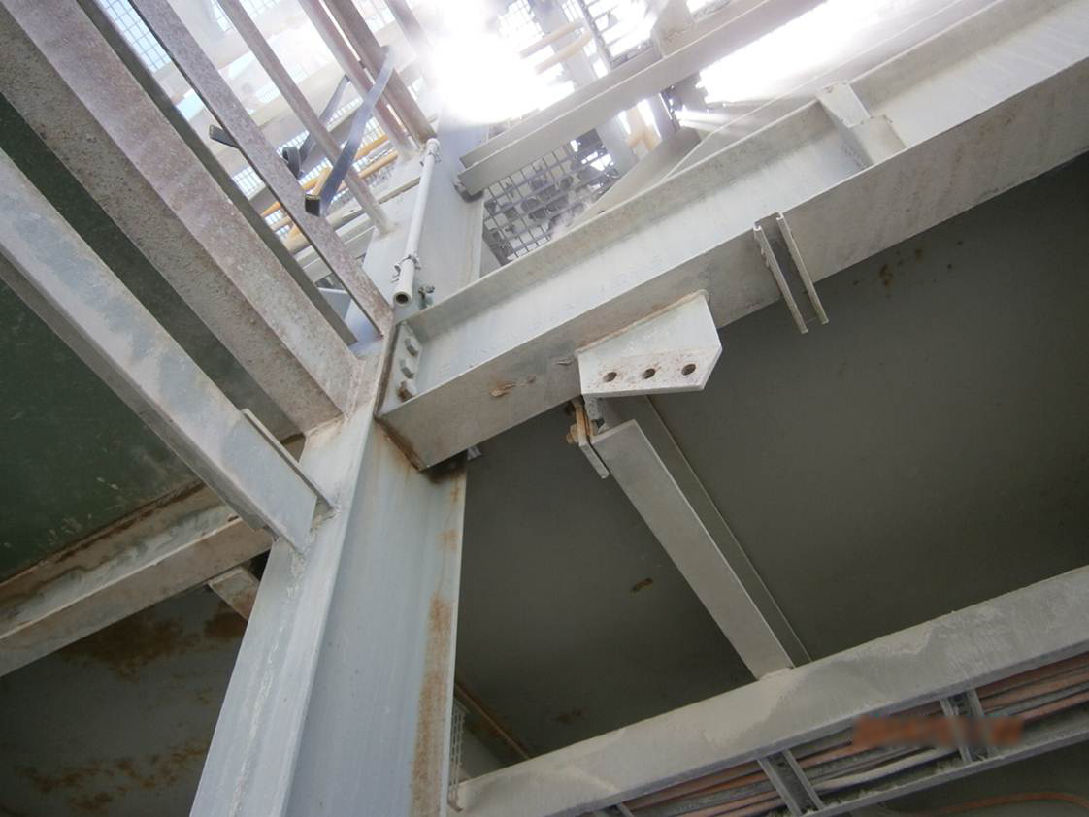
Modifications – what to look for
This is resistance below the line
Missing brace imposes different loads
Failed bolts are the result
Notes:
If there are signs of yielding, like bolts failing or loosening, failure is already happening.

Slide 38
Cracks
Most likely to find in structures associated with dynamic loads such as crushers and screens
Due to inadequate design and detailing
Can happen in concrete structures
Re-distribution of load based on ductility principles does not apply ― often secondary load path fails quickly
Most critical if repaired before ― likely to recur as root causes not dealt with
Notes:
Cracks indicate ongoing yielding failure. Cracks can propagate quickly and result in instability and total collapse. Cracks cannot be left unattended to.

Slide 39
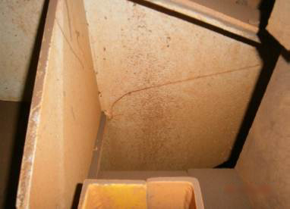
Cracks – incorrect design and detailing
Notes:
Cracks often propagate from a weld or sharp edge. Once initiated, the crack travels quickly. In this case the bracket has no residual strength and the structure can collapse. Structures resisting dynamic loads are more prone to crack development.
These require design and detailing by specialists competent in this facet of structural engineering.

Slide 40
Some reasons why structures do not fail catastrophically
By design, structure is robust ― not often done but requirement of the standards for many decades
Often a secondary resistance mechanism (e.g. sheeting can act as a diaphragm instead of the vertical bracing) ― not effective in high wind and seismic conditions and is not permitted by the standards
Fixity of connections is often more than the “pinned” condition assumed
Secondary structural mechanisms (e.g. catenary effects )
Luck?

Slide 41
Some reasons why structures fail catastrophically
Rules for robustness are not specified by clients, considered as mandatory, audited by regulators etc.
Structural mechanism was not catered for in standard at time ― standards are best practice at time and constantly develop, based on learnings from failures
Strength ≠ ductility ― most standards do not dictate ductility requirements
Designers not actively perusing CPD opportunities

Slide 42
Some indicators of inadequate structural integrity
No use or utilisation plan
Excessive corrosion
Concrete spalling
Impact damage (missing barriers)
Cracks
Inappropriate modifications
Structure not adequate
Non-standard construction practices

Slide 43
Reliance on competency
The Institute of Structural Engineers:
Dr Soane highlighted some of identified risks which frequently appear in Structural-Safety Reports and Alerts, including issues of competence…
He added “Before most, if not all, collapses there are pre-cursers elsewhere and if these are recognised, and lessons learned from them, then more serious events may be prevented.”
Notes:
Note the statement by Dr Soane. As mentioned on the previous slides, identifying indicators of structural failure and inadequacy are key to preventing collapse.

Slide 44
Reliance on competency
The Australian Steel Institute: Confidential reporting on Structural safety (Dec 2013)
David Ryan – ASI National manager:
“Commonly identified risks include lack of competence and engineering appreciation, fixings, tensile components, poor communications, over-reliance on IT, temporary works, free standing walls, lack of maintenance and falsified documentation, with the risk increasing when factors are combined.
Notes:
Note the statement by David Ryan. These are some of the same risks that have resulted in the collapses on mine sites.

Slide 45
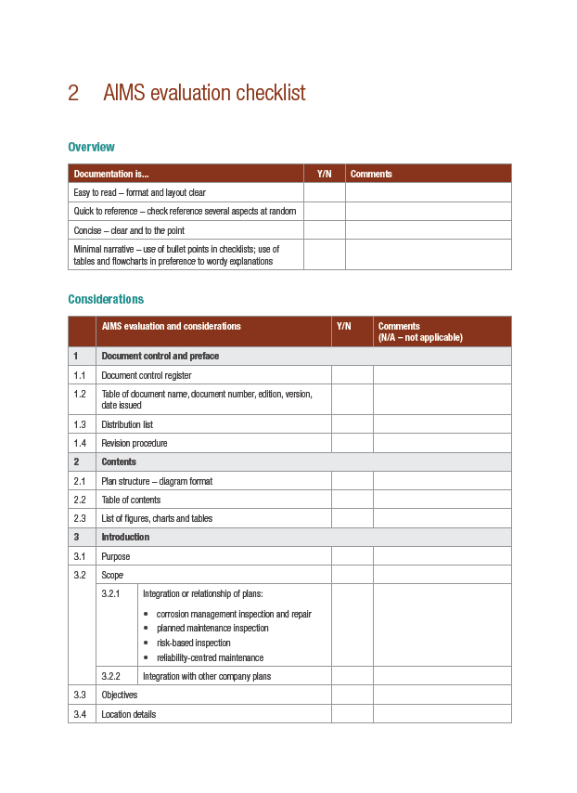
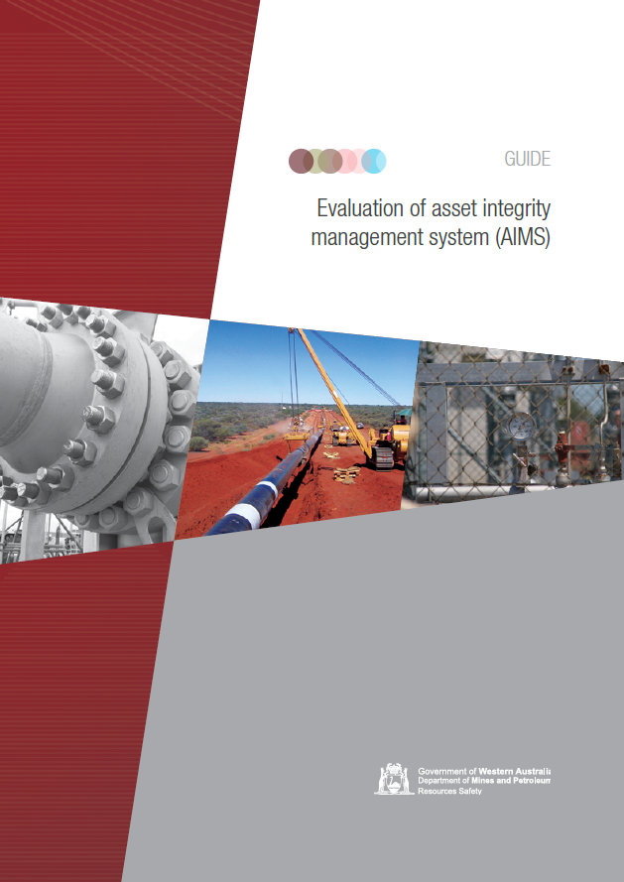
What possibilities exist for improvement
Increased competency in this area – How?
Development of guidelines, audit templates and checklists – What is your opinion?
Notes:
Please give the Department of Mines and Petroleum feedback through MinesSafety@dmp.wa.gov.au

