Slide 1
Please read this before using presentation
This presentation is based on content presented at the 2018 Exploration safety information session in July 2018.
Department of Mines, Industry Regulation and Safety(DMIRS) supports and encourages reuse of its information (including data), and endorses use of the Australian Governments Open Access and Licensing Framework (AusGOAL)
This material is licensed under Creative Commons Attribution 4.0 licence. We request that you observe and retain any copyright or related notices that may accompany this material as part of attribution. This is a requirement of Creative Commons Licences.
Please give attribution to Department of Mines, Industry Regulation and Safety, 2018.
For resources, information or clarification, please contact: SafetyComms@dmirs.wa.gov.au or visit www.dmirs.wa.gov.au/ResourcesSafety

Slide 2
2018 Exploration safety information session

Slide 3
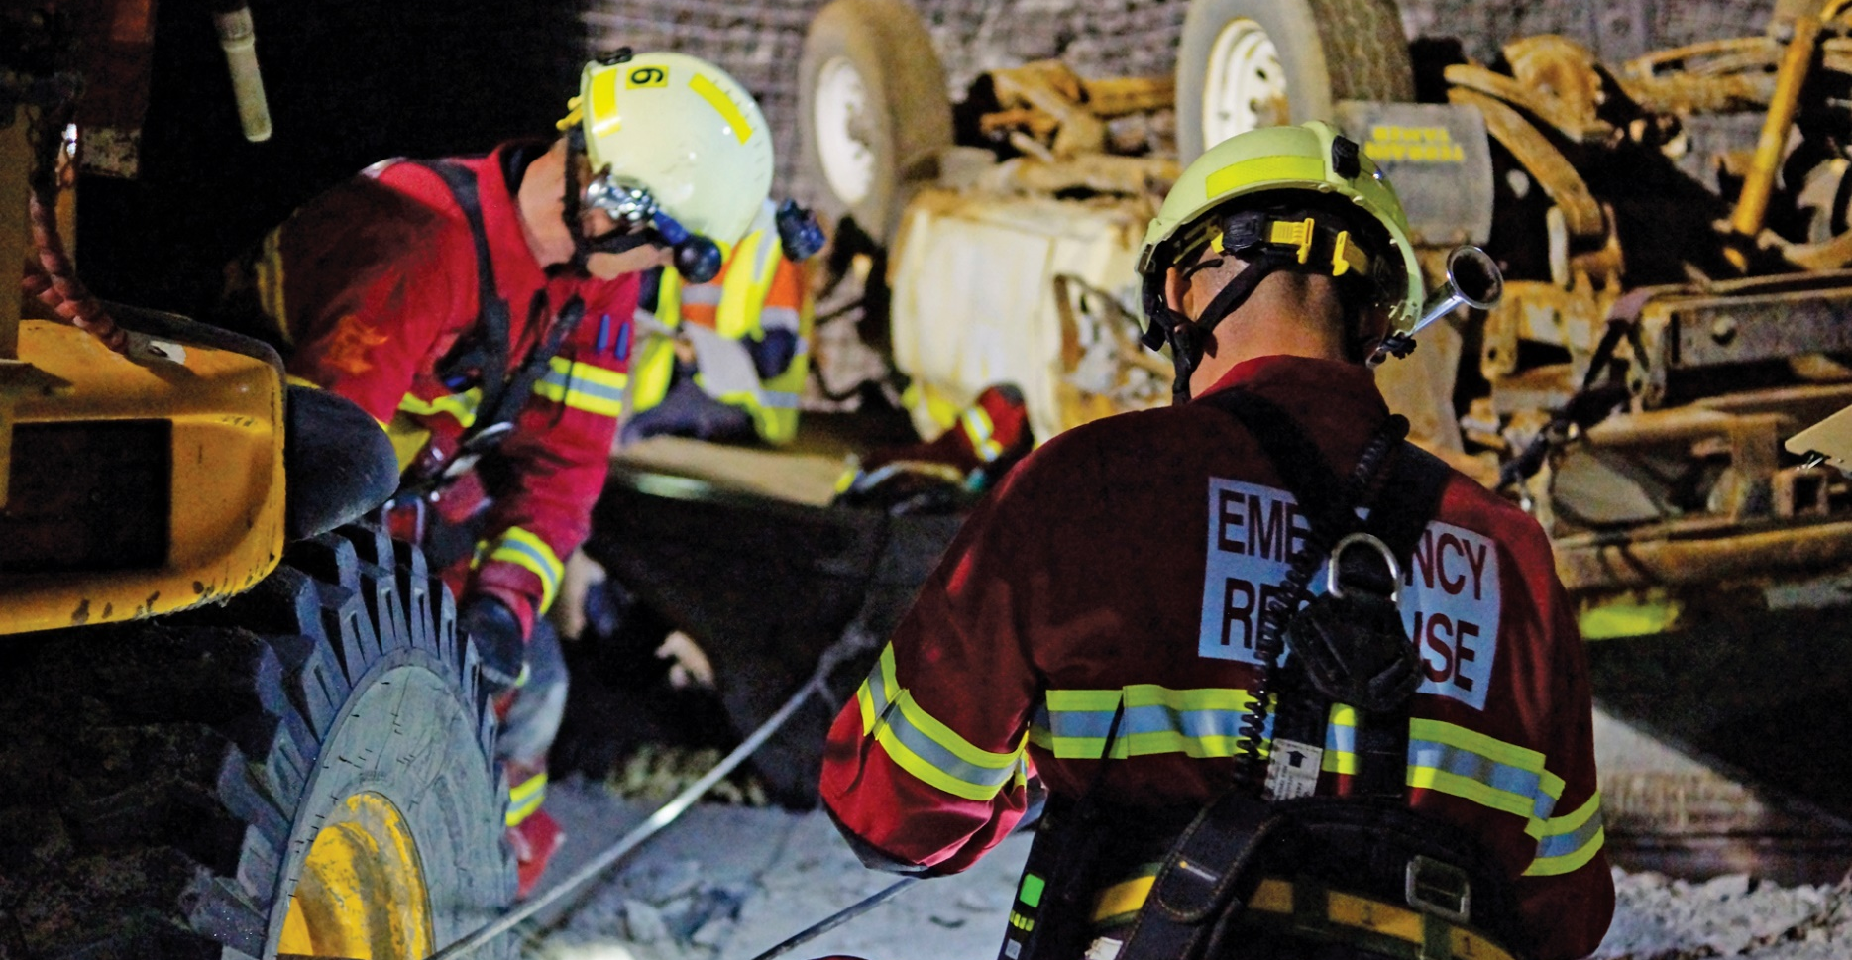
Emergency management in exploration – an operational imperative

Slide 4
Exploration emergency management arrangements
“A key element of the Australian Emergency Management Arrangements is effective emergency planning for all hazards.
The existence of such plans allows all emergency managers and responders to understand the roles, responsibilities, capability and capacity of other organisations.
These plans are tested through exercises and experiences to ensure they are current and appropriate to the task. This process also enhances relationship building between key personnel in different organisations”.
Australian Resilience Handbook Collection - 9

Slide 5
Presentation outline
Context, references and legislation
Hazard and risk management
Emergency management plans
Summary

Slide 6
Exploration statistics – last 12 months
2 Fatalities
4 Serious injuries
11 Minor injuries
84 Other reportable incidents

Slide 7
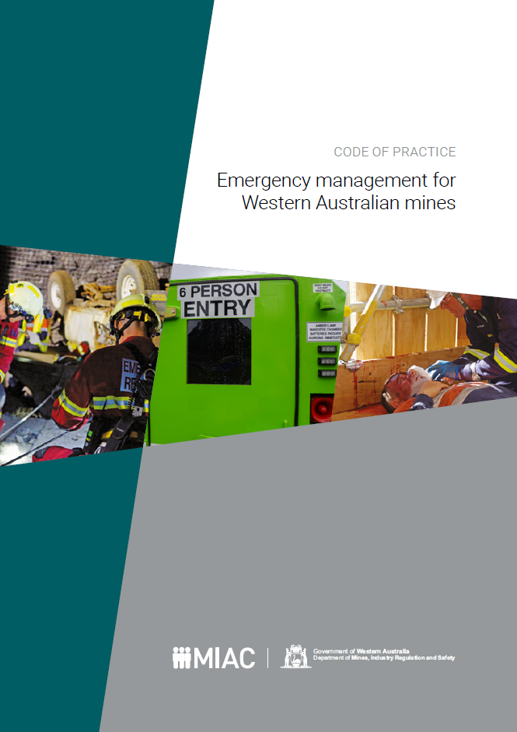
Guidance material for emergencies
Mines Safety Inspection Regulations 1995
Code of Practice – Emergency Management for Western Australian Mines
Code of Practice – Mineral Exploration Drilling – Section 3
Australian Disaster Resilience Handbook Collection

Slide 8
Legislative requirements r3.6, 3.7
Training of persons
An employer must ensure that each employee engaged in exploration operations is provided with such training as is necessary to enable the employee to manage risks associated with the hazards of exploration operations in remote sites, including the lack of infrastructure and support and adverse climatic conditions.
Suitable equipment to be provided
An employer must ensure that employees engaged in exploration operations are provided with suitable vehicles and appropriate equipment (including communications and emergency equipment) to engage in that operation.

Slide 9
Legislative requirements r4.24
First aid equipment to be provided
Principal employer at, and the manager of, a mine must ensure that appropriate first aid equipment, facilities and services are provided at the mine at all times when persons are working at the mine.
For the purpose of determining what first aid equipment, facilities and services are appropriate under subregulation (1), regard must be had to:
the nature of the hazards associated with mining operations at the mine
the risk level of those hazards
whether a doctor or medical officer is available at, or near, the mine
the proximity of the mine to hospital facilities and services.

Slide 10
Legislative requirements r4.26
First aid personnel
Principal employer at, and the manager of, a mine must ensure that:
a person qualified in first aid is available at the mine at all times when persons are working at the mine; and
so far as is practicable, a person qualified and experienced in advanced first aid is available, or on call, at the mine at all times while persons are working at the mine.

Slide 11
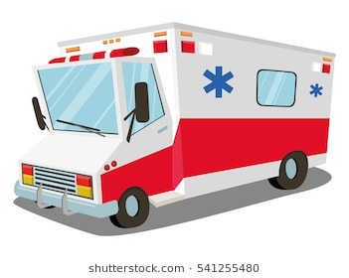
Legislative Requirements r4.27
First aid vehicles
Principal employer at, and the manager of, a mine must ensure that a vehicle equipped to transport injured or sick persons is available at the mine at all times while persons are working at the mine.

Slide 12
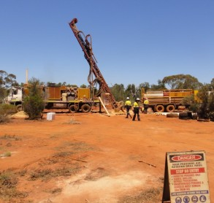
Why is exploration different?
Remote operations
Communications
Reduced equipment in the field
Reduced skill base
Increased response times
Accessibility issues

Slide 13
Issues
Thermal hazards - extremes
Weather – sometimes unpredictable – flash flooding
Bush fires – can start spontaneously
Access – driver skills, access for emergency services
Communication
Radio
Sat phones
Distress beacons – EPIRBS
Personal tracking devices
Nature of the work – What are the specific risks

Slide 14
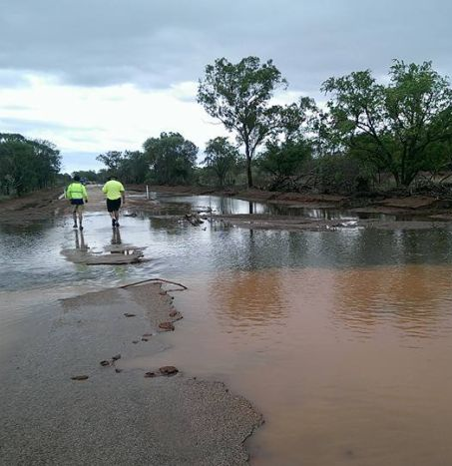
Risk assessment scope
Define the exploration operation
Where is it
What is the physical environment like
What is the weather likely to be
What is access like
What communication works

Slide 15
Increased vulnerability for exploration operations
Exploration operations may be more vulnerable to the effects of a particular emergency event, usually due to its specific circumstances and changing environment, than permanent operations.
Drilling operation in a low-lying area would be more vulnerable to the effects of flood than a nearby drilling operation on higher ground.
Likelihood of the flood occurring may be the same for both operations, however the potential consequence to the low-lying plant would be far greater thus making it particularly vulnerable to the effects of the flood.
When carrying out risk assessments, identify aggravating factors that increase risk levels.
Vulnerability is the lack of resilience to the potential impacts of an emergency event

Slide 16
Focus on site resources
An event such as a minor injury that occurs a long way from medical facilities may become an emergency event. Long response times are important to take into account These risks can be reduced by better resources on site:
First aid
Personnel skills (a single first aider may be the one injured)
Communications - redundancy

Slide 17
Opportunities to reduce risk
Ensure all potential emergencies have been identified
Ensure realistic consequence have been identified
Redundancy / backup for systems, equipment and people.

Slide 18
Emergency management plans
Site actions and response
Actions
Responsibilities
Communications
Organisational actions and response
Situational awareness on site
Is the site capable of carrying out planned actions
Contingencies

Slide 19
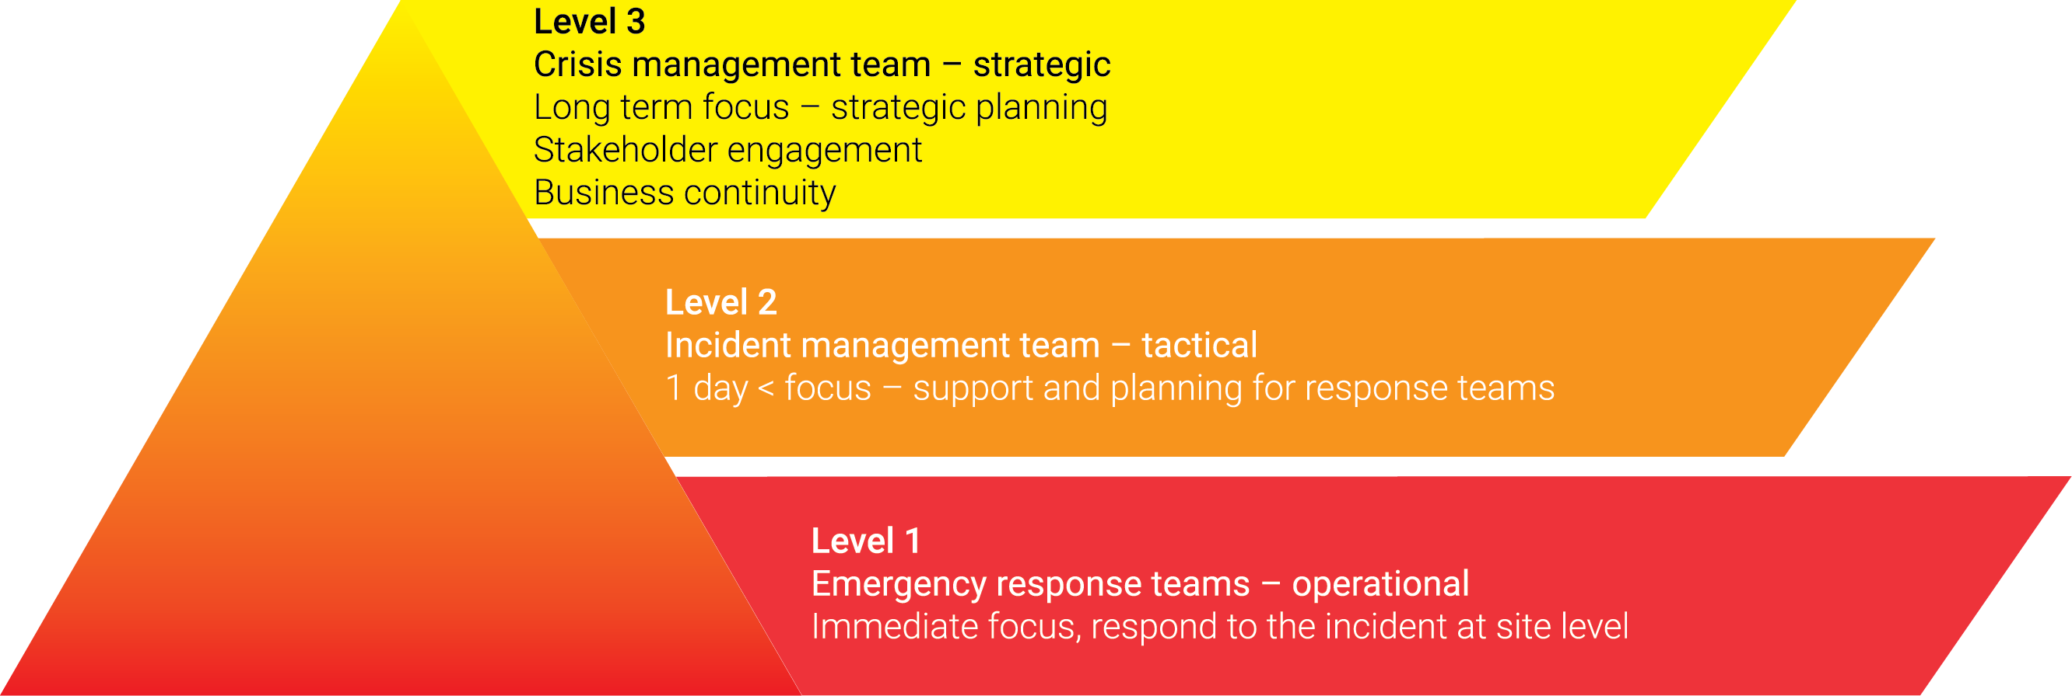
Emergency management structure
Exploration operations with limited resources still need a formal emergency management structure that is appropriate to the scale and nature of:
the operation
potential emergencies associated with the operation.

Slide 20
Typical Incident Escalation
Person injured on site
Provide first aid and communicate with local support and head office
IMT Stood up
Communicate with emergency services
Support site efforts, organize relief for site personnel
Communicate with external stakeholders ie family, regulator
Plan possible site evacuation
Deal with media

Slide 21
Validating plans and arrangements
Test and validate communications internally and with external stake holders
Emergency services
RFDS
Resources and potential support eg stations, townships
Regularly audit site resources
First aid and medical supplies
Communications equipment
Ensure site competency base
Fire fighting and other emergency equipment
Test emergency response plans
Conducting a post-emergency or exercise review of the effectiveness of the emergency response plan. Ensure objectives are achieved.

Slide 22
Summary
Identify hazards and prioritise according to risk. Consider vulnerability and aggravating factors
Formulate plans to manage all identified emergencies. Take the “All Hazards” approach
Identify resources needed to carry out plans
Regularly test and exercise plans and audit resources.

