Slide 1
Perth Basin Update WA Petroleum Day Thomas Nador – GM WA Development
13 September 2019

Slide 2
Disclaimer
This presentation contains forward looking statements that are subject to risk factors associated with oil, gas and related businesses. It is believed that the expectations reflected in these statements are reasonable but they may be affected by a variety of variables and changes in underlying assumptions which could cause actual results or trends to differ materially, including, but not limited to: price fluctuations, actual demand, currency fluctuations, drilling and production results, reserve estimates, loss of market, industry competition, environmental risks, physical risks, legislative, fiscal and regulatory developments, economic and financial market conditions in various countries and regions, political risks, project delays or advancements, approvals and cost estimates.
Underlying EBITDAX (earnings before interest, tax, depreciation, amortisation, evaluation, exploration expenses and impairment adjustments), underlying EBITDA (earnings before interest, tax, depreciation, amortisation, evaluation and impairment adjustments), underlying EBIT (earnings before interest, tax, and impairment adjustments) and underlying profit are non-IFRS financial information provided to assist readers to better understand the financial performance of the underlying operating business. They have not been subject to audit or review by Beach’s external auditors. The information has been extracted from the audited financial statements.
Free cash flow in this presentation is defined as cash flows from operating activities plus cash flows from investing activities less cash flows from acquisitions and divestments.
All references to dollars, cents or $ in this presentation are to Australian currency, unless otherwise stated. References to “Beach” may be references to Beach Energy Limited or its applicable subsidiaries. Unless otherwise noted, all references to reserves and resources figures are as at 30 June 2019 and represent Beach’s share.
References to planned activities in FY20 and beyond FY20 may be subject to finalisation of work programs, government approvals, joint venture approvals and board approvals.
Due to rounding, figures and ratios may not reconcile to totals throughout the presentation.
Assumptions
The five year outlook set out in this presentation is not guidance. The outlook is uncertain and subject to change. The outlook has been estimated on the basis of the following assumptions: 1. a US$62.50/bbl Brent oil price in FY20 and a US$70/bbl Brent oil price from FY21; 2. 0.70 AUD/USD exchange rate in FY20 and 0.75 AUD/USD exchange rate from FY21; 3. various other economic and corporate assumptions; 4. assumptions regarding drilling results; and 5. expected future development, appraisal and exploration projects being delivered in accordance with their current expected project schedules.
FY20 guidance is uncertain and subject to change. FY20 guidance has been estimated on the basis of the following assumptions: 1. a US$62.50/bbl Brent oil price; 2. 0.70 AUD/USD exchange rate; 3. various other economic and corporate assumptions; 4. assumptions regarding drilling results; and 5. expected future development, appraisal and exploration projects being delivered in accordance with their current expected project schedules.
These future development, appraisal and exploration projects are subject to approvals such as government approvals, joint venture approvals and board approvals. Beach expresses no view as to whether all required approvals will be obtained in accordance with current project schedules.
Reserves disclosure
Beach prepares its petroleum reserves and contingent resources estimates in accordance with the Petroleum Resources Management System (PRMS) published by the Society of Petroleum Engineers. The reserves and contingent resources presented in this report were originally disclosed to the market in the FY19 annual report released 19 August 2019. Beach confirms that it is not aware of any new information or data that materially affects the information included in the aforesaid market announcement and that all the material assumptions and technical parameters underpinning the estimates in the aforesaid market announcement continue to apply and have not materially changed.
The reserves and resources information in this report is based on, and fairly represents, information and supporting documentation prepared by, or under the supervision of, Mr David Capon (Manager Development Offshore Victoria, New Zealand and NT). Mr Capon is a full time employee of Beach Energy Limited and has a BSc (Hons) degree from the University of Adelaide and is a member of the Society of Petroleum Engineers. He has in excess of 25 years of relevant experience. The reserves and resources information in this presentation has been issued with the prior written consent of Mr Capon as to the form and context in which it appears.
Conversion factors used to evaluate oil equivalent quantities are sales gas and ethane: 5.816 TJ per kboe, LPG: 1.398 bbl per boe, condensate: 1.069 bbl per boe and oil: 1 bbl per boe. The reference point for reserves determination is the custody transfer point for the products. Reserves are stated net of fuel, flare & vent and third party royalties.

Slide 3
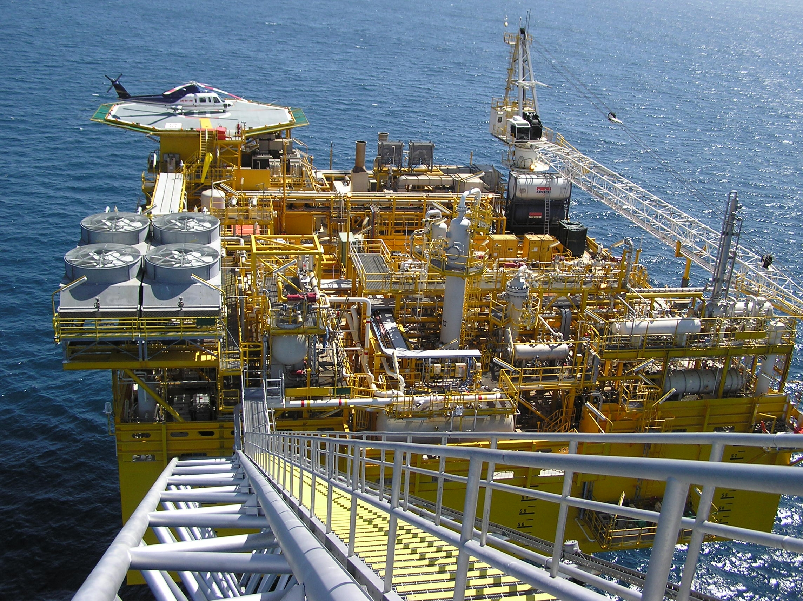
Beach Energy Limited
1961 Beach Petroleum formed by Dr Reg Sprigg
1962 First well ‘Grange-1’ in Adelaide (hence name ‘Beach’)
1975 Moves HQ to Melbourne
1997 HQ moves back to Adelaide, company rebuilt
2016 Acquisition of Drillsearch Ltd ($273m)
2018 Acquisition of Lattice Energy ($1.6bn) Head office commitment to SA for 10 years
2019 New brand implemented Head office moved to 80 Flinders Street, Adelaide Regional offices opened in Perth and Penola.
3rd Largest Australian E&P company ~$5bn market capitalisation
Dr Reg Sprigg, AO
Yolla platform

Slide 4
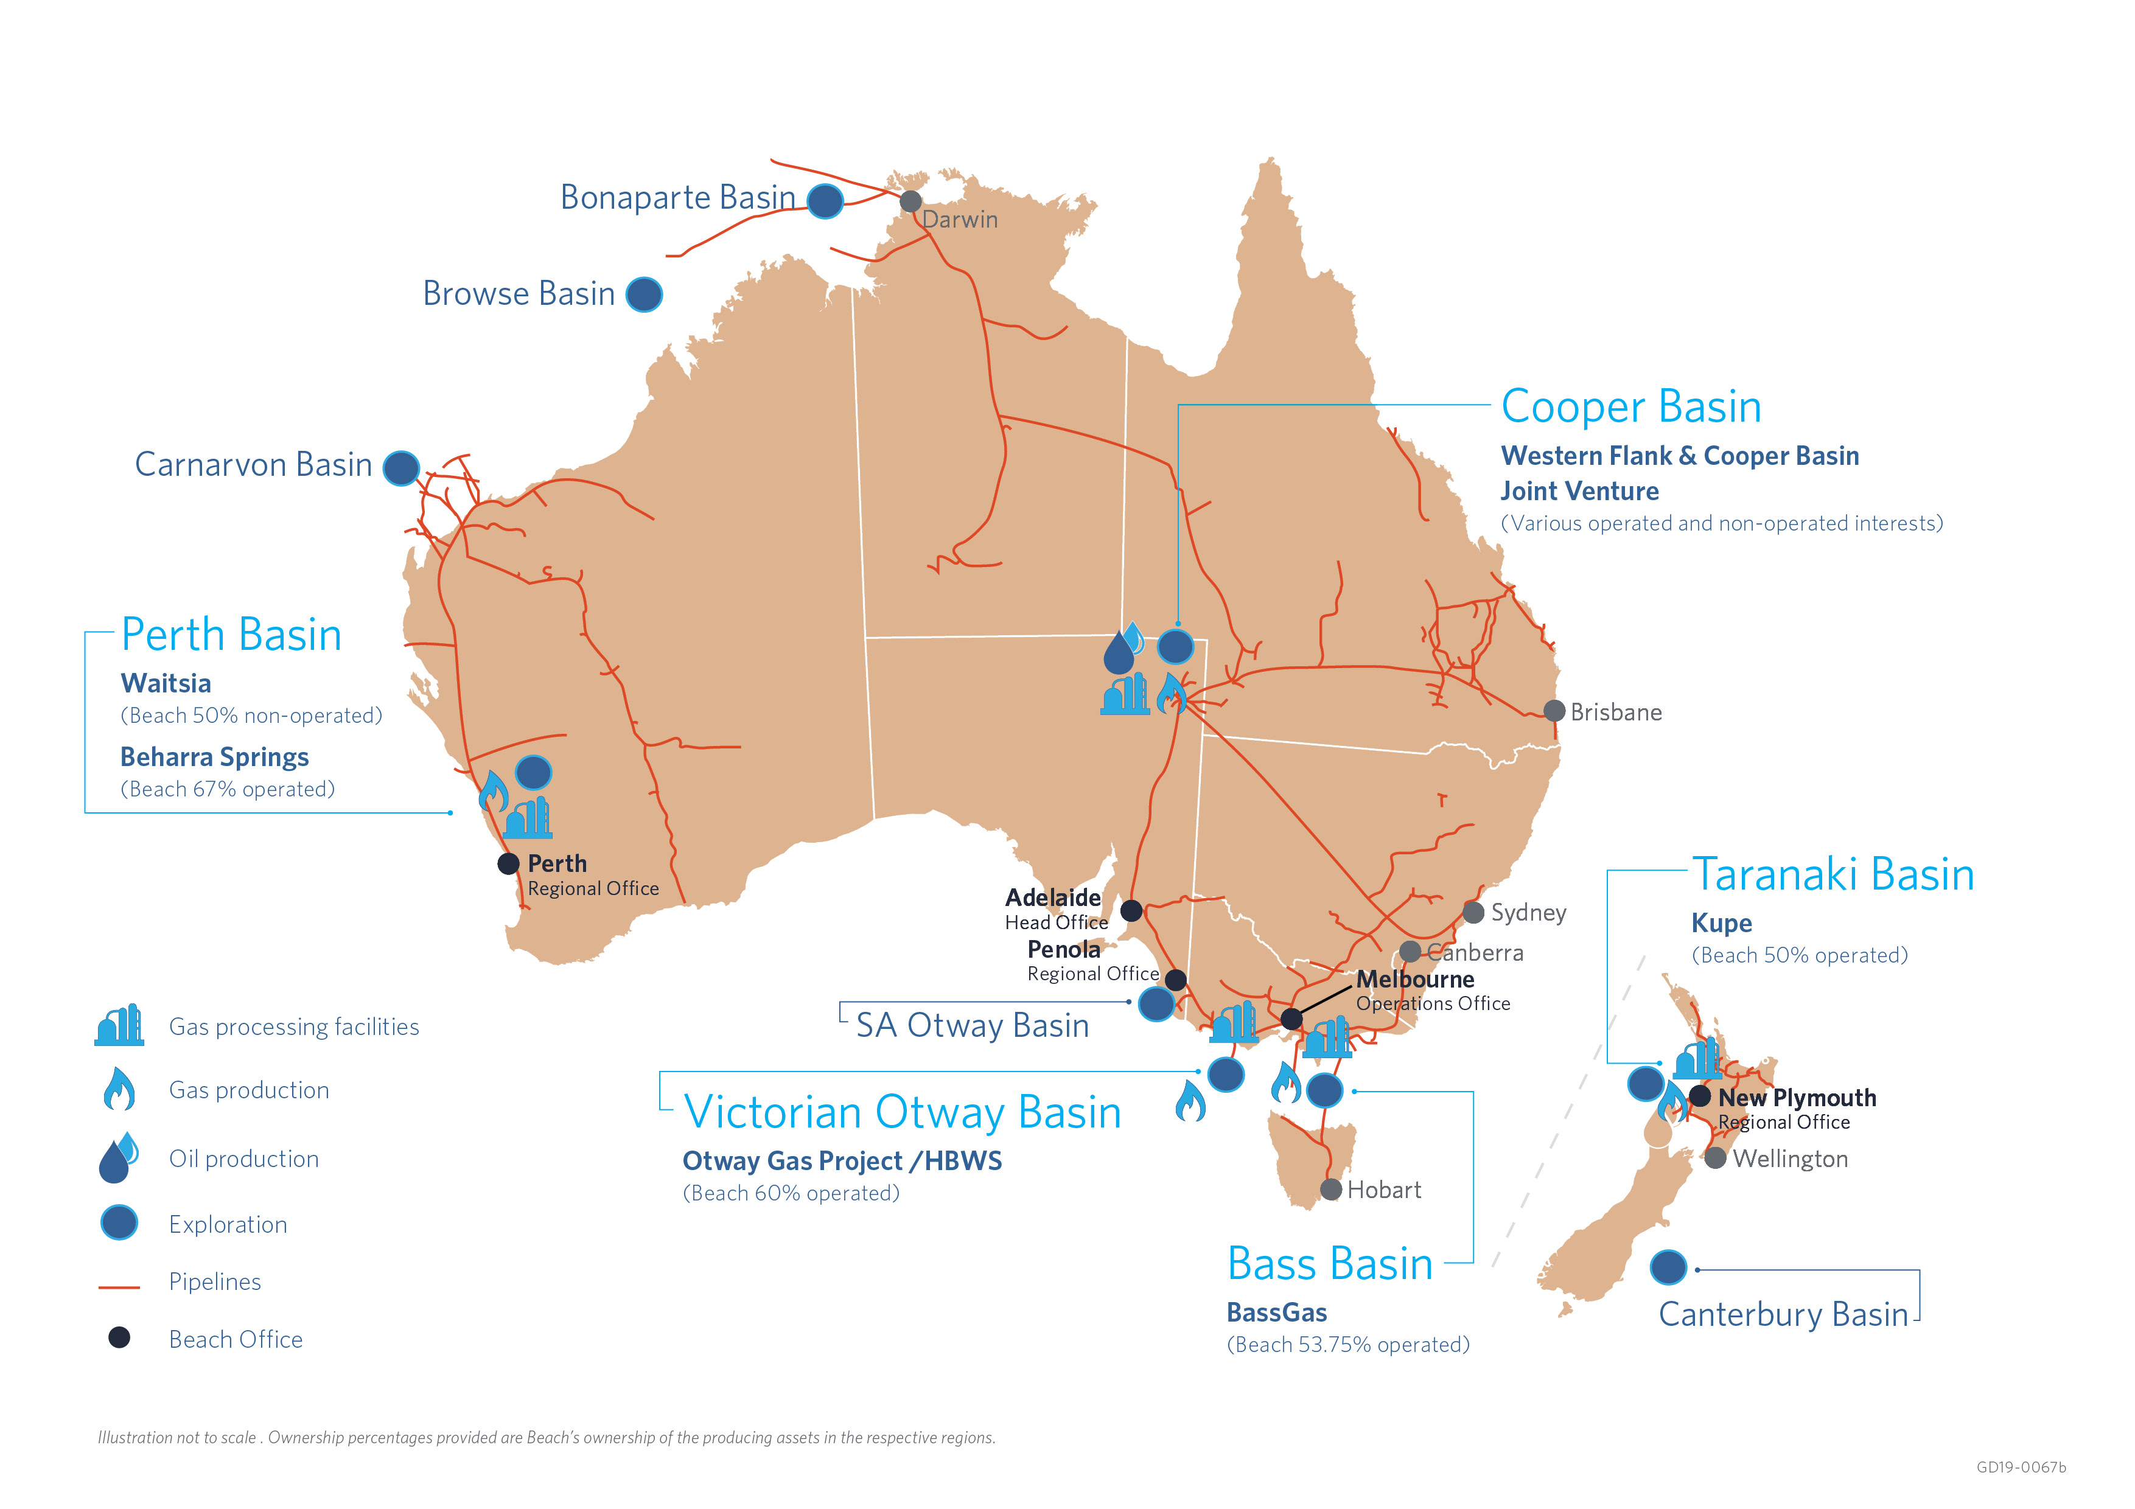
Beach Energy portfolio
FY19 production
29.4 MMboe
1
FY19 2P reserves
326 MMboe
1. Beach ownership currently 67% pending completion of a 17% sell down to Mitsui E&P Australia
Notes:
5 operating hubs
Operate 66% of our production
Onshore and offshore capability
Australia's largest onshore oil producer
Significantly reinvesting in Australia

Slide 5
FY19 – A new record for Beach Energy
1

Slide 6
Reinvesting to drive growth
1

Slide 7
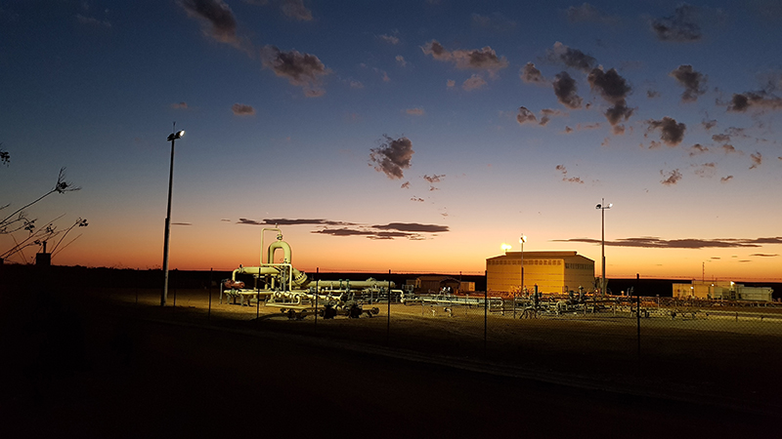
Beach’s history in the Perth Basin
Beach acquired a 50% non-operated interest in Waitsia via the Lattice Energy acquisition in 2018
The project consists of the Waitsia Gas Project, an interest in the Xyris Production Facility and other in-field pipelines. Waitsia Stage 1 production involves processing gas from two production wells at the Xyris Production Facility
Beach also acquired a 67%¹ operated interest in the Beharra Springs project, which consists of the Beharra Springs, Redback Terrace and Tarantula gas fields, and the Beharra Springs gas processing facilities
Gas from nearby wells is processed at the Beharra Springs gas processing facility and is sold to WA gas customers
Longstanding presence in the Perth Basin means that key stakeholders have long standing relationships with the sector and welcome its benefits
Beharra Springs gas processing facility
1. To become 50% pending completion of sale of 17% interest to Mitsui E&P Australia
Notes:
The Waitsia gas field began producing natural gas in August 2016 when the Waitsia Gas Project Stage 1A was commissioned. Gas is flowed from the Senecio-03 and Waitsia-01 wells to the Xyris Production Facility, which was refurbished in 2016 following a period of care and maintenance,
Safety and environmental sustainability are priorities for Beach, and only proven technologies are used in our operations.
Beach does not undertake any fracture stimulation (fracking) activities in the Perth Basin
Exploration in the Perth Basin commenced in the late 1940s.
More than 200 wells have been drilled onshore in the Perth Basin since that time – Beach has not drilled any wells to date.

Slide 8
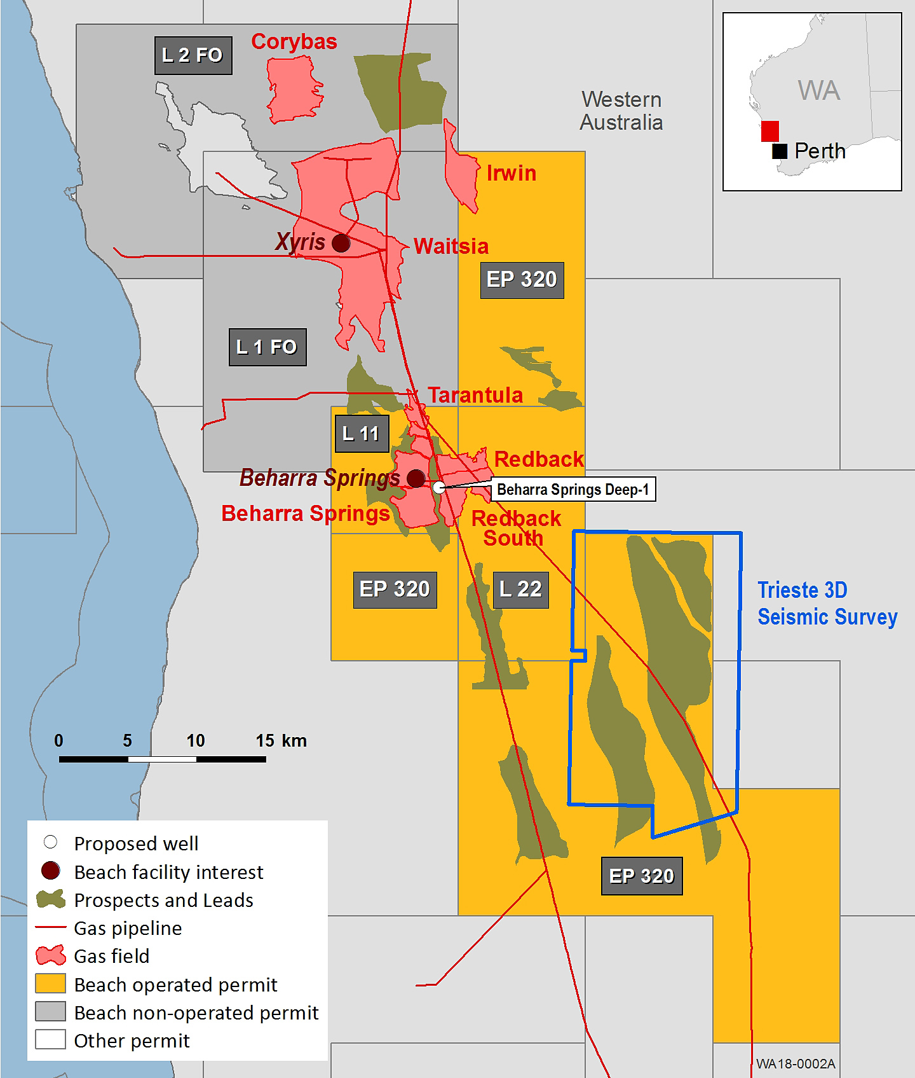
Significant progress in FY19
Waitsia (Beach 50%), Beharra Springs (Beach 50%¹ and operator)
FY19 Highlights:
GSA executed with Alinta Energy for delivery of 20 TJ/d from July 2020 for 4.5 years. FID reached on Waitsia Stage 1 expansion to 20 TJ/day
Waitsia Stage 1 includes large diameter connection to DBNGP
FEED completed and EPC tenders in progress on Waitsia Gas Project Stage 2
Beach and Mitsui E&P Australia (MEPAU) align interests 50:50 across Perth Basin
FY20 Focus:
Commence construction of Waitsia Stage 1 expansion
FID on Waitsia Gas Project Stage 2
Drill Beharra Springs Deep-1 exploration well
Trieste 3D seismic survey
FY19 production
0.7 MMboe
29.4 MMboe
FY19 2P reserves
73 MMboe
326 MMboe
1. Subject to completion of sale of 17% interest to Mitsui E&P Australia

Slide 9
Perth Basin exploration
Deep basin potential opened with Waitsia discovery
Perth Basin gas discoveries over time
Waitsia appraisal result is a game changer for the Perth Basin
Opened up the Kingia / High Cliff play, a new, deeper play with significant upside potential
Multiple prospects located close to existing infrastructure and customers
Beach acting on this via:
Renewed exploration focus to deep conventional gas reservoirs
Beach to drill Beharra Springs Deep-1 exploration well in October 2019.
Trieste seismic survey over Kerr prospect
Notes:
Beach is NOT exploring for tight gas, shale gas, coal seam gas, nor has any planned fracture stimulation projects in the Perth Basin
High flow rate reservoirs discovered at >4000m depth

Slide 10
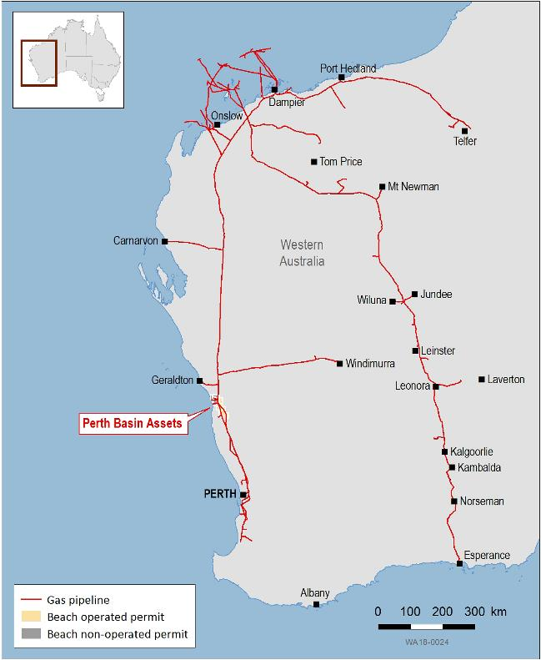
Perth Basin
Waitsia gas commercialisation
Waitsia Gas Project Stage 2 development progressing with the completion of FEED and issue of EPC tenders for the construction of a 100 – 250 TJ/day facility. FID is currently anticipated in FY20
Close proximity to DBNGP and Parmelia Pipeline
Joint Venture is evaluating several commercialisation options, including:
existing gas customers
potential new gas customers (including mining and petrochemical companies)
Increased gas volumes improve the economics of all commercialisation options, underpinning our ongoing exploration strategy
Ongoing stakeholder engagement

Slide 11
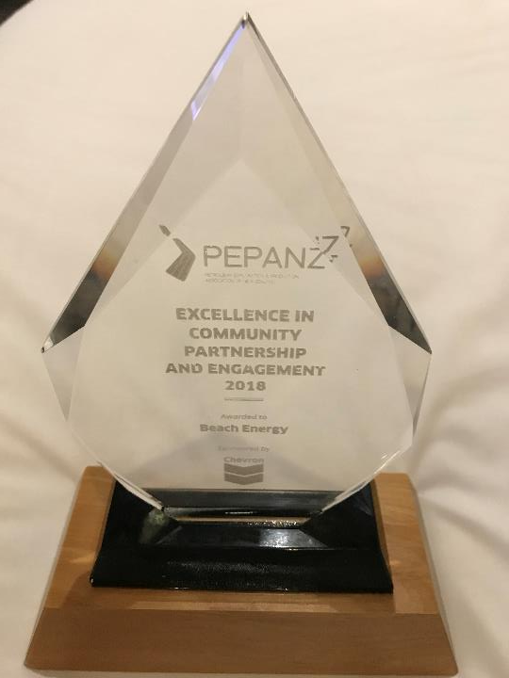
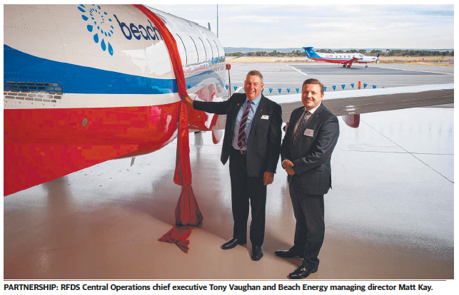
Community support a key to success

Slide 12
Beach Energy Limited
Level 8, 80 Flinders Street
Adelaide SA 5000 Australia
T: +61 8 8338 2833
F: +61 8 8338 2336
beachenergy.com.au
Investor Relations
Nik Burns, Investor Relations Manager Mark Hollis, Investor Relations Advisor
T: +61 8 8338 2833

