Slide 1

WA Petroleum Day
2019

Slide 2
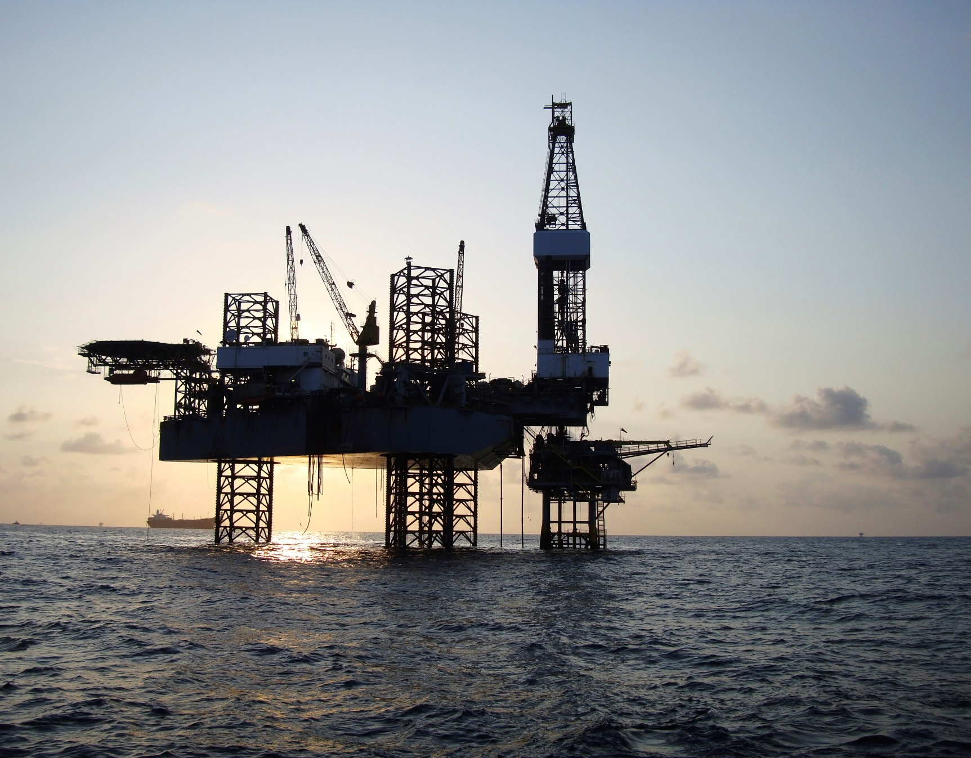
Streamline WA
Developing best practice principles for making and applying regulation.
PURPOSE
Improving how government interacts with the industry and community sectors.
Occidental Petroleum Corporation is an international oil and gas exploration and production company with operations in the United States, Middle East and Latin America. Headquartered in Houston, Occidental is one of the largest U.S. oil and gas companies, based on equity market capitalization.

Slide 3
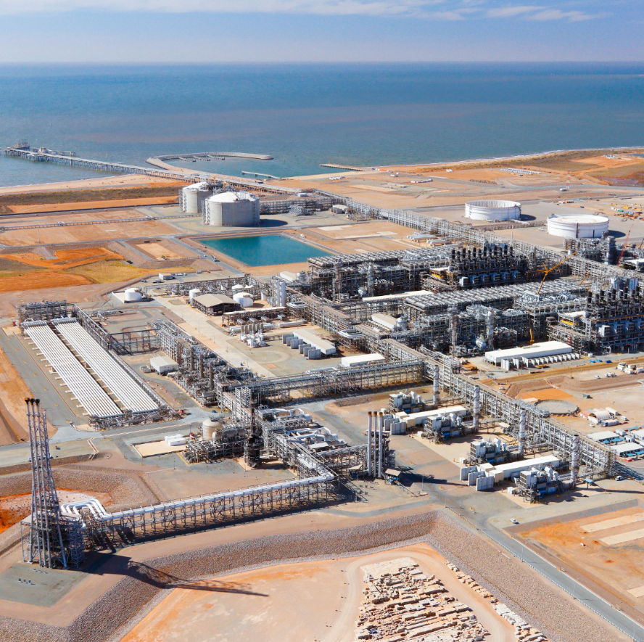
Diversify WA
A vision for a strong and diversified economy that delivers quality jobs across a broad range of industries.
An opportunity to highlight the diversified nature of the State’s resources sector and identify future growth opportunities.
Photo: Chevron

Slide 4

Orderly Reform
A Work Health and Safety Bill
A modernised Work Health and Safety Bill for Western Australia that will better protect workers and provide the primary legislation for workplace safety and health.
Occidental Petroleum Corporation is an international oil and gas exploration and production company with operations in the United States, Middle East and Latin America. Headquartered in Houston,

Slide 5
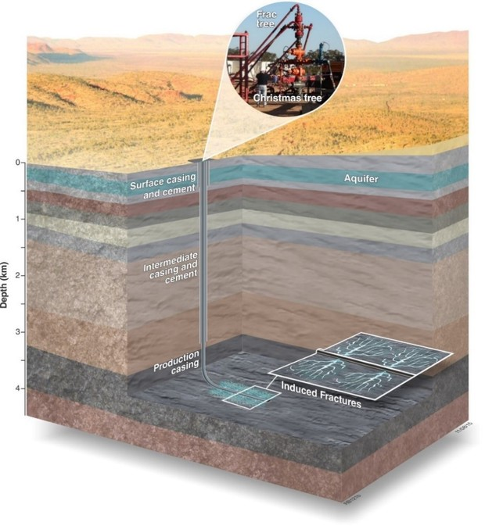
Orderly Reform
Hydraulic Fracture Implementation Plan
The Implementation Plan outlines the provision of balanced policy and responsible regulation that supports economic development, new jobs, environmental protection and landowner rights.

Slide 6
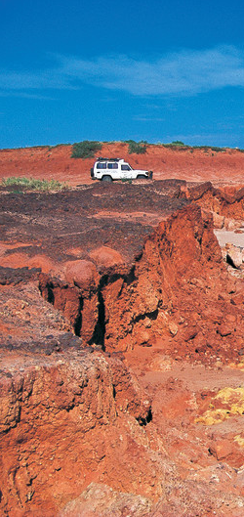
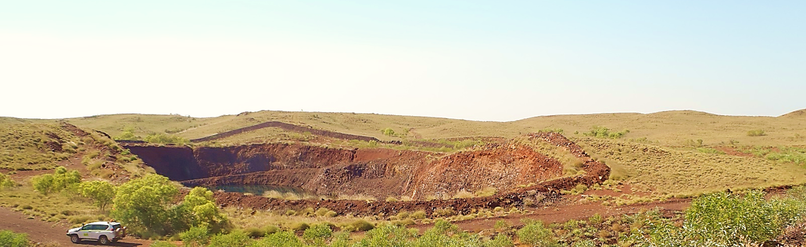
Regional prosperity
Growing regional success through exploration
The Exploration Incentive Scheme (EIS) Co-funded Exploration Drilling Program continues to be very successful.
DMIRS is developing a regulatory framework that supports increased activity for mineral and petroleum exploration.

Slide 7

Improved rehabilitation outcomes
The State Government is adopting a clear position on decommissioning and rehabilitation expectations.
DMIRS acknowledges industry is doing good work in regards to rehabilitation. This is contributing to an increased understanding, improved performance and better outcomes.

Slide 8



www.dmirs.wa.gov.au
@DMIRSResources
Department of Mines, Industry Regulation and Safety

