Slide 1

Attracting Diversified Investment into WA
13 September 2019
Rebecca Brown, Director General
Notes:
Welcome to our first focus group session and thank you for agreeing to participate.
Although some information has

Slide 2
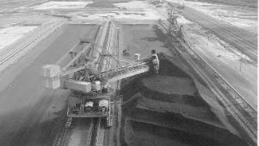
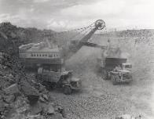

Our investment history
Credit BHP
Focus is to grow and diversify State economy
Businesses at all levels need support for trade and investment
Large infrastructure projects have utilised significant support resources, with great outcomes achieved
Important to also support small and medium size initiatives
Credit Woodside
Credit BHP
Credit Woodside

Slide 3



A new direction
Department has been created to deliver proactive services
The statistics show a new direction is required to future-proof the economy
Current economic structure creates uncertainty and challenges for business and government
We must diversify the State economy
Credit: Woodside
Credit: Chevron
Credit: Woodside

Slide 4

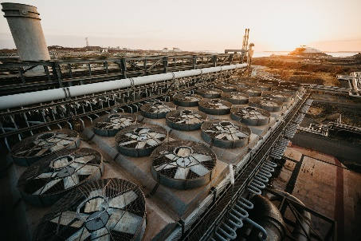

Diversifying WA’s LNG Industry
Leveraging oil and gas industry a vitally important part of State’s economic growth strategy
Energy identified as a priority in economic development framework
Western Australia has an opportunity to position itself as a globally-recognised LNG hub
Diversification of the LNG sector a promising and exciting initiative of economic plan
Credit: Woodside
Credit: Woodside

Slide 5


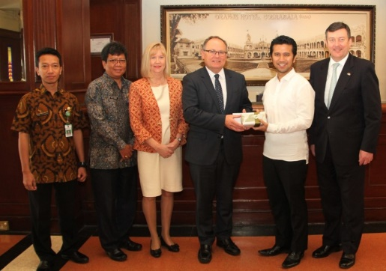
New markets
Credit: Woodside
State must be more tapped into global trends, insights and opportunities
Government recently launched the State’s first Asian Engagement Strategy
Western Australia’s current and future economic and social prosperity is tied to our Asian neighbours
State has many strengths that will support increased trade with Asia
Credit: Getty

Slide 6


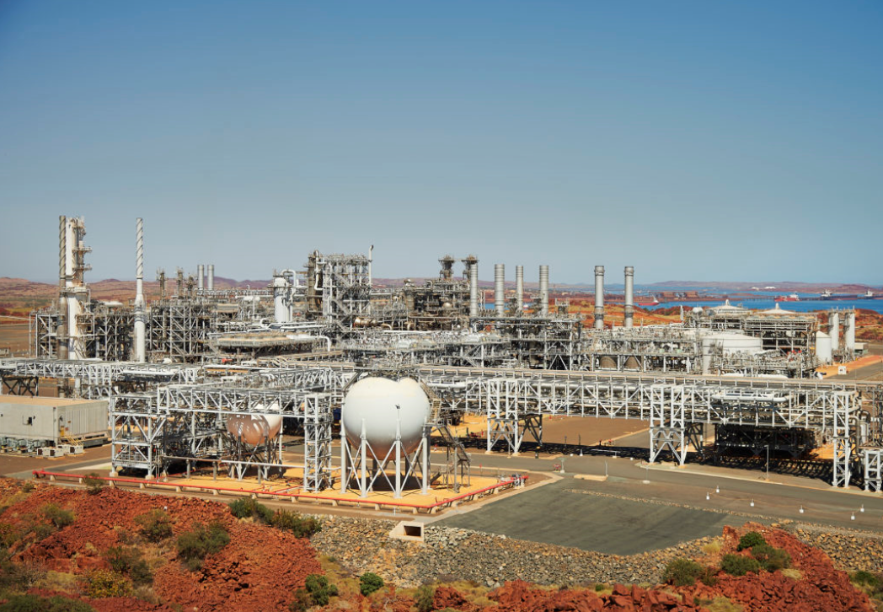
Invest and trade
Developing the processes and systems to actively promote investment in the State
Establishing a single-point-of-entry system
Further refining the value proposition for Western Australia
Establishing a multi-faceted Department that delivers on the needs of industry and community

Slide 7
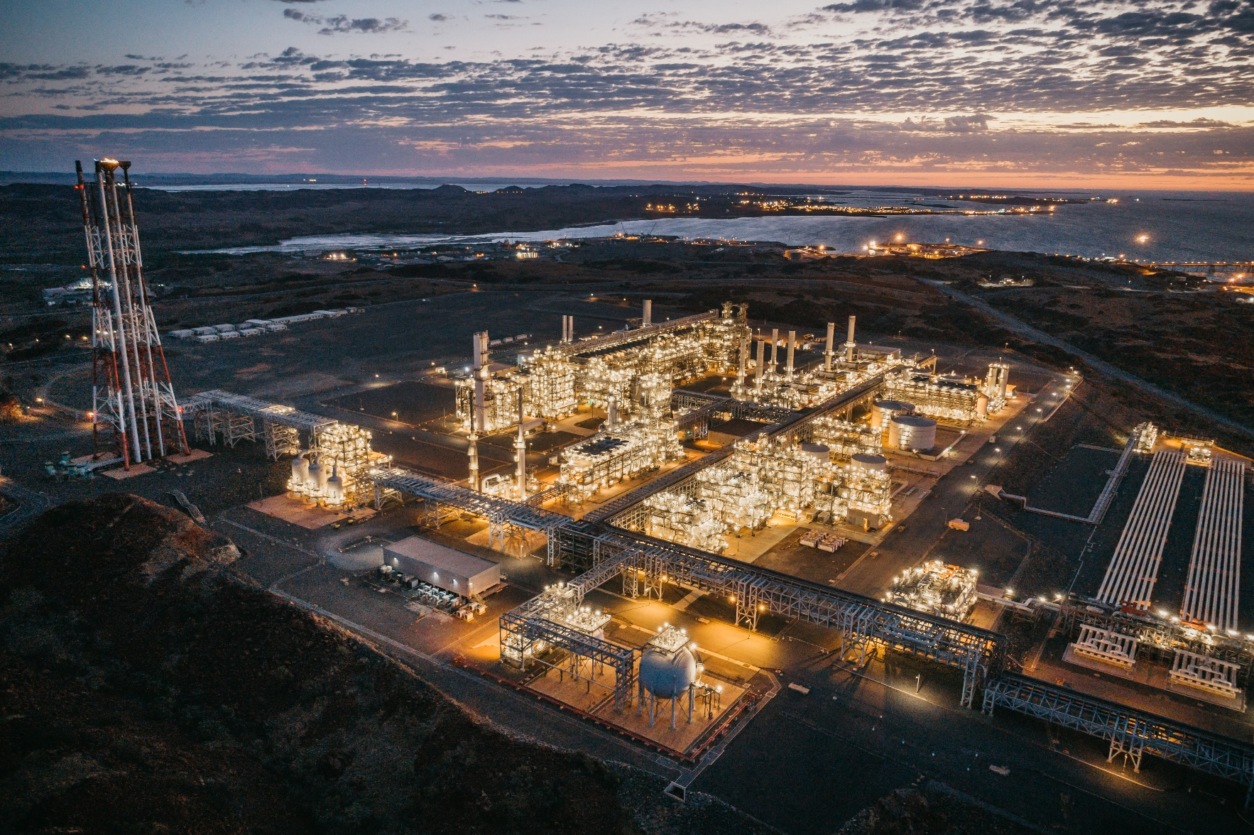
Thank you
More information
www.jtsi.wa.gov.au
Credit: Woodside

