Slide 1
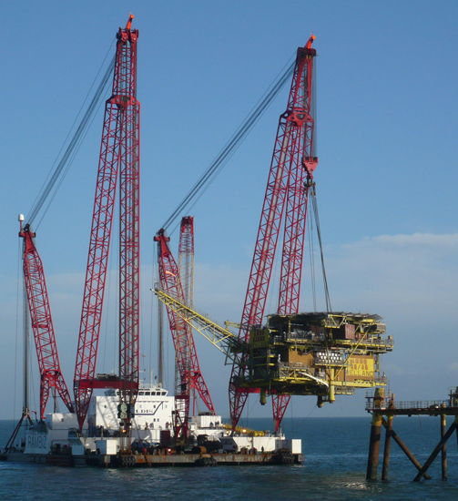
Decommissioning
Bruce Lake – Vermilion

Slide 2
Decommissioning
Decommissioning has already taken place in Australia
Decommissioning of newer, larger facilities starting to enter planning phase
Globally, substantial decommissioning has already occurred, and as technical solutions have evolved, so have frameworks
Consequently, there is an opportunity for Australia to learn from the experience of others.

Slide 3
Decommissioning Planning, Finance & Liabilities
Industry guide on Decommissioning Planning, Finance and Liabilities developed
Maximise late life field production
Establish trigger points for decommissioning
Provide guidance on security values

Slide 4
Decommissioning Planning, Finance & Liabilities
Industry guide provides a number of options for financial security that aim to:
Minimise the impact on existing cash flows
Not impair the ability to fund future developments
Allow flexibility and recognize the varying financial capacity of companies

Slide 5
The Commonwealth Decommissioning Framework Review
Decommissioning review initiated in October 2018
Focuses primarily on environmental and well integrity outcomes, and regulatory oversight
Discussion paper comments received in January 2019
Policy Options paper expected to be released late 2019

Slide 6
NDRI National Decommissioning Research Initiative
Independent Science funded by Industry
Submissions closing 30th September
www.ndriaustralia.org
Project awards expected in January 2020
Phase 2 would expect funding from other key stakeholders including Commonwealth

Slide 7
Where to from here?
Legacy issues need addressing
Legislative reform: industry serious on getting best outcomes
Numerous opportunities for learning from overseas
More work to do

